Slide 1
Welcome Class of 2021
Fall Senior Presentation
October 2020
Notes:
Karine

Slide 2
National Merit
National Merit Program Commended Students:
Andre Hiwatig
Sophie Peineke
Laura Minasian
Sevak Poghosyan
Notes:
Karine

Slide 3

Agenda
College Application Process: UC, CSU, Private Colleges
College Entrance Exams
University of California Personal Insight Questions
ELC
Letters of Recommendation
Scholarships/Financial Aid
Q & A (If time permits)
Notes:
Lucy

Slide 4
College Application Process
Important Dates and Deadlines:
August 2020: UC Application Opened
October 2020: Cal State Application Opened
November 1-30: UC Application submission window
Nov 1-Dec. 4 Cal State Application submission window
February 2021: Deadline to submit official SAT/ACT scores
March 2021: Notification of Fall 2021 admissions' decisions
May 1, 2021: Deadline to submit Statement of Intent to Register
July 15, 2021: Final high school transcripts due to university campuses
MEET ALL DEADLINES!!!
Notes:
Anna

Slide 5
Links to College Application Portals
University of California: https://admission.universityofcalifornia.edu/apply-now.html
California State University: https://www2.calstate.edu/apply
The Common Application (Private Colleges): https://www.commonapp.org/
The Coalition Application: https://www.coalitionforcollegeaccess.org/
Notes:
Anna

Slide 6


UC vs. CSU
Both are public school systems
Educational Focus
University of California
Designed for higher learning in theoretical, philosophical research based studies.
California State University
Combines theoretical and practical application.
Effective for students that are looking to learn specific skills that they can apply immediately as they enter the workforce, such as accounting, teaching and nursing careers.
Notes:
Lucy

Slide 7
College Entrance Exams: SAT/ACT
Test-Optional or Test-Blind for this application season
For individual school policies regarding testing visit the university websites.
SAT/ACT scores will not be taken into consideration during the admissions process.
Students who do not submit scores will not be penalized.
If submitted, SAT/ACT scores can be considered for academic placement or scholarship purposes.
For updates visit Counselors' Corner
Notes:
Karine

Slide 8

UC Eligibility Criteria
14 Comprehensive Review Criteria:
Grade Point Average
Test Scores (Test-Optional Class 2021)
Courses Completed & Planned
Honors/AP Courses
Top 9% Local Context (ELC)
Quality of Senior Year-Program of Study
Academic Opportunities in CA High Schools
Performance in Academic Subject Areas
Achievements in Special Projects
Improvements in Academic Performance
Special Talents, Achievements,Awards
Participation in Educational Preparation Programs
Academic Accomplishment Within Life Experiences
Geographic Location
Notes:
Anna

Slide 9
Eligibility in Local Context (ELC)
Who qualifies?
• California resident whose high school participates in the ELC program.
• Applicants must have a 3.0 GPA or better in a specific set of UC-approved
coursework completed in the 10th and 11th grades.
• Applicants enter coursework and grades in the UC application and the
application will compare their GPA to the historic top GPA for their school.
If the applicant meets or exceeds that GPA, they will be designated ELC and UC
will add a note to their application. Admission will be guaranteed to a UC campus, not necessarily students’ choice.
• Applications are automatically screened for ELC eligibility when submitted.
• After application submission, applicants can return to their My UC to see whether they have been designated as being in the top 9 percent of their class.
Notes:
Karine
• How does UC calculate a school’s historic or benchmark GPA?
• UC uses transcripts that your school has submitted for the top 15 percent of your high school’s junior class, after final junior year grades are entered.
• Based on transcripts from the previous three years, UC establishes a historic, or benchmark, GPA representing the expected GPA for the top 9 percent of the students from your school.
• Schools are periodically asked to submit transcripts so that we can monitor and adjust benchmark GPAs.
• Note: UC did not collect transcripts this year due to COVID-19.

Slide 10

UC Personal Insight Questions
Personal Insight Questions
8 questions, students must address four
350 words or less for each response
View as a personal interview on paper
This is no advantage or disadvantage to choosing certain prompts over others.
Select questions that are most relevant to your experience and that best reflect your individual circumstances.
Personal Insight Questions
Notes:
Anna

Slide 11
UC Additional Comments Section (Optional)
Two Additional Comments Sections with 550 word/character count each (optional)
Offered after Academic History and PIQ sections
Uses for Additional Comments Sections:
  Elaborate on relevant background information
  Provide context for your application: grade trends, low academic performance, change in life circumstances
  Discuss experiences or circumstances that you didn’t have space to talk about anywhere else in the application
Should I discuss COVID-19 & the recent social justice movements?
  If you have been significantly impacted personally and/or academically by COVID-19 or the social justice movements you can talk about it in the Additional Comments section.
Notes:
Anna
I think in the academic history area they can use only 500 words

Slide 12
Writing Tips
Include:
Use your authentic voice
Be genuine
Write in a way that reflects your character and values
Write in 1st person
Write persuasively
Give structure and organization to your writing
Engage the reader
Get feedback on writing
Edit, Edit, Edit!!!
Avoid:
Using acronyms
Not following instructions
Quotes/dialogue/clichés
Creative writing, scene setting
Excessive use of thesaurus
Repetition
Writing about recent events
Asking questions
Writing more about an inspirational person than
yourself
Being overly humorous, self-deprecating or glorifying
Notes:
Lucy

Slide 13

Writing Resources
How to Answer UC's Insight Questions?
Counselors' Corner: Writing College Admissions Essays
PowerPoint: Acing the College Essay
Notes:
Lucy

Slide 14
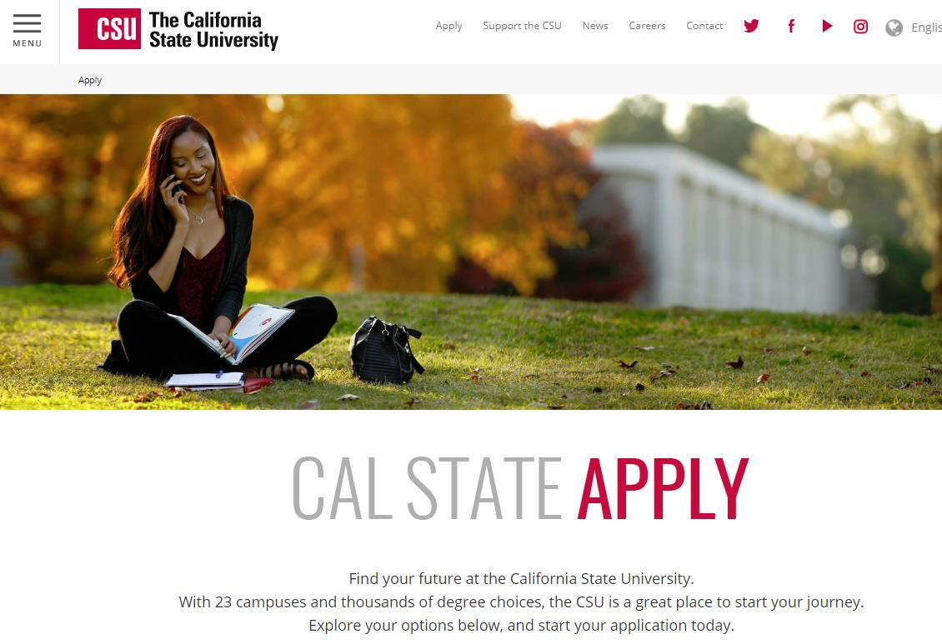
College Application Process
https://www2.calstate.edu/apply
Notes:
Karine

Slide 15
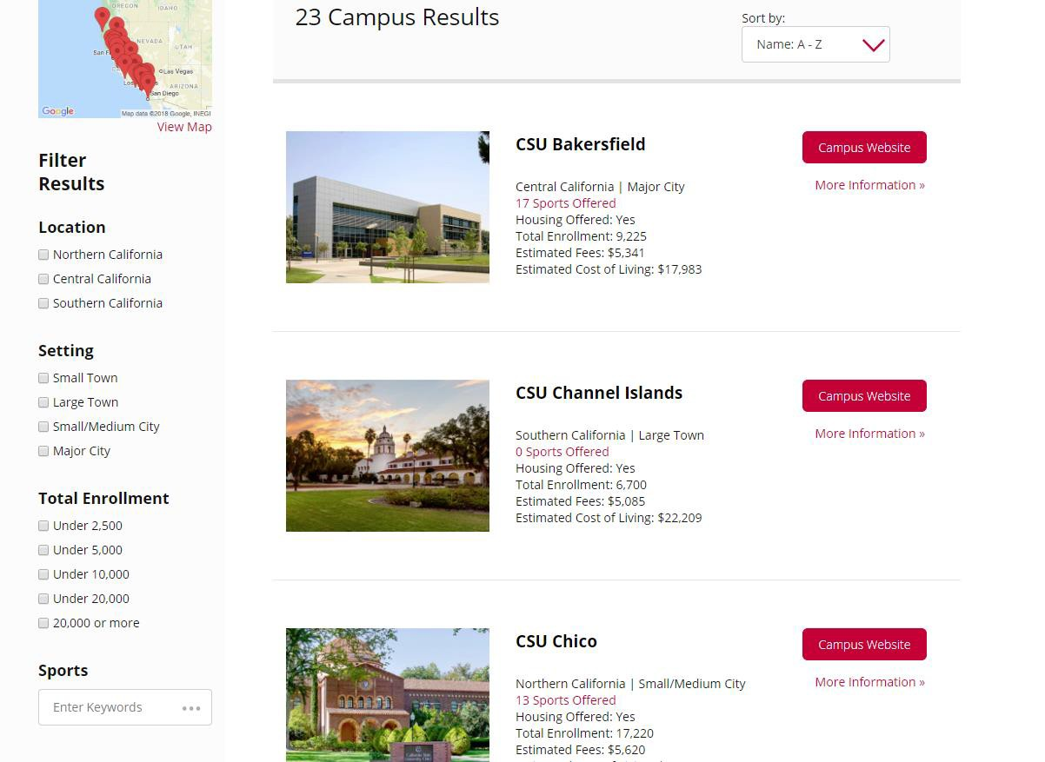
California State University System
Notes:
Karine

Slide 16
California State University
Redirection (new at CSU)
Students have the option to chose “Redirection” on their application which will make them eligible to be redirected to another CSU campus if they are wait-listed or not admitted to their campus of choice due to lack of space.
You cannot opt-in to Redirection after you have submitted your application.
If applicable, students will be notified April 1 of their Redirection
option. Redirection is final once campus is selected.
Notes:
Lucy

Slide 17
College Application Process: Private Colleges
Obtain a digital Green Folder online at Counselor’s Corner
Most Private Colleges Use Common Application
www.commonapp.org
Check for Application Submission Deadlines (vary by college)
Thoroughly complete student part of the application
Send an Invitation to your counselor no later than November 2nd, to submit your school report. A brag sheet must be completed and turned in to your counselor with your green folder by November 2nd.
Send an invitation to two teachers no later than November 2nd,
to submit a letter of recommendation
Notify your counselor ASAP of any changes made in your college list after turning in your Green Folder.
Notes:
Karine

Slide 18

Letters of Recommendation
Scholarship organizations and private colleges/universities ask for a letter of recommendation from your counselor/teachers. To better assist you with a letter we need you to do the following:
  Down the Student Information Sheet aka Brag Sheet & others items in the Digital Green Folder. Please be thorough and honest when completing the form. Be sure to TYPE out your responses.
  Email the completed Brag Sheet and other documents to your counselor no later than November 2nd.
  Teacher recommendations should be based on their knowledge of you in the classroom, not off the Brag Sheet. Please do not give your Brag Sheet to your teacher. It is best to select a teacher from your junior or senior year.
Notes:
Anna

Slide 19

Glendale Community College
Apply at https://www.glendale.edu/apply
Scholars Program – 3.25 GPA (unweighted)
  GCC Scholars Program
  Deadline to apply – March 15 (priority registration)
June 1 (regular registration)
Five steps to complete GCC registration:
January: Apply
February: Complete online orientation
March/April: Take placement tests/surveys
April/May: Meet your GCC counselor
June/July: Register for classes
If you have taken Jump Start classes you MUST apply now as a HIGH SCHOOL GRADUATE, but you will keep your GCC ID#
Notes:
Lucy

Slide 20

College Application Workshops & Information Sessions
Clark and the other GUSD high schools have partnered with universities across the country to host informational sessions and college application workshops throughout the fall. Take advantage of this opportunity to speak with college admissions representatives and get assistance with your application.
For information on upcoming college events and registration details frequently visit:
  Counselors' Corner: College Visits
  GUSD College & Career Division
Notes:
Lucy

Slide 21

Paying for College
There are two types of Financial Aid:
1. Gift Aid
  Scholarships
    Students should check with the institution if they need to complete a separate application
  Grants – Federal (FAFSA)
    Federal Pell Grants
    Federal Supplemental Educational Opportunity Grant
  Grants – State (FAFSA or Dream)
    Cal Grants A & B
    Chafee Grant
    Middle Class Scholarship (MCS)- $184,000 combined family income and assets
    CSU – State University Grant (SUG)
    CSU – Educational Opportunity Grant (EOG)
    Community Colleges – Board of Governor’s Grant (BOGG)
    UC – University Grant
Notes:
Karine

Slide 22

Paying for College
There are two types of Financial Aid:
2. Self-Help Aid
  Federal Work-Study (FWS)
  Federal Perkins Loan
  Federal Direct Loans
  PLUS (parent) Loan
Notes:
Karine

Slide 23
Middle Class Scholarship
State scholarship for students with family income & assets up to
$184,000 on a sliding scale
UC and Cal State specific
FAFSA and Dream applicants will be considered for eligibility
Students must file a FAFSA/DREAM Application by March 2
The MCS award will be reduced by any Federal, State, or institutionally administered grants or fee waivers received by the student
Student must maintain satisfactory academic progress
Notes:
Karine

Slide 24

Paying for College
Student Loans
Things to consider before borrowing:
  Interest rate, APR
  Fixed vs. variable
  Co-signer
  Fees
  Enrollment Requirements
  Payments, during school or after graduation
Shop around for loans, i.e. from schools vs. banks
Approximately 70% of students get some form of financial aid
Notes:
Karine

Slide 25

Other Important Dates & Deadlines
October 1, 2020 FAFSA Application Opens (USE 2019 FINANCIAL INFORMATION)
November 2, 2020 Green Folders Due to Counselors
November 1-30, 2020 Application Submission Period for Fall 2021
  Note Thanksgiving Break (Nov. 23-Nov.27)
December 1, 2020 Application Due to USC to be Considered for Financial Aid
February 1, 2021 FAFSA Deadline Some Private Colleges
March 2, 2021 FAFSA Deadline for Public Colleges (To be eligible for Cal Grant)
Note: Your Cal Grant verifications were submitted on 9/30 by your counselors
MEET ALL DEADLINES!!!
Notes:
Anna

Slide 26


Scholarships & Financial Aid
If you haven’t already started researching, NOW is the time!!!
    FAFSA
    Cal Grant
    Student Aid
    FastWeb
    WebGrants4Students
    California Colleges
Look Out for Scams!!! NEVER pay money to apply for a scholarship.
Check the Daily Bulletin and visit Counselors' Corner regularly for new scholarship opportunities.
Notes:
Lucy

Slide 27
Scholarship & Financial Aid Resources
CSU Financial Aid Information:
Financial Aid | CSU - California State University
UC Financial Aid Information:
https://admission.universityofcalifornia.edu/tuition-financial-aid/
FAFSA and federal ID Information www.fafsa.ed.gov
Cal Grant and MCS Information www.csac.ca.gov or 1-888-224-7268
California DREAM Application https://dream.csac.ca.gov/
Other:
www.WebGrants4Students.org ;
www.FastWeb.com
http://studentaid.ed.gov/repay-loans/understand/plans/standard/comparison- calculator
Notes:
Lucy

