Slide 1
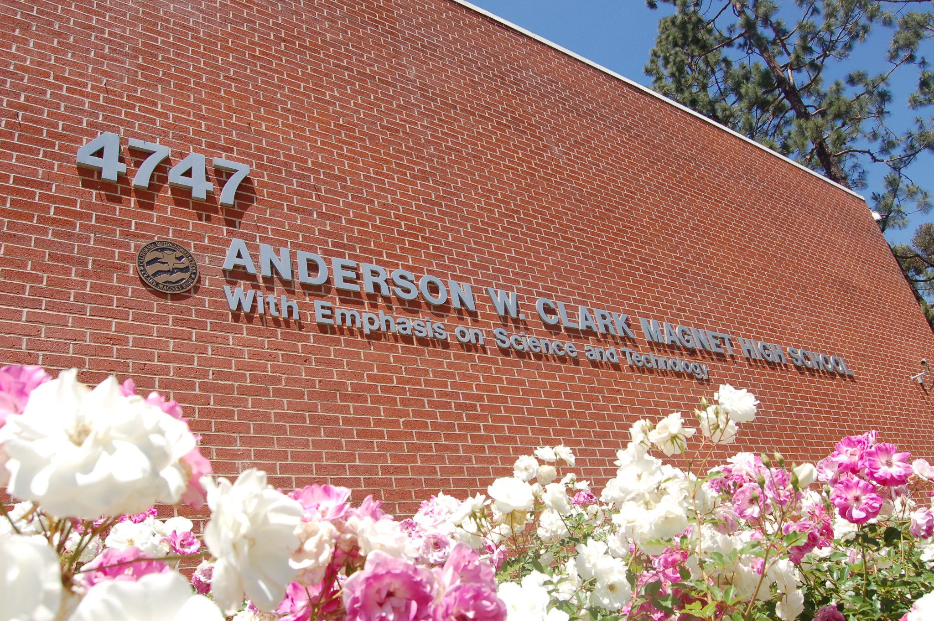
Welcome Class of 2027
Spring 2023
Notes:
Anna

Slide 2
Clark Administration
Dr. Brian Landisi (Principal)
Mrs. Tiffany Hirdler (Assistant Principal)
Notes:
Anna

Slide 3
Connecting With Your Counselor
Mrs. Turdjian: kturdjian@gusd.net (A-Ghar)
Ms. Cerda: lcerda@gusd.net (Ghas-Mkh)
Ms. Margaryan: amargaryan@gusd.net (Mkr-Z)
Please reach out to us, we are always here to guide and support you!
Notes:
Anna

Slide 4
Agenda
Attendance Policy
Dress Standard
Buses
Athletics & 7th Period Enrichment
Review of Graduation and A-G Requirements
Review of course registration process
How to Stay Competitive for College
Q & A (time permitting)
Notes:
Anna

Slide 5
Attendance Policy
Attendance is taken daily in each of your classes.
You are expected to be on time and attend every class session.
Excessive tardies and absences will result in a truancy, meetings with parents and disciplinary action. Students with excessive absences or tardies will be placed on a strict Attendance Contract and monitored regularly for compliance.
Keep in mind that satisfactory attendance is required in order to remain a student at Clark.
Notes:
Lucy

Slide 6
Clark Dress Standard
At Clark we are all professionals and our dress standard reflects that:
Students must wear:
  Slacks or pants that are uniform style and in a solid color
  Collared shirts and blouses with sleeves (must be in a solid color)
  Shorts or skirts can be worn that are uniform type, at an appropriate length and in a solid color
Students may not wear:
  Jeans (except on designated free dress days)
  Ripped jeans and ripped clothing of any type are never allowed
  Leggings, sweats, jeggings
Violating the dress standard will result in progressive disciplinary action being taken
For specifics on the dress standard please visit https://www.gusd.net/domain/2553
Notes:
Karine

Slide 7


Athletics & Enrichment Period
Clark students can participate in sports at their home high schools.
  Each day after 5th & 6th periods, student athletes take the sports buses to their home high schools to participate in sports.
  Clark does not have sports teams
Enrichment period: Daily from 2:55-3:30
  Visit a teacher to get help for a specific class
  Study hall
  Intramural sports
  Clubs and other activities
  Complete homework, work on assignments & projects
  You must have a pass from the teacher to attend Enrichment in another class
  Student athletes can attend enrichment, if needed, but they must make prior arrangements with their coach.
Notes:
Anna

Slide 8

Buses
Students from GHS and HHS use the bus service to and from school
Students select a bus stop that is convenient for them
We do not accommodate bus changes for students requesting to be with a friend on another bus
In May you will receive information on how to sign up for your bus
Notes:
Karine

Slide 9
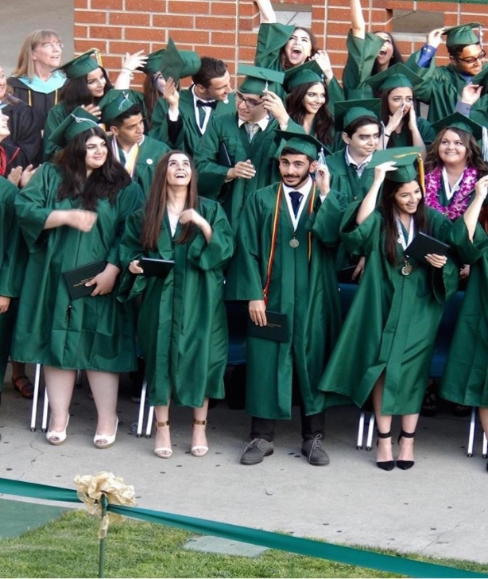
High School Graduation Requirements
English – 4 years (40 credits)
Mathematics – 2 years (20 credits)
  must pass Integrated Math II OR
  2 years of math (subject to change)
  if you started at Integrated Math II in the 9th grade
Science–3 years (30 credits)
2 years of physical science (Physics of the Universe and Chemistry in the Earth system and 1 year of biological science (Living Earth)
World History–1 year (10 credits)
US History– 1 year (10 credits)
Notes:
Lucy

Slide 10
High School Graduation Requirements
Government/Economics–
1 semester each (5 credits each)
Fine Arts– 1 year (10 credits)
Health/Guidance– 1 semester each
(5 credits each)
Physical Education– 2 years (20 credits)
Elective Classes (70 credits)
220 credits (earned 9th through 12th grade)
Notes:
Lucy

Slide 11
A-G College Entrance Requirements
“a”– History/Social Science – 2 years
“b”– English – 4 years
“c”– Mathematics – 3 years+
“d”– Laboratory Science – 2 years
  1 year Biology AND 1 year either Physics or Chemistry in the Earth system
“e”– Language other than English – 2 years
“f”– Visual and Performing Arts – 1 year
“g”– College-Preparatory Elective – 1 year
Notes:
Karine

Slide 12
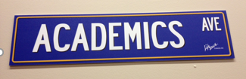
Academic Choices
 | 9th | 10th | 11th | 12th
English | Regular Advanced | Regular Honors | English 11 AP Eng. Lit | English 12 AP Eng Lang
Math | Integrated Math I through AP Calculus BC * depends on student’s ability
Science | Physics of the Universe | Living Earth Science | Chemistry in the Earth System
 | AP Physics 1, AP Physics 2, AP Biology, AP Chemistry
Social Science |  | World History Regular -Advanced/AP | US History Regular AP | Government Regular AP
PE/Sports | PE/Sports | PE/Sports | PE/Sports (optional)
a-g Classes
AP Courses
Intervention
Electives
7 Classes
CSF Tutoring
Enrichment
After School Tutoring
Notes:
Karine

Slide 13


Math Placement at Clark
Students coming from private schools will be placed in Integrated Math 1 unless they score a 70 or above on the Integrated Math 2 Readiness Test.
You will be contacted over the summer to schedule your math assessment.
Notes:
Karine

Slide 14





Elective Choices
9TH GRADE | 10TH GRADE | 11TH GRADE | 12TH GRADE
1 Elective | 2 Electives | 3 Electives | 4 Electives
Spanish Armenian Commercial Art Design Digital Photography Cinematography Int. Engineering Int. Manufacturing Robotics ASB Mock Trial Publications | Comp. Programming Honors IT 1-2 Geography of Disasters Int. Animation Int. Comics Adv. Engineering Adv. Manufacturing Robotics Honors Architecture 101/102 Film as Literature Ethnic Studies Creative Writing Modern Poetry | AP Computer Science Honors Business 1-2 Honors Geo. Info. Sys. Honors Environ. GIS AP Environ. Science Honors IT 3-4 Adv. Animation (H) Adv. Comics (H) AP 2D Art & Design | AP Psychology Honors Business 3-4 Cinema Internship
Notes:
Karine
SPEAKER:
------------
TO DO:

Slide 15
Publications & Mock Trial
Publications (Yearbook/School Newspaper):
  Application, Interview + Teacher Recommendation
  For students who are in journalism/school newspaper or yearbook in their middle school
Mock Trial:
  A or B in English + 2 Teacher Recommendations
    The recommendations must be directly emailed or mailed to Mrs. O’Gara by your teacher. Any teacher recommendations submitted to Mrs. O’Gara by the student will be automatically disqualified.
    If you’re selected for Mock Trial, but your English grade at the 2nd semester is below a B you will be dropped. You WILL NOT be considered for Mock Trial if you don’t apply by the deadline.
  To get information and apply visit the link below.
  https://www.gusd.net/domain/3286
  Email your application to Mrs. O’Gara by the deadline mogara@gusd.net
  Application Deadline: April 17
Notes:
Lucy

Slide 16

Mock Trial
Notes:
Lucy

Slide 17

Course Registration Process
All registration paperwork will be completed in a digital format (Google Form).
For Online Planning Form visit:
https://docs.google.com/forms/d/e/1FAIpQLSdz67XWCdcHu3D16rh_lF05nwLdg7qyvwkZT8n7Evqq90EqnQ/viewform
(Take a screenshot of the link)
Students only need to turn in their digital paperwork by the deadline:
  Friday, April 7 (Google Form Locked)
Digital Paperwork Includes:
  Freshman Planning Sheet (Course Selections)
Notes:
Anna

Slide 18
Important Reminders:
Digital registration paperwork submission deadline:
  Friday, April 7(Google Form Locked)
You MUST turn in the Online Planning Form
Select classes with your future college and career goals in mind.
If Google Form is not submitted, we will pick your classes for you.
Notes:
Anna

Slide 19
Things to Consider...
Your ALTERNATE courses must be different from your PRIMARY course selections. (Ex. Art 1-2 with Design 1-2 as alternate)
Freshman Planning Sheet must be turned in by in order for your counselor to begin reviewing your course requests. After you will no longer have access to the form.
Students must earn a C or better in all core academic classes (English, math, science, social science). Students who earn a D or an F in a core academic course will repeat the class in summer school.
Notes:
Anna

Slide 20

How to Stay Competitive for College
Take a challenging course schedule and do well
Take initiative in pursuing your
interests and passions
Get involved in school activities
Get involved in community service
Explore leadership opportunities at
school, home and in the community
Strive to do your best in ALL things
Notes:
Anna

Slide 21
Resources
amargaryan@gusd.net
kturdjian@gusd.net
lcerda@gusd.net
Clark Counselors' Corner
Notes:
Anna

Slide 22
Q & A
Notes:
Anna

