Slide 1
A.P. English Literature and Composition
An Overview
by Diana McGrath, teacher

Slide 2
Characteristics and Pre-Requisites of
A.P. English Literature Students:
Show extraordinary talent and ability in prior English classes. Students have a special mastery and understanding of language.
Prioritize the work and learning experience, rather than the grade/G.P.A.
3) Possess academic zeal—an independent yearning to learn, read, and make connections to current
events/the world.
4) Tend to have a mature personality and strong leadership qualities. These students want to discuss and
write about their ideas.
5) Exhibit high-level critical analysis and comprehension skills.
6) Show creative and innovative thinking through their writing ability and projects.

Slide 3

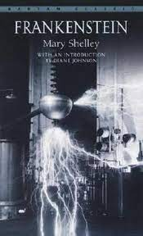

Reading Selections
We will read:
7 Novels, including some or all of the following:
The Catcher in the Rye by J. D. Salinger
Frankenstein by Mary Shelley
On Walden Pond by Henry David Thoreau
The Strange Case of Dr. Jekyll and Mr. Hyde by Robert Louis Stevenson
The Scarlet Letter by Nathaniel Hawthorne
The Great Gatsby by F. Scott Fitzgerald
The Things They Carried by Tim O’Brien
2 Plays, chosen from the following:
The Crucible
A Raisin in the Sun

Slide 4
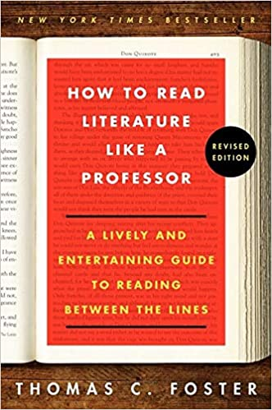
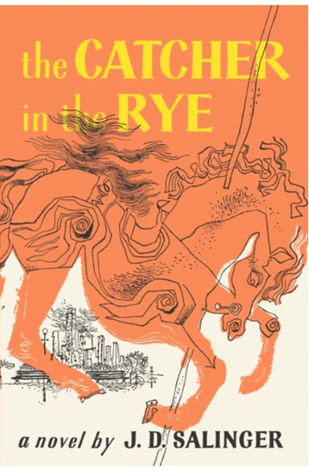
Summer Reading
How to Read Literature Like a Professor: A Lively and Entertaining Guide to Reading Between the Lines-REVISED EDITION, by Thomas C. Foster.
The Catcher in the Rye by J. D. Salinger.
Books will be distributed at the end of your 10th grade year for summer reading. See Mrs. McGrath about books. If you forget to take a book at the end of the year, you can purchase books on your own or find pdf versions online.

Slide 5
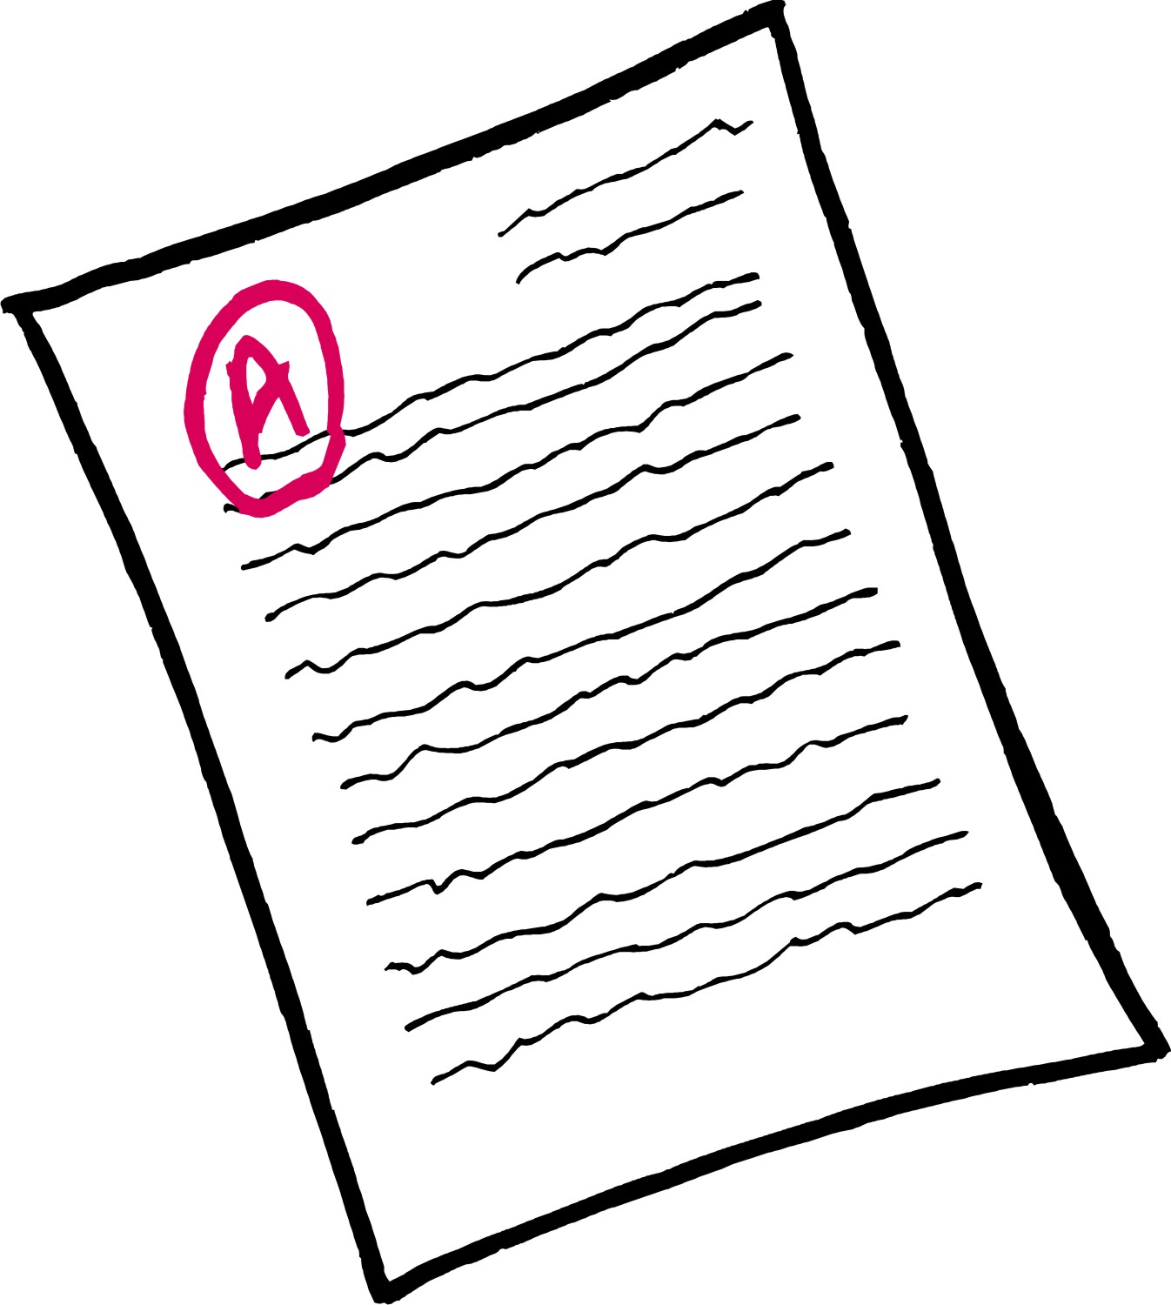
General Course Information
The majority of your grade EACH semester is based on writing and tests
Scoring of writing is based on College Board’s 6-Point Analytic Rubric
Course content and syllabus are College Board approved

Slide 6



Skills Assessed on A.P. Literature Exam
Six Big Ideas Explored through Poetry, Drama, Short Fiction, and Long Fiction:
Character
Setting
Structure
Narration
Figurative Language
Literary Argumentation

Slide 7

Exam Overview
Total Testing Session is 3 Hours
60 Minute Multiple Choice section—
55 Questions
120 Minute Essay Section—3 Essays
(40 minutes each)
Question 1 (Q1): Poetry Analysis
Question 2 (Q2): Prose Fiction Analysis
Question 3 (Q3): Literary Argument

Slide 8

How is A.P. Literature different from A.P. Language?
The language course (12th grade) uses nonfiction texts exclusively, and focuses on rhetorical analysis and the development of analytic and argumentative writing, while
The literature class (11th grade) focuses on literary analysis of fiction.

Slide 9
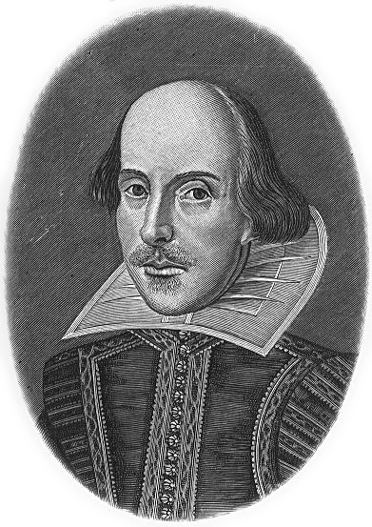
Reasons to take the class
You are a strong writer and enjoy literary analysis.
You are a strong reader and want to be challenged.
You like talking about literary works and characters.
You find yourself critiquing films, books, and writing.
You want to get a head start on college-level curriculum because your skills are above others in your same grade level.
When you get home, English assignments are the first on your list because you have a great interest in literature and poetry.
You naturally read and write on your own without being coerced by your teachers or parents.

Slide 10
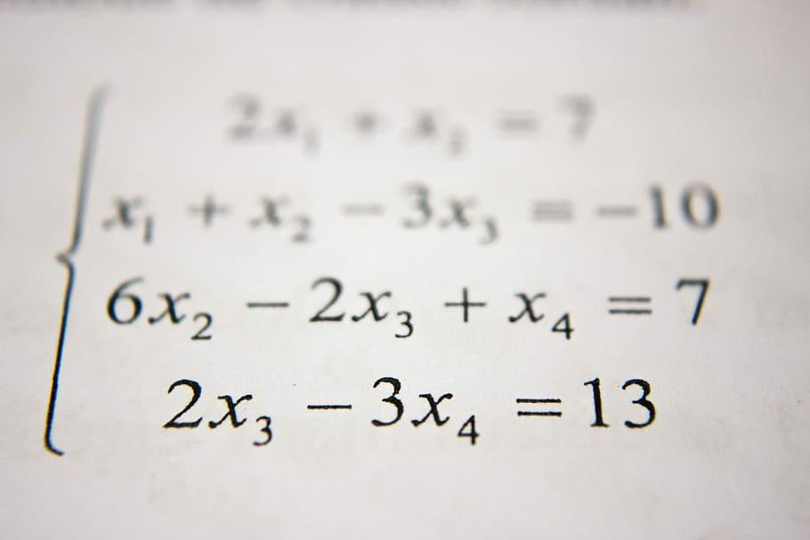


Reasons you should not take the class
You are not interested in a class that revolves around preparing for a test. You do not plan to take the A.P. Literature test.
You just want the extra course credit.
Your parents want you to take A.P. Literature but you are more interested in other subjects.
English class has always been your least favorite class and you struggle in the subject.
You do not really like reading or writing.
You do not have the time to meet the demands of a rigorous class among your other A.P. classes.

