Slide 1
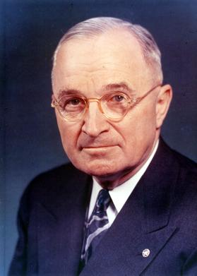
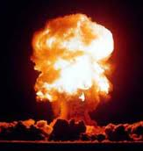
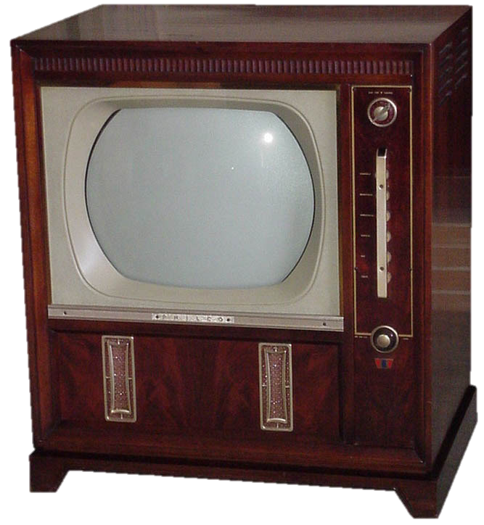
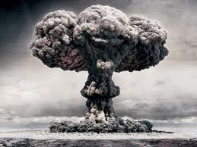
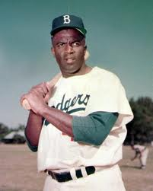
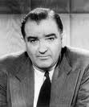
Post-War Society, 1945-1960

Slide 2
Theme #1
Truman’s first term was characterized by political battles with conservatives in Congress and modest gains in civil rights while his second term attempted to extend New Deal-type legislation through the “Fair Deal” which was soundly defeated by strong conservative opposition in Congress .

Slide 3
V. Truman’s 1st term: domestic policy
A. Taft- Hartley Act (June 1947)
1. Passed by Congress over Truman’s veto
2. Conservative response to the growing power of labor unions
3. Provisions
a. 80-day cooling-off period for strikers in key industries
b. Outlawed the “closed shop”
4. By 1954, 15 states passed “right to work” laws outlawing the “union shop”

Slide 4
C. Twenty-second Amendment, 1951
1. Limited president to two terms; or a maximum of 10 years if he, as vice president, assumed the presidency due to the death or departure of a previous president.
2. Largely a conservative move in the face of over 17 years of continuous Democratic rule in the White House (FDR and Truman)

Slide 5
VII. Election of 1948
A. Democrats spilt into three camps.
1. Truman supporters of the “Fair Deal”
-- Platform called for extension of New Deal programs and civil rights for African Americans
2. “Dixiecrats”: States’ Rights Party led by Strom Thurmond
-- Opposed to civil rights for blacks
3. A new Progressive party that believed Truman was not liberal enough

Slide 6
B. Republicans nominated Thomas Dewey
-- Anti-labor plank; sought to reduce the New Deal
C. Truman’s victory came with support from farmers, workers, and African Americans
D. Democrats established a clear majority in Congress

Slide 7
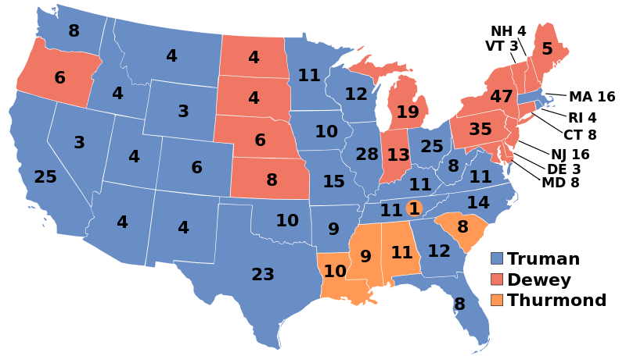
Election of 1948
Truman 303
Dewey 189
Thurmond 39
Southern support for Thurmond foreshadowed the eventual loss of the Deep South for Democrats in the 60s, 70s, 80s, and 90s.
Notes:
Wikipedia Commons

Slide 8
VIII. “Fair Deal”
A. Goal: Extension of New Deal programs
B. Results: modest gains in raising minimum wage, public housing and extending Social Security.
C. Truman was able to maintain, but not expand New Deal programs
-- Coalition of Republicans and conservative southern Democrats blocked Truman’s initiatives
D. Truman did not run for re-election in 1952

Slide 9
IX. Election of 1952
A. Adelai Stevenson nominated by Democrats
B. Dwight D. Eisenhower nominated by Republicans
-- Richard Nixon selected as vice presidential running mate
C. Results: Eisenhower defeated Stevenson 442-89

Slide 10
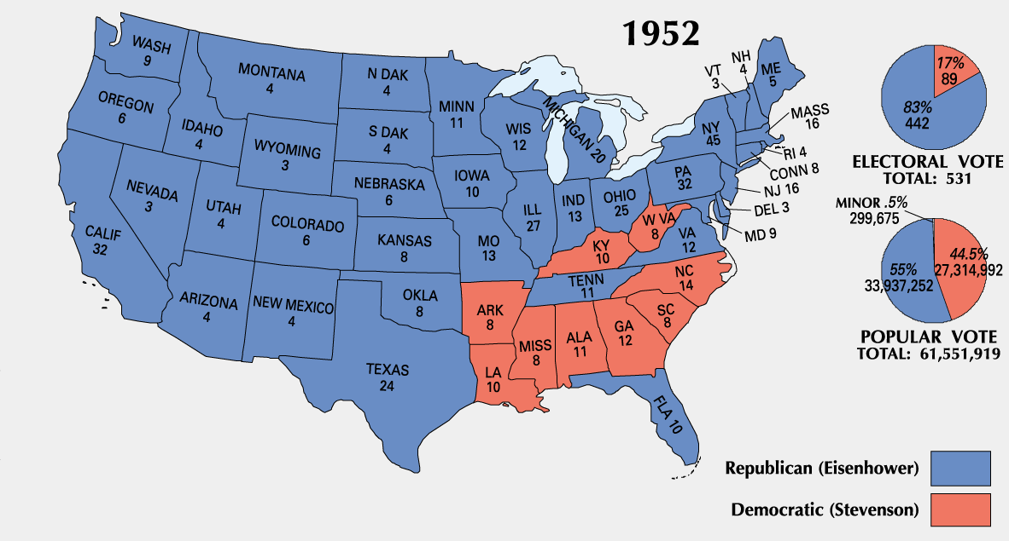
Notes:
Wikipedia Commons

Slide 11
X. The “Vital Center”: 1948-1968
A. A political consensus developed in America
B. Components
1. Anti-communism; containment
2. Belief that economic growth could solve all society’s problems
3. Political pluralism
C. “Vital Center” elected Truman in ‘48, Eisenhower in ‘52 and ‘56, Kennedy in ‘60, and Johnson in ‘64

Slide 12
D. Flaws in the “vital center”
1. Vietnam War exposed problems with “containment”
2. Poverty rate reached 25% in 1950s
3. Jim Crow demonstrated lack of true pluralism in America
E. “Vital Center” shattered in 1968
1. Vietnam War pit hawks against doves
2. White conservative backlash against liberalism emerged

Slide 13
1950s: President Eisenhower’s Modern Republicanism

Slide 14
Theme
American society emerged in the years following World War II as the world’s most productive and affluent society. Dramatic demographic changes occurred throughout the country as a result of a booming economy and a “baby boom.”

Slide 15
To what extent did the decade of the 1950’s deserve its reputation as an age of political, social, and cultural conformity?
Notes:
Lesson Plan for Wednesday, March 4, 2009: Warm-up question, Eisenhower video, Ike ppt notes

Slide 16
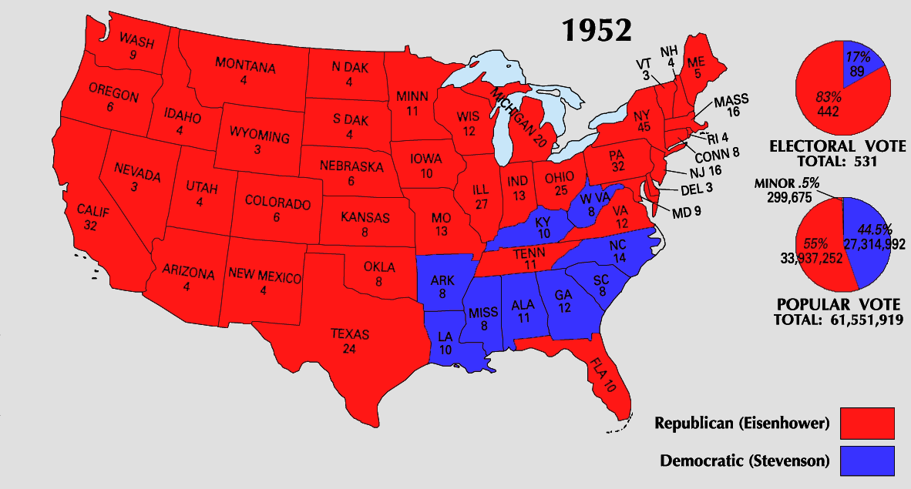
Eisenhower’s Modern Republicanism
Frustration with the stalemate in Korea & the Red Scare led to a Republican presidential takeover in the 1952
WW2 hero Dwight Eisenhower provided an antidote for “K₁C₂”
  VP Richard Nixon attacked communism & corruption
  Eisenhower vowed to go to Korea & personally end the war
Korean War
Communism
Gov’t Corruption
Once elected, Ike did go to Korea, overturned the U.N. battle plan, & threatened China with nuclear war to get an armistice signed in 1953

Slide 17
Eisenhower’s Modern Republicanism
Eisenhower labeled his politics “Modern Republicanism”:
  “Ike” believed in conservative gov’t spending & a balanced budget but he had no desire to end New Deal programs
  The affluent, postwar “good life” at home was dependent upon a strong Cold War foreign policy
“I’m conservative when it comes to money and liberal when it comes to human beings”

Slide 18
Eisenhower’s Modern Republicanism
During the Eisenhower era, the U.S. economy avoided spiraling inflation & brought middle-class prosperity to more Americans
In his 8 years as president, Ike had a modest domestic record:
  Instead of ending New Deal programs, Eisenhower added to social security & minimum wage
  Used FDR’s Federal Housing Admin to help finance building & purchasing of suburban homes
  Created the Depts of Health, Education, & Welfare

Slide 19
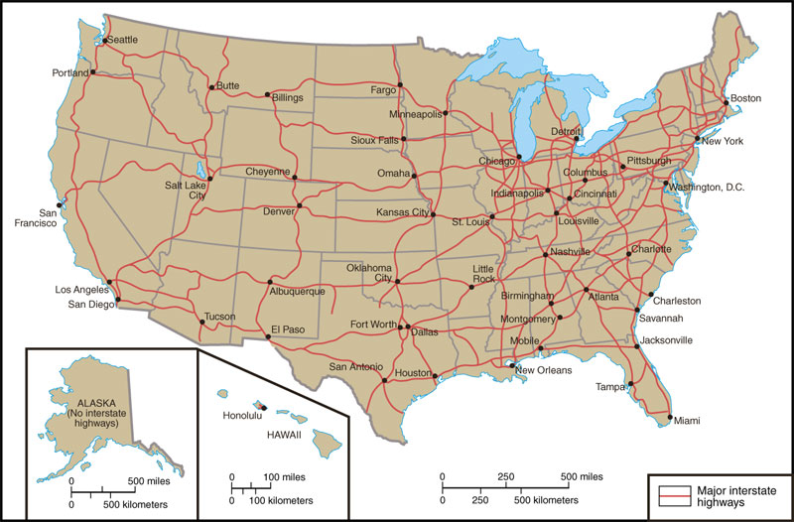
Eisenhower’s Modern Republicanism
Interstate Highway System:
  Highway Act of 1956 created 41,000 miles of divided highway to connect major U.S. cities
  These highways helped promote national defense, interstate trade, & vacation travel
  All funds were raised exclusively through gas, tire, & car taxes

Slide 20
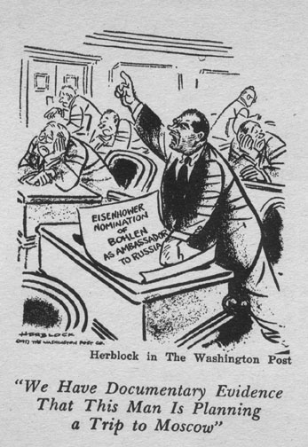
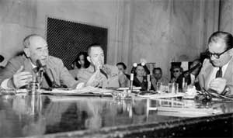
The Republicans in Power
“Have you no decency, Mr. McCarthy?”
Regarding McCarthyism, Ike provided McCarthy “just enough rope to hang himself” in 1954
  In the televised “Army hearings,” the nation saw McCarthy’s style & fact-less attacks
  The Senate censured McCarthy & his “communist” attacks quickly died
“I am not going to get into a [peeing] contest with a skunk”

Slide 21
Postwar American Society

Slide 22
An Affluent Society
The Marshall Plan
The postwar boom was caused by
  A desire for consumer goods (suppressed in the 1930s & 40s)
  Gov’t spending during Cold War
  Baby boom & movement to the suburbs increased the demand for consumer goods
But, this affluence led to a shift from individualism to conformity
The Korean War
Hi-fi record players
The American economy grew from crippling depression to the highest standard of living in all of world history in just 1 generation
Refrigerators
Cars with automatic transmissions
Filter cigarettes
TVs

Slide 23
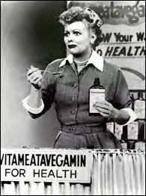
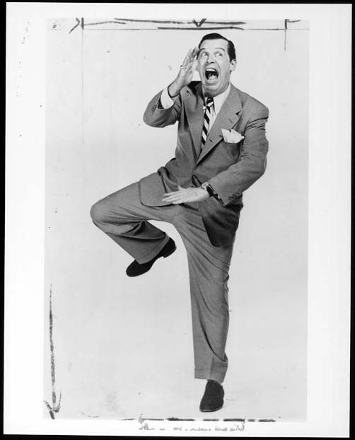
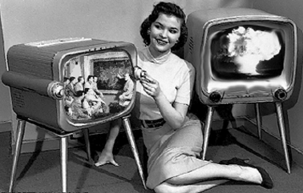
TV in the 1950s
“The Milton Berle Show”
“I Love Lucy”
$64,000 Question
21 Questions
Bonanza
The Untouchables
I Love Lucy
1950s TV networks
TV replaced radio & magazines as the primary conveyer of American consumer culture

Slide 24
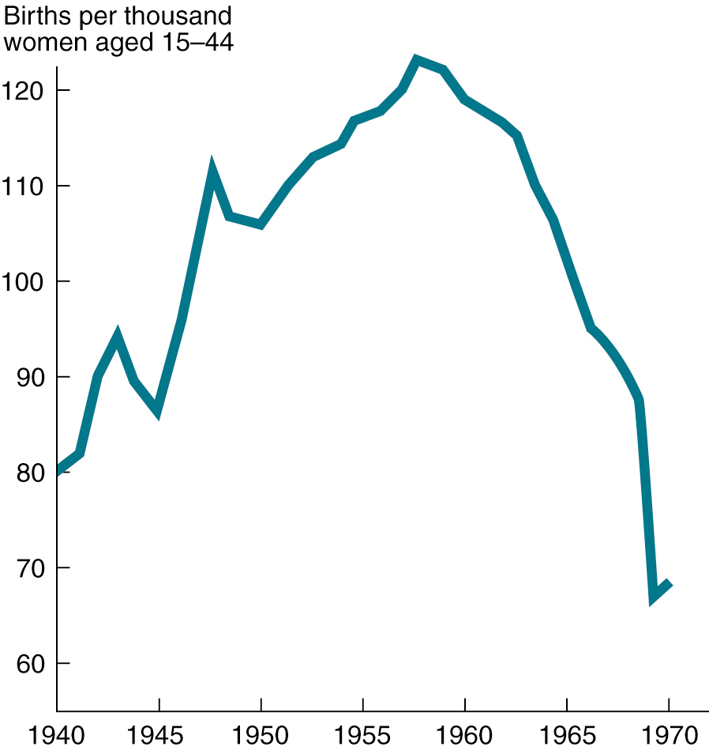
Birthrate, 1940-1970
The late 1940s & 1950s experienced the “baby boom”

Slide 25
Life in the Suburbs
The rapid growth of suburbs altered American life:
  “Blue” & “white collar” workers lived in the same neighborhoods
  Suburbs depended upon cars, grocery stores, & shopping malls
  Suburbs allowed for the nuclear-family, not the extended family
  “White-flight” to the suburbs left behind largely black urban cores

Slide 26
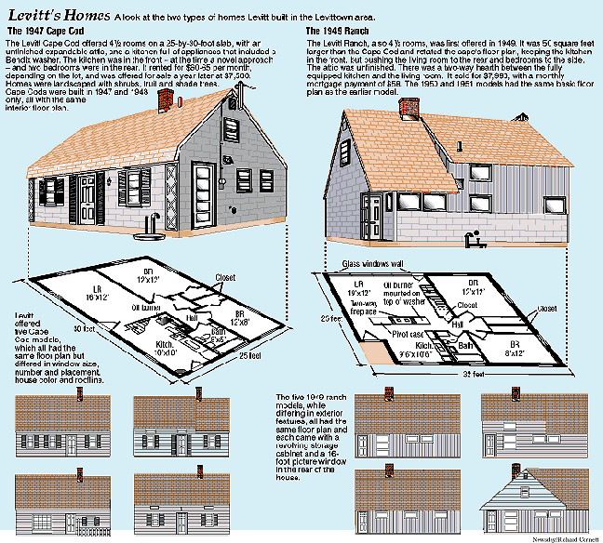
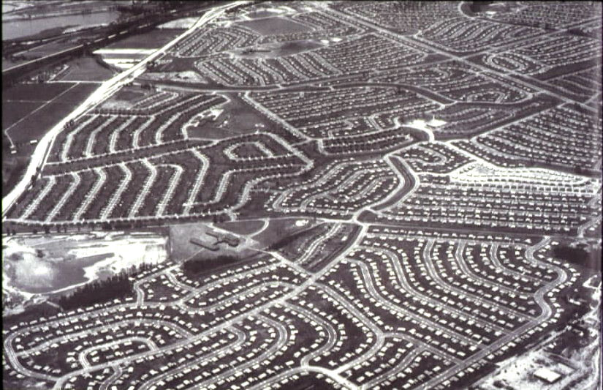
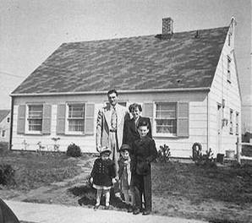
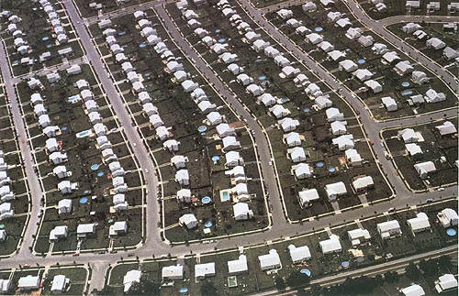
A Suburban Case Study: Levittown, New York
Grew to 17,000 sold homes in 1951
Begin in 1947 with 4,000 rental homes to veterans
Notes:
So many babies were born in Levittown that it was called Fertile Valley & the Rabbit Hutch

Slide 27
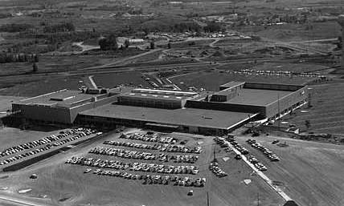
Southdale Shopping Center, Minnesota—the 1st enclosed, air-conditioned shopping mall

Slide 28
Areas of Greatest Growth
The rapid growth of suburbs led to
  Increased church membership; Religious preference became the primary identifying feature of the suburbs
  Public schools grew & a college education was a goal for middle class children

Slide 29
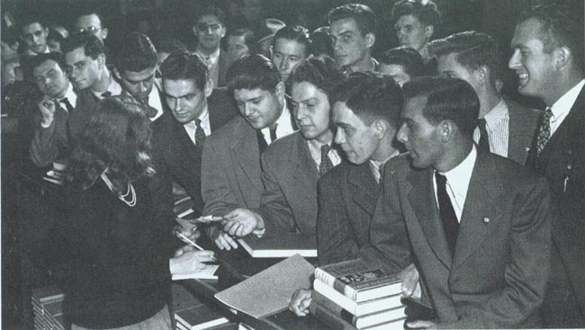
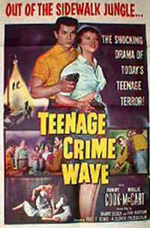
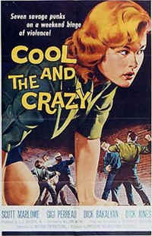
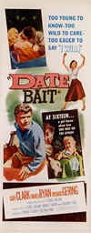
Juvenile Delinquency Movies of the 1950s

Slide 30
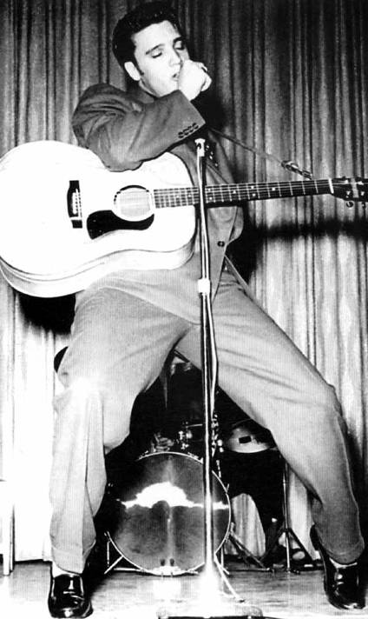
The Music of the 1950s
The music of the early 50s was dominated by doo-wop
But, rock n’ roll quickly struck a chord with young listeners:
  Black artists: Ray Charles, Chuck Berry, Fats Domino, & Little Richard
  White artists: Jerry Lee Lewis, Roy Orbison, Buddy Holly, & Elvis Presley

Slide 31
Critics of the Consumer Society
Some criticized suburban culture:
  William Whyte’s Organized Man & David Riesman’s Lonely Crowd criticized American conformity to social pressures
  Jack Kerouac & the Beats (Beatniks) emerged as a new counter-culture by refusing to conform to 1950s culture
Gave rise to counter-culture reactionaries of 1960s
Inspired by Zen Buddhist state of inner grace called “beatitude”

Slide 32
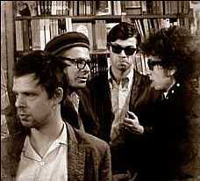
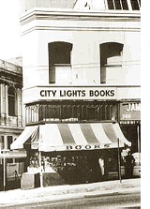
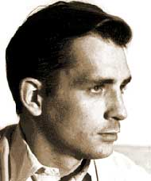
Beat Artists (Beatniks)
“City Lights” in San Francisco was a hotbed for Beat artists
Find images

Slide 33
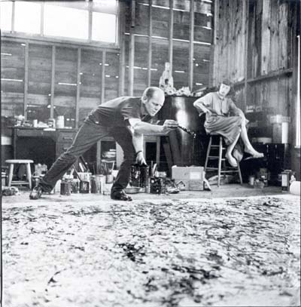
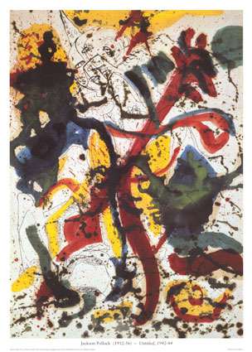


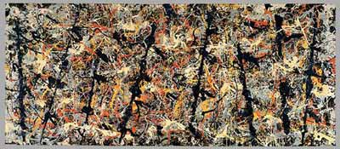
Mar
Abstract Expressionism
Jackson Pollock
Mark Rothko

Slide 34
Conclusions
By 1960, the American people were more optimistic than in 1950
  Americans were no longer afraid of a return of another Great Depression
  Anxiety over the Cold War continued but was not as severe
  But, American values & race relations were areas of concern

Slide 35
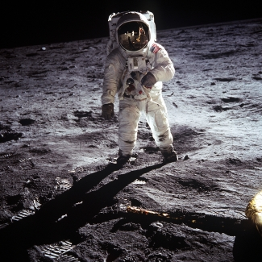
The 1960s…

Slide 36
Essential Question:
  To what degree did Kennedy’s “New Frontier” domestic & foreign policy differ from Truman & Eisenhower in the 1950s?
Notes:
Lesson Plan for Wednesday, March 18, 2009: RQ 28A, JFK Notes & Video

Slide 37
Essential Question #2:
  To what degree was Lyndon Johnson’s “Great Society” a continuation of JFK’s “New Frontier” domestic agenda?
Notes:
Lesson Plan for Friday, March 20, 2009: RQ 28B, LBJ Notes & Video

Slide 38
Essential Question #3
Comparing FDR’s New Deal with LBJ’s Great Society
Which reform movement was more important?

Slide 39
Kennedy & the New Frontier
Notes:
18:46- 27:00 (8.15 minutes long)

Slide 40
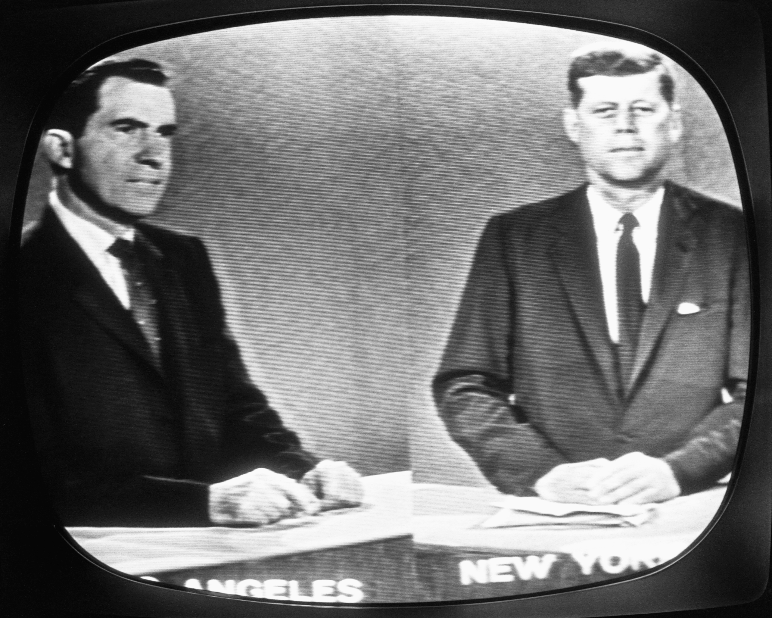
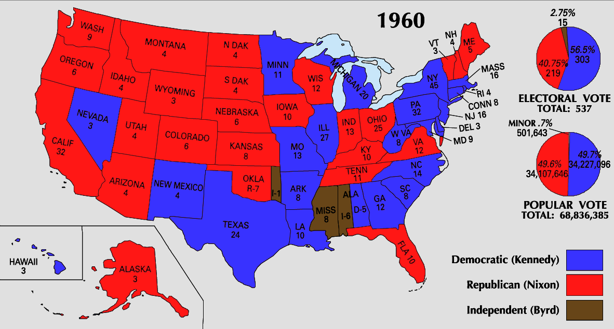
JFK’s New Frontier
But, it was not the 1st time TV influenced politics…
The election of 1960 between Richard Nixon & John F. Kennedy was the 1st to use TV debates:
  Nixon was much better known but the TV debates helped swing undecided voters towards JFK
  1960 marked the beginning of television dominance in politics
  Image & appearance became essential traits for candidates
Eisenhower used TV to campaign in 1952 & 1956
McCarthy was destroyed by TV in the Army-Senate hearings
Nixon used to TV to defend himself in the “Checkers” speech
TN Senator Kefauver used TV to investigate organized crime

Slide 41
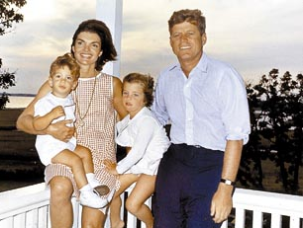
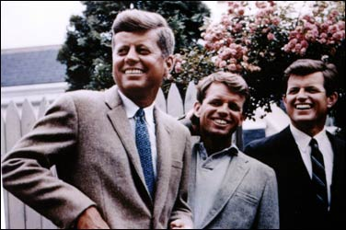
JFK’s New Frontier
Kennedy’ administration reflected youth, energy, & sharp break from Eisenhower
JFK promised a New Frontier:
  Domestic reforms in education, health care, & civil rights
  A foreign policy committed to defeating the Soviet Union & winning the Cold War
The JFK era began “Camelot” comparisons with JFK as a modern-day Lancelot

Slide 42
JFK’s New Frontier
…the extension of Social Security…
JFK’s New Frontier promised a return of FDR-era liberal policies:
  But, Conservatives in Congress opposed JFK’s social reforms in education & health care
  Congress did help the poor
  The modernization of industry, gov’t spending, & a major tax cut in 1963 stimulated the economy & created jobs
Aid for public schools…
An increase in the minimum wage
…and medical insurance for the elderly were all shot down by Congress
…unemployment benefits…
Increased funds for public housing

Slide 43
JFK’s New Frontier
One long-lasting achievement of the JFK-era was strengthening the presidency:
  Eisenhower left many decisions to his staff, but JFK demanded more direct presidential control
  JFK transferred much of the decision-making power from the cabinet to his White House staff
JFK appointed tough, pragmatic, & academic “New Frontiersmen” to his staff
Kennedy referred to his staff as the “the best & the brightest”

Slide 44
"Let Us Continue"
On Nov 22, 1963 in Dallas, JFK was assassinated & VP Lyndon Johnson became president:
  LBJ was a master politician with a reputation for getting results
  LBJ promised to continue Kennedy's liberal agenda
  LBJ ultimately exceeded JFK’s record on providing economic & racial equality
LBJ helped push through the greatest array of liberal legislation in U.S. history (“Great Society”), surpassing FDR’s New Deal

Slide 45
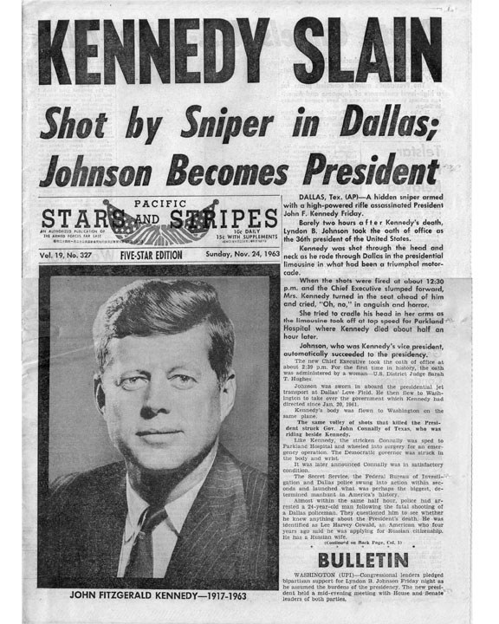
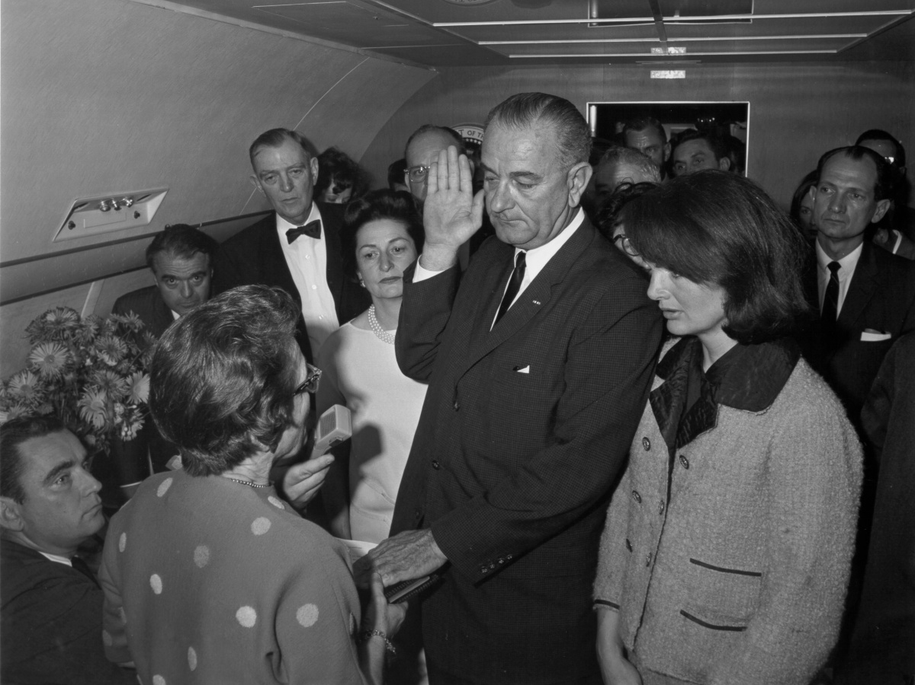
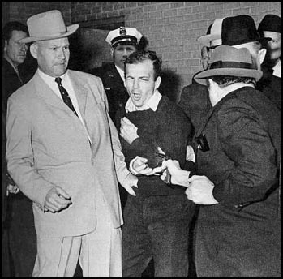
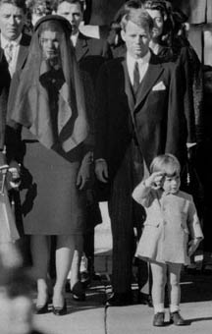

Americans were stunned this rapid succession of events

Slide 46
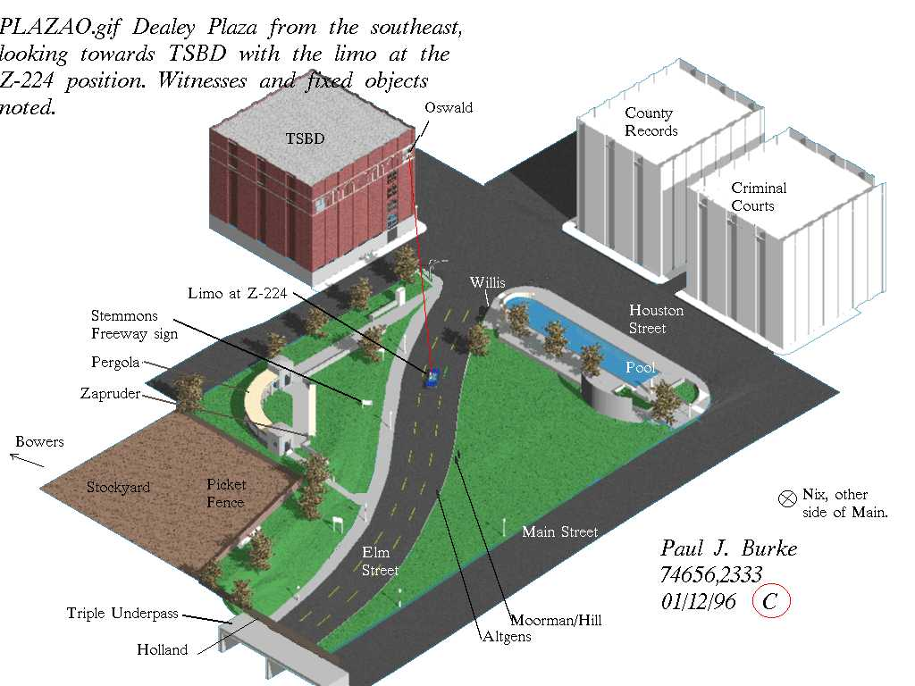
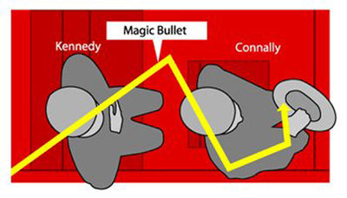
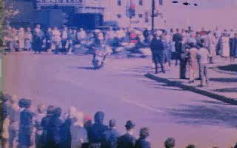
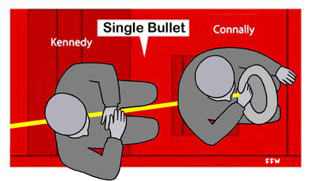
The Zabruder Film

Slide 47
Lincoln
Lincoln was elected to Congress in 1846 & as President in 1860
He was directly concerned with Civil Rights
Lincoln was shot in the head in front of his wife on a Friday
Lincoln shot in the Ford Theatre
The assassin, John Wilkes Booth, was known by three names of 15 letters
Booth shot Lincoln in a theater and fled to a warehouse (barn)
Booth was killed before being brought to trial
There were theories that Booth was part of a greater conspiracy
Lincoln's successor was Andrew Johnson, born in 1808
Kennedy
Kennedy was elected to Congress in 1946 & as President in 1960
He was directly concerned with Civil Rights
Kennedy was shot in the head in front of his wife on a Friday
Kennedy shot in a Lincoln (Ford)
The assassin, Lee Harvey Oswald, was known by three names of 15 letters
Oswald shot Kennedy from a warehouse and fled to a theater
Oswald was killed before being brought to trial
There were theories that Oswald was part of a greater conspiracy
Kennedy's successor was Lyndon Johnson, born in 1908

Slide 48
Lyndon Johnson in Action
LBJ quickly pushed through Congress 2 key “Kennedy” bills:
  A $10 billion reduction in income taxes that led to increased consumer spending & new jobs
  The Civil Rights Act of 1964 that declared segregation in public facilities illegal & protected black voting rights
The most significant legislation on race since the Reconstruction Amendments

Slide 49
Lyndon Johnson in Action
In 1964, LBJ waged a “war on poverty in America” & created the Office of Economic Opportunity:
  Created the Job Corps for high school dropouts
  Head Start for preschoolers
  Adult education & technical training opportunities
As a result, America had 10 million fewer poor people by 1970
In 1964, the U.S. had 35 million poor people

Slide 50
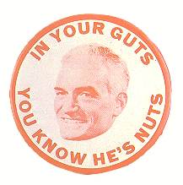
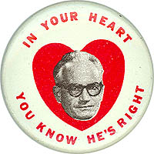
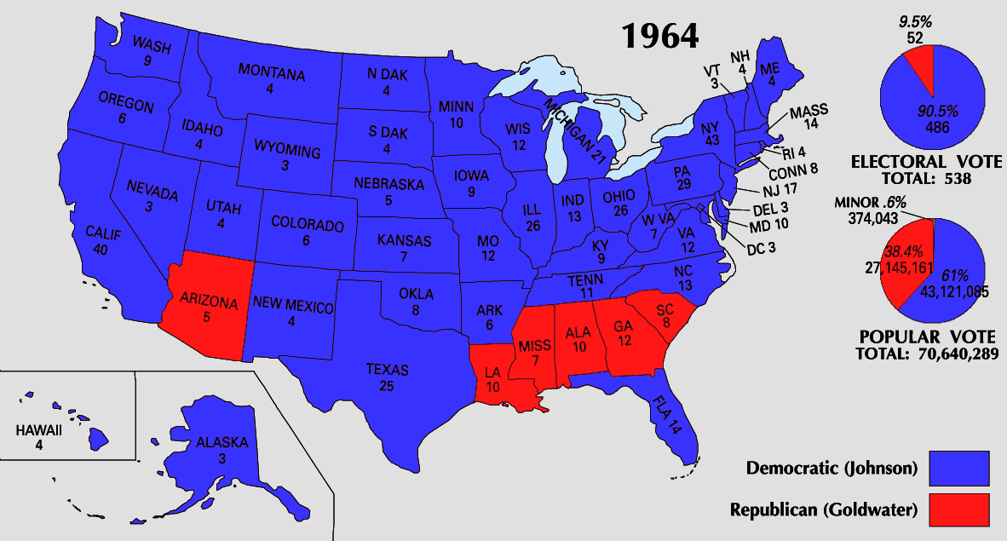
The Election of 1964
In 1964, LBJ ran against:
  Conservative Republican Barry Goldwater rejected LBJ’s liberal welfare programs & called for a stronger foreign policy stance
  Segregationist George Wallace
LBJ won in a landslide & the Democrats took control of Congress for 1st time in 25 years

Slide 51
The “Daisy” Campaign Spot
http://www.livingroomcandidate.org/commercials/1964/peace-little-girl-daisy

Slide 52
The Great Society
Once elected, LBJ initiated his “Great Society” domestic agenda:
  Medicare & Medicaid extended health insurance to the elderly & the poor
  Extended $1 billion to improve public & parochial schools
  The Voting Rights Act of 1965 banned literacy tests & provided for federal registrars for polls

Slide 53
The Triumph of Reform
By 1965, Congress passed 89 laws or reforms as part of LBJ’s social agenda:
  The Great Society was the most comprehensive agenda of social reform since FDR
  But…the American people did not respond well to LBJ
  Soon…events in Vietnam, would taint his presidency

Slide 54
The Presidency of Richard Nixon

Slide 55
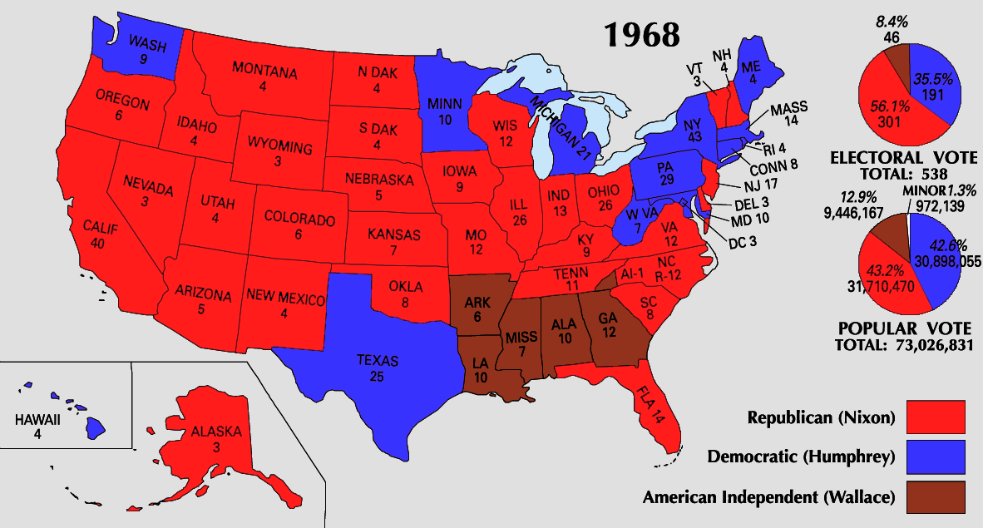
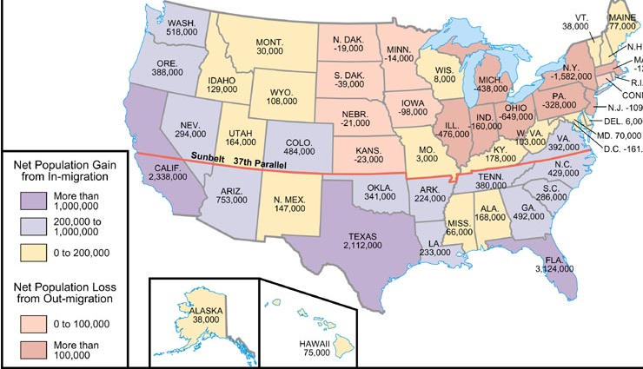
The Republican Resurgence
In 1968, Republicans benefited from the Vietnam disaster & division in the Democratic party:
  Richard Nixon (R) ran as the one candidate who could restore order in America
  Humphrey (D) was plagued by anti-war protesters
  George Wallace (3rd) attacked blacks & liberals
Nixon claimed to represent the “silent majority” who worked, paid taxes, & did not protest
Nixon was the first candidate to appreciate the new importance of the “Sunbelt”: military bases, high-tech industries, retirement communities, anti-segregationists made the South more conservative than before
Notes:
Nixon won by narrow victory

Slide 56
The End of an Era
The presidential election of 1968 ended 30 years of:
  Liberal reform—Americans began to favor conservative political leaders
  Activist foreign policy—Vietnam proved that Containment failed to be applied to global scale
A “silent majority” seemed fed up with protest, violence, long hair, drug use, & sexual promiscuity

Slide 57
Nixon’s Domestic Policy
Nixon entered office as a moderate who kept LBJ’s Great Society in place
  But, Nixon shifted responsibility for social problems to state & local governments
  Nixon reshaped the Supreme Court along conservative lines when 4 justices retired
Replaced retiring chief justice Earl Warren with Warren Burger
Nominated Harry Blackmun, Lewis Powell, & William Rehnquist
Notes:
named too

Slide 58
Nixon’s Domestic Policy
Nixon oversaw the creation of:
  Environmental Protection Agency
  Occupational Safety & Health Administration (OSHA)
  A failed plan to replace welfare benefits with a minimum income
  Quotas for minority construction firms for gov’t projects
  Ended the gold standard in 1971
Notes:
named too

Slide 59
Nixonomics
The economy was a challenge:
  Nixon inherited inflation & deficit spending from the Vietnam War
  Nixon’s decrease in government spending & increase in interest rates led to the 1st American recession since 1958
In 1971, Nixon responded with a 90-day freeze on wages & prices & imposed a 10% tax on imports
Democrats coined “Nixonomics” to describe Nixon’s failed plan
This “Great Nixon Turnaround” ended the recession

Slide 60



The Election of 1972
The 1972 election saw a shift in voting patterns:
Only blacks, Jews, & the poor voted overwhelmingly Democratic while the GOP continued its dominance in the Sunbelt
In 1972, Nixon ran for re-election
  Democrat George McGovern was labeled an “outsider” who supported “acid, abortion, & amnesty”
  Nixon won in the 4th largest margin of victory in history
But…the Watergate scandal ended the Nixon presidency

Slide 61
Watergate:
A Crisis of Democracy

Slide 62
The Watergate Scandal
In 1972, a break-in at Democratic candidate George McGovern’s headquarters revealed a well-funded plan of espionage & sabotage by the Committee to Re-Elect the President (CREEP)
The Watergate cover-up led to Nixon’s resignation & a changed American perception of the gov’t & the role of the media

Slide 63


The Watergate Complex

Slide 64


Bob Woodward & Carl Bernstein of the Washington Post broke the Watergate story
Their investigation revealed…

Slide 65





The Burglars

Slide 66


Formation of the “Plumbers”

Slide 67






All the President's Men

Slide 68



Daniel Ellsberg’s Pentagon Papers

Slide 69
Nixon’s Enemies List
Jane Fonda
Paul Newman
Edward Kennedy
Joe Namath
Daniel Schorr
Bill Cosby
Several 100 more U.S. citizens

Slide 70
The Watergate Scandal
The Watergate scandal began to unravel in 1973:
  The discovery that Nixon recorded conversations proved most damning
  The Supreme Court ordered Nixon to turn over all tapes to a Senate investigative committee
  The House brought 3 articles of impeachment against president
Due largely to Washington Post reporters Bob Woodward & Carl Bernstein
Obstruction of justice
Abuse of power
Contempt of Congress

Slide 71



Stonewalling

Slide 72




Notes:
May 2005, Deep Throat was revealed as FBI Deputy Secretary W. Mark Felt

Slide 73
The Watergate Scandal
Teddy Roosevelt began the trend of a stronger president than Congress; a trend that continued throughout the 20th century until Nixon
Impact of the Watergate scandal:
  26 members of Nixon’s administration were sent to jail
  The press began to be seen as a “watchdog” over the gov’t
  An independent judiciary branch was vital to protect individual freedom & national interests
  Power shifted from the president to Congress
After Nixon, Congress enacted campaign finance reform, made it easier for the Justice Dept to investigate the Executive Branch, took back some control of the federal budget, passed the Freedom of Information Act, & reigned in CIA covert operations
Notes:
No president went further than Richard Nixon in concentrating powers in the presidency. He refused to spend funds that Congress had appropriated; he claimed executive privilege against disclosure of information on administration decisions; he refused to allow key decision makers to be questioned before congressional committees; he reorganized the executive branch and broadened the authority of new cabinet positions without congressional approval; and during the Vietnam War, he ordered harbors mined and bombing raids launched without consulting Congress.
Watergate brought a halt to the "imperial presidency" and the growth of presidential power. Over the president's veto, Congress enacted the War Powers Act (1973), which required future presidents to obtain authorization from Congress to engage U.S. forces in foreign combat for more than 90 days. Under the law, a president who orders troops into action abroad must report the reason for this action to Congress within 48 hours.
In the wake of the Watergate scandal, Congress passed a series of laws designed to reform the political process. Disclosures during the Watergate investigations of money-laundering led Congress to provide public financing of presidential elections, public disclosure of sources of funding, limits on private campaign contributions and spending, and to enforce campaign finance laws by an independent Federal Election Commission. To make it easier for the Justice Department to investigate crimes in the executive branch, Congress now requires the attorney general to appoint a special prosecutor to investigate accusations of illegal activities. To re-assert its budget-making authority, Congress created a Congressional Budget Office and specifically forbade a president to impound funds without its approval. To open government to public scrutiny, Congress opened more committee deliberations and enacted the Freedom of Information Act, which allows the public and press to request the declassification of government documents.
Some of the post-Watergate reforms have not been as effective as reformers anticipated. The War Powers Act has never been invoked. Campaign financing reform has not curbed the ability of special interests to curry favor with politicians or the capacity of the very rich to outspend opponents.
On the other hand, Congress has had somewhat more success in reining in the FBI and the CIA. During the 1970s, congressional investigators discovered that these organizations had, in defiance of federal law, broken into the homes, tapped the phones, and opened the mail of American citizens; illegally infiltrated anti-war groups and black radical organizations; and accumulated dossiers on dissidents, which had been used by presidents for political purposes. Investigators also found that the CIA had been involved in assassination plots against foreign leaders--among them Fidel Castro--and had tested the effects of radiation, electric shock, and drugs (such as LSD) on unsuspecting citizens. In the wake of these investigations, the government severely limited CIA operations in the United States and laid down strict guidelines for FBI activities. To tighten congressional control over the CIA, Congress established a joint committee to supervise its operations.

Slide 74
Conclusions:
Politics After Watergate
The Watergate scandal eroded public trust in their own gov’t
The growing tension between president & Congress prevented strong, effective leadership from meeting foreign & domestic problems in the 1970s
The discontent of the 1960s & 1970s revealed an America at war with itself

