Slide 1
Cold War Beginnings
1946-1962

Slide 2
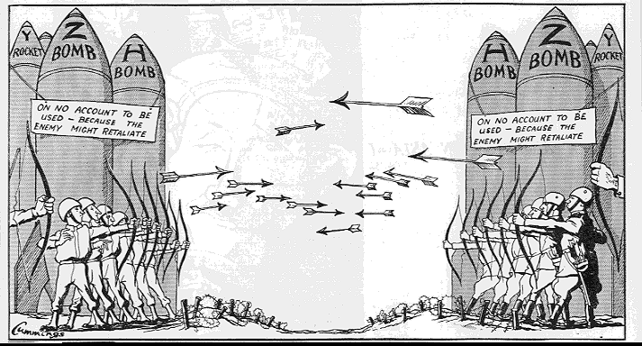
What was the Cold War?
The time period between 1945-1991 when the United States and the Soviet Union ideologically opposed one another.
This “war” will shape the world for almost 50 years.

Slide 3
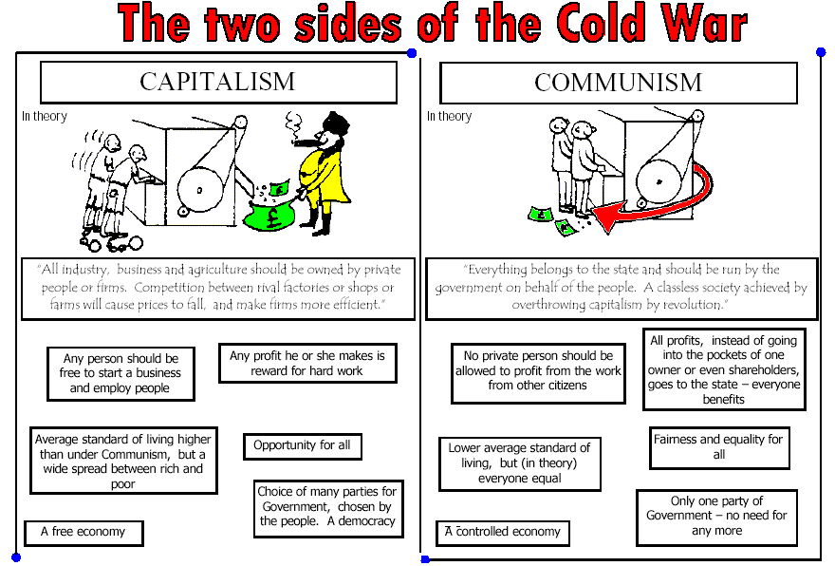

Slide 4
Two visions of the World
Atlantic Charter-FDR (signed by Churchill)- abandoned military alliances and spheres of influence for a creation of a democratic international organization settling disputes and maintains peace
Soviet View- Determined to create a secure sphere for itself in Eastern Europe as protection to possible future aggression from west. Great powers would control areas of strategic interest to them.

Slide 5
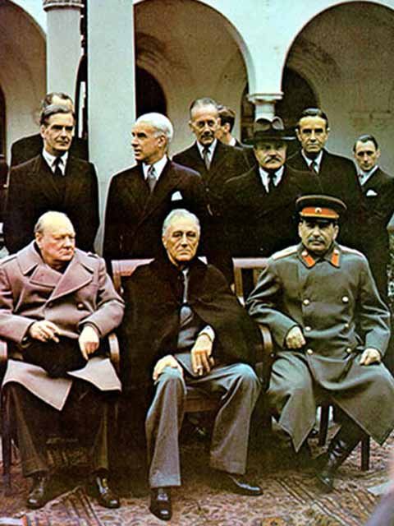
Show the differences in thought with the following events
Yalta Conference (1944) (what was agreed upon?)
United Nations (whose idea? Everyone support it?)
Polish Question (what did Stalin want with Poland?)
Post War Germany (what did they agree upon?)

Slide 6
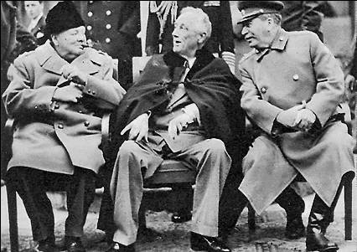
Yalta
Settled border disputes
organizing the postwar occupations of Germany and Japan
Creating the United Nations

Slide 7
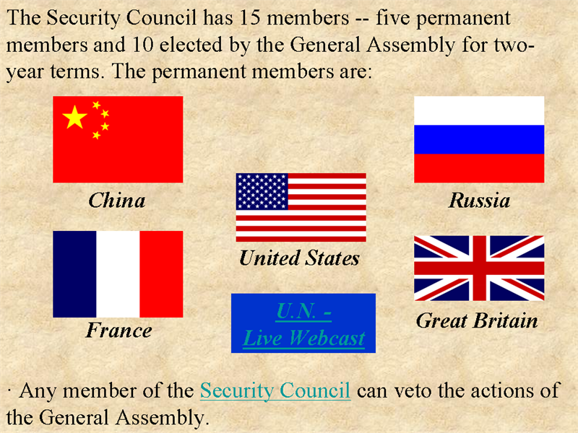
The United Nations

Slide 8
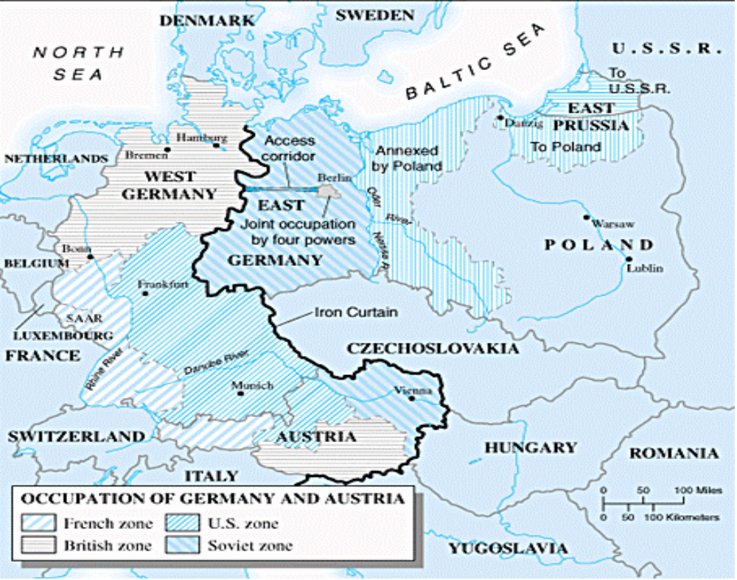
Polish Question

Slide 9
Poland
"Poland is a question of life or death for Russia“
Churchill's and Roosevelt's reluctantly acceptance of a Communist-dominated provisional government for Poland.
In exchange, Stalin pledging to assist "the peoples liberated from the dominion of Nazi Germany and the peoples of the former Axis satellite states of Europe to solve by democratic means their pressing political and economic problems."

Slide 10
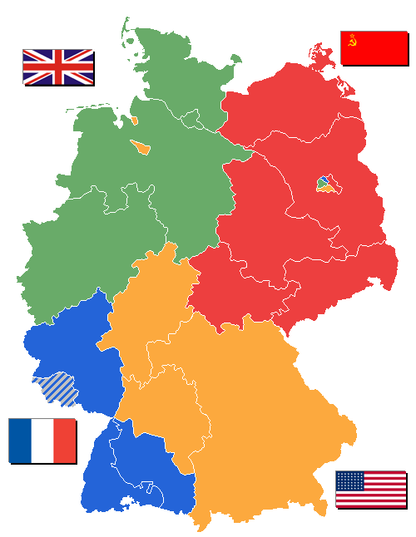
Focus on Berlin
After World War II, Germany was divided into four zones, occupied by French, British, American, and Soviet troops.
Occupation zones after 1945. Berlin is the multinational area within the Soviet zone.

Slide 11
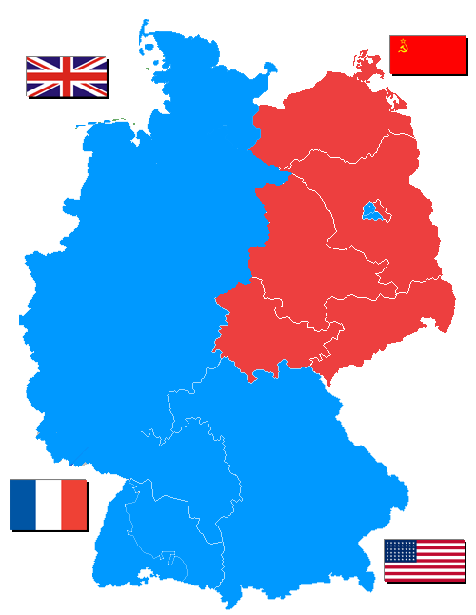
Soviet blockade:
East Berlin
West Berlin
West Germany
East Germany
· In June of 1948, the French, British and American zones were joined into the nation of West Germany after the Soviets refused to end their occupation of Germany.

Slide 12
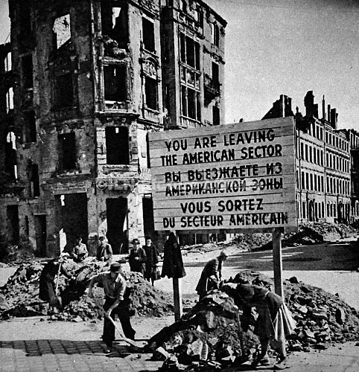
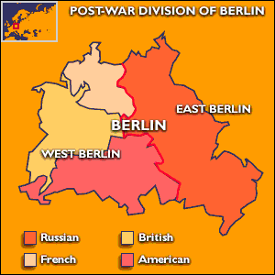
Berlin Blockade and the Division of Germany
Allies merge three zones of occupation in western part of Germany
Stalin sees this as a direct challenge and imposes a blockade around city of Berlin
Goal was for Truman to back down on a permanently divided Germany
Truman refuses and orders a massive airlift that lasts for 11 months
Oct. 1949- Federal Republic of Germany (west) and Democratic Republic of Germany (east) are created.

Slide 13
US Response to Communism
Containment Doctrine
Truman Doctrine
Marshall Plan
The National Security Act

Slide 14
The Policy of Containment
Definition:
  By applying firm diplomatic, economic, and military counter pressure, the United States could block Soviet aggression.
Formulated by George F. Kennan as a way to stop Soviet expansion without having to go to war.
Ironically, the Soviets were looking for insulation from the Capitalist West.

Slide 15
The Truman Doctrine (1947)
Reasoning
  Threatened by Communist influence in Turkey and Greece
  “Two hostile camps” speech
Financial aid “to support free peoples who are resisting attempted subjugation”
Sent $400 million worth of war supplies to Greece and helped push out Communism
The Truman Doctrine marked a new level of American commitment to a Cold War.

Slide 16
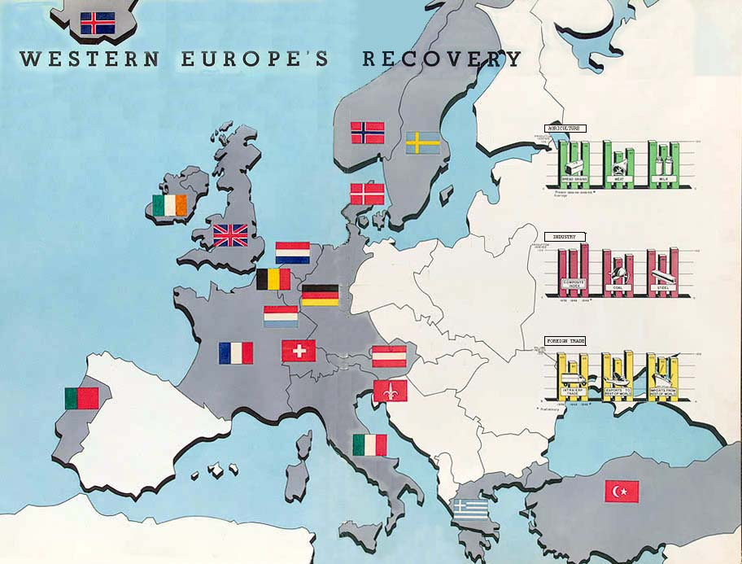
* The U.S. gave over $12 billion in aid to European countries between 1948 and 1952, helping to improve their economies and lessen the chance of communist revolutions.

Slide 17
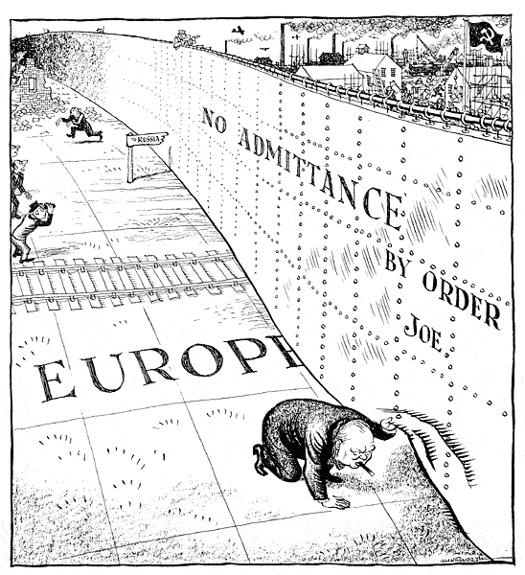
Formation of New Alliances
April 1949- Formation of NATO (North Atlantic Treaty Organization).
Soviets create the Warsaw Pact
The “Iron Curtain” has now been created

Slide 18
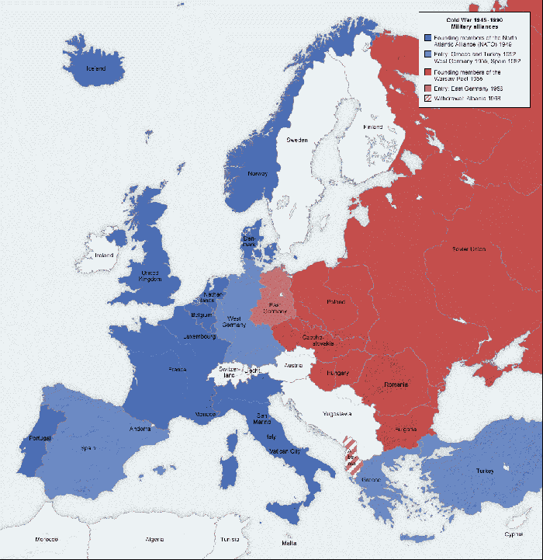

Slide 19
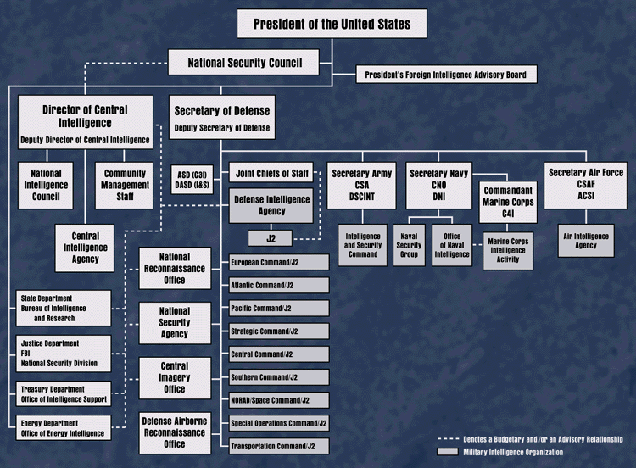
National Security Act

Slide 20
Korean War: the first hot war of the Cold War (1950-1953)

Slide 21
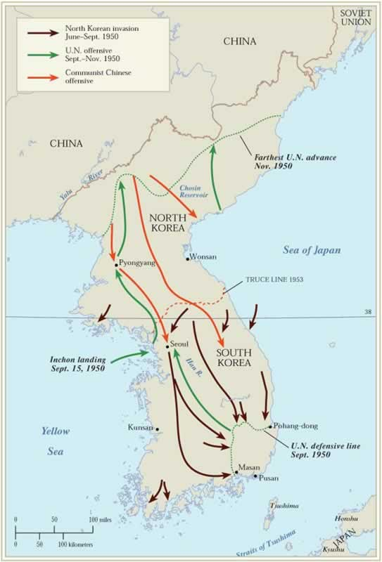
First test outside of Europe: Korea
Who? What? When? Why?
Japan controlled Korea from 1910-1945
By agreement, USSR accepted the surrender of all Japanese forces in Korea north of the 38th Parallel, while United States accepted the surrender of Japanese units south of 38th parallel.
North-controlled by communists, most of industry there, 9 million Koreans
South- military govt. largely agricultural, 21 million.

Slide 22
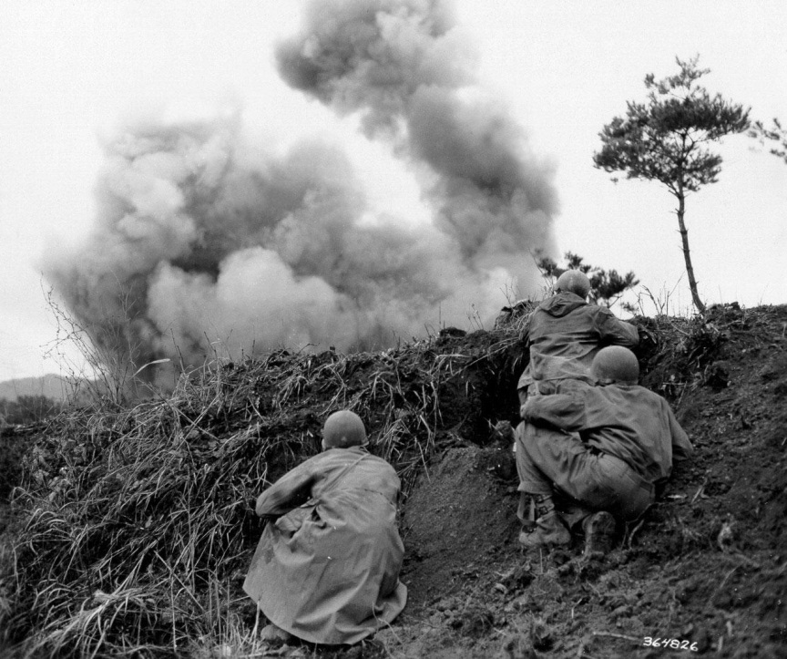
Korea- Timeline
1947-US went to United Nations to reunite Korea and hold free elections. Voted that free elections should occur, USSR vetoed and only had them in the south.
South Korea called the Republic of Korea (Syngman Rhee)
North-communist dictatorship-Peoples Republic of Korea under (Kim Il Sung)
1949-both USSR and US leave Korea. China Turns Communist.
June 25, 1950-North invades South to unified Korea.

Slide 23
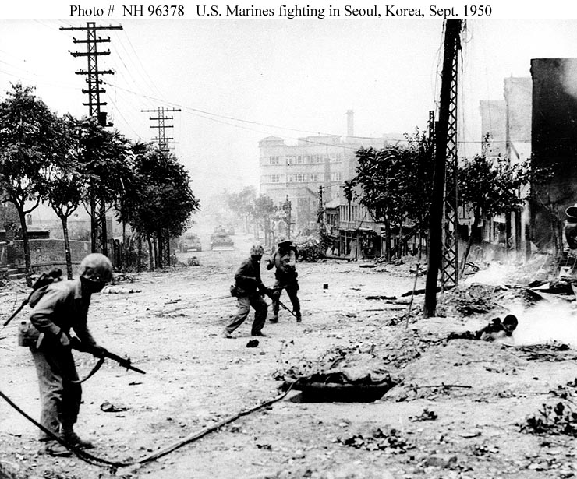
United Nations Reaction
June 27, 1950-UN Security Council called for cease fire.
North Korea ignored.
16 nations sent troops. US, Australia, New Zealand, British (US most.) Heaviest burden was of South Koreans (400,000)

Slide 24
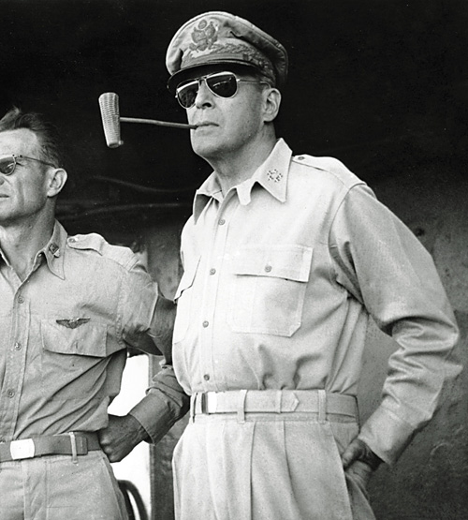
United States Reaction
Truman orders General Douglas MacArthur to supply weapons to SK
June 26- US air and naval forces supported SK ground units.
July 26- Douglas MacArthur became commander of UN forces

Slide 25
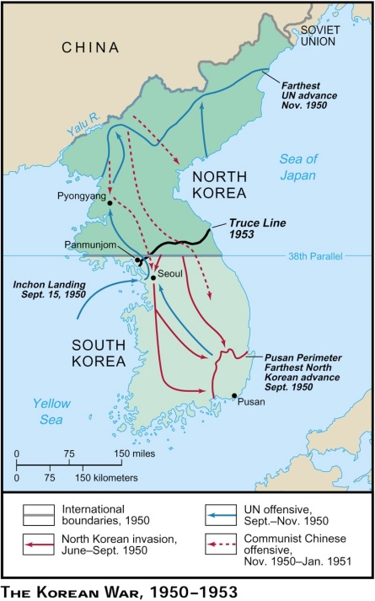
Counter-Offensive by UN (1950)
By end of July-Seoul, capital of SK fell and US units were pushed pressed into a small area surrounding the port of Pusan on S. eastern tip of Korea.
September- Counter-offensive by UN. MacArthur lands in port city of Inchon. Pushes North Korea back behind 38th Parallel.
October- UN moves into North Korea up to the Yalu River.
November- China enters the war. Front becomes stabilized at 38th parallel.

Slide 26
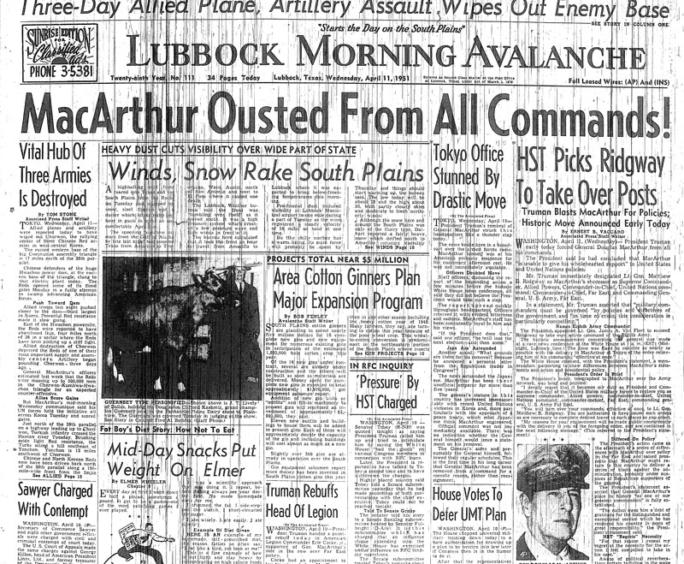
In 1951, President Truman declares a limited war. fearing a nuclear war with USSR
April- MacArthur wants to invade China. Criticized Truman. Truman fires him.
June-August- attempts of a truce between UN and North Korea fail. War drags on for two more years

Slide 27
Ending of War- Reasons
1. In 1952 Dwight Eisenhower becomes President. Promised to end the war.
2. Soviet Leader Joseph Stalin dies. USSR does not fully support China in the war.
July 27, 1953- truce finally signed. Wars ends.
Results of War- 54,000 American casualties
US troops remain in South Korea
First no win war for US.

Slide 28
Korean War review!
Who controlled Korea in WWII?
Name of the dividing line separating N. and S. Korea.
Names for North and South Korea
Capital of S. K.
Southern port city which was the last democratic strong hold.
Who fired MacArthur?
Name of river the borders N. Korea and China.
What year did it end?
Give one outcome of the war.

Slide 29
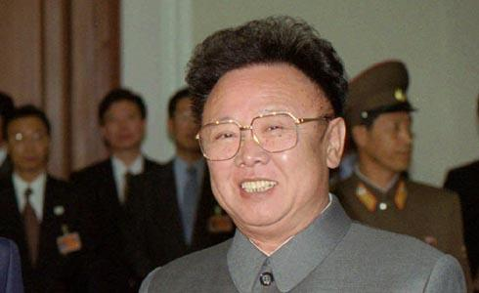
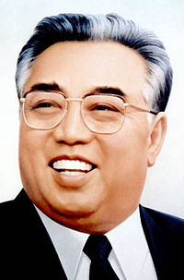
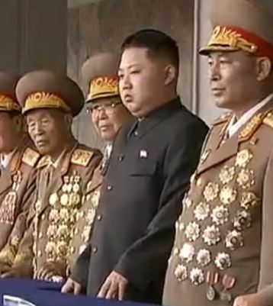
Kim Jong Il
1942 –2011
Kim Il Sung
1912 –1994
Kim Jong-un
1984-

Slide 30
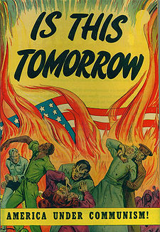
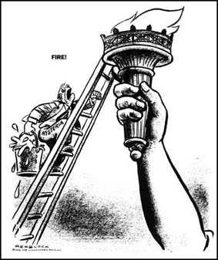
Communism at Home
(The 2nd Red Scare and McCarthyism)

Slide 31
Why again?
The Soviet domination of Eastern Europe and the Communist takeover of China shocked Americans, fueling a fear of communism that would spread around the world
President Truman issued an executive order, in March 1947, setting up the Federal Employee Loyalty Program.
From 1947 to 1951, government loyalty boards investigated 3.2 million employees and dismissed 212 as security risks.
The House Un-American Activities Committee, (HUAC), began to investigate Communist influence in the movie industry.
In September 1947 the HUAC subpoenaed 43 witnesses from the Hollywood film industry. Some witnesses were “friendly,” some were “unfriendly.” (The “unfriendly” witnesses were called to testify but refused. These men became known as the Hollywood Ten.)
In 1950, Congress passed the McCarran Internal Security Act

Slide 32
How to spot a Communist!

Slide 33
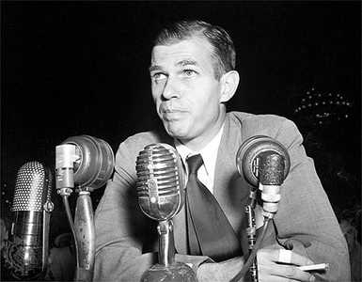
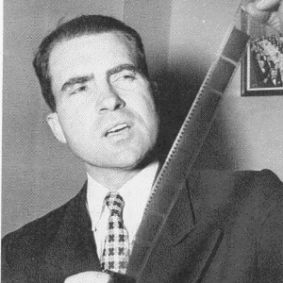
Spy Cases!
Alger Hiss-Whittaker Chambers Spy Case
  In 1948, a former Communist spy named Whittaker Chambers accused Alger Hiss, a former State Department official, of spying for the Soviet Union.
  Chambers produced microfilm to support his charges. (aka pumpkin papers!)
  Hiss claimed to be innocent but was convicted of perjury – for lying about the passing of documents – and was sent to jail

Slide 34
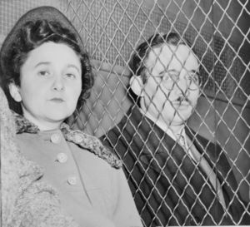
Spy Cases!
The Rosenbergs
1949 Soviets exploded an atomic bomb.
In 1950, the German-born physicist Klaus Fuchs admitted giving the Soviet Union information about America’s atomic bomb while working on the Manhattan project..
Implicated were Ethel and Julius Rosenberg, minor activists in the American Communist Party.
pleaded the Fifth Amendment when asked if they were communists.
were found guilty of espionage and sentenced to death. They were executed in the electric chair in 1953

Slide 35
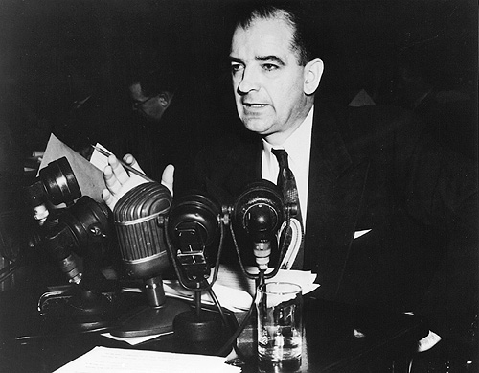
“McCarthyism”
Was a Republican from Wisconsin.
Needed a winning issue to ensure reelection in 1952 so he stated that Communists were taking over the government.
claimed to have in his hands the names of 57, 81, and 250 Communists in the State Department ( never produced a single name.)
He was always careful to do his name-calling only in the Senate, where he had legal immunity that protected him from being sued for slander.

Slide 36
Activity
As you read the telegram (1-5) focus on the following words.
What motivated McCarthy to send this telegram?
"fellow traveler"
“bed-fellow”
“McCarthyism”
"guilt by association,“
blacklisting,
browbeating
How do you think these words related to the telegram?

Slide 37
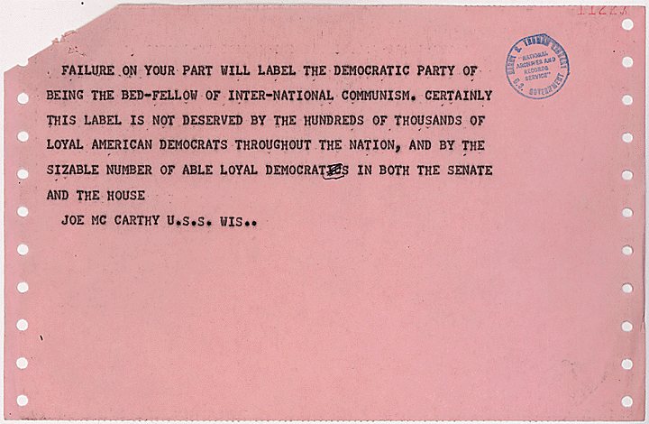
Page 6
Any change in motivation?

Slide 38
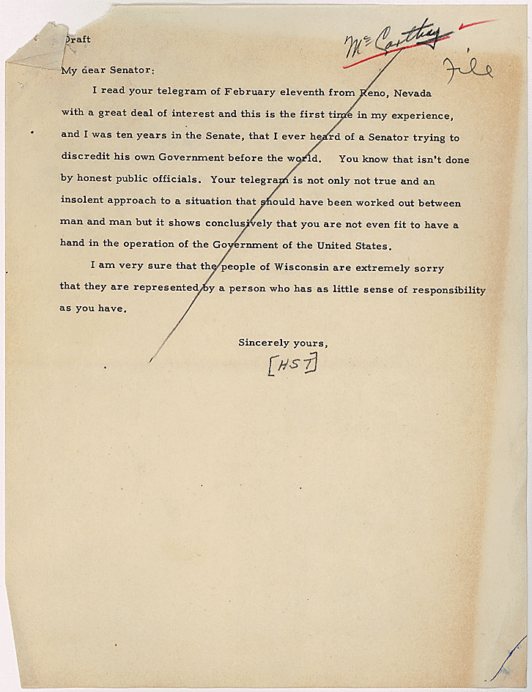
Truman’s response

Slide 39
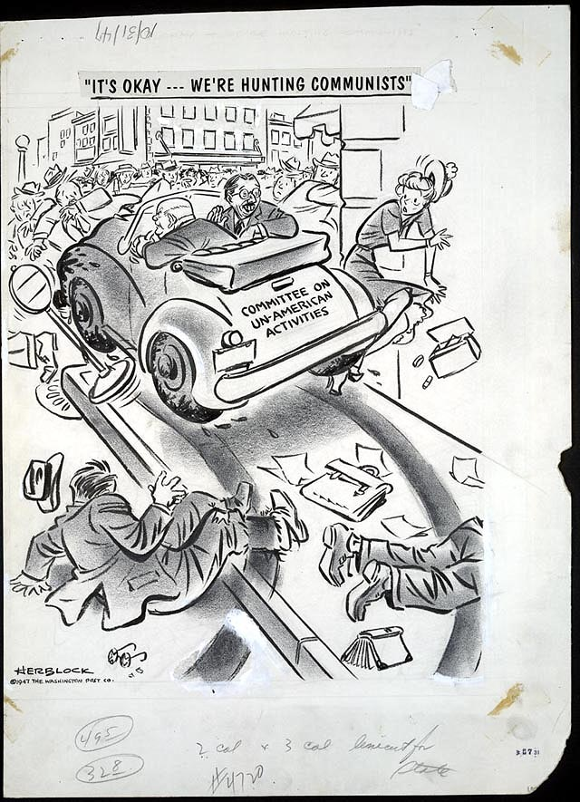
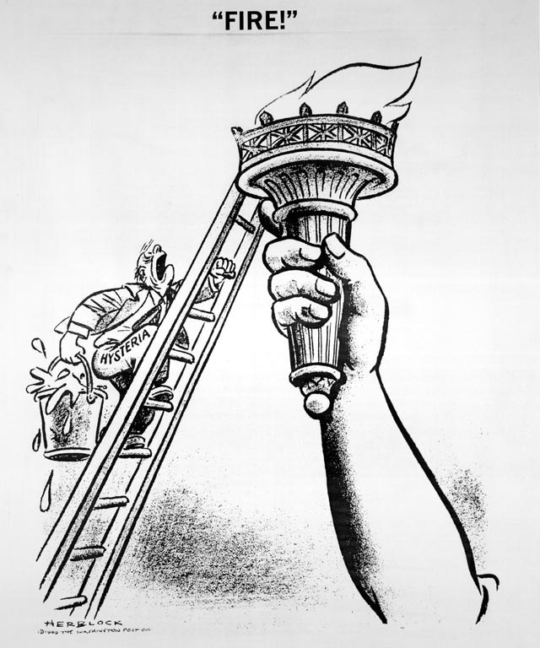

Slide 40
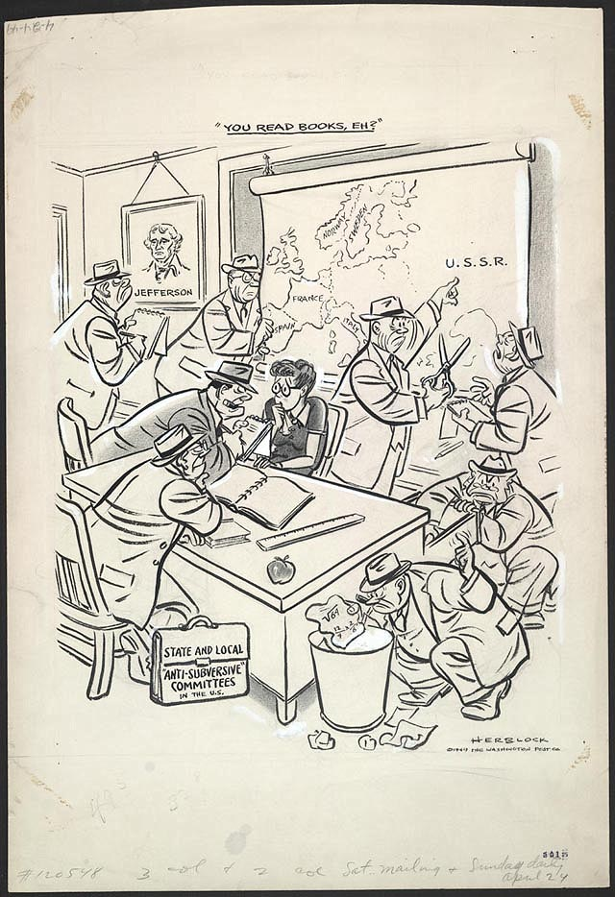
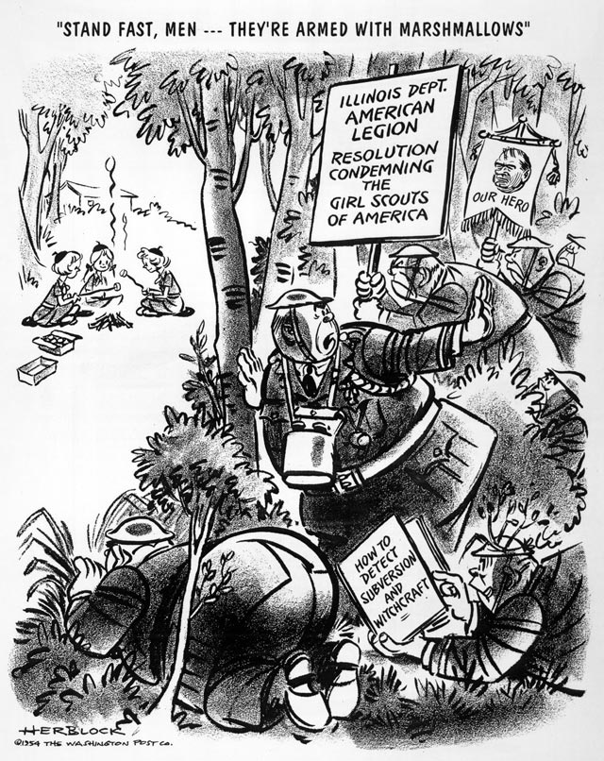

Slide 41
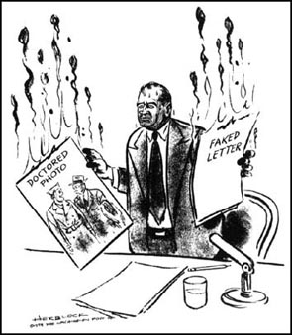
Republicans did little to stop McCarthy. They used him as a tool to show the public they were trying to purge the nation of communists.
He made accusations against the Army, which resulted in a nationally televised Senate investigation. (Censured 67-22 in 1954)
Remained a Senator but succumbed to alcohol and exhaustion and died in 1957 at the age of 48

Slide 42
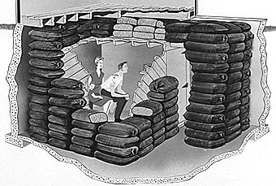
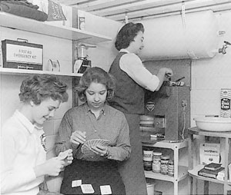

Slide 43
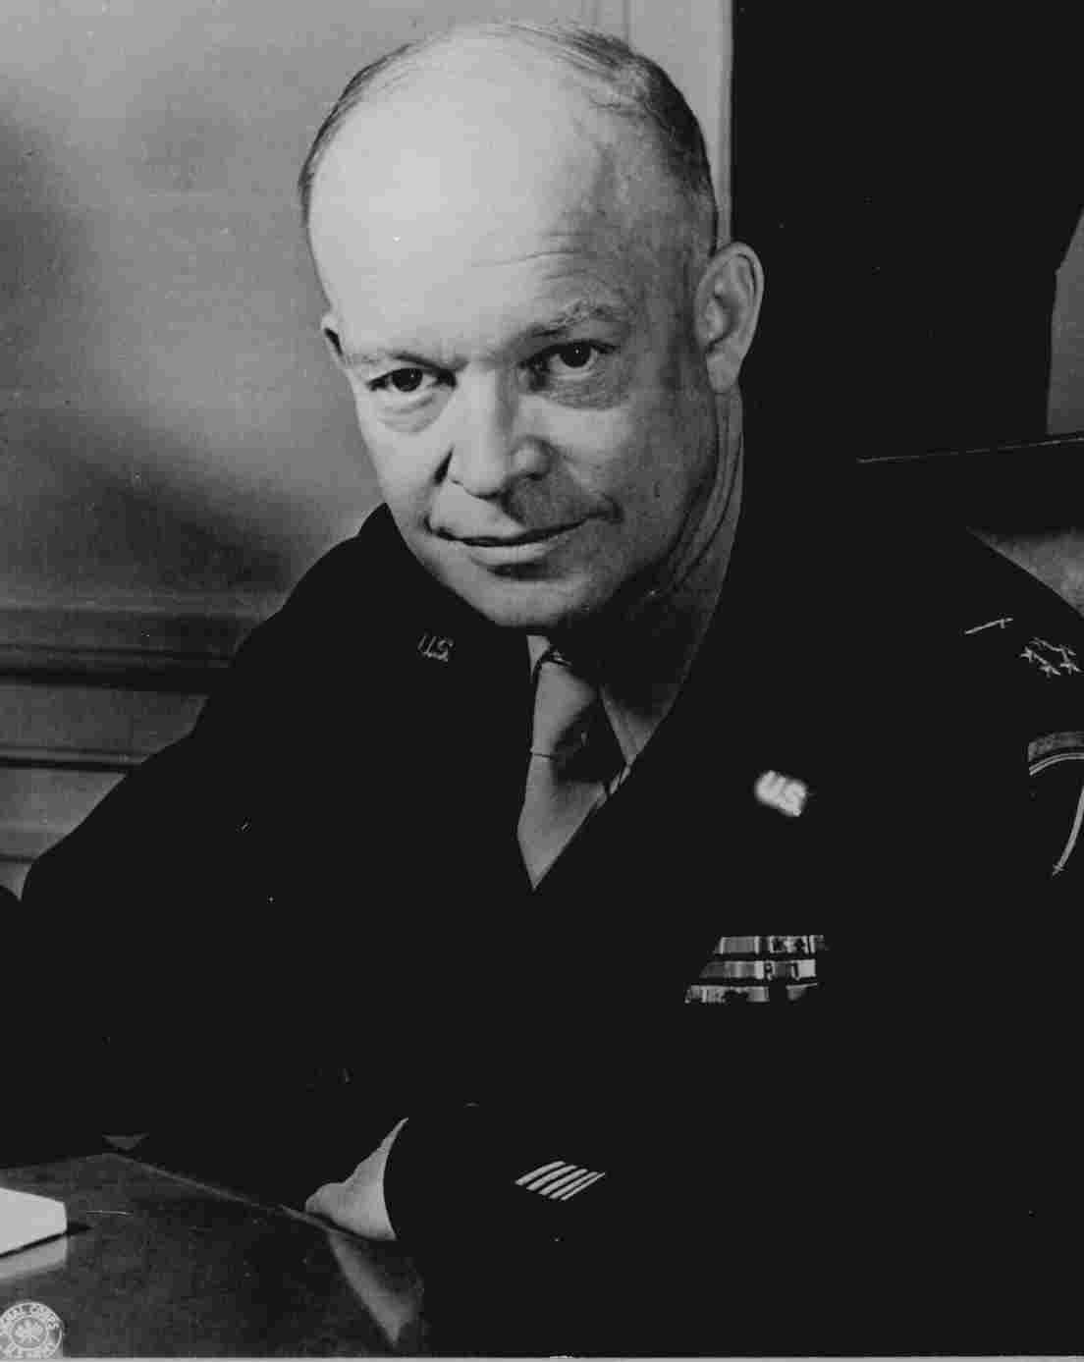
Cold War under Eisenhower
Period of atomic bomb while both sides edged away from direct confrontations. Focused on hot spots in the world. Particularly “Third world” areas.
US should “liberate” countries that were in the shadow of communism
Brinkmanship- confronting the Soviet Union even if it meant going to the brink of war. “massive retaliation”

Slide 44
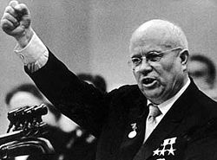
The Eisenhower Doctrine
urged the provision of economic aid to those countries with anti-Communist governments
military force if necessary
Nikita Khrushchev becomes
Soviet Premier in 1953
Notes:
Egyptian Crisis
Egypt asks US to help build Aswan Dam (Suez Canal) along the Nile.
Leader Nassar asks Soviets as well
US refuses to help, Nassar controls Dam
In response, Israel invades Egypt with help of GB and France
Iran Crisis
PM Mossadegh began to resist pro-west economic interests in Iran
Soviets begin to court Mossadegh
CIA overthrows Mossadegh and replaces him with pro-west Shah Pahlevi. US friends with Iran until 1979

Slide 45
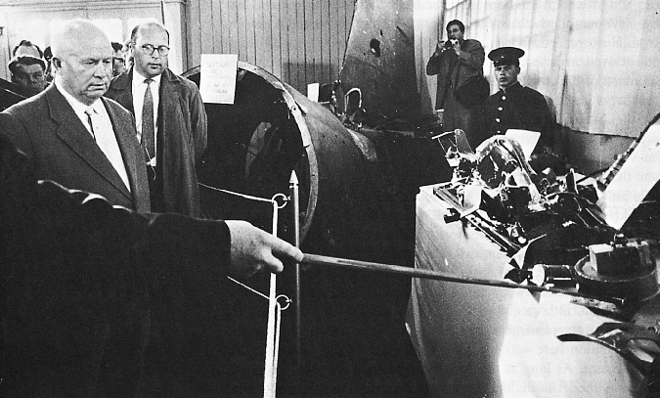
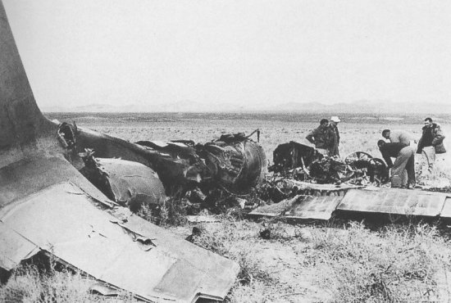
U-2 Crisis
On 1st May, 1960, a high-altitude spy plane, the U-2, was shot down over the Soviet Union.
The pilot, Francis Gary Powers was taken prisoner.

Slide 46
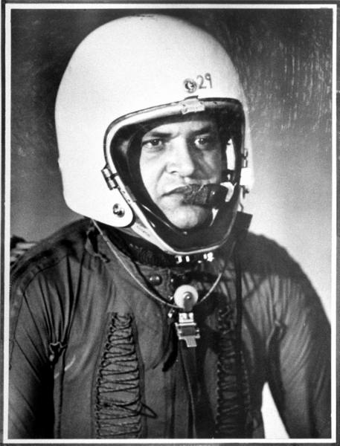
U-2
Soviet leader Nikita Khrushchev demands apology from Eisenhower on two occasions. Eisenhower refuses.
Cancels upcoming Peace talks in Paris.
Originally sentenced to 10 years, Powers returns to the United States in 1962 in a spy exchange.

Slide 47
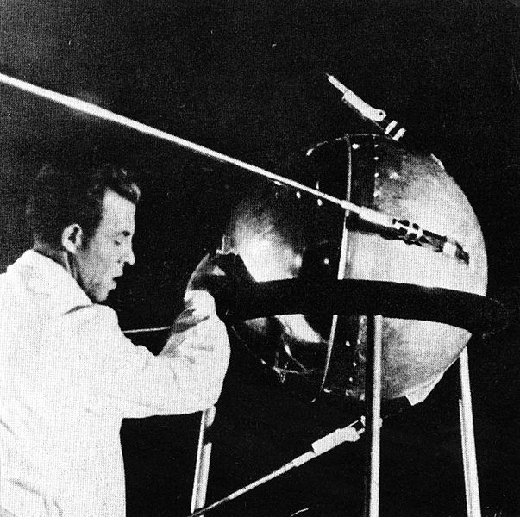
Space Race
In October, 1957, the Soviet Union launched the first satellite — named Sputnik.
In response, NASA, the National Aeronautics and Space Administration, was created in 1958
United States launched its first satellite, Explorer I

Slide 48
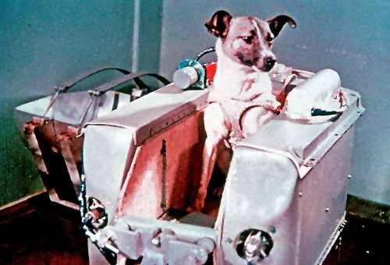
First Man in Space?
The first animal sent into orbit, dog Laika ("Barker"), traveled in Sputnik II.
Died 5 hours later
Notes:
In 1960 Soviet space dogs Belka and Strelka orbited the earth and successfully returned. (Russian)
The American space program imported chimpanzees from Africa and sent at least two into space before launching their first human orbiter. The Soviet Union launched turtles in 1968 on Zond 5, which became the first animals to fly around the Moon.

Slide 49
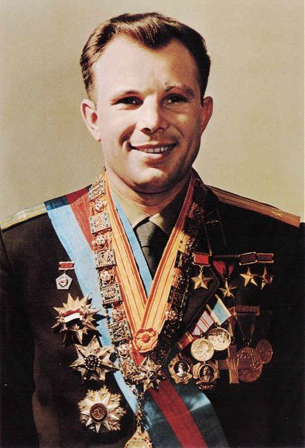
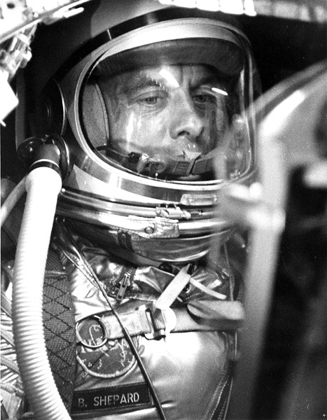
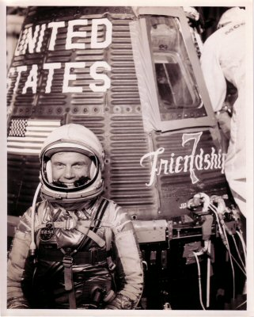
First Men is Space
Cosmonaut Yuri Gagarin became the first human in space in 1961.
First American was Alan Shepard, who was then followed by John Glenn as the first HUMAN to ORBIT the earth.

Slide 50
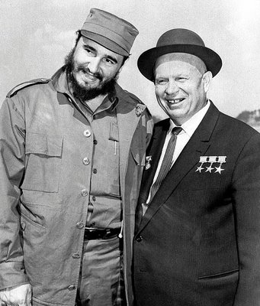
Foreign Policy and Kennedy
Bay of Pigs (1961)- failed attempt to overthrow Fidel Castro as Communist leader of Cuba.

Slide 51
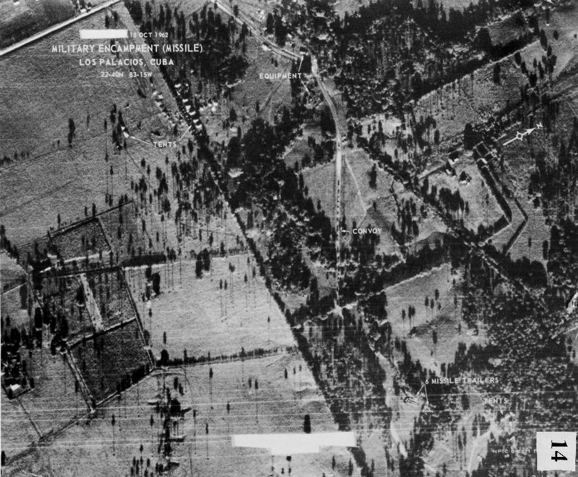

Cuban Missile Crisis
October 14, 1962, U-2 spy plane takes photos of the Missile sites.
Although pressured to launch an air assault, Kennedy chose a naval blockade of Cuba.

Slide 52

For 13 days, US and Soviets negotiated until an agreement was made- Silos out of Cuba. US missiles out of Turkey.

Slide 53

The Berlin Wall
By 1961, More than 3 million people left East Germany. The Soviets knew it had to stop the exodus.
A barbed-wire barrier was strung between East and West Berlin. It effectively divided the city in half. Within days, workers cemented concrete blocks into a low wall through the city.

Slide 54


An estimated 10,000 of them tried to escape to the West. About 5,000 made it.
One group took six months in 1964 to dig a 145-yard tunnel from the cellar of a former West Berlin bakery to an outhouse on the eastern side. They freed 57 East Berliners.

Slide 55

In all, 246 people died at the wall. Perhaps the best known was 18-year-old bricklayer Peter Fechter.
On Aug. 17, 1962, he tried to jump the barbed wire. East German soldiers fired and would not allow anyone to help him as he bled to death.

Slide 56

“Ich bin ein Berliner”
June 1963, President Kennedy paid a visit to West Berlin.
“You live in a defended island of freedom, but your life is part of the main. so let me ask you, as I close, to lift your eyes beyond the dangers of today, to the hope of tomorrow, beyond the freedom merely of this city of Berlin, or your country of Germany, to the advance of freedom everywhere, beyond the wall to the day of peace with justice, beyond yourselves and ourselves to all mankind. “
All free men, wherever they may live, are citizens of Berlin, and therefore, as a free man, I take pride in the words "Ich bin ein Berliner."
Notes:
Literally "I am a Berliner, a kind of pastry"

Slide 57


Notes:
The speech was peppered with German and one sentence in Latin, written phonetically on one of the speech cards here.
National Archives, John F. Kennedy Library, Boston, Massachusetts
President Reagan's speech card from his remarks in Berlin, June 12, 1987

Slide 58

Fall of the Berlin Wall
November 9, 1989

