Slide 1

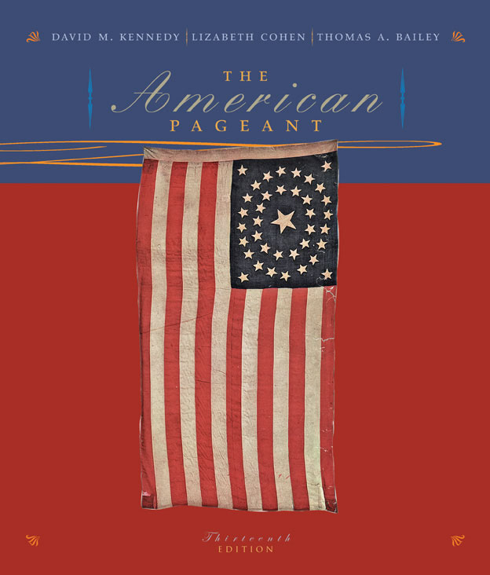
Cover Slide
The American Pageant
Chapter 41
America Confronts the Post-Cold War Era, 1992-2004
Copyright © Houghton Mifflin Company. All rights reserved.

Slide 2
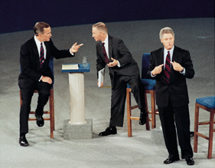
1992 Debate: Clinton, Bush, and Perot
1992 Debate: Clinton, Bush, and Perot
The televised presidential debates took on an informal air in 1992. At this debate at the University of Richmond, President George Bush (left) talked with independent presidential candidate Ross Perot, while Democratic candidate Bill Clinton responded to a question from the audience. (Wide World Photos, Inc.)
Copyright © Houghton Mifflin Company. All rights reserved.

Slide 3
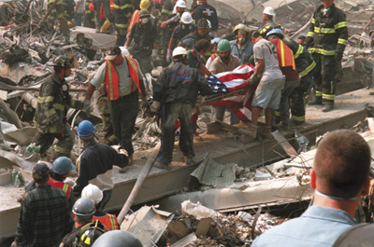
9/11 rescue efforts at Ground Zero
9/11 rescue efforts at Ground Zero
Rescuers remove a flag-draped body from the ruins of the World Trade Center. (Don Tellock/Gamma Press USA, Inc.)
Copyright © Houghton Mifflin Company. All rights reserved.

Slide 4
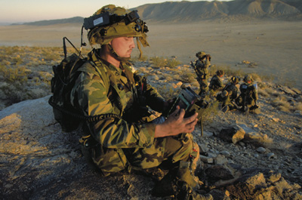
Afghan war scene--high-tech army
Afghan war scene--high-tech army
A U.S. soldier uses a laptop computer in a training exercise at Fort Irwin, California. Such technology loomed large in the post-September 11 U.S. campaign in Afghanistan. (Copyright Sigma/Corbis)
Copyright © Houghton Mifflin Company. All rights reserved.

Slide 5
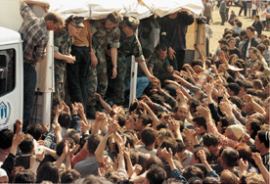
Albanian refugees leaving Kosovo with presence of U.S. or NATO forces
Albanian refugees leaving Kosovo with presence of U.S. or NATO forces
In the spring of 1999, as NATO bombing raids pounded Serbia (Yugoslavia) and Serb military positions in Kosovo to punish Serbia for killing and displacing ethnic Albanians, the number of Kosovar refugees dramatically increased. Desperate and hungry, they fled to neighboring nations. Here, in a NATO-run refugee camp outside Skopje, Macedonia, U.S. Marines distribute food to some of the 850,000 forced to leave their Kosovo homes. (Wide World Photos, Inc.)
Copyright © Houghton Mifflin Company. All rights reserved.

Slide 6
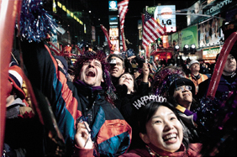
Americans welcome their future
Americans welcome their future
Just after midnight on January 1, 2000, these jubilant Americans welcomed the new year, century, and millennium in New York City's Times Square. (Nicole Beniveno/The New York Times)
Copyright © Houghton Mifflin Company. All rights reserved.

Slide 7
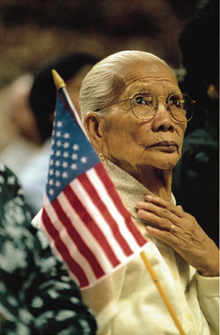
Asian woman at naturalization service, San Jose, CA
Asian woman at naturalization service, San Jose, CA
New immigrants are often eager to become new citizens. In 1996, in a naturalization ceremony held in San Jose, California, a woman from Southeast Asia proudly held an American flag as she took the oath to become a citizen of the Untied States. ((c) David Butow/Saba)
Copyright © Houghton Mifflin Company. All rights reserved.

Slide 8
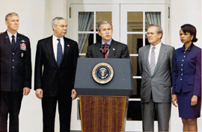
Bush, Rumsfeld, Rice, and Powell
Bush, Rumsfeld, Rice, and Powell
When George W. Bush assumed the presidency in 2001, many believed that domestic policy would dominate the agenda, but national security issues soon became the overriding priority. Those most important in shaping U.S. national security policy are shown here with the president: Secretary of State Colin Powell, Secretary of Defense Donald Rumsfeld, and National Security Adviser Condoleezza Rice. (AP Photo/J. Scott Applewhite)
Copyright © Houghton Mifflin Company. All rights reserved.

Slide 9
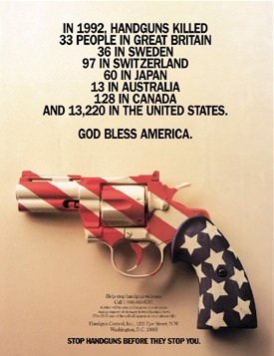
Clinton legislative success, gun control ad
Clinton legislative success, gun control ad
In 1993 Congress took action on gun control, passing the Brady Bill into law. Named for James Brady, paralyzed by a gunshot wound during an assassination attempt on President Ronald Reagan in 1981, the new law mandated a short waiting period before the purchase of a handgun. Brady and his wife Sarah founded Handgun Control, Inc., which sponsored this magazine advertisement. (Handgun Control, Inc.)
Copyright © Houghton Mifflin Company. All rights reserved.

Slide 10
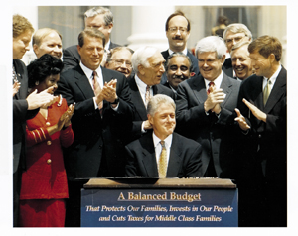
Clinton's balanced budget bill, August 5, 1997
Clinton's balanced budget bill, August 5, 1997
On August 5, 1997, Bill Clinton signed the Balanced Budget Act. Applauding the president are Vice President Albert Gore (left) and House Speaker Newt Gingrich (right). In the fall of 1998, Clinton announced a budget surplus of $70 billion, and the first surplus since 1969. (Ron Edmonds/World Wide)
Copyright © Houghton Mifflin Company. All rights reserved.

Slide 11
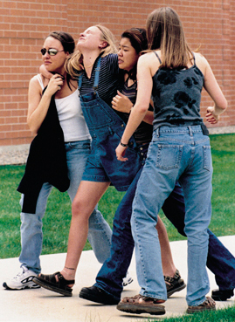
Columbine, April 20, 1999
Columbine, April 20, 1999
On April 20, 1999, students evacuated Columbine High School in Littleton, Colorado, after two schoolmates went on a shooting rampage, killing twelve students and a teacher before killing themselves. (Wide World Photos, Inc.)
Copyright © Houghton Mifflin Company. All rights reserved.

Slide 12
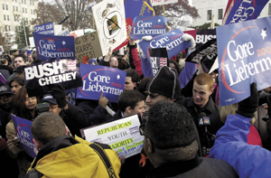
Election of 2000--signs during Supreme Court debate
Election of 2000--signs during Supreme Court debate
The winner of the 2000 presidential election was determined by a disputed vote count in Florida that was later upheld by the Supreme Court. As the justices considered their decision, supporters of Gore and Bush confronted each other outside of the Supreme Court building. (Douglas Graham/Corbis Sygma)
Copyright © Houghton Mifflin Company. All rights reserved.

Slide 13
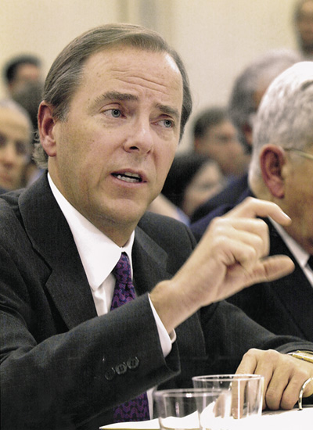
Enron executives testifying--CEO Jeffrey Skilling testifying on Capitol Hill, February 7, 2002
Enron executives testifying--CEO Jeffrey Skilling testifying on Capitol Hill, February 7, 2002
Jeffrey Skilling, former CEO of Houston's collapsed Enron Corporation, testifies before a Congressional committee in February of 2002. A cascade of other corporate scandals soon followed. (Wide World Photos, Inc.)
Copyright © Houghton Mifflin Company. All rights reserved.

Slide 14
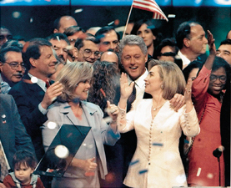
Hillary Clinton and Tipper Gore at the 1996 Democratic convention
Hillary Clinton and Tipper Gore at the 1996 Democratic convention
President Bill Clinton suffered political repudiation in the Republican sweep of Congress in 1994. But two years later his popularity was on the upswing. Here he and Hillary Clinton and Vice President Al Gore (with wife Tipper) celebrate their renomination at the 1996 Democratic National Convention in Chicago. (Wide World Photos, Inc.)
Copyright © Houghton Mifflin Company. All rights reserved.

Slide 15
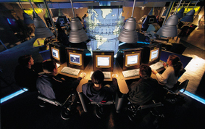
Internet
Internet
Internet use skyrocketed in the 1990s, aided by the development of commercial Web "browsers" and by the Telecommunications Act of 1996, which stimulated mergers between telephone companies and cable companies. By 2000 there were two hundred million Internet users worldwide, including these patrons of a cybercafé. (Markus Matzel/Das Fotoarchiv)
Copyright © Houghton Mifflin Company. All rights reserved.

Slide 16
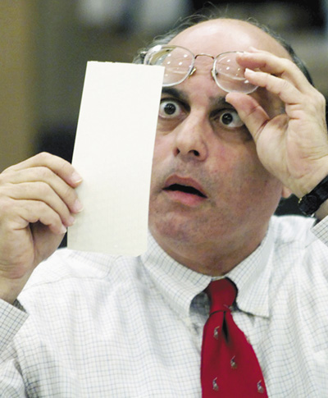
Judge Robert Rosenberg examining a dimpled ballot
Judge Robert Rosenberg examining a dimpled ballot
A Fort Lauderdale judge scrutinizes a partially punched-out ballot in late November 2000. ()
Copyright © Houghton Mifflin Company. All rights reserved.

Slide 17
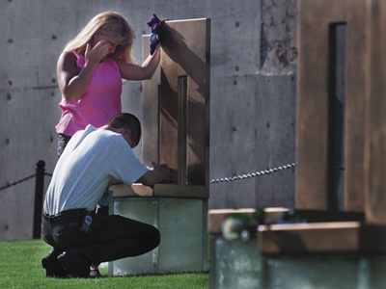
Matt Story at chair dedication for Oklahoma City bombing victims
Matt Story at chair dedication for Oklahoma City bombing victims
Matt Story and Dawn Mahan, whose mother died in the 1995 bombing of the Murrah federal building in Oklahoma City, pause at her memorial in the commemorative park honoring the 168 victims. (Reuters/Corbis)
Copyright © Houghton Mifflin Company. All rights reserved.

Slide 18
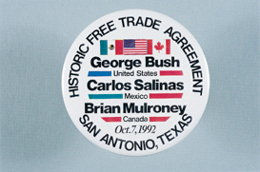
NAFTA button
NAFTA button
Efforts to create the North American Free Trade Agreement began under the George Bush administration. But it was the Clinton administration that obtained Senate approval for the agreement over the objections of many within the Democratic Party. (Collection of Janice L. and David J. Frent)
Copyright © Houghton Mifflin Company. All rights reserved.

Slide 19
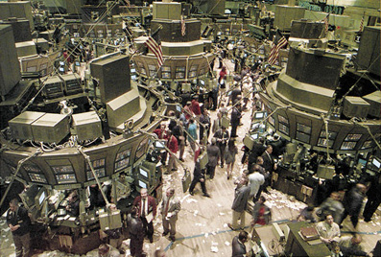
New York Stock Exchange
New York Stock Exchange
Despite economic crises elsewhere, U.S. stock prices soared as the 1990s wore on, fueled especially by computer and information-technology stocks. (Wide World Photos, Inc.)
Copyright © Houghton Mifflin Company. All rights reserved.

Slide 20
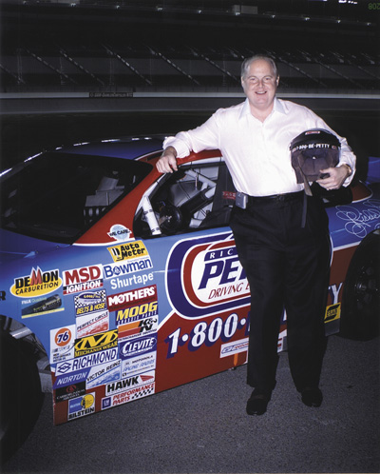
Rush Limbaugh at Las Vegas Motor Speedway
Rush Limbaugh at Las Vegas Motor Speedway
The conservative radio talk-show host enjoyed a loyal following in the 1990s and after, and helped produce a Republican landslide in the 1994 midterm election. (Photo Courtesy Richard Petty Driving Experience)
Copyright © Houghton Mifflin Company. All rights reserved.

Slide 21
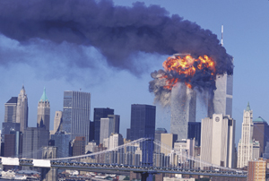
September 11th
September 11th
The September 11, 2001 attack on the World Trade Center by terrorists who hijacked two civilian airliners and used them as missiles against the twin towers left the nation stunned, angry, and determined to bring those who had orchestrated the attack to justice. (Robert Clark/Aurora)
Copyright © Houghton Mifflin Company. All rights reserved.

Slide 22
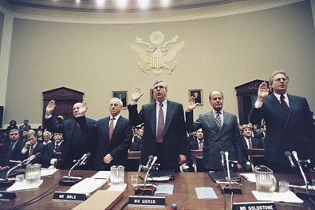
Tobacco executives testifying
Tobacco executives testifying
Tobacco-industry executives prepare to testify before the House Commerce Committee in January of 1998. Political and legal issues related to smoking loomed large in the 1990s, as cigarettes' deadly effects became more widely understood. (Agence France Presse (c) Bettmann/Corbis)
Copyright © Houghton Mifflin Company. All rights reserved.

Slide 23
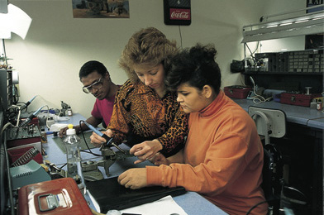
Welfare to work
Welfare to work
A former welfare recipient in Georgia receives training for a new job. (Brooks Kraft/Corbis/Sygma)
Copyright © Houghton Mifflin Company. All rights reserved.

Slide 24
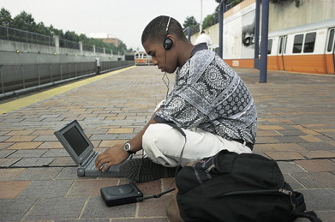
Wired college student
Wired college student
A young college student studies on his laptop and listens to a CD while awaiting a train on his way to classes. (Dorothy Littel Greco/Stock Boston)
Copyright © Houghton Mifflin Company. All rights reserved.

Slide 25
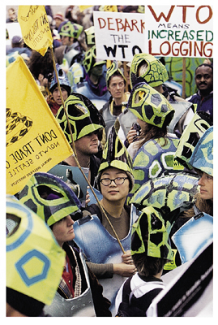
WTO protest: Turtles
WTO protest: Turtles
Chanting demonstrators marched in the streets of Seattle, Washington, on November 30, 1999, claiming that the World Trade Organization (WTO) possessed the dangerous power to challenge any nation's environmental laws if the WTO deemed them barriers to trade. Critics of the WTO have claimed that sea turtles and dolphins had already been victimized by the WTO. Demonstrators identified the WTO as an example of globalization gone wrong. The WTO meeting went on, but the results proved meager because nations could not agree on rules governing dumping, subsidies for farm goods, genetically altered foods, and lower tariffs on high-tech goods. (Paul Joseph Brown/Seattle Post-Intelligencer)
Copyright © Houghton Mifflin Company. All rights reserved.

Slide 26
Map: Afghanistan
Afghanistan
Following the terrorist attacks on American targets in September 2001, the Bush administration linked the terrorist organization Al-Qaeda to the attacks. It then asked the Taliban government of Afghanistan to take action against the Al-Qaeda, which used Afghanistan as a base of operations. When Taliban leaders refused to turn over the leaders of the Al-Qaeda, particularly Osama bin Laden, the United States and its allies joined with anti-Taliban forces in military action in Afghanistan. By the end of December 2001, the Taliban government and Al-Qaeda forces had collapsed, although leaders of both organizations eluded capture.
Copyright © Houghton Mifflin Company. All rights reserved.

Slide 27
Map: Presidential Election, 1992
Presidential Election, 1992
Although a minority of voters cast ballots for Bill Clinton, he won handily in the electoral college. Clinton's share of the popular vote was the lowest for anyone elected president since Woodrow Wilson won with 42 percent of the popular vote in 1912. Exit polls revealed that the votes cast for Perot would have divided about evenly between Clinton and Bush had Perot not been in the race.
Copyright © Houghton Mifflin Company. All rights reserved.

Slide 28
Map: Presidential Election, 1996
Presidential Election, 1996
Although Bill Clinton did not win a majority of the vote, he came close at 49 percent, winning thirty-one states to nineteen for Bob Dole. Ross Perot, with 8 percent of the vote, was less of a factor than in 1992, when he had earned 19 percent of the vote. Despite Clinton's victory, the Republicans retained control of both houses of Congress.
Copyright © Houghton Mifflin Company. All rights reserved.

Slide 29
Map: The Election of 2000
The Election of 2000
Democratic candidate Al Gore won the popular vote, but George W. Bush succeeded in gaining electoral victory by four votes. Among white males, Bush ran extremely well, while Gore won a majority of minority and women voters. Ralph Nader's Green party won less than 3 percent of the national vote, but his votes in Florida may have detracted from the Gore tally, helping Bush win the critical electoral votes.
Copyright © Houghton Mifflin Company. All rights reserved.

Slide 30
Map: The Election of 2000
The Election of 2000
For the first time since 1888, the winner of the popular vote, Al Gore, failed to win the presidency. The electoral-college system and the Supreme Court's intervention in the disputed Florida vote put George W. Bush in the White House.
Copyright © Houghton Mifflin Company. All rights reserved.

Slide 31
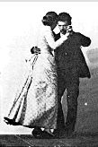
Video: Man and Woman Dancing a Waltz
Click on image to launch video.
Apple QuickTime® required for viewing
Man and Woman Dancing a Waltz
(1887. Eadweard Muybridge, Muybridge’s Complete Human and Animal Locomotio (New York: Dover Publications, Inc., 1979.))
Copyright © Houghton Mifflin Company. All rights reserved.

Slide 32
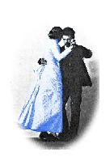
Video: Man and Woman Dancing a Waltz, Color
Click on image to launch video.
Apple QuickTime® required for viewing
Man and Woman Dancing a Waltz, Color
(1887. Eadweard Muybridge, Muybridge’s Complete Human and Animal Locomotio (New York: Dover Publications, Inc., 1979.))
Copyright © Houghton Mifflin Company. All rights reserved.

