Slide 1
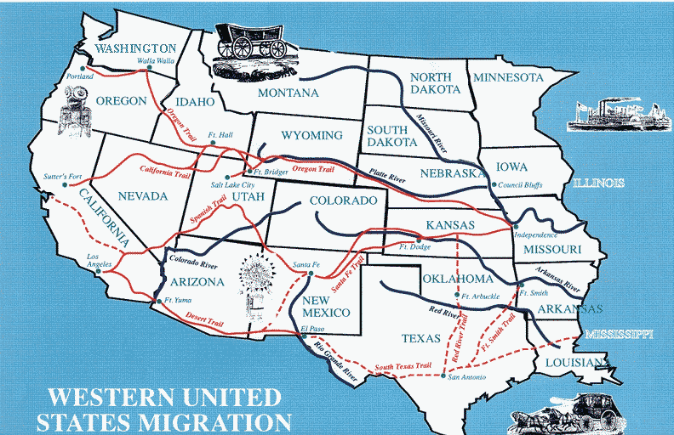
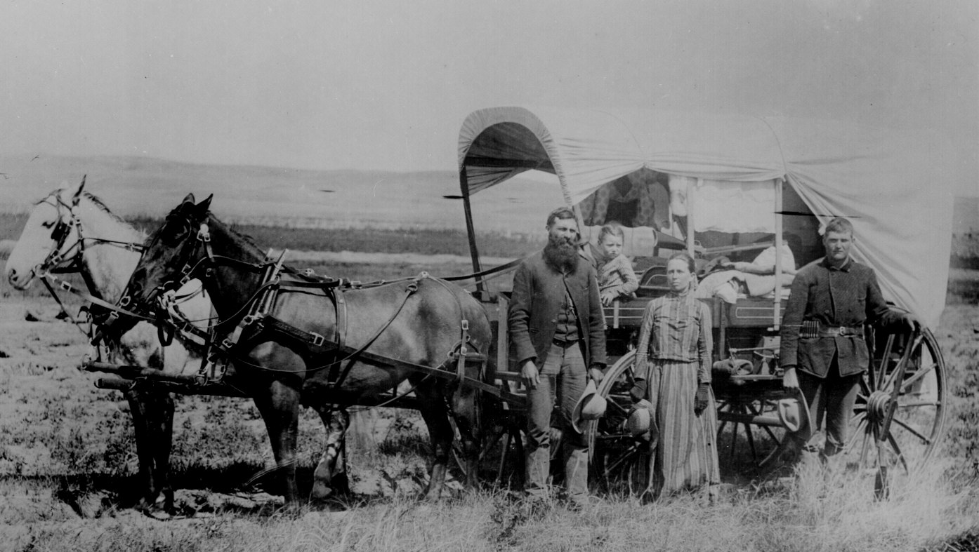
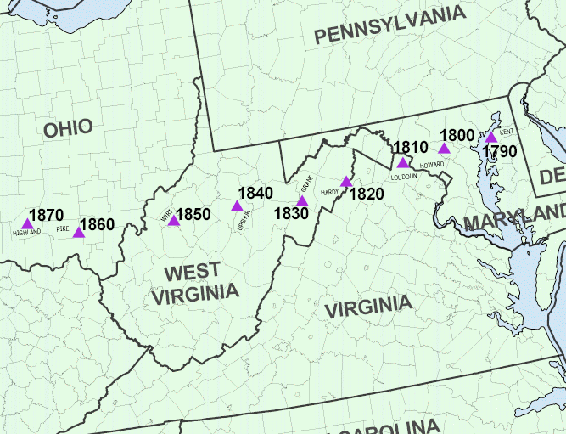
Moving West
Americans moved west looking for opportunity
  Cities emerge along rivers and Great Lakes
By 1840 demographic center was west of Allegheny Mountains
Newspapers and hotels attracted migrants out west
Most settlers were poor, ill equipped pioneer families
  Life very difficult, cut off from rest of society, needed to be almost entirely self reliant
  Emphasis on rugged individualism
Demographic Center of US

Slide 2
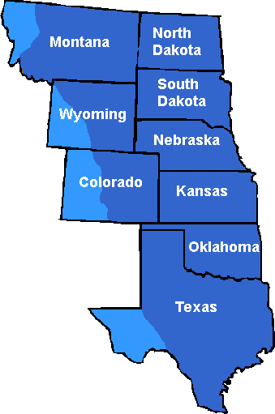
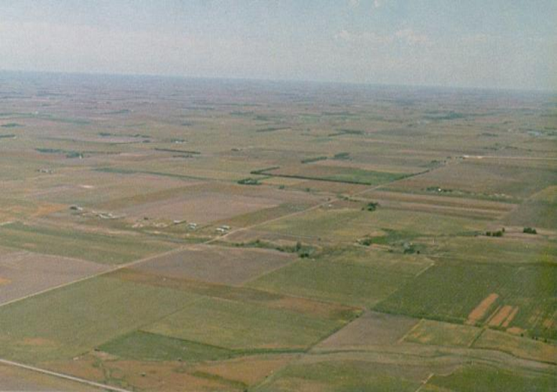
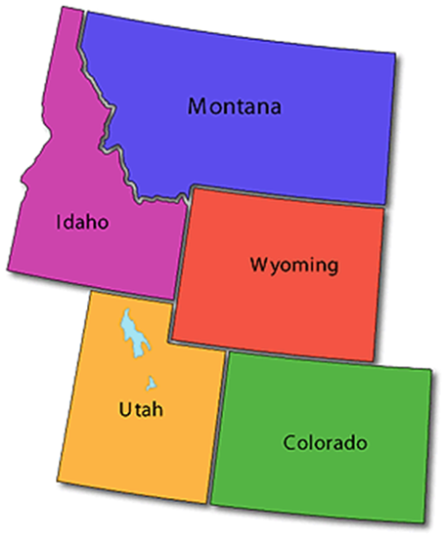
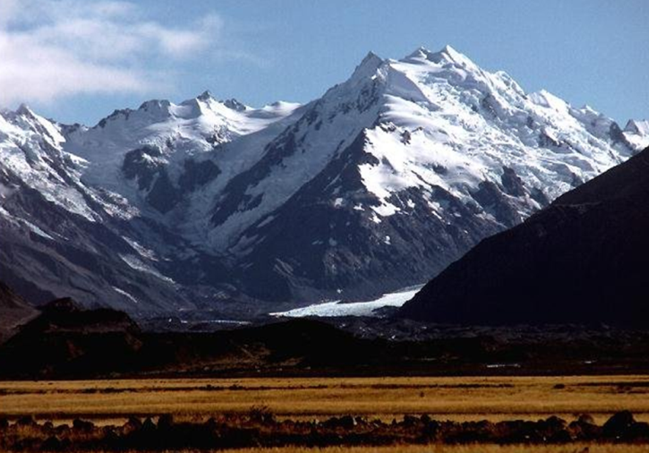
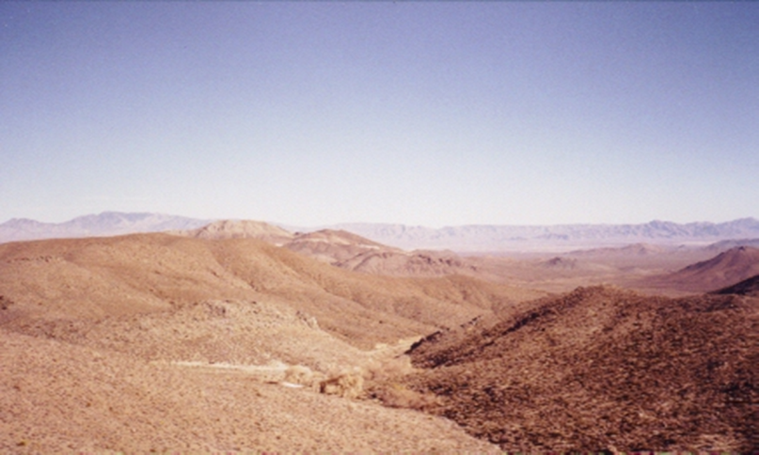
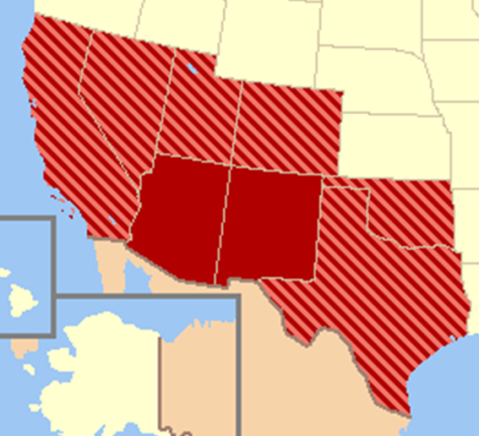
Geography of the West
Great Plains
West of Mississippi to Rocky Mountains
Open grassland, no trees, a lot of buffalo
Rocky Mountains
Stretches from Canada to American Southwest
Rugged mountains, high altitudes
Southwest
Controlled by Mexico
Deserts and mountains
Notes:
http://www.manishin.com/photogallery/pg14.html

Slide 3
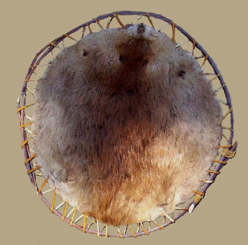
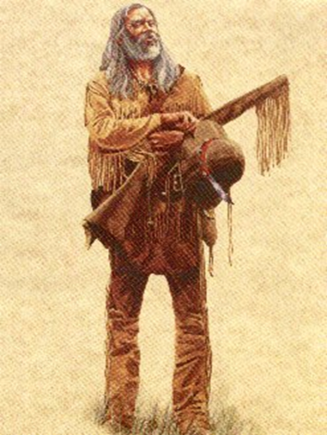
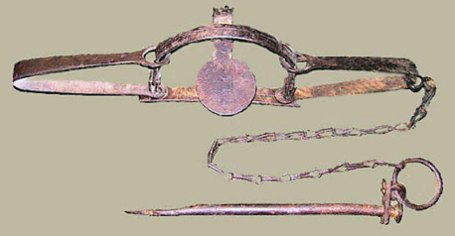
Shaping Western Landscape
Americans would change environment to meet their needs
  Resulted in destruction of natural environment, introduction of new species of plants and animals and the killing of profitable or nuisance animals (ecological imperialism)
Mountain men
  Trapped furs and hunted in Rockies
    Hunt many animals especially beaver
  Very independent and rugged
  Rendezvous system
    Traders would travel to mountains to meet with trappers and bring pelts back to market
Settlement of west contributed to nationalism and idea of American exceptionalism – that US is unique in the world in opportunity and form

Slide 4
Forging a National Economy
Chapter 14

Slide 5
Theme
In the era of Jacksonian democracy, the American population grew rapidly and changed in character. More people lived in the raw West and in the expanding cities, and immigrant groups like the Irish Catholics and Germans added their labor power to America’s economy, sometimes arousing hostility from native-born Americans in the process.

Slide 6
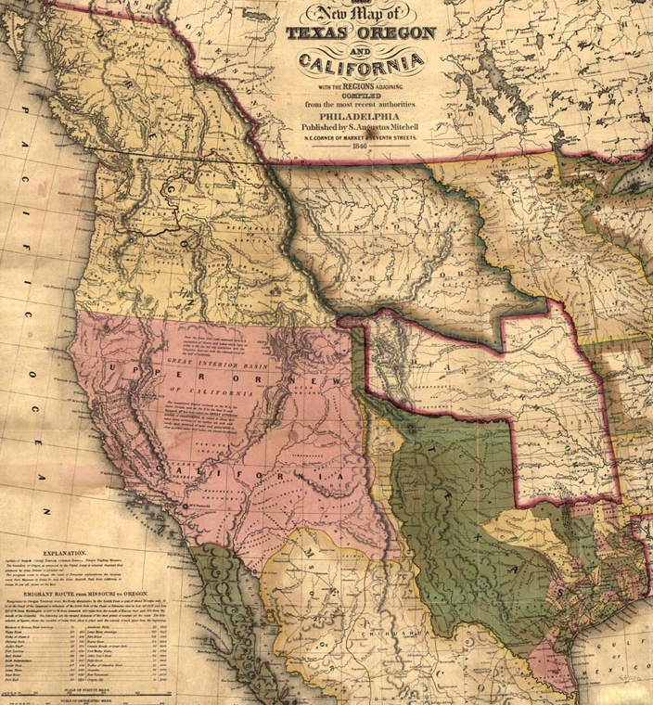
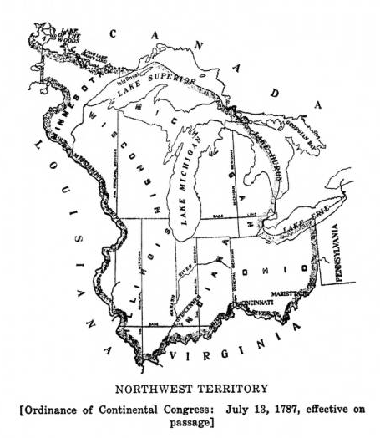
Westward Movement
Original Areas of settlement
Oregon Territory
California Territory
“Northwest Territories”
Texas
  Great Plains were not settled because it was hard to farm

Slide 7
March of Millions
American population doubled every 25 years
  By 1860, US was 4th most populated nation in world
  By 1860 US went from 2 cities to 43 cities
  US had high birthrate, but by 1840s large numbers of immigrants were entering into nation
Urbanization brought overcrowding, filth, corruption, struggles with government meeting needs
Immigration
  European population had grown rapidly resulting in not enough land, jobs or opportunity in Europe causing people to move within Europe and to America
    Easier trans-Atlantic travel encouraged immigration

Slide 8
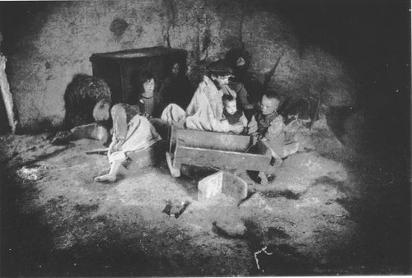
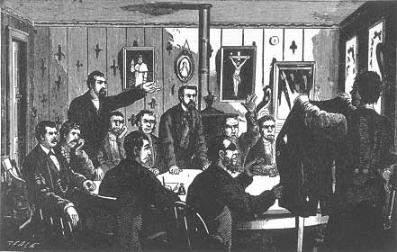
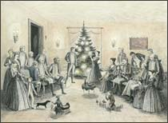
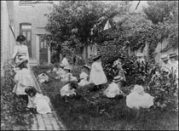
Irish and German Immigrants
Irish
  Irish Potato Famine began 1845 (Black Forties)
  Were poor, uneducated, settled mostly in cities
  Faced severe discrimination, NINA, forced into
  manual, low wage jobs
    Were seen as threat to society by established groups
  Ancient Order of Hibernians
    Created to provide support for immigrants
  Molly Maguires
    Miner union that violently campaigned for improved wages and working conditions
  Politics attracted Irish – Tammany Hall, police, fire department
Germans
  Fled crop failures and political unrest
  Most came with modest wealth and settled in mid-west (Wisconsin etc.)
  Encouraged American isolationism in since they had fled rampant militarism in Europe (Revolutions of 1848)
    Brought Conestoga Wagons, Christmas trees, kindergartens
  Opposed slavery led by Carl Schurz

Slide 9
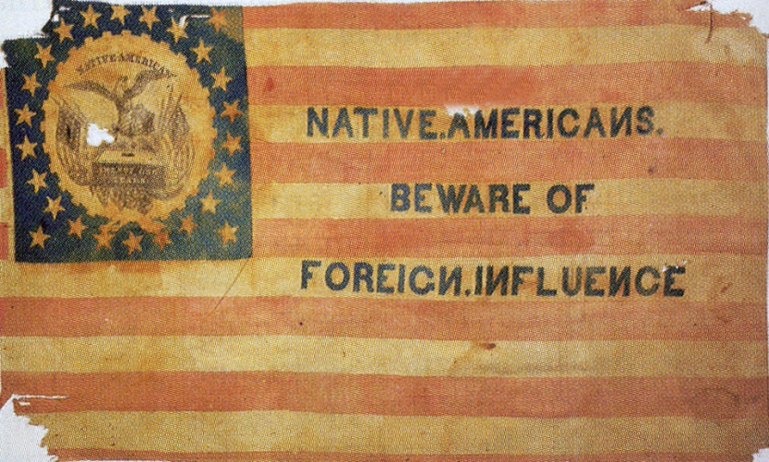
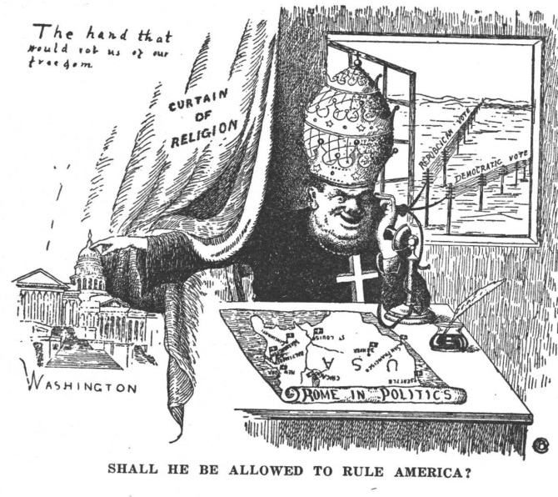
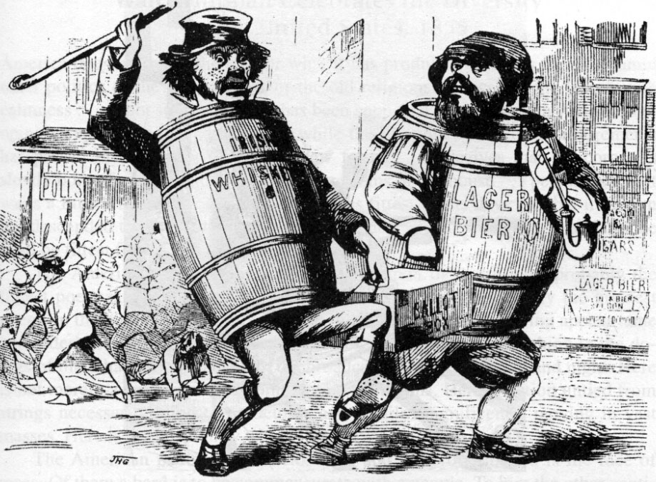
Flare-ups of Antiforeignism
“Native” Americans feared and opposed growing numbers and political and economic influence of immigrants
  1844 riots in Philadelphia between nativists and Irish Catholics
Catholics were distrusted
  Catholic schools were opened in response to prejudice
  By 1850 more Catholics than any other denomination
Order of Star Spangled Banner
  Becomes “Know Nothing” Party
  Nativists argued for strict immigration laws
  Encouraged bias and violence against immigrants
Temperance movement develops in response to popularity of beer drinking of immigrants

Slide 10
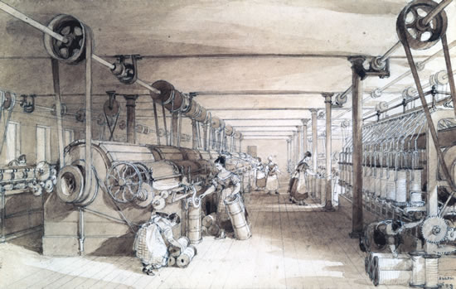
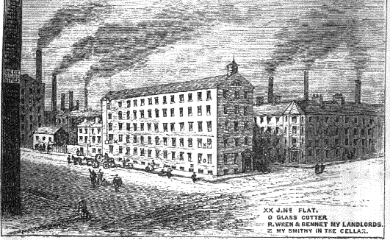
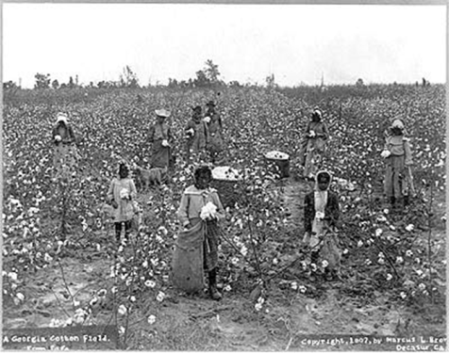
Factory System
Factories were developed because machines were too big to run at home
Factories brought together people and machines to make large quantities of goods
Developed in England first. Were slow to come to America because land was cheap and abundant
  made labor scarce until immigrants came in 1840s
Was high consumer demand, but Americans bought British products
Samuel Slater brought British textile factory system to America in 1791
Cotton gin developed by Eli Whitney in 1793 which allowed for efficient separation of cotton seed from cotton fiber
  Made growing cotton profitable
  Revived slavery in South
  Increased demand for land to grow cotton
  Provided cheap cotton for Northern factories, allowed America to compete with Britain

Slide 11
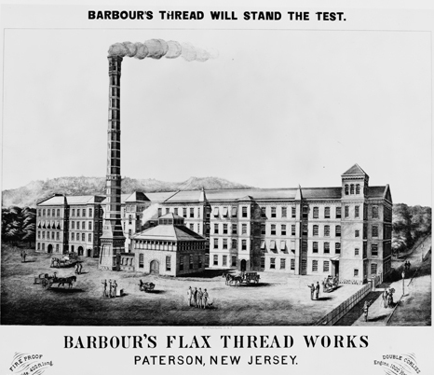
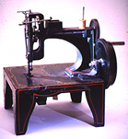
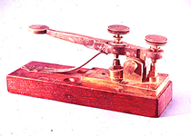
Manufacturing in US
    New England had most of mills (i.e. Patterson NJ)
      Mills develop along fast flowing rivers in NY, NJ, PA and New England
      Dense population provided cheap labor and abundant markets
      Shipping provided capital and access to distant markets
    Conflict with Britain (1807-1815) spurred American manufacturing
    1798 - Eli Whitney developed concept of interchangeable (standardized) parts for building firearms
      By 1850, became basis of mass-production and assembly lines
      Allows for development of mass armies
      Made north militarily stronger than south
    Elias Howe (1846) and Isaac Singer develop and perfect sewing machine
    Samuel Morse (1844) developed telegraph

Slide 12
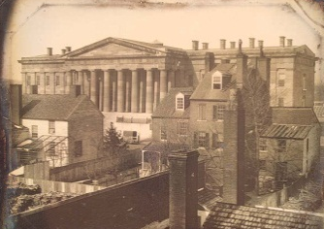
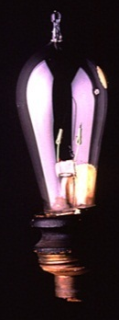
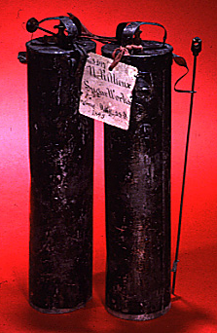
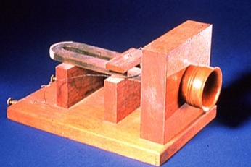
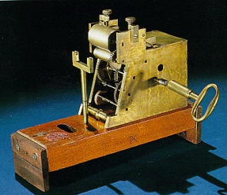
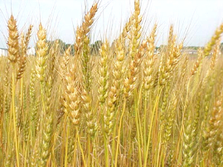
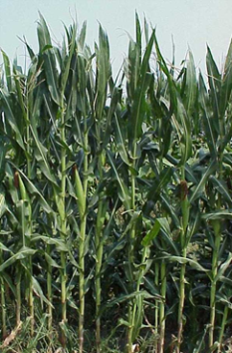
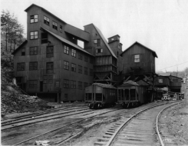
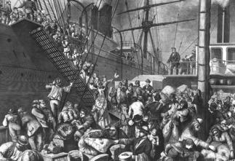

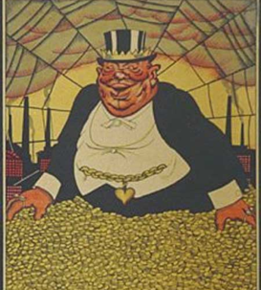

Why Did Industry Grow?
Inventions
  Patent – guarantees profits from invention for a period of time
  1800 306 patents; 1859 28,000 1860 – 36,000 patents, 1900 – 650,000
Natural Resources
  Coal, iron, oil, forests, fertile land
  provide material for industrial growth
  Grains provided food for urban workers and residents
Human talent and labor
  massive immigration especially from Ireland and Germany
Capital
  Money used for investment
  Wealthy people take their profits and loan it as business investments
  New businesses get money needed to start business
Limited Liability encouraged investment by reducing risk of financial loss
  Boston Associates – first investment capital company
Protestant work ethic encouraged investment

Slide 13
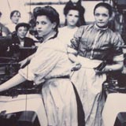
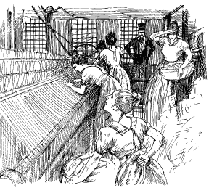
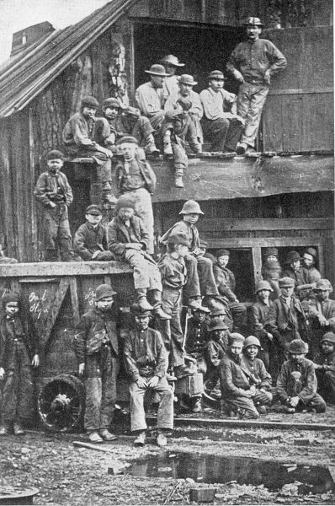
Workers and “Wage Slaves”
Children used because they were small and cheap
  Used orphans because no one protected them
  Were beaten to insure compliance
Women used as laborer because they could be paid less
Factory owners were able to make huge amounts of money while laborers scraped by
Working conditions were dangerous and forming labor unions was illegal
Expansion of suffrage allowed workers to vote for politicians that would advocate for their needs
  Wanted 10 hour day, higher wages, better working conditions, public education and end imprisonment for debt
  1840 Van Buren passed 10 hour day for federal employees
Strikes began in 1830s-1840s to protest working conditions
  Scabs and police used to break up labor movements
Commonwealth v. Hunt (1842) MA supreme court ruled labor unions were not illegal conspiracies
Notes:
i

Slide 14
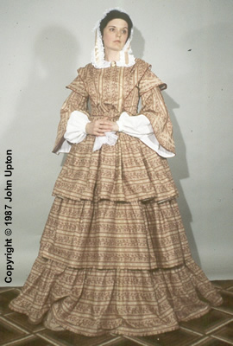
Women and the Economy
Preindustrial women played major role in the economy of the home and production of necessary goods. Factories undermine that.
Factory girls
  Were young. Given economic independence from families from wages.
  Lowell girls lived in boarding houses, closely supervised, worked 6 hours a day
Teaching became profession for women to gain opportunity. Other women became maids.
“Cult of Domesticity” – belief women should stay home once married. Gave women moral power but eliminated economic independence.
  Families became more tight knit and based on love
“Domestic feminism”
  Women began to exert control of size and organization of family
  Family size began to decline
  Families became more focused on needs of child
  Children raised to be independent, not submissive

Slide 15
Welcome Back! Bell Ringer…
This transformation of the condition of the country from gloom and distress to brightness and prosperity, has been mainly the work of American legislation, fostering American industry, instead of allowing it to
be controlled by foreign legislation, cherishing foreign industry....” -Excerpt from the American System by Henry Clay 1832
1. In the above quote, what action did Congress take to foster American industry?
a. Passing of tariffs
b. A renewal of the National Bank
c. Develop foreign trade relationships
d. Federal regulations of interstate trade
2. Why would the South be least supportive of Henry Clay’s American System?
a. The Second National Bank was not open to make loans to common man
b. Tariffs interfered with their trade of cotton in the world market
c. Canals and road systems did not extend to the South
d. State governments were required to raise interstate taxes
3. What was the effect of the roads and canals system such as Cumberland Road to the American markets?
a. Urbanization of the western territory and movement of big business
b. Movement of eastern industry to western areas closer to natural resources
c. Closer Ties between the western resources and eastern industry
d. An economic recession due to the increased amount of consumer goods

Slide 16
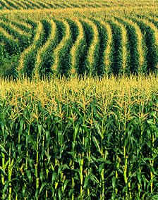
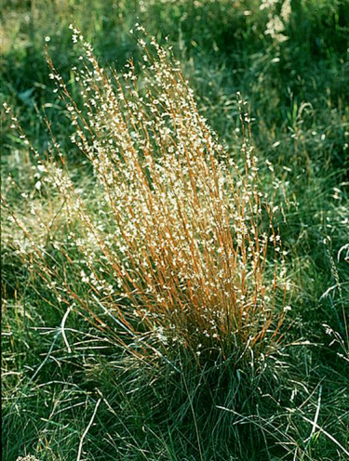
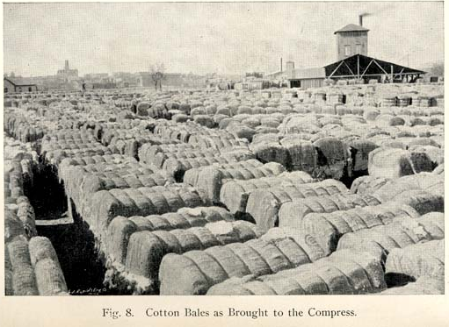
Western Farmers Reap a Revolution in Fields
Prairie Grass
Ohio to Illinois became bread basket for US
Corn grown to be fed to hogs or distilled to liquor
  Towns like Cincinnati, Ohio develop to handle growing trade
  Much sold to Cotton Kingdom in deep south
John Deere developed steel plow to cut into western soil
Cyrus McCormick developed mechanical reaper
Subsistence farming replaced by cash crop farming
  Required farmers to assume enter into cycle of debt
  Increased production drove need for new markets and improved transportation

Slide 17
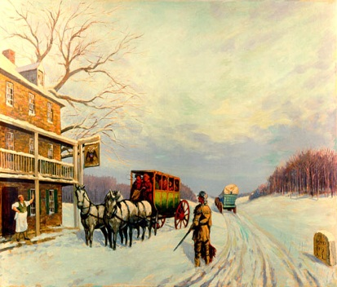
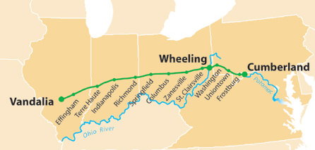
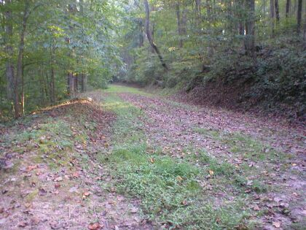
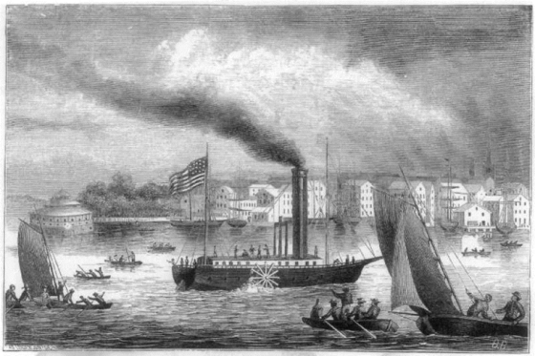
Roads and Turnpikes
Turnpike
  Travelers paid toll for access
  Privately owned and profitable
  Lancaster Turnpike
    First one in US in 1790s
  Stimulated western trade and development
Lancaster Turnpike
National (Cumberland) Road (1811)
  Built with federal money
  Connected Maryland to Illinois
Robert Fulton made first working steamboat, Clermont (known as “Fulton’s Folly”)
  Sailed Hudson from NYC to Albany in 1807
Steamboats made travel on Mississippi River easier
  Were light and fast, travelled in shallow water
  Went from 60 in 1820 to more than 1,000 in 1860
Allowed easy transportation against wind and water currents
Led to development of river cities and increased farm production in the west

Slide 18
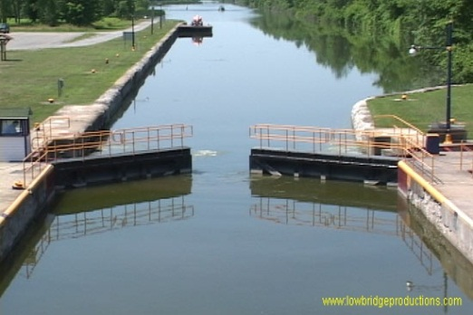
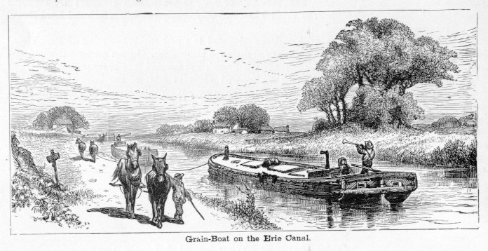

Canals
Governor DeWitt Clinton of New York wanted canal to connect NYC to western farmlands
  Known as “Clinton’s Big Ditch”
  Began in 1817 completed in 1825
    Clinton emptied water from Lake Erie into Hudson River
Dramatically reduced cost of shipping goods
  Price of shipping dropped from $100 to $5 per ton of grain
NYC became leading American city
  Great Lakes cities became important (Chicago, Buffalo, Cleveland)
  Smaller cities in NY also develop – Syracuse, Rochester
New England farmers could no longer compete so moved to midwest or worked in mills
Inspired more canals to be built
Demonstrate how technology transforms economies

Slide 19




Railroads
Began in 1828 – cheaper, easier to build than canals
  Opened entire interior to transportation
  Allowed growth of towns away from waterways
  Encouraged immigration and migration for labor sources
1850s was decade of railroad building
  By 1860, 32,000 miles of track – most in north
Americans took many risks building railroads
  Brakes ineffective, sparks could cause fires, accidents were deadly
  Eventually standard gauge developed to improve transportation
  Pullman sleeping cars introduced in 1859
Federal government gave public lands to railroad companies to encourage investment
Replaced canals as primary transportation of goods
  Canal companies unsuccessfully tried to prevent spread of railroads

Slide 20



Cables, Clippers and Pony Riders
First trans-Atlantic cable laid in 1858 by Cyrus Field
Clipper ships allowed for fast ocean travel to California
  Took control of Asian tea trade
  Brought miners in search of gold
  Replaced by steamships when rail line was built through Panama
Stage Coach
  Popular overland method of travelling cross country
Pony Express
  Mail route between St. Joseph Missouri and Sacramento, California
  Sprinted on horses year round
  Only lasted 18 months
  Replaced by telegraph

Slide 21


Transportation Revolution: Review
Trade in west had gone one way south through New Orleans until steam boat allowed two way trade
  Connected western and southern regions
Canals and railroads allowed east west trade and trade across Alleghenies
  Reduced influence of Mississippi
Shifted influence of cities from New Orleans to New York City and Buffalo
  South believed upper Mississippi Valley was linked to South; but canals and railroads linked it more tightly east
National interrelated economies
  South made cotton for New England and Britain
  East made machines and textiles for South and West
  West produced food for North and South

Slide 22

Market Revolution: Review
Chief Justice Marshall protected contract rights with irrevocable charters
  Chief Justice Taney issued rulings (Charles Bridge) that encouraged greater commercial competition
Families stopped being self sufficient. Relied on market for basic needs
  Wages to buy manufactured clothing and items; food eaten from distant farms
  “women’s work” in home was devalued decreasing importance of woman
Prosperity for all Americans increased but gap between rich and poor became huge
  Rags to riches stories were rare
  General prosperity reduced chances of class conflict

Slide 23

Panic of 1837
Roads and canals were financed by state and national government
  Increased government spending
Economic depression ended government spending
When Railroads were built, used private funds to avoid financial problems created by canals and roads

