Slide 1
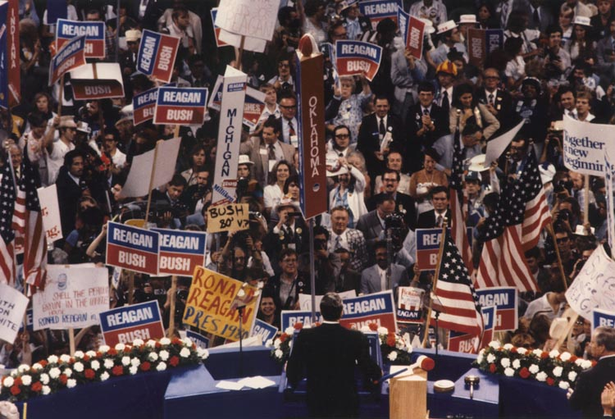
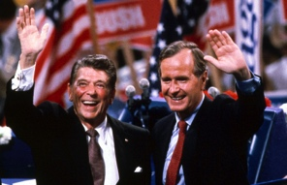
A Conservative Resurgence
The United States from 1980-2000
Notes:
1980 RNC image 1: https://en.wikipedia.org/wiki/Republican_Party_presidential_primaries,_1980
1980 RNC image 2: http://neilleifer.com/ptags/1980-republican-national-convention/

Slide 2
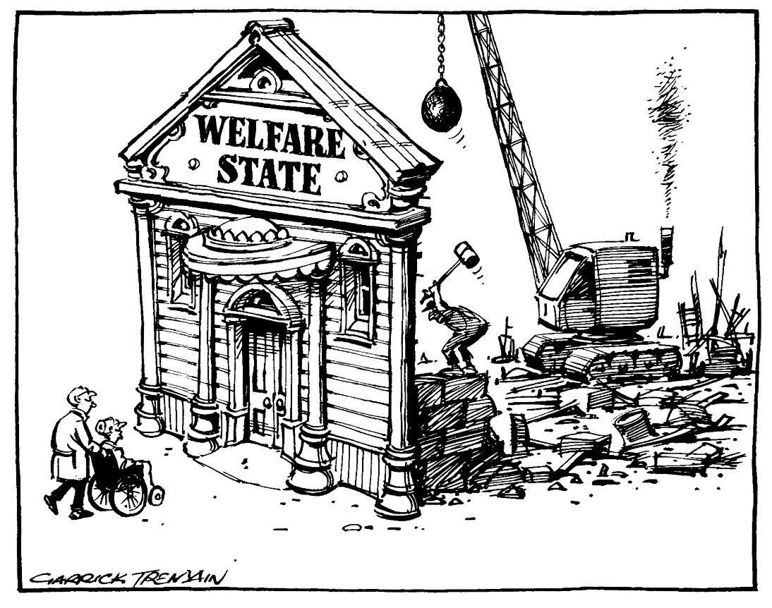
The Rise of Conservatism
Political Figures:
  Barry Goldwater
  Nixon & Ford
Theorists:
  William F. Buckley, Jr.
  Milton Friedman
Response to:
  Big Government
  New Deal Liberalism
  Feminism
  Gay Rights
  Welfare
  Affirmative Action
  Sexual Permissiveness
  Drug Use
  Gun Control
  “Liberal” SCOTUS Decisions
Notes:
Cartoon: http://www.cartoons.org.nz/cartoons/welfare-state

Slide 3
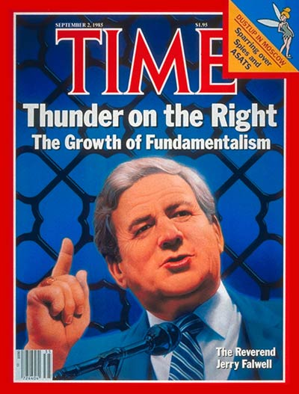
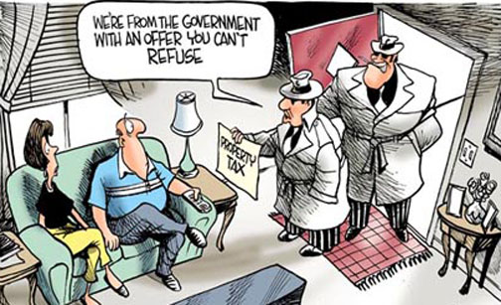
Leading Issues
Taxpayers’ Revolt
  CA’s Prop 13
  Laffer Curve
    Inspiration for tax cuts
Conservative Religious Revival
  The Televangelists
    Robertson, Roberts, Baker
    Falwell & the “Moral Majority”
  Pro-Life Movement
Elimination of Racial Preferences
  U.C. Regents v. Bakke (1978)
De-Regulation of Business
  PAC’s & “Think Tanks”
    Heritage Foundation & Cato Institute
    U.S. Chamber of Commerce
Notes:
Prop 13 Cartoon w/description of current status: http://www.santamonicapropertyblog.com/senators-dare-to-tamper-with-prop-13/
Time Falwell Cover: http://content.time.com/time/covers/0,16641,19850902,00.html

Slide 4
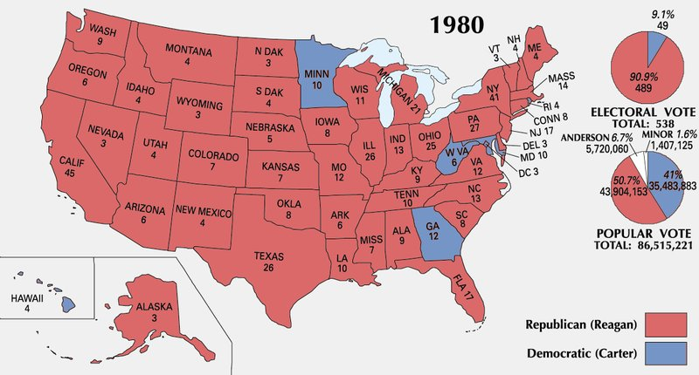
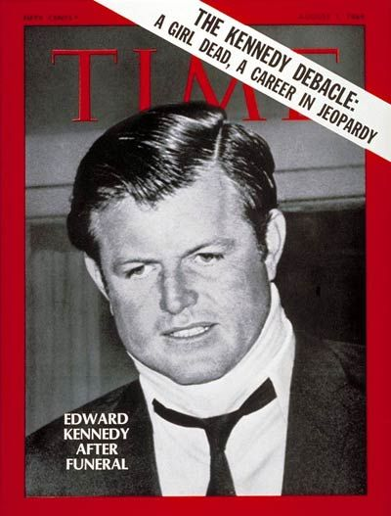
Ronald Reagan and the Election of 1980
Background:
  Actor, SAG President, Governor of California
Campaign
  Democratic Squabbles:
    Kennedy vs. Carter
      Memories of Chappaquiddick
  Republican Attacks
    “Are you better off now than four years ago?
Results:
  Reagan:
    51% popular, 91% Electoral
    The “Reagan Revolution”
      Demographic shift to Republican party
Notes:
Map: http://kc-johnson.com/history-3442-the-1980-election/1980-presidential-election-map-picture/

Slide 5
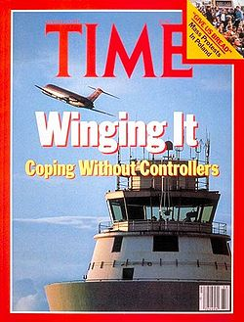
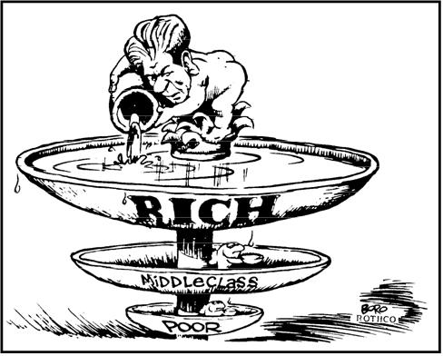
The Reagan Revolution
Iranian Hostage Crisis Ends (Jan. 20, 1981)
Result of Demographic Shift
  Conservative Republicans & the “Boll Weevils”
Supply Side Economics
  “Trickle Down Theory”
  Federal Tax Reduction
    Economic Recovery Act (1981)
  Spending Cuts
    $40 billion
Deregulation
  PATCO Strike
Notes:
Cartoon: http://thecompanion.in/serious-thoughts-after-watching-in-time/
PACO Strike, with description: https://historyrat.wordpress.com/2012/10/14/reagan-and-the-patco-strike-broken-promises/

Slide 6

Recession & Recovery
The “Reagan Recession”
  Bank failures
  11% Unemployment
  “Reaganomics” ends recession, but increases wealth gap
  “Yuppies”
Social Issues
  SCOTUS Nominations
    O’Connor, Scalia, Kennedy
    Rehnquist = Chief Justice
    Restrict Affirmative Action & Limit Scope of Roe

Slide 7

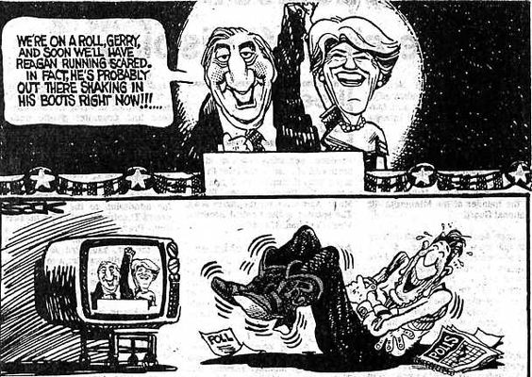
The Election of 1984
Republicans:
  “It’s Morning Again in America”
Democrats
  Jesse Jackson & the “Rainbow Coalition”
  Walter Mondale & Geraldine Ferraro
Results:
  Electoral Tally: 525 to 13
Notes:
“It’s Morning in America” – Link to ad: http://www.livingroomcandidate.org/commercials/1984/prouder-stronger-better#4085
Cartoon: http://apushrshs.wikispaces.com/Political%20Cartoons%201980s-2004
Rainbow Coalition Button: http://i.ebayimg.com/00/s/NTAwWDQ3Mw==/z/B5kAAOSwDNdV6JAP/$_1.JPG

Slide 8
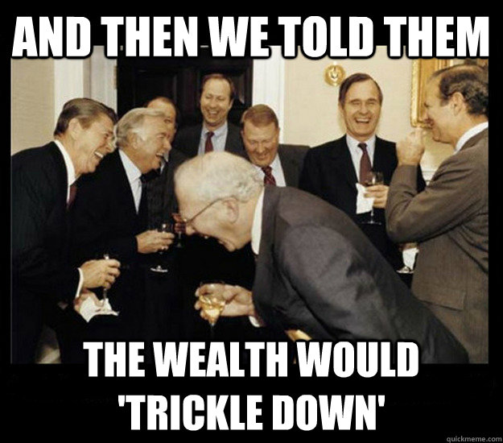
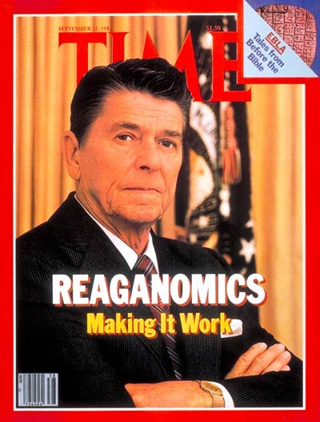
Economic Legacy
Budget & Trade Deficits
  $200 billion deficit per year
  Debt: $900 billion (1980) → $2.7 trillion (1988)
  Tax cuts increased consumption…
    Of foreign goods
    Trade deficit = $150 billion per year
  1985 Gramm-Rudman-Hollings Balanced Budget Act (1985)
Impact of Reaganomics
  Legacy of social spending cuts and increased military spending
  Proliferation of the national debt
Notes:
Time Cover: http://content.time.com/time/covers/0,16641,19810921,00.html
Meme: https://theprogressivecynic.com/2015/02/09/reaganomics-or-rigonomics-the-right-wings-nonfactual-economic-ideology/

Slide 9
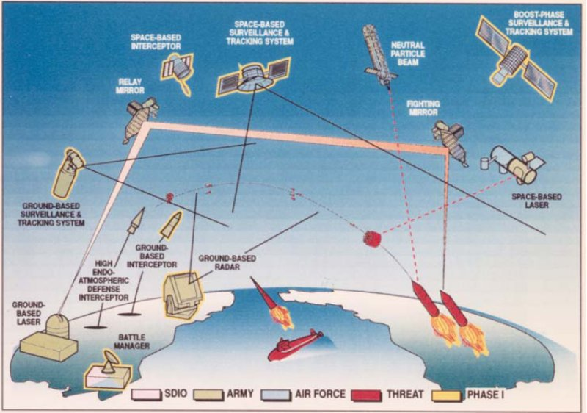
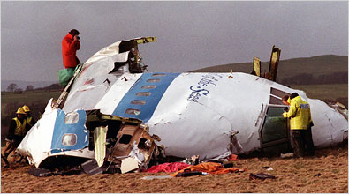
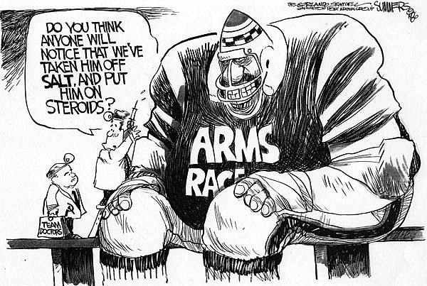
Foreign Policy
Renewing the Cold War
  Military Buildup
    B1 program, SDI, Pershing II
  Central America
    Nicaragua (1979-1985)
      Boland Amendment
    El Salvador (1979-1985)
  Grenada (1983)
  Iran-Contra Scandal
    Iran-Iraq War (1979)
    John Poindexter & Oliver North
      Against Hezbollah, for Contras
  Lebanon, Israel, and the PLO
    Israeli invasion (1982)
    Beirut Bombing (1983)
    West Berlin Bombing (1986)
      Gaddafi
    Air Strikes on Libya
    Pan-Am Flight 103 (1988)
Notes:
SDI: http://www.globalsecurity.org/space/systems/sdi.htm
Cartoon: http://deadspin.com/5958173/a-brief-history-of-sports-in-political-cartoons
Pan-Am 103: http://topics.nytimes.com/top/reference/timestopics/subjects/a/airplane_accidents_and_incidents/pan_am_flight_103/index.html

Slide 10

Improved U.S.-Soviet Relations
1980 (Moscow) & 1984 (Los Angeles) Olympic Games Boycotts
Mikhail Gorbachev (1985)
  Glasnost & Perestroika
  INF Treaty (1987)
“… tear down this wall!”
Notes:
https://www.youtube.com/watch?v=YtYdjbpBk6A

Slide 11
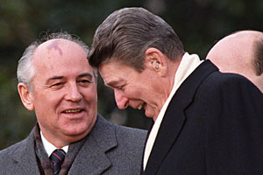
Assessing Reagan’s Policy
Military Buildup
  Pro: Ended Cold War
  Con: Debt
End of the Cold War
  Most responsible?
    Kennan
    Nixon
    Reagan
    Gorbachev
The “Reagan Revolution”
  Extreme Popularity
  Changed the face of politics
Notes:
Did Reagan Win the Cold War?:http://www.salon.com/2006/01/25/gaddis/

Slide 12
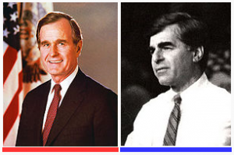
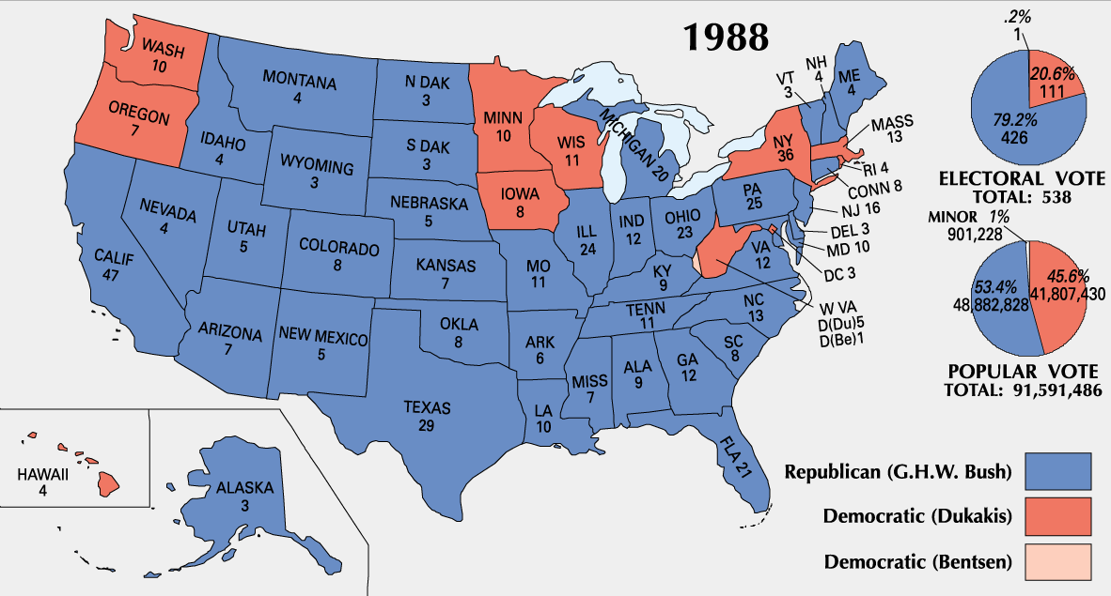
The Election of 1988
Background:
  1986 midterms saw Democrats take control of both houses
  Massive deficits and debt gave Democrats strength
Candidates:
  Michael Dukakis & Lloyd Bentsen
  George H.W. Bush & Dan Quayle
Impact of the Campaign:
  Bush attacks Dukakis on Foreign Policy & Crime
  “Read my lips…”
Notes:
Photo: http://bostonlocaltv.org/blog/2012/10/election-season-1988/
Map: http://www.philipcaruso-story.com/222-election-of-1988/
“Dan Quayle” is a link to the Vice-Presidential Debate – “you’re no Jack Kennedy”: https://www.youtube.com/watch?v=iQ5CIkSlUFI
“Foreign Policy” is a link to the “tank” ad: http://www.livingroomcandidate.org/commercials/1988/tank-ride#4119
“Crime” is a link to the Willie Horton ad: http://www.livingroomcandidate.org/commercials/1988/willie-horton#4123

Slide 13
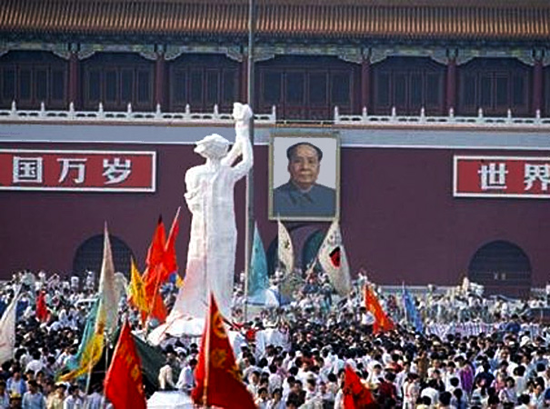
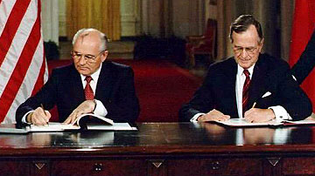
The End of the Cold War
Tiananmen Square (1989)
Collapse of Satellites (1989-1992)
  Poland (Walesa)
  Hungary, Czechoslovakia, Bulgaria, & Romania
  East Germany
    Collapse of Berlin Wall (1990)
  Yugoslavia, Bosnia & Herzegovina
End of the Soviet Union
  START I (1991)
  Gorbachev → Yeltsin (1991)
    START II (1992)
Notes:
Tiananmen, Goddess of Democracy: http://bhoffert.faculty.noctrl.edu/HST265/12.ARoadIsMade.html
START Signing: http://www.atomicarchive.com/History/coldwar/page25.shtml

Slide 14
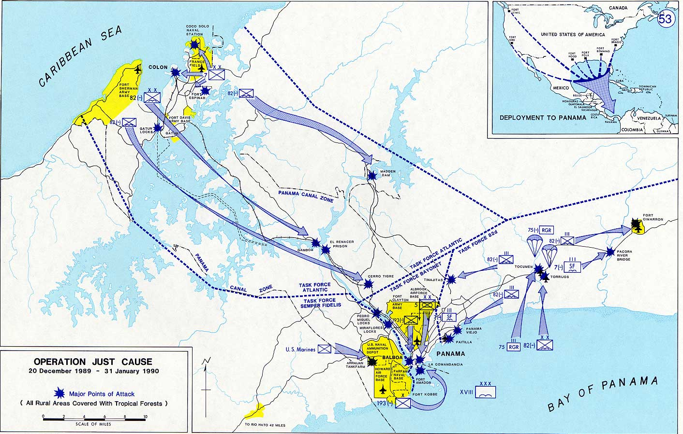
Foreign Policy
Panama
  Operation Just Cause (1989)
    Manuel Noriega
Persian Gulf War (1990-91)
  Operation Desert Storm
    Saddam Hussein
Notes:
Operation Just Cause: https://en.wikipedia.org/wiki/United_States_invasion_of_Panama

Slide 15
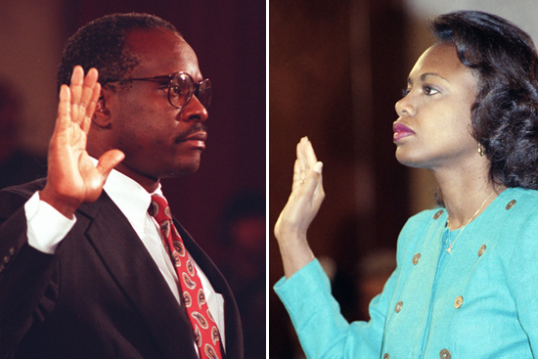
Domestic Issues
Nomination of Clarence Thomas
Taxes and the Economy
  S&L Scandal
  Democratic Congress proposes tax hikes
Political Inertia
  Struggles w/Congress
  ADA (1990)
Notes:
Clarence Thomas: http://www.salon.com/2010/10/27/anita_hill_clarence_thomas/

Slide 16
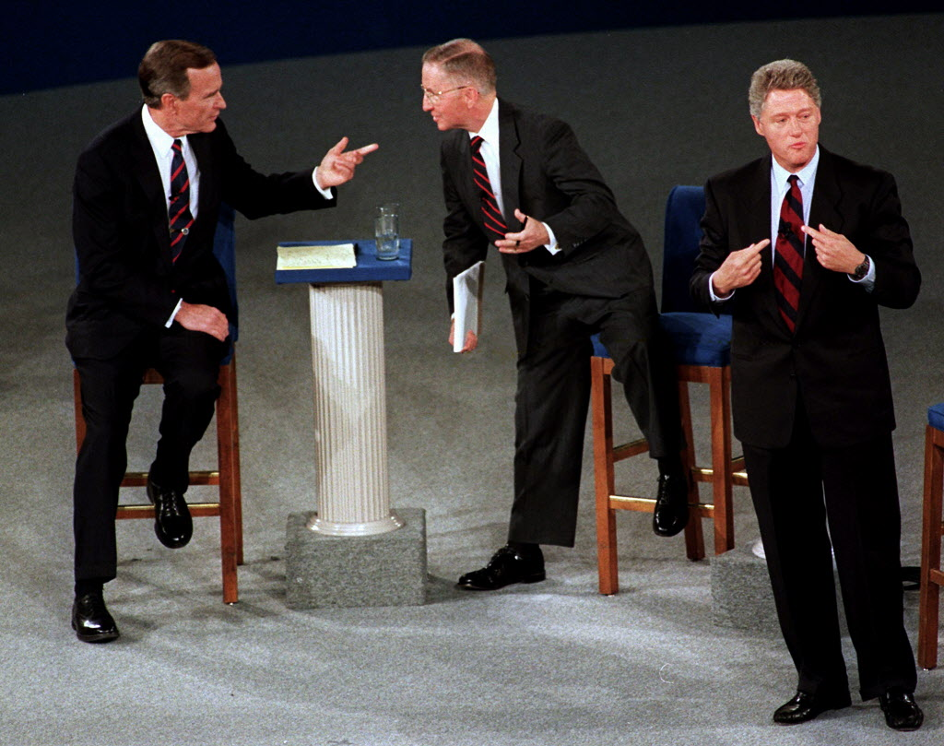
Election of 1992
Background:
  Anti-incumbent mood
  27th Amendment (1992)
  Partisan Politics on Capitol Hill
Democrats:
  William Jefferson Clinton
An Independent Billionaire:
  H. Ross Perot
Results:
  Clinton wins w/less than 43% of the popular vote
  Electoral tally: 370 to 168
Notes:
Debate image: http://popcultureblog.dallasnews.com/2014/11/george-w-bush-says-perot-cost-41-a-second-term-i-just-cant-prove-it.html/

Slide 17
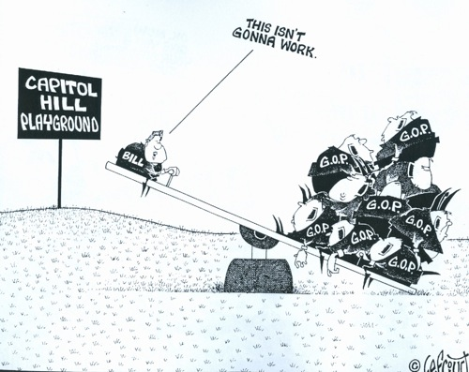
Clinton’s First Term (1993-1997)
Goals:
  Economic Stimulus
  Campaign Finance Reform
  Environmental Legislation
  Health Care Reform
Results:
  Senate Republicans use filibuster against all proposals
Compromise:
  “Don’t ask, don’t tell.”
Accomplishments:
  Family Medical Leave Act
  “Motor-Voter” Law
  Brady Bill
  Spending Cuts and Tax Increases
  NAFTA
Notes:
Cartoon: http://www.pbs.org/wgbh/americanexperience/features/teachers-resources/clinton-guide/

Slide 18
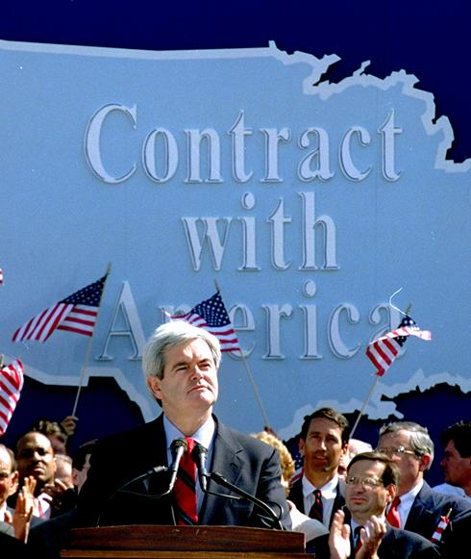
A Republican Revolution
1994 Midterms
  “Contract with America”
    Newt Gingrich
Results/Reactions:
  Gridlock: 1995 shutdown
  Oklahoma City Bombing (1995)
  Balanced Budget (1998)
    Impact of tech boom, Baby-boomer income, spending cuts, and tax increases
Notes:
Contract With America: http://content.usatoday.com/communities/onpolitics/post/2010/01/gingrich-offers-new-contract-with-america/1

Slide 19
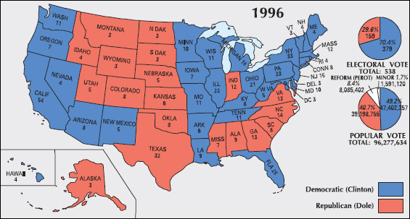
Election of 1996
Republicans:
  Bob Dole/Jack Kemp
  15% tax cut proposal
Reform: Ross Perot
Results:
  Less than 50% voter turnout
  Electoral tally: 379 to 159
Notes:
“Bob Dole” – Link to SNL skit: http://www.nbc.com/saturday-night-live/video/cold-opening-nightline/n10863
Map: http://clinton.procon.org/view.resource.php?resourceID=004025

Slide 20
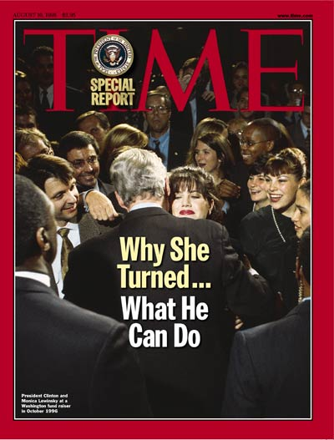
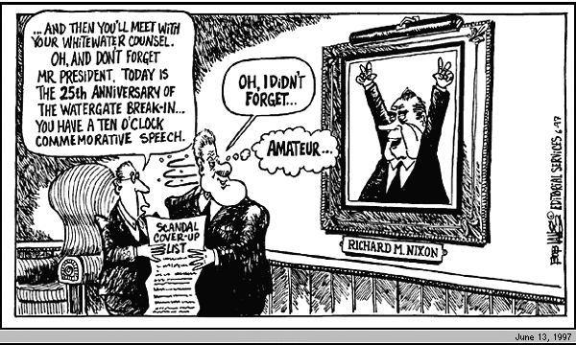
Clinton’s Second Term (1997-2001)
Economic Prosperity
  Tech & Stock Boom
  3.9% Unemployment
The Politics of Impeachment
  Divided Government
  Allegations, Investigation, and Impeachment
    Whitewater, Travelgate, Filegate
    Lewinsky
      Independent prosecutor: Kenneth Starr
      Clinton’s possible perjury
  1998 Midterms → Dems gain House
    Clinton escapes removal by Senate
Notes:
Time Cover: https://www.youtube.com/watch?v=xHlt1W83JFU
Picture is a link to the Clinton grand jury deposition – “definition of ‘is’ is…”: https://www.youtube.com/watch?v=xHlt1W83JFU
Cartoon: http://www.cnn.com/ALLPOLITICS/1997/12/24/toons.97/

Slide 21
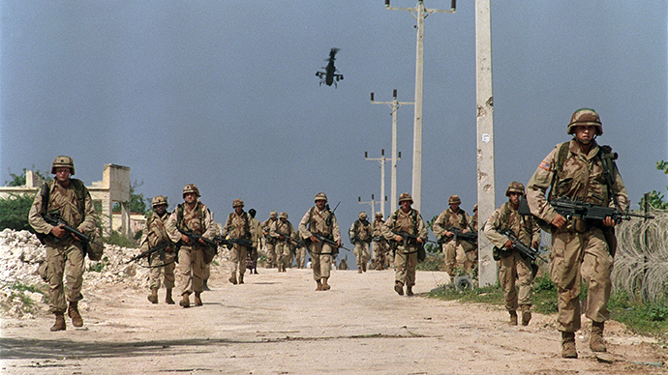
Foreign Policy
Secretary of State: Madeleine Albright
Peacekeeping:
  Somalia (1993)
  Haiti (1994)
  Northern Ireland (1998)
Europe
  Formation of EU (2002)
  Russia
    Yeltsin → Putin
    Chechnya (1999)
  Serbia
    Milosovic
      Targets: Slovenia, Croatia, Bosnia-Herzegovina
  Bosnia (1995) Kosovo (1999)
Middle East
  Israel v. Palestine
Notes:
Synthesis – 20 Years After Somalia: https://horseedmedia.net/2014/01/11/somalia-20-years-black-hawk-us-military-advisers-back-somalia/

Slide 22
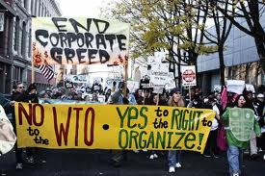
Assessing Clinton’s Legacy
Partisanship
  Struggles w/Congress
  Impeachment
Globalization
  WTO
  IMF
  G8
Notes:
WTO Protest Seattle, 1999: http://www.herinst.org/BusinessManagedDemocracy/government/trade/millennium.html

Slide 23
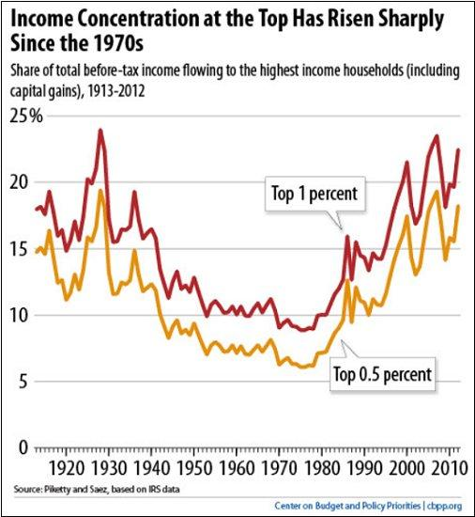
American Society in 2000
Demographics
  Nearly 300 million
  Expansion in West and South
    Political shift
    Suburban expansion
Immigration
  Immigration Reform and Control Act (1986)
    Illegal immigration
  27% of population growth of the ’90’s
  Largest growing population: Hispanic
Aging and the Family
  The “Graying” of America
  Decline of Traditional Family
Income and Wealth
  Home ownership 67%
  Huge increase in per capita income
  Extreme Wealth Gap: 5% control half of all income
Notes:
Graph: http://www.msnbc.com/rachel-maddow-show/welcome-the-new-gilded-age

