Slide 1

Limits of a Superpower
United States Policy, Economy,
and Culture during the 1970’s
Notes:
Disco Stu (animated): http://bunkerpop.mx/bunker-cine/apoco-no-quieren-unos-zapatos-con-pescadito-como-los-de-disco-stu/

Slide 2
Essential Questions
Analyze the continuities and changes that occurred in U.S foreign policy during the the 1970’s. To what extent did policy change, to what extent did it stay the same?
Analyze the effectiveness of social movements in addressing major problems and inequalities, and assess the ability of these movements to affect political change during the 1970’s.

Slide 3
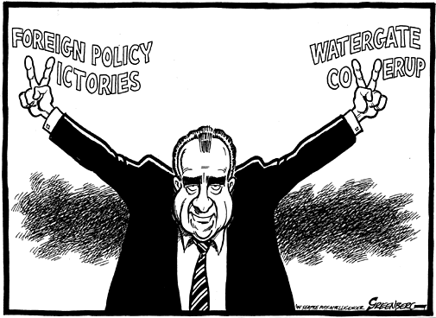
Richard M. Nixon
Background:
  Yorba Linda, CA
  Quaker
  Whittier → Duke
  Navy, World War II
  Congressman & Senator
  Vice President
The “Imperial Presidency”
Notes:
Cartoon: http://www.greenberg-art.com/.Toons/.Toons,%20Obits/NixonObit.html

Slide 4
Foreign Policy
Vietnamization and Détente

Slide 5
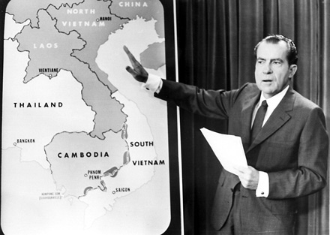
Vietnam
“Peace with Honor”
  Reduce involvement
“Vietnamization”
  Withdrawal:
    540,000 (1969) → 30,000 (1972)
  Nixon Doctrine
    Support in Asia, without troops
Notes:
Image: http://dkobner.blogspot.com/2011/12/two-policies-in-vietnam-americanization.html

Slide 6
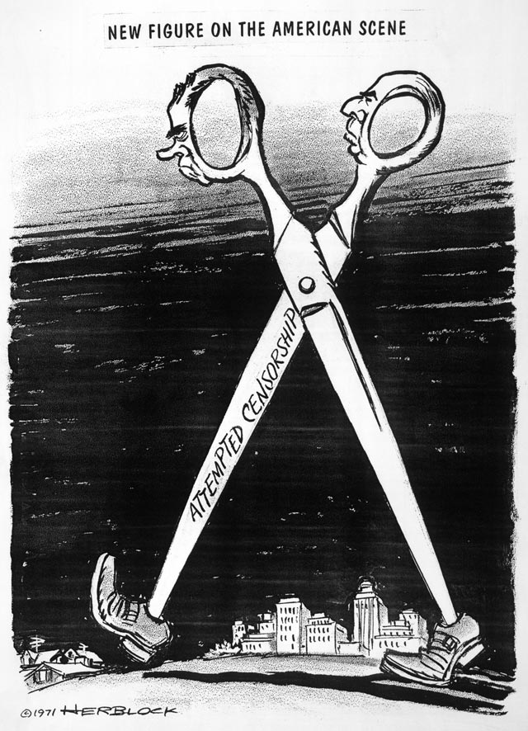
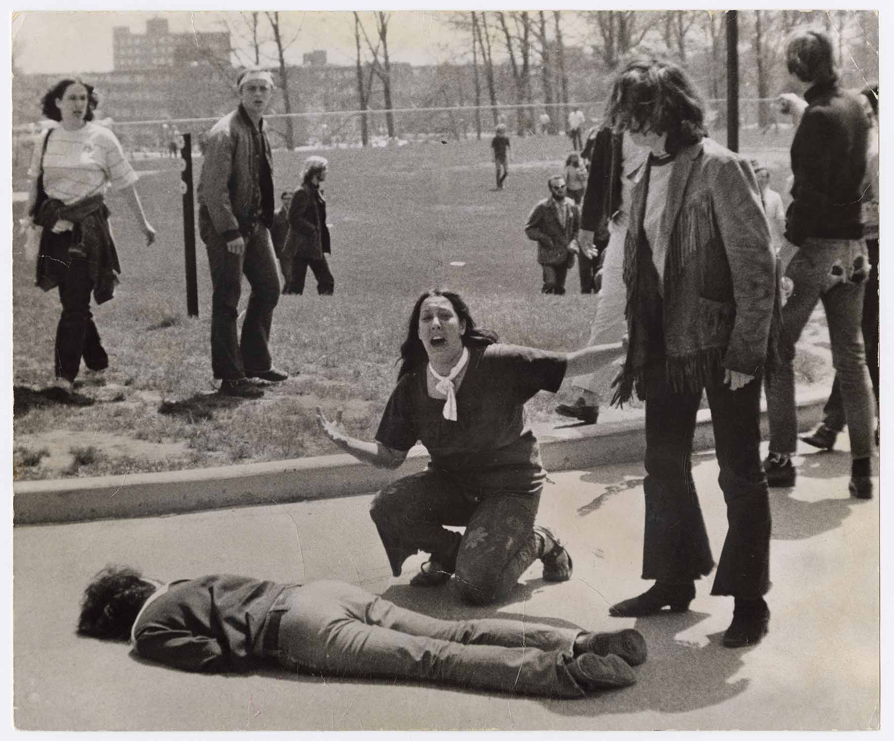
Opposition to Nixon’s War Policies
Laotian and Cambodian Campaigns
  Kent State Massacre (1970)
Public Revelations:
  My Lai Massacre (1968)
  Pentagon Papers (Ellsberg, 1971)
    NY Times v. United States
Notes:
Cartoon: http://voiceseducation.org/node/345

Slide 7
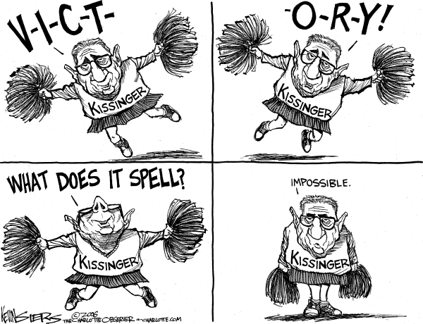
Ending the Conflict
Kissinger: “Peace is at hand”
Bombing of North Vietnam (1972)
Paris Accords (1973)
  Armistice
  Withdrawal
  Return of POW’s
Results:
  58,000 deaths
  $118 Billion
    Inflation
Notes:
Kissinger Cartoon: http://thecomicnews.com/edtoons/archive/2006/1122/kissinger/01.shtml

Slide 8
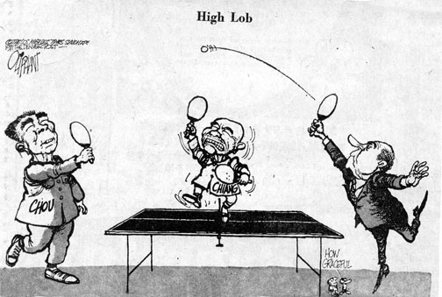
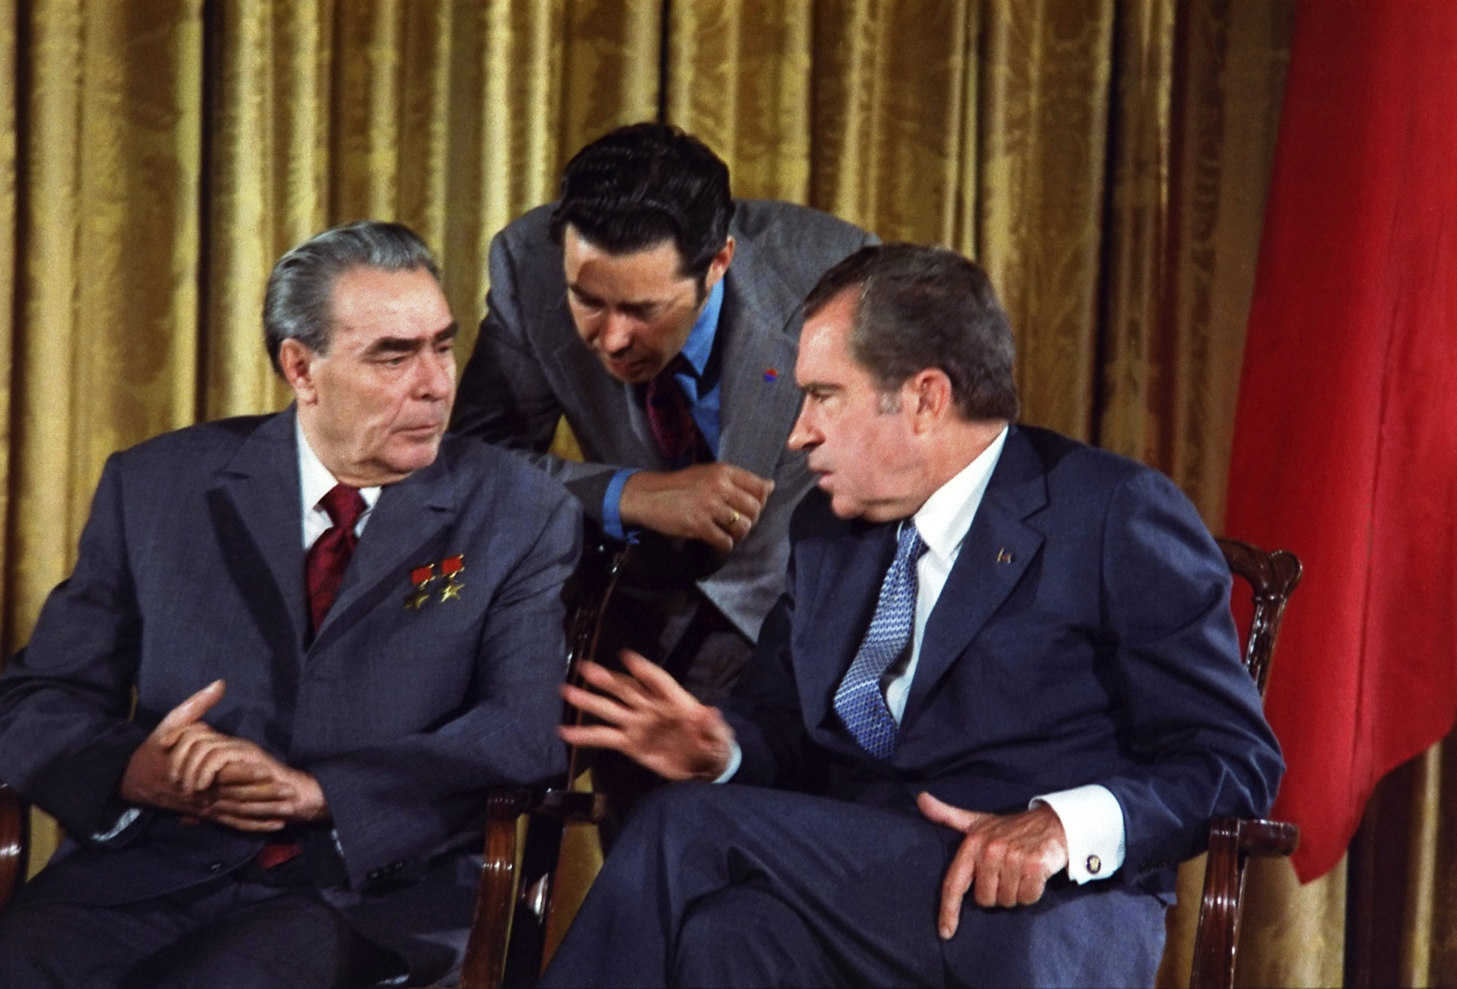
Détente with China and the Soviet Union
Visit to China
  Travel ban lifted
  “Ping-pong” diplomacy
  Nixon meets w/Zhou Enlai & Mao Zedong (1972)
Arms Control with the Soviet Union
  SALT I (1969-1972)
  Visits U.S.S.R. (1972)
  ABM Treaty
    Arms limitations
Notes:
Ping-Pong Diplomacy: http://www.tabletenniscoaching.com/taxonomy/term/91
Breznev’s Visit to Washington, 1973: http://en.wikipedia.org/wiki/D%C3%A9tente

Slide 9
Domestic Policy
Nixon and the Rise of Conservatism

Slide 10
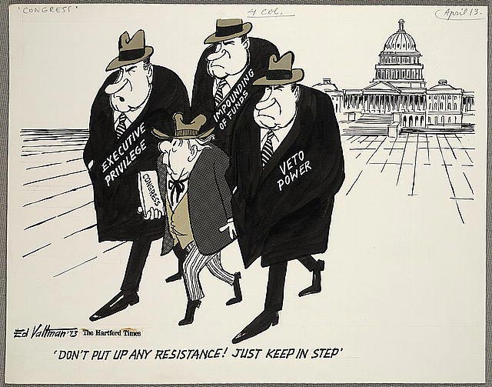
The New Federalism
Goal: shift responsibility of welfare back to the states
Manifestations:
  Family Assistance Plan
    Reduce welfare → defeated by Congress
  Revenue sharing & Block grants
    $30 billion to states
  Impoundment of Funds
Notes:
Cartoon: http://www.loc.gov/rr/print/swann/valtman/presentation.html

Slide 11
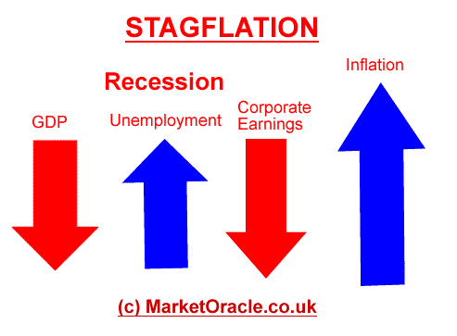
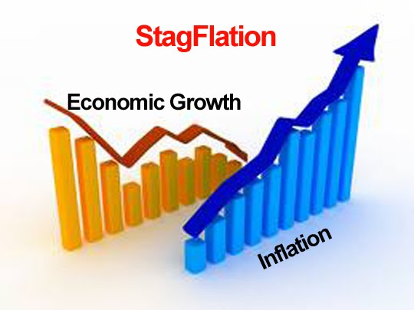
Nixon’s Economic Policies
Stagflation
  Stagnation + inflation
  Attempts to cut spending
  90 day wage and price freeze (1971)
  Removed gold standard
    Improved balance of trade
  Recession Ends (1972)
  Increases Social Security w/COLA
  Congress adds Title IX(CRA-64)
    Includes sex discrimination (schools)
Notes:
Stagflation: http://www.darkgovernment.com/news/stagflation/
http://www.321gold.com/editorials/schoon/schoon092012.html

Slide 12
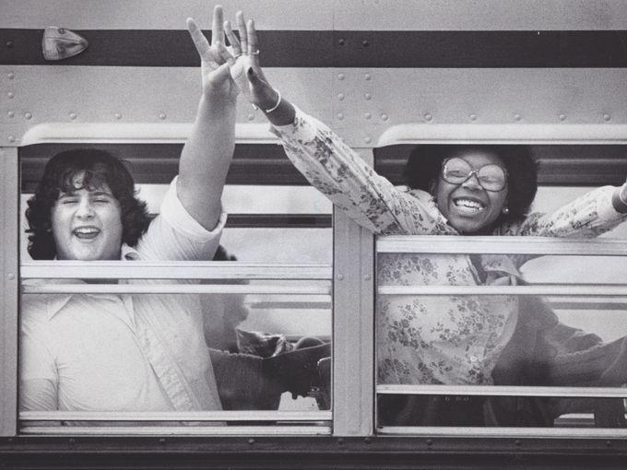
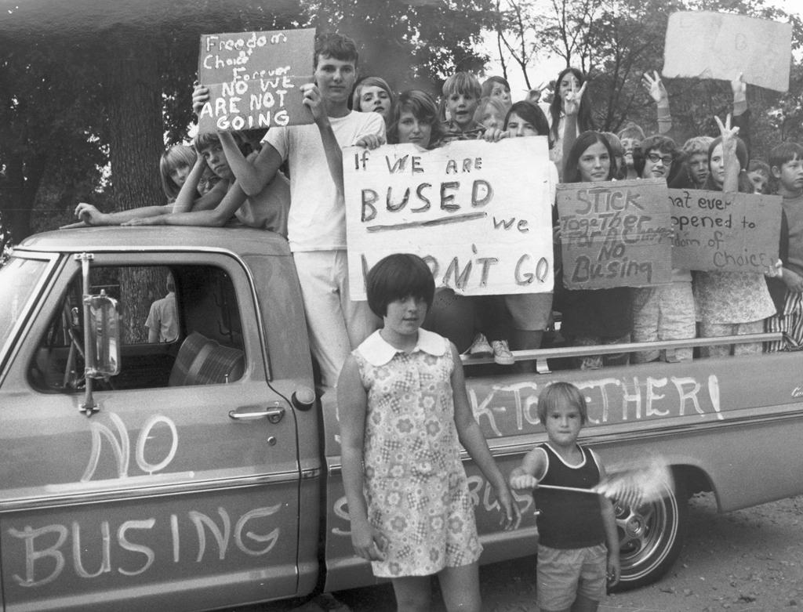
Conservatism
A New Coalition
  The “Silent Majority”
  Appeal to disaffected, conservative democrats
  The “Southern Strategy”
    Slow down desegregation
      Appeal to Southern Democrats
      Swann v. Charlotte-Mecklenburg (1971)
The Burger Court
  Roe v. Wade (1973)
  U.S. v. Nixon (1974)
Notes:
Image 1, school busing: http://www.delawareonline.com/picture-gallery/news/education/2014/05/16/looking-back-busing-in-wilmington/9201879/
Image 2, protest: http://www.vahistorical.org/collections-and-resources/virginia-history-explorer/civil-rights-movement-virginia/school-busing

Slide 13

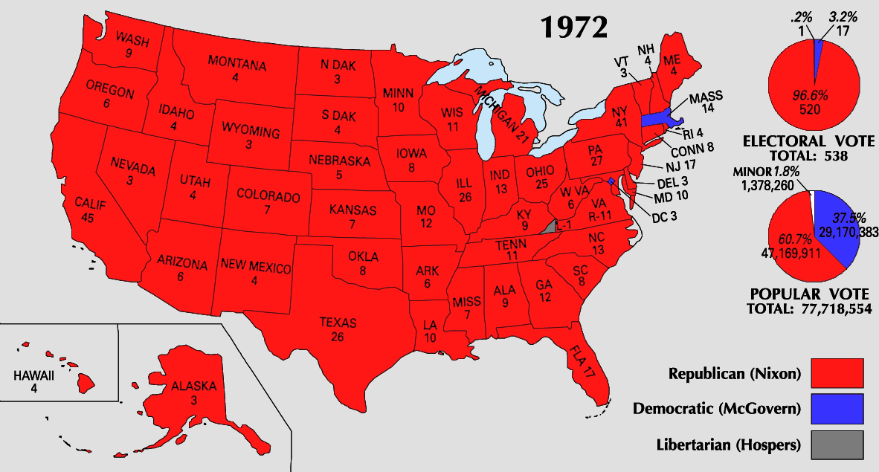
The Election of 1972
Republican Advantages
  Foreign policy success
  Removal of George Wallace
  Democratic nominee
Democrats
  Indecision, mismanagement
  McGovern = very liberal, antiwar, antiestablishment
Results:
  Nixon Landslide: 61% popular = carried every state except MA
  Political realignment: Sunbelt and suburbs
Notes:
Life Magazine Cover: https://lostlaurel.wordpress.com/2012/05/15/laurel-shopping-center-george-wallace-40-years-later/
Electoral Map: http://hermelink-nixon.blogspot.com/2010/04/election-of-1972-second-term.html

Slide 14
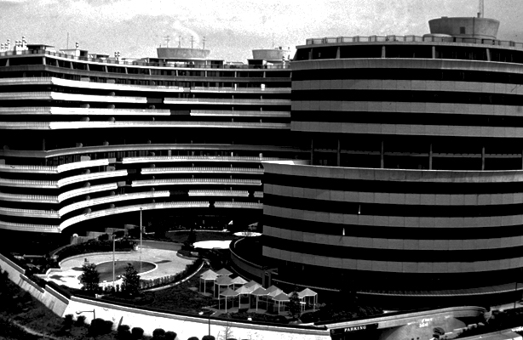
Watergate
The Scandal that Changed the Presidency and the Role of Media
Notes:
Watergate: http://www.esquire.com/blogs/politics/watergate-40-years-later-9747335

Slide 15
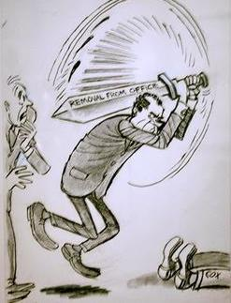
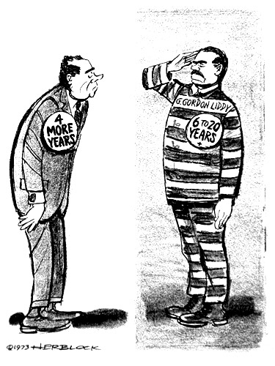
White House Abuses
The Break-in (June, 1972)
  CREEP
Nixon’s “Dirty Tricks”
  Wiretaps
  “Plumbers”
  “Enemies List”
  All the President’s Men
    Haldeman, Ehrlichman, and Dean
Washington Post
  Woodward & Bernstein
Other Scandals
  ITT Case – Agnew’s Resignation
    Replaced by Gerald Ford
  “Saturday Night Massacre” (Oct. 1973)
    Two AG’s resign, Solicitor General (Bork) fires Cox
Notes:
Liddy Cartoon: http://www.dailykos.com/story/2013/05/10/1207661/-U-S-since-1865-Watergate-in-Cartoons-Herblock-s
Saturday Night Massacre: http://www.statecollege.com/news/columns/to-herblock-and-to-spring-flowers-postcard-from-washington,682171/

Slide 16
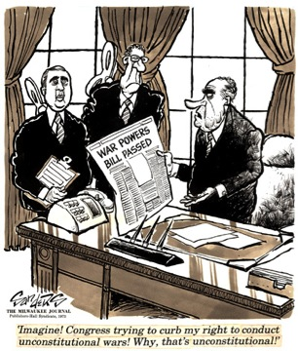
Other Developments - 1973
War Powers Act
  Retaliation for Cambodian bombing
  President must report to Congress any troop commitments within 48 hours
    60 day limit to commitment w/out Congressional consent
    Has largely been ignored by every subsequent president
October War and Oil Embargo
  Yom Kippur War
    U.S. sends $2 billion in arms to Israel
  OPEC retaliates → embargo
    Results:
      Oil shortage, inflation, introduction of Japanese cars, collapse of auto industry, national speed limit (55 mph)

Slide 17
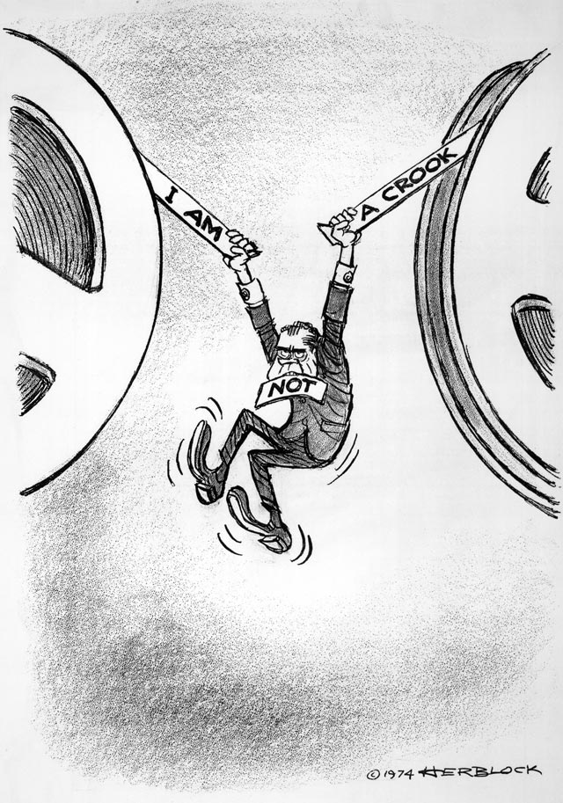
Resignation of the President
Impeachment Proceedings (1974)
  The Tapes:
    Transcripts (redacted) released
    U.S. v. Nixon (July)
      The “smoking gun”
  Articles of Impeachment:
    Obstruction of justice
    Abuse of power
    Contempt of Congress
Nixon Resigns (August 9, 1974)
  Pardoned by Ford

Slide 18
The Ford Interlude
The Administration of the First Non-elected President (1974-1977)

Slide 19
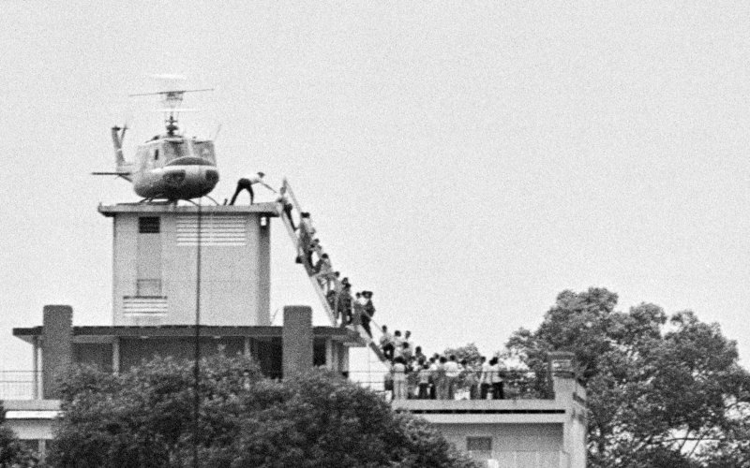
The Ford Administration
Investigating the CIA
  Attempting to expose assassination plots
    Salvador Allende (Chile)
  Ford appoints George H.W. Bush to head CIA
Southeast Asia Policy
  Fall of Saigon (April, 1975)
  Genocide in Cambodia
  Economic growth of the rest of SE Asia
Notes:
Fall of Saigon: http://www.thedailybeast.com/articles/2014/04/30/remembering-the-fall-of-saigon-and-vietnam-s-mass-boat-people-exodus.html

Slide 20
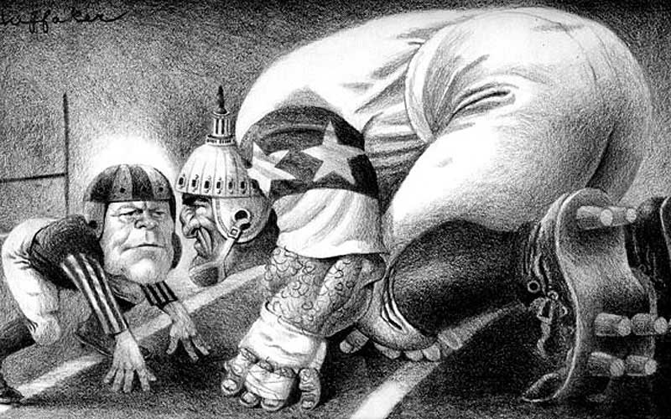
Ford Administration (con.)
Domestic & Economic Policy
  The “WIN” Campaign
  The Veto (39)
  The Bicentennial (1976)
Foreign Policy
  Vietnam
  Helsinki Accords (1975)
Notes:
Cartoon: http://www.huffakerart.com/illustration/big/Gerald%20Ford.html

Slide 21
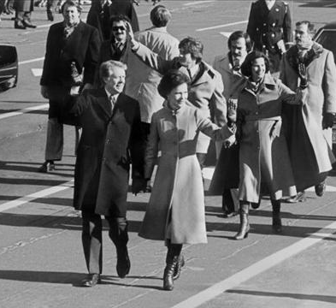

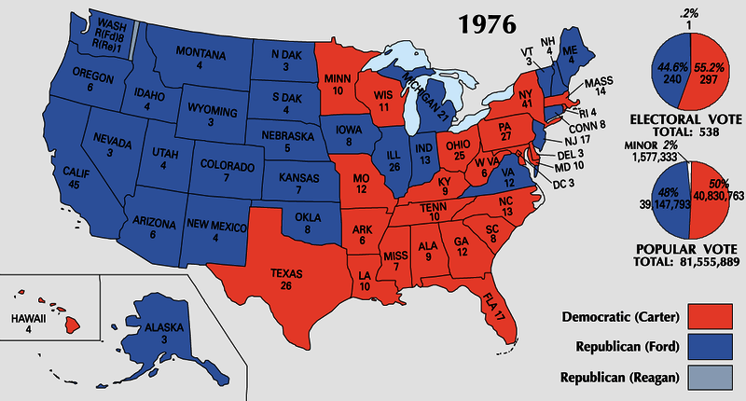
The Election of 1976
Ford vs. Carter
  Low Turnout (53%)
  Desire to move away from “politics as usual.”
  Electoral: 240 to 297
Notes:
Ford Pin: http://www.vahistorical.org/sites/default/files/uploads/VHE_Campaigns_IL.2012.2.43.4.jpg
Map: http://i0.wp.com/www.philipcaruso-story.com/wp-content/uploads/2015/04/Election-of-1976.png
Carter’s “Presidential Strut”: http://archive.13wmaz.com/news/article/212316/318/Presidential-Strut-is-Now-Iconic-Inaugural-Moment

Slide 22
The Carter Administration
America at the End of the 1970’s

Slide 23
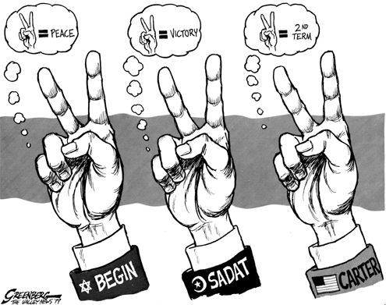
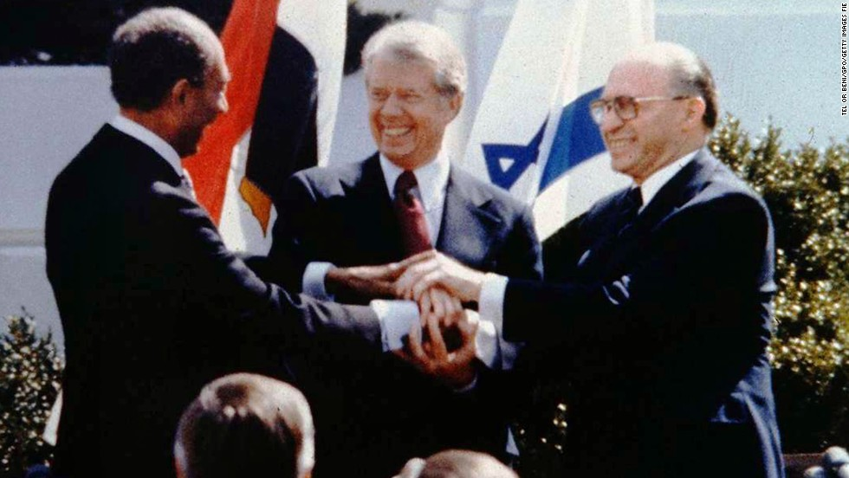
Foreign Policy & Human Rights
Human Rights
  Guided policies w/South Africa and Latin America
Panama Canal
  Nationalization by 2000
Camp David Accords (1978)
  Begin (Israel) & Sadat (Egypt)
    Egypt first Arab nation to recognize Israel
Notes:
Camp David Accords Image & Facts: http://www.cnn.com/2013/08/23/world/meast/camp-david-accords-fast-facts/
Cartoon: http://www.greenberg-art.com/.Toons/.Toons,%20political/CampDavid.html

Slide 24
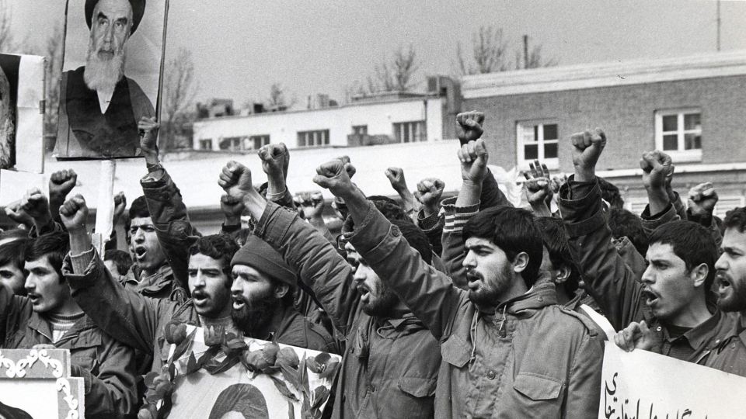
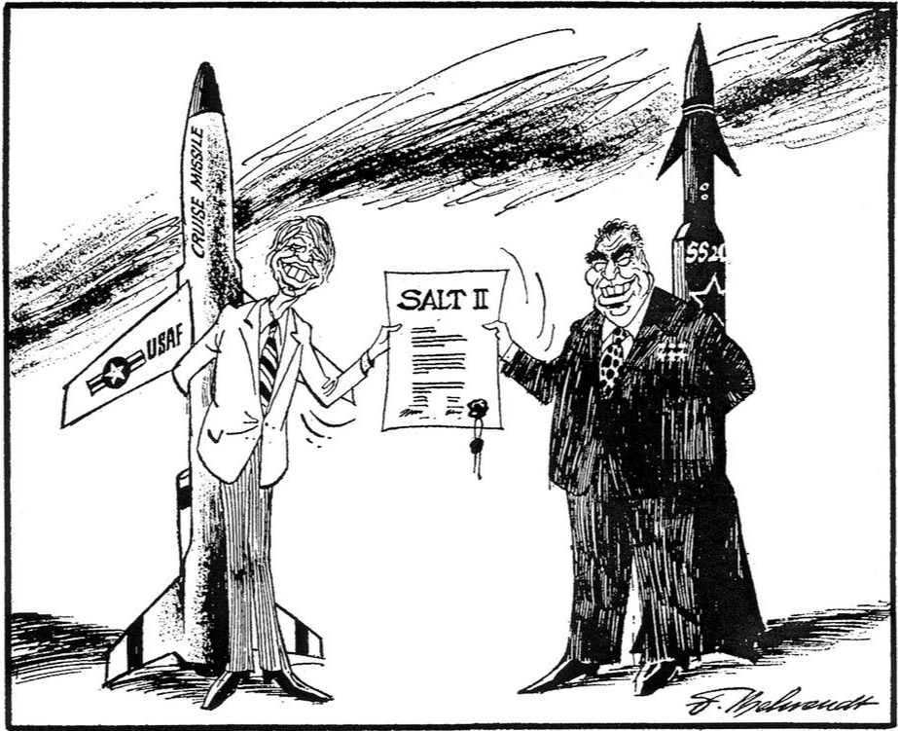
Foreign Policy Limitations
Iran Hostage Crisis (1979)
  Rise of the Ayatollah Khomeini
  2nd Oil Shortage
  Seizure of Embassy in Teheran (Nov. 4, 1979)
    Operation Eagle Claw (April, 1980)
    Hostages not freed until January 20, 1981
Cold War
  Continuance of Détente
    Recognizes PRC (1979)
    SALT II (1979)
    Soviet-Afghan War (December, 1979)
      US embargo on exports
      Boycott 1980 Olympic games
Notes:
Image and Review of Argo: http://www.ctvnews.ca/w5/argo-iran-hostage-crisis-film-fiddles-with-the-facts-1.1167994
Cartoon: http://www.cvce.eu/en/obj/cartoon_by_behrendt_on_the_salt_ii_disarmament_agreement_4_may_1979-en-09e3b4d4-0b02-4b54-8ab6-afc0ef4c9246.html

Slide 25
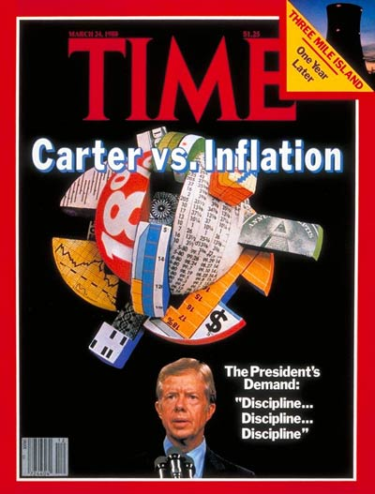
Domestic Policy
Dealing with Inflation
  13%
  Volcker (Fed) pushed interest rates to 20%
    Impact on the auto industry
  Federal deficit to $60 billion (1980)
Loss of Popularity
  “Malaise” Speech
  Approval: 23%
Notes:
Image: http://topics.time.com/economy/covers/

Slide 26
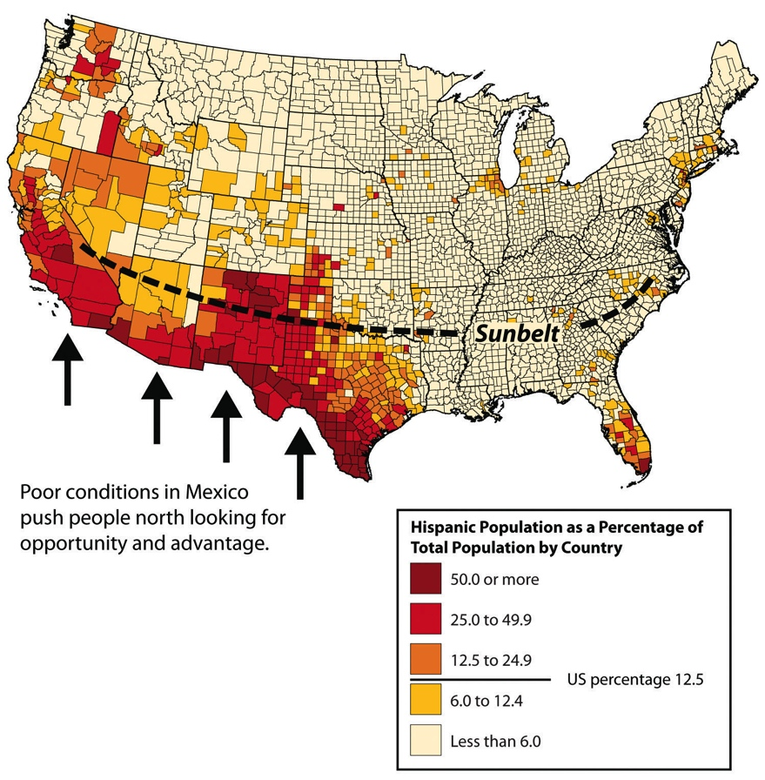
American Society in Transition
Rise of the Sunbelt & Senior Citizens
Changing Demographics
  Increase in minorities and cultural pluralism
Growth of Immigration
  Largest segments: Latin America & Asia
  Undocumented Immigrants
    Est. 12 million by mid-70’s
Notes:
Map & Historical Population Analysis: http://2012books.lardbucket.org/books/regional-geography-of-the-world-globalization-people-and-places/s07-north-america.html

Slide 27
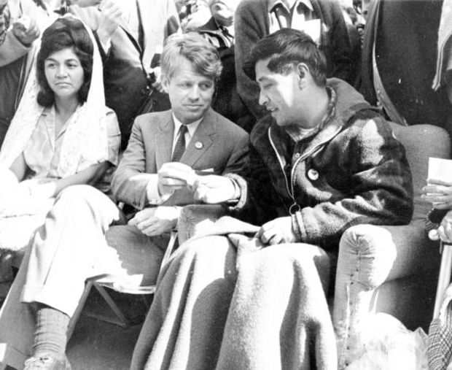
Demands for Minority Rights: Latinos
Hispanic Americans
  Cesar Chavez, the UFW, and the Delano Boycott & March (1966)
    Collective bargaining for farm workers (1975)
  MALDEF (1968)
  Educational Reforms
    Bilingual schools
Notes:
Image and Chavez Bio: http://www.biography.com/news/cesar-chavez-biography-facts
UFW website on the Delano March: http://www.ufw.org/_board.php?mode=view&b_code=60_video&b_no=16344&page=1&field=&key=&n=1

Slide 28
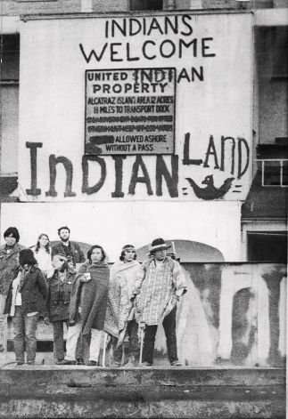
Demands for Minority Rights: Native Americans
American Indian Movement (AIM-1968)
  Occupation Movement
    Wounded Knee & Alcatraz
  Indian Self-Determination Act of 1975
  Tribally Controlled Community College Assistance Act of 1978
Notes:
Occupation of Alcatraz: http://jewishcurrents.org/tag/american-indian-movement

Slide 29
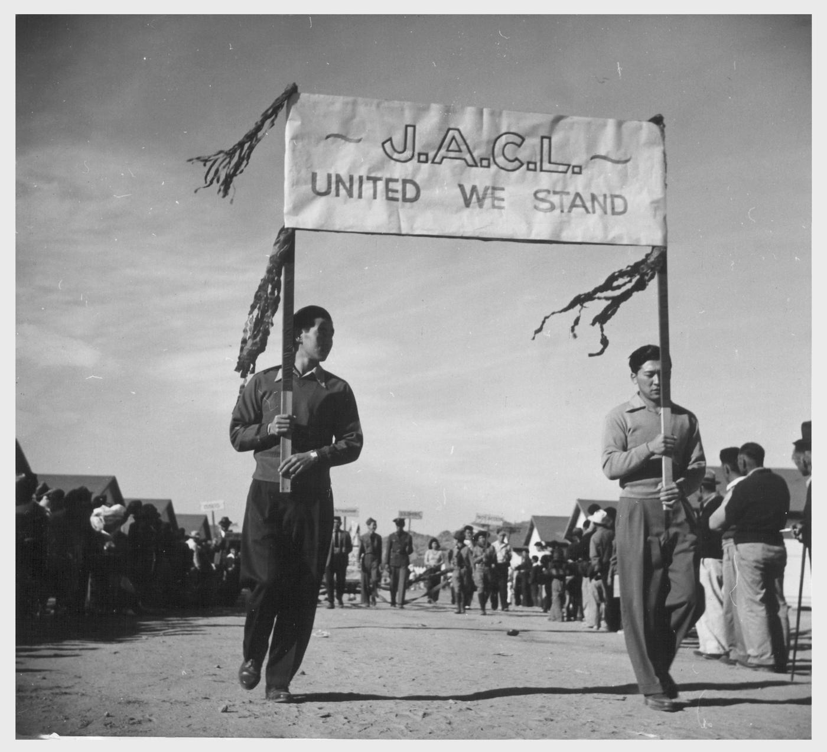
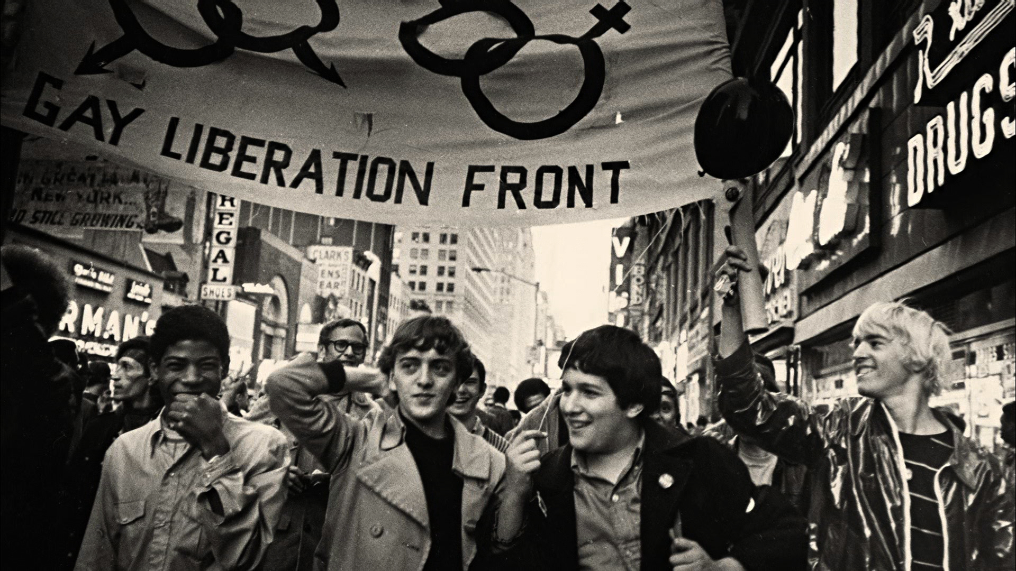
Demands for Minority Rights (con.)
Asian Americans
  Fastest growing ethnic minority
  Emphasis on education
  Discrimination
  JACL (1929)
Gay Liberation Movement
  Stonewall Riot (1969)
  Milk-Moscone Murders and the “White Night” Riots in SF 1978-79)
  “Don’t Ask, Don’t Tell” (1993)
  Movement for LGBT Rights
Notes:
JACL Parade: http://content.cdlib.org/ark:/13030/ft2d5nb0c3/
Legacy of the Stonewall Riots (PBS Video): http://video.pbs.org/video/2365073798/

Slide 30
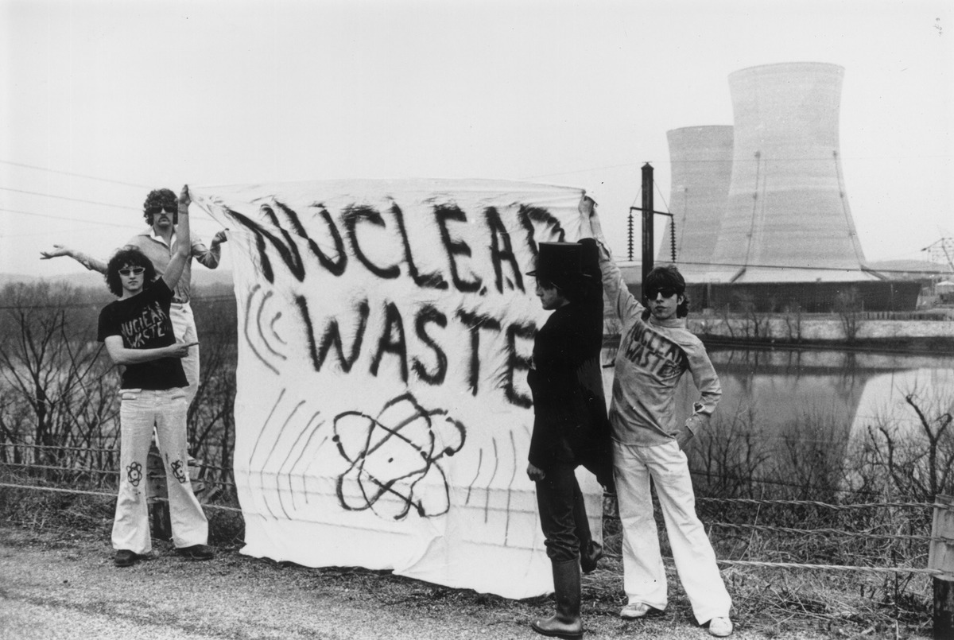
The Environmental Movement
Increased Awareness
  Rachel Carson’s Silent Spring (1962)
  Earth Day (1970)
  Major Oil Spills
    Santa Barbara (1969)
    Exxon Valdez (1989)
  Nuclear Disasters
    Three Mile Island (1979)
    Chernobyl (1986)
  Pollution and Dumping
    Love Canal (NY)
Notes:
Three Mile Island Protest: http://mashable.com/2014/07/15/nuclear-disasters-before-after/#NSRpiN99_5qW

Slide 31
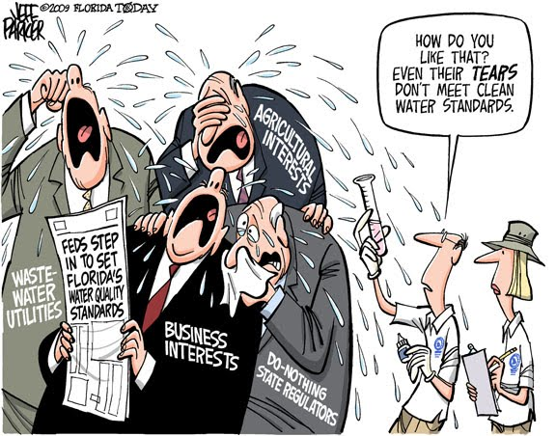

Protective Legislation
Environment:
  Clean Air Act & the EPA (1970)
  Clean Water Act (1972)
  Endangered Species Act (1973)
Consumer Protection
  Ralph Nader’s Unsafe at Any Speed (1965)
    Automobile regulations: seat belts, weight distribution, and design
  Freedom of Information Act (1967)
  OSHA (1971)
  Consumer Products Safety Act (1972)
Notes:
Simpsons’ Movie Intro Image: http://s177.photobucket.com/user/diskoboy1974/media/cap008.jpg.html
Cartoon: http://archive.floridatoday.com/content/blogs/jparker/2009/12/1211-cartoon-cry-us-river.shtml

Slide 32

Conservative Backlash
Conservative Reaction to “liberal” policies
Causes:
  Rise of Religious Right
  Response to SCOTUS decisions
  Reaction to New Deal and Great Society Programs
Notes:
Synthesis to Trump campaign: http://www.businessinsider.com/donald-trump-trademarked-make-america-great-again-2015-5

