Slide 1
Promise and Turmoil
The 1960’s

Slide 2
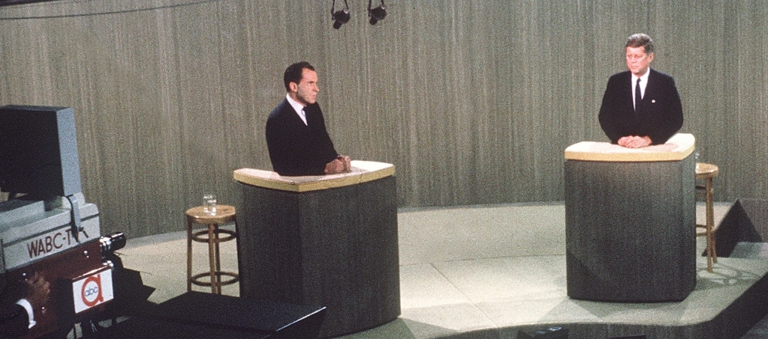
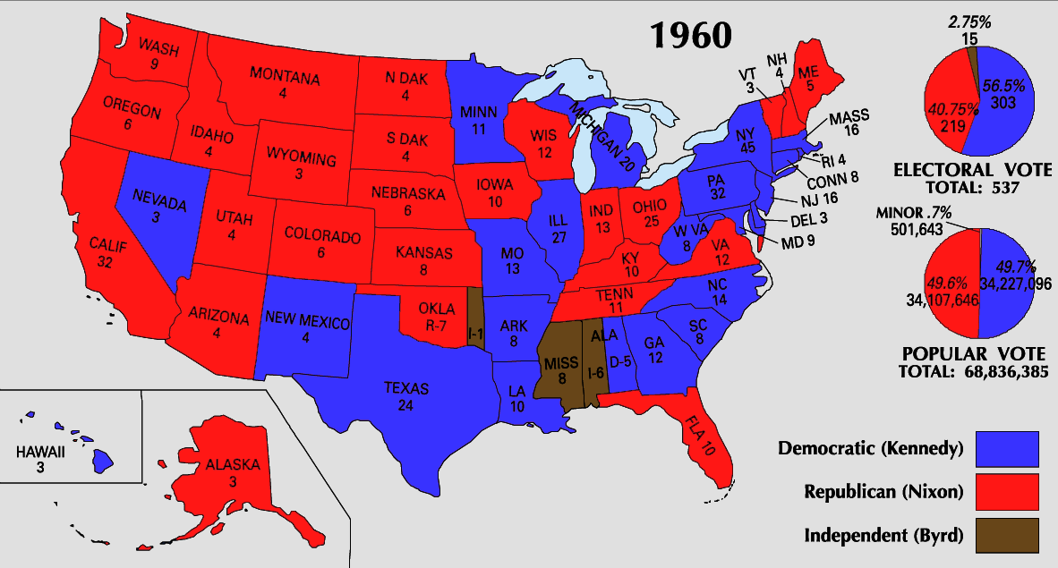
John F. Kennedy’s New Frontier
The Election of 1960
  Nixon
    Quaker, from CA
    Prominence: Hiss Trial, “Checkers,” and the “Kitchen Debate”
  Kennedy
    Catholic, from MA
    Prominence: Congressman, PT-109
  Campaign
    First Televised Debates
  Results
    Kennedy wins popular by just over 100,000
    303 to 219
Notes:
Debate: http://www.history.com/topics/us-presidents/kennedy-nixon-debates
Map: http://kc-johnson.com/history-3442-the-1960-election/

Slide 3
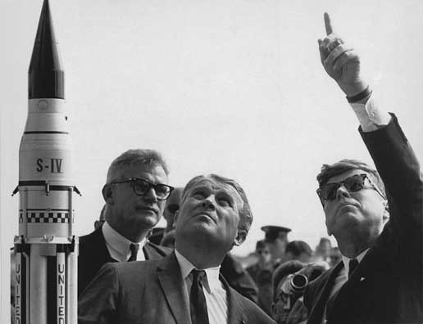
Domestic Policy
Kennedy’s “Camelot”
A New Frontier
  Federal Aid for:
    Education, health care, urban renewal
  Economics:
    Tax cuts, defense and space spending
  Moon Speech
Notes:
New Frontier Speech: http://infinite-frontier.blogspot.com/2009/02/kennedys-new-frontier-speech.html

Slide 4
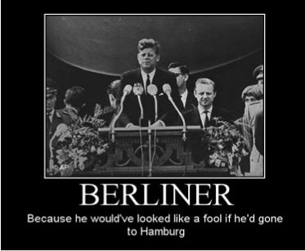
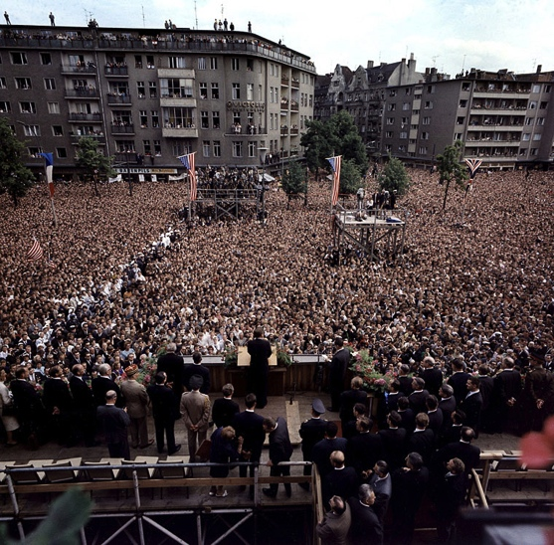
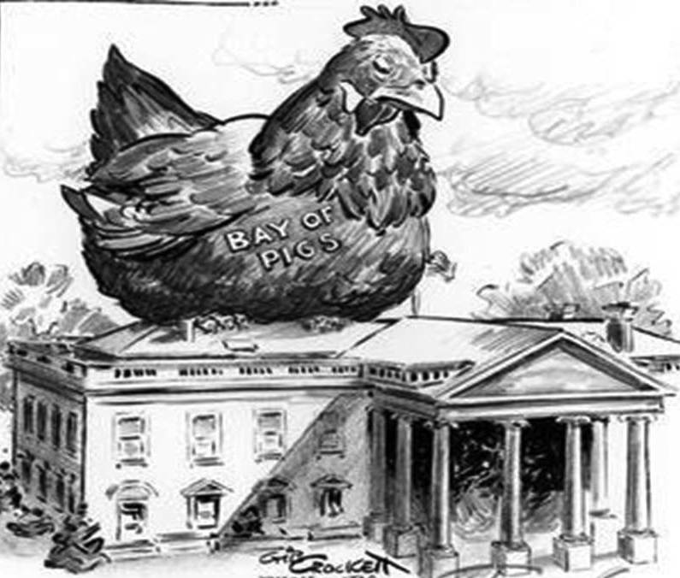
Foreign Policy
Latin America
  Peace Corps (1961)
  Alliance for Progress (1961)
  Bay of Pigs Invasion
Soviet Union
  Berlin Wall
    “Ich bin ein Berliner”
  Cuban Missile Crisis (1962)
Flexible Response
Notes:
Bay of Pigs: http://mrortlieb.weebly.com/cold-war-in-the-1960s.html
Berliner Speech: http://en.wikipedia.org/wiki/Ich_bin_ein_Berliner
Berliner – Play on “jelly doughnut” translation

Slide 5
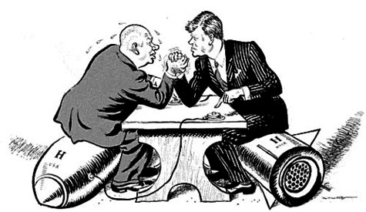
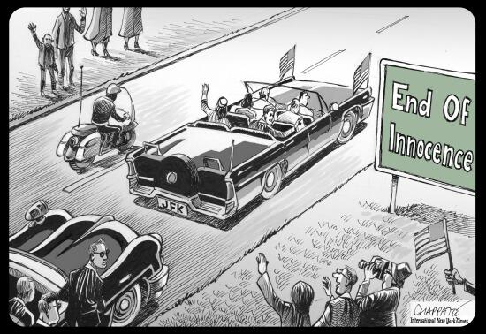
Kennedy Legacy
Assassination in Dallas (November 22, 1963)
  Warren Commission
In Retrospect
  “Ask not…”
  Foundations for Civil Rights
  Impact of foreign policy: McNamara
    Cuban Missile Crisis
    Vietnam
Notes:
Cuban Missile Crisis: http://teachinghistory.org/nhec-blog/23484

Slide 6
Lyndon Johnson’s Great Society
The “Zenith” of Liberalism*
* From the AP Framework – don’t shoot the messenger
Notes:
Commentary on new standards—include discussion of use of “zenith”: http://www.burtfolsom.com/?p=2901

Slide 7
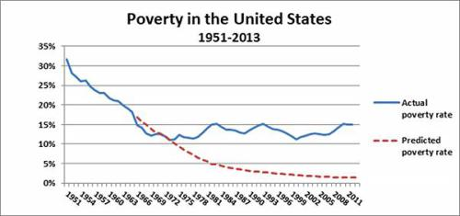
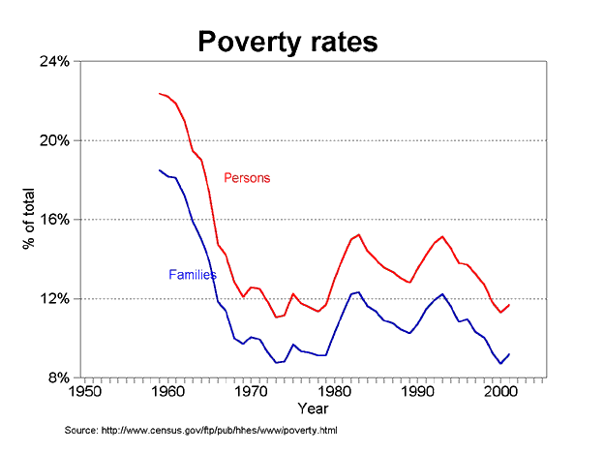
Essential Question
To what extent were efforts to use federal power to end racial discrimination, eliminate poverty, and address other social issues while attacking communism abroad, effective?
Notes:
How to use statistics-
Graph 1: http://www.americanhistoryusa.com/5-liberal-falsehoods-of-american-history/
Graph 2: https://thedrpete.wordpress.com/tag/great-society/

Slide 8
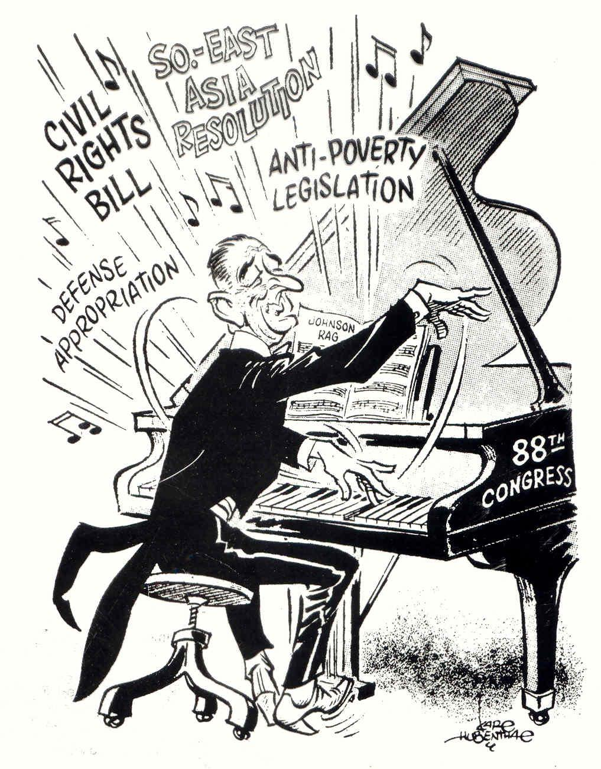
LBJ
Texas Democrat
Goal: expand reforms of New Deal
First Actions:
  Expand:
    Kennedy’s Civil Rights Bill
    Tax cut
Notes:
Cartoon: http://www.glogster.com/hannahray15/apush-johnson-s-great-society/g-6ksmfcl0nh2289d783g7ga0

Slide 9
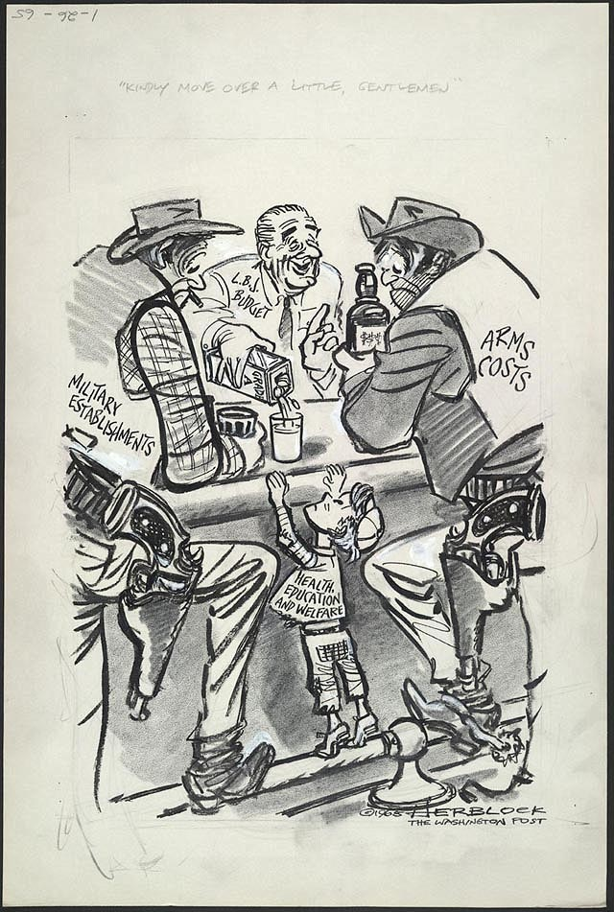
War on Poverty
The Other America (Harrington, 1962)
Office of Economic Opportunity (1964)
  Head Start, Job Corps
Costs:
  Social/welfare programs
  Vietnam…
Notes:
Criticism: http://vicepresidents.com/blog/2012/10/10/historic-lyndon-b-johnson-political-cartoon/

Slide 10
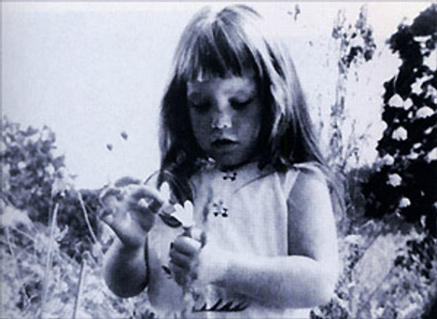
Election of 1964
Johnson vs. Goldwater
  Expansion vs. Ending Welfare State
  Impact of Campaign Ads
Results:
  Johnson: 61% of pop.
  Democratic sweep of Congress (filibuster-proof Senate)
Notes:
Daisy Girl Image: http://theinspirationroom.com/daily/2008/lyndon-johnson-picks-a-daisy/
Link to Campaign Ad: http://www.livingroomcandidate.org/commercials/1964/peace-little-girl-daisy#3983

Slide 11
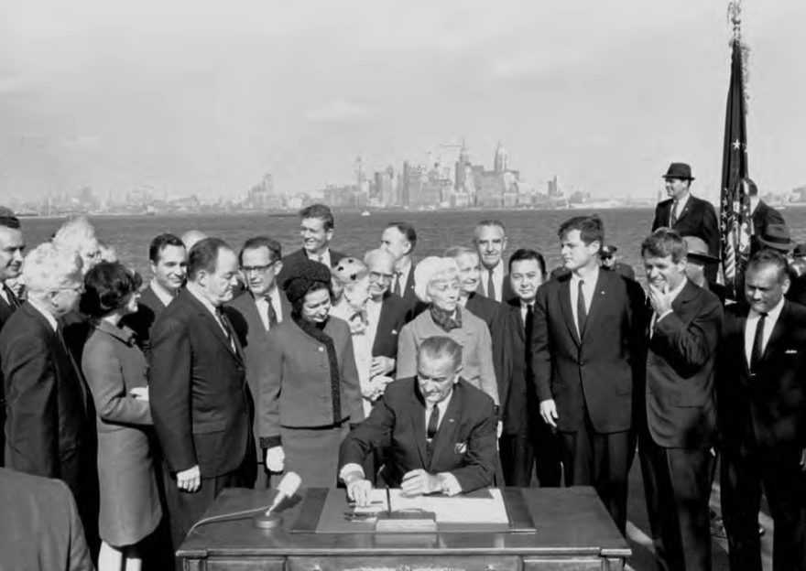
Great Society Reforms
Welfare
  Food Stamp Act (1964)
  Medicare & Medicaid (1965)
  Child Nutrition Act (1966)
Other Programs
  ESEA (1965)
  Immigration Act (1965)
Expanding Government
  DOT
  HUD
Notes:
Johnson Signs Immigration Act of 1965 on Ellis Island: http://immigrationinamerica.org/594-immigration-and-nationality-act-of-1965.html
Note Humphrey (L) and Edward and Robert Keenedy (R)

Slide 12
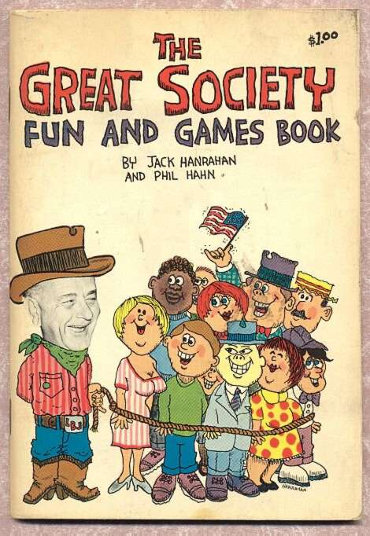
Evaluating the Great Society
Liberal Perspective
  Foundation of welfare
  Addressed needs of previously ignored groups:
    Poor, disabled, elderly
Conservative Perspective
  “tax and spend”
  Birth of modern welfare state
  Overexpansion of government
Notes:
Image: http://tomatobubble.com/id378.html

Slide 13
Civil Rights and Conflict
The Movement Expands

Slide 14
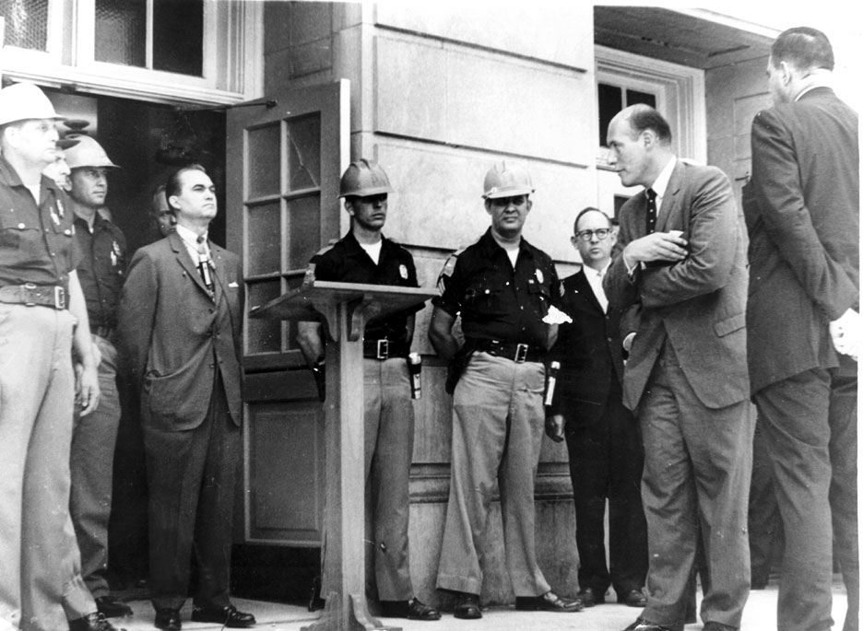
Events
De Jure vs. De Facto Segregation
Alabama & Mississippi
  State vs. Federal Government
  James Meredith & Ole Miss (1962)
  George Wallace & University of Alabama (1963)
Notes:
Wallace @ Alabama: http://www.alabamacivilrights.ua.edu/tuscaloosa/album.html

Slide 15
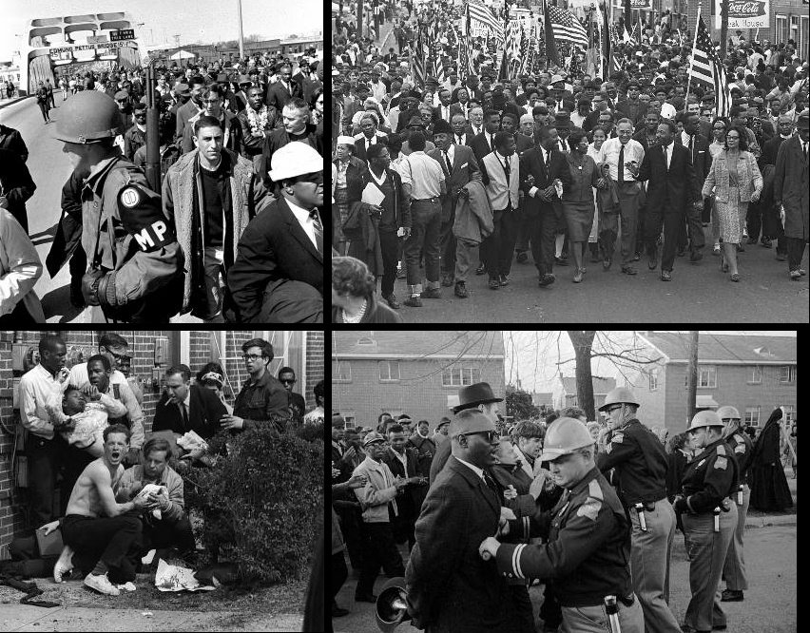
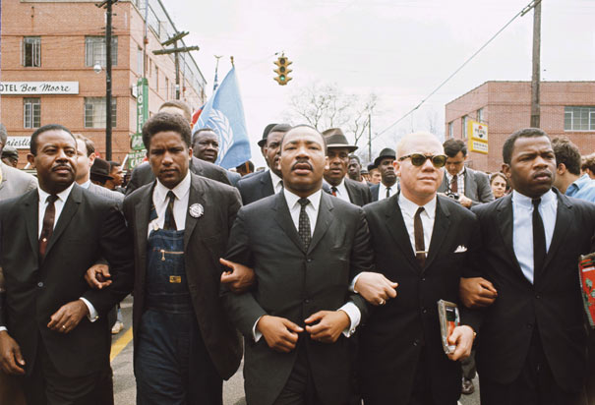
The Leadership of MLK Jr.
Letters from a Birmingham Jail (1963)
March on Washington (1963)
  “I Have a Dream”
March to Montgomery (1965)
  Selma & “Bloody Sunday”
Notes:
Image 1, Selma: http://www.history.com/photos/martin-luther-king-jr/photo8
Image 2, Bloody Sunday: https://www.remember.com/memories/selma-to-montgomery-march-(bloody-sunday-1965)/10002841

Slide 16
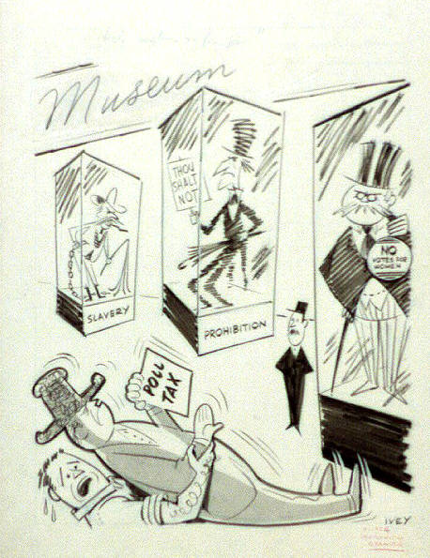
Legislation
Civil Rights Act of 1964
  Segregation illegal in public facilities
  EEOC
    No discrimination based on:
      Race, religion, sex, or national origin
24th Amendment (1964)
Voting Rights Act of 1965
  Banned literacy tests
  Federal marshals enforce voting rights
Notes:
Cartoon: http://www.americaslibrary.gov/jb/modern/jb_modern_polltax_1_e.html

Slide 17
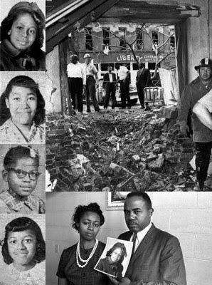
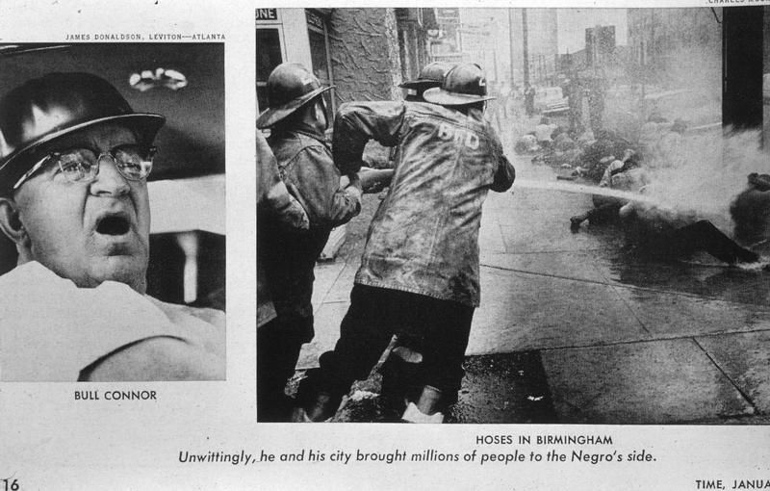
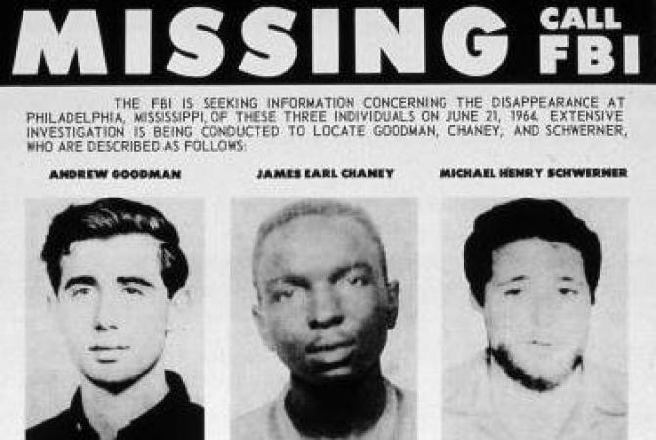
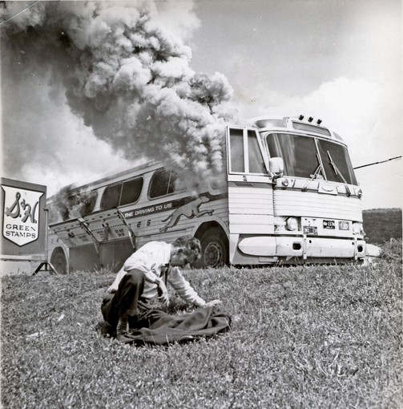
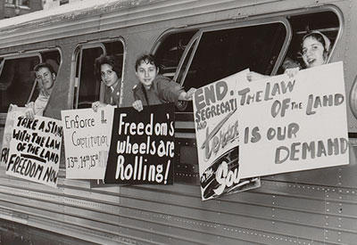
Other Events
Freedom Rides (1962)
SNCC Voter Registration Drives (1963)
Medgar Evers (1963)
Birmingham & “Bull” Connor
16th Street Baptist Church (1963)
Freedom Summer (1964)
  “Mississippi Burning”
  Goodwin, Schwerner, and Cheney
Notes:
Image 1, Freedom Riders: http://mdah.state.ms.us/freedom/
Image 2, Freedom Ride Bus: http://articles.latimes.com/2011/apr/24/travel/la-tr-freedomriders-20110424
Image 3, Bull Connor: http://rhodescivilrights.wikispaces.com/Bull+Connor's+Birmingham
Image 4, “Four Little Girls”: http://2.bp.blogspot.com/-0OKj1fweZNA/UjWuipmGIUI/AAAAAAAABtg/cqsOY-ciq1o/s400/4girls2.jpg
Image 5, Goodman, Schwerner, Cheney: http://www.theroot.com/articles/culture/2014/06/freedom_summer_remembering_those_who_died_for_democracy.html

Slide 18
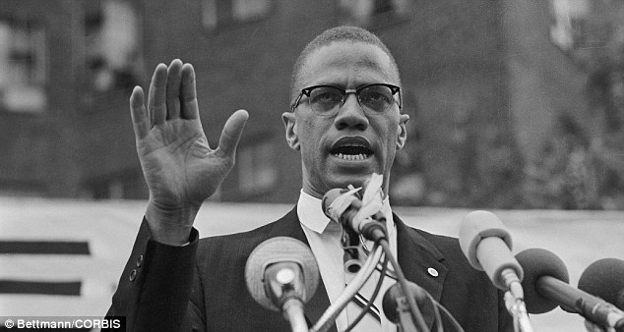
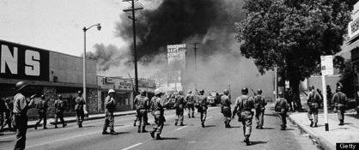
Radical Movement
Black Muslims and the Nation of Islam
  Elijah Muhammed
Malcolm X
  The “Ballot or the Bullet”
Race Riots and Black Power
  SNCC & CORE
    Stokely Carmichael
  Black Panthers
    Huey Newton
  Watts Riots (1965)
Notes:
Malcolm X: http://www.dailymail.co.uk/news/article-2329045/Malcolm-Xs-grandson-Malcolm-Shabazz-buried-NY-cemetery.html
Watts Riots: http://www.huffingtonpost.com/2013/06/23/rena-price-dead-woman-whose-arrest-triggers-watts-riots_n_3486647.html

Slide 19
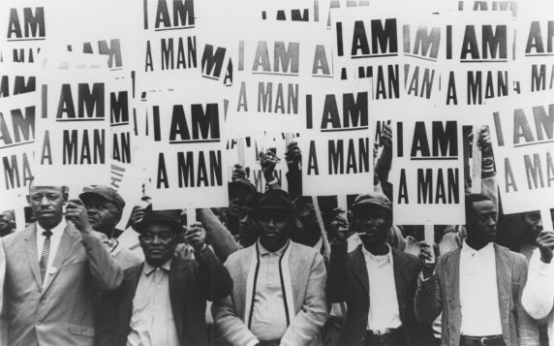
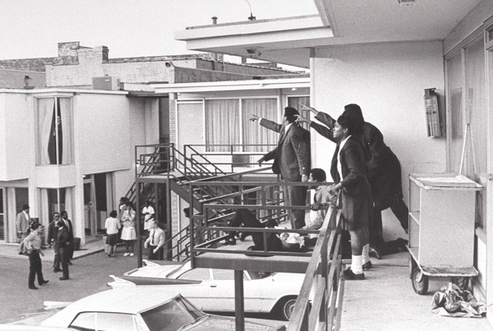
Murder in Memphis
King receives Nobel Prize (1964)
  Nonviolence comes under fire
Memphis Garbage Workers’ Strike (1968)
King’s Mountaintop Speech
Lorraine Motel (April 4, 1968)
Ensuing Violence and Riots
Notes:
Memphis Strike: http://www.lawyersgunsmoneyblog.com/2012/04/this-day-in-labor-history-april-4-1968
Lorraine Motel: http://midliferoadtrip.tv/the-national-civil-rights-museum/

Slide 20
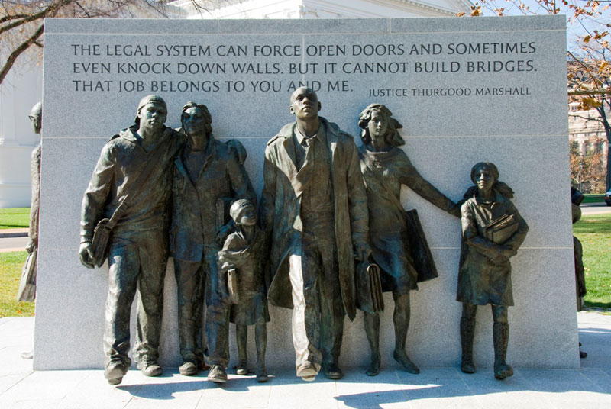
Impact of Civil Rights Movement
Achieved Federal Legislation
Racism Continues
w/King’s Death, Movement becomes more radical/violent and begins to lose support
Movement Became model for other social movements:
  Combatting Social Injustice
  Student Movements of the Vietnam-Era
Notes:
Virginia Civil Rights Memorial: http://www.virginiamemory.com/online_classroom/shaping_the_constitution/doc/virginia_civil_rights_memorial

Slide 21
Social, Cultural, and Political Unrest
The Changing Roles and Views of American Government and Society During the 1960’s

Slide 22
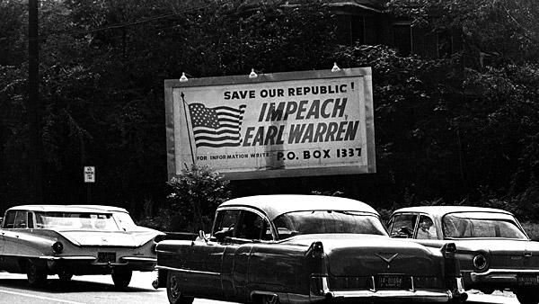
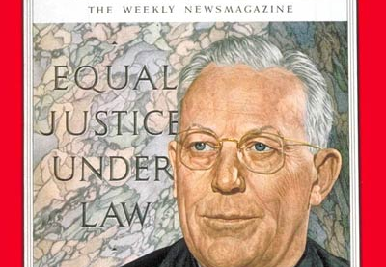
The Warren Court
Focus on Individual Rights
Criminal Justice
  Mapp v. Ohio (1961)
  Gideon v. Wainwright (1963)
  Escobedo v. Illinois (1964)
  Miranda v. Arizona (1966)
Reapportionment
  Baker v. Carr (1962) & Wesberry v. Sanders (1964)
Freedom of Expression & Privacy
  Yates (1957) & Brandenburg (1969)
  Engel v. Vitale (1962)
  Griswold v. Connecticut (1965)
Notes:
Time Magazine Cover, 1953: http://content.time.com/time/covers/0,16641,19531221,00.html
Billboard: http://www.latimes.com/news/mlk_j69oh8nc-photo.html

Slide 23
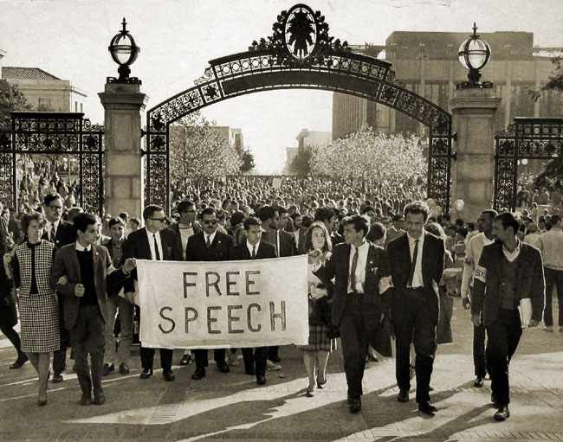
The Student Protest Movement
SDS & The Port Huron Statement (1962)
  The “New Left”
  Tom Hayden
  Weather Underground (1969)
Free Speech Movement
  Berkeley, CA (1964)
  Mario Savio
The Vietnam War and the Teach-in Movement
Notes:
Free Speech Movement, Savio, and Berkeley: http://www.lib.berkeley.edu/MRC/FSM/fsmchronology1.html

Slide 24
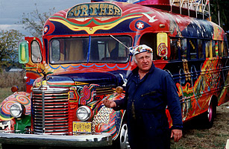
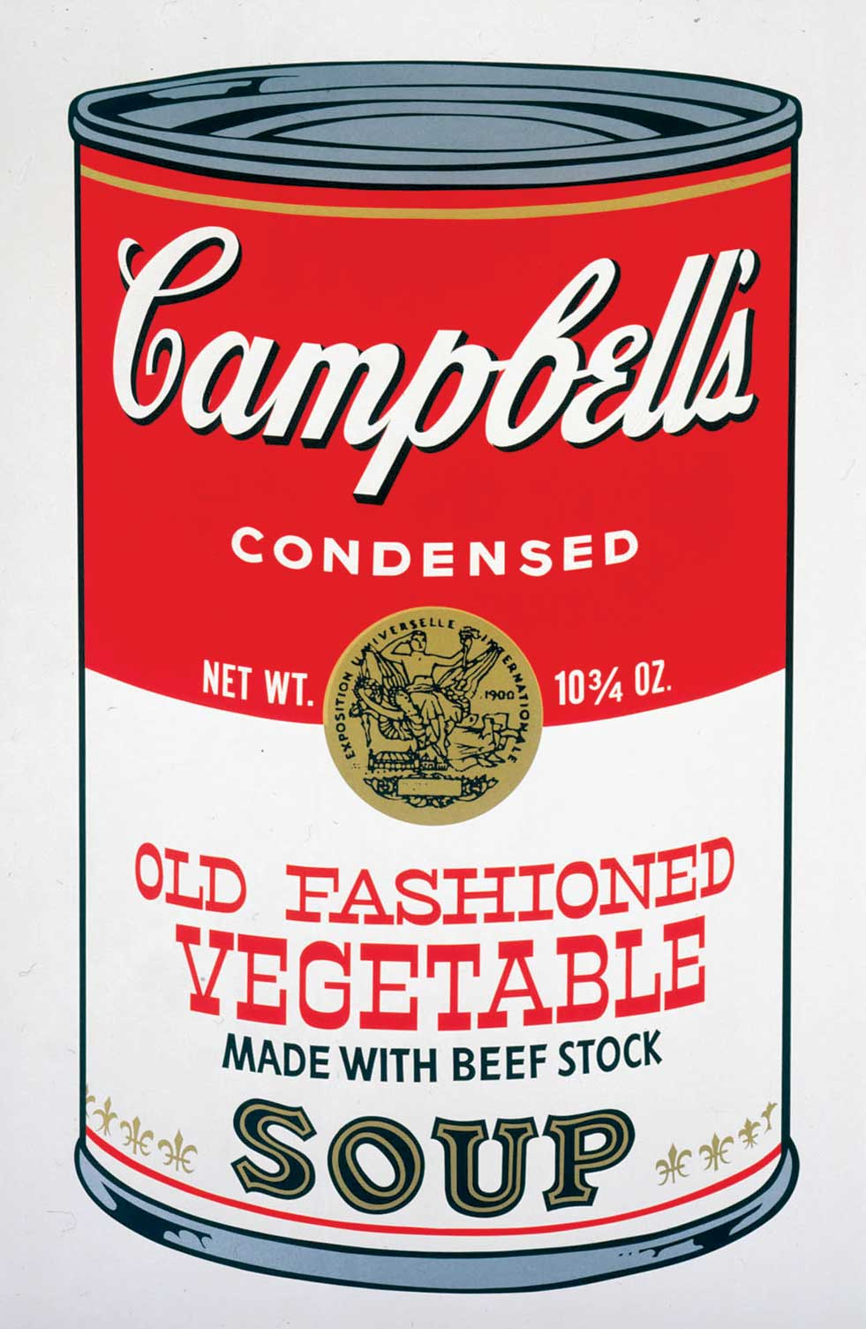
The Counterculture
Art
  Pop Art & Op Art
    Andy Warhol
Literature
  Ken Kesey
  Tom Wolfe
Music
  Woodstock & Altamont
    Joan Baez, Bob Dylan, Janis Joplin
Hallucinogenic Drugs
  LSD
Sexual Revolution
Notes:
Warhol: http://artasiapacific.com/Magazine/82/TheLittleCanThatCould
Ken Kesey: http://content.time.com/time/specials/packages/article/0,28804,2088972_2088978_2088962,00.html

Slide 25
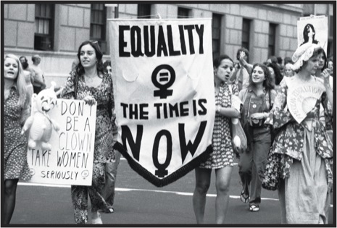
The Women’s Movement
The Feminine Mystique (Friedan, 1963)
NOW (1966)
Campaign for ERA
  Passage, not ratification (1972)
  Phyllis Schlafly
“Glass-ceiling”
Notes:
NOW: https://sites.google.com/a/peddie.org/60s-e-period-2012/fighting-for-our-rights/the-women-s-rights-movement

Slide 26
The Conflict in Vietnam
US Involvement in Indochina to 1969

Slide 27
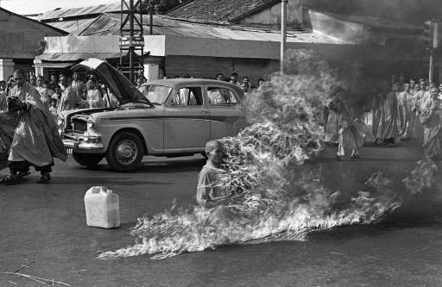
Early Stages
Buildup Under Kennedy
  “Strategic Hamlets”
  Overthrow of Diem
Gulf of Tonkin Resolution (1964)
  “all necessary measures”
Notes:
Self-immolation in protest to Diem’s gov’t: http://en.wikipedia.org/wiki/Th%C3%ADch_Quảng_Đức

Slide 28
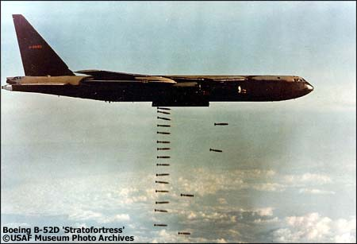
Escalating the War
Operation Rolling Thunder (1965)
  NVA & Vietcong
540,000 troops by 1969
  William Westmoreland
Chemical Warfare
  Napalm & Agent Orange
Controversy
  Hawks vs. Doves
    Dean Rusk & Robert McNamara
    Impact of Student Protest Movement
    Rise of Eugene McCarthy
Notes:
Operation Rolling Thunder: http://vietnamwarproject1961-1969.wikispaces.com/Operation+Rolling+Thunder

Slide 29
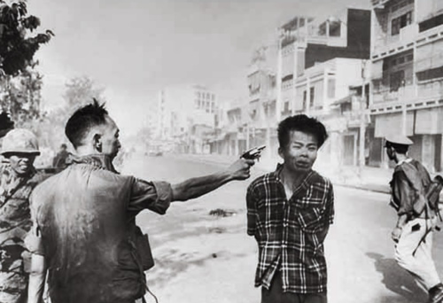
1968
Tet Offensive (January)
  Kronkite’s “Stalemate” (February)
  My Lai Massacre (March)
De-escalation & Attempts at Peace in Vietnam
MLK (April) and RFK’s (June) Assassinations
Prague Spring (August)
Notes:
Kronkite’s Stalemate Speech: https://facultystaff.richmond.edu/~ebolt/history398/cronkite_1968.html
Execution of Vietcong Guerilla: http://www.worldsfamousphotos.com/2007/03/18/execution-of-a-viet-cong-guerrilla-1968/

Slide 30
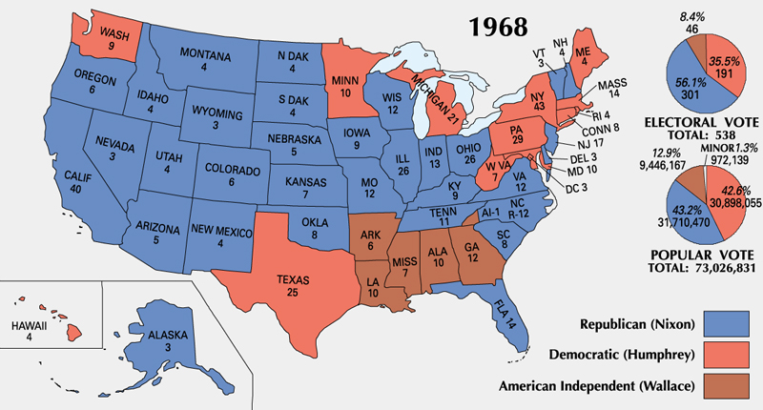
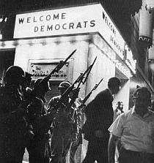
Election of 1968
Democratic Convention in Chicago
  Richard Daley
  Rioting
  Dems choose Humphrey (pro-Civil Rights, pro-War)
White Backlash & George Wallace
  American Independent Party (AIP)
Republicans
  Richard Nixon & Spiro T. Agnew
Results:
  Conservative backlash
  Nixon 301 to 191
Notes:
National Convention: http://www.pophistorydig.com/topics/1968-presidential-racedemocrats/

Slide 31
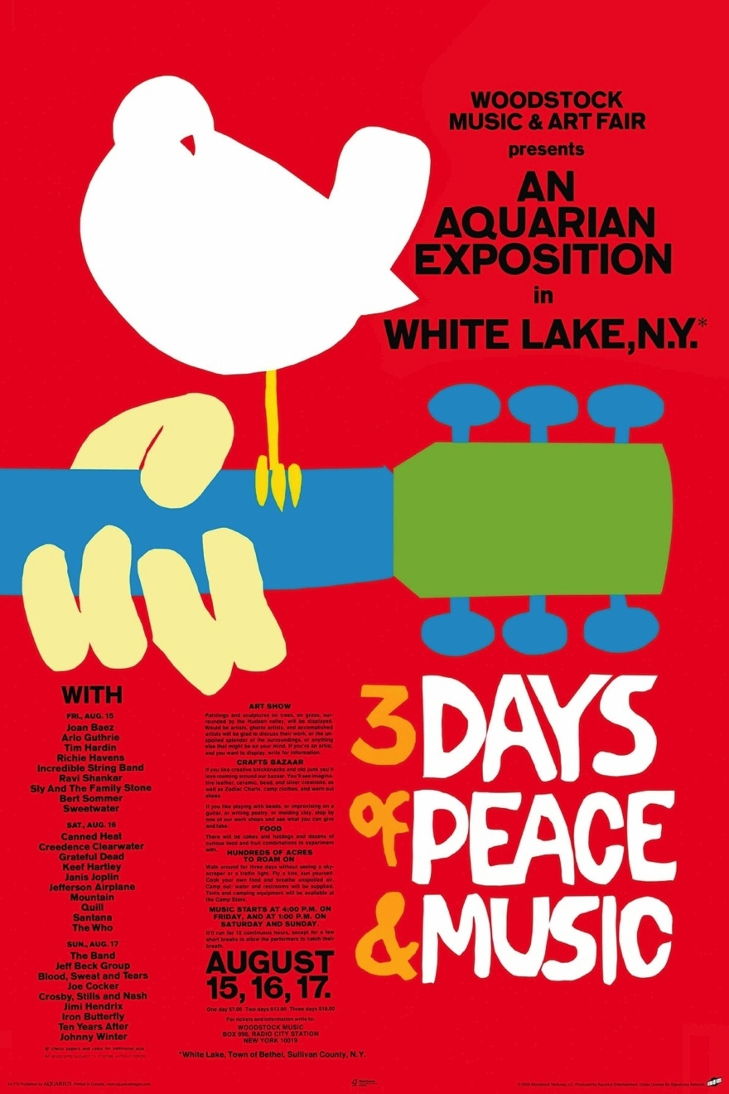
Legacy of the 1960’s
Reaction to 1950’s
  Liberal movements
  Counterculture
Expansion of Civil Rights
Growth of Government
  Welfare
  Defense/Military
Notes:
Woodstock Poster: http://ecx.images-amazon.com/images/I/81ryzsl8ssL._SL1500_.jpg

