Slide 1
Foreign Policy The 1980s

Slide 2
Reagan & Foreign Policy

Slide 3
Reagan & Foreign Policy
Reagan was committed to restoring America’s supremacy in the world
  Blamed Carter for allowing U.S. prestige to drop to an all-time low
  Increased military spending
  Confronted challenges in the Middle East & in Latin America
  Ended the Cold War with the Soviet Union

Slide 4
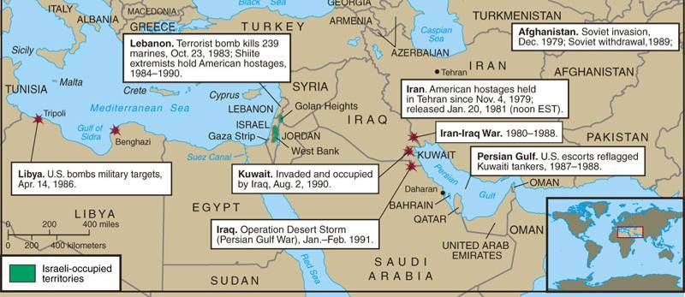
Trouble Spots in the Middle East under Reagan & Bush, 1980-1991
In 1982, Reagan sent Marines to help evacuate Lebanon during an Israeli attack on PLO bases
Marines were seen as the enemy & 239 were killed when attacked by a suicide bombing
Reagan was concerned that the Palestinian Liberation Org (PLO) would threaten the Camp David accords
In 1983, the terrorist group Hezbollah captured 6 American hostages
Reagan gave the order to withdraw from Lebanon in 1984

Slide 5
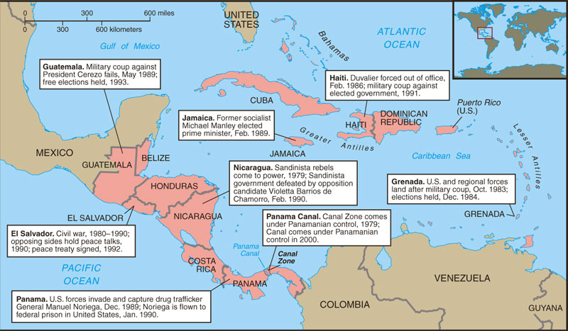
Trouble Spots in Latin America
Reagan attempted to resist Communism in Latin America
U.S. Marines invaded Grenada in 1983 to keep a radical regime from turning over an airfield to Cuba or the USSR
In 1979, Nicaraguan Sandinista rebels led a coup against a U.S.-backed regime
In 1983, Congress denied Reagan’s request to aid Nicaraguan efforts to overthrow the Sandinista gov’t (Contras)

Slide 6
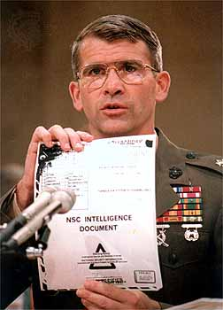
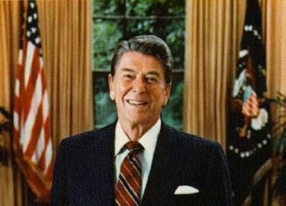
The Iran-Contra Affair
In 1987, the Iran-Contra Affair rocked the Reagan administration:
  To free 6 U.S. hostages in Iran, the NSC & CIA covertly sold missiles to Khomeini’s gov’t
  Profits from missile sales were used to aid Nicaragua Contras
Reagan avoided implication through “plausible deniability”
The “Teflon President”
The “Teflon president”

Slide 7
Challenging the "Evil Empire"
Reagan viewed the USSR as the "focus of evil in the modern world” & as a threat to U.S. security
Maintained a hard-line approach
  Sent 572 nukes within range of Moscow to match USSR ICBMs aimed at NATO nations
  Began the Strategic Defense Initiative, an anti-missile laser system in space to defend U.S.
SDI was dubbed the “Star Wars” program
“Soviet-sponsored guerillas & terrorists are at work in Central & South America, in Africa, the Middle East, in the Caribbean, & in Europe, violating human rights & unnerving the world with violence.”

Slide 8
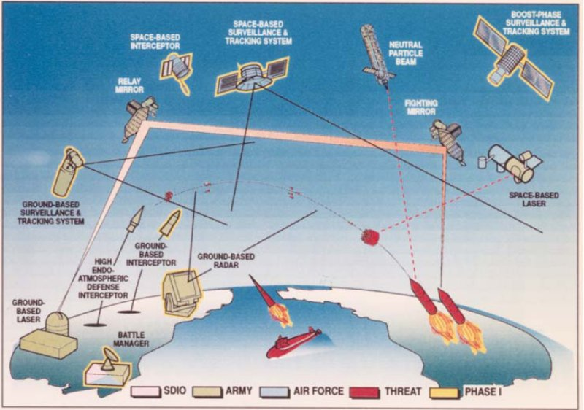

Slide 9
Ending the Cold War
Introducing moderate capitalism into the Soviet economy such as legalization of small private business cooperatives, relaxed laws prohibiting land ownership, & approval of foreign investment within the USSR
Gorbachev cut the Soviet defense budget, withdrew Soviet troops from Afghanistan, & promoted the democratization of former satellite nations in Eastern Europe
Reagan’s most important foreign policy triumph was working with new USSR leader Mikhail Gorbachev to end the Cold War:
  In 1985, Mikhail Gorbachev began perestroika & glasnost & eased Cold War tensions
  The Reagan-Gorbachev summits from 1986 to 1988 led to a reduction of nuclear arms
“Political openness” led to freedom of press, assembly, travel, & religion; the 1st working legislature; the 1st competitive elections; & liberation of hundreds of political prisoners
Notes:
In 1982, 75-year-old Soviet party leader Leonid Brezhnev died. Growing stagnation, corruption, and a huge military buildup had marked his regime. Initially, the post-Brezhnev era seemed to offer little change in U.S.-Soviet relations. KGB leader Yuri Andropov succeeded Brezhnev, but died after only 15 months in power. Another Brezhnev loyalist, Konstantin Chernenko, who died just a year later, replaced him. In 1985, Soviet party leadership passed to Mikhail S. Gorbachev, a 54-year-old agricultural specialist with little formal experience in foreign affairs. Gorbachev pledged to continue the policies of his predecessors.
Within weeks, however, Gorbachev called for sweeping political liberalization (glasnost) and economic reform (perestroika). He allowed wider freedom of press, assembly, travel, and religion. He persuaded the Communist party leadership to end its monopoly on power; created the Soviet Union's first working legislature; allowed the first nationwide competitive elections in 1989; and freed hundreds of political prisoners. In an effort to boost the sagging Soviet economy, he legalized small private business cooperatives, relaxed laws prohibiting land ownership, and approved foreign investment within the Soviet Union.
In foreign affairs, Gorbachev completely reshaped world politics. He cut the Soviet defense budget, withdrew Soviet troops from Afghanistan and Eastern Europe, allowed a unified Germany to become a member of NATO, and agreed with the United States to destroy short-range and medium-range nuclear weapons. Most dramatically, Gorbachev actively promoted the democratization of former satellite nations in Eastern Europe. For his accomplishments in defusing Cold War tensions, he was awarded the 1990 Nobel Peace Prize.

Slide 10
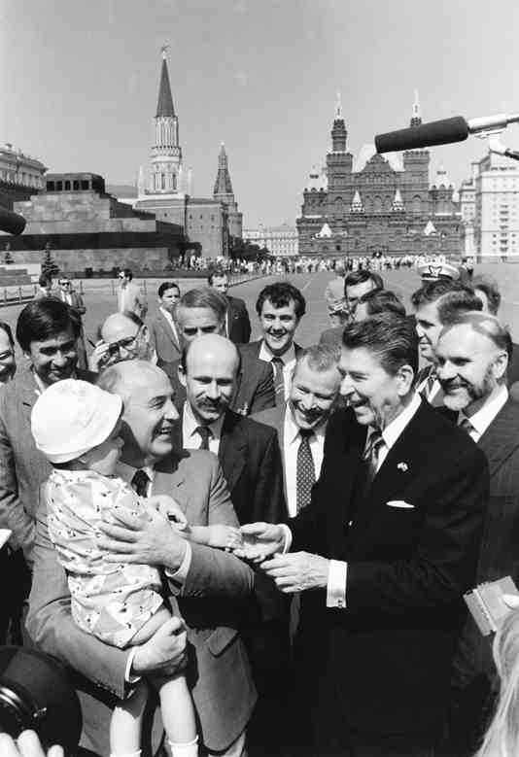
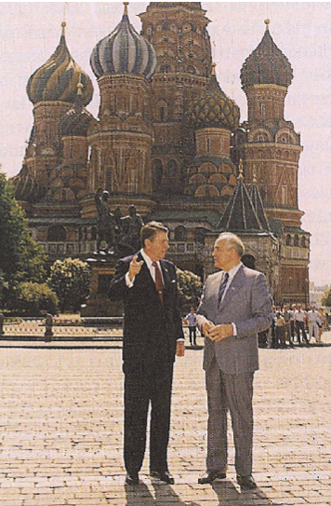
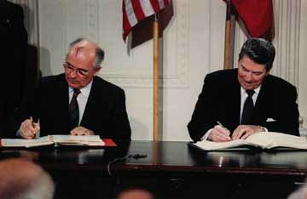
In 1987, Reagan & Gorbachev signed the INF Treaty eliminating ICBMs in Europe

Slide 11
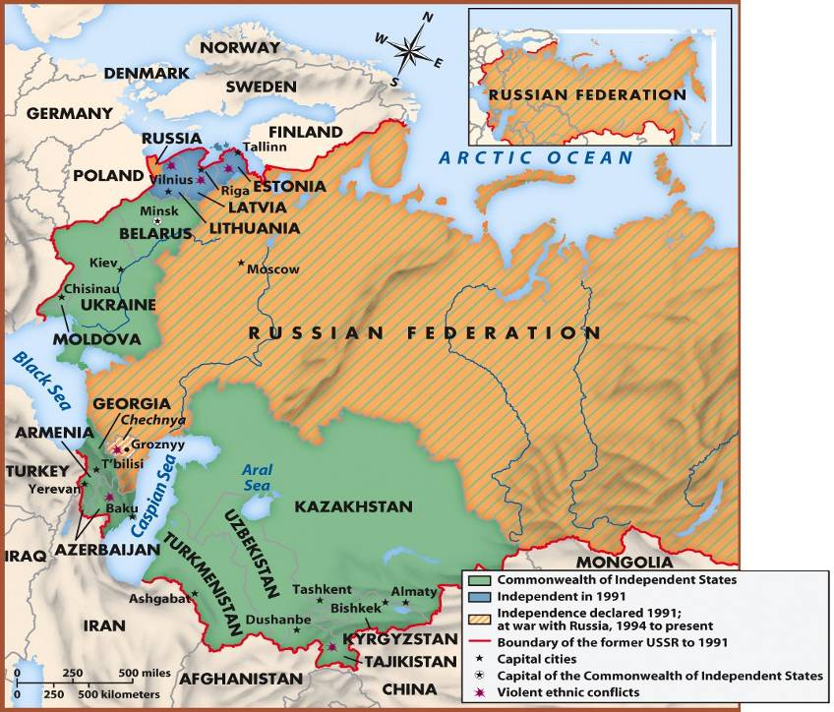
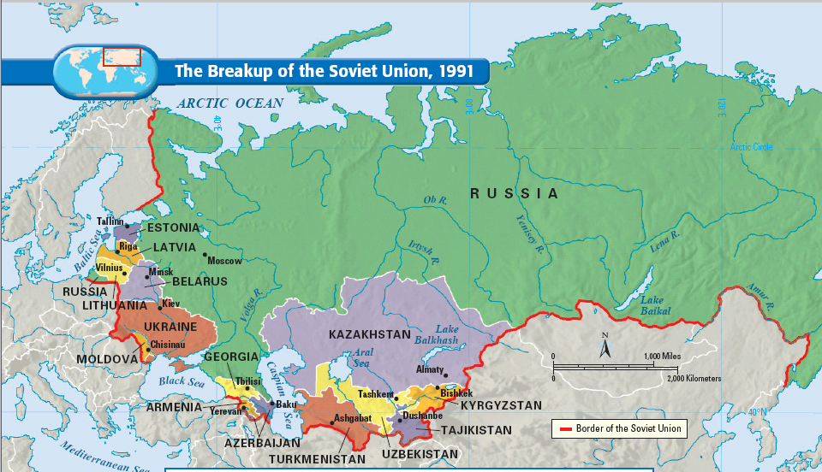
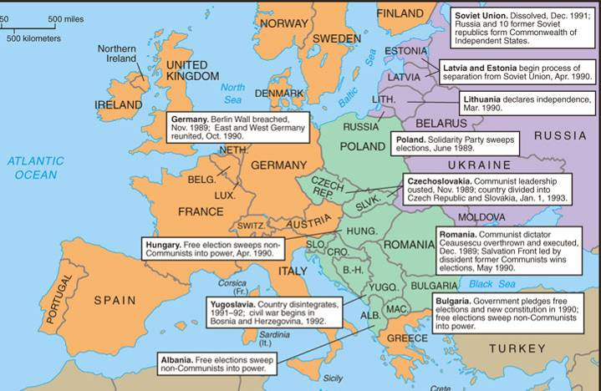
The End of the Cold War
In 1989, Gorbachev’s promotion of democratization in Eastern Europe inspired the overthrow of 40 years of communist rule
Countries of the former USSR by 2000
In 1990, following the example of Eastern Europe, many Soviet republics within the USSR demanded independence, leading to…
Notes:
For 40 years, Communist Party leaders in Eastern Europe had ruled confidently. Each year their countries fell further behind the West; yet, they remained secure in the knowledge that the Soviet Union, backed by the Red Army, would always send in the tanks when the forces for change became too great. But they had not bargained on a liberal Soviet leader like Mikhail Gorbachev.
As Gorbachev moved toward reform within the Soviet Union and détente with the West, he pushed the conservative regimes of Eastern Europe outside his protective umbrella. By the end of 1989, the Berlin Wall had been smashed. All across Eastern Europe, citizens took to the streets, overthrowing 40 years of Communist rule. Like a series of falling dominos, Communist parties in Poland, East Germany, Hungary, Czechoslovakia, Romania, and Bulgaria fell from power.
Gorbachev, who had wanted to reform communism, may not have anticipated the swift swing toward democracy in Eastern Europe. Nor had he fully foreseen the impact that democracy in Eastern Europe would have on the Soviet Union. By 1990, leaders of several Soviet republics began to demand independence or greater autonomy within the Soviet Union.
Gorbachev had to balance the growing demand for radical political change within the Soviet Union with the demand by Communist hardliners. The hardliners demanded that he contain the new democratic currents and turn back the clock. Faced with dangerous political opposition from the right and the left and with economic failure throughout the Soviet Union, Gorbachev tried to satisfy everyone and, in the process, satisfied no one.
In 1990, following the example of Eastern Europe, the three Baltic states of Lithuania, Latvia, and Estonia announced their independence, and other Soviet republics demanded greater sovereignty. Nine of the 15 Soviet republics agreed to sign a new union treaty, granting far greater freedom and autonomy to individual republics. But in August 1991, before the treaty could be signed, conservative Communists tried to oust Gorbachev in a coup d'etat. Boris Yeltsin, the President of the Russian Republic, and his supporters defeated the coup, undermining support for the Communist Party. Gorbachev fell from power. The Soviet Union ended its existence in December 1991, when Russia and most other republics formed the Commonwealth of Independent States.

Slide 12
Passing the Torch to George Bush
Notes:
Bush video 7:00 minutes

Slide 13
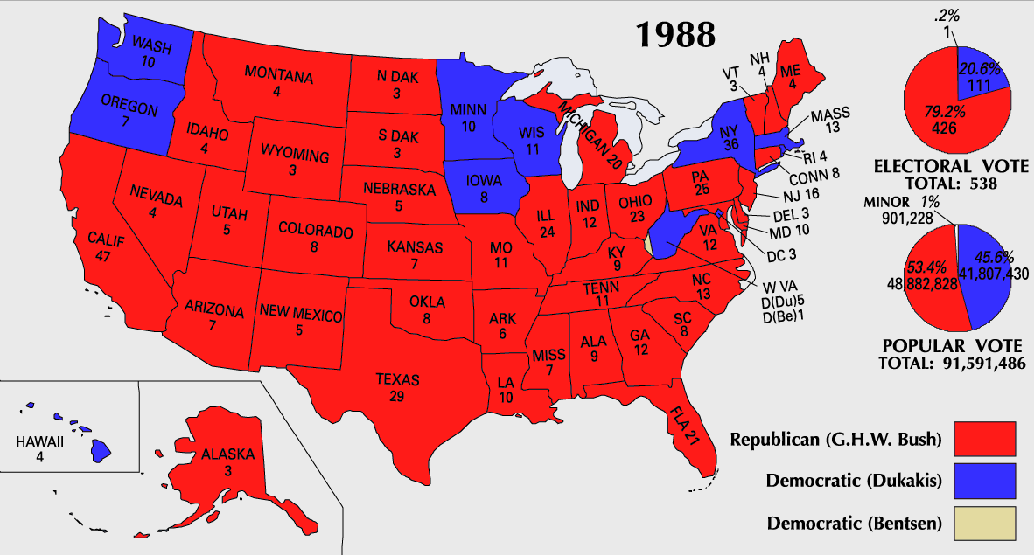
Reagan’s Successor: George Bush
Reagan’s successor was George Bush who promised voters in 1988 a “kindler, gentler nation”
  Bush kept most of Reagan’s domestic agenda but added few policies of his own
  Bush had great foreign policy experience before becoming president which he needed to win the Persian Gulf War
Especially the war on drugs
Former envoy to China
Former director of the CIA
Former UN ambassador
Two-term VP under Reagan

Slide 14
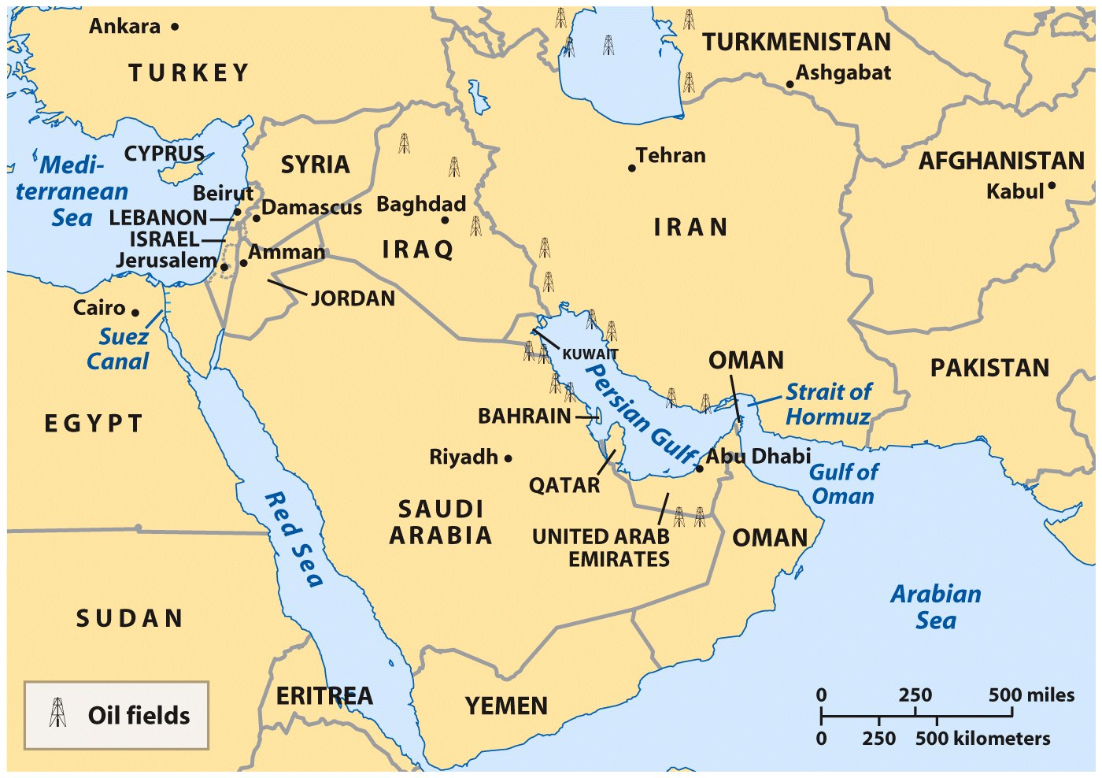
The Persian Gulf War, 1991
In 1990, Saddam Hussein ordered an Iraqi invasion of oil-rich Kuwait
The U.S. feared a subsequent invasion of ally Saudi Arabia
The U.S. forged an international coalition against Iraq & the UN imposed economic sanctions on Iraq
Notes:
At 2 a.m., August 2, 1990, some 80,000 Iraqi troops invaded and occupied Kuwait, a small, oil-rich emirate on the Persian Gulf. This event touched off the first major international crisis of the post-Cold War era. Iraq's leader, Saddam Hussein, justified the invasion on the grounds that Kuwait, which he accused of intentionally depressing world oil prices, was a historic part of Iraq.
Iraq's invasion caught the United States off guard. The Hussein regime was a brutal military dictatorship that ruled by secret police and used poison gas against Iranians, Kurds, and Shiite Muslims. During the 1970s and 1980s, the United States--and Britain, France, the Soviet Union, and West Germany--sold Iraq an awesome arsenal that included missiles, tanks, and the equipment needed to produce biological, chemical, and nuclear weapons. During Baghdad's eight-year-long war with Iran, the United States, which opposed the growth of Muslim fundamentalist extremism, tilted toward Iraq.
On August 6, 1990, President Bush dramatically declared, "This aggression will not stand." With Iraqi forces poised near the Saudi Arabian border, the Bush administration dispatched 180,000 troops to protect the Saudi kingdom. In a sharp departure from American foreign policy during the Reagan presidency, Bush also organized an international coalition against Iraq. He convinced Turkey and Syria to close Iraqi oil pipelines, won Soviet support for an arms embargo, and established a multi-national army to protect Saudi Arabia. In the United Nations, the administration succeeded in persuading the Security Council to adopt a series of resolutions condemning the Iraqi invasion, demanding restoration of the Kuwaiti government, and imposing an economic blockade.
Bush's decision to resist Iraqi aggression reflected the president's assessment of vital national interests. Iraq's invasion gave Saddam Hussein direct control over a significant portion of the world's oil supply. It disrupted the Middle East balance of power and placed Saudi Arabia and the Persian Gulf emirates in jeopardy. Iraq's 545,000-man army threatened the security of such valuable U.S. allies as Egypt and Israel.
In November 1990, the crisis took a dramatic turn. President Bush doubled the size of American forces deployed in the Persian Gulf, a sign that the administration was prepared to eject Iraq from Kuwait by force. The president went to the United Nations for a resolution permitting the use of force against Iraq if it did not withdraw by January 15, 1991. After a heated debate, Congress also gave the president authority to wage war.
President Bush's decision to liberate Kuwait was an enormous political and military gamble. The Iraqi army, the world's fourth largest, was equipped with Exocet missiles, top-of-the-line Soviet T-72 tanks, and long-range artillery capable of firing nerve gas. But after a month of allied bombing, the coalition forces had achieved air supremacy; had destroyed thousands of Iraqi tanks and artillery pieces, supply routes and communications lines, and command-and-control bunkers; plus, had limited Iraq's ability to produce nuclear, chemical, and biological weapons. Iraqi troop morale suffered so badly under the bombing that an estimated 30 percent of Baghdad's forces deserted before the ground campaign started.
The allied ground campaign relied on deception, mobility, and overwhelming air superiority to defeat the larger Iraqi army. The allied strategy was to mislead the Iraqis into believing that the allied attack would occur along the Kuwaiti coastline and Kuwait's border with Saudi Arabia. Meanwhile, General H. Norman Schwarzkopf, American commander of the coalition forces, shifted more than 300,000 American, British, and French troops into western Saudi Arabia, allowing them to strike deep into Iraq. Only 100 hours after the ground campaign started, the war ended. Saddam Hussein remained in power, but his ability to control events in the region was dramatically curtailed. The Persian Gulf conflict was the most popular U.S. war since World War II. It restored American confidence in its position as the world's sole superpower and helped to exorcise the ghost of Vietnam that had haunted American foreign policy debates for nearly two decades. The doubt, drift, and demoralization that began with the Vietnam War and the Watergate scandal appeared to have ended.

Slide 15
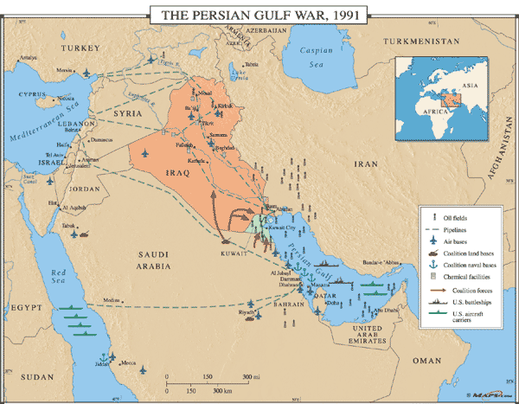
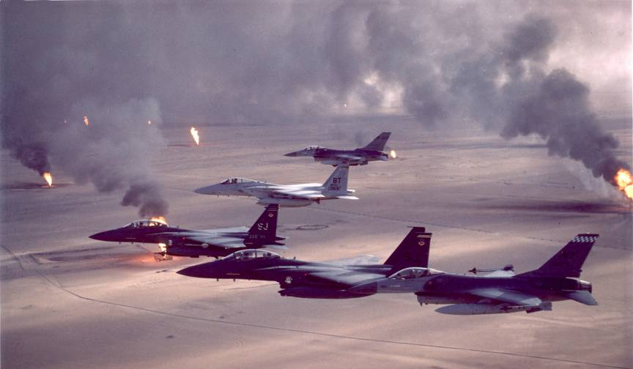
In 1991, Bush gained approval from Congress to begin Operation Desert Storm & removed Iraqi forces in Kuwait in 100 hours

Slide 16
The Persian Gulf War
U.S. success in Iraqi led Bush to declare a “new world order” & saw his approval ratings soar to 90%
But…
  Hussein was not removed from power & economic sanction did little to weaken his rule
  American troops in Saudi Arabia led to increased anti-American sentiment & the rise of Al Qaeda under Osama bin Laden
From 1980 to 2000, the U.S. engaged in 17 distinct military operations in the Middle East

Slide 17
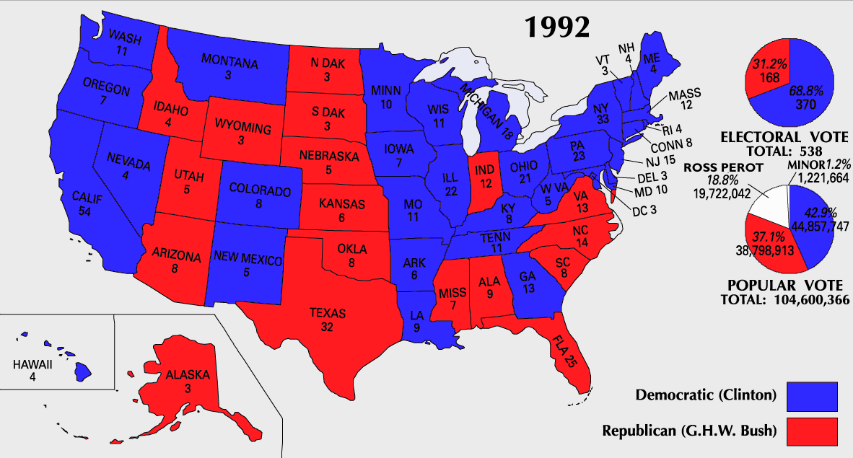
The Election of 1992
Despite voter approval of his handling of Iraq, Bush’s real problem was the economy:
  The massive federal deficit & downward trend in the stock market led to a 1989 recession
  Bush cut military spending & broke a 1988 campaign promise not to raise taxes
By 1992, Clinton took advantage of the economic recession & won
“It’s the economy, stupid”

Slide 18
Conclusions:
The Success of Neoconservativism?

Slide 19
Conclusions
Reagan was the 1st president to serve 2 full terms since Eisenhower
  Reagan’s supporters claim he restored the economy, military, patriotism, family values, & America’s place as a world power
  Reagan’s detractors claim he removed social safety-nets, skirted Congress in foreign policy, & tripled the national debt
Notes:
In the presidential election of 1984, Ronald Reagan and Vice President George Bush won in a landslide over Walter Mondale and Geraldine Ferraro. Ferraro was the first woman nominated for vice president on a major party ticket. Although Reagan's second term was plagued by the Iran-Contra scandal, he left office after eight years more popular than when he arrived. He could claim the distinction of being the first president to serve two full terms since Dwight Eisenhower.
Ronald Reagan could also point to an extraordinary string of accomplishments. He dampened inflation, restored public confidence in government, and presided over the beginning of the end of the Cold War. He doubled the defense budget, named the first woman to the Supreme Court, launched a strong economic boom, and created a heightened sense of national unity. In addition, his supporters said that he restored vigor to the national economy and psyche, rebuilt America's military might, regained the nation's place as the world's preeminent power, restored American patriotism, and championed traditional family values.
On the other hand, his detractors criticized him for a reckless use of military power and for circumventing Congress in foreign affairs. They accused Reagan of fostering greed and intolerance. His critics also charged that his administration, in its zeal to cut waste from government, ripped the social safety net and skimped on the government's regulatory functions. The administration, they further charged, was insensitive on racial issues. Reagan's detractors were particularly concerned about his economic legacy. During the Reagan years, the national debt tripled, from $909 billion to almost $2.9 trillion (the interest alone amounted to 14 percent of the federal budget). The deficit soaked up savings, caused interest rates to rise, and forced the federal government to shift more and more responsibilities onto the states. Corporate and individual debt also soared. During the early 1990s, the American people consumed $1 trillion more goods and services than they produced. The United States also became the world's biggest debtor nation, as a result of a weak dollar, a low level of exports, and the need to borrow abroad to finance budget deficits.

