Slide 1
Transition from Parent to Teacher
Glendale Unified School District

Slide 2
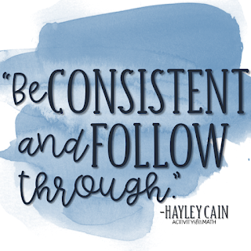
How to be a Teacher
Walk the Talk.
Ensure that your words and actions are consistent.
Believe in Yourself.
Be confident in who you are and what you represent.
Nobody’s Perfect.
Accept responsibility for your mistakes and actions.
Stay Organized.
Try and plan together with your kids an agenda to teach them independence and responsibility.

Slide 3
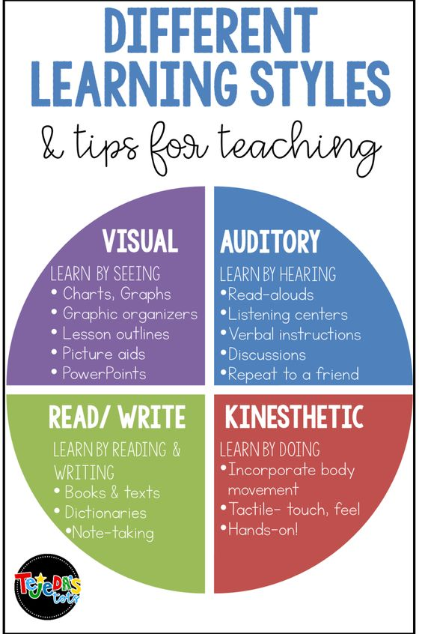
Everyone Learns & Understands Differently
Learn By Seeing
  Charts & Pictures
  Lesson Outline
Learn By Hearing
  Read “Out Loud”
  Repetition
Learn By Reading & Writing
  Note-taking
  Books & Worksheets
Learn By Doing
  Hands-on
  Incorporate body movement.

Slide 4

Stay Engaged
Be actively involved with the completion of their assignments.
  This can look like:
    Creating a To-Do list
    Having an Agenda for the Day
    Use of Timers & Compromise
Try to motivate them with activities of “free time,” after each completed task.
Make yourself available if they need help/have questions!

Slide 5

Use of Timers & Compromise
15 minutes - Assignment #1
  10 minute break (stretch, go for a walk)
20 minutes - Assignment #2
  10 minute break (screentime, activity of their choice)
15 minutes - Assignment #3
  10 minute break (art, journaling)
Questions & going over assignments together
  20 minutes together

Slide 6

Practice Being Mindful
Be present in the “now”
  You have control to predict what your day to day activities look like.
Have faith in yourself.
  Know that you not alone in this process.
  You have the ability to guide your children through this difficult change.

Slide 7
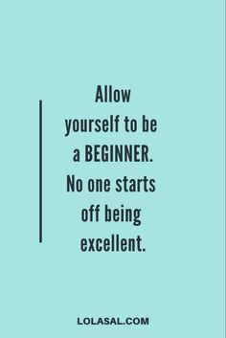
How to Adapt:
Have patience.
All things are difficult before they become easy.
Look at the situation from the child’s perspective.
Take a deep breath.
  Stop what you’re doing and take a few deep breaths. Count to 10 (or 50 if you need to) and slowly breathe in your nose and out your mouth.
Use the distraction technique on yourself.
  When you start to feel that irritation building, distract yourself with something else.
  Redirect the conversation into a different topic.
Notes:
Tools when the parent becomes frustrated

Slide 8
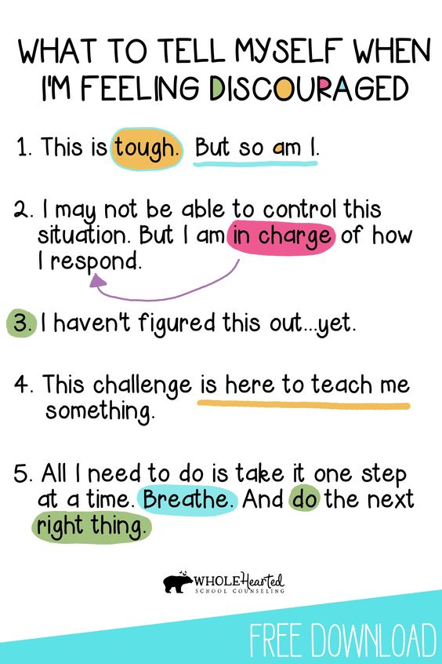
Keep an Open Mind
  Meet your child where they’re at.
  Have sit down talks to gauge how they are adapting to changes.
  Take it one step at a time.

Slide 9
It’s Okay to Not Know Everything!
You’re learning as they’re learning.
  Create a step by step process.
The ability to learn how to expect and accept mistakes is essential.
  There will be a lot of misunderstandings and mistakes. That is OKAY!
Take breaks when needed.
Acknowledge that this change is new and may not be understood or comprehended the same way you do.

Slide 10
Ice Breaker
What has been your experience in the transition from parent to educator?
Share with us something that is working.

