Slide 1
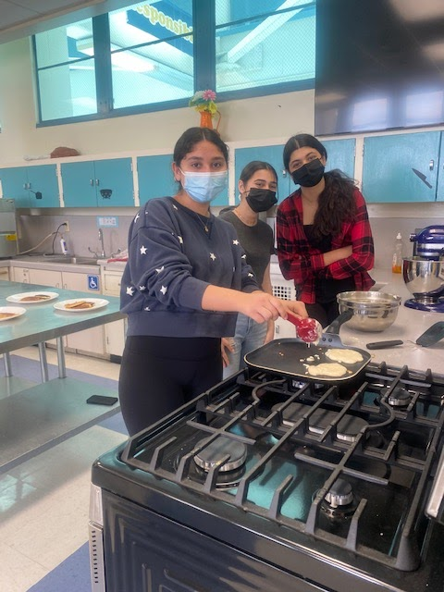
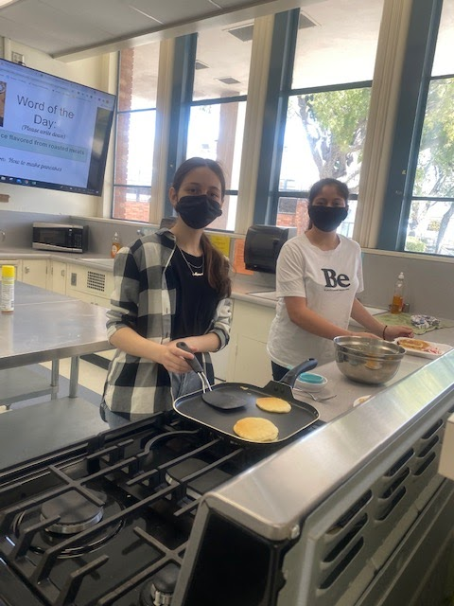
Wilson Culinary Awards Class of 2021

Slide 2

Brings beauty to our space
Amanda

Slide 3
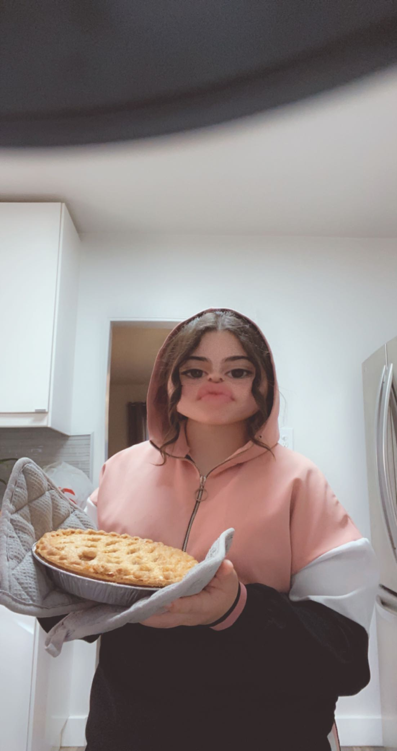
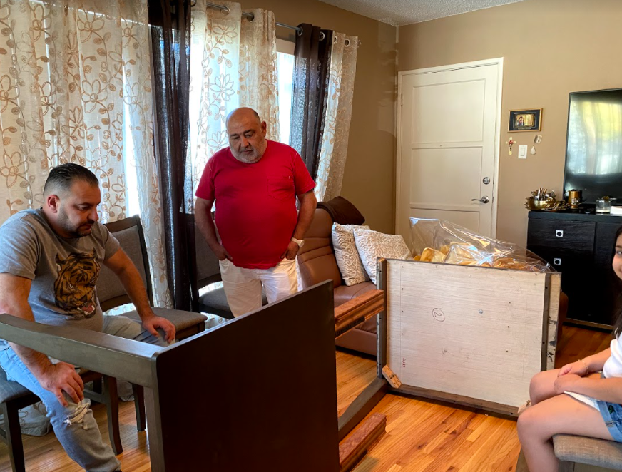
Best Sense of Humor...Victoria

Slide 4

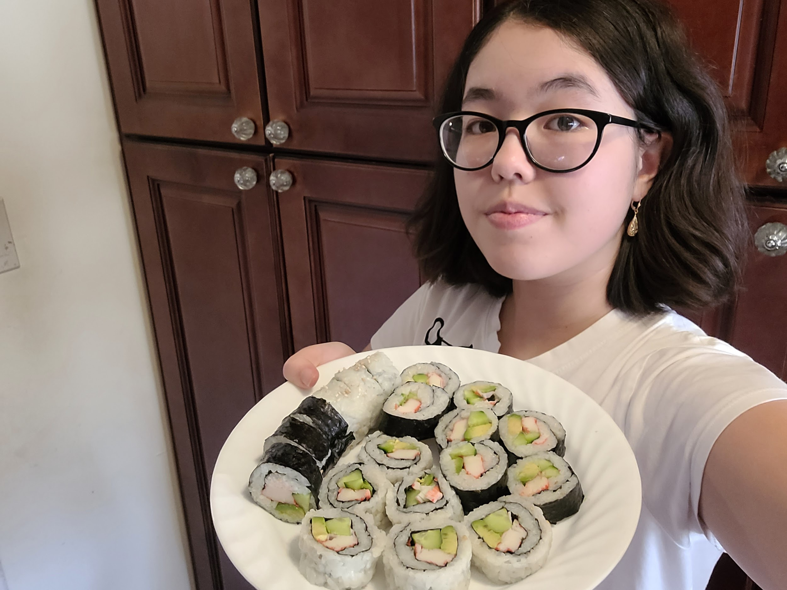
Social Butterfly and Future Fashion Designer….Maya

Slide 5
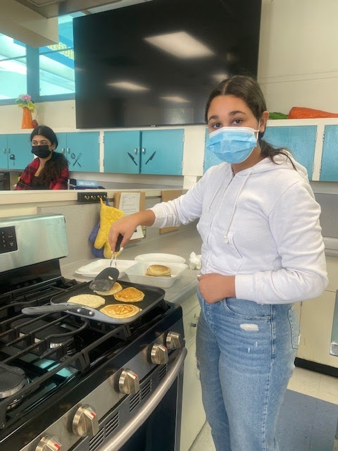
Excellence in Following Directions
Brina

Slide 6

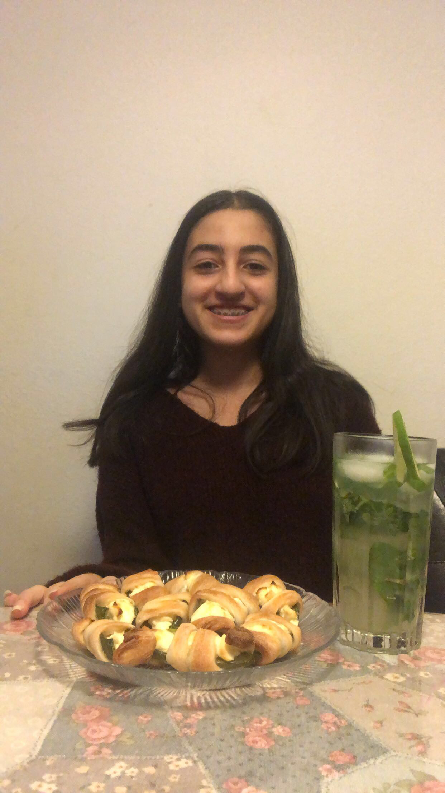
Best Smile
Haily

Slide 7

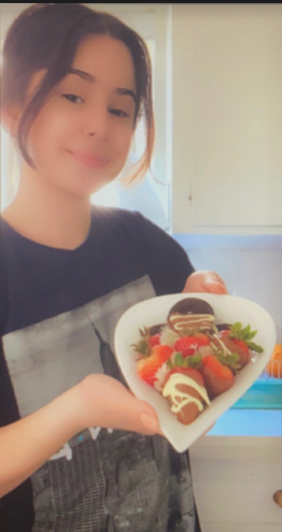
The “Dream” Student;
Always knows what’s going on,
Always does her best,
Always comes through!
Lilit S.

Slide 8
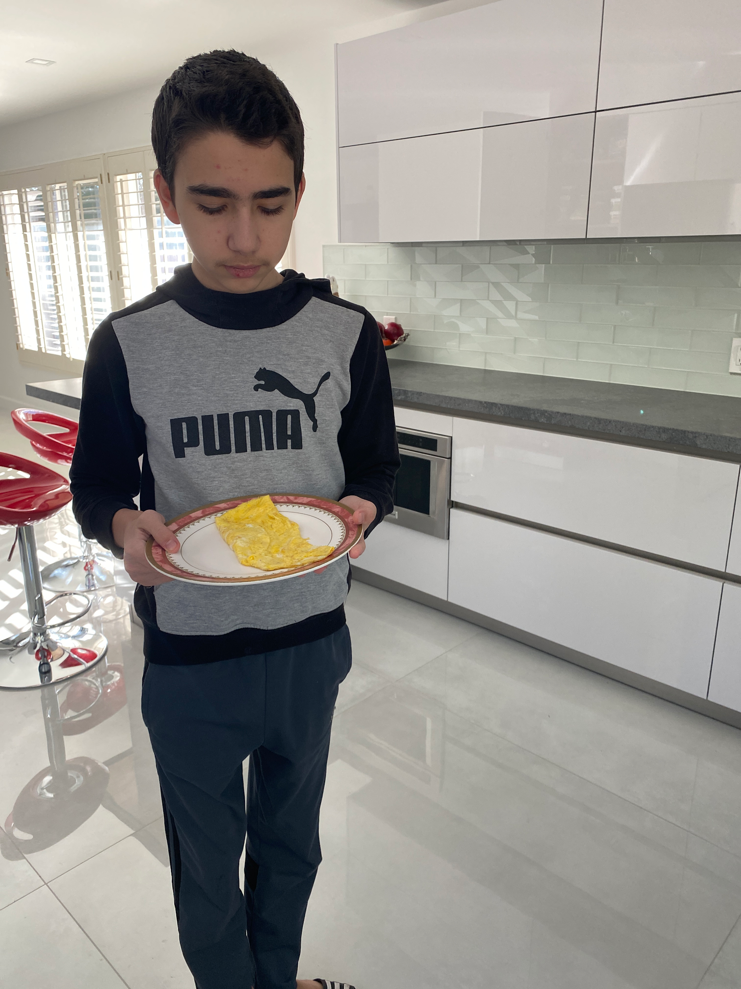
Cleanest, Shiniest Home Kitchen
(and a great chef, too!)
Grigor

Slide 9
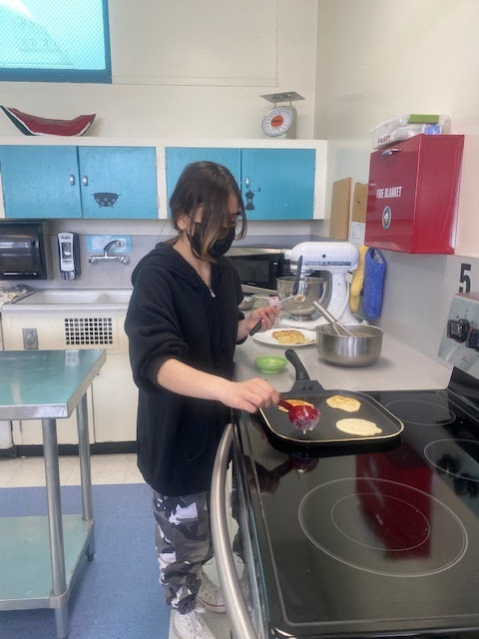
Most Creative Outfits and Headwear…
Talar

Slide 10

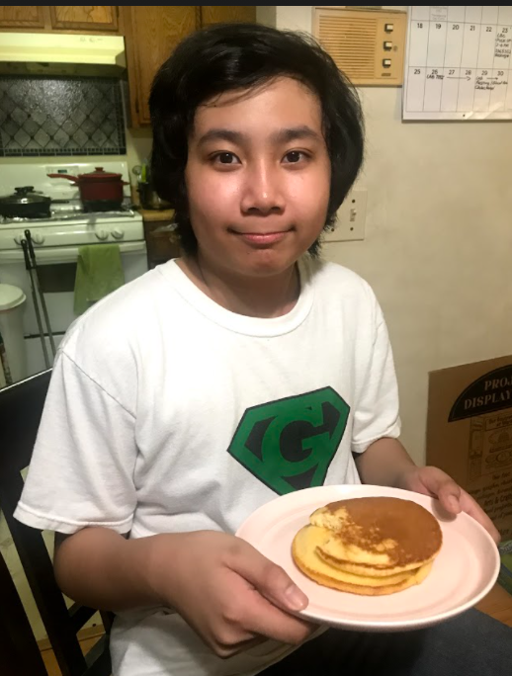
Most Likely to Host a World Travel Show
Jeremiah

Slide 11
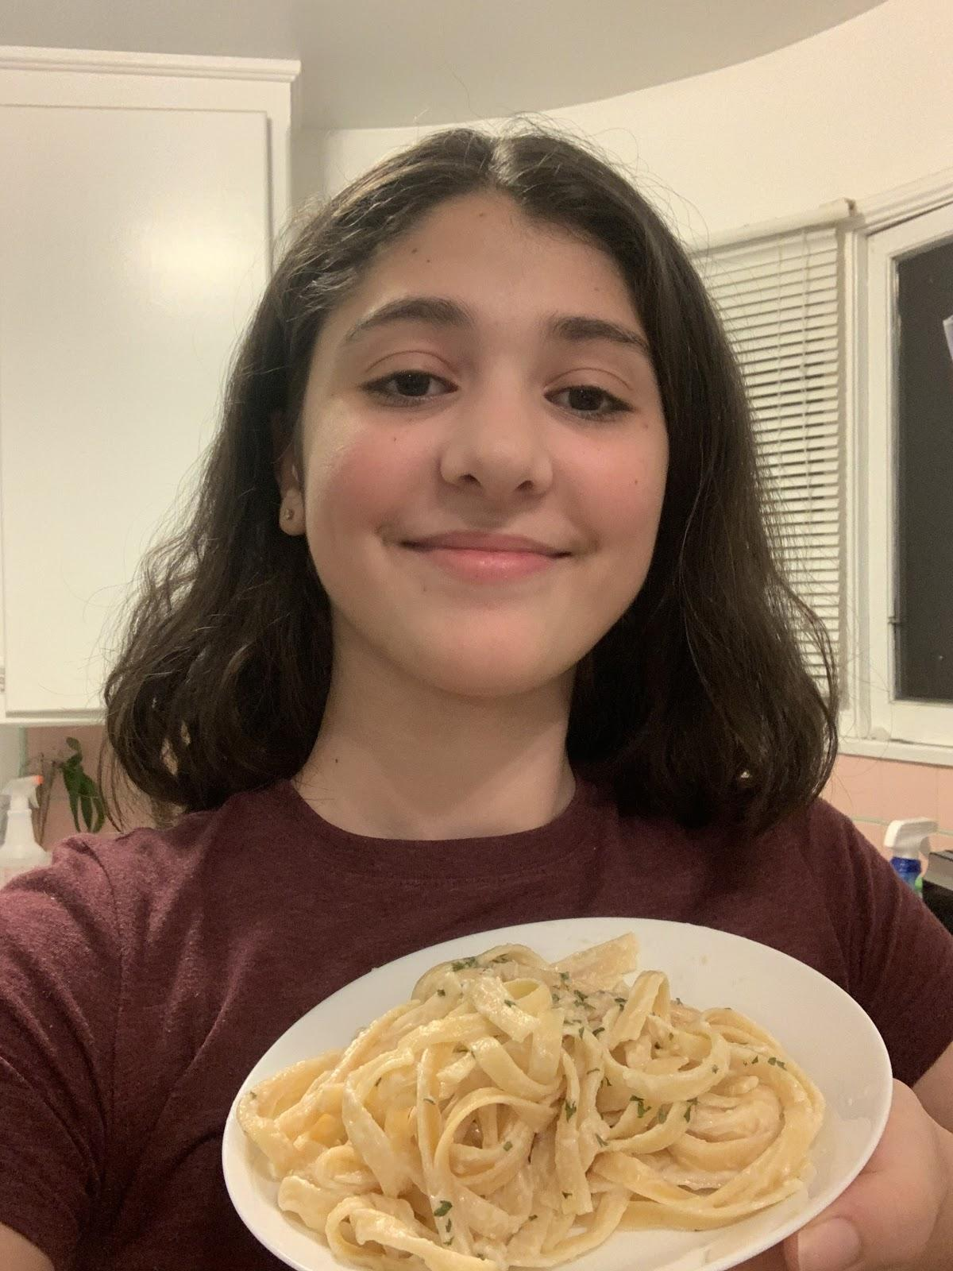
Most Likely
To write her own cookbook
Christina

Slide 12

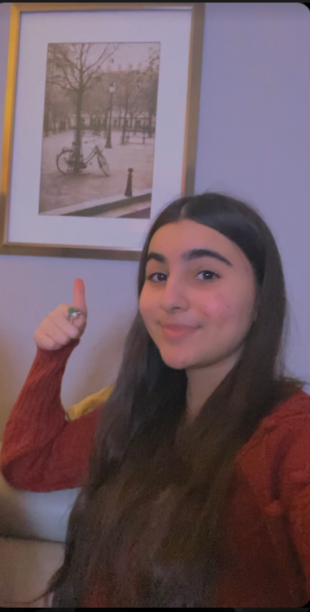
Cheerful, Mature and Positive
Ani

Slide 13

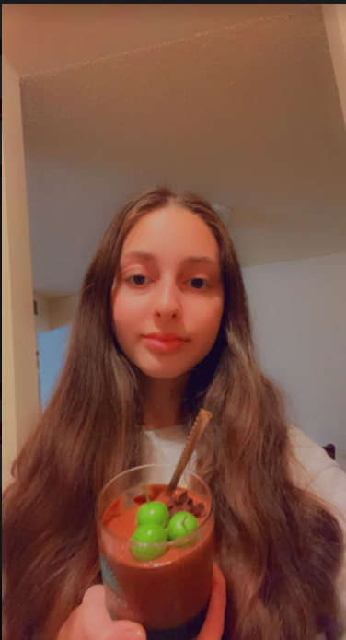
Excellent Student and Creative Chef
Mane

Slide 14
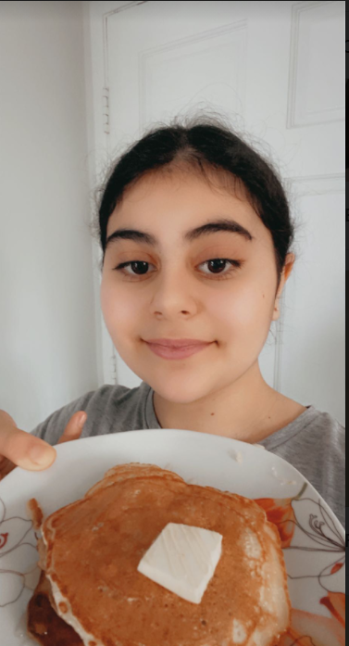
This student makes those around her feel happy; she is so pleasant to be around!
Elza

Slide 15
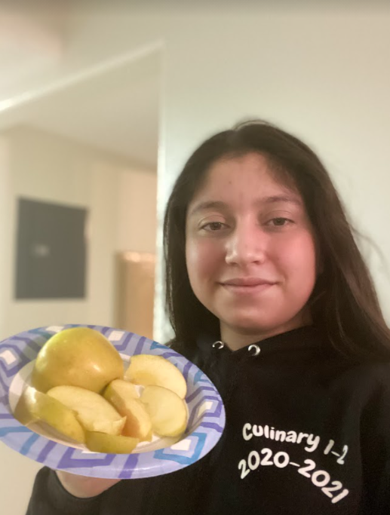
Miss Mise en Place
Lilit M.

Slide 16
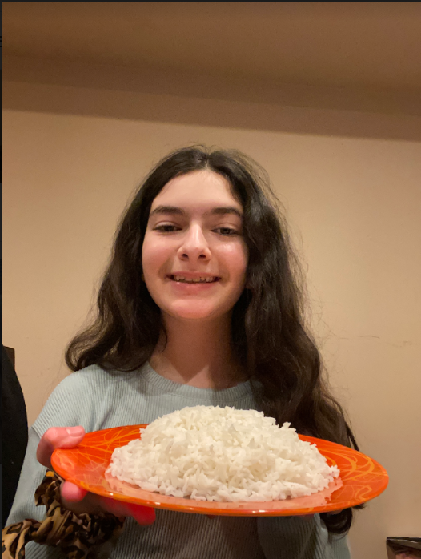
Shining Example of Cheerful Leadership
Kayla

Slide 17

Such a Talented Chef; we May See Her on the Food Network someday!
Laren

Slide 18
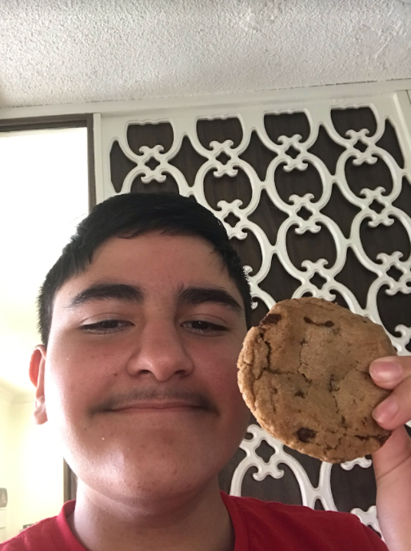
Excellent Chef
Successful Student
Kind Heart
A True Wilson Knight!
Narbe

Slide 19
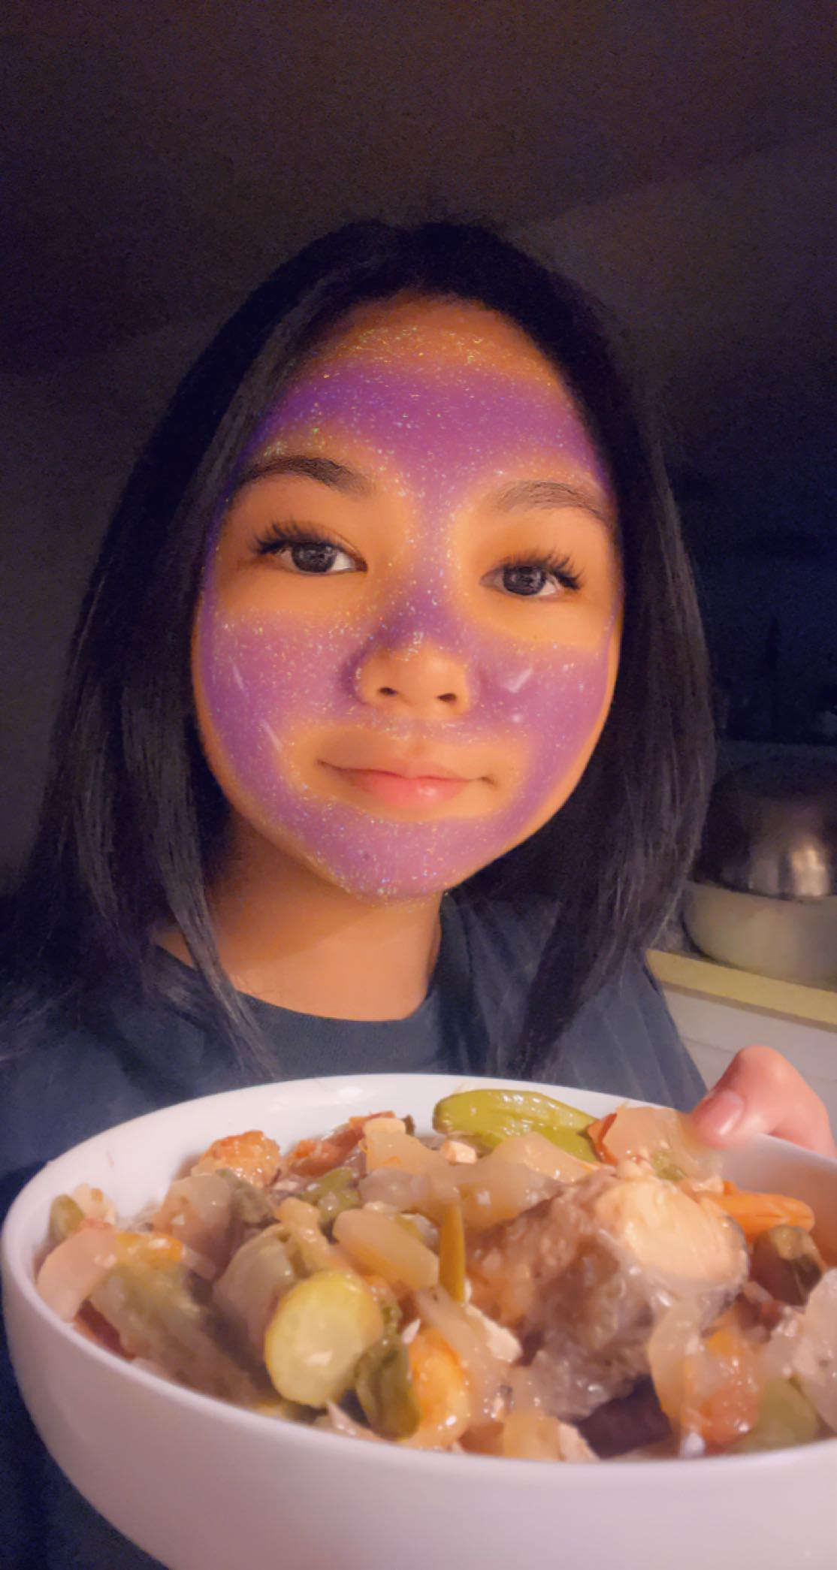
Our Technology Genius!
Angelica

Slide 20

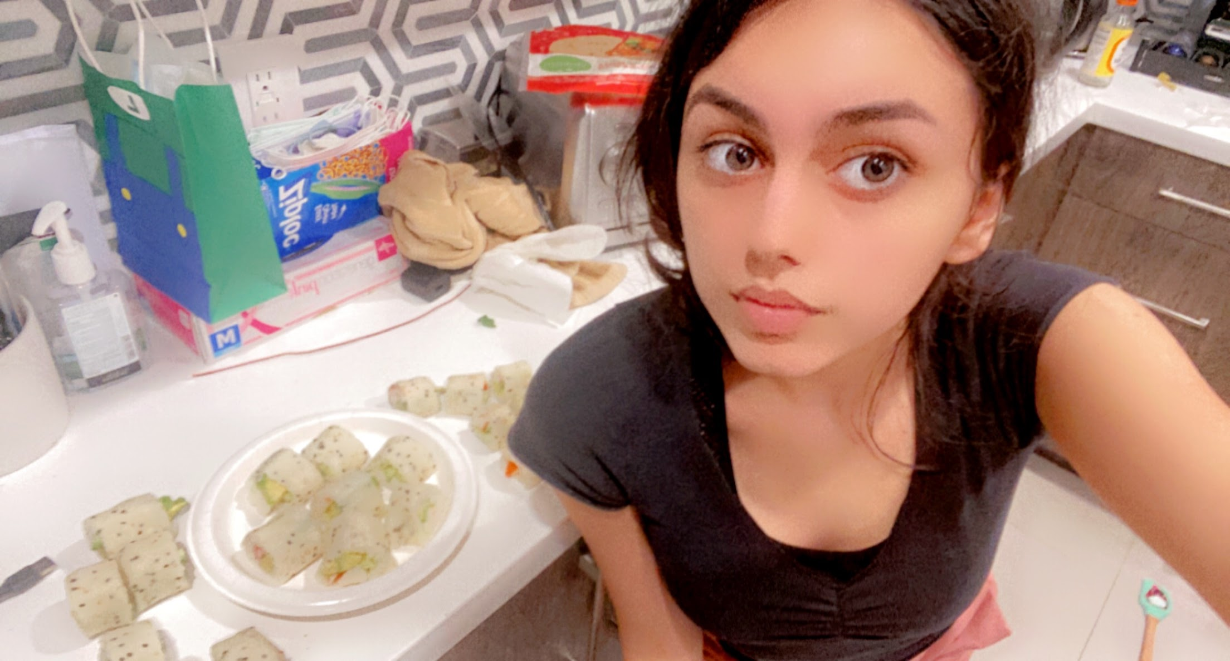
Exceptional Cooking Skills
Eviana

Slide 21
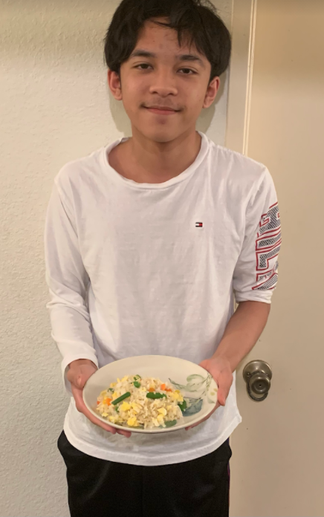
Kind
Responsible
Reflective
Eugene

Slide 22
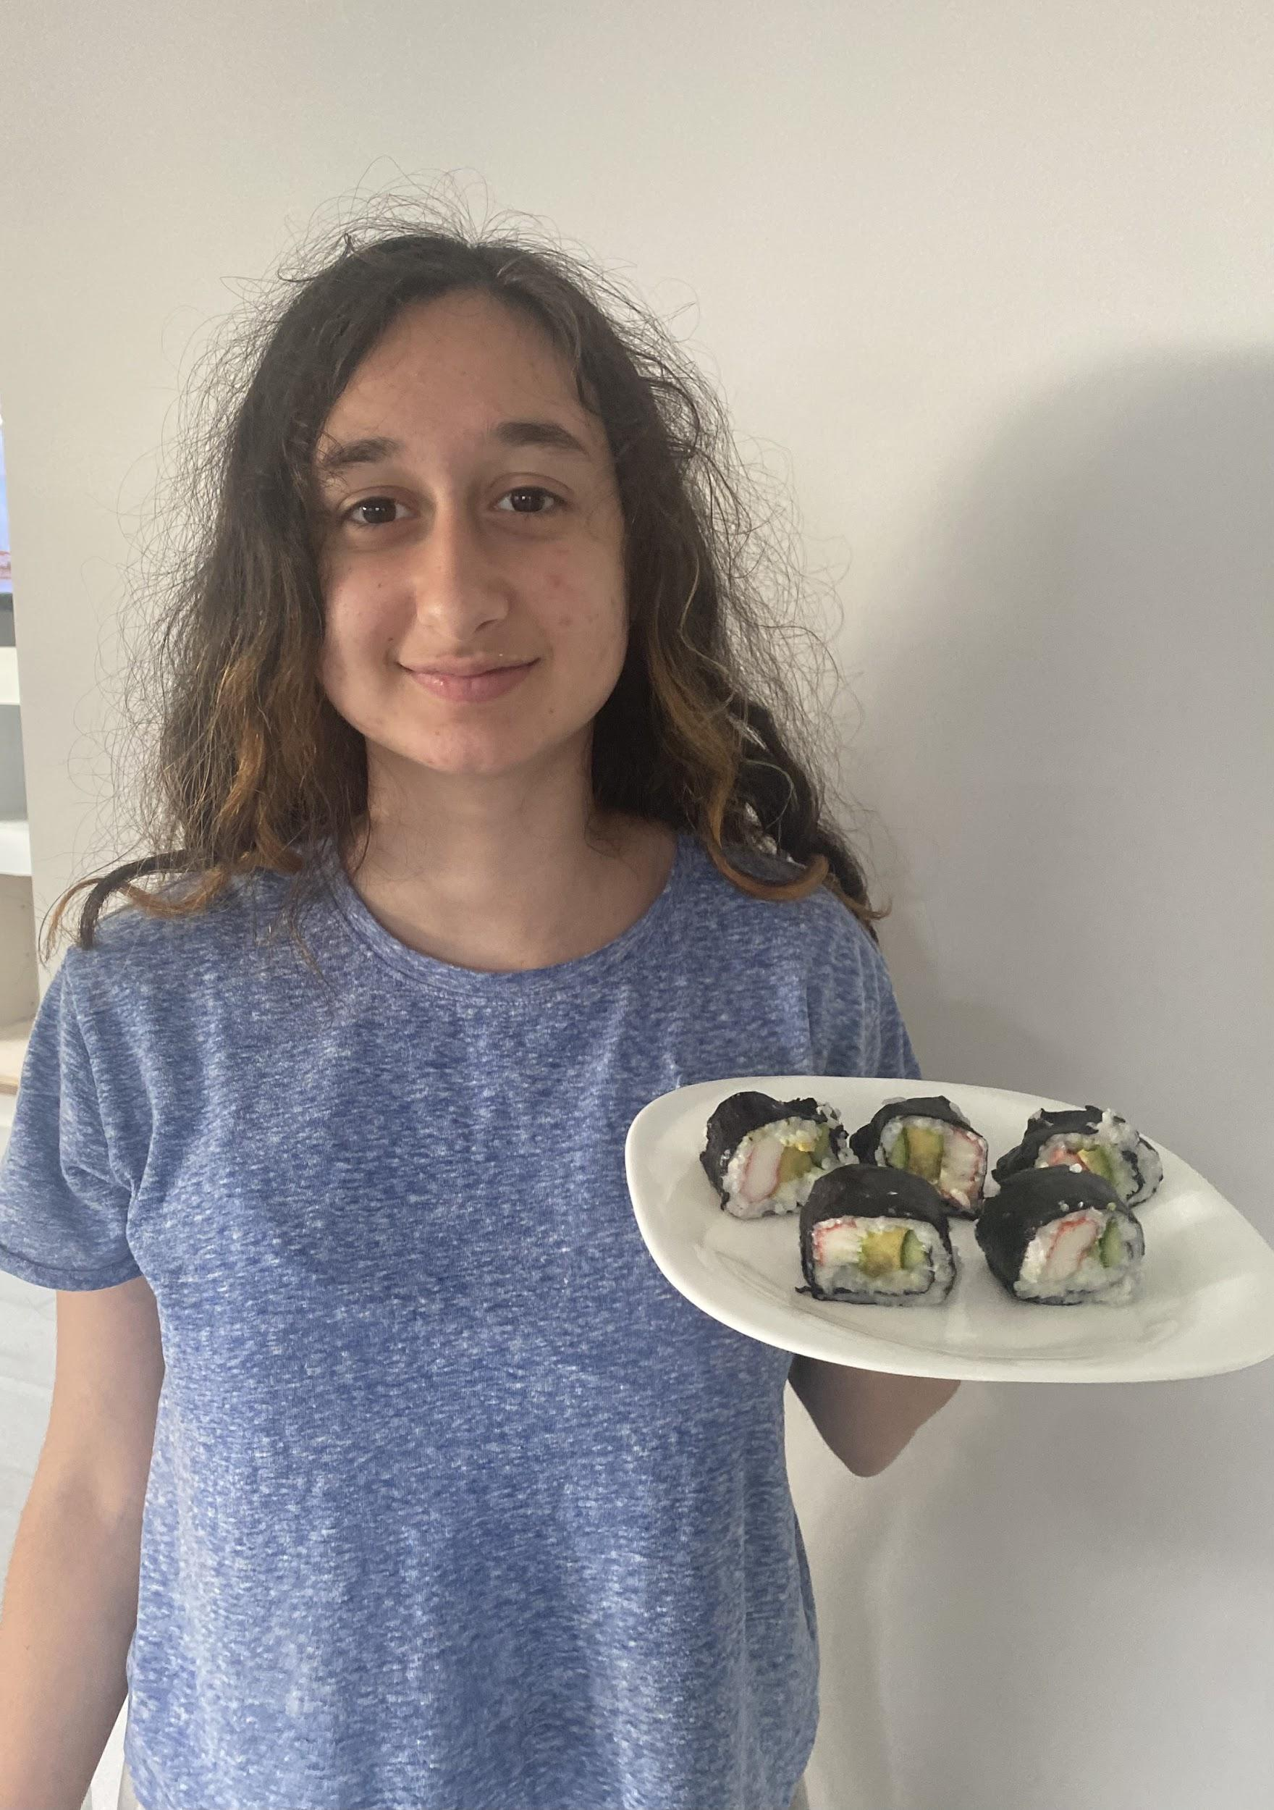
Truly an amazing chef; she made the most of cooking at home!
Juliette

Slide 23
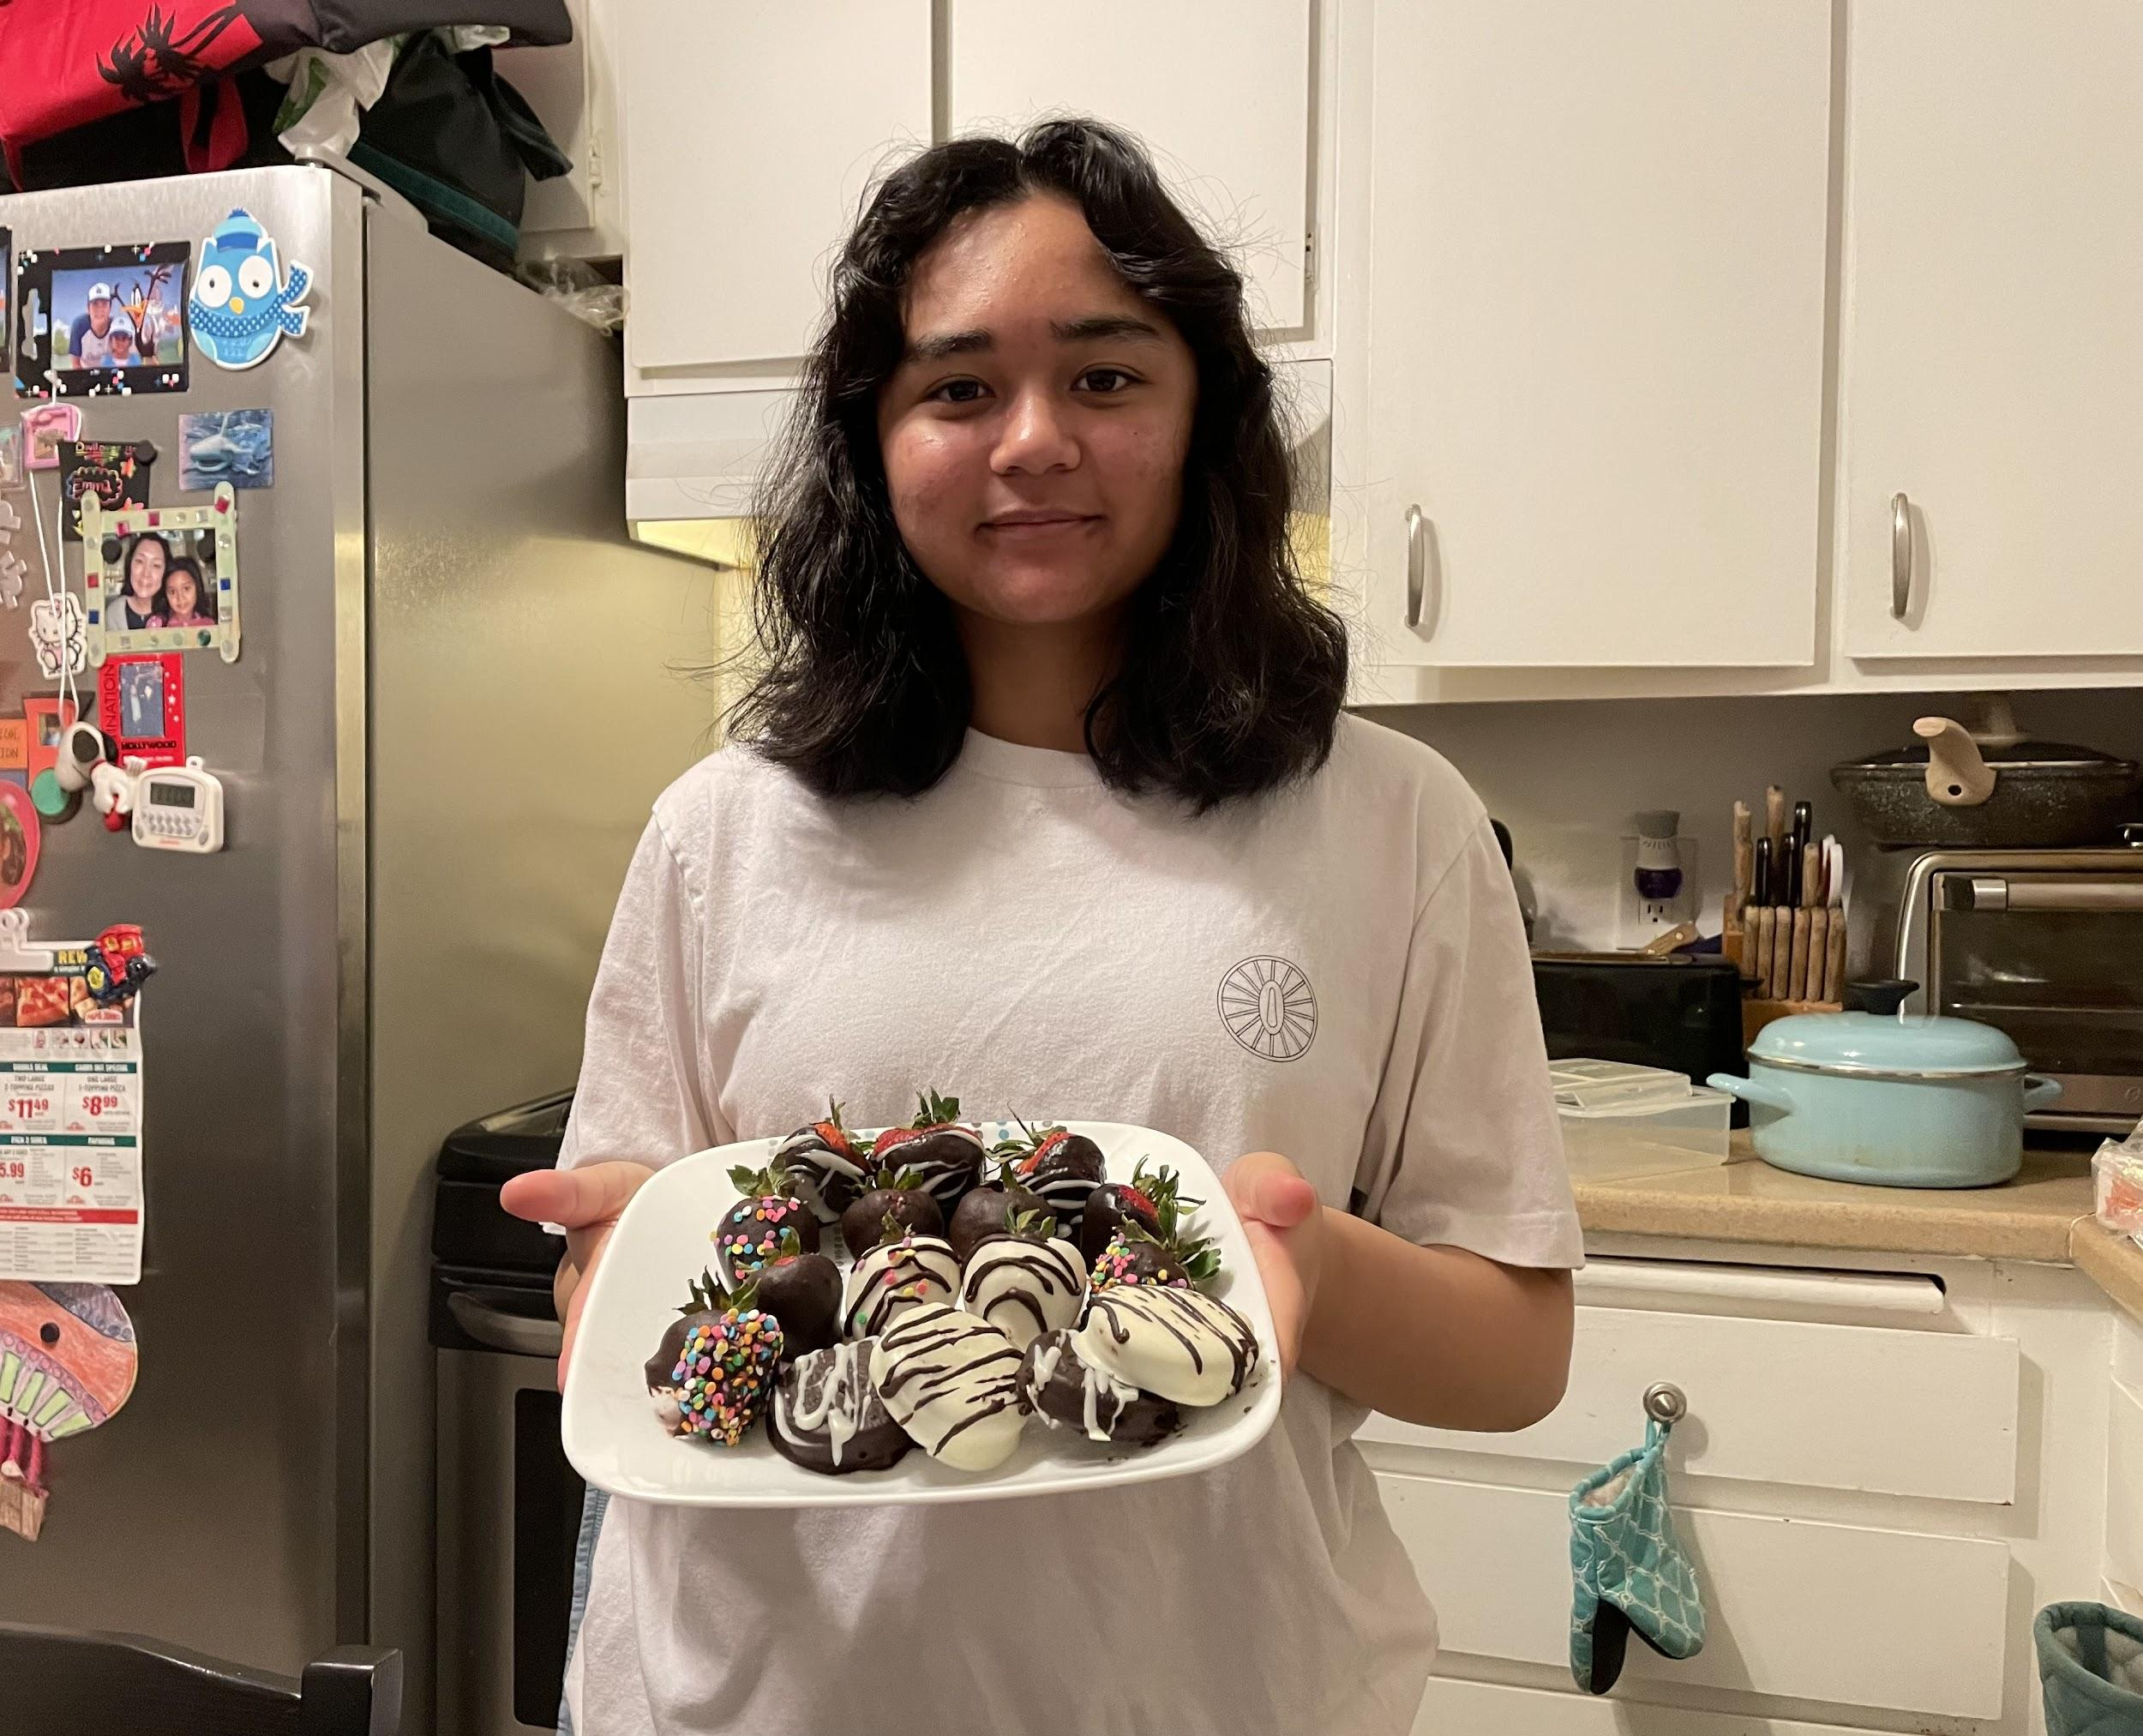
Hard Working Student,
Exceptional Chef
Emma

Slide 24
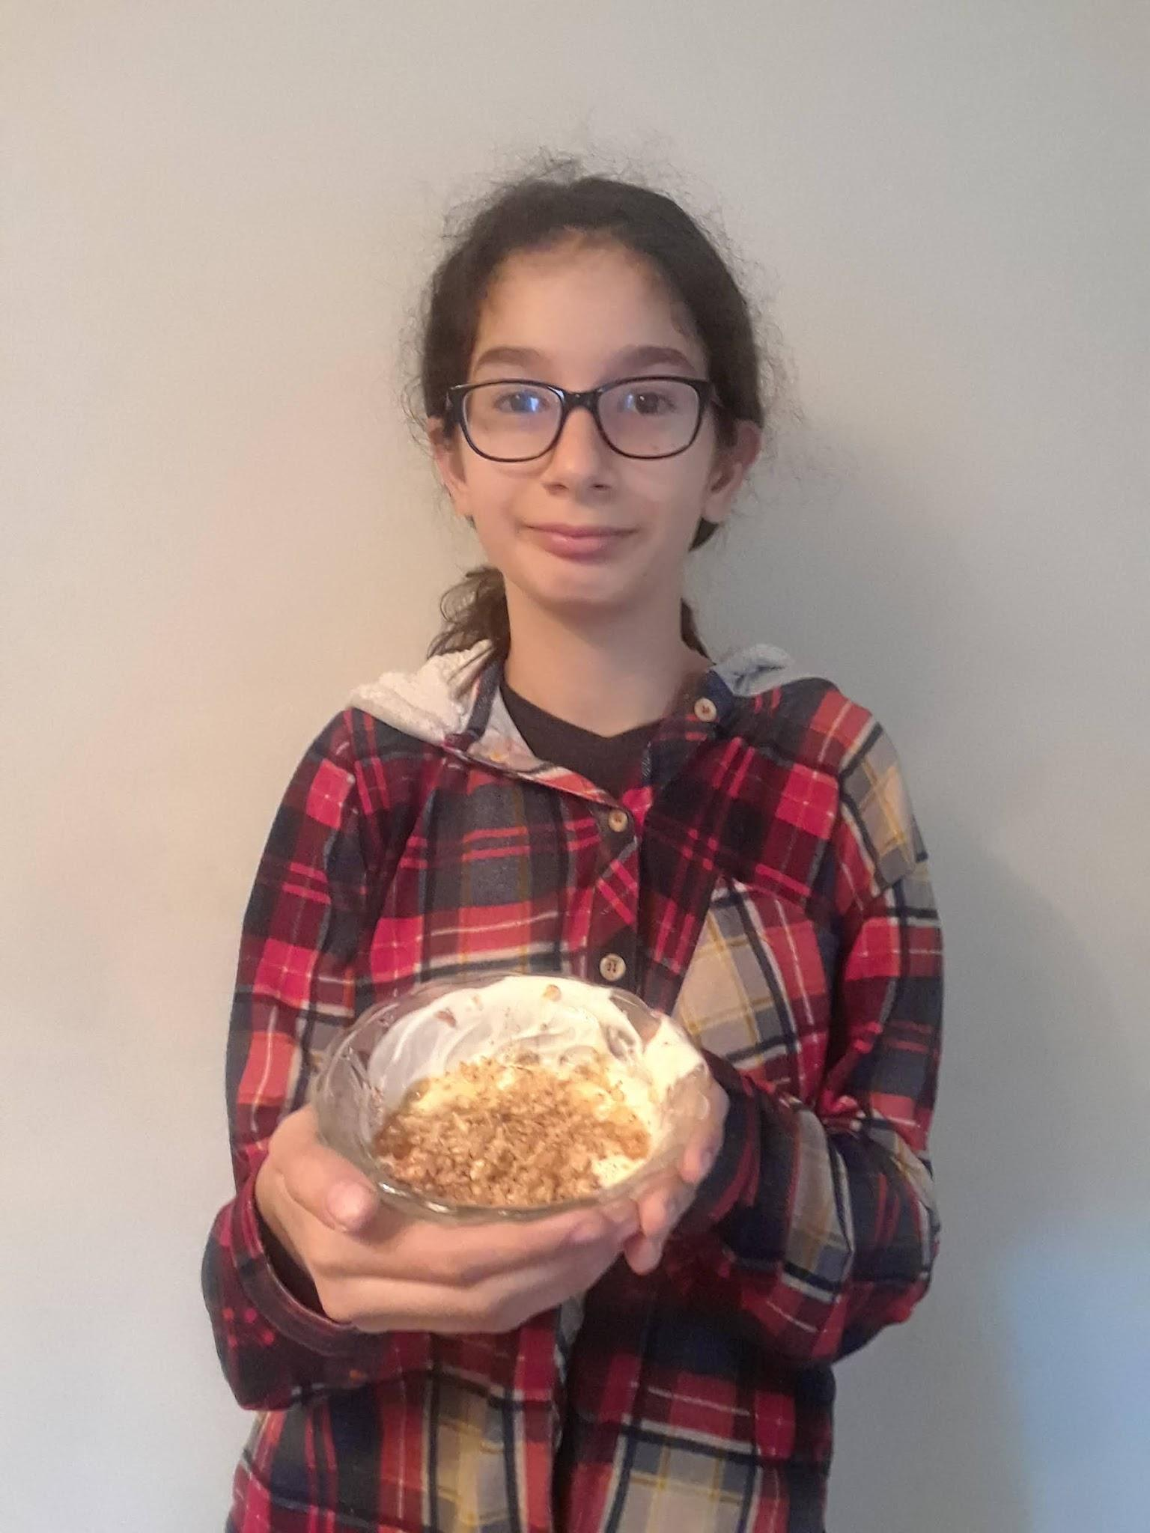
Dependable Leader
Emily

Slide 25
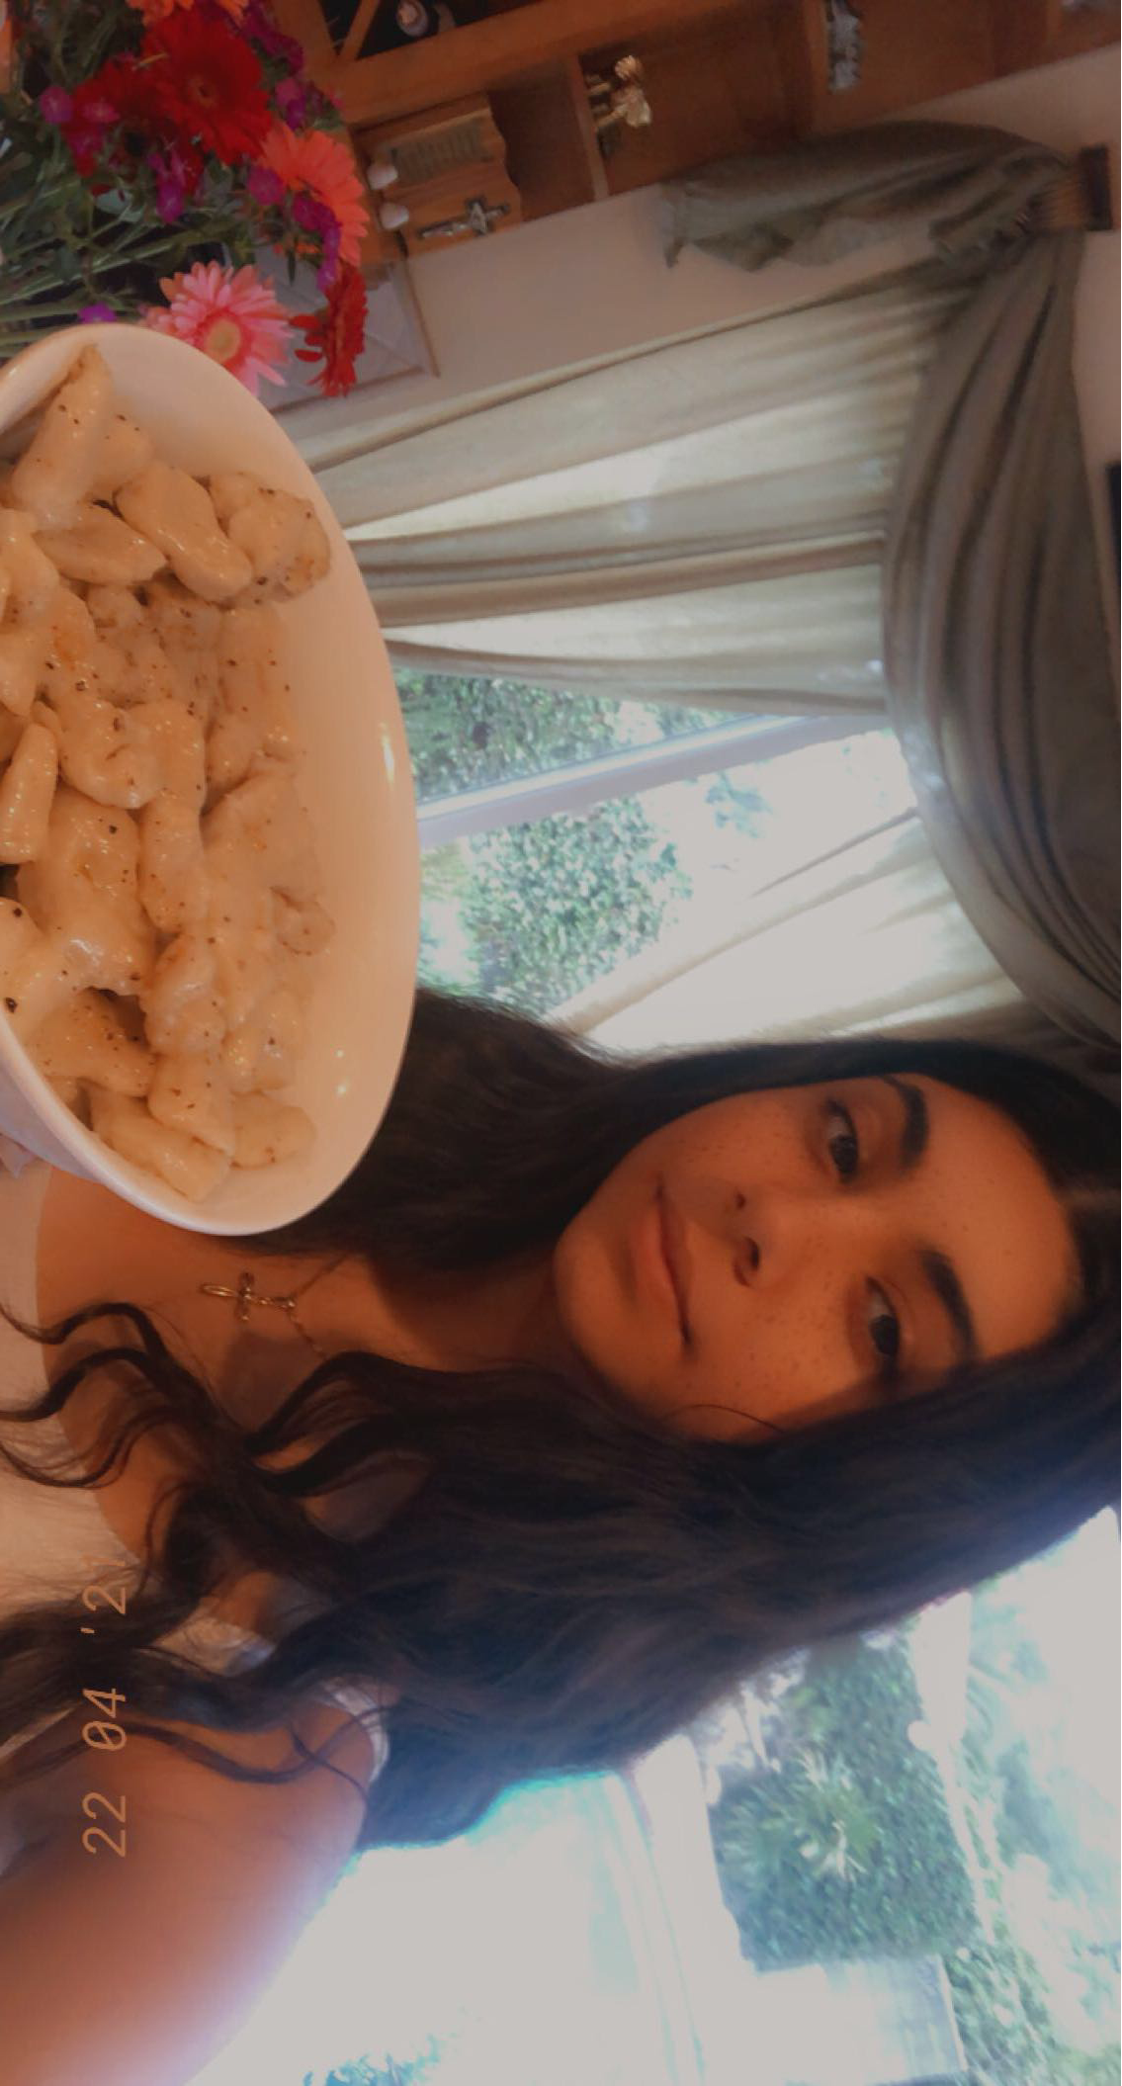
She really knows how to cook well!
And she’s so nice, too!!
Lily

Slide 26

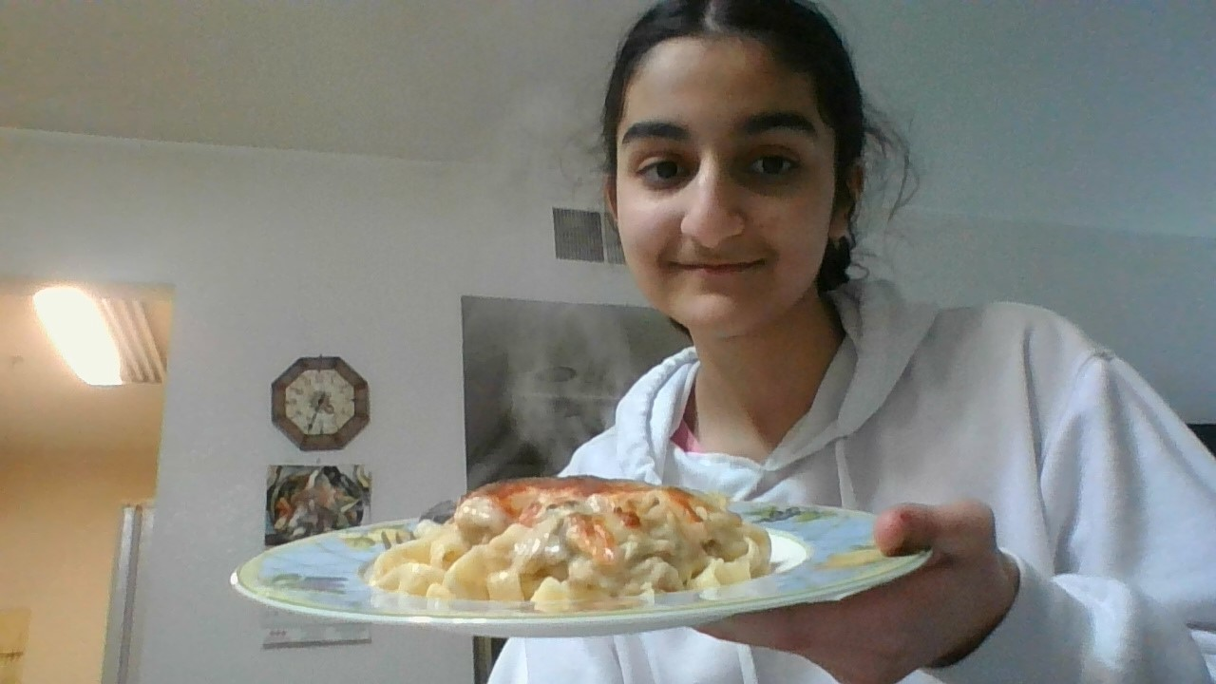
Talented, Resilient Chef who Never Gives Up
Nanar

Slide 27
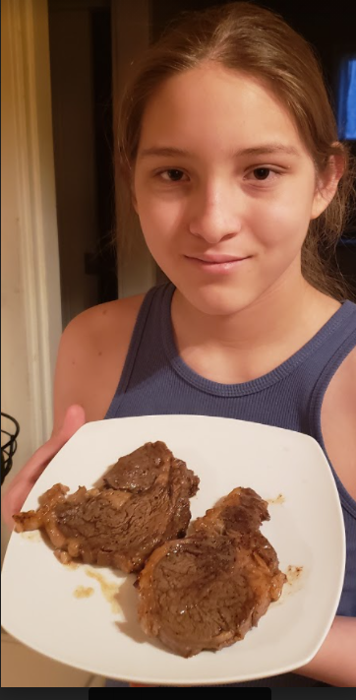
Excellent Baker and Chef
Adrian

Slide 28
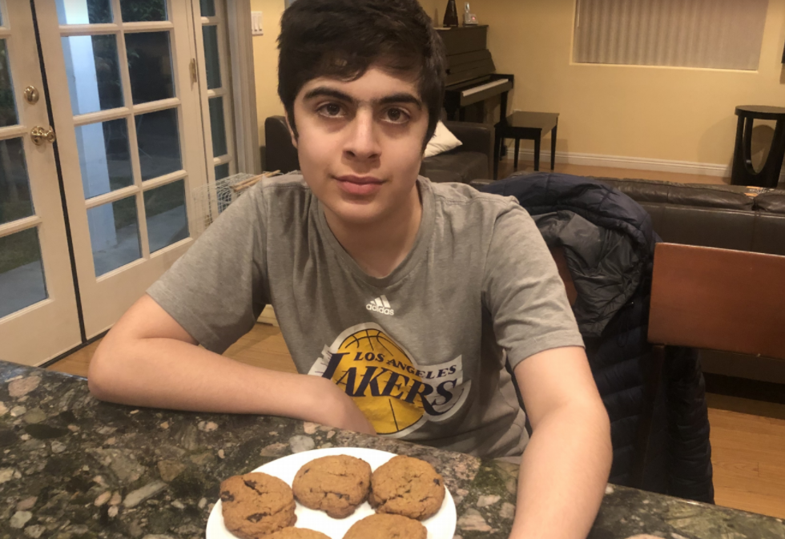
You will definitely see this guy as a successful chef in the future….perhaps he will compete on “Chopped,” and we can all visit the restaurant he opens!
Michael

Slide 29
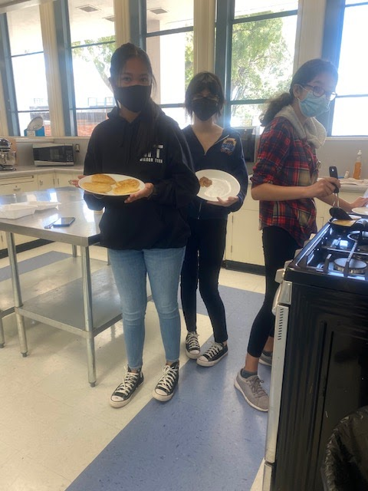
Works Well With Others, and Had Fun Doing It!
Madalene

Slide 30
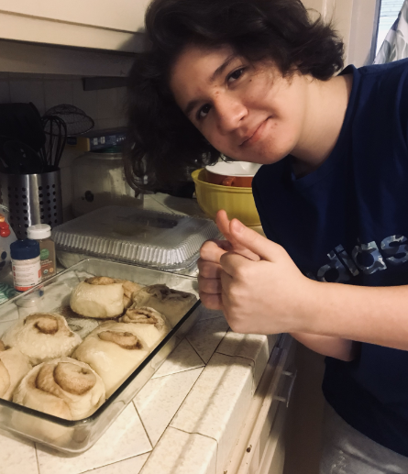
Most Likely to Beat Bobby Flay and Have His Own Cooking Show!
Carlos

Slide 31

Brilliant Writer - Rosemarie

Slide 32

A beautiful person, inside and out.
Elena

Slide 33

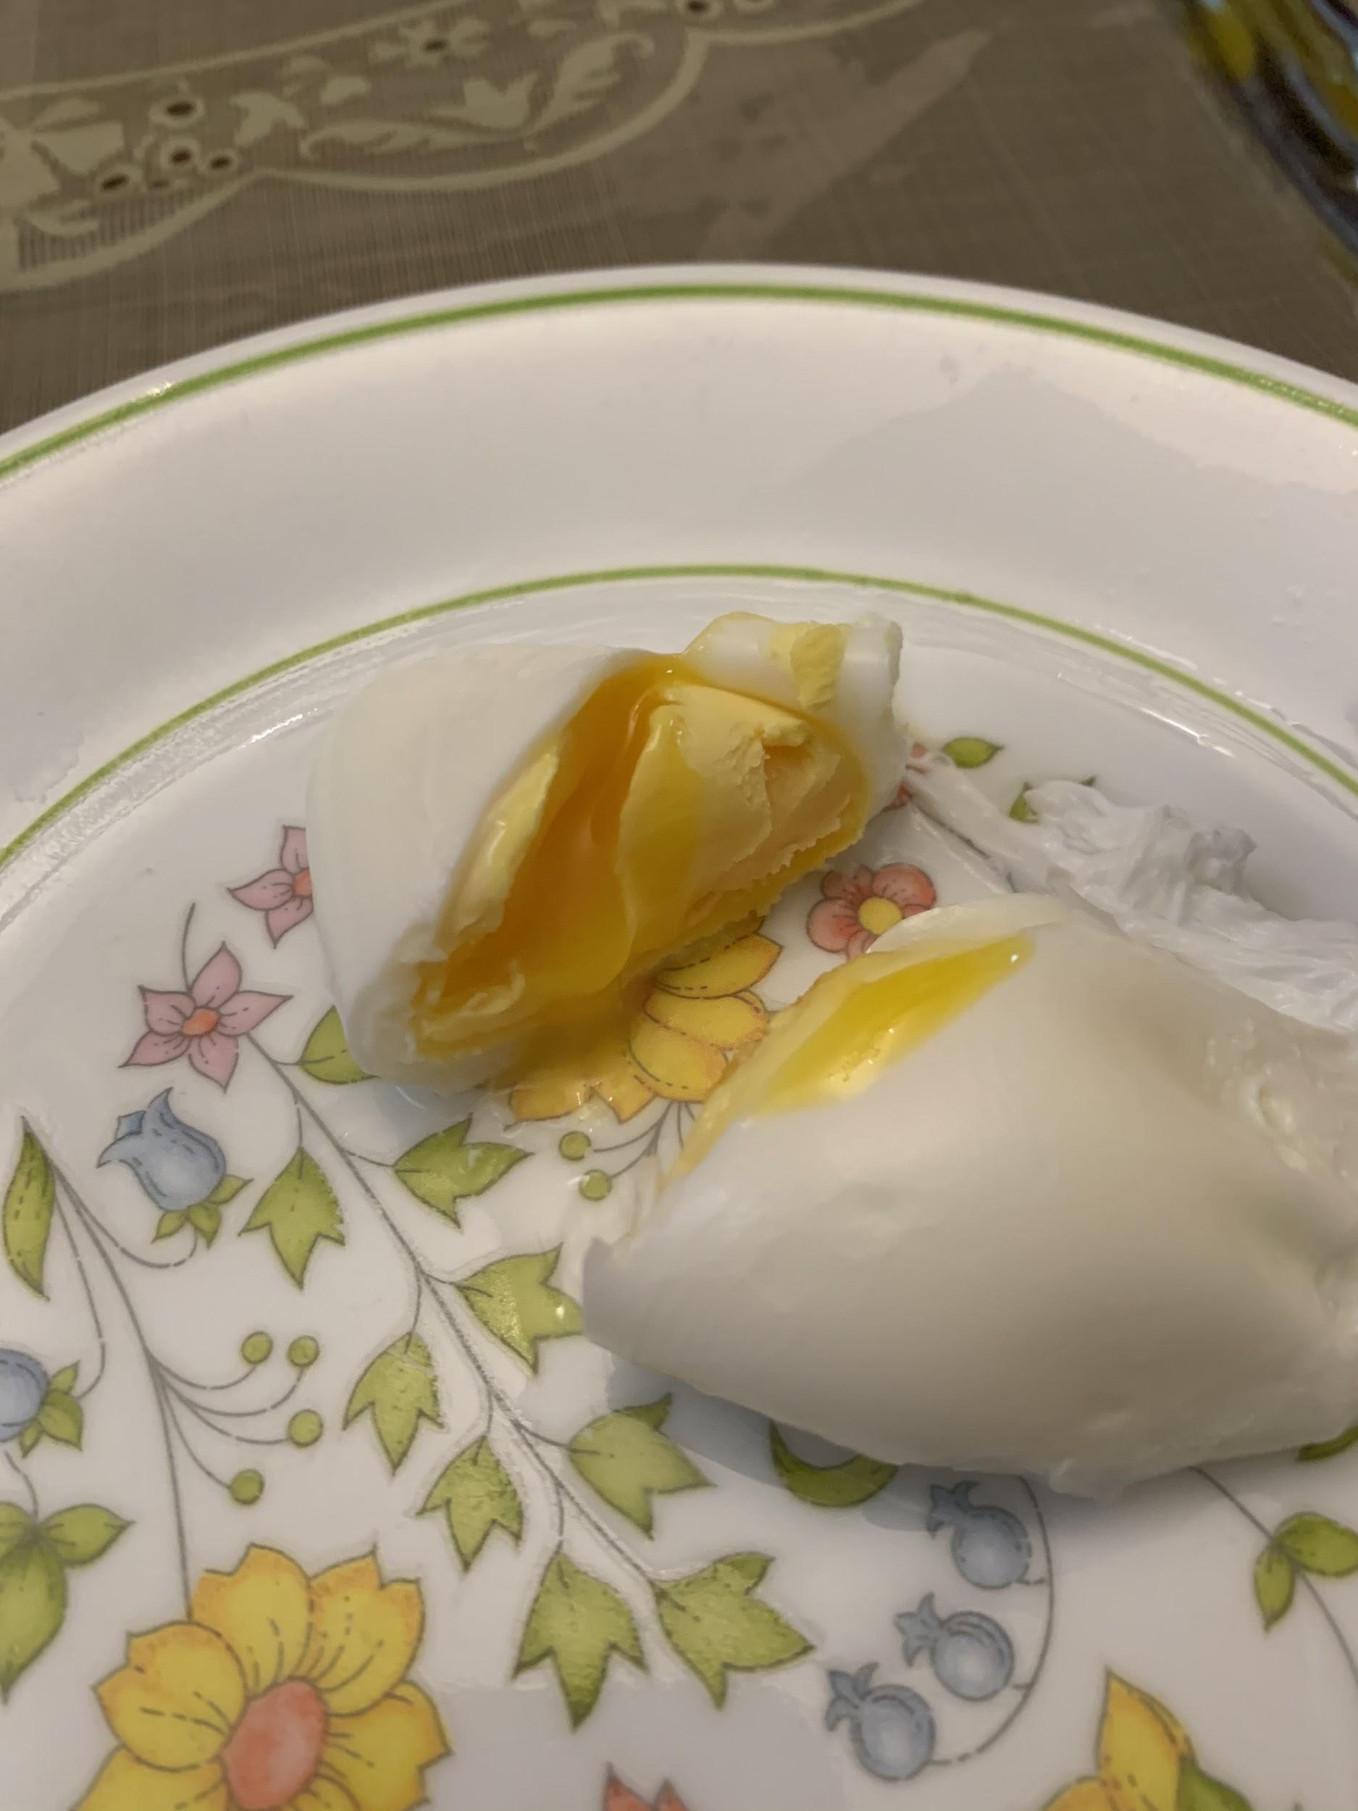
Perfect Egg Poacher!
David

Slide 34

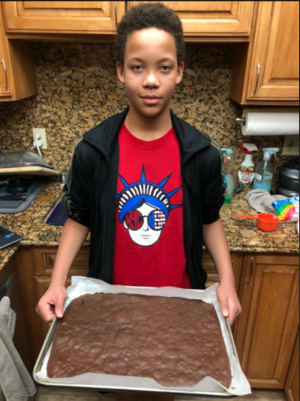
Can you even imagine what our culinary Zooms would be like without him? He is the lifeblood of the class!
Amari

Slide 35

My Dear 2020-2021 Culinary “Kids,”
Thank you for a wonderful year. In spite of
hardships and difficulties, joys and sorrows, we
made it. We supported and helped each other.
We shared food together, even if it was virtually.
Remember that we are a family. As you go off to
high school, remember that the people you shared
Culinary class with are your brothers and sisters.
Say “hi” when you see each other. Invite people to
come and sit with you. Be kind and welcoming.
Stay friends. We all need each other. I wish you all
well. Please keep in touch and come back to visit
me when you can. God bless you all and I love you all.
Mrs. Orris
corris@gusd.net

