Slide 1

Germantown Central School
2021-2022 Budget Proposal

Slide 2

Budget Calendar
November 2020-April 2021: Leadership Team Meets to discuss budget for 2021-22
December 9, 2020: BOE Adoption of budget calendar
February 10, 2021: Present 2021-22 preliminary budget forecast & budget assumptions to the BOE.
March 1, 2021: Submit 2021-22 calculation for tax levy limit to OSC, Tax & Finance & SED
April 21, 2021: Board of Education considers adoption of
finalized 2021-22 educational plan and budget. District submits property tax report card to SED within 24 hours of adoption
April 23, 2021: Final date for Budget adoption by the BOE, budget document available to public, plan for voting with Columbia County Board of Elections of adoption
All other dates are to be announced by NYS and NYSED

Slide 3
Budget Process
  Begin with 3 years of actual spending.
  Revenue State Aid Numbers and make adjustment based on actual numbers.
  Calculate Tax levy.
  Adjust Budget model for known increases (Salary, Debt, Etc.).
  Review implications of previous years’ budget
  Talk to other departments ( Building and Grounds, Café, Etc.).
  Meanwhile, design program based on STUDENT NEEDS for next year
    Leadership Team meets to review enrollment, IEPs and assessment results to recommend a program that is aligned with the district’s vision and focus goals.
    All support areas meet with Superintendent to review expenses, explore new ideas for increased efficiency and make recommendations..
  Review adjustments with Board of Education.

Slide 4
Board of Education, District Office, Legal Expenses, BOCES
ACCOUNT |  | 2017-18 | 2018-19 | 2019-20 | 20/21 Budget | 21/22 Proposed Budget
A 10....BOARD OF EDUCATION |  | 4,146 | 5,765 | 10,100 | 9,500 | 9,500
A 12....CENTRAL ADMINISTRATION |  | 222,902 | 230,093 | 240,700 | 237,600 | 204,200
A 13....FINANCE (BUSINESS ADMIN) |  | 217,917 | 264,714 | 262,800 | 275,000 | 264,916
A 14....STAFF (LEGAL & BOCES) |  | 48,453 | 109,684 | 124,600 | 87,900 | 92,542

Slide 5
Operations, Maintenance, Central Data Processing, Special Items
Account | 2017-18 | 2018-19 | 2019-20 | 20/21 Budget | 21/22 Proposed Budget
A 1620…Operation of Plant- | 493,999 | 550,823 | 675,200 | 687,200 | 769,746
A 1621…Maintenance of Plant | 270,260 | 371,036 | 282,000 | 295,600 | 363,447
A 1622…Security | 0 | 0 | 0 | 40,000 | 40,800
A 1680… Central Data Processing | 73,639 | 73,873 | 77,000 | 96,000 | 93,000
A 19... Special Items | 121,431 | 126,198 | 211,000 | 221,900 | 201,610

Slide 6
Account | 2017-18 | 2018-19 | 2019-20 | 20/21 Budget | 21/22 Proposed Budget
A 2020…Supervision-Regular School | 341,106 | 330,291 | 341,900 | 349,900 | 351,836
A 2060 -70… Research, Planning & Evaluation Inservice Training (Combined) | 108,343 | 108,000 | 106,100 | 101,500 | 90,266
A 2110… Teaching-Regular School (Including Summer Programs) | 3,600,793 | 3,537,578 | 4,074,800 | 3,702,225 | 3,811,188
A 2250… Programs-Students W/Disabilities | 1,577,920 | 2,000,665 | 2,308,920 | 2,017,371 | 2,406,782
A 2280… BOCES Occ. Ed. Services- | 292,329 | 259,619 | 241,000 | 264,700 | 278,500
Teaching & BOCES Programs

Slide 7
Account | 2017-18 | 2018-19 | 2019-20 | 20/21 Budget | 21/22 Proposed Budget
A 2610…School Library& Audiovisual - No Library Media Specialist | 68,925 | 50,198 | 56,600 | 58,750 | 57,563
A 2630…Instructional Technology | 240,246 | 199,324 | 223,000 | 251,200 | 240,500
A 2810…Guidance-Reg School | 137,026 | 125,122 | 137,600 | 142,500 | 127,100
A 2815…Health SVCS-Reg School | 85,164 | 93,229 | 94,800 | 94,300 | 91,200
A 2825…Social Work Reg Sch | 59,437 | 60,600 | 61,300 | 65,700 | 69,200
A 2850…Co-Curricular Activities | 51,402 | 62,052 | 64,450 | 61,600 | 67,898
A 2855…Interschool Athletics | 149,172 | 144,870 | 171,500 | 174,800 | 159,978
Library, Technology, Guidance, Health Services, Social Worker, Extra-Curricular, Athletics, Transportation

Slide 8
Account | 2017-18 | 2018-19 | 2019-20 | 20/21 Budget | 21/22 Proposed Budget
A55…District Transportation Services | 820,904 | 585,809 | 891,850 | 926,950 | 958,750
A 9010.. State Retirement | 110,704 | 81,229 | 100,000 | 165,000 | 173,852
A 9020…Teachers' Retirement | 472,317 | 601,711 | 515,000 | 546,000 | 558,748
A 9030…Social Security | 441,629 | 354,985 | 543,000 | 505,000 | 518,262
A 9040…Workers' Comp | 34,612 | 39,577 | 0 | 0 | 0
A 9050…Unemployment Ins. | 9,823 | 2,828 | 0 | 0 | 0
A 9060…Hospital, Medical & Dental Insurance | 2,477,025 | 2,951,953 | 3,069,800 | 3,359,900 | 3,715,322
A 9089…Retirement Sick Pay | 14,945 | 0 | 0 | 0 | 0
A9711…Debt Service | 898,940 | 465,823 | 575,298 | 834,050 | 854,200
A9901…Transfer to other Funds | 121,300 | 105,948 | 130,000 | 130,000 | 130,000
RETIREMENT, EMPLOYEE BENEFITS, DEBT SERVICE, TRANSFER TO OTHER FUNDS

Slide 9
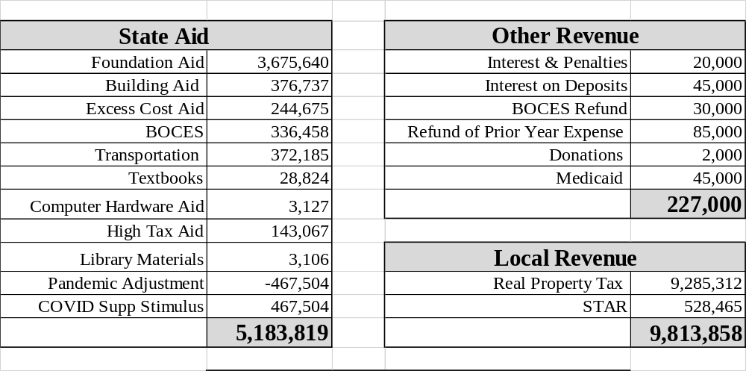
Total Revenue 15,224,677
Anticipated Revenue

Slide 10
The spending plan, as presented, is the product of an extensive examination of previous years’ expenses, revenue reductions due to the COVID-19 emergency and the anticipated needs of our students in 2021-22.
This spending plan is within the tax levy limit (tax cap) of 1.67%.
 | Spending Plan | Anticipated Revenues
Recommend Expenses | 16,720,906
Anticipated Revenues w/o FED CARES RESTORATION |  | 15,224,677
Appropriated Retirement Reserves |  | 165,000
Appropriated Fund Balance Fund (Cover anticipated Federal) |  | 596,101
Foundation Aid Restored Cuts 2020-21 (20%) |  | 735,128
Federal CARES Restoration (Anticipated) |  | (497,000)
 | 16,720,906 | 16,720,906
State has indicated the Foundation Aid cuts from 2020-21 will be restored $735,128.00
Purpose is to support staffing and in-person learning transition
Summary

