Slide 1

Germantown Central School
2021-2022 Budget

Slide 2
Agenda March 24, 2021
REVISED Budget Calendar
FINAL Tax Levy
ENACTED State Budget - Revenue

Slide 3

Budget Calendar - Revised
November 2020-April 2021: Leadership Team Meets to discuss budget for 2021-22
December 9, 2020: BOE Adoption of budget calendar
February 10, 2021: Present 2020-21 preliminary budget forecast & budget assumptions to the BOE.
March 1, 2021: Submit 2020-21 calculation for tax levy limit to OSC, Tax & Finance & SED
March 30 – April 3 2021: Legal Notice of School Budget Hearing and Annual Budget Vote.
April 21, 2021 Board of Education Meeting: Board of Education considers adoption of finalized 2021-22 educational plan and budget. District submits property tax report card to SED within 24 hours of adoption.
April 19, 2021: Last Day to submit petitions for Board of Education candidates.
April 23, 2021: Final date for budget adoption by the BOE, plan for voting with Columbia County Board of Elections.
April 26 2021: Property tax report card must be submitted to SED within 24 hours of budget adoption, but no later than April 26, 2021
April -May 18, 2021: Budget available at the school, and public/free association libraries in the District
May 5, 2021: Budget Hearing
May 5-12 2021: Budget Notices mailed to all residents
May 18, 2021: Annual Meeting/Board Election/Budget Vote, 12:00 PM –9:00 PM

Slide 4
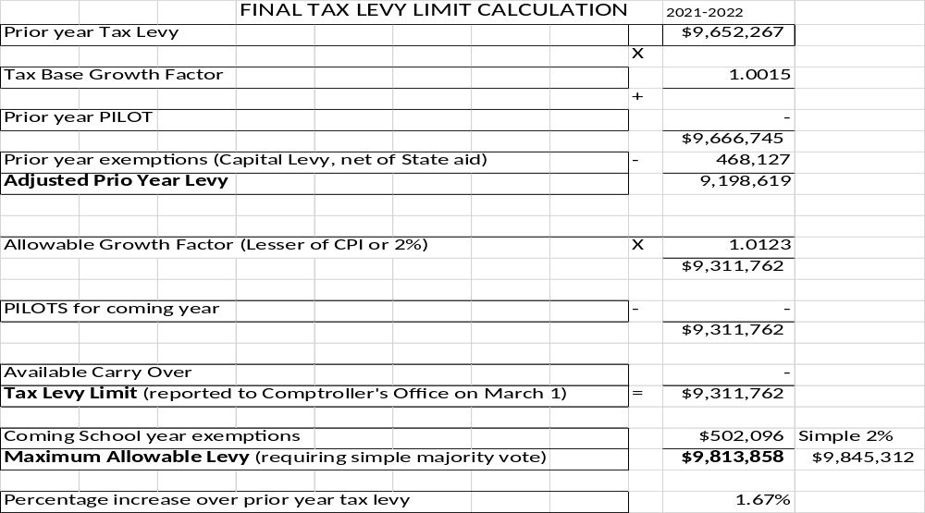
Final Tax Levy Limit Calculation

Slide 5
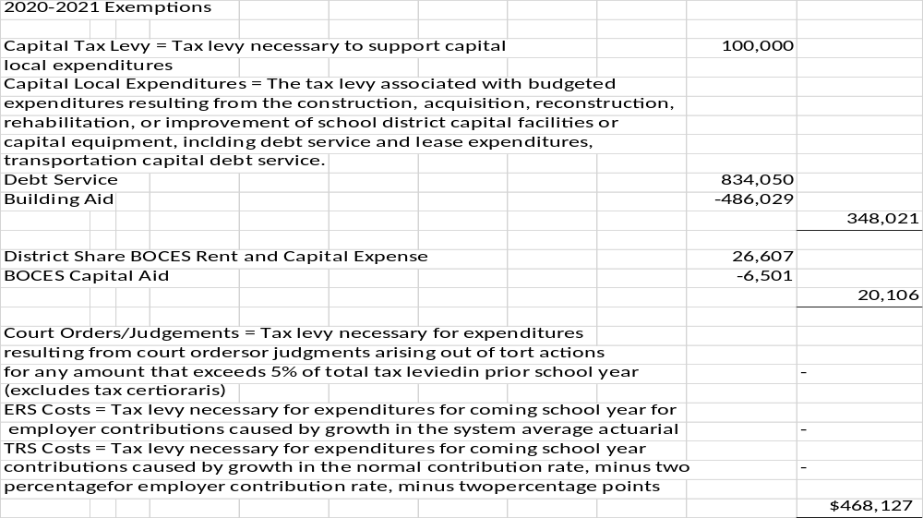
FINAL Tax Levy Limit – 2020-21 EXEMPTIONS

Slide 6
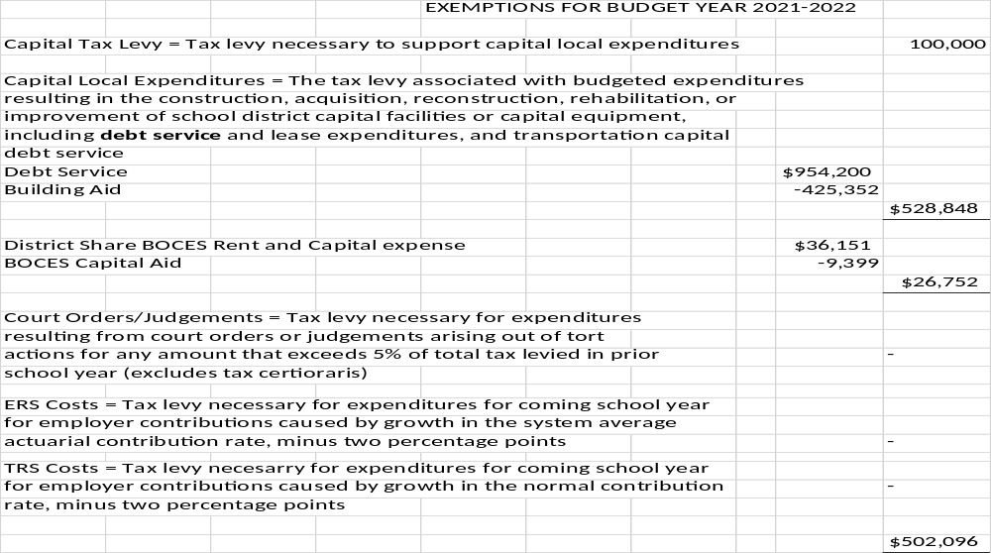
Final Tax Levy Limit – 2021-22 EXEMPTIONS

Slide 7
Enacted State Budget - Aid Revenue
 | 20-21 Enacted Budget | 21-22 Enacted State Budget | Adjustments | Reason for Adjustment | 21-22 Adjusted State Aid
Foundation Aid | 3,675,640 | 3,675,640 |  |  | 3,675,640
Pandemic Adjustment | -86,975 | -467,000 |  |  | -467,000
Universal Pre-K | 380,000 | 380,000 | -380,000 | PreK is separate
Building Aid | 233,804 | 376,737 | 142,933 | Cap Project | 376,737
Access Cost Aid | 234,387 | 244,675 | 10,288 |  | 244,675
BOCES | 333,186 | 336,458 | 3,272 |  | 336,458
Transportation | 356,601 | 372,185 | 15,584 |  | 372,185
Textbooks | 39,761 | 28,824 | -10,937 |  | 28,824
Computer Hardware Aid | 3,154 | 3,127 | -27 |  | 3,127
High Tax Aid | 143,067 | 143,067 |  |  | 143,067
Other State | 70 | 3106 | 3036 |  | 3106
Total | 5,312,695 | 5,560,715 | -380,000 |  | 5,183,819
Federal CARES ACT restoration | 86,975 | 467,000 |  |  | 467,000
Total after Restoration | 5,399,670 | 6,027,713 |  |  | 5,650,819
 |  | Increase in Foundation Aid |  |  | 0
 |  | Without Restoration |  |  | -467,000

