Slide 1

Germantown Central School
2021-2022 Proposed Budget

Slide 2
Agenda
Budget Calendar
Draft Tax Levy
Proposed State Aid Revenue
Questions

Slide 3

Budget Calendar
November 2020 -April 2021: Leadership Team Meets to discuss budget for 2021-22
December 9, 2020: BOE Adoption of budget calendar:
February 10, 2021: Present 2021-22 preliminary budget forecast & budget assumptions to the BOE.
March 1, 2021: Submit 2021-22 calculation for tax levy limit to OSC, NYS Tax & Finance & SED
March 10, 2021 Board of Education Meeting: Present 2021-22 Operational and General Support Budget to the BOE for review and comment ( Operations & Maintenance, Transportation and General Support)
March 24, 2021 Special Board of Education Meeting: Present 2021-22 Debt Service, Employee Benefits, Instructional and Special Education budget to BOE for review and comment.
March 30-April 3, 2021: Legal Notice of School Budget Hearing and Annual Budget Vote.
April 7, 2020 Board of Education Meeting: Board of Education considers adoption of finalized 2021-22 educational plan and budget. District submits property tax report card to SED within 24 hours of adoption but no later than April 26, 2021.
April 19, 2021: Last Day to submit petitions for Board of Education candidates.
April 23, 2021: Final date for budget adoption by the BOE, budget document available to public, plan for voting with Columbia County Board of Elections.
April/May 18, 2021: Budget available at the school, and public/free association libraries in the district
May 5, 2021: Budget Hearing
May 5-12, 2021: Budget notices mailed to all residents, 5/11/21 Last day for Voter Registration
May 18, 2021: Annual Meeting/Board Election/Budget Vote, 12:00 PM – 9:00 PM
Notes:
Personal Voter Registration is held throughout the year.

Slide 4
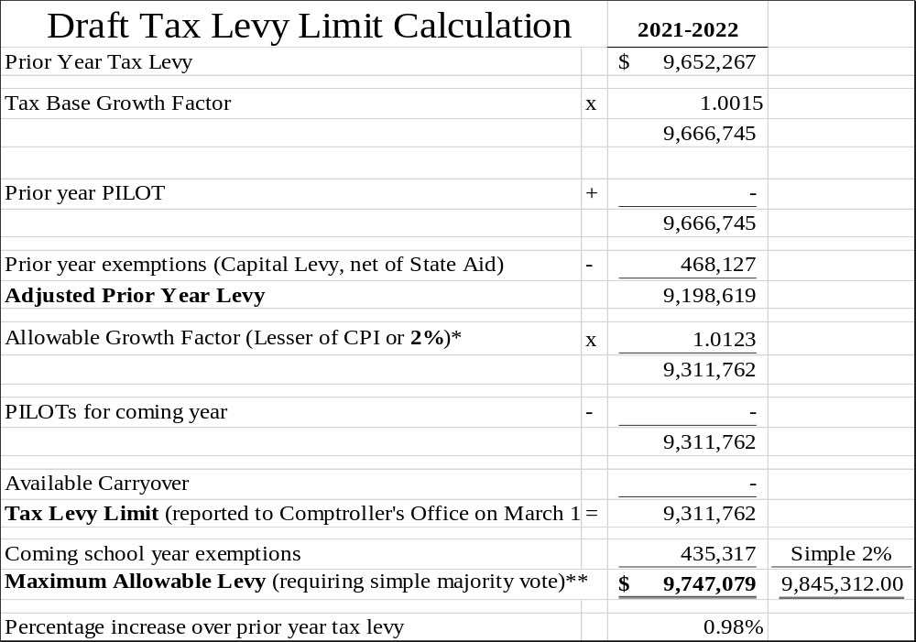
Draft Tax Levy Limit

Slide 5
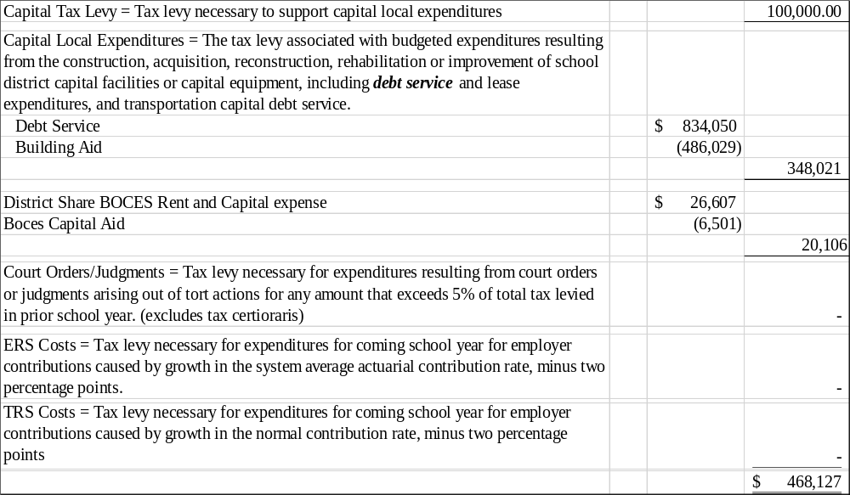
Draft Tax Levy Limit – 2020-21 EXEMPTIONS

Slide 6
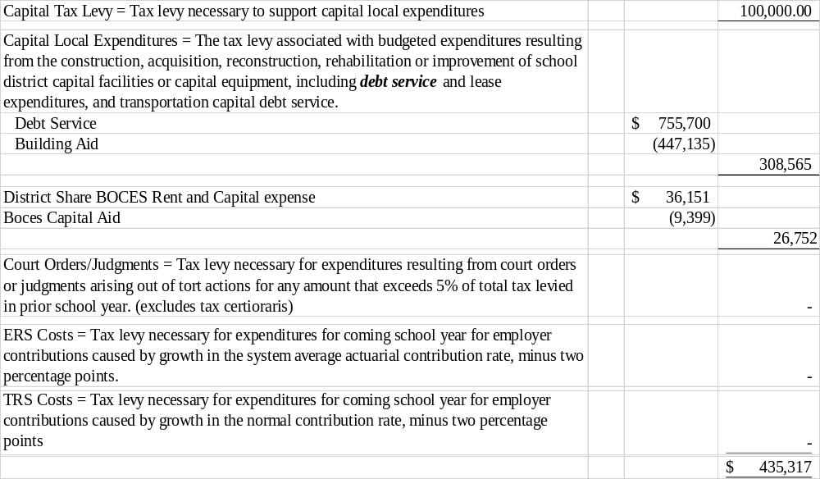
Draft Tax Levy Limit – 2021-22 EXEMPTIONS

Slide 7
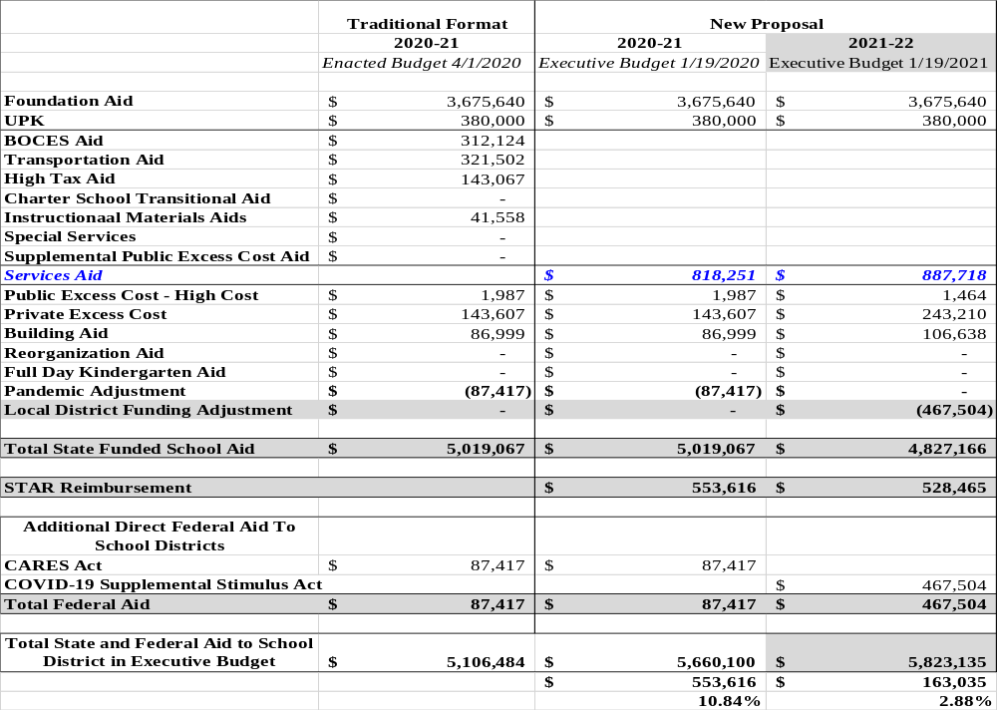
Proposed State Aid Revenue
Notes:
>This proposal is based on NYS receiving an additional $6 Billion in Federal Aid
>The Governor's Total Aid figure includes the STAR Reimbursement which districts don’t typically think of as state aid, but rather as a reimbursement for the exempted STAR amount on the tax bills
>The Services Aid Proposal combines aid categories (BOCES, Transportation, High Tax Aid Instructional Materials Aids)

Slide 8
2021-2022 Estimated Revenue

