Slide 1

Germantown Central School
2021-2022 Budget

Slide 2

Budget Calendar
November 2020-April 2021: Leadership Team Meets to discuss budget for 2021-22
December 9, 2020: BOE Adoption of budget calendar
February 10, 2021: Present 2020-21 preliminary budget forecast & budget assumptions to the BOE.
March 1, 2021: Submit 2020-21 calculation for tax levy limit to OSC, Tax & Finance & SED
March 30 – April 3 2021: Legal Notice of School Budget Hearing and Annual Budget Vote.
April 21, 2021 Board of Education Meeting: Board of Education considers adoption of finalized 2021-22 educational plan and budget. District submits property tax report card to SED within 24 hours of adoption.
April 19, 2021: Last Day to submit petitions for Board of Education candidates.
April 23, 2021: Final date for budget adoption by the BOE, plan for voting with Columbia County Board of Elections.
April 26, 2021: Property tax report card must be submitted to SED within 24 hours of budget adoption, but no later than April 26, 2021
April -May 18, 2021: Budget available at the school, and public/free association libraries in the District
May 5, 2021: Budget Hearing
May 5-12 2021: Budget Notices mailed to all residents
May 18, 2021: Annual Meeting/Board Election/Budget Vote, 12:00 PM –9:00 PM

Slide 3
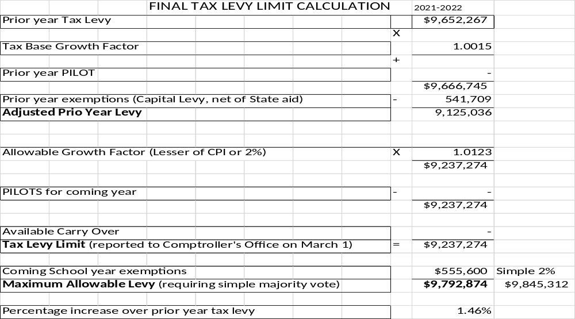
Final Tax Levy Limit Calculation

Slide 4
State Aid Revenue
 | 20-21 Budget | 21-22 State Budget | Adjustments | Reason for Adjustment | 21-22 State Aid
Foundation Aid (20% withheld 2020, Returned 2021) | $3,675,640 | $3,794,409 | $118,769 | Additional Aid | $3,794,409
Special Aid Adjustment/State/Fed | -$86,975 | -$1,001,938 |  | Special Aid | -$1,001,938
Universal Pre-K | $380,000 | $380,000 | -$380,000 | PreK is separate
Building Aid | $233,804 | $425,352 | $191,548 | Cap Project | $425,352
Access Cost Aid | $234,387 | $17,070 | $217,317 | Less outside Placements | $17,070
BOCES | $333,186 | $332,688 | $1,001 |  | $332,688
Transportation | $356,601 | $372,185 | $15,584 |  | $372,185
Textbooks | $39,761 | $29,533 | $10,228 |  | $29,533
Computer Hardware Aid | $3,154 | $3,102 | $52 |  | $3,102
High Tax Aid | $143,067 | $143,067 |  |  | $143,067
Other State/Software | $70 | $10,466 | $10,396 |  | $10,466
Total | $4,944,838 | $5,127,872 | -$380,000 |  | $5,127,872
UPK | $380,000 | $380,000 |  |  | $380,000
Total after Special Aid | $5,324,838 | $5,507,872 |  |  | $5,507,872

Slide 5
Local/Other Revenue
Other Revenue
Interest and Penalties | $20,000
Interest on Deposits | $45,000
BOCES Refund | $30,000
Medicaid | $45,000
Refund Prior Exp. | $85,000
Donations | $2,000
Total | $227,000
Local Revenue
Real Property Tax | $9,264,409
STAR | $528,465
Total | $9,792,874

Slide 6
2021-2022 Estimated Revenue

Slide 7
Item | Description | Proposed 2021-22
General Support | Board of Education, District Central Administration, Business Office, Finance, Legal Services, BOCES Support | $571,158
Operations | Operation of Plant, Maintenance of Plant, Insurance, BOCES Support | $1,504,603
Teaching-Regular School | Principals, Teachers, Support Personnel, Professional Development, Special Programs for Students (Outside of GCSD), Textbooks, Supplies, Equipment, BOCES Support | $4,273,239
Special Ed., Occ Ed., Tech, Guidance, Library, Health, Extra-Curricular | Programs/Staff for students with disabilities, BOCES Occupational Education programs, Regular Education Summer Programs, School Library, Instructional Technology, Guidance Services, Health Services, Co-Curricular Activities, Interscholastic & Athletic Programs | $3,382,013
Transportation | Transportation Services for all students who reside in the District, Fuel | $958,750
Employee Benefits, Debt Service, Special Education Summer School | Retirement, Medical Insurance, Social Security, Workers Compensation, Unemployment Insurance, Principal and Interest on Bonds, District Share of Support for Special Education Summer Program | $5,641,419
Total $16,331,182
Spending Plan

Slide 9
The spending plan, as presented, is the product of an extensive examination of previous years’ expenses, revenue reductions due to the COVID-19 emergency and the anticipated needs of our students in 2021-22.
This spending plan is within the tax levy limit (tax cap) of 1.46%.
 | Spending Plan | Anticipated Revenues
Recommend Expenses | 16,331,182
Anticipated Revenues |  | 15,147,746
Appropriated Reserves |  | 150,000
Appropriated Fund Balance |  | 1,033,436
Projected Fund Balance From Current School Year |  | 1,100,000
Federal Special Aid |  | 1,001,938
 | 16,331,182 | 16,331,182
2020-2021 Fund Balance Revenue Expected - $1,100,000
Purpose is to support staffing and in-person learning transition, closing
gaps, and bring back electives.
Summary

Slide 10
The Spending Plan, as presented, is the product of an extensive examination of all previous years’ expenses and anticipated needs of our students in 2021-2022.
Our goal is to re-allocate staffing positions decimated by the COVID-19 pandemic while providing our district ample electives for student success while closing achievement gaps.
Recommend Expenses $16,331,182
Anticipated Revenues $15,147,746
Fund Balance Use $1,033,436
Appropriated Reserve Use $150,000
Projected Fund Balance Return $1,100,000
Federal Special Aid $1,001,938
This Spending plan is within the tax cap
Summary

