Slide 1
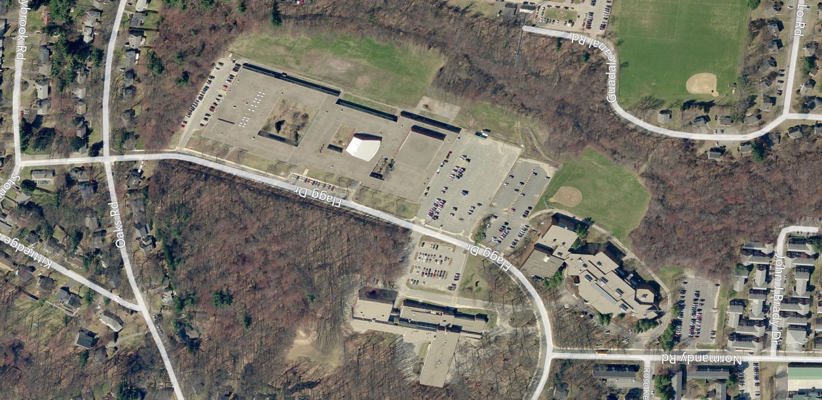

Framingham Public Schools
Fuller / Farley
Pre-Feasibility Study
Overview
Thursday, October 6, 2016
Farley Middle School
Fuller Middle School
BARGMANN HENDRIE + ARCHETYPE, INC.

Slide 2
Pre-Feasibility Study
Assess Fuller and Farley Building Conditions
Conditions Assessments and Recommendations
Repairs v. Comprehensive Renovation
Required Code and Accessibility Upgrades
Site Issues
Evaluate Options for Renovation / New Construction
  Renovation / Hybrid / New Construction
Assist with MSBA Process
Identify requirements and process
Help prepare relevant information

Slide 3
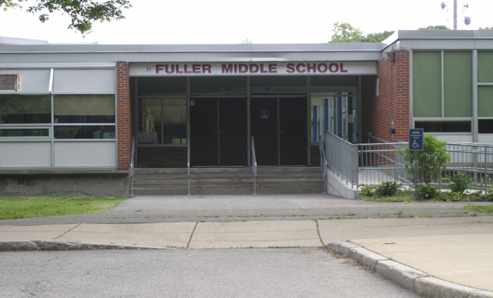
Fuller Building

Slide 4
Fuller Middle School
Built in 1958
Formerly Framingham South High School
Single Story, 196,000 SF Building
  Cast-in-place concrete structure on pile foundation
Fuller MS uses ~160,000 SF 447 Students
Non-school uses ~36,000 SF
  Buildings & Grounds
  Framingham Public Access TV
  ACCEPT Transportation
  ESL Program Offices

Slide 5
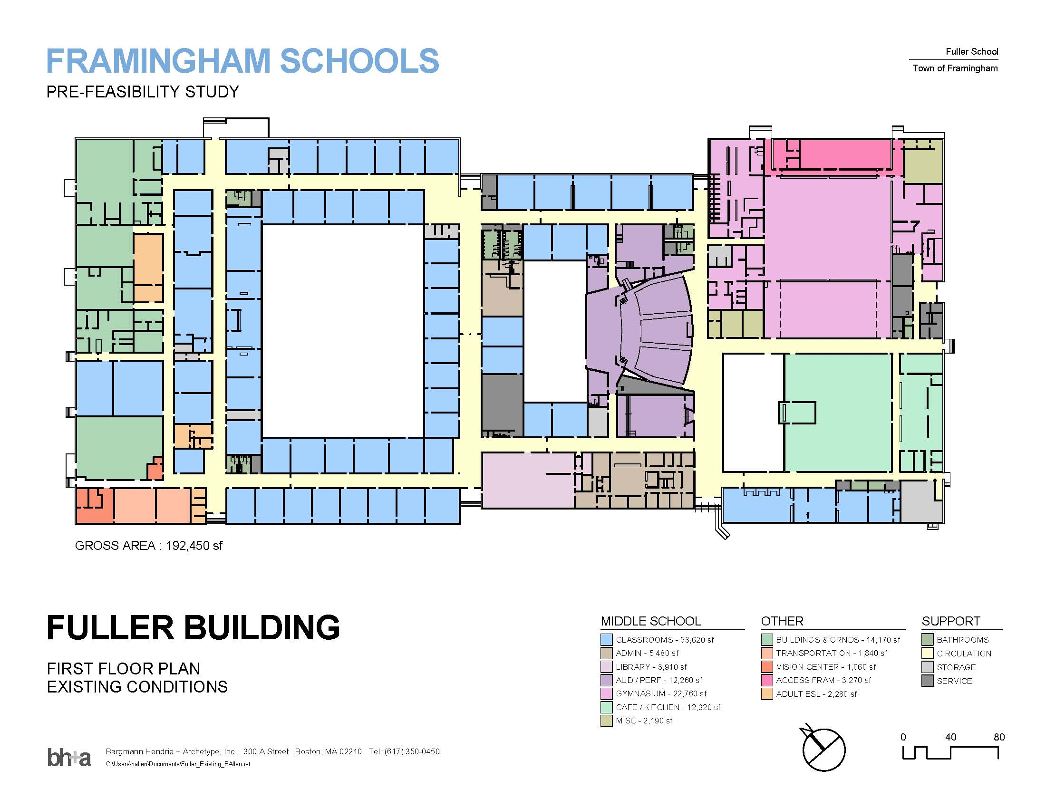
Existing 196,000 SF Fuller Middle School

Slide 6
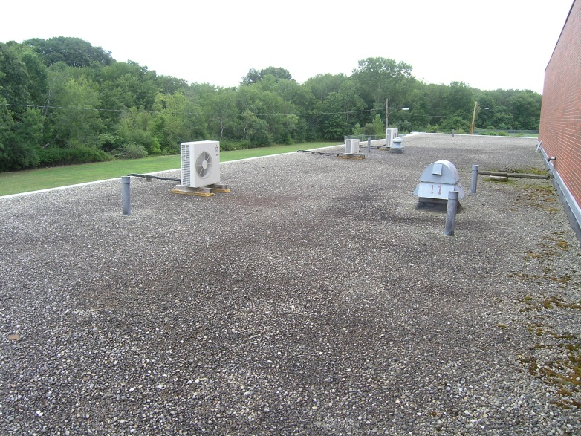
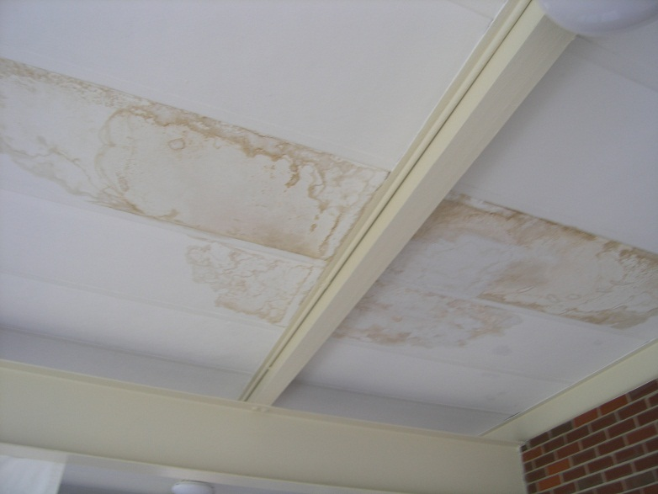
Fuller Building
Roof has organic growth, poor drainage and ongoing leaks
Roof warranty expires in 2014
Moisture has affected roof structure and interior spaces
    Users complain of odors
$4M estimated cost for roofing replacement
    30% structural roof deck replacement additional

Slide 7
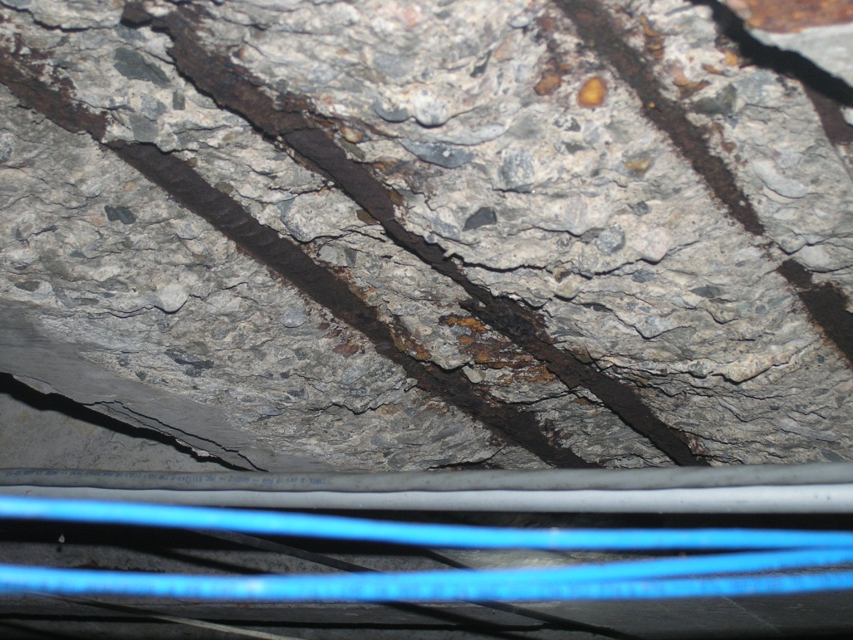
Fuller Building
Building is on concrete pile foundation
Crawl space below first floor is used to route MEP systems piping
Floor slab has rusted reinforcing and spalled concrete.
Repairs & insulation required

Slide 8
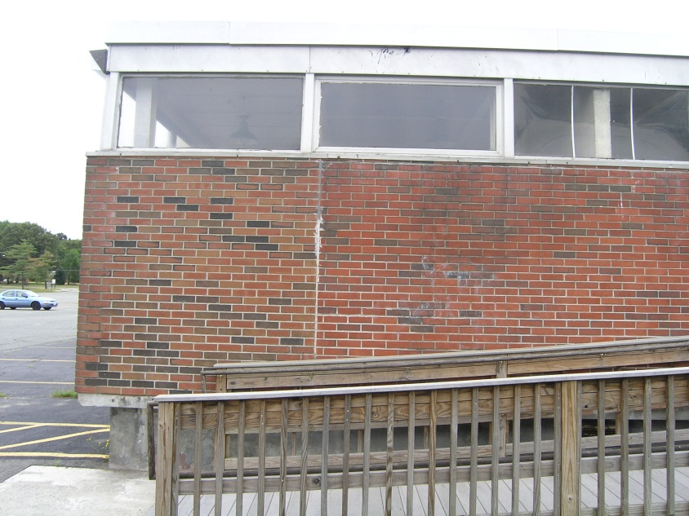
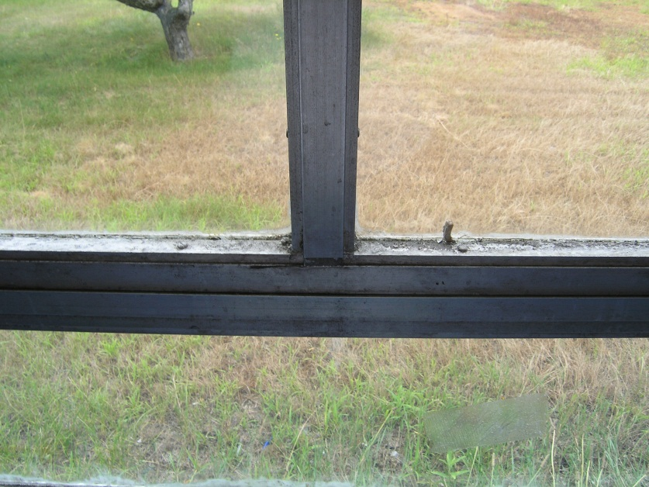
Fuller Building
Original 1950’s aluminum windows are deteriorating.
Heat-loss and solar-gain through single glazing increases energy consumption
Renovation would require full window replacement

Slide 9
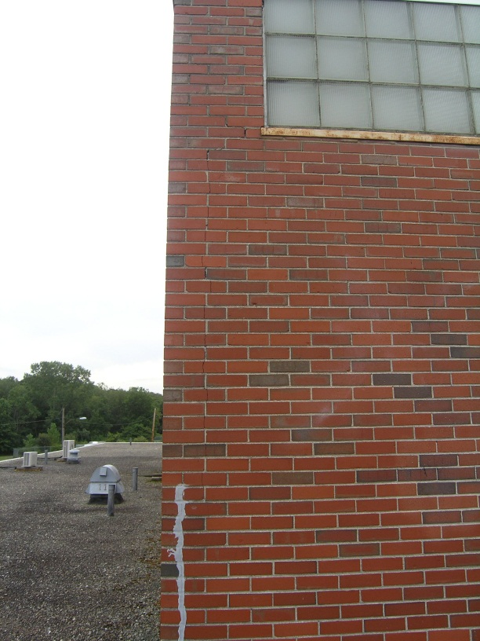
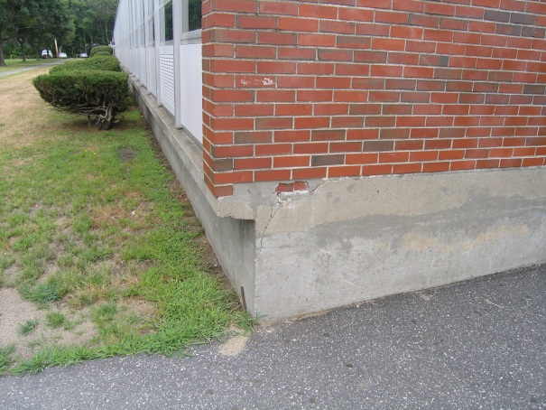
Fuller Building
Masonry cracks allow moisture to enter the building
Inadequate masonry expansion joints exacerbate deterioration
Water infiltration has caused concrete spalling and brick deterioration

Slide 10
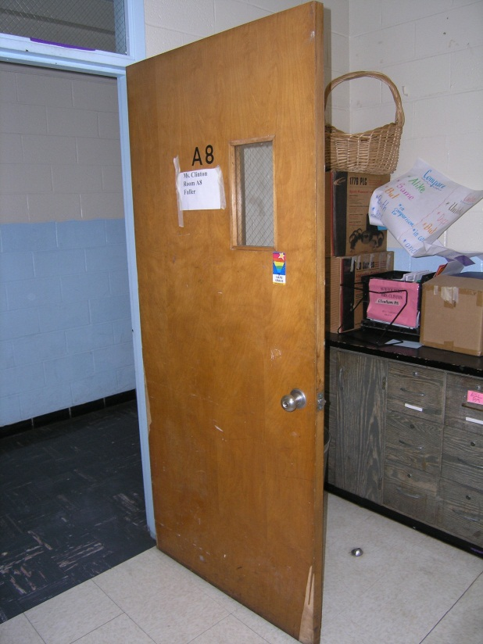
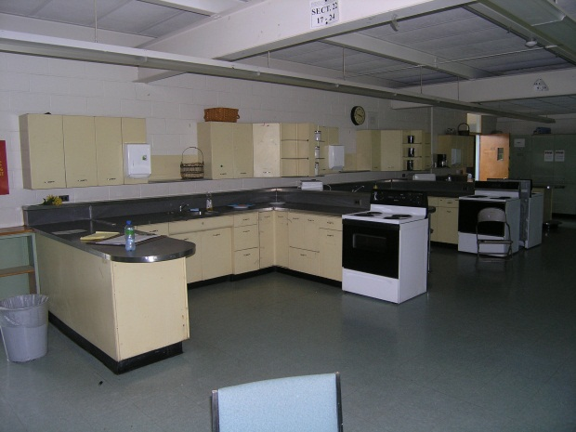
Fuller Building
Doors, hardware, and other components do not meet MAAB and ADA accessibility requirements
Built-in casework is not accessible
Full renovation would require building to meet MAAB accessibility requirements

Slide 11
Fuller Building
Conclusions:
Building systems are at the end of useful life
Systems will be increasingly costly to maintain
    Repairs more frequent and extensive
Code compliance will require costly work
5-year Capital Requirements could exceed $10 Million
  Concrete & Masonry $2,750,000
  Roofing $4,000,000
  Furnishings $ 800,000
  Fire Suppression $1,000,000
  HVAC $ 650,000
  Electrical $ 200,000
  Utilities & Site Improvements $ 850,000

Slide 12
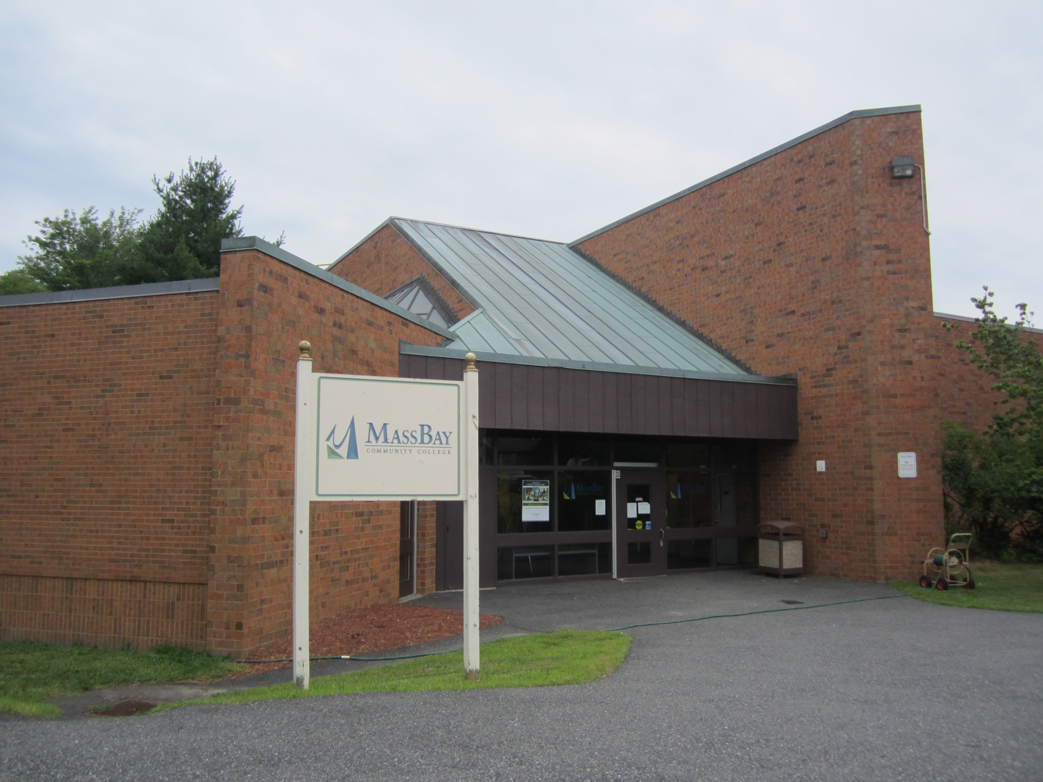
Farley Building

Slide 13
Farley Building
Built in 1973 as Junior High School
  Identical layout to Barbieri and Cameron (before 2000 renovation)
Currently leased to Mass Bay Community College
2-story, 114,000 SF Building with split-levels
10,000 SF Pool area is unused

Slide 14
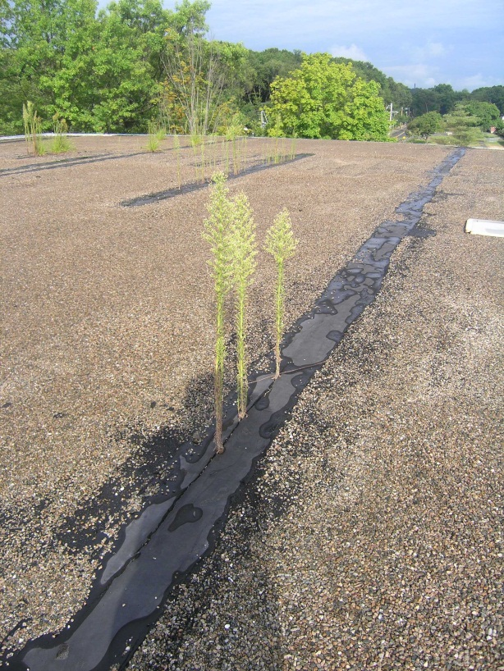
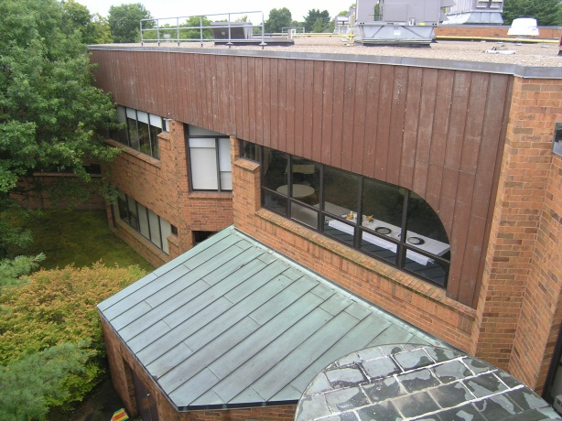
Farley Building
Roof above pool wing requires replacement
Exterior wood panels are rotted and require replacement
Windows are generally serviceable
Masonry is in good condition

Slide 15
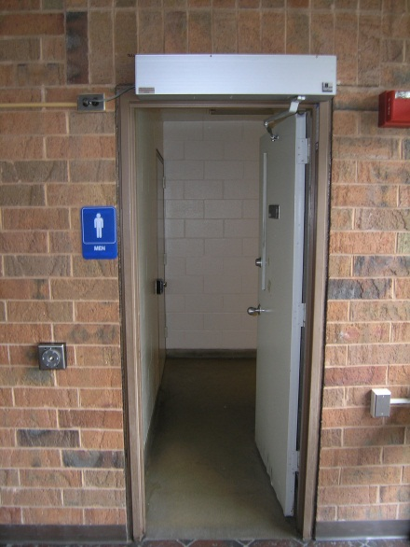
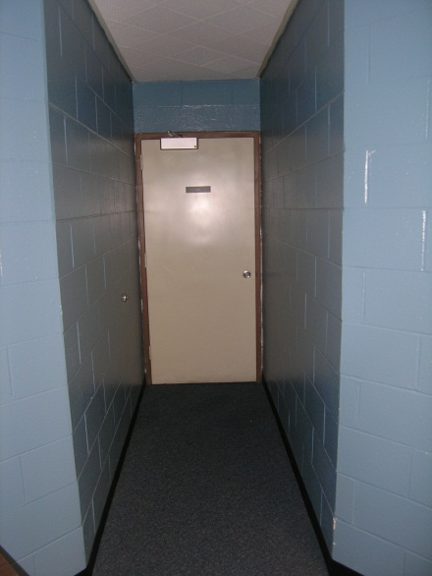
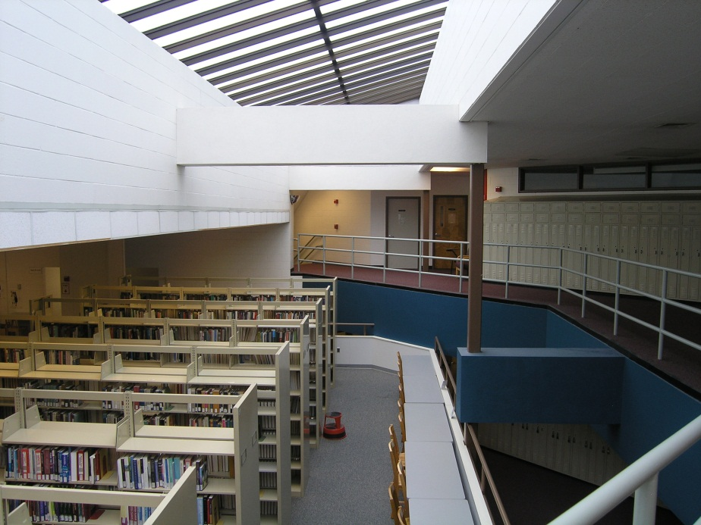
Farley Building
Some accessibility compliance work has been done at toilet rooms
Clearances at doors are difficult to achieve with existing partitions
Guardrails are non-compliant and require retrofit

Slide 16
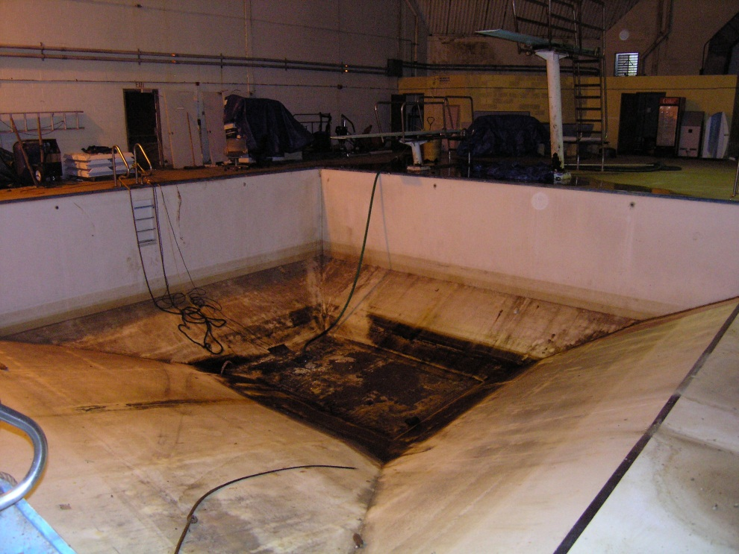
Farley Building
The abandoned swimming pool leaks groundwater into pool
10,000 SF requires full renovation into non-pool usable space
    Kitchen
    Cafeteria

Slide 17
Farley Building
Conclusions:
Building is in reasonably sound condition
Work will be required to update and maintain building
Pool, accessibility upgrades and life safety are significant capital projects
5-year Capital Requirements approach $5 Million
  Superstructure & Exterior Envelope $1,600,000
  Roofing $ 200,000
  Interior Construction (kitchen, cafeteria, MAAB) $1,500,000
  Fire Suppression $ 600,000
  Plumbing $ 750,000
  Electrical $ 350,000
  Utilities & Site Improvements $ 50,000

Slide 18
Redevelopment Options
Site Constraints
Fuller Middle School 120,000 SF ~700 Students
    100% Renovation
    100% New
    Hybrid – Renovate core; new classrooms
Farley Middle School 120,000 SF ~700 Students
    100% Renovation
    100% New
    Hybrid – Renovate core; new classrooms
K-8 Options 196,000 SF ~1,250 Students
    Single School
    Farley Middle School with Fuller Elementary School

Slide 19
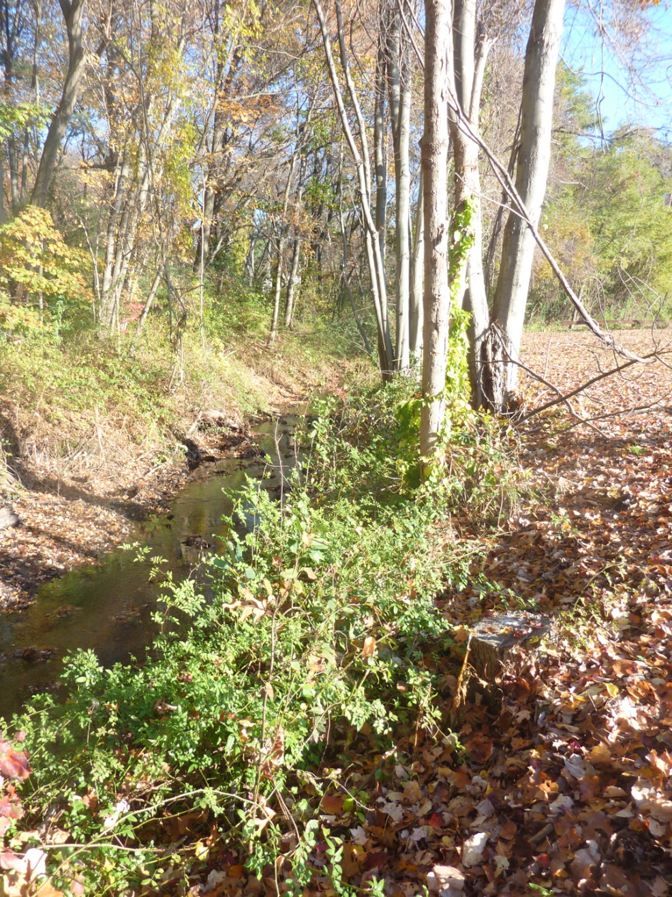
Site Constraints
Zoning
Wetlands
Parking

Slide 20
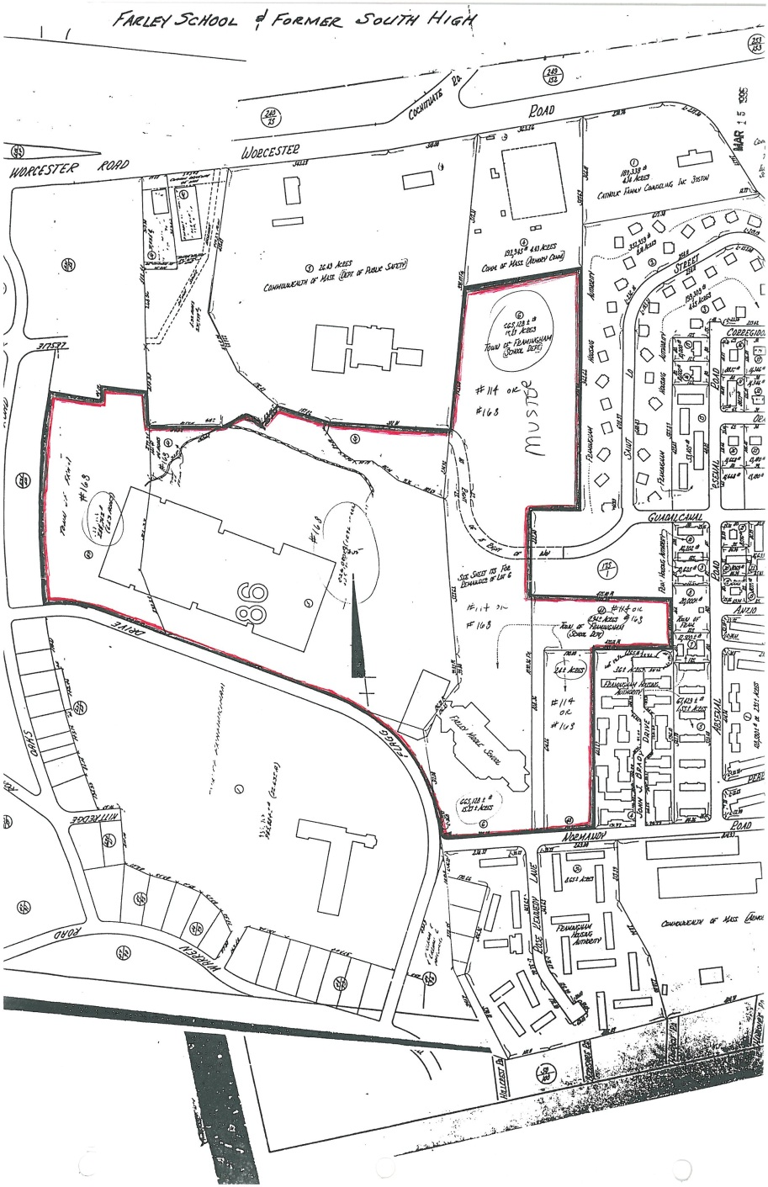
Zoning Issues
Property area includes Muster fields
Zoning By-Law dictates
Maximum building height
Maximum lot coverage
Setback requirements
Parking requirements

Slide 21
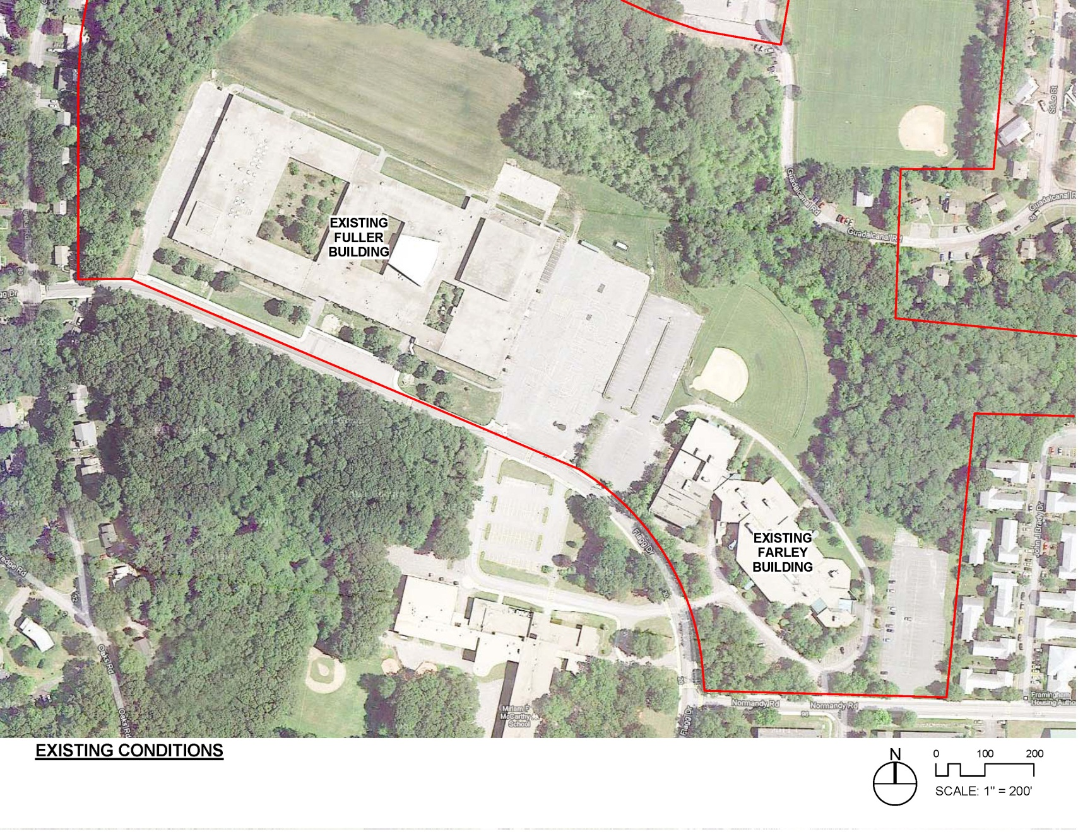
Site Aerial

Slide 22
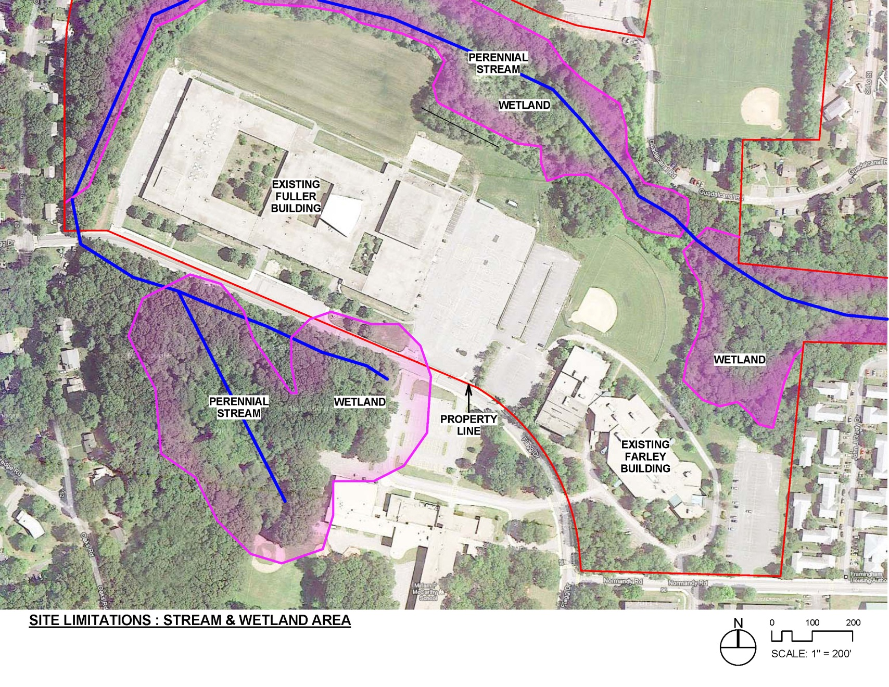
Stream and Wetlands

Slide 23
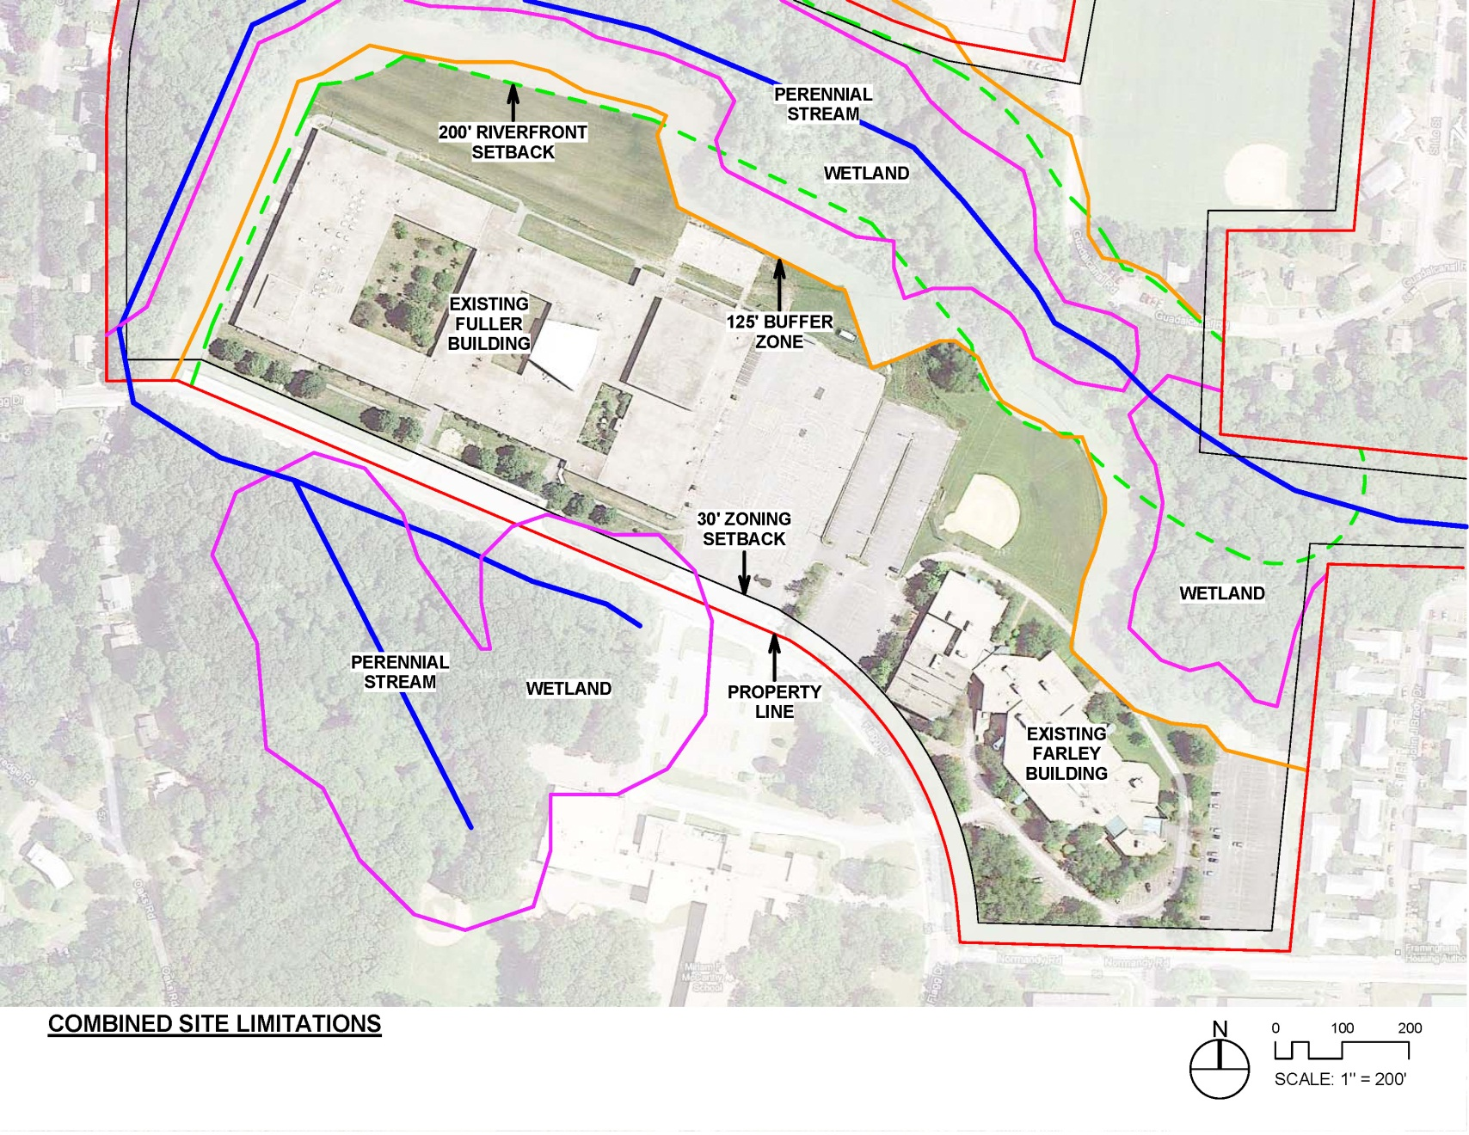
Buildable Area

Slide 24
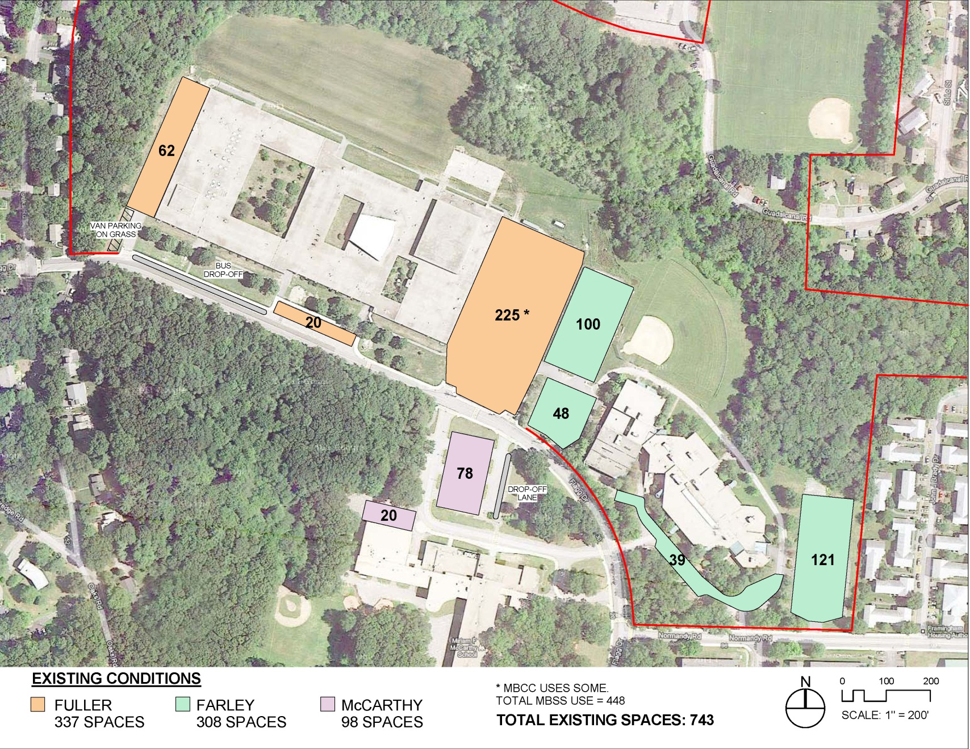
Existing Parking

Slide 25
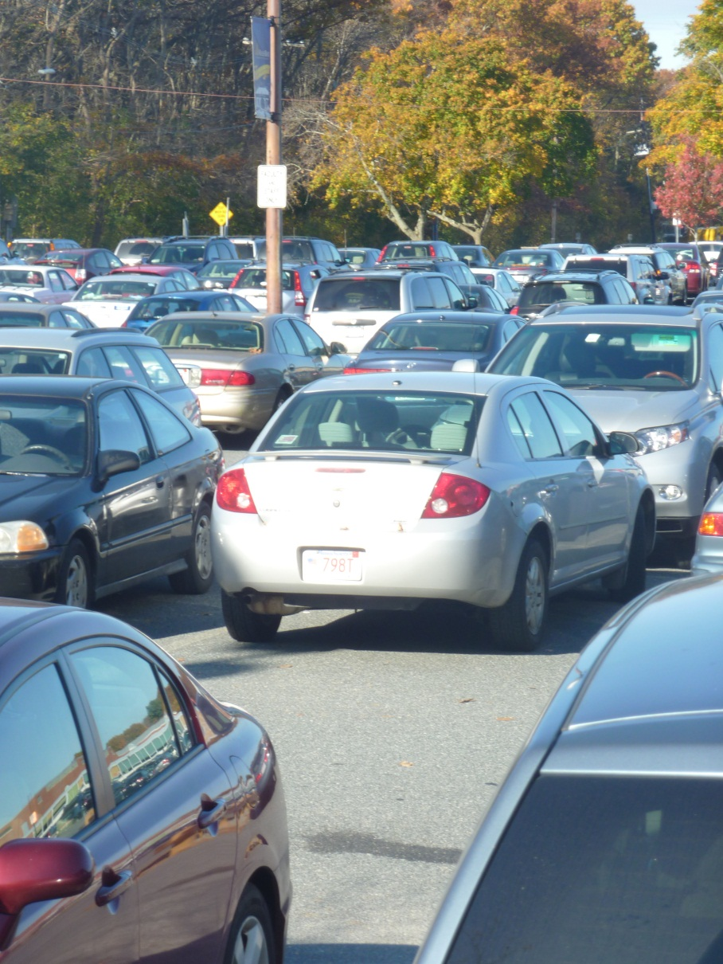
Parking Issues
Middle School w/ 700 students
    160 staff requires approximately 145-170 spaces plus visitor parking
ESL program and evening school uses drive higher need
Desire to relocate parking for 76 buses and 70 bus-driver cars, possibly to this site

Slide 26
Site Limitations
Buildable area is limited to existing building footprints and parking areas between Fuller and Farley
3-story, 35 foot height limitation imposed by zoning
Parking demand must be taken into account
Existing non-school users need a home, too

Slide 27
Program Issues
School | Total Size (GSF) | Students | GSF per student
Existing Fuller Middle School Program | 160,000 * | 447 | 358
MSBA Program Template (675 students) | 98,400 | 675 | 146
Walsh Middle School | 201,000 | 701 | 287
Cameron Middle School | 114,000 | 563 | 202
Program for New / Renovated Middle School | 120,000 | 650-800 | 150-185
*196,000 gsf – 36,000 gsf non-middle school uses.

Slide 28
Existing 196,000 SF Fuller Middle School

Slide 29
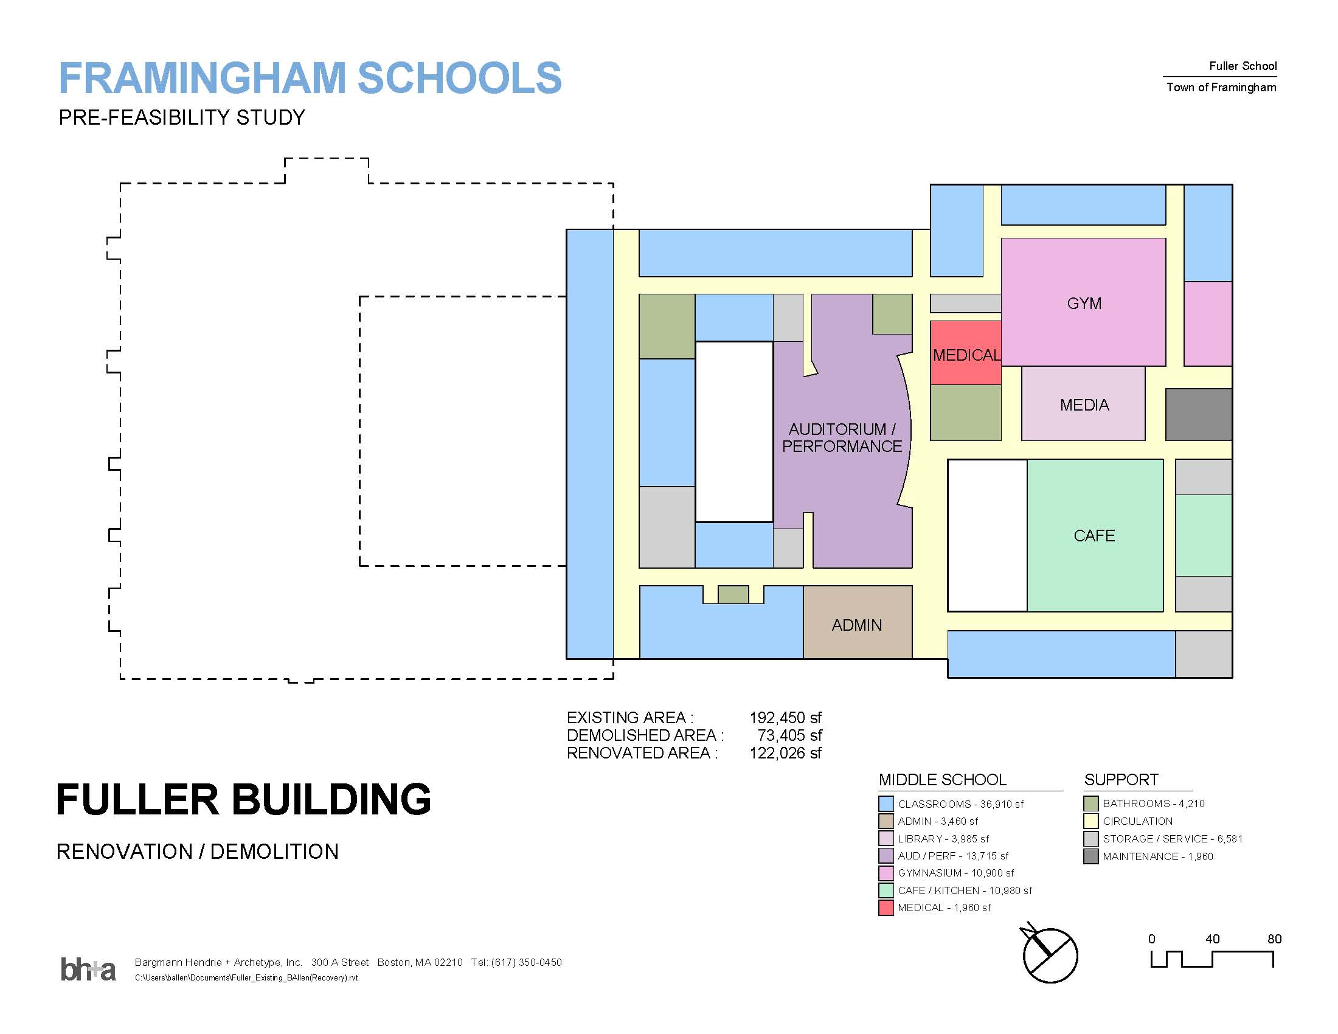
Renovated 120,000 SF Fuller Middle School

Slide 30
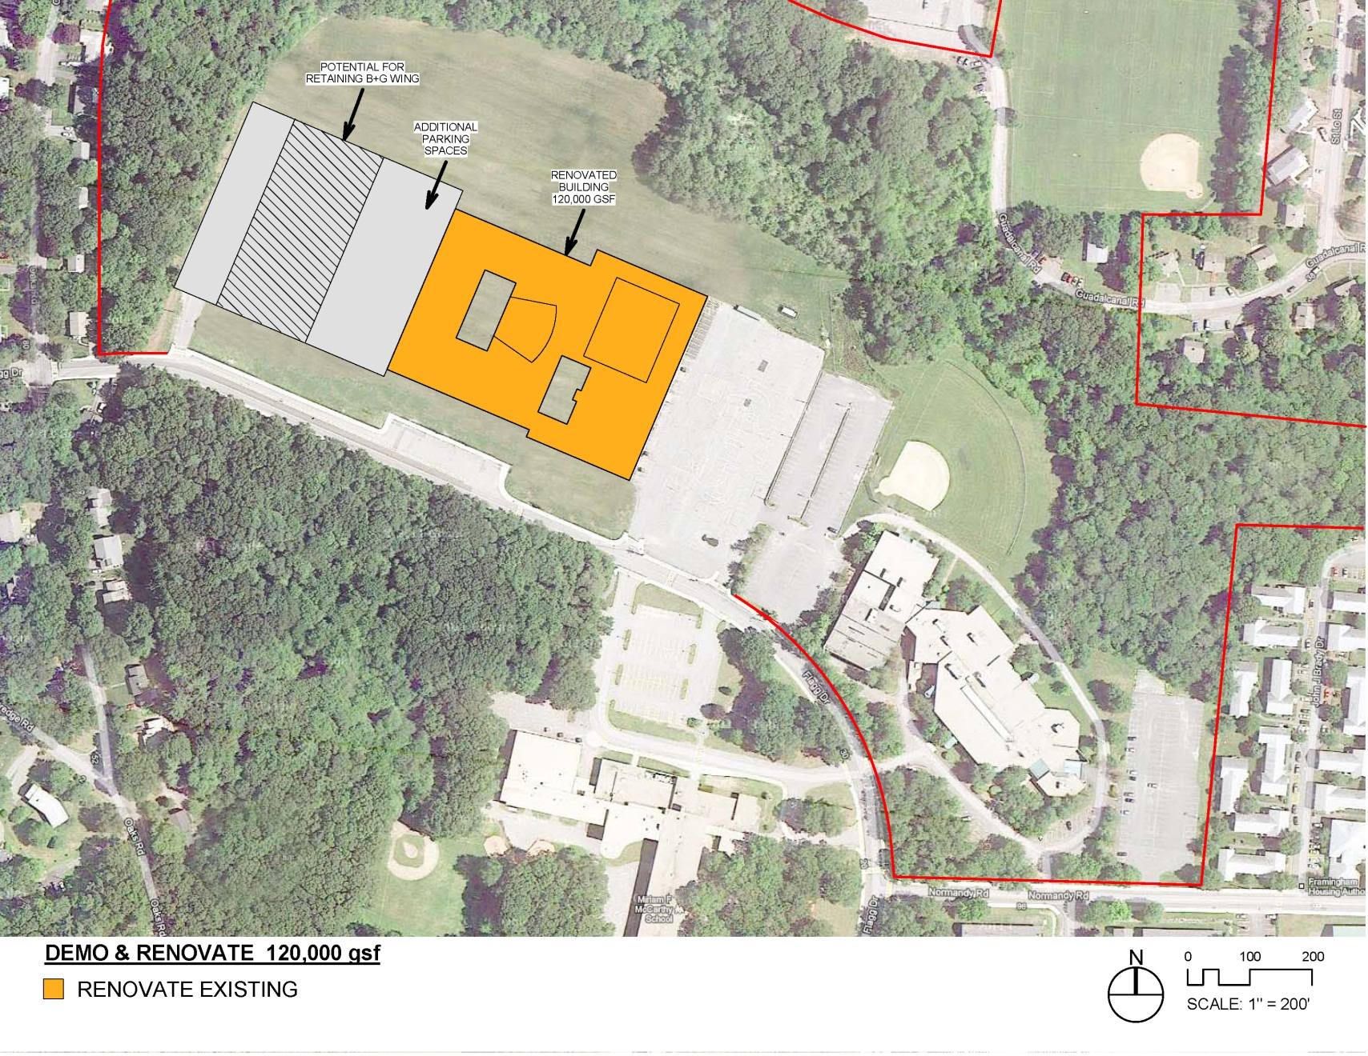
Renovated 120,000 SF Fuller Middle School

Slide 31
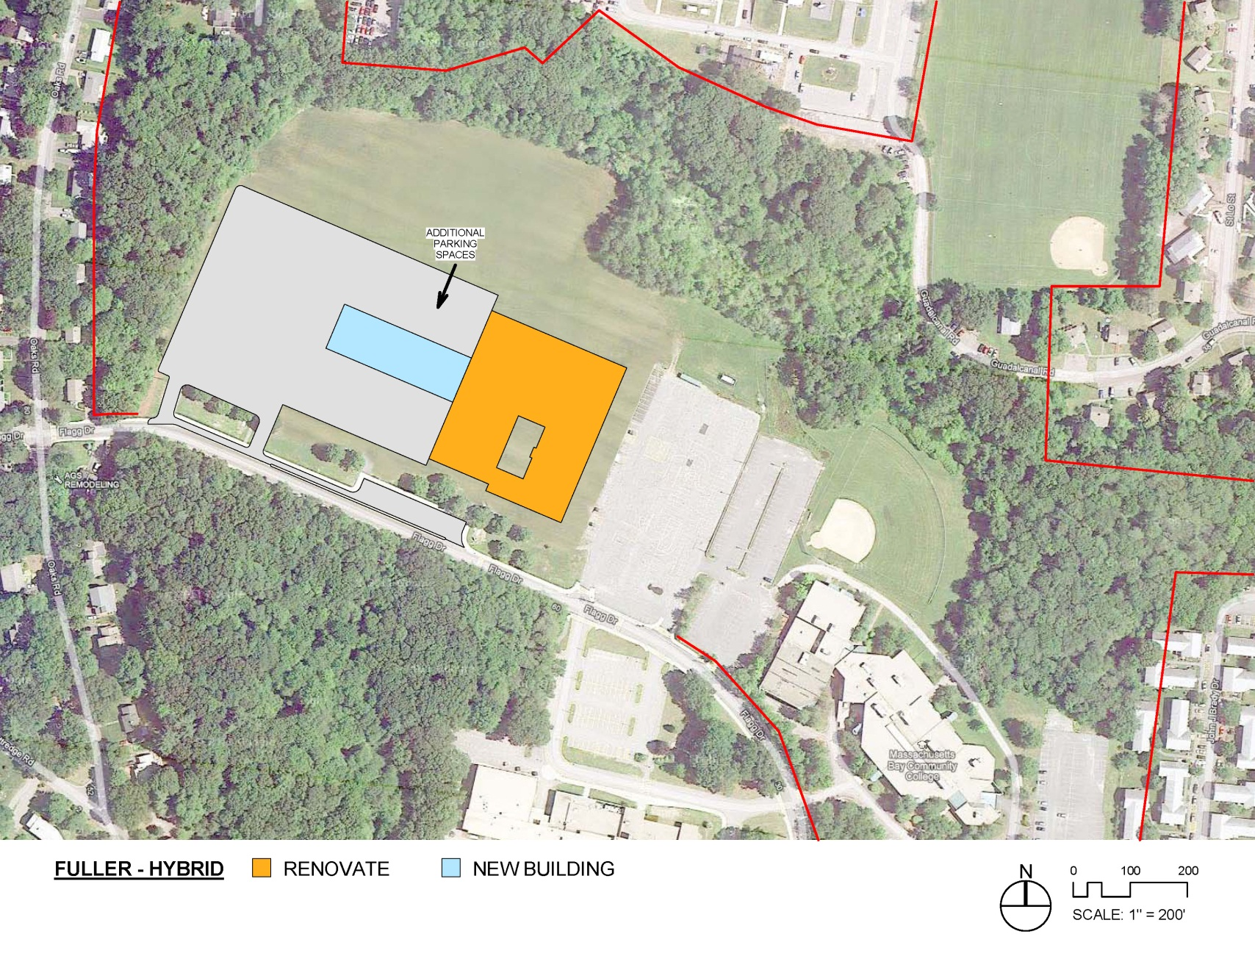
Hybrid 120,000 SF Fuller Middle School

Slide 32
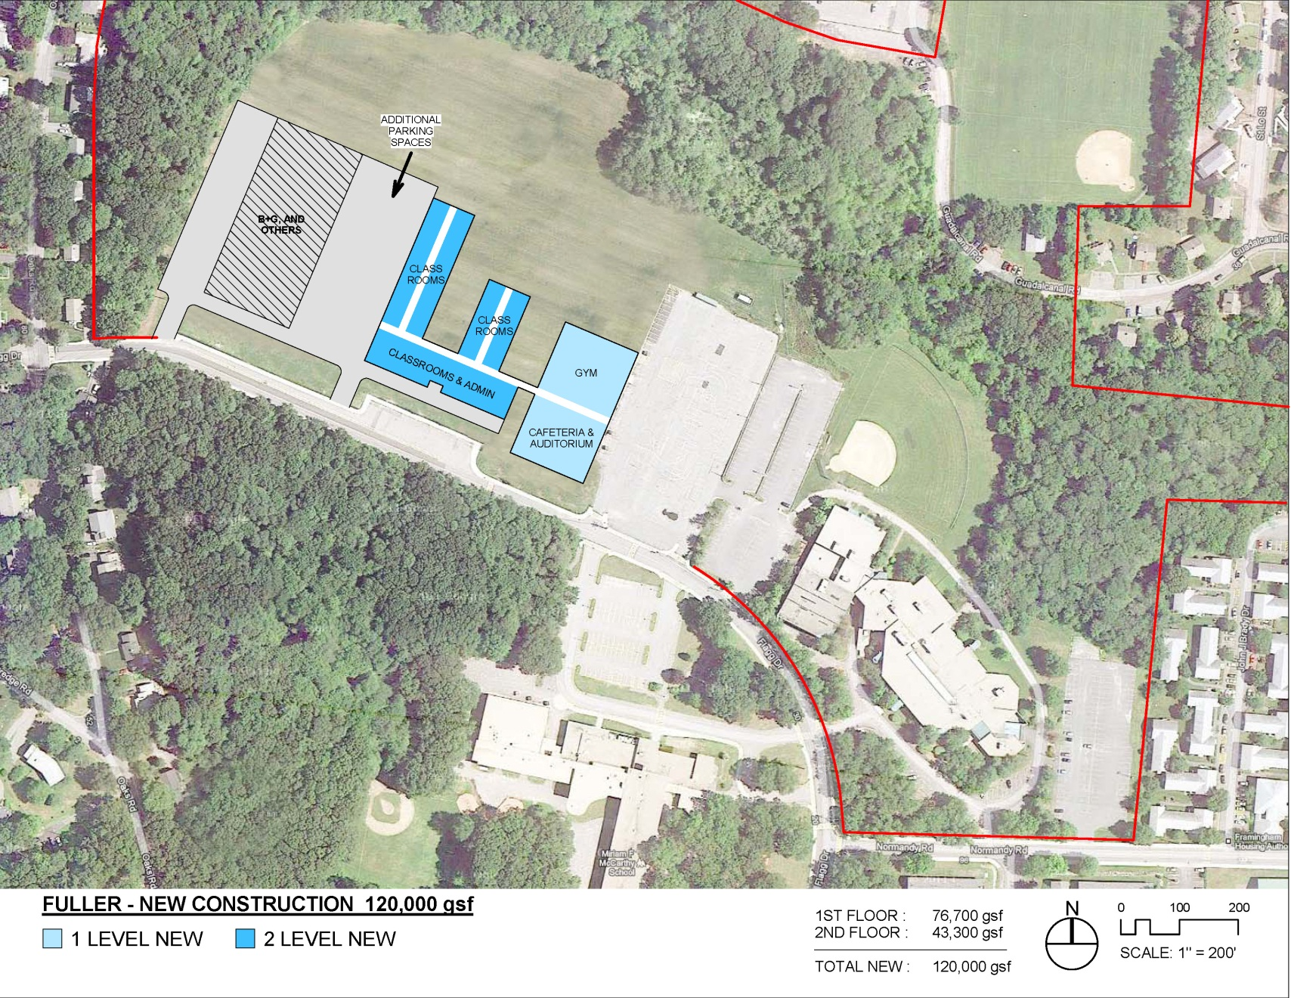
New 120,000 SF Fuller Middle School

Slide 33
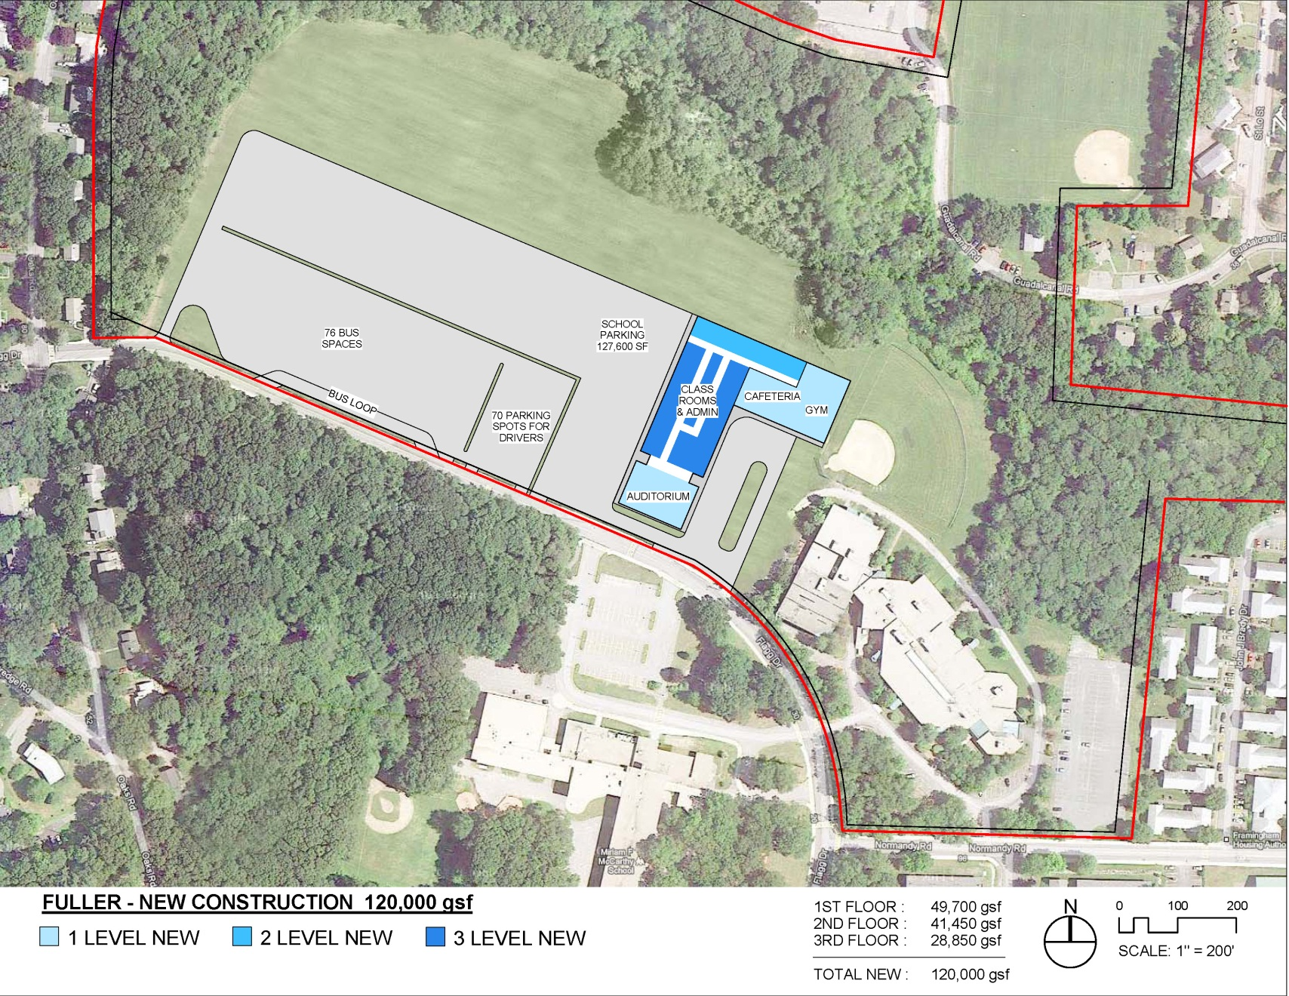
Alternate New 120,000 SF Fuller MS

Slide 34
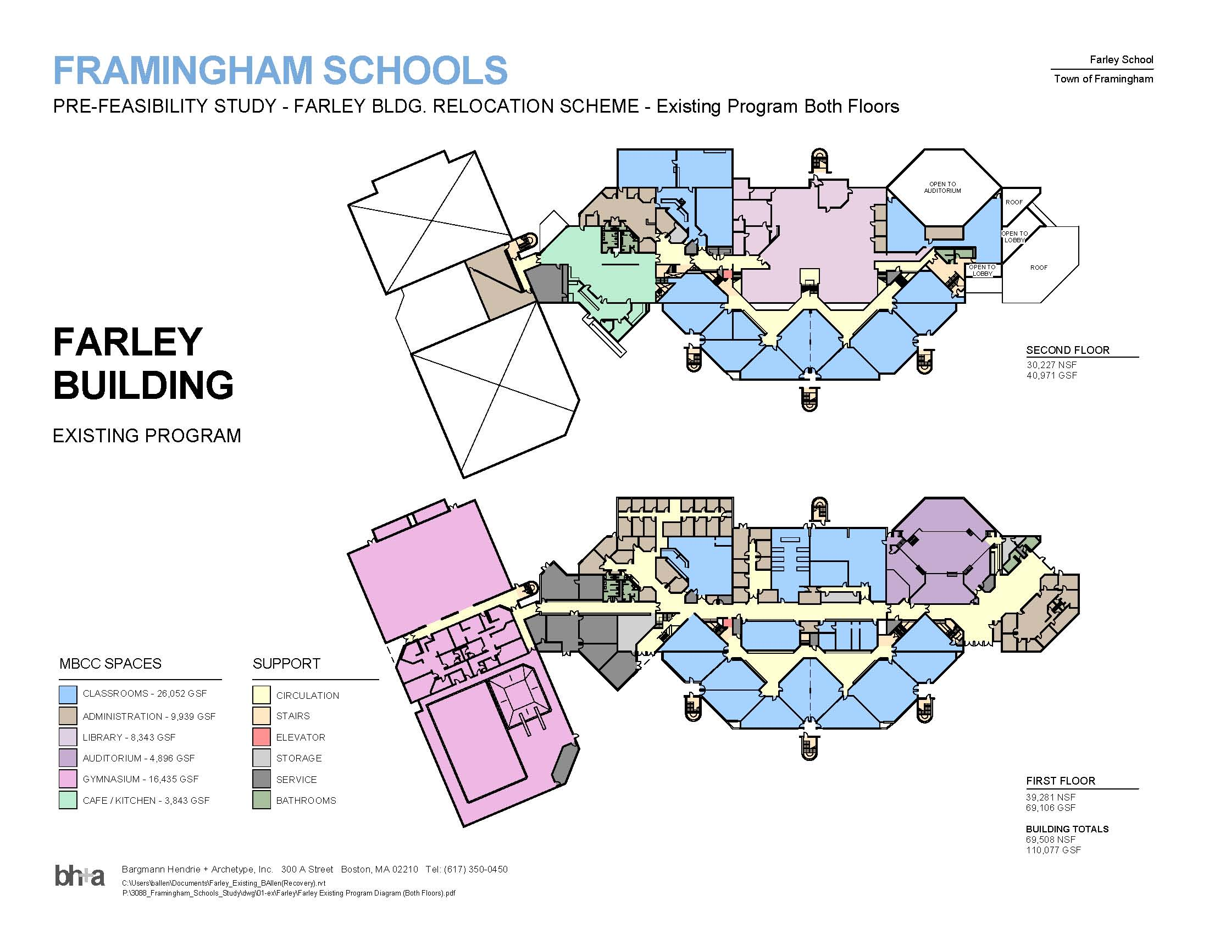
Existing 114,000 SF Farley Building

Slide 35
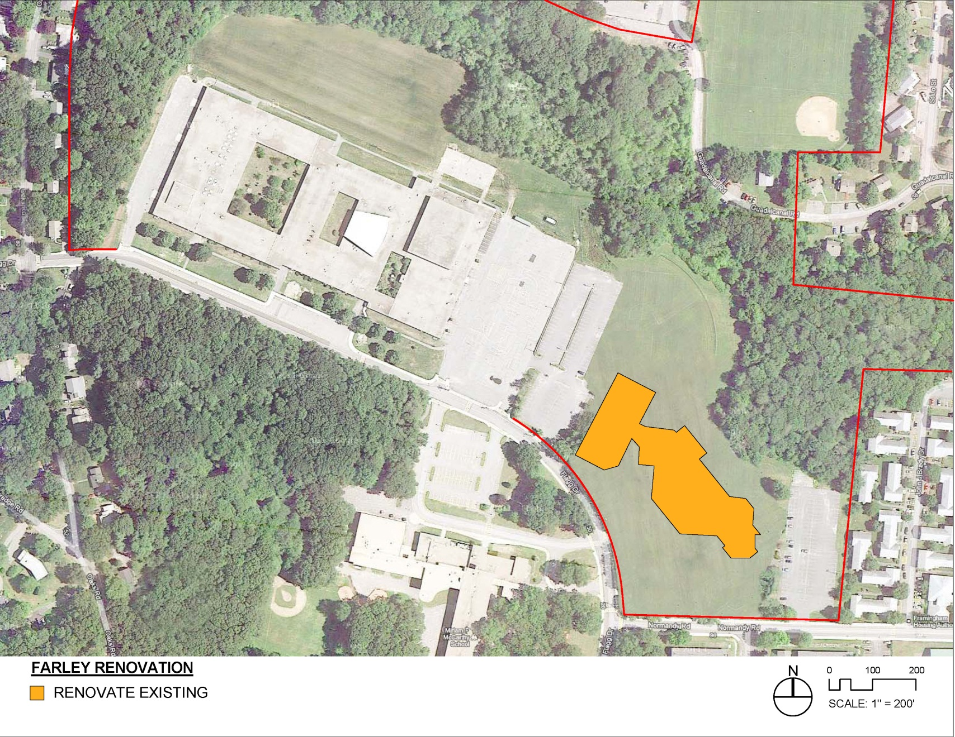
Renovated 120,000 SF Farley Middle School

Slide 36
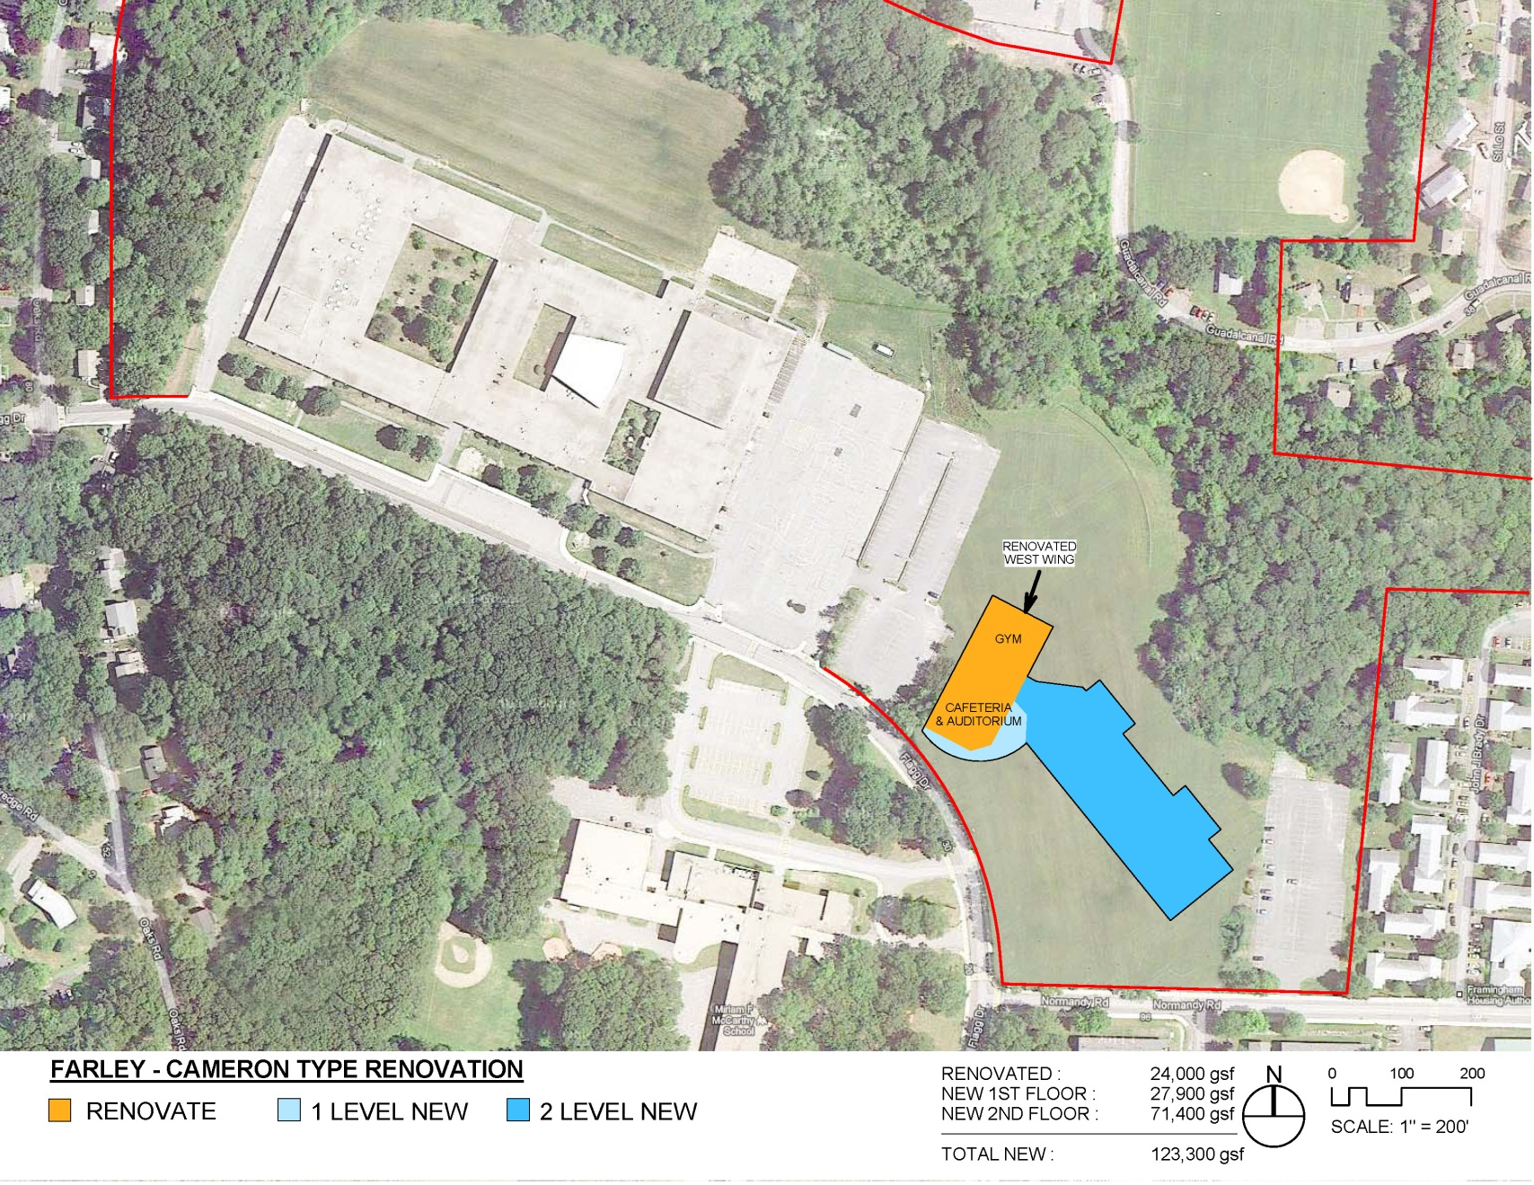
Hybrid 120,000 SF Farley Middle School

Slide 37
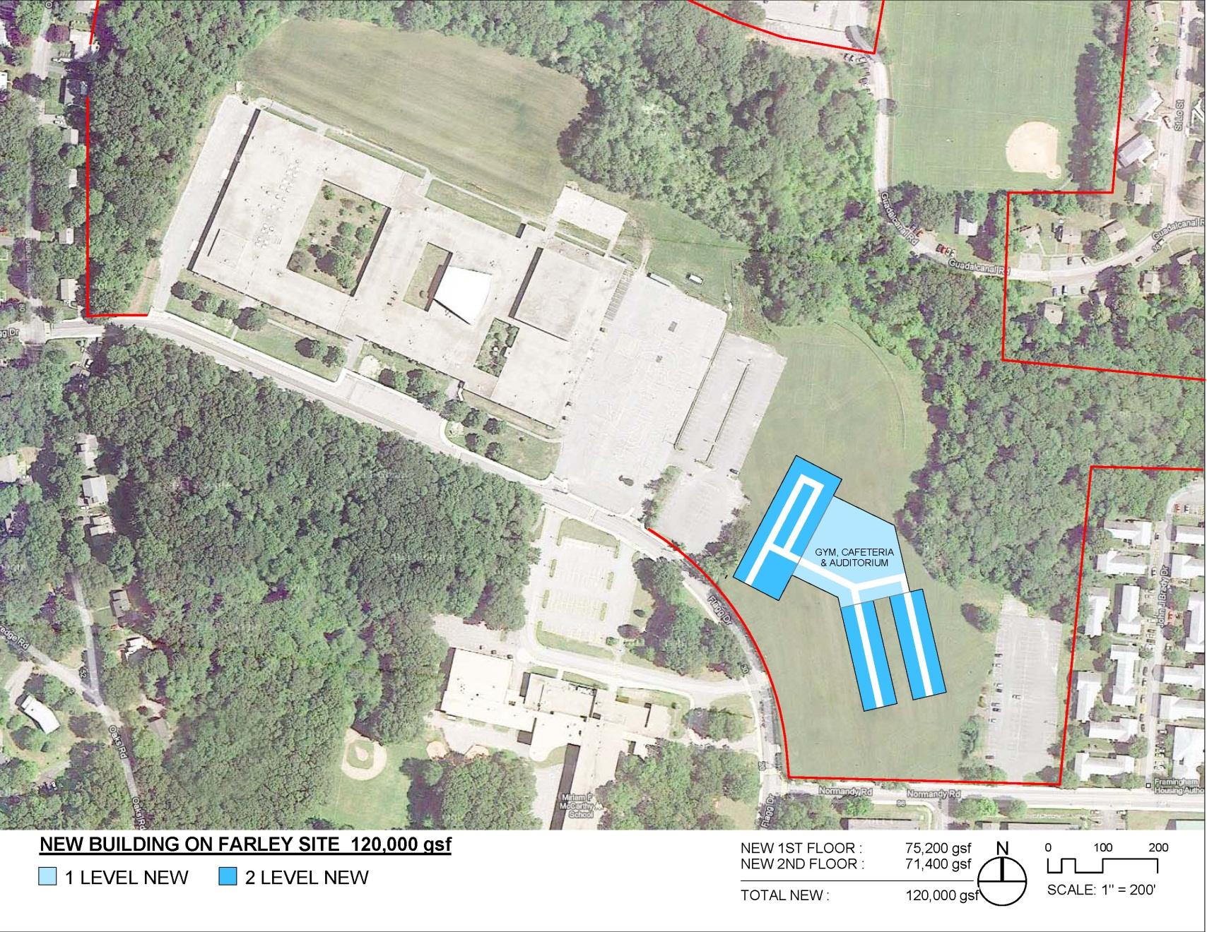
New 120,000 SF Farley Middle School

Slide 38
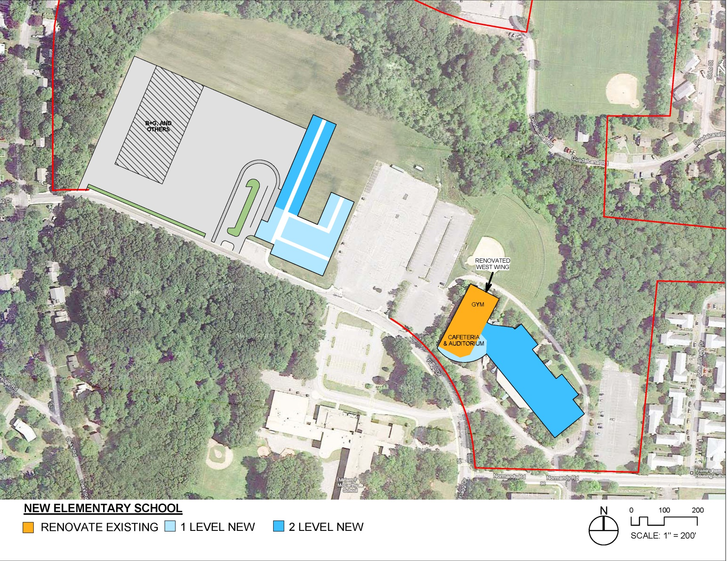
Hybrid Farley MS and New Fuller ES

Slide 39
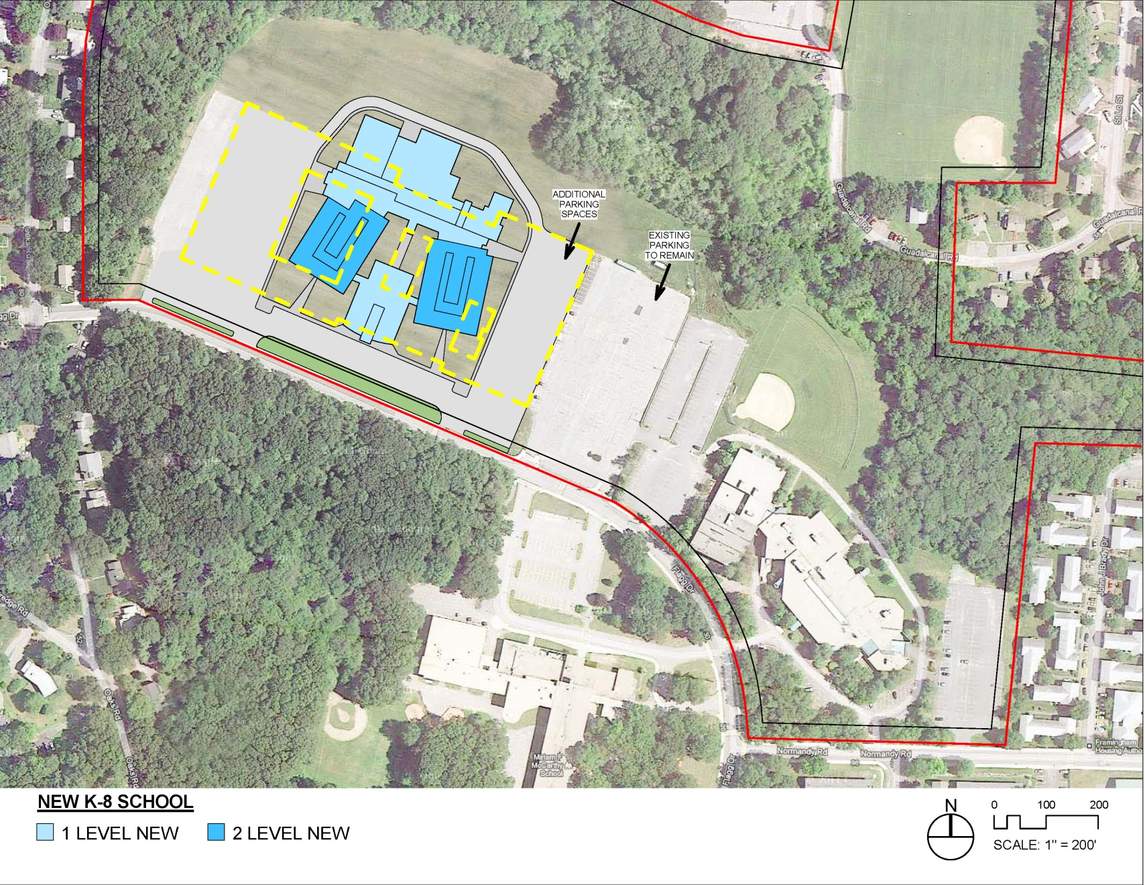
New 196,000 SF Fuller K-8

Slide 40
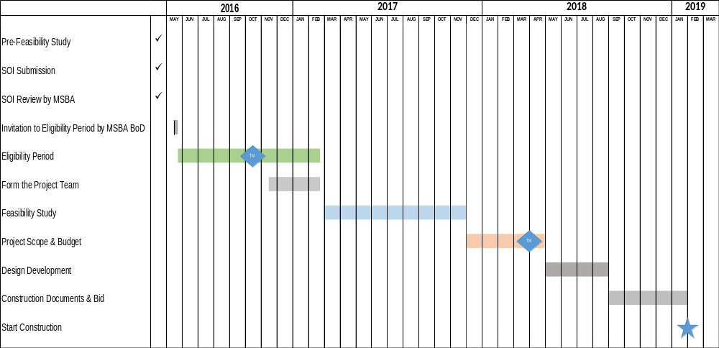
MSBA Process

Slide 41
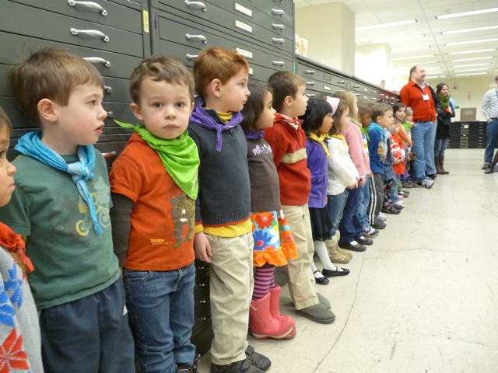

Questions?

