Slide 1
Framingham Public Schools
Space Needs Strategy

Slide 2
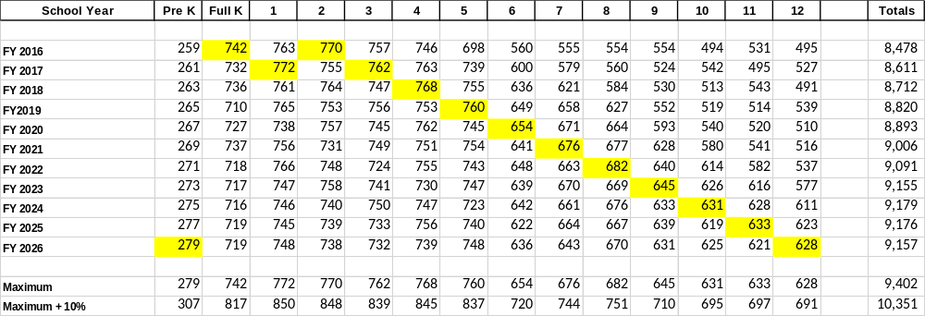
Projected Enrollment

Slide 3
Enrollment Impact on Classroom Needs
Class of 2026 creates maximum demand
  Currently in 2nd grade
Classroom needs based on maximum student population + 10%
Classroom needs driven by multiple factors
  FPS/Teacher Contract maximum class size
  FPS target class size
  Increasing demand for small group teaching spaces
  Evolving impact of technology
  Need for updated STEAM space at all grade levels

Slide 4
Defining the Problem
Class of 2026 establishes maximum school population
Middle schools have adequate number of classrooms
  Fuller MS is obsolete … but in the pipeline for upgrade
High School is most pressing need for space
Class of 2026 enters HS in 6 years (September 2022)
Use of large classrooms for small group instruction exacerbates space constraints
Obsolete infrastructure needs technology space upgrade at all grade levels

Slide 5
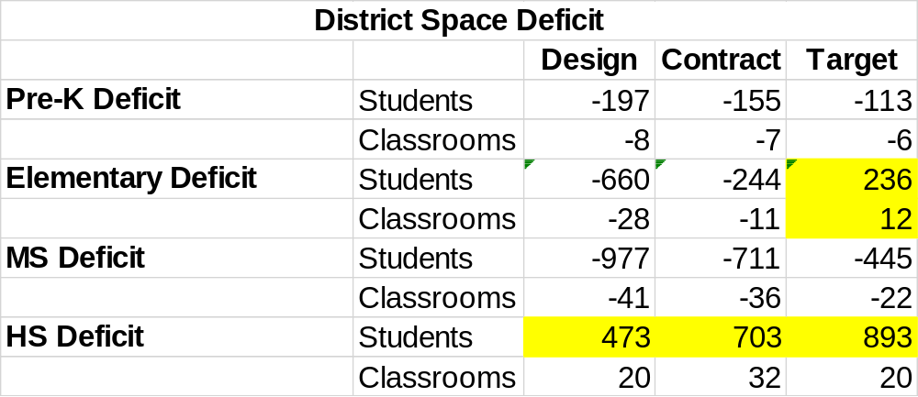
District Space Constraints

Slide 6
Developing a Strategy
Class of 2026 is currently in 2nd Grade
Will age out of elementary school before ES solution can be executed
New Fuller MS will upgrade quality of MS spaces in 2020
Fuller K-8 could relieve ES pressure and provide needed ES quality upgrade
New HS in 2022 would relieve pressure for Class of 2026
Added small instruction spaces could free-up larger classrooms
Added technology spaces could upgrade quality of existing buildings

Slide 7
A Possible Approach – Phase 1
Work with MSBA to develop long-range plan
Build new Fuller K-8
  Open in September 2020
  What to do with Fuller students during 2-year construction period?
Start planning new HS immediately
  Open in September 2022
Develop small instruction Modules to add to existing buildings
Develop technology Modules to add to existing buildings

Slide 8
A Possible Approach – Phase 2
Build MS campus at former HS site
  Replace Cameron & Walsh
  Open in 2024
Begin renovation/replacement of ES after MS campus
  Use Cameron/Walsh as swing-space
  Get on 3-year cycle for elementary school projects
  Set school renovation priority
  What about Farley?
Stay in touch with MSBA
Consider non-MSBA alternates

Slide 9
Review How Schools are Utilized
Elementary School
K-5
Middle School
6-8
High School
9-12
Learning to Read
Reading to Learn
Adolescence
Young Adults
Transition to College & Work-force
K-2
3-4
5-7
8-10
11-12
MCAS/PARCC

