Slide 1
CM at Risk v.
Design-Bid-Build
Alternate delivery methods for Fuller-Farley School Project
December 1, 2016

Slide 2
Overview
Design-Bid-Build
CM at Risk
OIG Approval Process for CMR
CMR Selection Process
Advantages/Disadvantages

Slide 3
Design
Bid
Build
Program by Designer & District
Program & Schematic Design (+) approved by MSBA
Project Budget Fixed with MSBA
Design Development with Dual Estimates
Construction Documents with Dual Estimates
  60%
  90%
Pre-qualify GCs
Pre-qualify Filed Sub-Bidders
  18 Categories of Work
Consider E-Bidding
Advertise
Receive Filed Sub-Bids
Receive GC Bids
Award Contract
Temporary Facilities
Relocation of existing students & programs
18 – 24 Month Construction Schedule
Possible Multi-phase Project
Commissioning by MSBA
  MEP CxA
  Enclosure CxA
Training
Close-out

Slide 4
CM at Risk
Approval by OIG Required
Select CMR
  Phase 1 – Qualifications
  Phase 2 – Fee Proposal
Probably on-board at beginning of Design Development Phase
Support for Designer & District During Design and Bidding
  Scheduling
  Estimating
  Constructability Review
  Phasing Plans
  Temporary Facilities
  Trade Contractor Pre-Qualification (same categories as Filed Sub-Bidders)
  Approval of subcontractor pool by District is required
Cost
  Pre-construction fee ~$150 - $200K
  General Conditions ~6-7%
  Contingency ~2%
  Fee ~2.25% - 2.75%

Slide 5
OIG Approval
Submit Application to OIG
  District has authorization from governing body to contract with CMR
  District has capacity, plan & procedures in place to procure and manage CMR
  Retained services of qualified OPM
  Procedures to ensure fairness in competition, evaluation and reporting throughout procurement process
  Building project >$5,000,000
  District has determined CMR is appropriate and states in writing reasons for determination
60-day Approval Period
  130 Applications to Date
  $6.4 Billion project costs

Slide 6
CMR Selection Process
2-Phase Selection
Probable CMRs
Qualifications Phase
  Issue RFQ
  Receive SOQs from respondents
  Rate respondents by Prequalification Committee
    Qualified
    Not-Qualified
Proposal Phase
  Issue RFP to Qualified CMR firms
  Evaluate Proposals on multiple factors
    Cost
    Team
    Approach
  Rate CMR firms on composite ratings – including fee proposal
  Negotiate contract with highest ranked firm
Agostini
Bond Brothers
Consigli
Dimeo
Gilbane
W.T. Rich
Shawmut Design & Construction
Skanska
Turner

Slide 7
Advantages of CMR
Disadvantages of CMR
Constructability review during design
Document review during design
Front-end specification support
Realistic phasing analysis
Estimate support during design
Existing condition
Open book accounting
Trade contractor prequalification support
Participation in subcontractor procurement
MBE/WBE compliance
Designer/District partnership with contactor
OIG approval required
Sophisticated OPM required
District participation requires District effort

Slide 8
MSBA Process from Feasibility Study to Project Funding Agreement Schematic Design

Slide 9
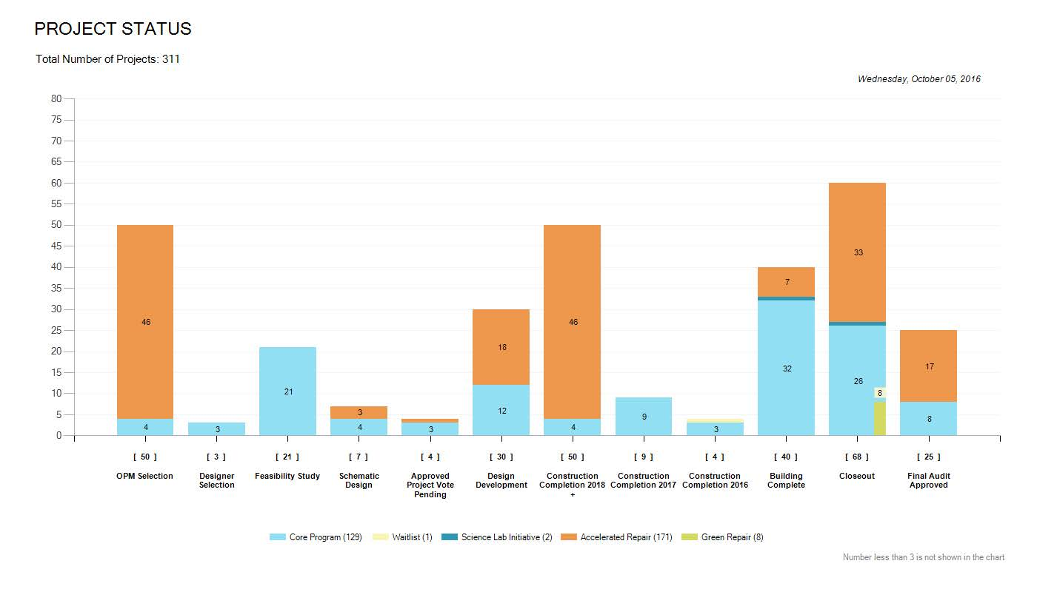

Slide 10
Participants
School Building Committee
Owner’s Project Manager (OPM)
Architect
MSBA

Slide 11
Module 3 Feasibility Study
3.1 Preliminary Design Program (POP)
3.2 MSBA review (approval) of Preliminary Design program
3.3 Preferred Schematic Report (PSR)
3.4 MSBA staff and Board Approval

Slide 12
Module 4 Schematic Design
DESE approval
Construction delivery method
Schematic Design document
Total project budget Form
Project Scope and Budget review with MSBA
MSBA board approval

Slide 13
Module 5 Project Funding
Town approval of Project Funding agreement

