Slide 1

Why the Bethany Property is Critical to the Future of Framingham

Slide 2

“The story of Framingham is the story of America.”
Framingham An American Town
by Stephen W. Herring

Slide 3
The Need
Capacity
Growth
Balance

Slide 4
October 2014 and 2015
October Report Comparisons
By Grade Level
 | Pre | Full K | 1 | 2 | 3 | 4 | 5 | 6 | 7 | 8 | 9 | 10 | 11 | 12 | Tot
October 2014 | 153 | 725 | 785 | 767 | 742 | 704 | 655 | 523 | 545 | 559 | 499 | 525 | 497 | 474 | 8153
October 2015 | 259 | 742 | 763 | 770 | 757 | 746 | 698 | 560 | 555 | 554 | 554 | 494 | 531 | 495 | 8478
Total Change | 106 | 17 | (22) | 3 | 15 | 42 | 43 | 37 | 10 | (5) | 55 | (31) | 34 | 21 | 325
K-12= 219
October 1 DESE Reports-Revised January, 2016

Slide 5
Continued Growth
October 1 to January 25= 100 additional K-12 students
Total net gain = 319 new K-12 students
Registrations continue on a daily basis

Slide 6
How Framingham Has Evolved

Slide 7
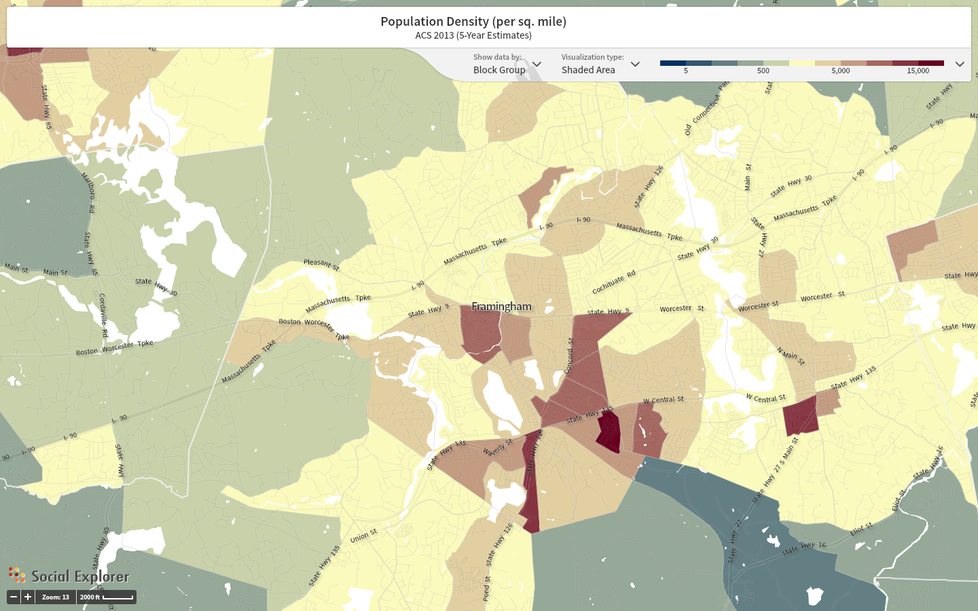

Slide 8
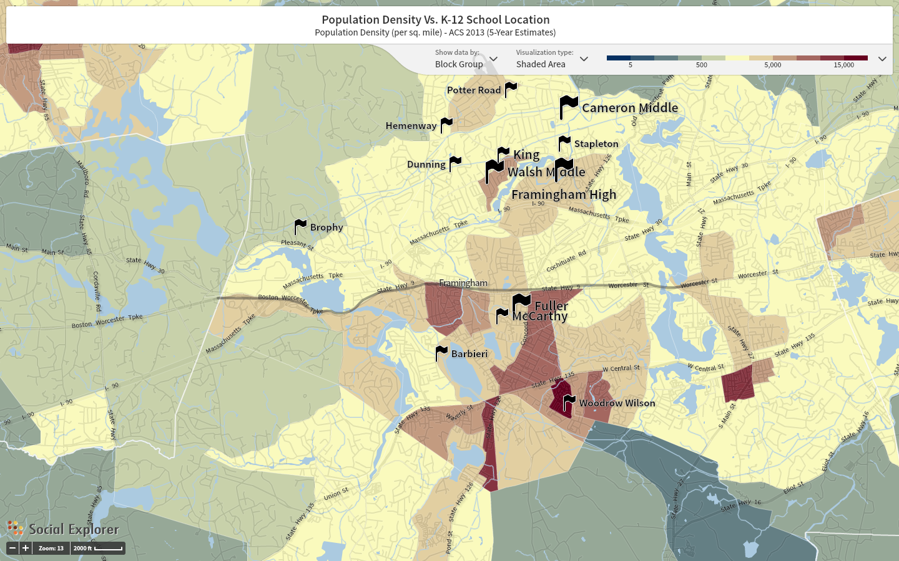

Slide 9
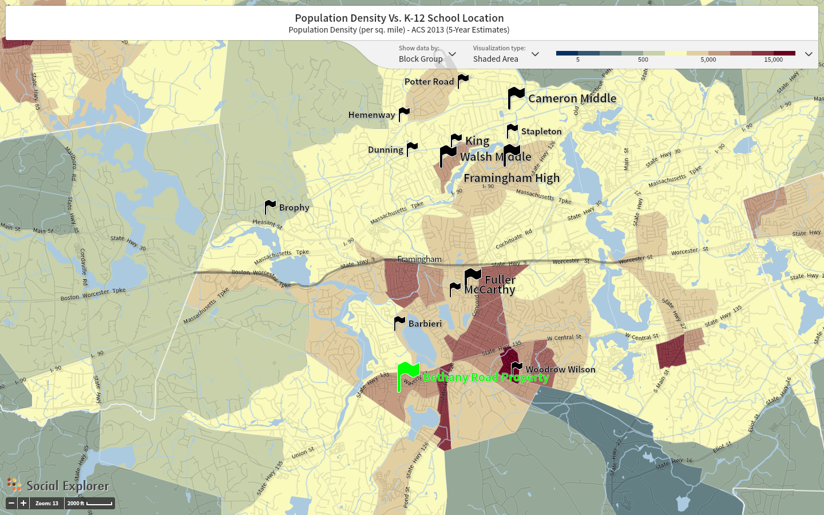

Slide 10
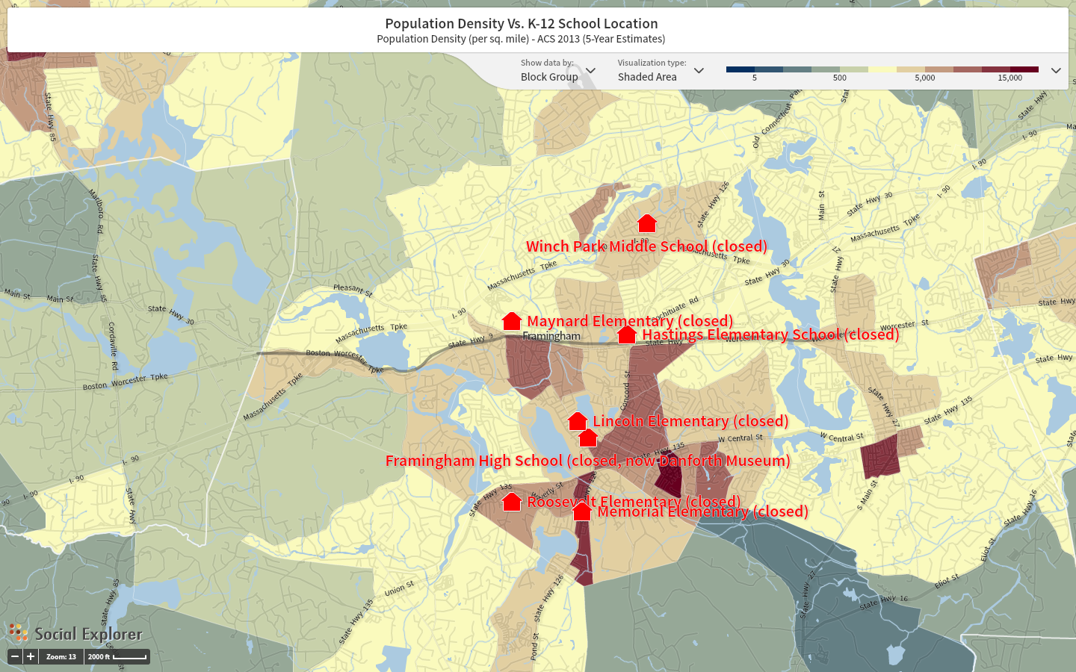

Slide 11
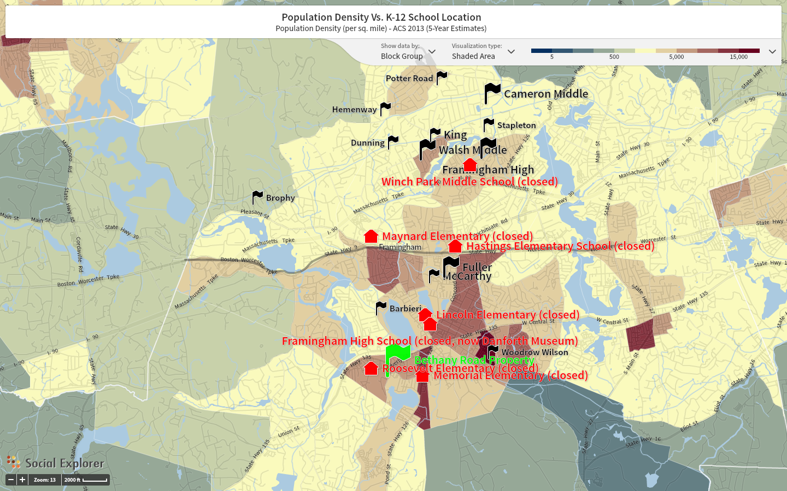

Slide 12
Students living within 1 mile boundary of 85 Bethany Rd
BARBIERI SCHOOL – 163 STUDENTS
BROPHY SCHOOL – 84 STUDENTS
DUNNING SCHOOL – 34 STUDENTS
HEMENWAY SCHOOL – 30 STUDENTS
KING SCHOOL – 21 STUDENTS
McCARTHY SCHOOL – 118 STUDENTS
POTTER ROAD SCHOOL – 62 STUDENTS
STAPLETON SCHOOL – 48 STUDENTS
WOODROW WILSON SCHOOL – 120 STUDENTS
LIVING WITHIN 1 MILE OF 85 BETHANY RD = 680 TRANSPORTED TO THESE SCHOOLS = 572
NOT ASSIGNED TO A BUS = 108

Slide 13
Summary
We are at current capacity in our schools
We are continuing to grow
We are out of balance
There are 680 students within a 1-mile radius of the Bethany site
The site has been identified as a site that meets unique requirements of Chapter 30B (MA Procurement Law)

Slide 14
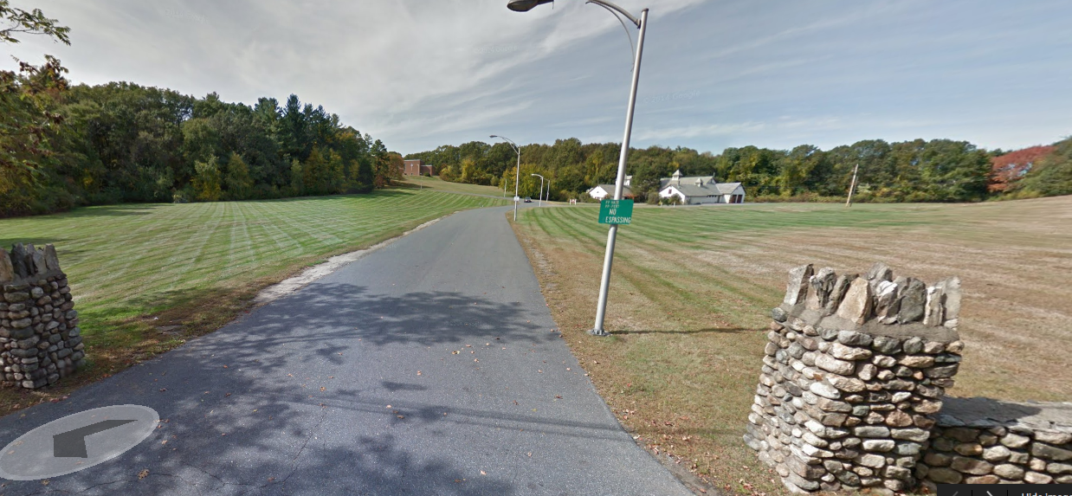
The Road to the Future

