Slide 1

Build With Us
Overview of MSBA Building Process and
Project Timeline

Slide 2
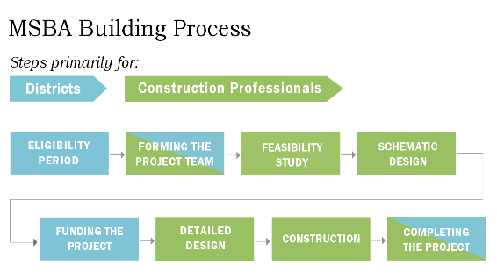
www.MassSchoolBuildings.org

Slide 3
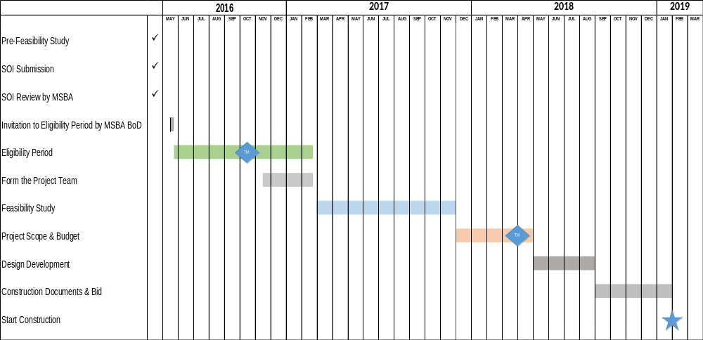
MSBA Process

Slide 4

Statement of Interest

Slide 5
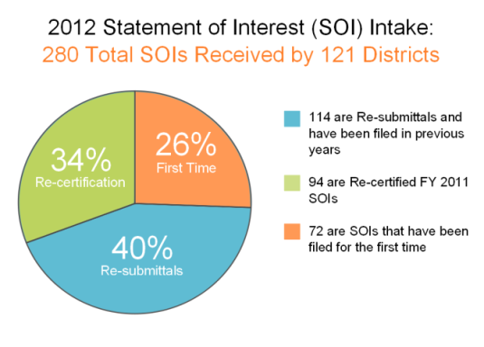
Statement of Interest
Informs MSBA about deficiencies that inhibit delivery of District’s educational program
    Submitted by School Superintendent
    Requires School Committee vote
    Requires Board of Selectmen vote
One SOI per School
  except for accelerated repairs – windows/roofs/boilers; science labs
One school designated as District Priority SOI if multiple school SOIs in District

Slide 6

The MSBA Wants You …

Slide 7
Eligibility Period
Invited into Eligibility Period after review and approval of SOI by MSBA
Eligibility Period is up to 270 days long
      Initial Compliance Certification
      Form a School Building Committee
      Maintenance documents and enrollment certification
      Local Authorization of Funding
        Vote to authorize full amount of Feasibility Study

Slide 8
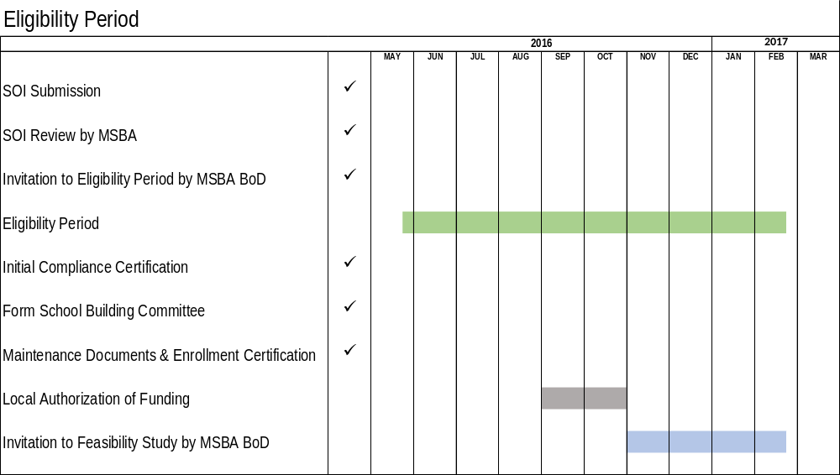

Slide 9

Form the Project Team

Slide 10
Form the Project Team
Select an OPM
    Identify MCPPO certified employee to oversee procurement
    Identify Selection Committee
    Draft RFP
    Advertise
    Evaluate Respondents
    Select OPM
    Submit to MSBA for Approval
Select a Designer
    Complete RFS template
    Advertise
    MSBA Designer Selection Panel reviews applications
      District is represented on DSP (3 of 13 members)
    Applicants are ranked by DSP
    Interview may be held with 3 top-ranked firms
    District negotiates agreement with top ranked firm

Slide 11
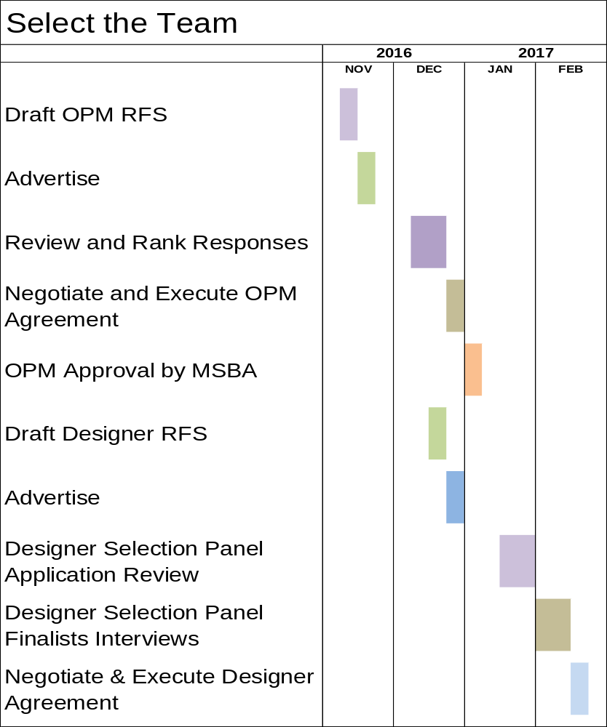

Slide 12
Perform Feasibility Study
Start after Project Team is Selected
    Document Educational Program
    Document Existing Conditions
    Develop and Evaluate Alternatives
    Recommend Preferred Solution to MSBA BoD
    MSBA BoD Preferred Solution Approval
    Prepare Schematic Design Documents

Slide 13
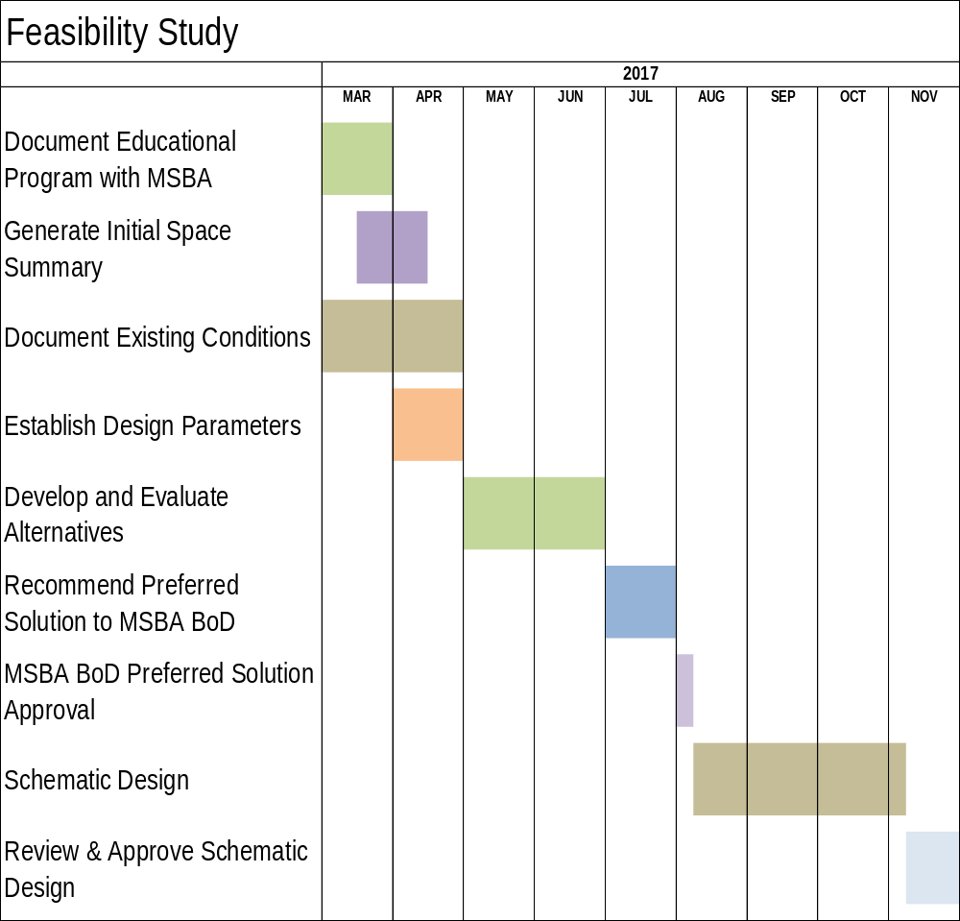

Slide 14

Project Scope & Budget

Slide 15
Project Scope & Budget
120 Days to secure local funding
  Requires Town appropriation for full cost of Project
Negotiate Project Funding Agreement
  Establish basis of grant
  Project Scope
  Project Schedule
  Project Site
  Furniture, Fixtures & Equipment
Execute Project Funding Agreement

Slide 16
Design Development & CDs
Preparation of Bid Documents
Independent Estimates at DD, 60% CD & 90% CD
Quality of Bid Documents influences quality of Project
Contractor & Subcontractor pre-qualification during this phase
Should consider CM at Risk (Ch. 149A) in lieu of GC (Ch. 149)

Slide 17
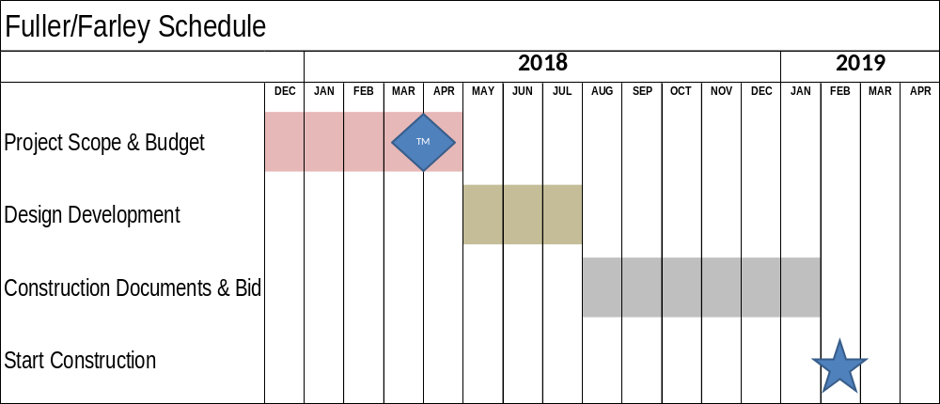

Slide 18

Build with us!

Slide 19
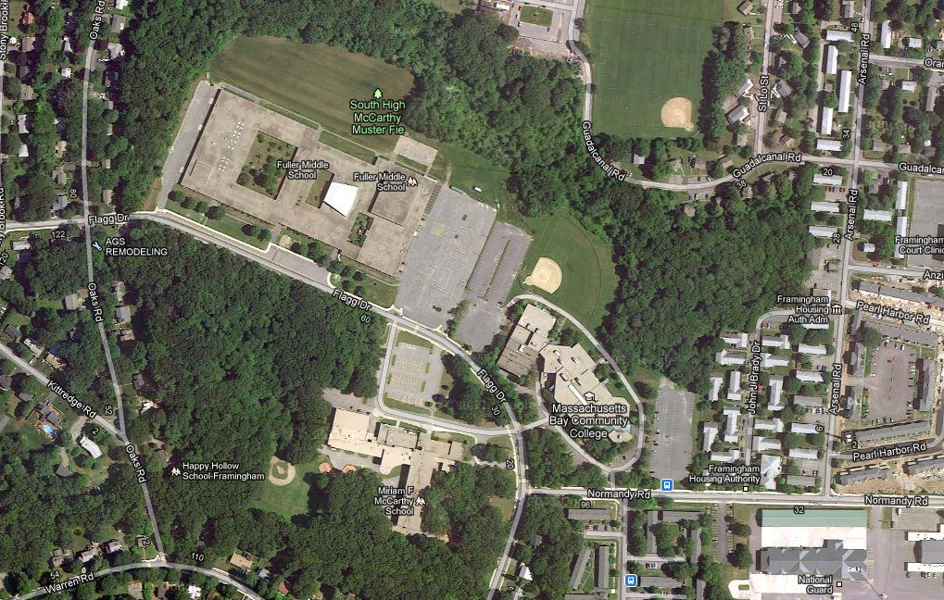
Applying MSBA Process to Framingham Public Schools
Fuller Middle School
and
Farley Middle School

Slide 20
FPS Facility Hierarchy
District
Facilities
Actualization
Facilities enhance District educational goals, rather than limit them ...
Master Plan Compliance
Facilities reflect pre-K to 12 population age and geographic distribution...
Program Compliance
Adequate spaces to meet educational requirements ...
Life Safety
Fire Alarm, Sprinklers, Code Compliance ...
Building Systems
Heat, Roof, Windows ...

Slide 21
What does MSBA process imply?
MSBA schedule is independent of which site becomes new school
MSBA process must be followed
Existing buildings must make do until 2021
Choices abound
  MS or K-8
  Existing site(s) or new site(s)
  Fuller v. Farley v. Other
  MS v. K-8
  Short term v. long term MBCC extension
  Renovate v. All New v. Part New
    Temporary facility requirements and solutions impact cost and schedule

Slide 22
School Options
Fuller School
Renovate
  100% vs Cameron approach
New Building
  Custom v. Model School
Temporary facility required
  Farley – requires upgrades
  Modular classrooms
  Other – Danforth?
  Occupied renovation
  5% per phase construction cost premium
Farley School
Renovate
  100% vs Cameron approach
New Building
  Custom v. Model School
No temporary facility required;
but
MBCC must vacate by June 2018

Slide 23
Life after Fuller/Farley Project
What to do with remaining school site(s)?
  Valuable South Framingham location
Many Options
Home for existing non-school users
          Building & Grounds
          ESL
          Framingham Public Access TV
          ACCESS Transportation
          Vision Center
  Swing space during other school renovation(s)
  New replacement home for existing school

Slide 26
Next Steps
Complete Eligibility Period requirements
  Appropriate 100% of Feasibility Study Costs
Garner approval of MSBA BoD to enter Feasibility Study
Consider CM at Risk vs. GC
Continue Update of District Capital Plan
Develop Long-range Major Capital Plan

Slide 27
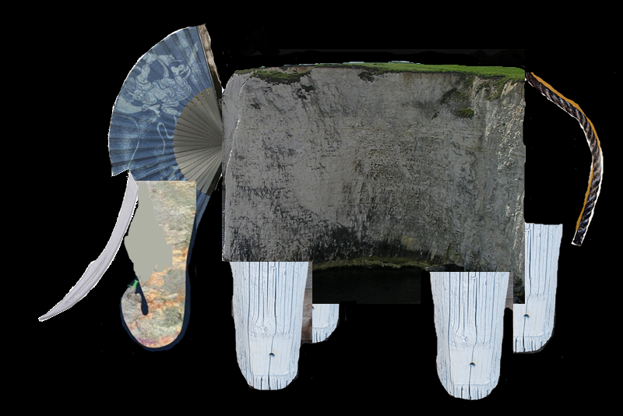

Questions?

