Slide 1

FULLER MIDDLE SCHOOL FEASIBILITY STUDY
Finance Subcommittee
October 10, 2018
PROJECT MANAGEMENT | SMMA

Slide 2
Agenda
Introduction and Project Need
The Design: Site and Building
Benefits to the Students and Community
Schedule and Cost
Important Dates
Questions
PROJECT MANAGEMENT | SMMA

Slide 3
SCHOOL BUILDING COMMITTEE MEMBERS
Dr. Yvonne Spicer Mayor
David Miles Co-Chair, Resident with Finance Experience
Dr. Edward Gotgart Co-Chair, Chief Operating Officer, FPS
Thatcher Kezer, III Chief Operating Officer
Adam Freudberg School Committee Chair
Dr. Robert Tremblay Superintendent of Schools
Charlie Sisitsky City Council Member
Richard Finlay School Committee Member and Convenor
Noval Alexander School Committee Member
Scott Wadland School Committee Member
Mary Ellen Kelley Chief Financial Officer
Jennifer Pratt Chief Procurement Officer
Heather Connolly Former School Committee Chair
Matt Torti Director of Buildings and Grounds, FPS
Anne Ludes Director of Secondary Education
PROJECT MANAGEMENT | SMMA

Slide 4
SCHOOL BUILDING COMMITTEE MEMBERS
Jose Duarte Principal, Fuller Middle School
Caitlin Stempleski Teacher, Fuller School Middle
Patrick Johnson Principal, Walsh Middle School
Michael Tusino Building Commissioner
Richard Weader II Member
Michael Grilli Member
Dr. Jennifer Krusinger Martin Member
Donald C. Taggart Ill Member
David Panich Member
Thomas Barbieri Member
Dr. Dale Hamel Member
PROJECT MANAGEMENT | SMMA

Slide 5
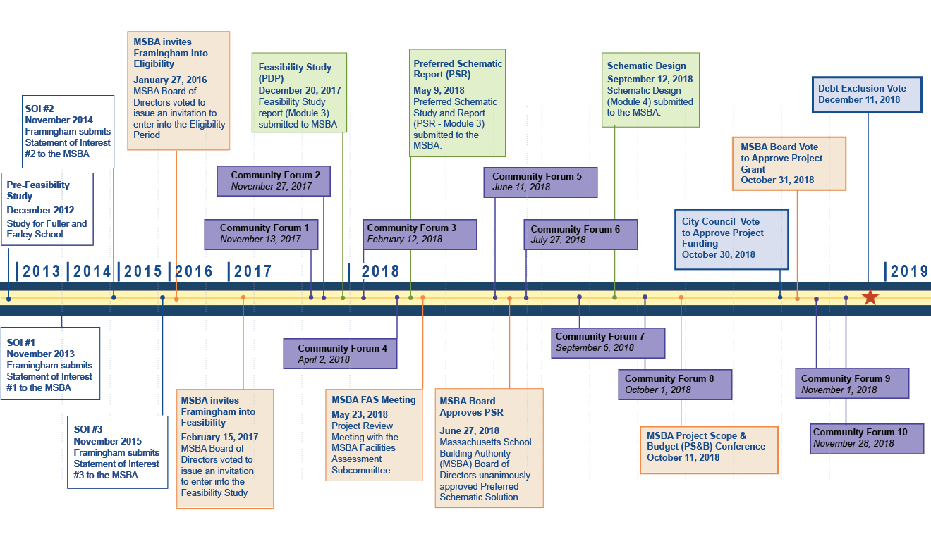
SIX YEARS OF PLANNING
PROJECT MANAGEMENT | SMMA

Slide 6
HOW WE GOT HERE
The Fuller Middle School is an aged facility that requires significant upkeep, spending which will not result in long-term educational benefits.
Framingham submitted its initial application to MSBA for a grant in November 2013.
The MSBA receives approximately 120 grant applications for capital projects annually, of which approximately 10 are approved annually.
Framingham residents voted to approve the Feasibility Study funding at its October 18, 2016 Special Town Meeting.
PROJECT MANAGEMENT | SMMA

Slide 7
OPEN, TRANSPARENT AND PUBLIC PROCESS
For the past 18 months, public meetings have included:
27 School Building Committee Meetings
8 Community Forums
4 City Council Meetings
4 School Committee Meetings
2 Public Presentations at Library
1 Public Hearing at ZBA
1 Neighborhood Meeting
Project Website: www.fullerbuildingproject.com
PROJECT MANAGEMENT | SMMA

Slide 8

PROJECT MANAGEMENT | SMMA

Slide 9
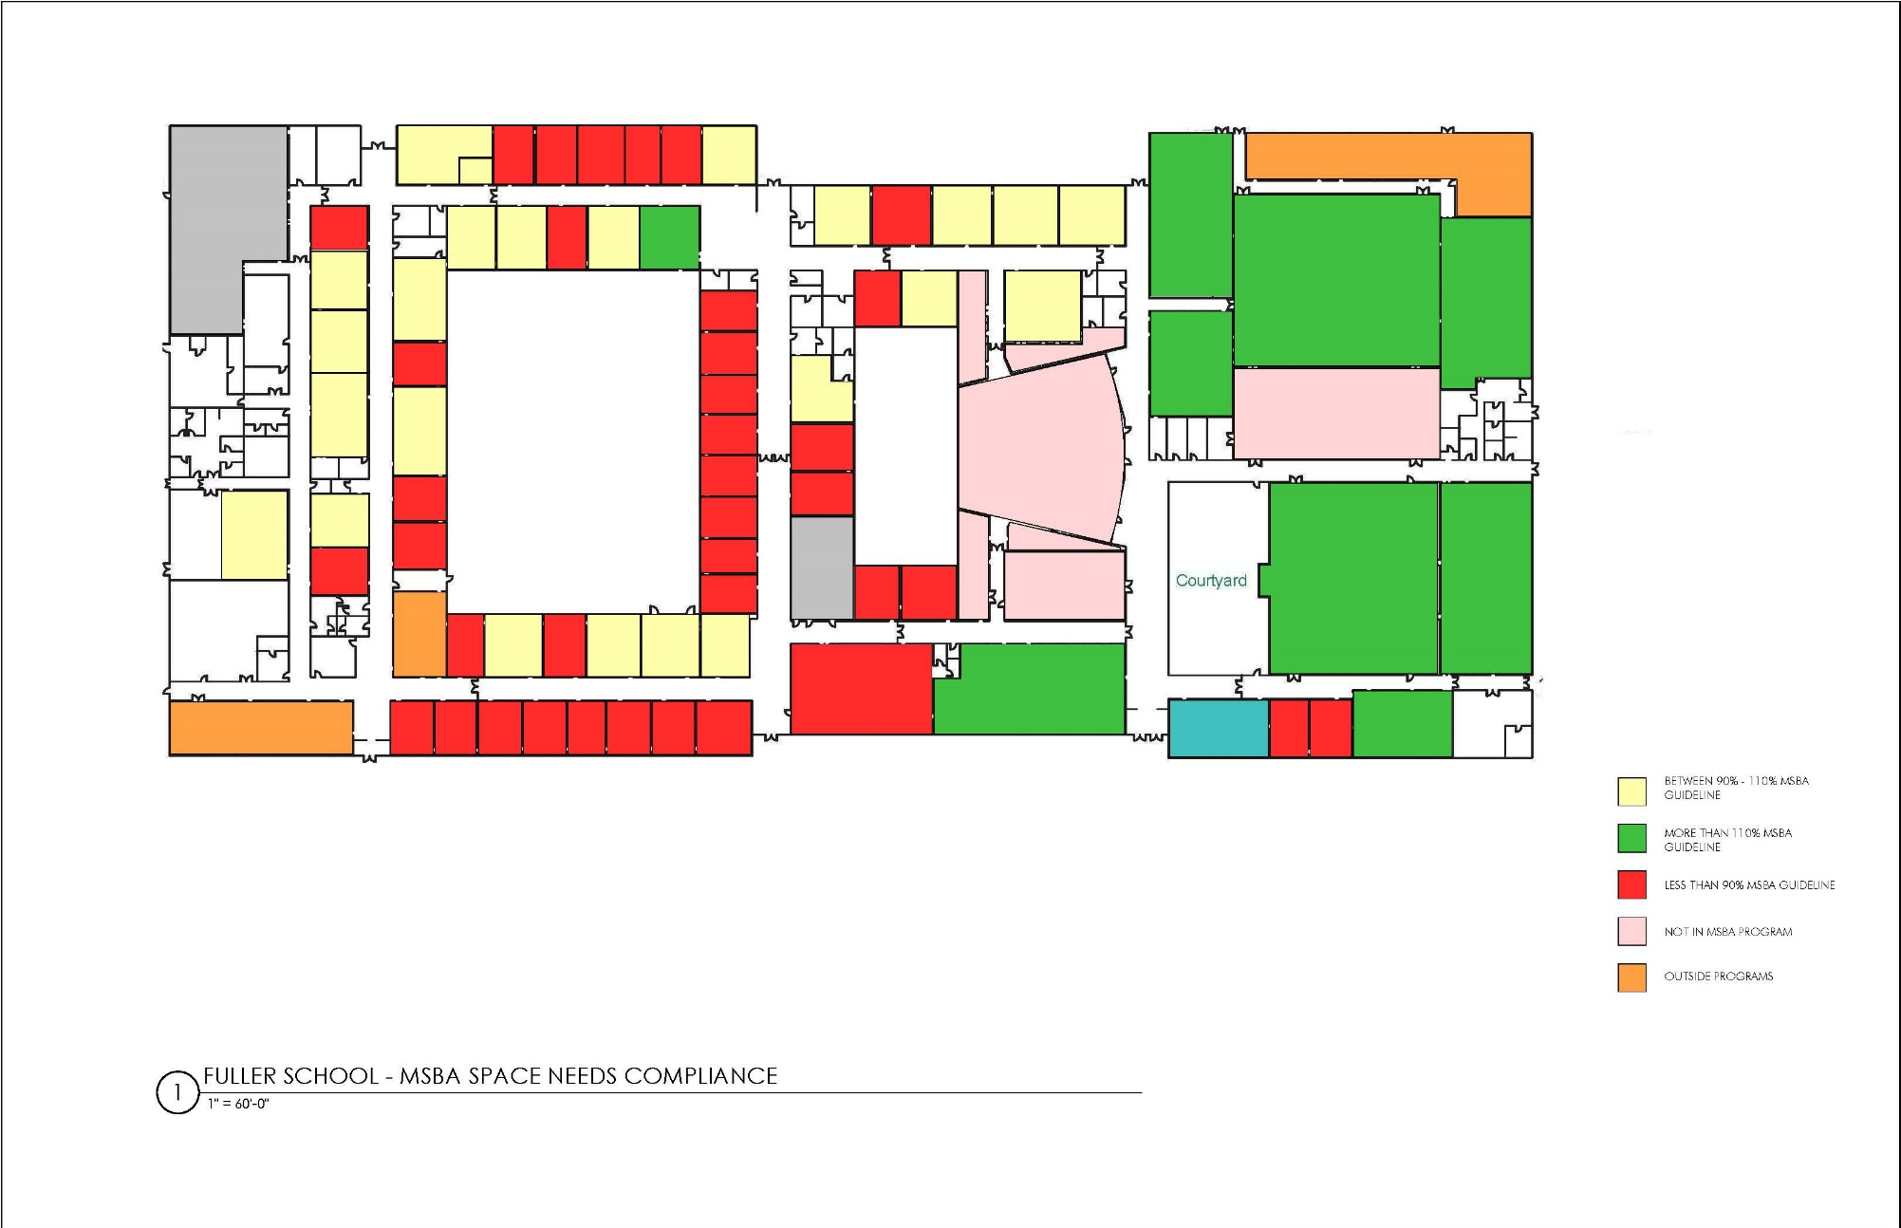
EDUCATIONAL DEFICIENCIES
PROJECT MANAGEMENT | SMMA

Slide 10
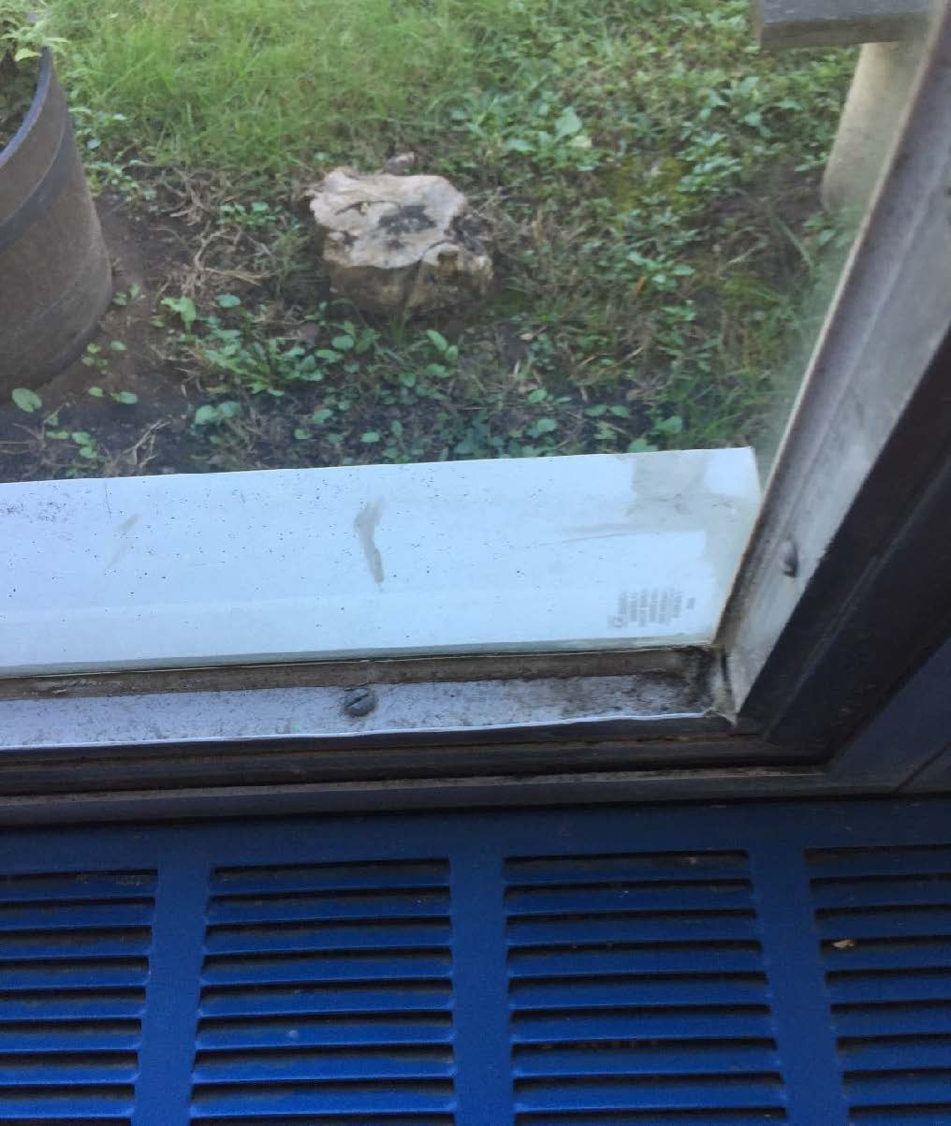
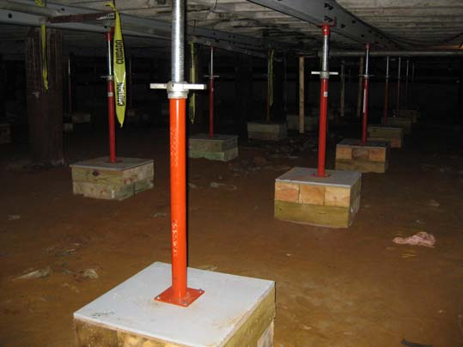
PHYSICAL BUILDING DEFICIENCIES
Energy Code
Envelope
Accessibility
Structural
Mechanical, Electrical and
Plumbing Systems
Hazardous Materials
PROJECT MANAGEMENT | SMMA

Slide 11
DESIGN ENROLLMENT
The MSBA initially provided an enrollment cap of 580 students, based on their demographic projections.
FPS successfully appealed, and persuaded the MSBA that an enrollment of 630 students in grades 6-8 is appropriate
630 students is a good and supportable number
Now established, the MSBA does not allow further renegotiation of the enrollment figure
Current design allows flexibility to support more than 630 students
PROJECT MANAGEMENT | SMMA

Slide 12
VISIONING HIGHLIGHTS
  Personalized and Collaborative Learning
  Transdisciplinary Instruction
  Visible Learning
  Adaptability
  Whole Child, Whole Community
  Community and Civic
PROJECT MANAGEMENT | SMMA

Slide 13
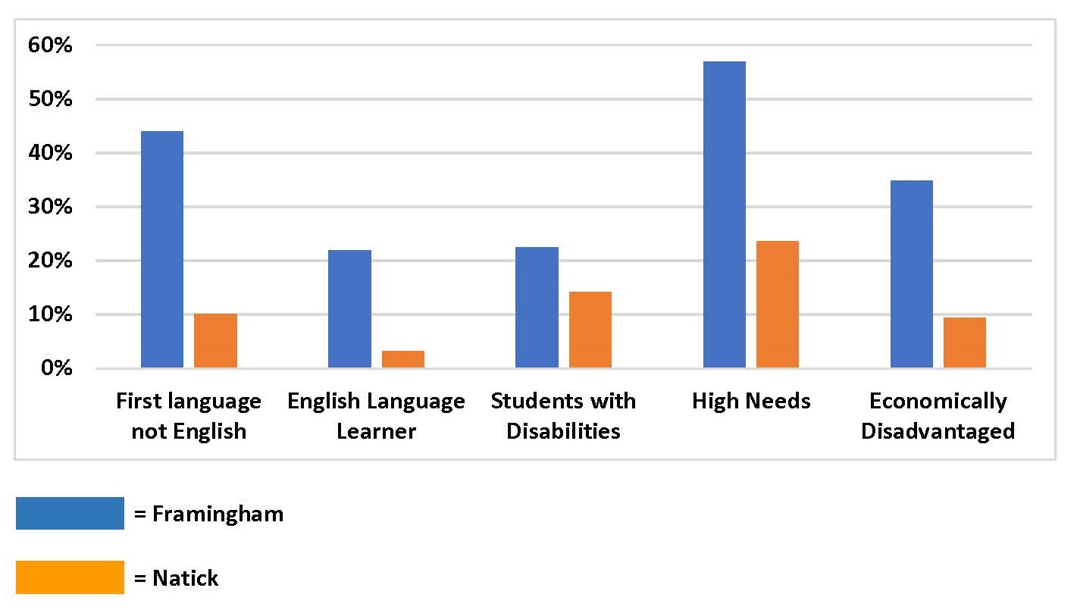
FRAMINGHAM DEMOGRAPHICS – ILLUSTRATIVE COMPARISON
Source: Mass Dept of Elementary and Secondary Education
PROJECT MANAGEMENT | SMMA

Slide 14

TRANSLATING THE EDUCATIONAL PROGRAM INTO SPACE PLANNING
Fuller Middle School 21st Century Teaching and Learning
Student Driven, Web Complimentary, Collaboration-Based
Space Principles
Space Initiatives
Ubiquitous Learning
Agile, Varied Scale Classroom
Specialized Learning Spaces
Team Teaching
STEAM Exploratory
Maker Space
Visible Teacher Office
Small Group Collaboration Spaces
Community Collaboration Spaces
Small Scale
Collaborative Teaching Collaborative Learning Interdisciplinary Content Project Based Learning
Visible Learning Flexible Learning Outdoor Learning Community Engagement
PROJECT MANAGEMENT | SMMA

Slide 15
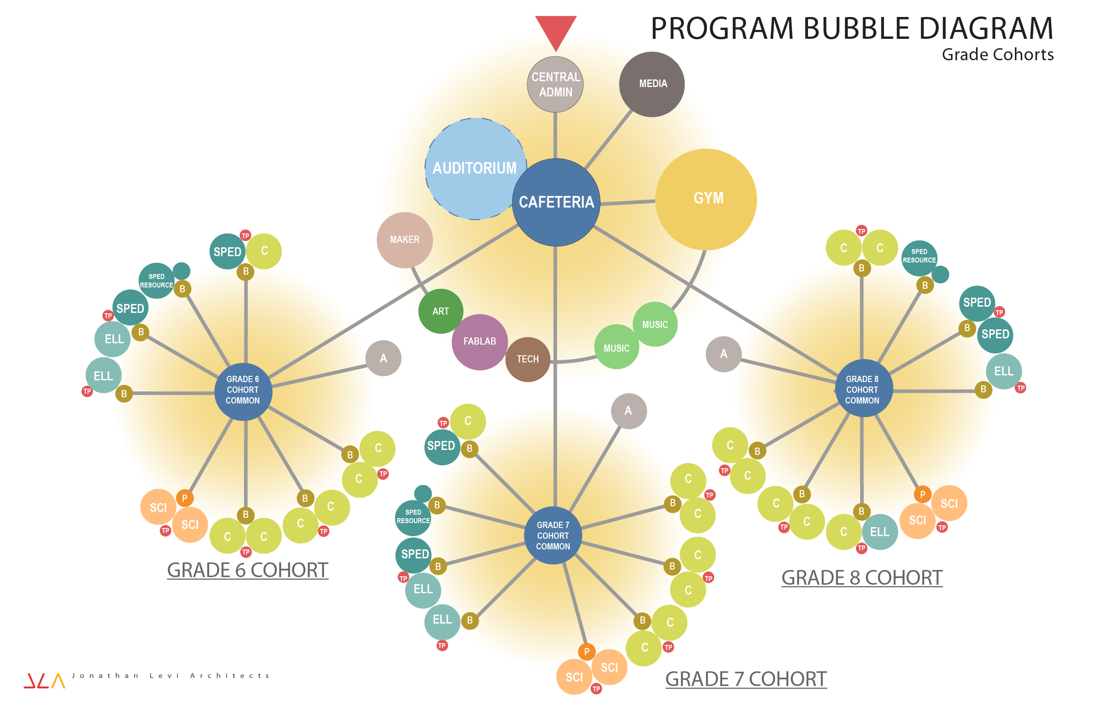
Building Space and Adjacency Diagram
PROJECT MANAGEMENT | SMMA

Slide 16
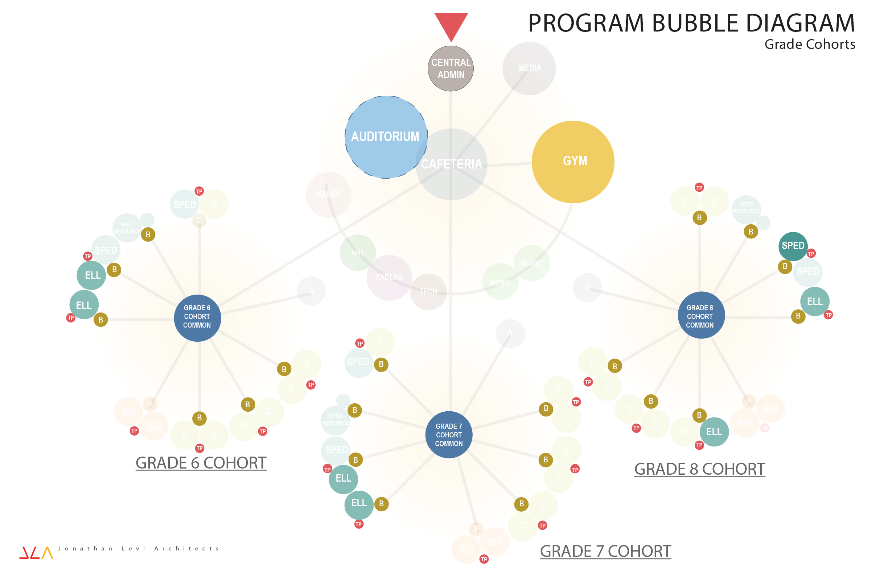
Spaces to Support Framingham Demographics and STEAM
PROJECT MANAGEMENT | SMMA

Slide 17
WHY AN AUDITORIUM AND INCREASED GYMNASIUM SPACE
The existing 1958 Fuller auditorium and gyms, to be demolished, serve an important function for the school and the South Framingham community.
The new school will:
Continue to provide a home for these functions
Maintain parity with Framingham's other Middle Schools
Provide a safe and flexible environment for teaching and learning
PROJECT MANAGEMENT | SMMA

Slide 18
SQUARE FEET PER STUDENT DIFFERENTIATORS
Added auditorium space beyond MSBA standard including related circulation, toilets and services
Increased gym size beyond MSBA standard
Added stem educational program areas including collaboration zones, break-out areas and satellite administration suites
Added spaces for specialized ELL programs
Added space for Special Education due to Framingham student demographics
Minimum MSBA Space Sizes disproportionate in smaller Design populations
PROJECT MANAGEMENT | SMMA

Slide 19
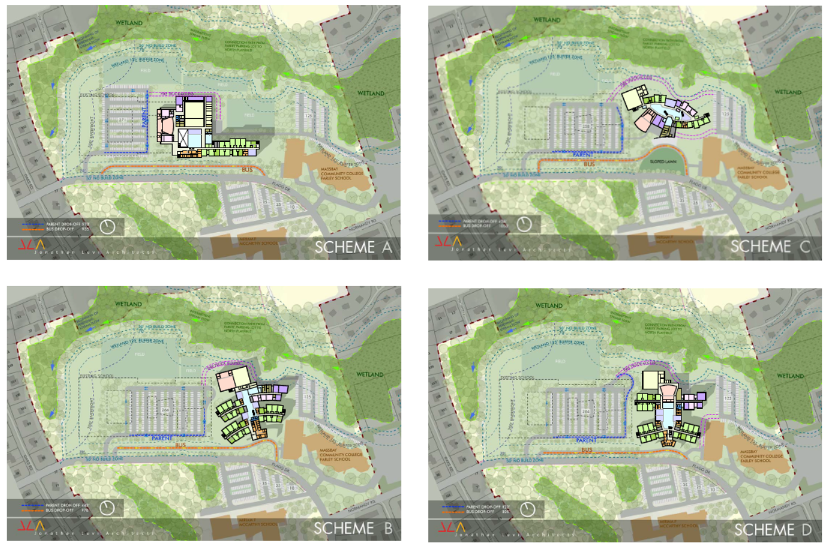
OPTIONS STUDIED
PROJECT MANAGEMENT | SMMA

Slide 20
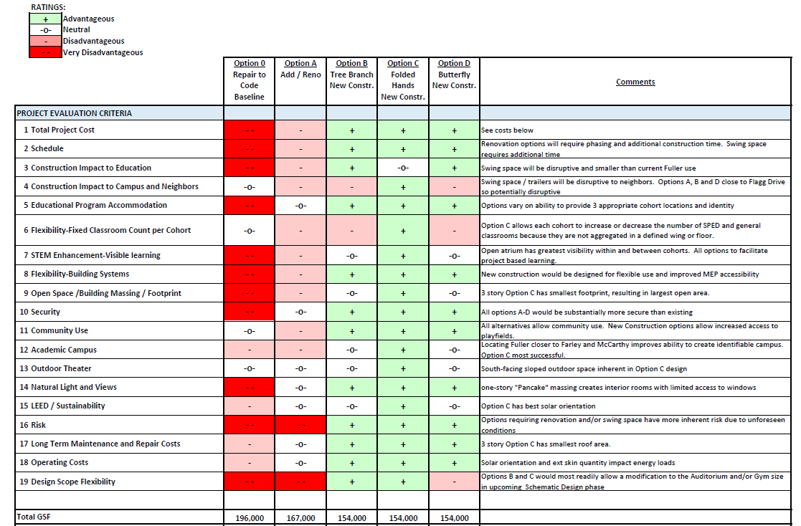
OPTIONS STUDIED
PROJECT MANAGEMENT | SMMA

Slide 21
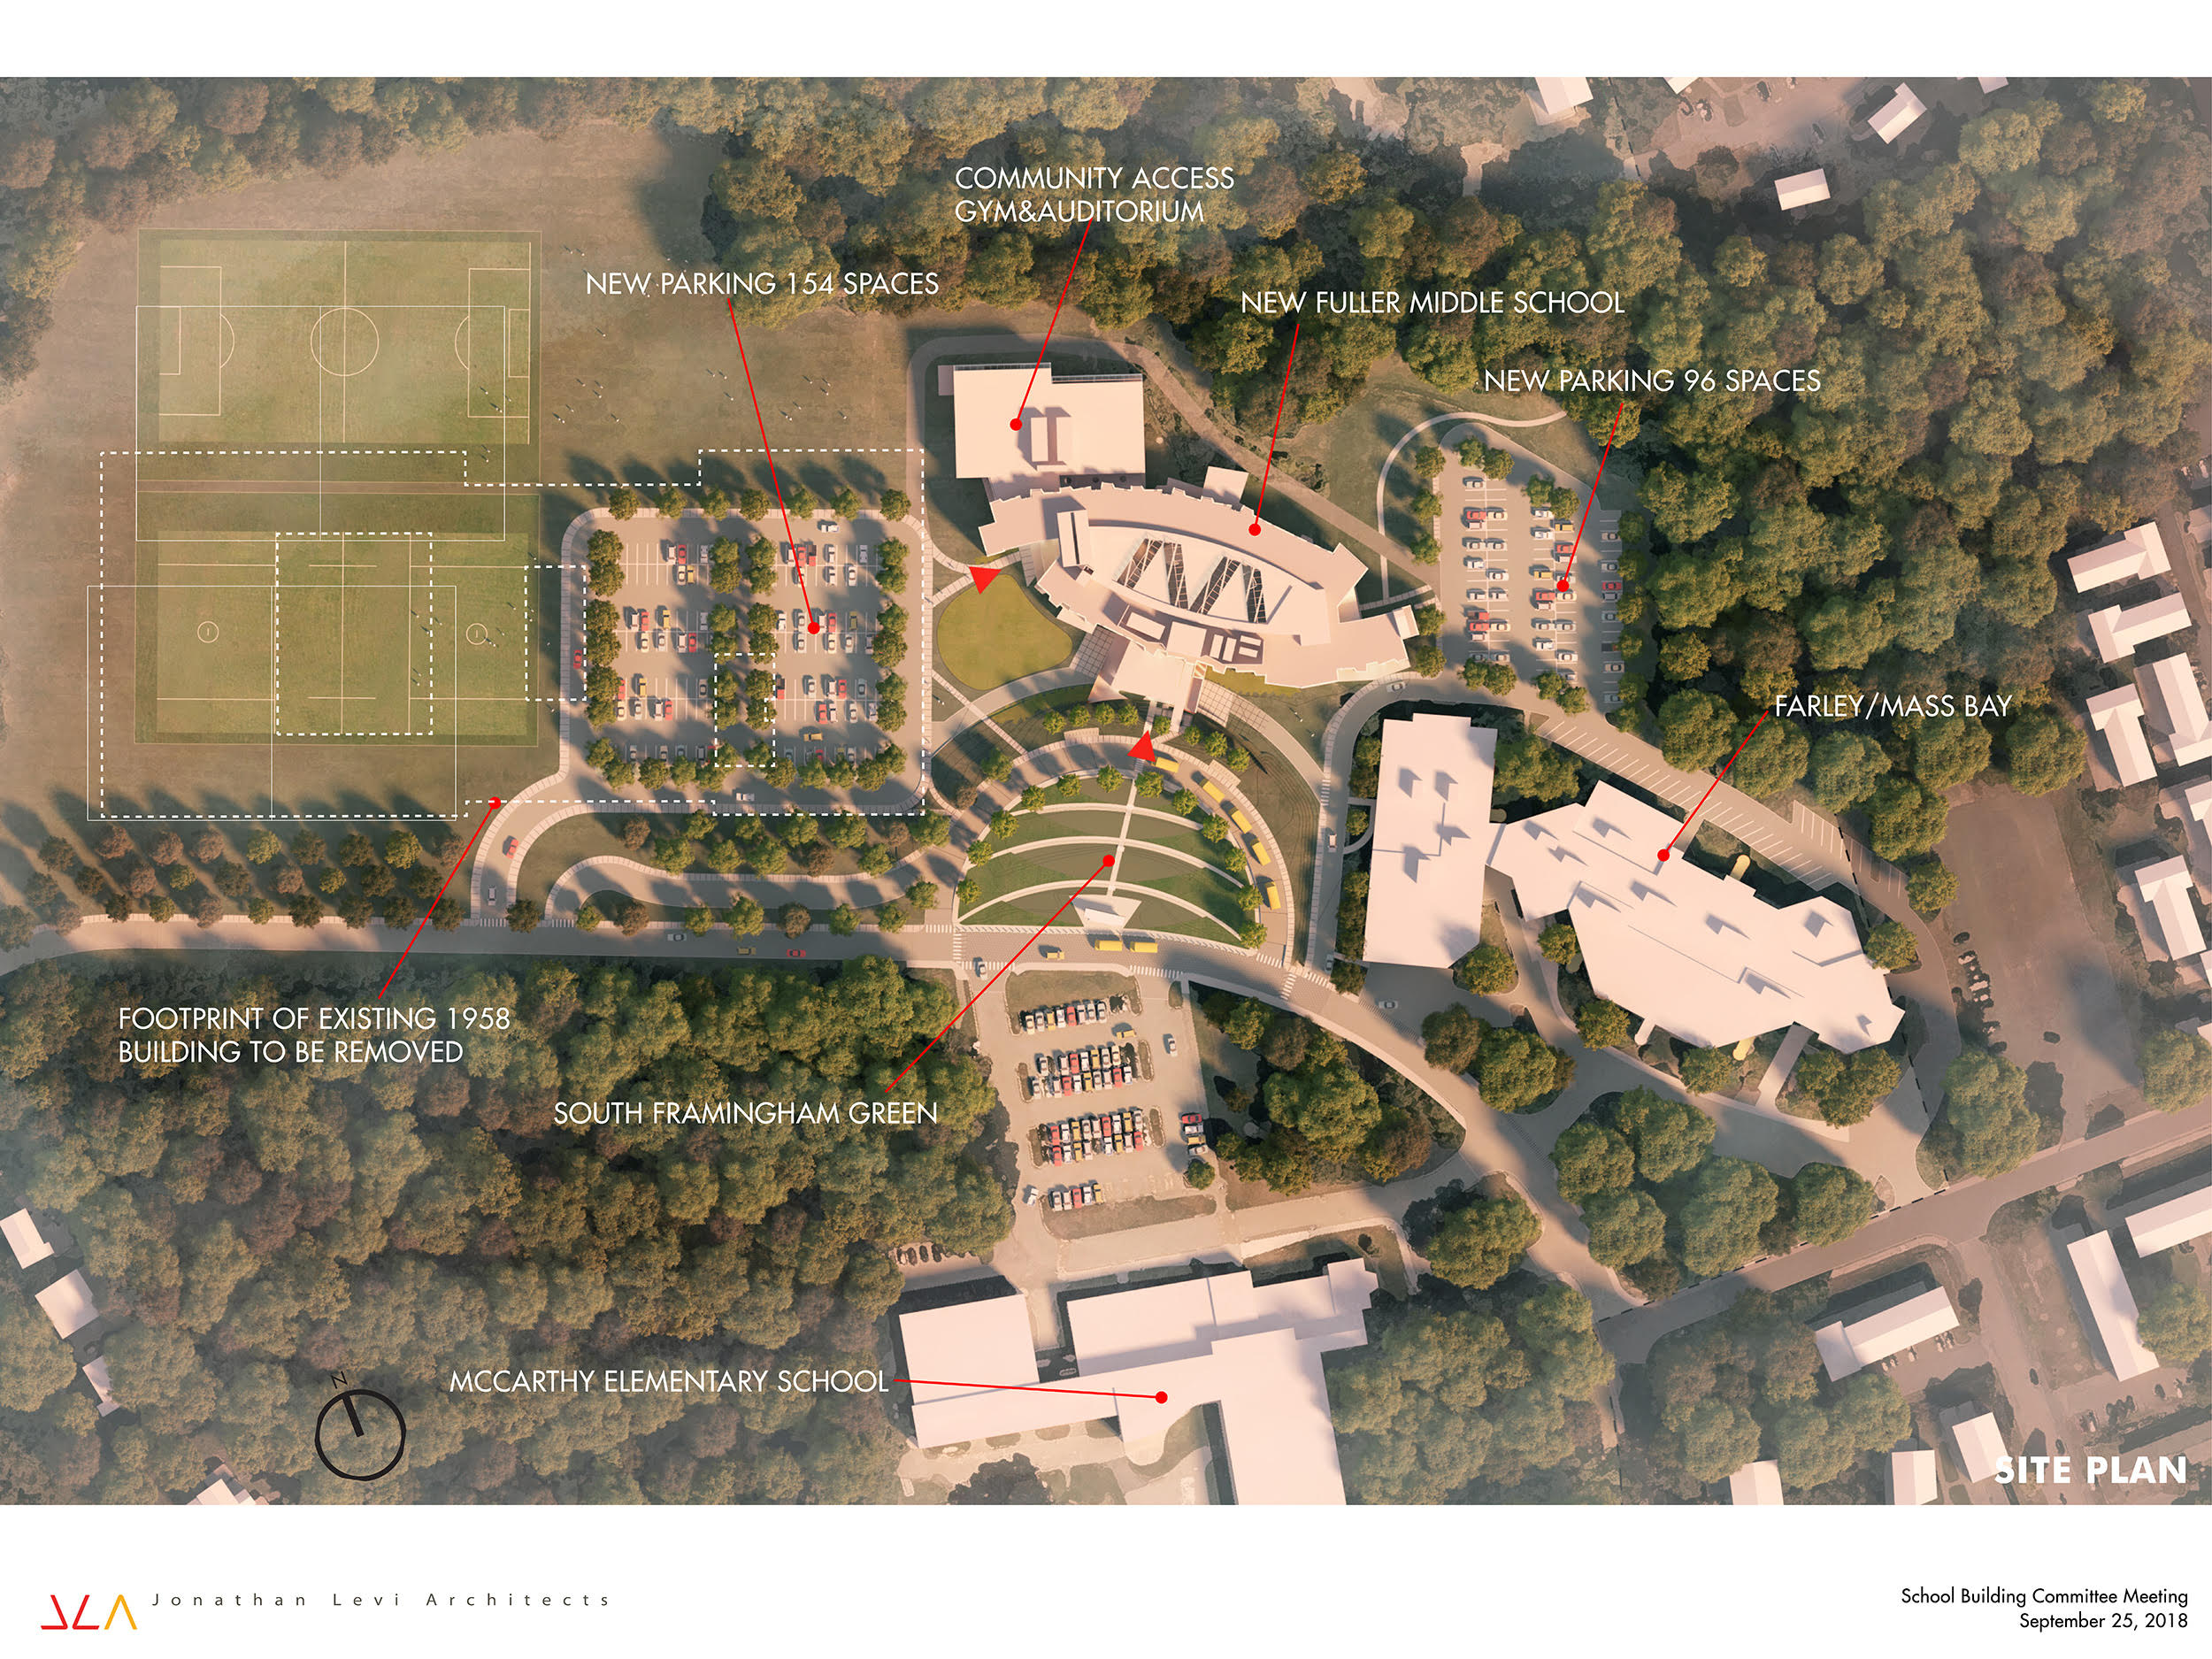

Slide 22
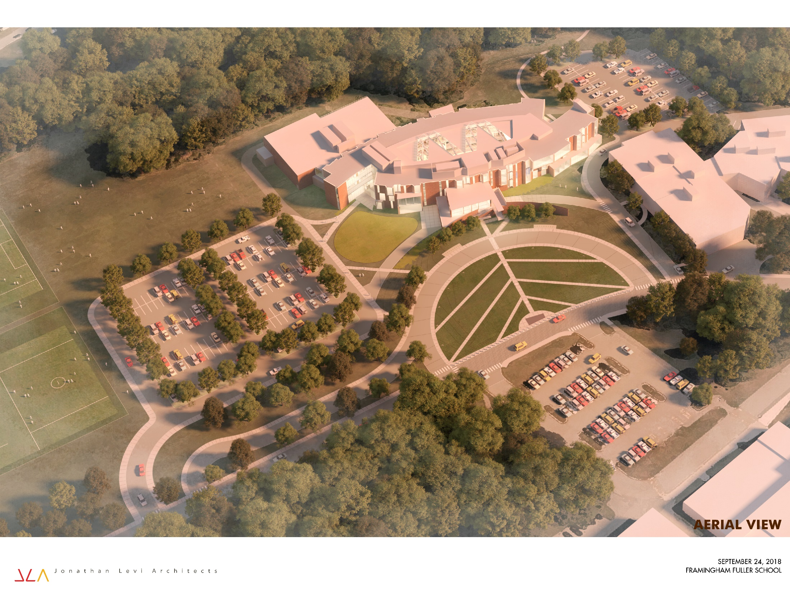

Slide 23
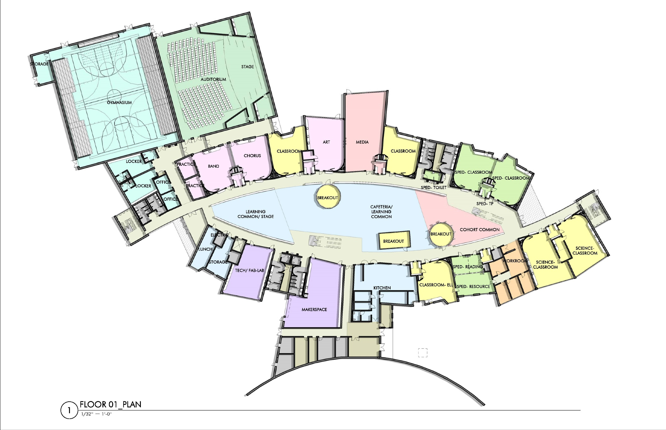
FIRST FLOOR PLAN

Slide 24
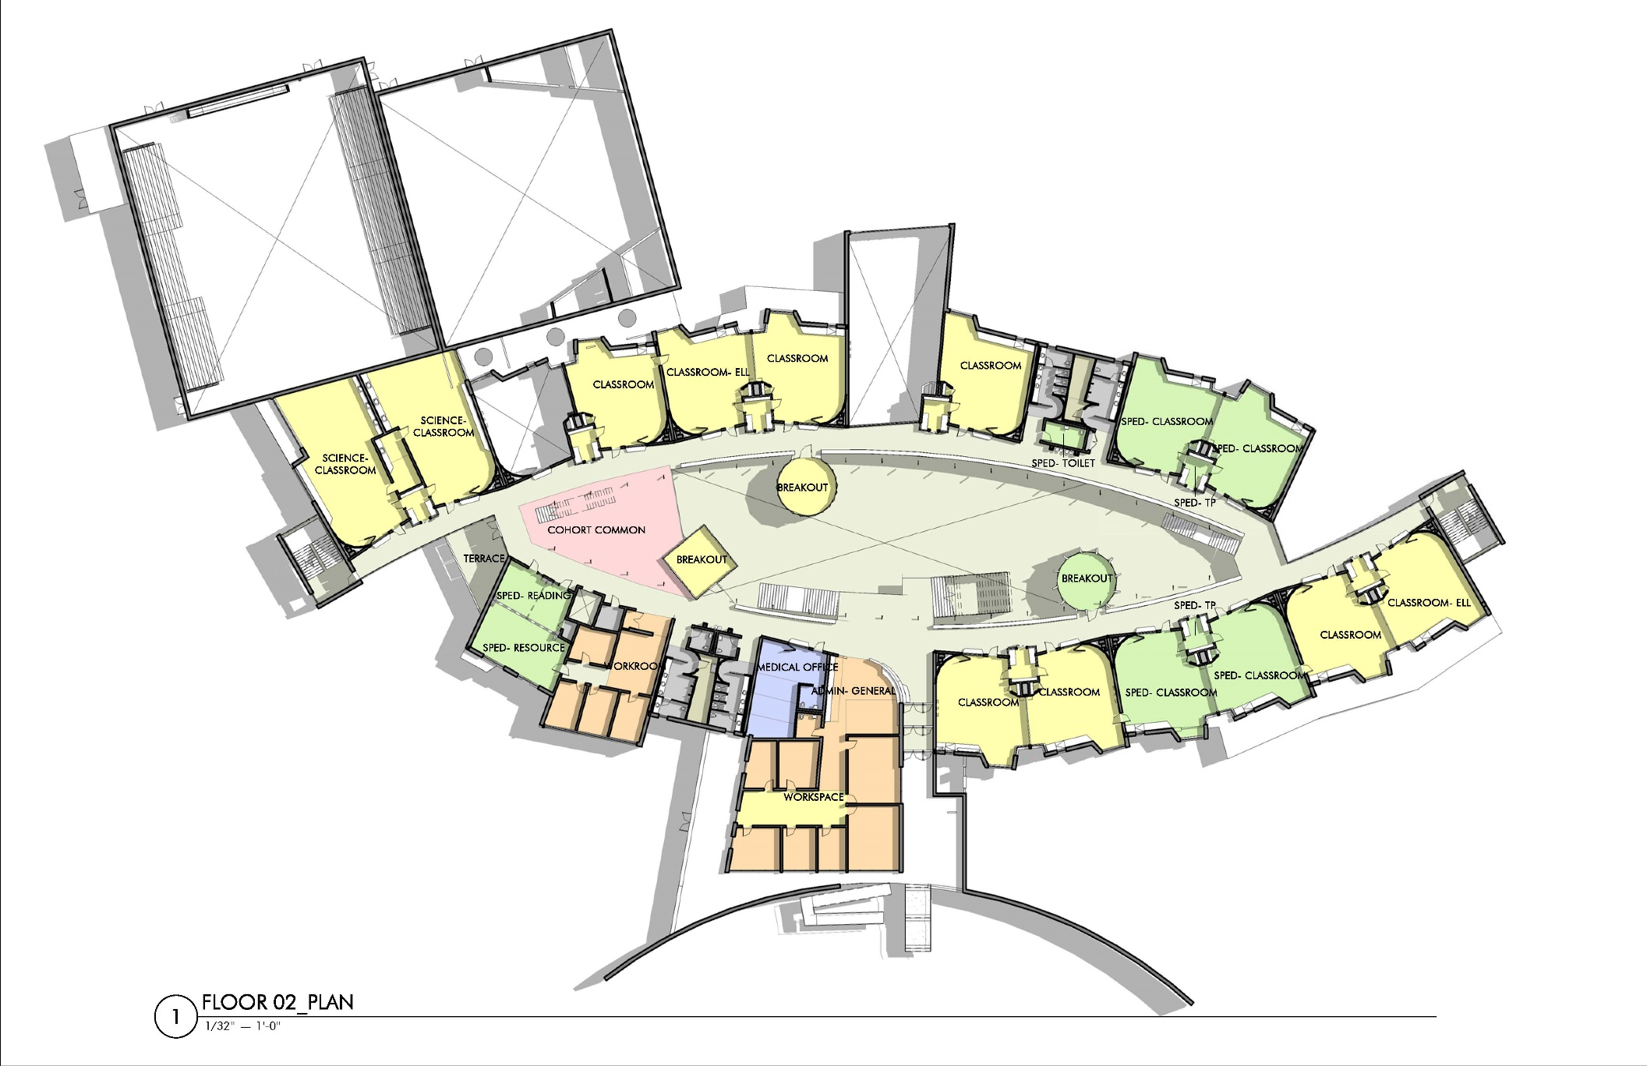
SECOND FLOOR PLAN

Slide 25
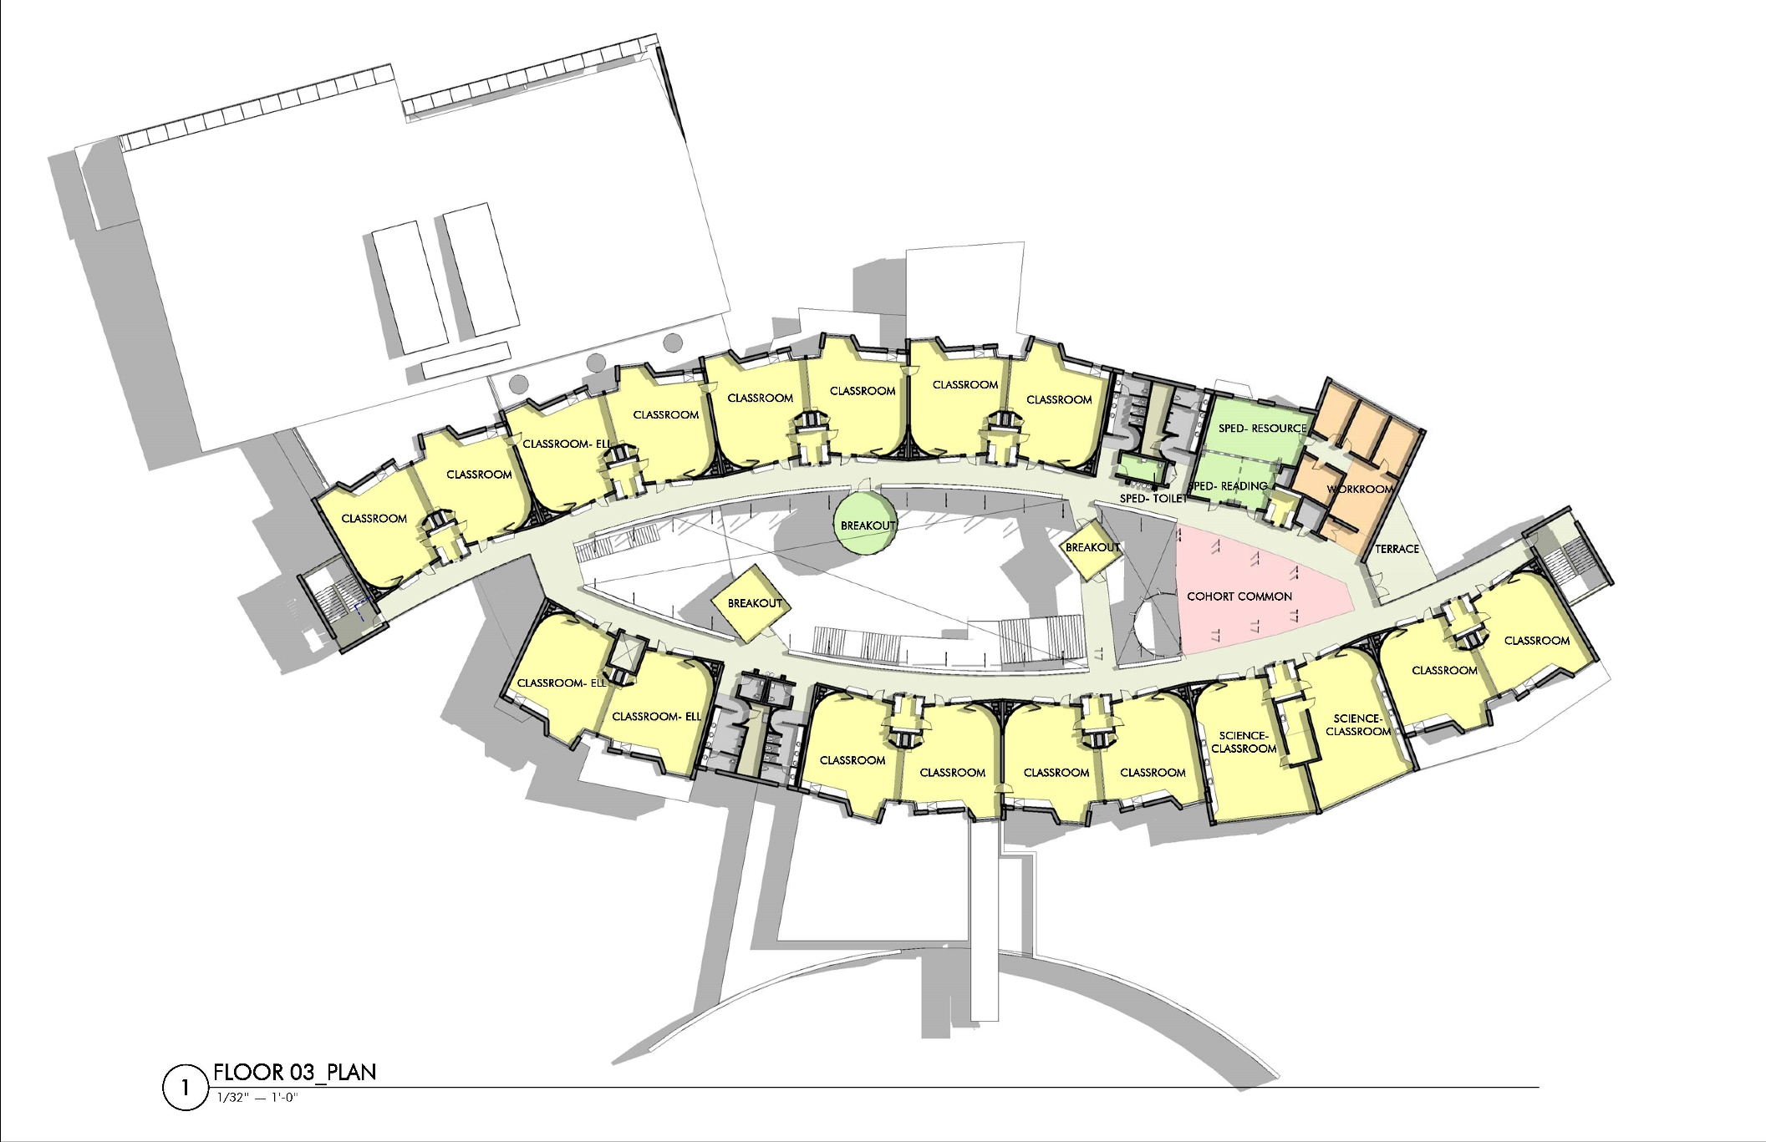
THIRD FLOOR PLAN

Slide 26
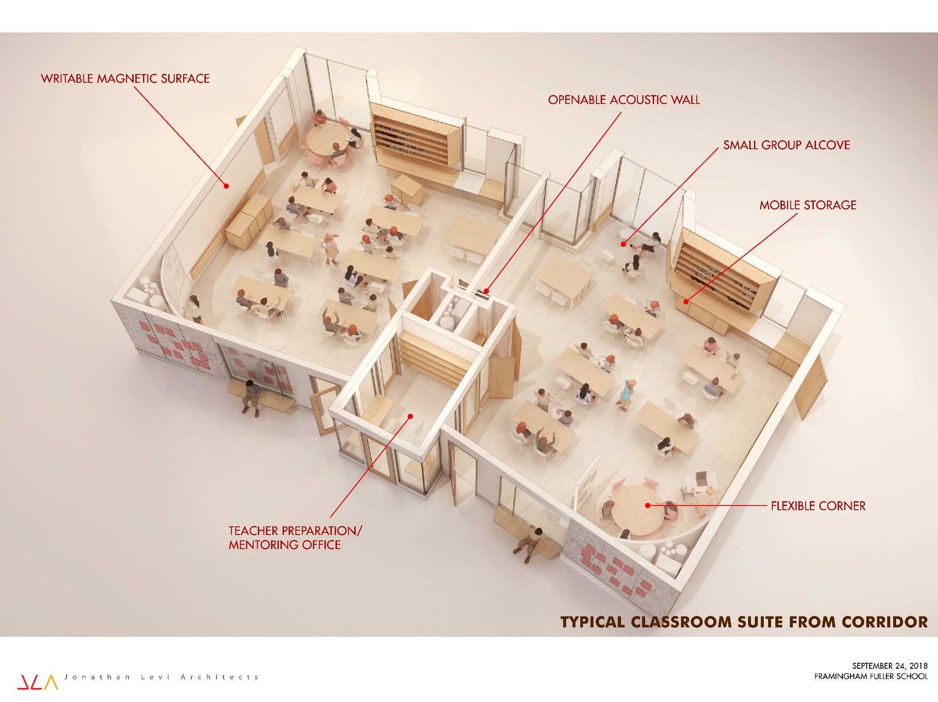

Slide 27
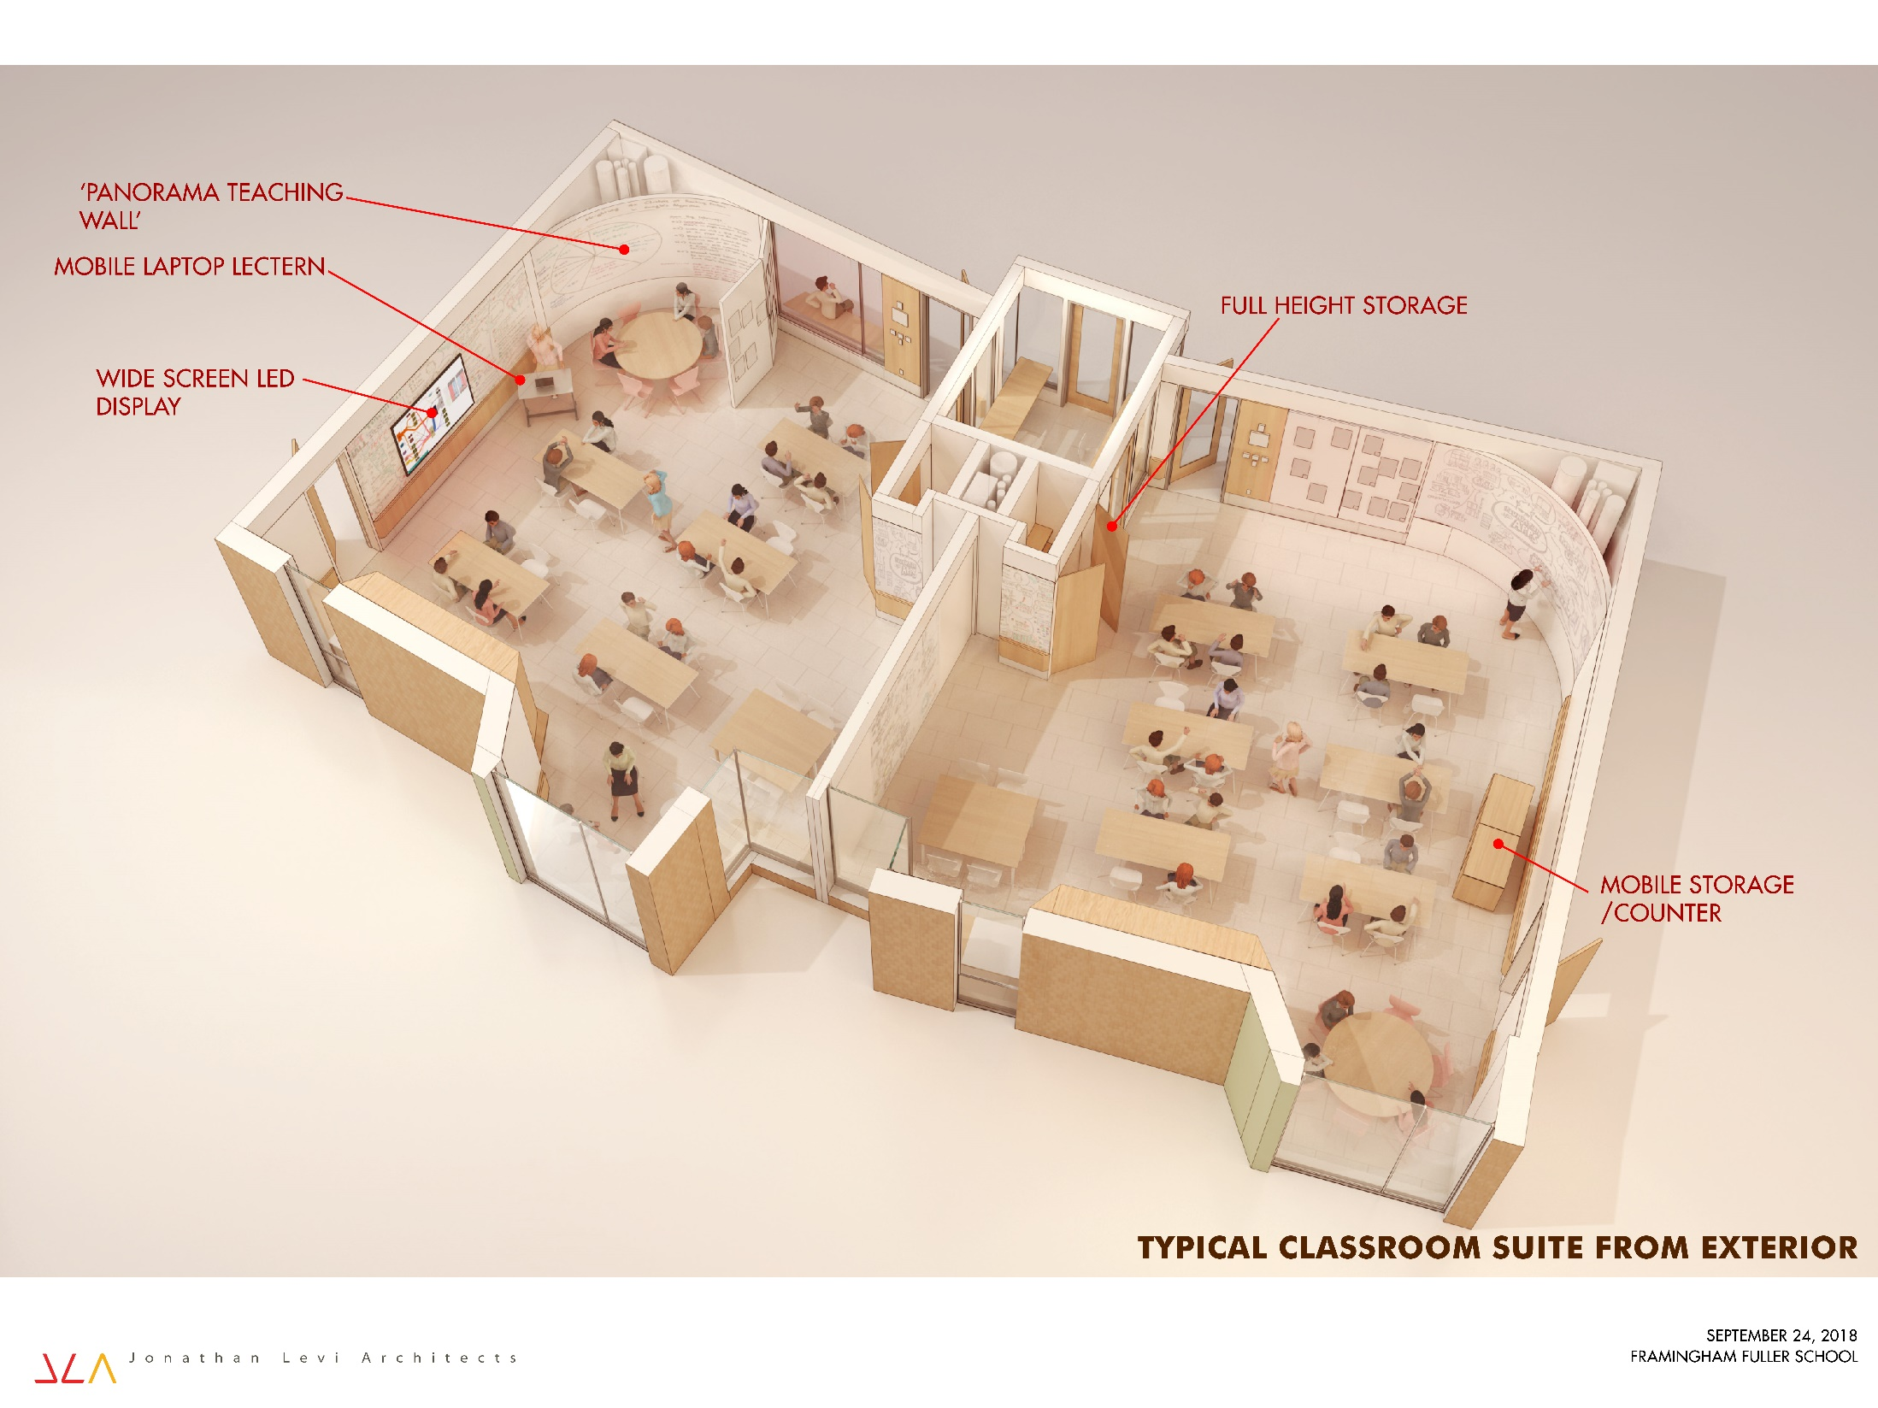

Slide 28
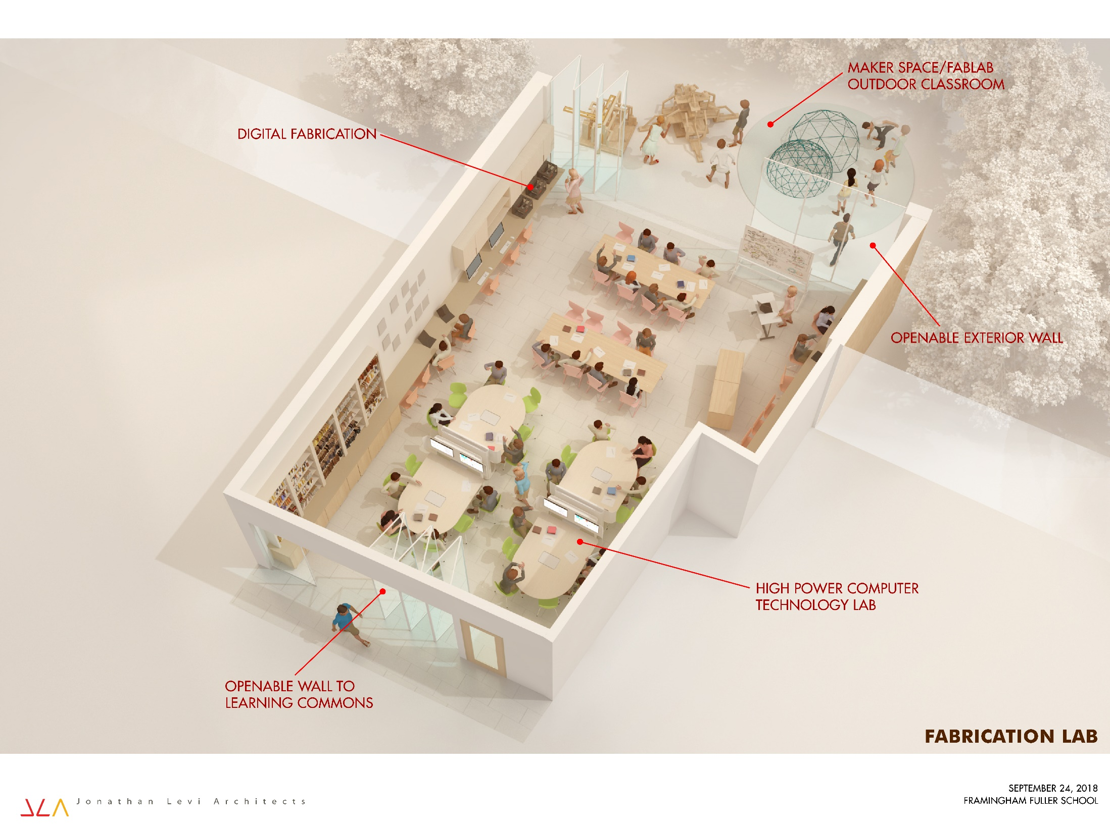

Slide 29
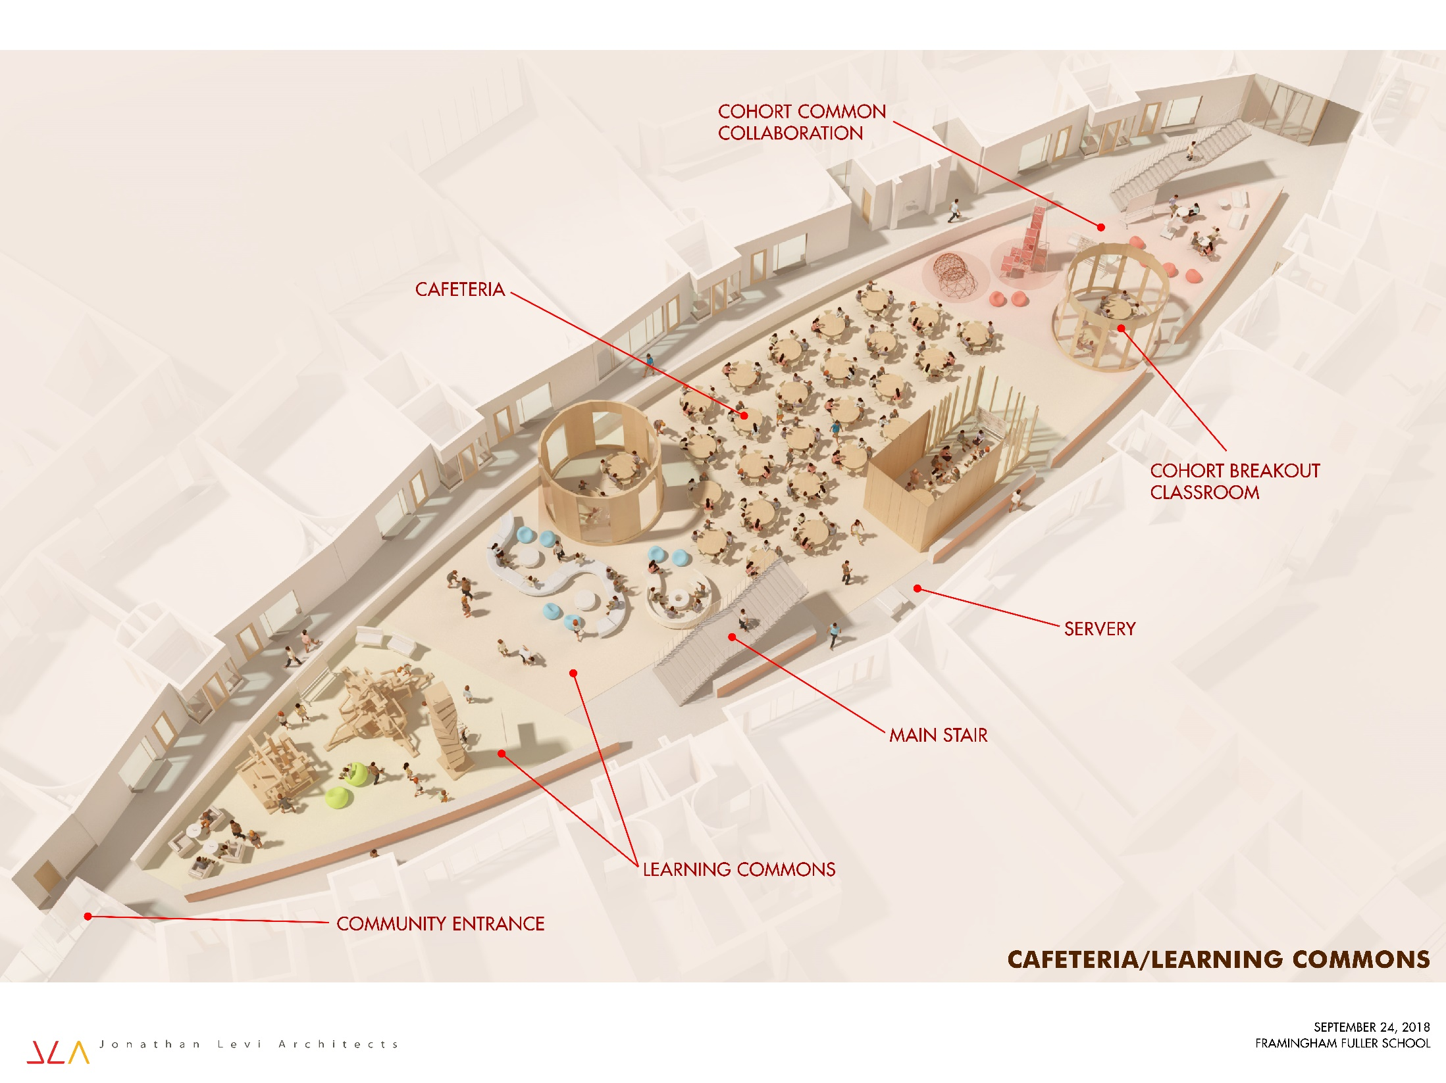

Slide 30
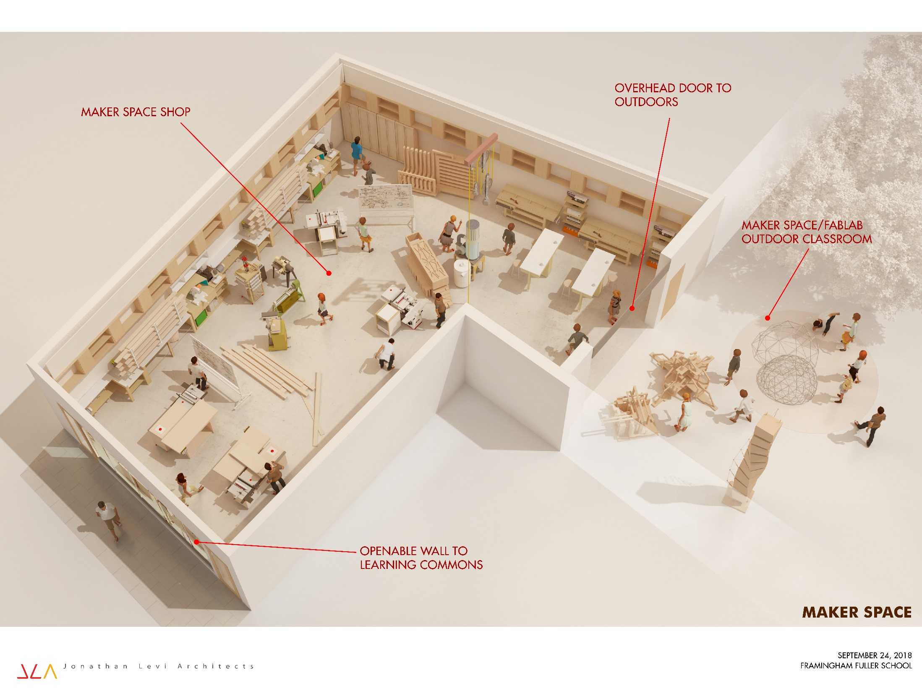

Slide 31
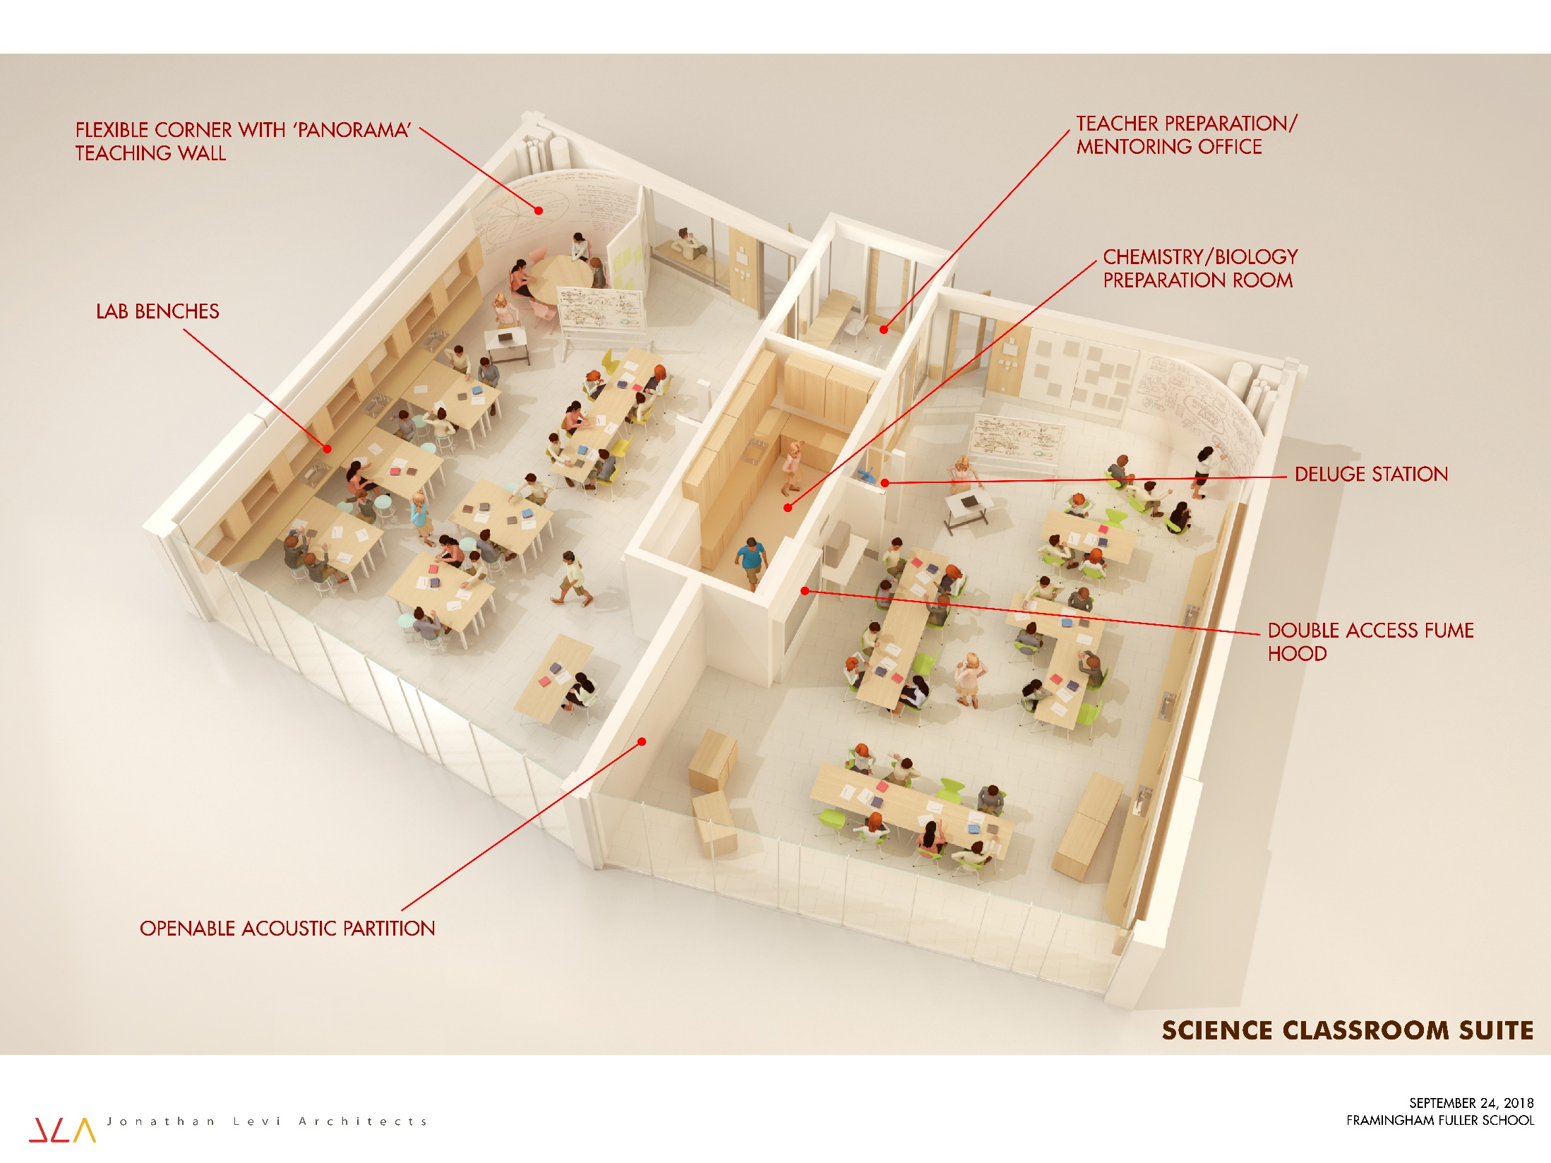

Slide 32
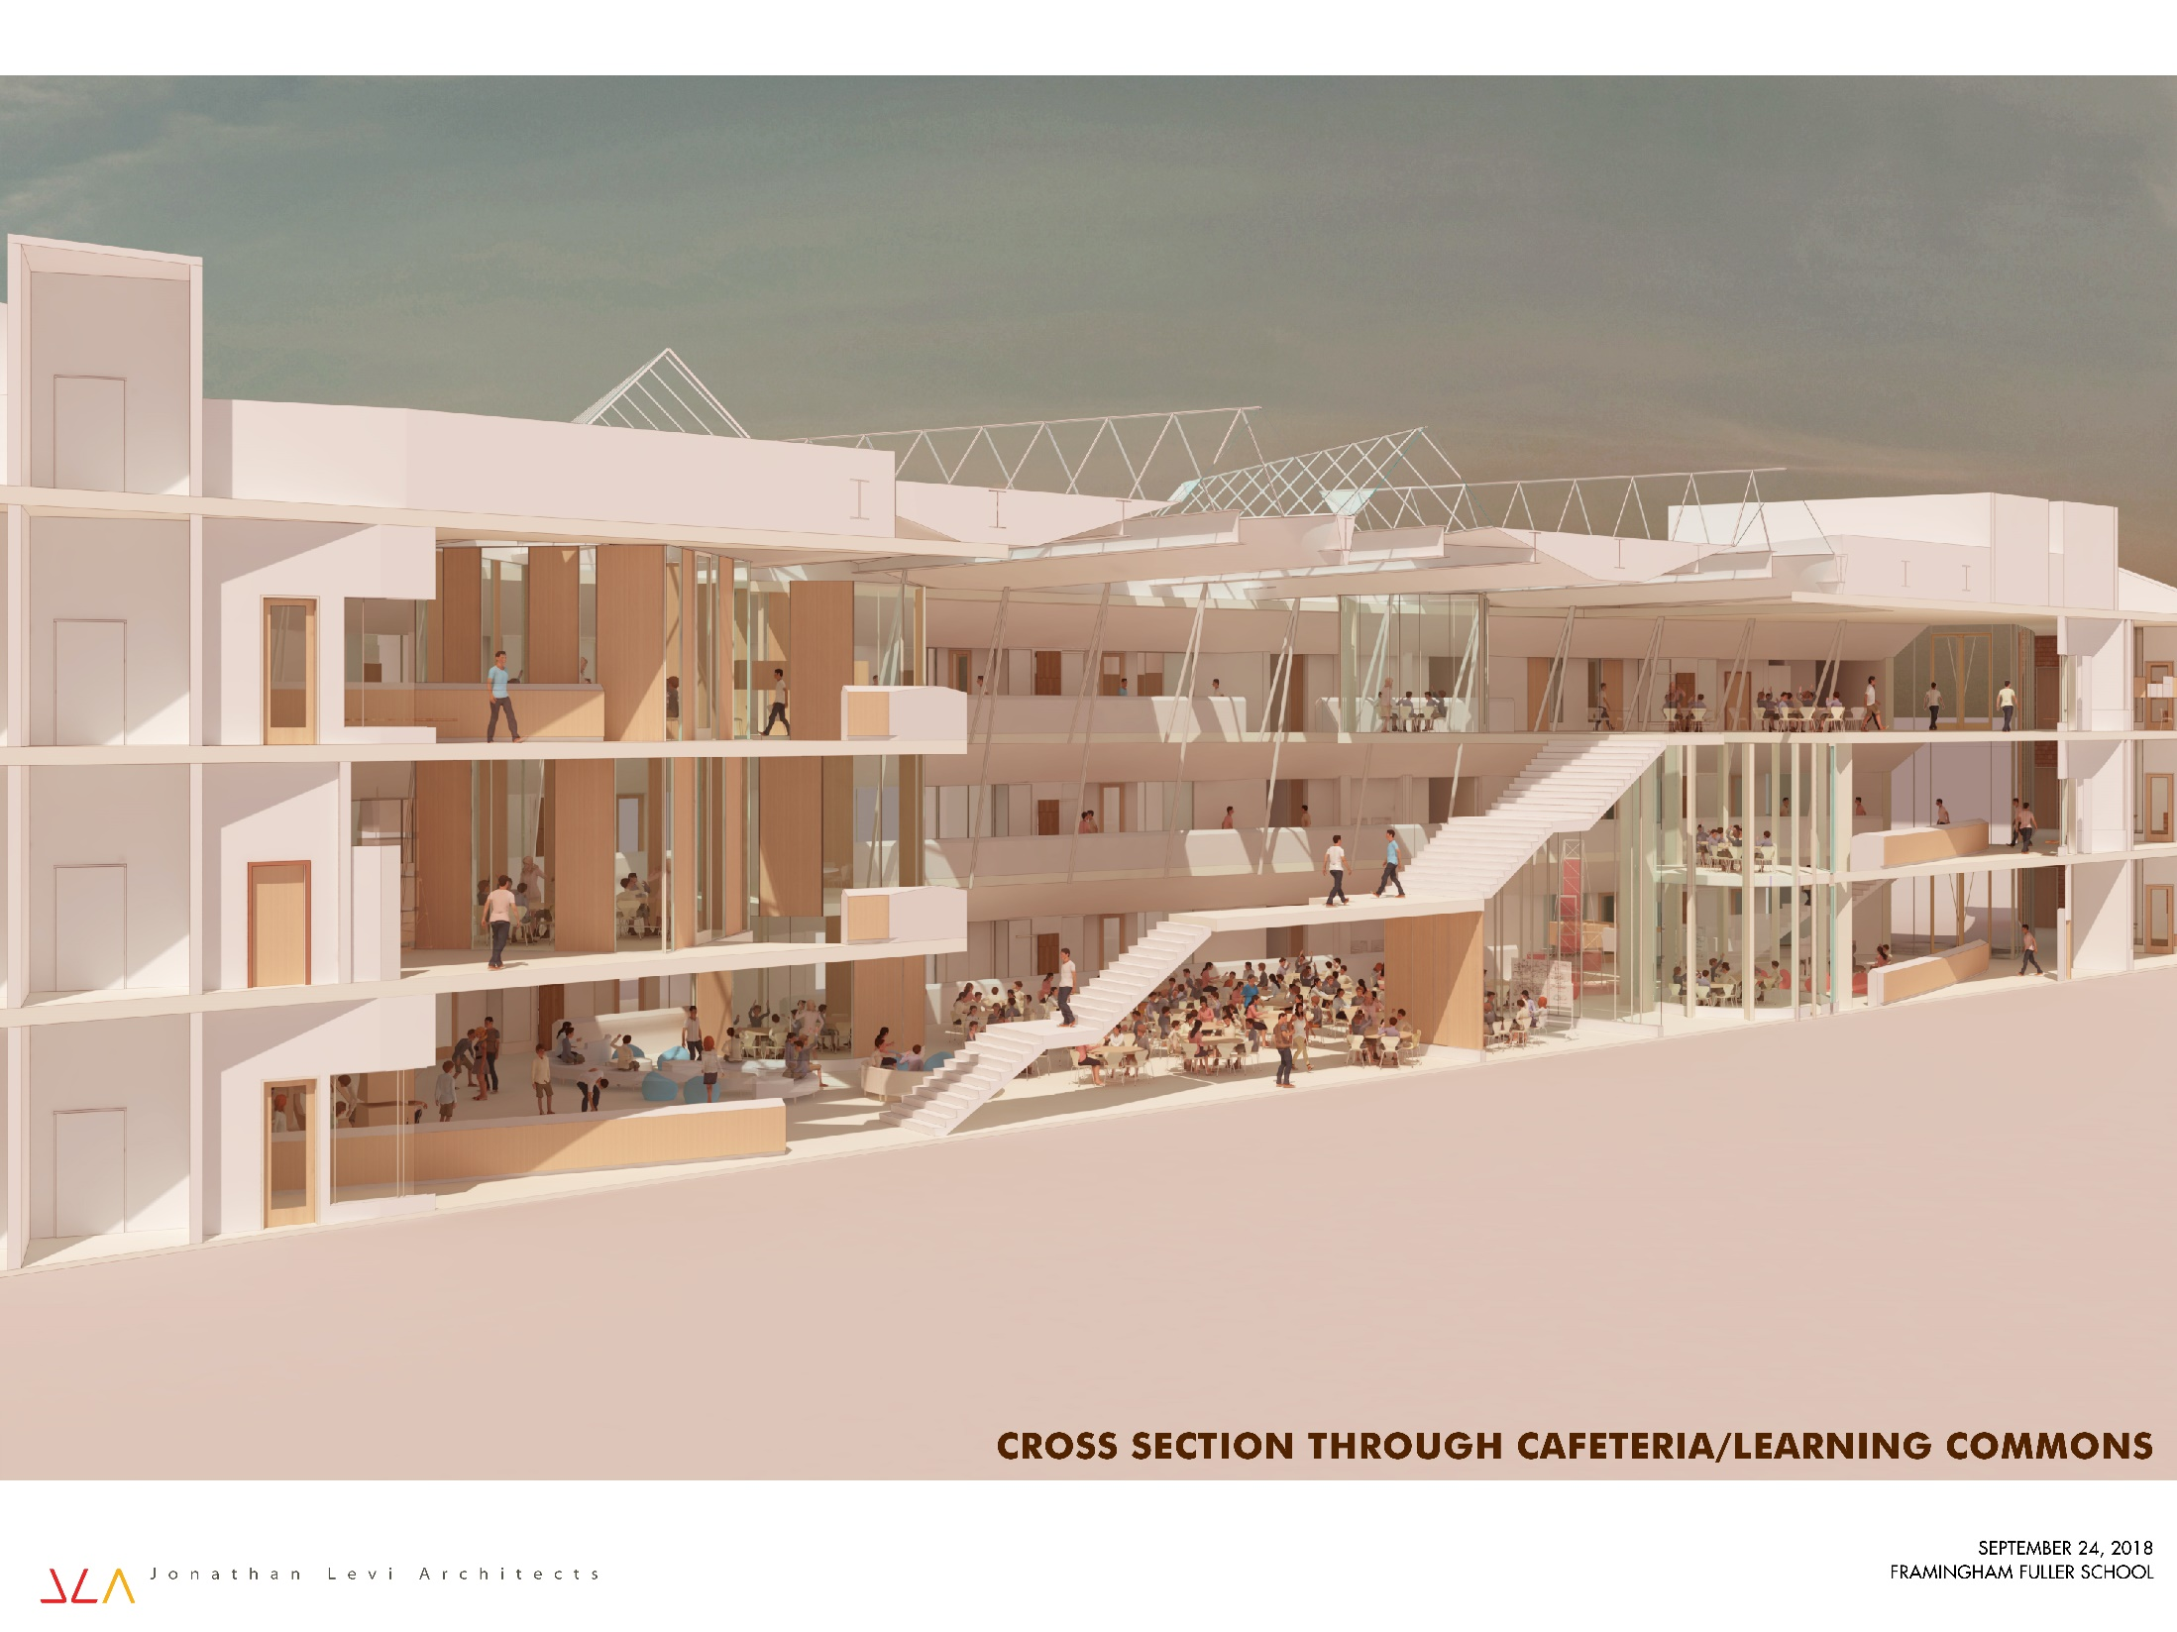

Slide 33
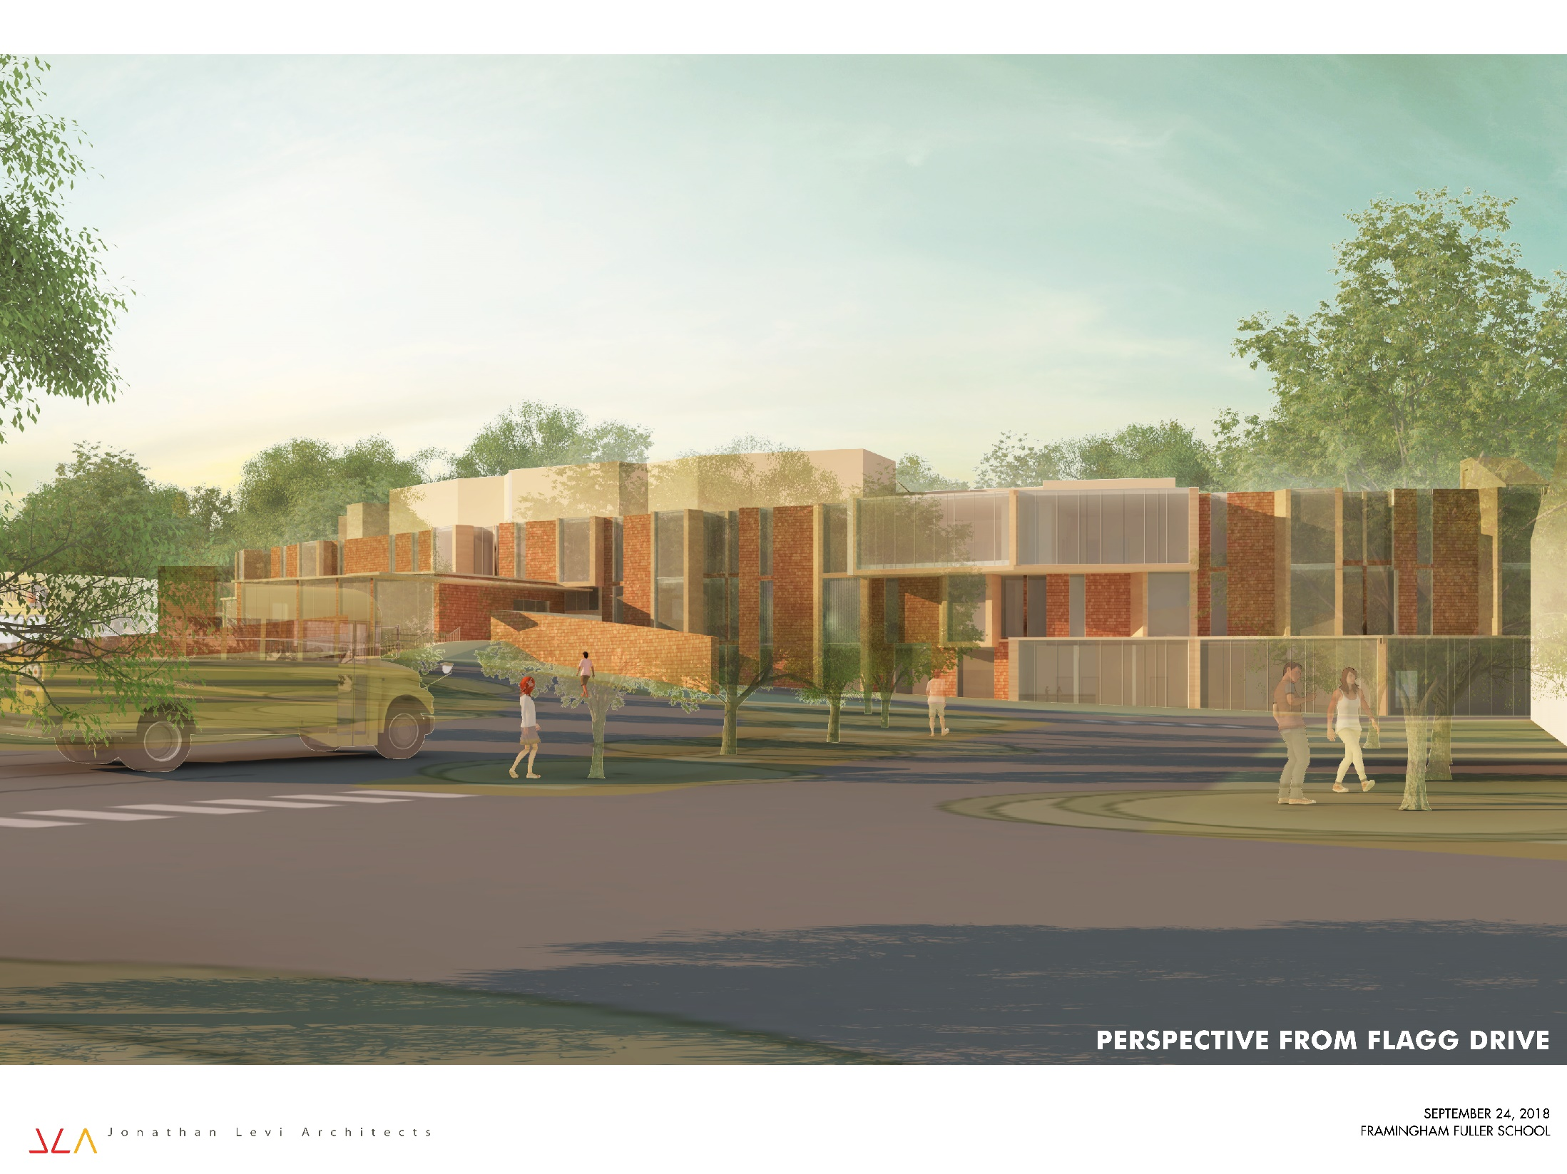

Slide 34
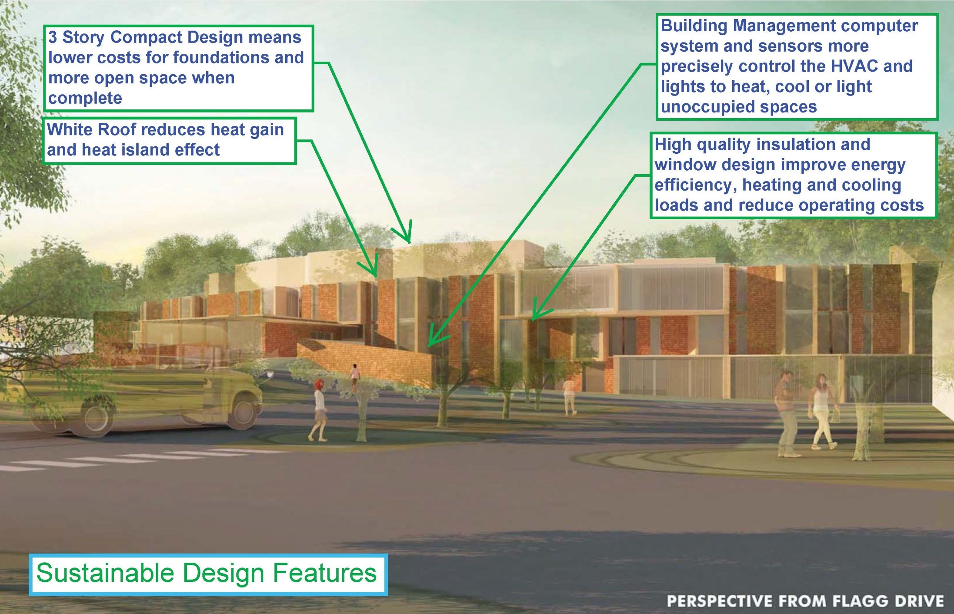

Slide 35
BENEFITS TO THE STUDENTS AND EDUCATORS
  Appropriate classroom sizes and relationships according to contemporary educational standards.
  Collaboration spaces that support project based learning - preparing students for the contemporary workforce.
  Natural daylighting and healthy ventilation for improved educational outcomes.
  Full range of special education spaces to support individual student needs.
  STEAM (science, technology, engineering, art and mathematics) instruction spaces to fulfill district's elementary feeder school commitment to STEM curricula.
  Spaces that facilitate teacher collaboration toward improved teaching practices.
PROJECT MANAGEMENT | SMMA

Slide 36
BENEFITS TO THE COMMUNITY
  Replacement of decaying, inefficient facility with ever increasing maintenance and operation cost burden to the City. Reduced building size, modern materials, and far more energy efficient HVAC systems will increase operating efficiency over the next 70 years.
  Reduced building footprint yields increased City open space and playfield space, and improves impact to adjacent conservation lands.
  Traffic calming measures improve public safety.
  Renewal of community access athletic and performance facilities for future use.
PROJECT MANAGEMENT | SMMA

Slide 37
PROJECT TIMELINE
December 2018 – Detailed Design Commences
Summer 2019 – Construction Commences
Summer 2021 – New Building is Completed
December 2021 – Demolition and Sitework Completed
PROJECT MANAGEMENT | SMMA

Slide 38
TOTAL PROJECT COST
CONSTRUCTION COST (BUILDING + SITE WORK+ MARK-UPS) | $77.9M
FEES & EXPENSES | $12.6M
FURNITURE, FIXTURES & EQUIPMENT | $2.3M
CONTINGENCIES | $5.5M
TOTAL | $98.3M
PROJECT MANAGEMENT | SMMA

Slide 39
Was the total Project Cost reduced?
 | PROJECT COST | COST TO CITY | BUILDING SIZE
PSR SUBMISSION - 5/9/2018 | $110.5M | $66.6M | 153,905 SF
REDUCED ELL SPACES - 6/18/2018 | $104.5M | $63.6M | 141,750 SF
REDUCED AUDITORIUM - 7/16/2018 | $101.3M | $60.8M | 136,790 SF
SCHEMATIC DESIGN SUBMISSION - 9/12/2018 | $ 98.3M | $58.8M | 136,790 SF
TOTAL REDUCTION | $ 12.2M | $7.8M | 17,115 SF
PROJECT MANAGEMENT | SMMA

Slide 40
COLLABORATIVE COST REDUCTION STRATEGY ACTION
Reduce 30 Classrooms to 27
Reduce 9 Science Classrooms to 6
Combine Tech Classroom with Fabrication Lab
Combine Small Group Seminar with Teacher Work Rooms
Reduce Auditorium from 750 seats to 420 seats
Combined total reduction of 17,115 GSF, representing a savings of approximately $12.2M in total project costs, representing a savings of $7.8M to the City.
PROJECT MANAGEMENT | SMMA

Slide 41
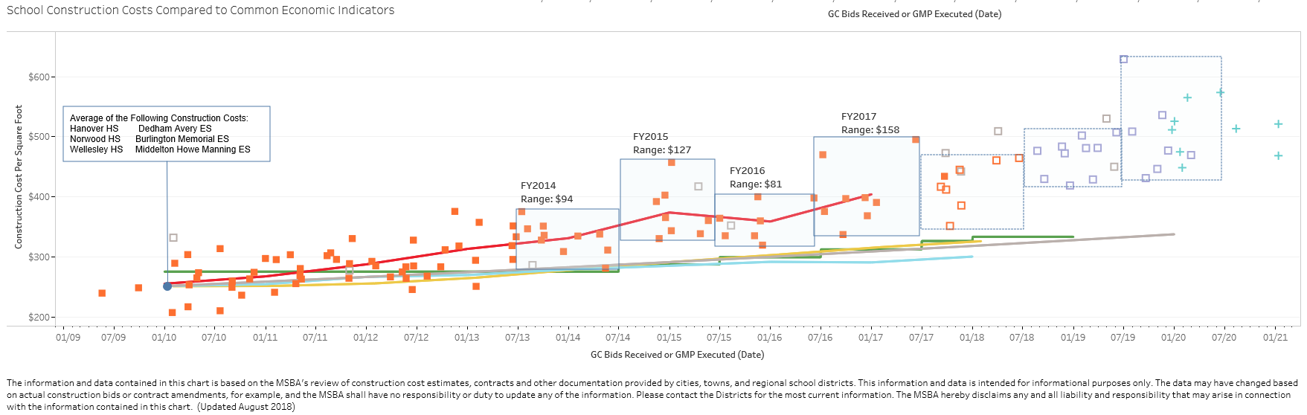

HOW DOES THAT COMPARE TO RECENT MIDDLE SCHOOL PROJECTS?
FY2017
FY2018
FY2019
FY2020
ANNUAL INCREASE 14.5% 8.0% 8.4% 8.1%
PROJECT MANAGEMENT | SMMA

Slide 42
HOW DOES THAT COMPARE TO RECENT MIDDLE SCHOOL PROJECTS?
(Sorted by Total Project Cost)
Project Name | Students | Cost Escalated to Fuller ($M)
Lynn Middle Schools | 1,660 | $213
Saugus Middle/High School | 1,360 | $186
Beverly Middle School | 1,395 | $136
Holyoke Lawrence Middle School | 1,100 | $132
Abington Middle/High School | 1,115 | $129
Natick Kennedy Middle School | 1,000 | $116
Dennis-Yarmouth Mattacheese Middle School | 940 | $113
Westport Middle/High School | 860 | $112
Framingham Fuller Middle School | 630 | $98
Boston Dearborn STEM Academy | 600 | $94
Quincy Sterling Middle School | 430 | $70
PROJECT MANAGEMENT | SMMA

Slide 43
HOW DOES THAT COMPARE TO RECENT MIDDLE SCHOOL PROJECTS?
(Sorted by Cost per Student)
Project Name | Students | Cost/Student ($K)
Quincy Sterling Middle School | 430 | $162
Boston Dearborn STEM Academy | 600 | $156
Framingham Fuller Middle School | 630 | $156
Saugus Middle/High School | 1,360 | $137
Westport Middle/High School | 860 | $130
Lynn Middle Schools | 1,660 | $129
Dennis-Yarmouth Mattacheese Middle School | 940 | $120
Holyoke Lawrence Middle School | 1,100 | $120
Natick Kennedy Middle School | 1,000 | $116
Abington Middle/High School | 1,115 | $115
Beverly Middle School | 1,395 | $97
PROJECT MANAGEMENT | SMMA

Slide 44
HOW DOES THAT COMPARE TO RECENT MIDDLE SCHOOL PROJECTS?
(Sorted by Cost per Square Feet)
Project Name | Students | Cost/SF
Boston Dearborn STEM Academy | 600 | $730
Quincy Sterling Middle School | 430 | $727
Framingham Fuller Middle School | 630 | $718
Saugus Middle/High School | 1,360 | $693
Lynn Middle Schools | 1,660 | $674
Natick Kennedy Middle School | 1,000 | $638
Holyoke Lawrence Middle School | 1,100 | $617
Dennis-Yarmouth Mattacheese Middle School | 940 | $614
Westport Middle/High School | 860 | $597
Beverly Middle School | 1,395 | $586
Abington Middle/High School | 1,115 | $546
PROJECT MANAGEMENT | SMMA

Slide 45
COST PER SQUARE FEET DIFFERENTIATORS
Increased Site Costs against Small Building Area
Overlarge Existing Building Demolition and Abatement
Soil Conditions Foundation Support
Auditorium and Added Gymnasium Premium
Full Air Conditioning
PROJECT MANAGEMENT | SMMA

Slide 46
Msba reimbursement
rate
Base Points | 31.00
Income Factor | 7.73
Property Wealth Factor | 17.68
Poverty Factor | 1.42
BASE RATE | 57.83
Maintenance | 1.48
CM @ Risk | 1.00
“Green Schools” | 2.00
INCENTIVE POINTS | 4.48
REIMBURSEMENT RATE | 62.31
PROJECT MANAGEMENT | SMMA

Slide 47
WHAT WILL BE FRAMINGHAM’S SHARE?
to the City, , $60,789,683
Total Project Cost | $ 98,276,878
Approximate Ineligible Costs | $ 34,910,495
Eligible Costs | $ 63,366,383
Eligible Costs | $ 63,366,383
Reimbursement Rate | 62.31%
Approximate MSBA Grant | $ 39,483,593
Total Project Cost | $ 98,276,878
Approximate MSBA Grant | $ 39,483,593
Approximate Cost to the City | $ 58,793,285
PROJECT MANAGEMENT | SMMA

Slide 48
WHAT ARE THE APPROXIMATE INELIGIBLE COSTS?
Legal fees | $ 80,000
OPM fee associated with Ineligible Spaces | $ 286,361
Architect fee associated with Ineligible Spaces | $ 837,936
Asbestos flooring abatement | $ 388,800
Site costs over 8% | $ 4,162,845
Building costs over $333/s.f. | $16,912,791
Auditorium ineligible space | $ 5,823,829
Gymnasium ineligible space over 6,500 s.f. | $ 1,440,421
Administration ineligible space over MSBA Guideline | $ 904,095
Furnishings and equipment over $1,200/student | $ 378,000
Educational technology over $1,200/student | $ 378,000
Moving expenses | $ 200,000
Construction contingency over 1% | $ 3,117,417
Total Approximate Ineligible Costs | $34,910,495
PROJECT MANAGEMENT | SMMA

Slide 49
WHAT WILL BE FRAMINGHAM’S SHARE?
PROJECT COST | $98.3M
APPROXIMATE MSBA GRANT | $39.5M
APPROXIMATE COST TO FRAMINGHAM | $58.8M
PROJECT MANAGEMENT | SMMA

Slide 50
WHAT DOES THIS MEAN TO THE AVERAGE tAXPAYER?
  29 Cents annual tax increase per $1,000 valuation
  $101 per year, OR
  $8.41 per month, OR
  28 Cents per day
  Based on a 20-year bond utilizing $8 million of the Capital Stabilization Fund
PROJECT MANAGEMENT | SMMA

Slide 51
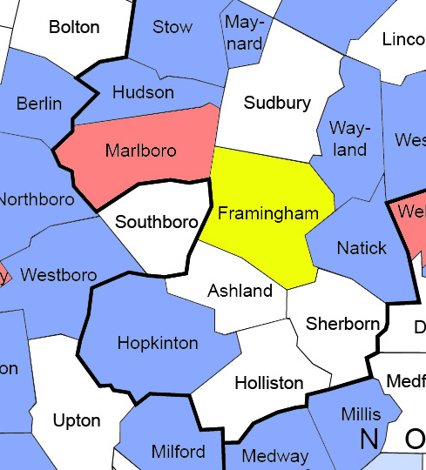
WHAT HAVE OUR NEIGHBORS BEEN DOING?
34.58%
50.85%
MSBA CORE PROGRAM PROJECTS IN NEIGHBORING TOWNS
(within past ten years):
58.11%
52.21%
67.71%
40.00%
Completed or Under Construction
52.88%
62.31%
48.21%
In Feasibility to Design Development Phase
57.93%
44.50%
59.94%
50.79%
57.27%
51.26% Average
PROJECT MANAGEMENT | SMMA

Slide 52
SURROUNDING COMMUNITIES 2018 RESIDENTIAL TAX RATE
($/$1,000 Assessed Value)
$/$1,000
PROJECT MANAGEMENT | SMMA

Slide 53
THE COST OF VOTING “NO”?
Case Study: Lincoln – Paying More… Getting Less
July 2012 (MSBA Board Approval)
November 2012 (Lincoln Town Meeting Failed)
  $50M Total Project Budget
  $21M MSBA Grant
Not re-accepted into MSBA program after several attempts
Now evaluating options forecast to cost $90-100 million at 100% Town cost
PROJECT MANAGEMENT | SMMA

Slide 54
The cost of voting “no”?
Possible Scenarios
 |  | COST TO CITY |  | AVERAGE RESIDENTIAL TAX IMPACT
VOTE PASSES
NEW FULLER NOW (with MSBA GRANT) |  | $ 58.8M |  | $101
VOTE FAILS
NEW FULLER IN 10 YEARS (ASSUMED with MSBA GRANT) |  | $ 84.4M * |  | $145
OPERATE AND MAINTAIN EXISTING FULLER |  | $ 18.6M ** |  | ?
 |  | $103.0M
REPAIR-ONLY FULLER NOW |  | $131.0M |  | $244
* - Based on 4% escalation, current borrowing rate, 20 year term, using $11M of Capital Stabilization Fund, MSBA Grant not guaranteed.
** - Assumes no major system failures in next 10 years.
PROJECT MANAGEMENT | SMMA

Slide 55
THE COST OF VOTING “NO”?
A “NO” vote means educational offerings continue to not meet the needs of students and educators due to facility needs
A “NO” vote does not avoid future expenses. In fact, the opposite is true:
  State aid ($39.5M) will go to another district and the City is unlikely to get another opportunity.
  No benefit to show for the Feasibility Study funds expended by the City.
  Current and future generations inherit an inadequate building with big costs ahead ($131M).
  The cost of future repairs and construction will only go up, including their impact on taxes.
PROJECT MANAGEMENT | SMMA

Slide 56
IMPORTANT DATES
October 16, 2018 – City Council Public Hearing
October 30, 2018 – City Council Meeting to approve funding
October 31, 2018 – MSBA Board Meeting to approve project
November 1, 2018 – Community Forum No. 9
November 28, 2018 – Community Forum No. 10
December 11, 2018 – Anticipated Debt Exclusion Ballot Vote
PROJECT MANAGEMENT | SMMA

Slide 57

WHY A NEW FULLER?
Physical and Educational Deficiencies
STEAM based Educational Vision
6 Years of Study
MSBA Partnership
PROJECT MANAGEMENT | SMMA

