Slide 1
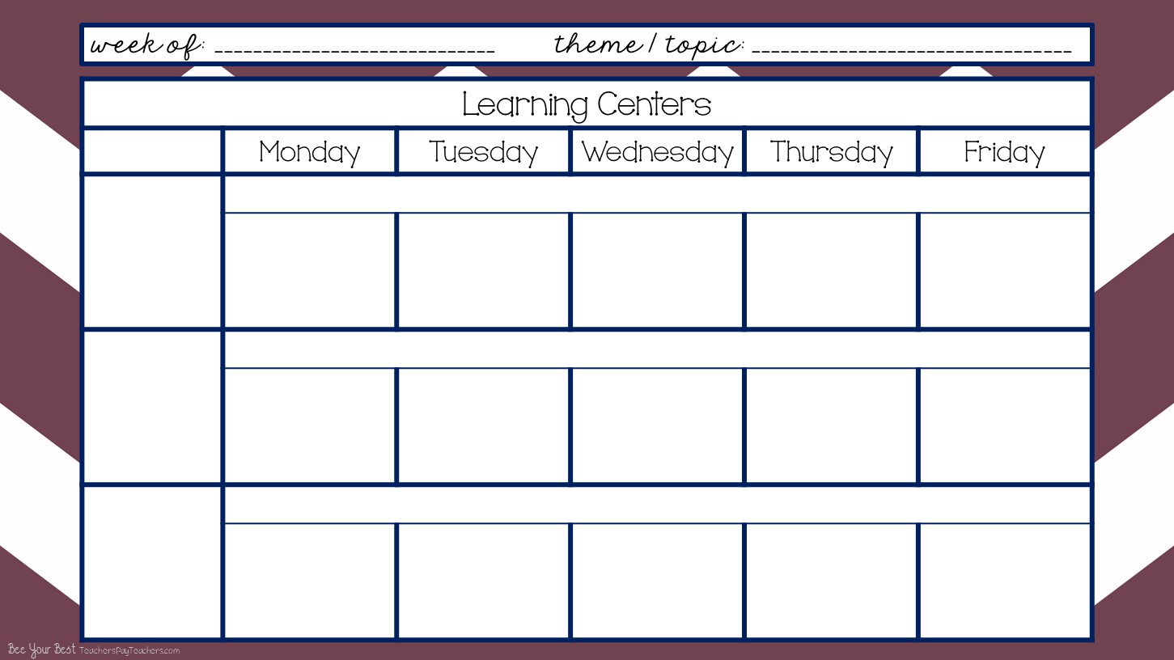
Wk# 3 -- Sept. 8-11,,2020
Brown Bear Brown Bear & Elmer the Elephant
Arrival & Free Play
8:40-9:40
I can become more independent. I can recognize and find my name and cubby. I can put my stuff away. I can choose an activity and friends to play with.
FOCUS - Letter Ff #2, Circle / Square, Brown
Letter Ff Paper
Name Writing Practice
Letter Ff Paper
Name Writing Practice
Letter Ff Paper
Clean Up
9:40-9:45
I can work with my friends and clean up and put things away then come to the carpet and get ready to learn altogether.
Community Carpet Time
9:45-10:10
I can sit on my spot on the carpet. I can listen to my teacher. I can keep my hands to myself. I can participate and learn.
Learning Letter Sounds A-Z
Square Song
Brown Song
This Is Your Land
Oklahoma
Baby Shark
ABC Rap + Letter Ff Rap
Shape Song Singing Walrus
You’re a Grand Old Flag
Oklahoma
Herman the Worm
See It, Say It, Sign It
Circle Song
Brown Song
Countdown to Blastoff
This Is Your Land
Oklahoma
Do You Know Your Alphabet?
Shape Agent Song
Shape Song Singing Walrus
You’re a Grand Old Flag
Oklahoma
Alligator Chomp
Zoophonics
Square Song
Brown Song
On Top of Spaghetti
This Is Your Land
Oklahoma

Slide 2
Wk# 2-- August 24-28 , 2020
Chicka Chicka Boom Boom / All About Me
Morning Recess
10:10-10:40
I can play with my friends and share the equipment. I can play on the equipment correctly. I can line up when it’s time to go in.
Outside on Playground
(if there’s inclement weather then do rainy day boxes inside the classroom)
Mini Lessons
10:40-10:55
I can listen, learn, and participate in mini literacy, math, social skills, science, and social studies lessons.
Mini Literacy Lesson
Read Aloud
Class Discussion
Mini Math Lesson
Mini Literacy Lesson
Name of the Day
Mini Social Skills Lesson + Class Discussion / Anchor Chart
Mini Science / Social Studies Lesson -- use Weekly Reader + Class Discussion
Lunch
11:00-11:30 Afternoon Recess
11:30-noon
I can eat lunch and clean up my mess when I’m done. I can line up and walk to and from lunch and recess. I can keep my hands to myself and be nice to my neighbors.
Cafeteria & Outside on Playground
(if there’s inclement weather then do rainy day boxes inside the classroom)

Slide 3
Wk# 2 -- August 24-28, 2020
...
Chicka Chicka Boom Boom / All About Me
Smart Board Activity
noon-12:45
I can enjoy engaging Smart Board Activities while cooling down or warming up from being at recess. I will go to the bathroom and wash my hands. I will participate in smart board activities.
Smart Board / Brain Breaks
Smart Board / Brain Breaks
Smart Board / Brain Breaks
Smart Board / Brain Breaks
Smart Board / Brain Breaks
Work Stations / Center Rotations with Buddy
12:15-1:15
I can work with my work station buddy. I can share and communicate. I can clean up. I can put my papers away. I can learn the chart and move around. I can follow instructions. I can learn and grow!
Library -2- Thematic Unit Books
Home & Living -2 - Play and Pretend
Shannon -4- Monday - Brown Bear Sack Puppets
Tuesday - 4- Color Brown Bear correctly
NO Work Stations because it’s Early Out Day
Library -2- Thematic Unit Books
Home & Living - 2- Play & Pretend
Shannon -4- Thur - Paste Mosaic Squares on Elephant
Friday - 4- Color Elmer the Elephant correctly
Work Stations cont’d.
Math -2- Number Trace Brown Bear
Literacy -2- Dob the B for Bear + manipulatives
NO Work Stations because it’s Early Out Day
Math -2- Trace the Number on Write/Wipe #s
Literacy -2- manipulatives

Slide 4
Wk# -2 - August 24-28,2020
...
Chicka Chicka Boom Boom / All About Me
Work Stations cont’d.
Teacher Table -4- Monday - Brown Bear Booklet
Tuesday - 4 - Re-Tell Elmer the Elephant + Bang Game
Blocks -2- Build & Create
Sensory Bin - 2 Hands on Play
NO Work Stations because it’s Early Out Day
Teacher Table -4 - Manipulaties + TESTING
Blocks -2- Build & Create
Sensory Bin - 2- Hands on Play
.
I can eat and drink at snack time. I can wash up before and after snack. I can toss my trash.
Afternoon Snack
1:15-1:30
Wash Up -- Eat & Drink -- Clean Up & Toss Trash
Extra! Extra!
1:30 - 2:15
BIG GROUP -- Name of the Day
Weekly Reader
Journals
White Boards
Cosmic Yoga -- Color Changing Experiment

Slide 5
Wk# -2 August 24-28, 2020
Chicka Chicka Boom Boom / All About Me
Pack Up & Get Ready to Go Home Daily Review
2:15-2:20
I can pack up my backpack and put on my jacket. I can sit on my square on the carpet and be kind to my neighbors. I can listen and learn.
Dismissal
2:20-2:30
I can line up and follow instructions of where to go and what to do from my teachers. I can be happy to go home!
Teacher Planning
2:30-3:40
I can plan awesome opportunities to learn and grow and be flexible as changes inevitably come.
PK
Grade Level
Mtg.

