Slide 1
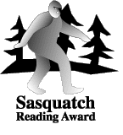
Sasquatch Award
2018 - 2019
Take the Challenge!
Read the Books!

Slide 2
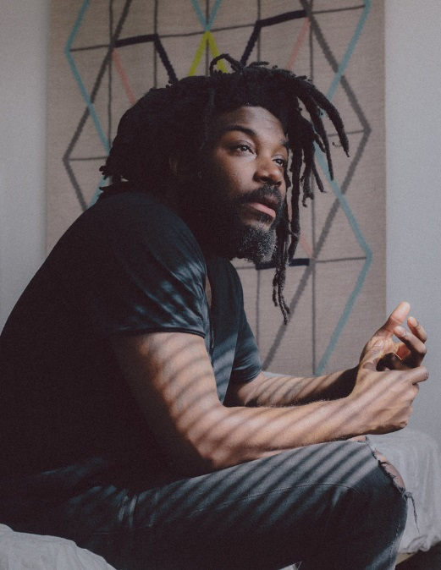

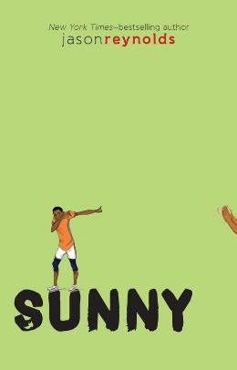



Ghost by Jason Reynolds
Ghost is #1 in the Defenders Track Team
Series. Here are the others.
Jason Reynold lives in Brooklyn, New York and is a 34 year old writer. He likes to play ball and does not like boring books.

Slide 3
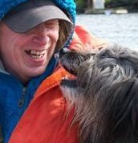
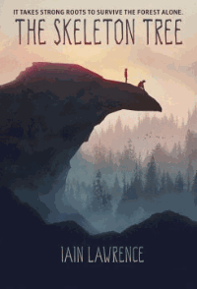
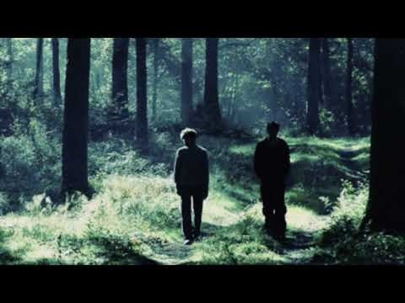
The Skeleton Tree by Iain Lawrence
“Fans of Hatchet will be drawn to this harrowing survival story!
Iain has worked at many different jobs including logging, salmon fishing and fighting forest fires. He lives on Gabriola Island, Canada and has written 15 books for young readers.

Slide 4
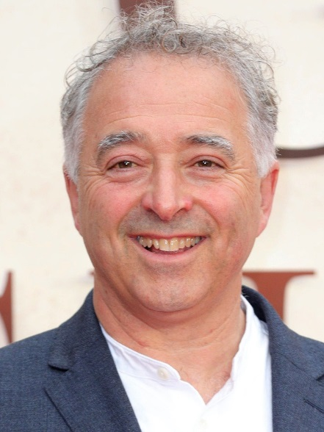
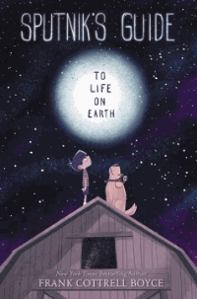
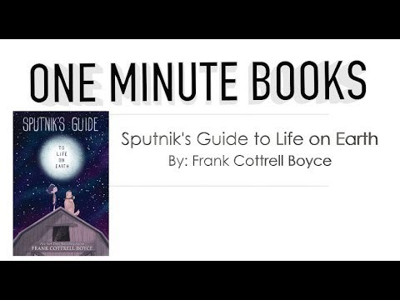
Sputnik’s Guide to Life on Earth by Frank Cottrell Boyce
★ “This book invites readers to suspend belief while going on a physics-defying, mind-bending adventure that’s sure to appeal to a wide audience. Full of escapades, humor, and spunk, this is a stand-alone gem.”
Frank has written books for young readers and adults as well and screen plays and scripts. He has won many awards and lives in Liverpool, England with his family.

Slide 5
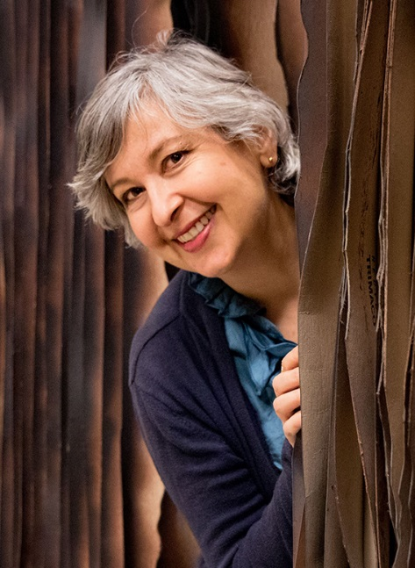
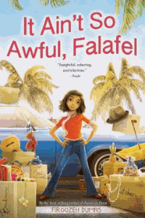
It Ain’t So Awful Falafel by Firoozeh Dumas
* "Dumas’ semi-autobiographical novel is both funny and affecting...Readers will be thoroughly invested in Cindy’s story, whether holding their breath or laughing out loud, and always hoping that the Yousefzadehs will come out on top."
—Booklist, STARRED review
Firoozeh was born in Iran and moved to California when she was seven. Her family would go back and forth during her childhood. She writes for young readers and also for newspapers and magazines.

Slide 6
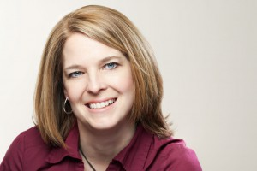


A Night Divided by Jennifer Nielsen
"Absorbing and deeply suspenseful, with plenty of ticking-clock tension... an eye-opening glimpse of history."
Jennifer Nielsen, was born and raised in northern Utah, where she still lives today with her husband, three children, and a dog that won’t play fetch. She is the author of The Ascendance trilogy, the MARK OF THE THIEF series, and A NIGHT DIVIDED. She loves chocolate, old books, and lazy days in the mountains.

Slide 7
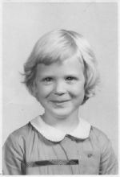
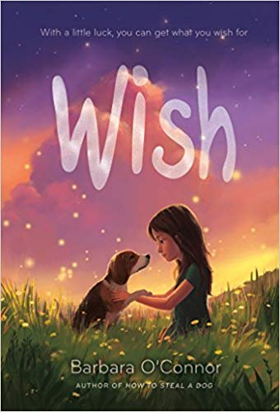

Wish by Barbara O’Connor
“This heartwarming story is not to be missed.” ―Kidsreads
This is Barbara in first grade! As a child she loved dogs, tap dancing and school. She now lives in North Carolina with her husband, 2 dogs and she has a grown up son. She has written many award winning books.

Slide 8



The Tapper Twins Go To War by Geoff Rodkey
"
*"This uproarious series opener... is packed with both laugh-out-loud moments and heart."
~Publishers Weekly, starred review
Hi! I’m Geoff Rodkey. I write things for a living: mostly books, movies, and TV shows…but I’ve also written for magazines, newspapers, video games, web sites, standup comedians, and even two United States Senators.

Slide 9
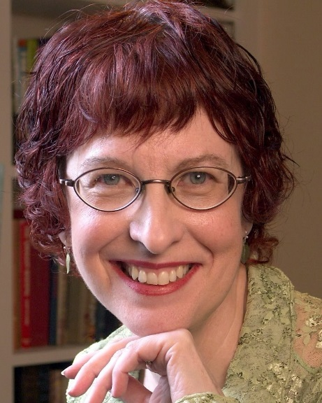
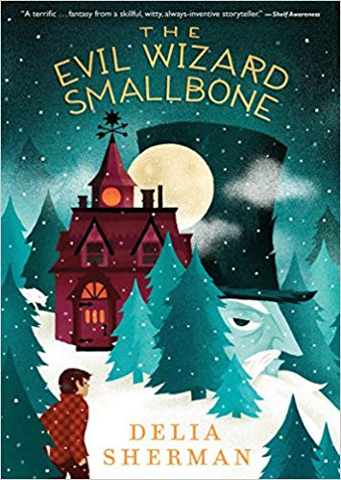
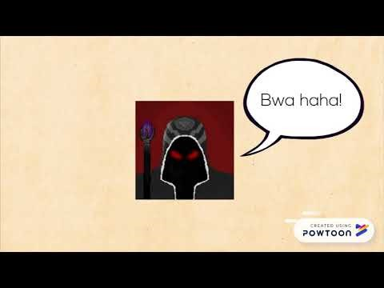
Evil Wizard Smallbone by Delia Sherman
Readers will be hooked early on with the numerous spells, enchanted animals, dueling wizards, and constant action in this fantasy tale. A couple plot twists add to the action.
Delia was born in Japan but grew up and lives in New York. She loves to travel. This is her 5th book.

Slide 10

Save Me a Seat by Sarah Weeks and Gita Varadajaran
Gita was born and raised in India. Now she lives in New Jersey and teaches second grade
Sarah lives in New York with her husband. She has 3 grown children. She has a dog named Meems.
* "A novel treatment of a familiar situation delivered with fizz." -- Kirkus Reviews, starred review

Slide 11
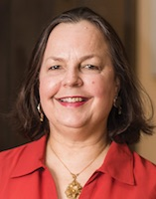
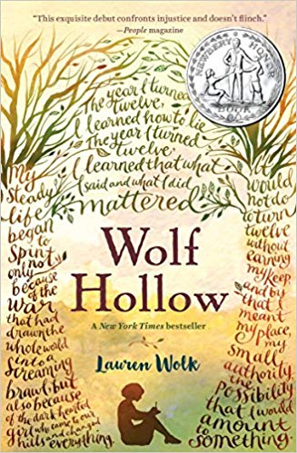
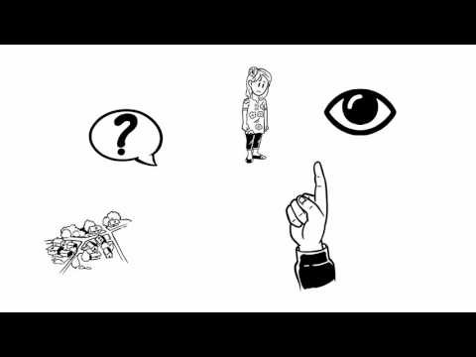
Wolf Hollow by Lauren Wolk
“Superb…beautifully written…A compelling story [that] will have readers—young and old alike— thinking about it a long time after the final page has been turned.”
Lauren Wolk is a novelist, poet, visual artist, and Associate Director at the Cultural Center of Cape Cod.

Slide 12
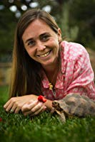

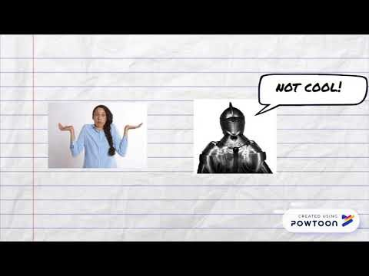
The Midnight War of Mateo Marinez by Robin Yardi
“A magnificent novel that defines what it is to be an older brother, a friend, and, yes, even a knight.”
Robin Yardi lives in the California foothills, where–every once in a while, in the dark of night–a skunk or two will sneak by. She loves good stories, animals of all sorts, homemade cakes, and kids.

Slide 13
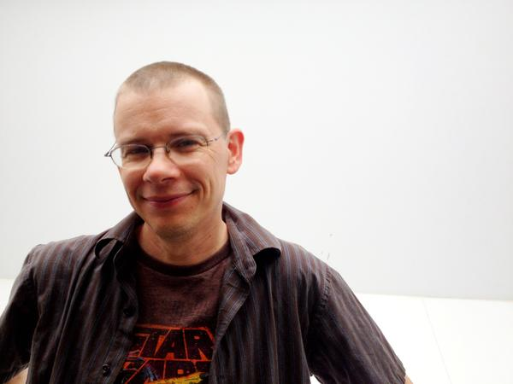
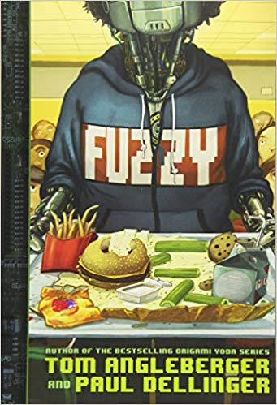
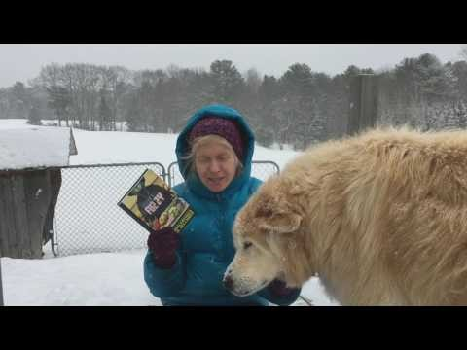
Fuzzy by Tom Angleberger and Paul Dellinger
"A tech-infused wild ride, with some suspenseful moments and brilliant twists—an ideal book for reluctant readers, young science fans and really anyone who wishes their best friend were a robot."
Tom lives in Virginia with his wife who is an illustrator. He was a biology research assistant, juggler and newspaper columnist before he started writing books.

