Slide 1


Standards Based Progress and Report Card Information
2020-2021

Slide 2

Did you know?
Standards Based Report Cards are based upon END OF YEAR EXPECTATIONS.
Performance Indicators are used to assess students’ progress towards MASTERY of the standard.

Slide 3
PERFORMANCE INDICATORS
4 Exceeds Standards
Student independently and consistently exceeds grade level concepts and skills with high quality work reflecting higher thinking skills.
3 Meets Standards
Student consistently demonstrates proficiency of grade level concepts and skills, with accuracy, quality, and independence.
2 Progressing Toward Standard
Student demonstrates progress toward grade level concepts and skills, given support and assistance.
1 Beginning Demonstration of Standard
Student demonstrates a beginning understanding of grade level concepts and skills given support and assistance.
Performance Indicators allow students to be graded more objectively
– subjective qualities such as EFFORT are not part of this rubric.

Slide 4
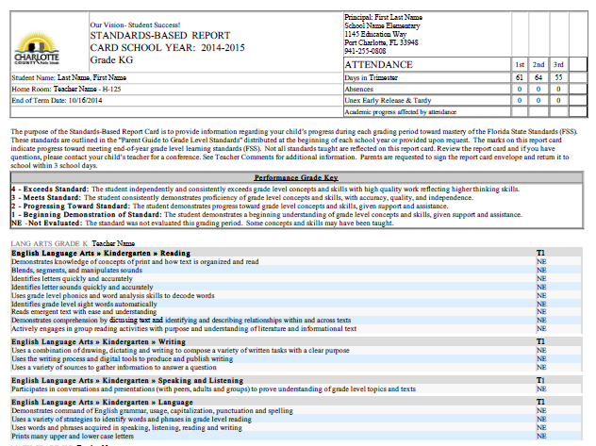
Performance Indicators
Standards

Slide 5
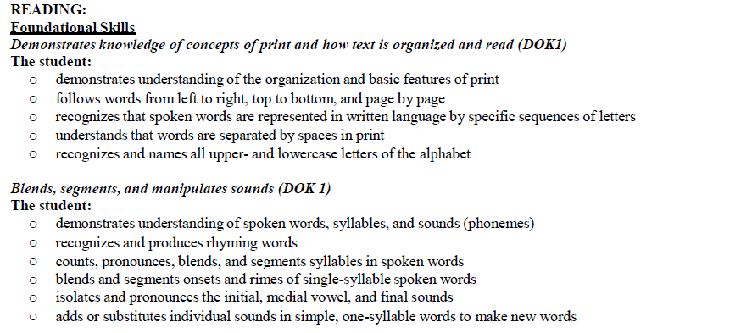
These are the skills that are assessed under each standard.
Standard
5 skills for ONE standard
Standard
6 skills for ONE standard

Slide 6

Key Things to Remember:
The are END OF YEAR expectations.
Grading is done using Performance Indicators (rubric) and is not subjective.
Each standard has MULTIPLE skills that are assessed.
A student must show consistent mastery of the skill over time in order to meet or
exceed standard expectations.

Slide 7
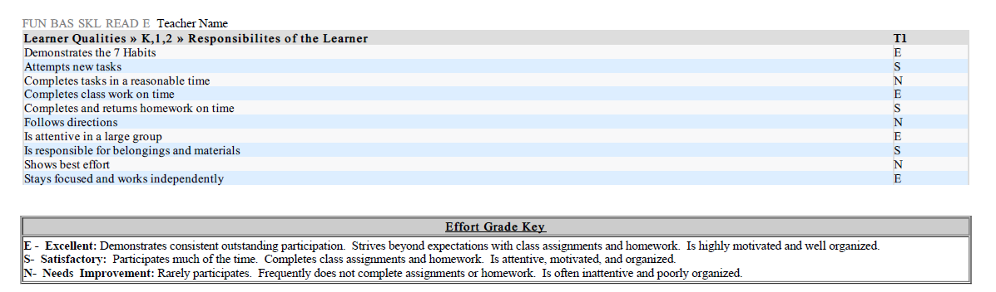
But what about EFFORT?
Insert Effort Grade Key HERE
Students will be assessed on their Learner Qualities as well.

Slide 8
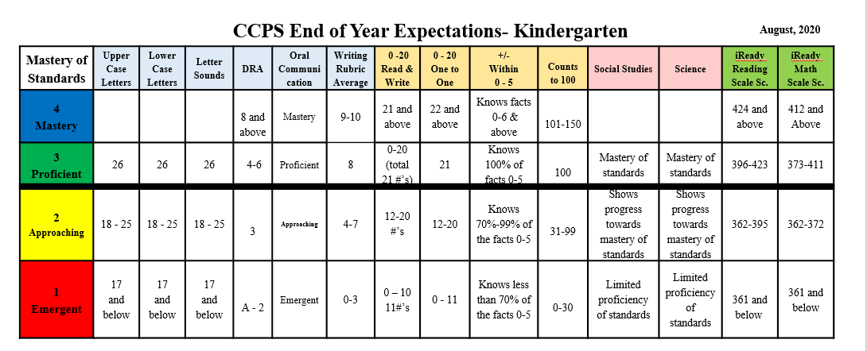
The CCPS Student Progression Plan uses END of YEAR expectations to help teachers make sound
instructional decisions for each child.

Slide 9
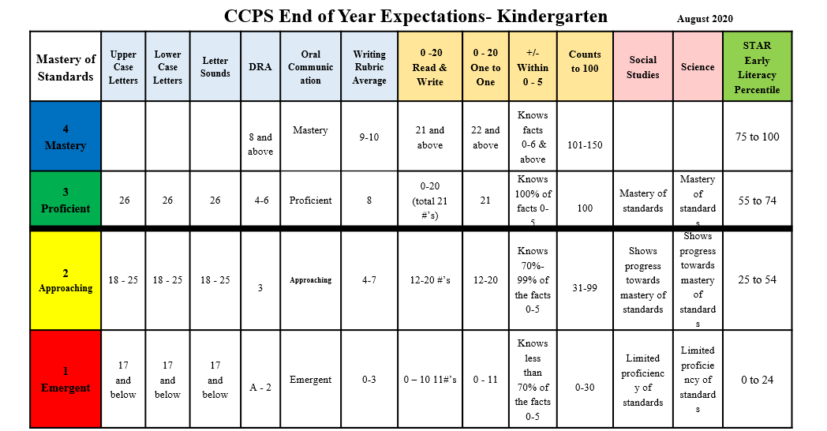
The CCPS Student Progression Plan uses END of YEAR expectations to help teachers make sound
instructional decisions for each child.

