Slide 1


I am SO happy you are here!

Slide 2

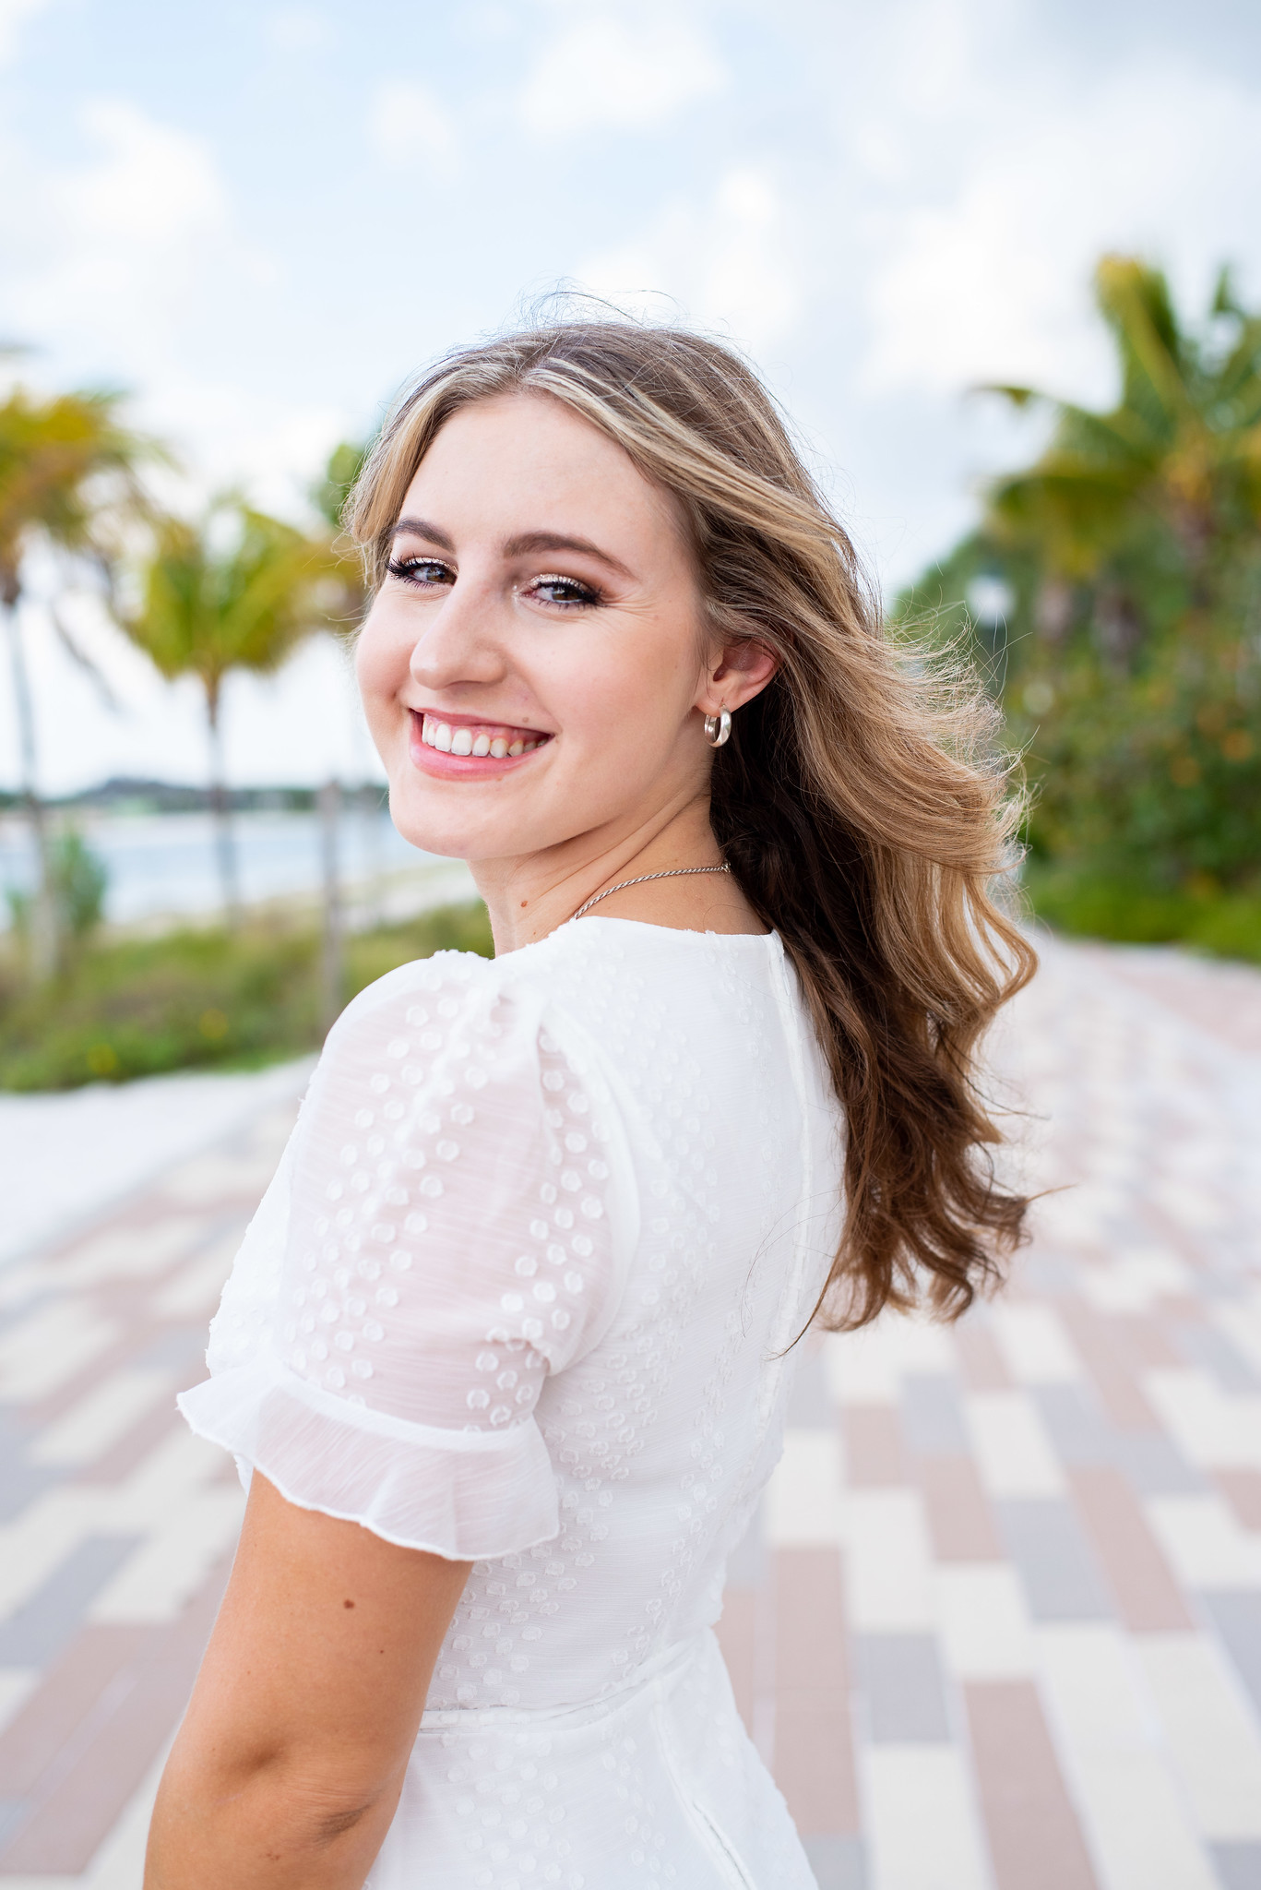
Hello Eagle Parents,
I am Ms. Ressel, and I will be your child's first grade teacher this school year. I am so excited to be working with you and your student to help them grow and succeed in the 2022-2023 school year!

Slide 3


8:10 AM- 8:40 AM Arrival
8:45 AM-9:30 AM Math
9:30 AM-11:00 AM Reading
11:10 AM-11:40 AM Lunch
11:45 AM-12:15 PM Recess
12:30 PM-1:15PM Specials
1:15 PM- 1:45 PM Reading Block Continued
1:45 PM-3:05 PM Social Studies/ Science
3:05 PM- 3:40 PM Dismissal
Rotating Specials:
Music, P.E., Media Center, STEM,
Art, and Computer

Slide 4

Students are expected to:
Follow all directions
Keep their hands and feet to themselves
No teasing or foul language
Try their best each and everyday

Slide 5


Eagle
In the EES planners, I will share any news and what color your student earned for that day based on the SOAR chart.

Slide 6

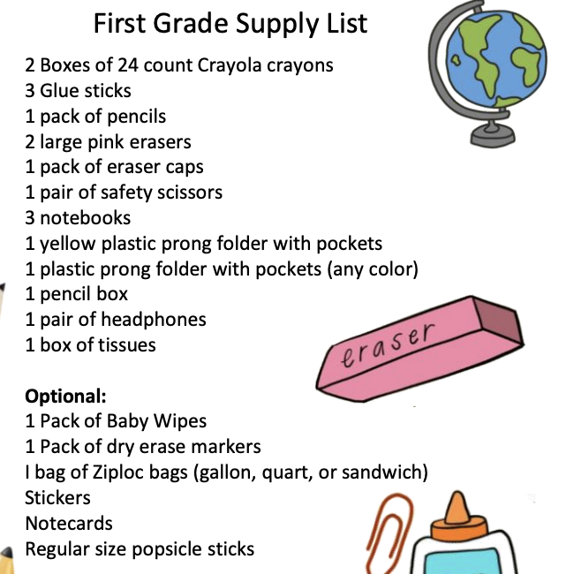
East Elementary School asks that you do not label the supplies please and thank you ☺
Please do NOT buy pencil
sharpeners for your child.

Slide 7


If you would like, your student may bring a low sugar class snack if there are enough for all students (around 20 students).
Our class is Nut, egg, and Tree Nut free. Please be mindful of this when buying snacks.
This gives everyone the opportunity to share with the class, build character, and feel good about sharing their favorites! If your child would like to bring their own drink, water is permitted.
If you have any academic games, books, or extra school supplies it would be GREATLY appreciated!

Slide 8

Students need to be reading at least 20 minutes every night.
Homework assignments will begin on Monday July 18th. Daily instructions will be provided. Homework assignments should be completed, reviewed by a parent, and returned to school on Friday.

Slide 9
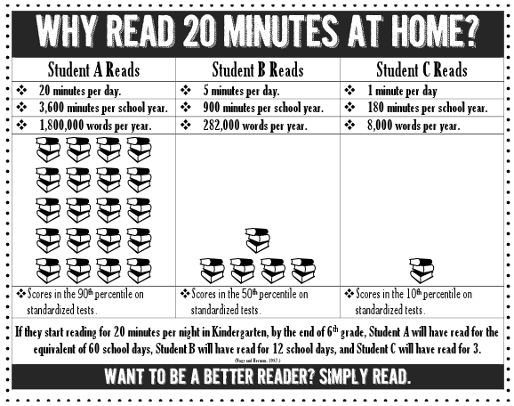

Slide 10

It is important for your child to arrive at school on time.
If it is necessary to change your child’s transportation, even if it is just for one day, please notify me in writing using planner/ agendas or call the office ASAP.
No changes of transportation can be made without notification from a parent.
Please do not forget to sign the Transportation Paper tonight :)

Slide 11

Please keep in touch with me if you have any questions!
Send any communication in your child’s communication folder, via email, student planner, phone call, or through the remind app.

