Slide 1


Welcome to the
Annual Title I
Parent Meeting
2022-2023

Slide 2

“We don’t enroll students,
We enroll FAMILIES!”
-Hamish Brewer

Slide 3
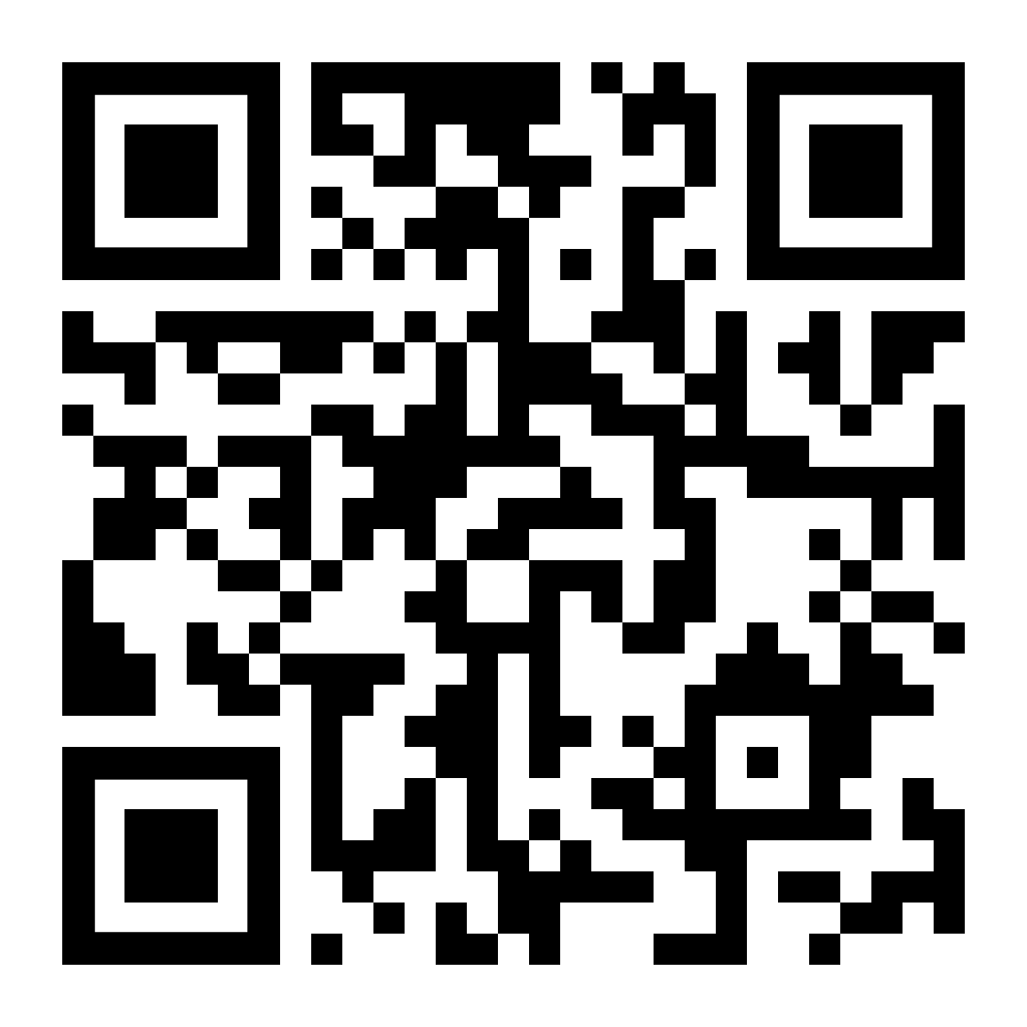
It’s not a Title I presentation without a sign in sheet!
Please click the link to the sign in sheet or use the QR Code
Sign in
https://forms.gle/iBdfPJ4wSF3fT3tU9

Slide 4
WHAT IS Title I?
The largest federal program supporting education
Supports the academic growth of students attending Title I Schools.
Provides extra support to those students that are the furthest from meeting the standards the state has set for all students

Slide 5
Title I Goals
To ensure that every student has a high-quality education
To challenge and motivate students
To provide highly qualified teachers, who use proven teaching methods
To ensure a safe, drug free learning environment

Slide 6
How Does Title I Help MY School?
Supports the Family Reading and Resource Experience
Provides for the Achievement and Family Associate para-professional
Provides for the Lead Teacher & Academic Coach
Provides supplemental learning materials

Slide 7





Title I Supports
Supplemental teaching methods and materials
S.T.A.R. Programs
Thinking Maps
And More...

Slide 8
Title I Supports
Professional Development for Staff
Workshops
Conferences
Academic Coaches
Data Days
School PD
Lead Teachers

Slide 9
Title I Supports
Parent and Family Engagement
Workshops and Family Events
Reading Workshops
Family Engagement Conference
Getting Ready for Kindergarten
Transition to Middle School
FSA for Families
School determined events
Math & Movement
STEM Nights

Slide 10

Parents’ Right to Know

Slide 11
Parents’ Right to know…
Your school is a Title I School
Deep Creek Elementary
East Elementary
Kingsway Elementary
Liberty Elementary
Meadow Park Elementary
Myakka River Elementary
Neil Armstrong Elementary
Peace River Elementary
Sallie Jones Elementary
Vineland Elementary
Port Charlotte Middle School
Murdock Middle School
The Academy

Slide 12

That your child’s teacher is qualified and certified for the grade and subject taught
That the paraprofessional working with your child is highly qualified
Parents’ Right to know…

Slide 13

The right to participate in the education of your child
  S.A.C. (School Advisory Council)
  P.T.O. (Parent and Teacher Organization)
  School Wide Improvement Planning Team
Your child’s academic progress
  Standardized test results (such as FSA result)
  Progress Monitoring Scores & Progress
  Classroom Grades
Parents’ Right to know…

Slide 14

Families have the right to participate on the Parent and Family Engagement Planning Team
To know what is being done to improve your school
Whether your school is safe and drug free
Parents’ Right to know…

Slide 15

Family engagement is not just nice,
it is NECESSARY for student success!
Together, schools and families are a powerful TEAM for Student Success!

Slide 16
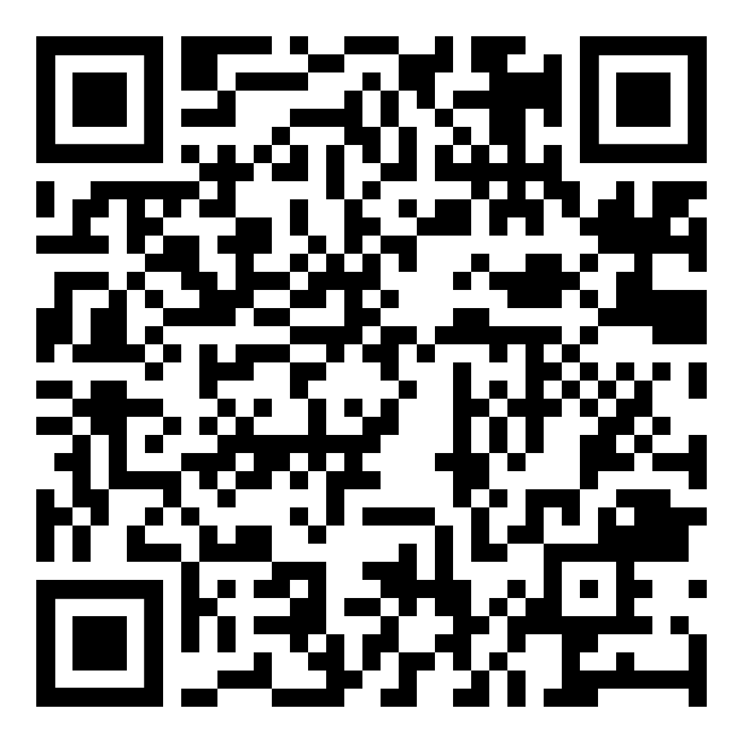
Florida Accountability Reports
Informs parents and the community about each school’s:
Demographic data
School Safety and climate for learning
Academic data
Graduation rates
Class sizes
Teacher and staff information
Curriculum and instruction descriptions
Postsecondary preparation information
Use your camera to follow this QR code to the Florida Department of Education’s Accountability Reports

Slide 17
Ways for Families to be ENGAGED with SCHOOL
Parent Teacher Organization (P.T.O.)
School Advisory Committee (S.A.C.)
Parent-Teacher Conferences
Student Led Conferences
Family Engagement Activities
Family Engagement Planning
School Improvement Planning
Parent-School Compact Updating

Slide 18
YOU!
YOU! You are your child’s first teacher.
YOU! have the biggest influence on your child’s education.
YOU! know your child BEST! Share the knowledge with your child’s teacher(s)
YOU! can ask about academic progress and other areas of progress

Slide 19

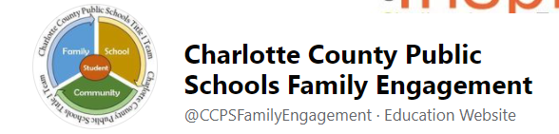
Visit the CCPS
Family Engagement Facebook page
@CCPSFamilyEngagement

