Slide 1

Traffic Signs and Rules around Kingsway Elementary School (KES)
Deputy S. Guerin
KES- School Resource Officer
Thank you for helping us keep our students, staff and families safe.

Slide 2
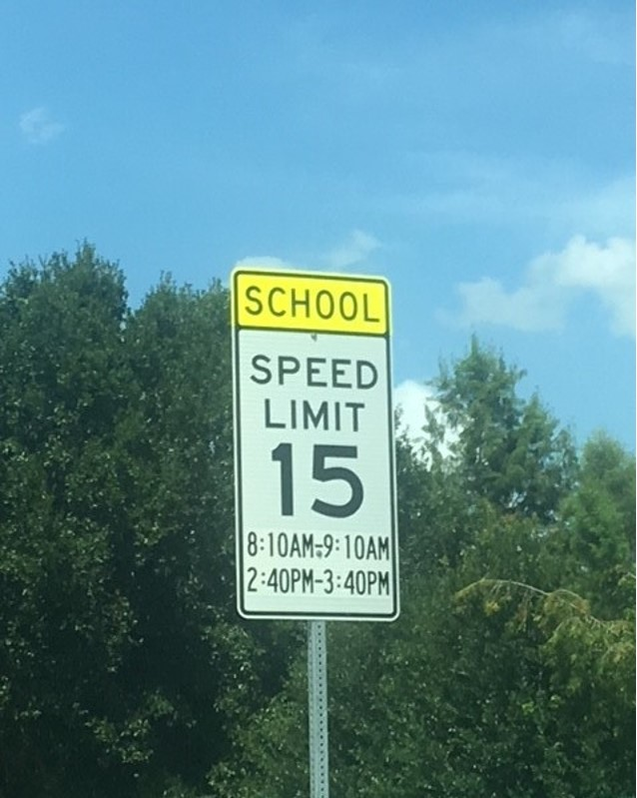
Please monitor your speed in the School Zone
There is a 15 MPH speed limit at specific times AM and PM.
There are multiple signs posted around the school.
The School Zone is the front, back and sides of our building.
PLEASE NOTE: The SRO is NOT the only unit monitoring and enforcing the Traffic laws around at the school. The CCSO Traffic Unit and the zone Deputy also monitors the school zone.

Slide 3
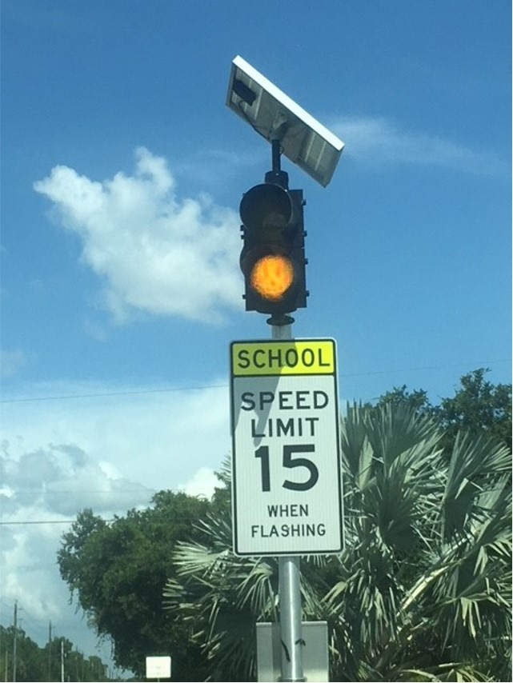
Please follow the Speed Limit coming into the school AND leaving the parking lot.

Slide 4
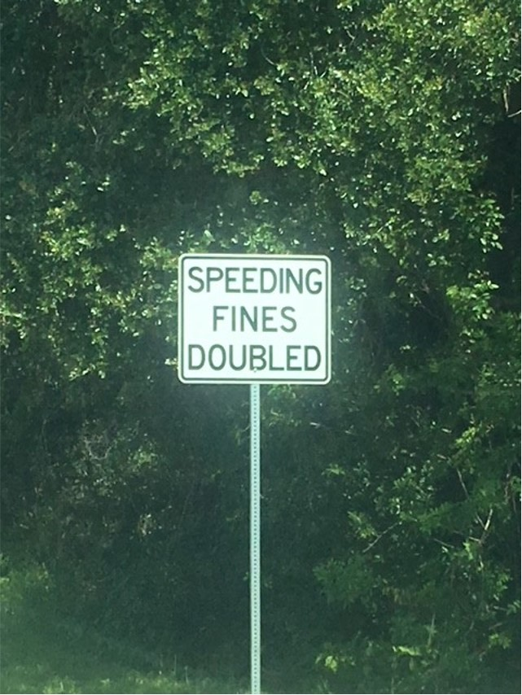
Speed Fines can be very expensive.

Slide 5
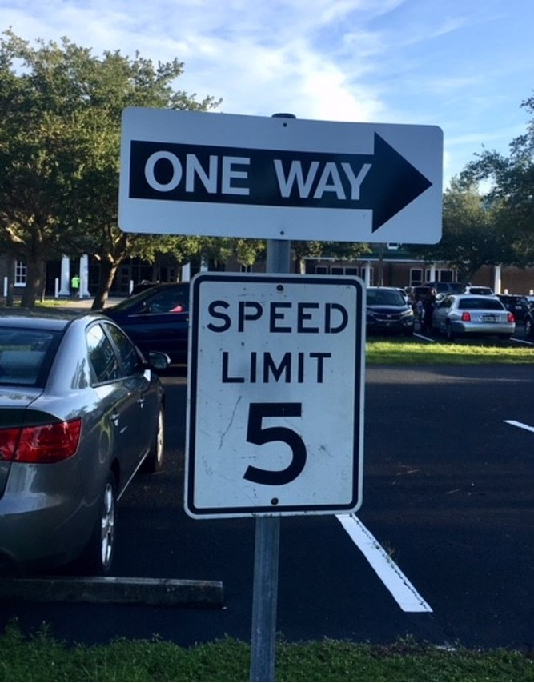
The Speed Limit in the School Parking lot is 5 MPH at All times.
Drive slow even when there is not a line of traffic! Please remember this is an elementary school and some of our students are smaller than some vehicles.

Slide 6
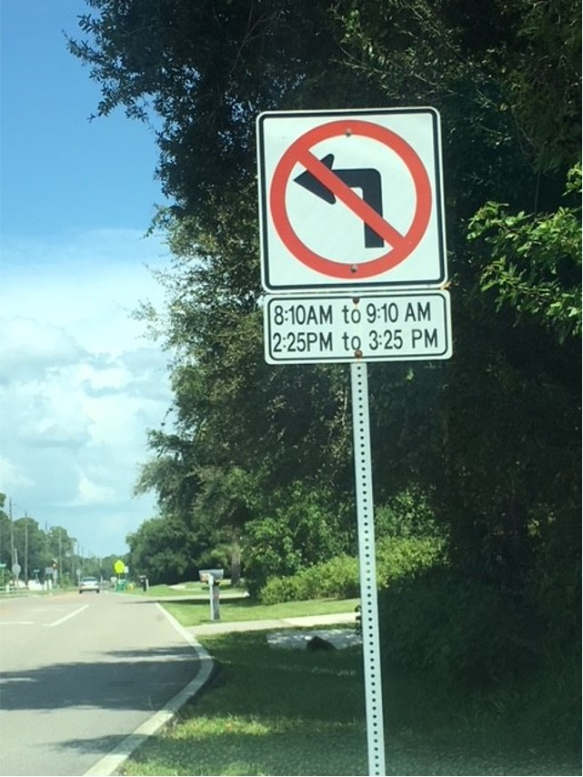
No left turns into Kingsway during the posted times.
There is a sign on Quasar Blvd as you head towards the school.
The best way to come into the school when the no left turn hours are in effect, is to make a left on Abner St. and drive behind the school back to Quasar Blvd.

Slide 7
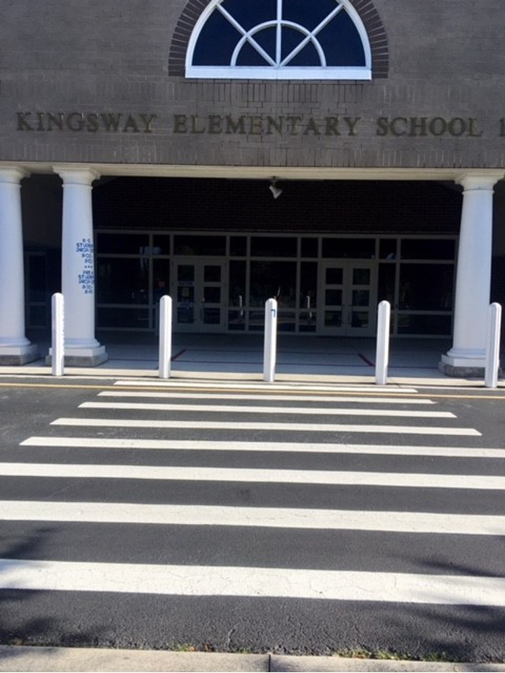
Please DO NOT block the Cross Walk at any time!
(No stopping, Standing or Parking)

Slide 8
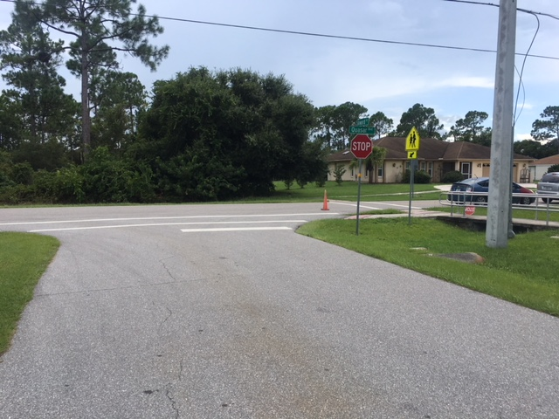
Please do not block the intersection of Alward St. and Quasar Blvd. There is a crosswalk for students and parents at this location. Also, busses leave the school via this intersection. If the intersection is blocked, the busses can’t leave which interferes with the bus schedule for ALL students.
Per Florida State Statute 316.1945:
It is prohibited to Stop, Park, Stand within an intersection OR Stand or Park a vehicle within 20 feet of a crosswalk at an intersection, Within 30 feet of a Stop sign. Violation of this can lead to a parking infraction.

Slide 9
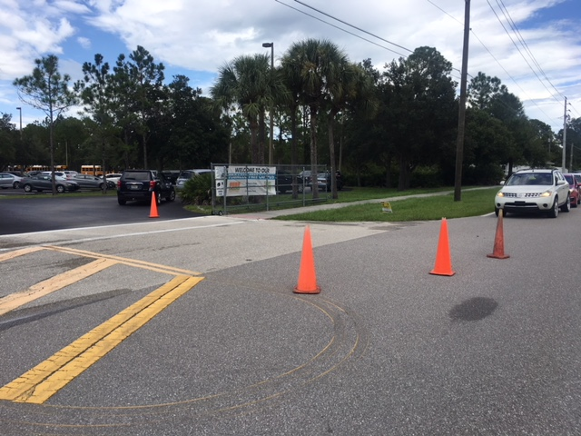
If you are in the parent pick up line, during the afternoon dismissals, please do not block the entrance to the school. We need to keep the entrance of the school open for any other vehicle coming into school. Some visitors may not be here to pick up a student, they may be here for a meeting or conducting other business.
The photo shows the ideal way to wait in line at the parent pick up line without blocking the entrance. Please remember the parent pick up traffic does not move until after dismissal 3:10 PM.

Slide 10
Thank you!
Thank you for helping us keep our students, staff and families safe.
If you have questions or need clarifications on these traffic rules, please call our school (941-255-7590) and ask for Deputy Guerin.
You can also email Deputy Guerin at: Sguerin@ccsofl.net
Have an awesome day and safe travels!

