Slide 1

STEPS OF INFORMATION PROCESSING
The Journey of Information: From Sensation to Action
Notes:
Created from: https://app.briskteaching.com/onboarding_try_article

Slide 2
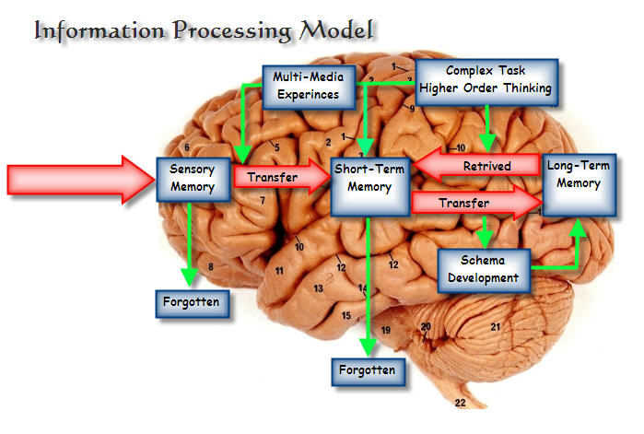
Introduction to Information Processing
Information processing is how we take in, interpret, and respond to the world around us
It involves multiple steps from sensation to action
We'll explore each stage of this fascinating process
How do you think your brain processes the information you're receiving right now?

Slide 3

Sensory Information and Sense Organs
Sensory information: Data collected by our senses
Sense organs: Eyes, ears, nose, tongue, skin
Each organ specializes in detecting specific types of stimuli
Which sense do you rely on most in your daily life?

Slide 4
The Power of Display
Display: How information is presented to our senses
Can be visual, auditory, tactile, etc.
Impacts how easily we process information
Examples: graphs, charts, warning sounds, textures
How might different display types affect your understanding of complex data?

Slide 5

Perception: Making Sense of Sensations
Perception: The brain's interpretation of sensory information
Influenced by past experiences, expectations, and context
Can sometimes lead to misinterpretations (e.g., optical illusions)
How might your personal experiences affect how you perceive new information?

Slide 6

Decision Making: Choosing a Course of Action
Decision making: Selecting a response based on perceived information
Involves weighing options, considering consequences
Can be conscious or unconscious
Affected by emotions, logic, and past experiences
Think of a recent decision you made. What factors influenced your choice?

Slide 7
Effector Mechanism: Preparing for Action
Effector mechanism: Systems that carry out the decided action
Primarily involves the nervous system and muscles
Translates decisions into physical responses
Can you describe the process of how you move your hand to write?

Slide 8
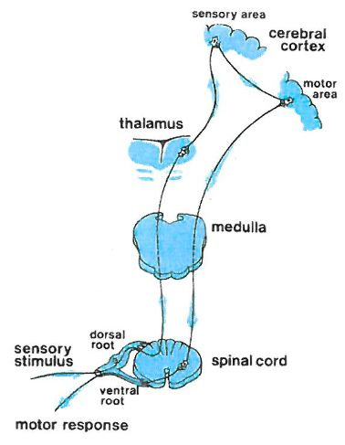
Response: Taking Action
Response: The observable action or behavior
Can be physical (e.g., moving, speaking) or internal (e.g., increased heart rate)
Result of the entire information processing chain
How quickly do you typically respond to new information?

Slide 9
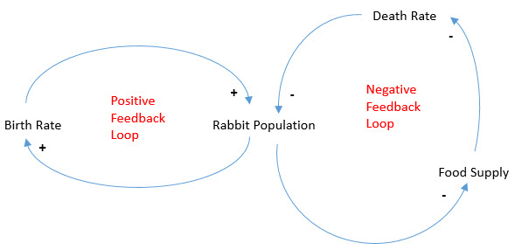
Feedback: Learning from Outcomes
Feedback: Information about the results of our actions
Helps us learn and adjust future responses
Can be internal (how we feel about the outcome) or external (others' reactions)
How do you use feedback to improve your performance in school or sports?

Slide 10
The Continuous Cycle of Information Processing
Information processing is ongoing and cyclical
Each step influences and is influenced by others
Our responses can create new sensory information, starting the cycle again
How might understanding this cycle help you in your daily life?

Slide 11

Conclusion: The Marvels of Human Information Processing
Our ability to process information is complex and remarkable
It allows us to navigate and interact with our world
Understanding this process can help us improve our learning and decision-making
How might you apply what you've learned to enhance your own information processing?

