Slide 1
Chapter 07
Lecture Outline
See separate PowerPoint slides for all figures and tables pre-inserted into PowerPoint without notes.

Slide 2
7.1: Introduction to the Skeletal System
Bones are very active, living tissues
Each bone is made up of several types of tissues (bone, cartilage, dense connective tissue, blood, and nervous tissue), and so is an organ of the skeletal system
Bone functions: muscle attachment, protection and support of soft tissues, blood cell production, and storage of inorganic salts

Slide 3
7.2: Bone Structure
Classification of bones according to shape:
Long: long with expanded ends; examples: arm and leg bones
Short: almost equal in length and width; examples: bones of the wrist and ankles
  Sesamoid (round) bones: a small, nodular bone that develops within a tendon; a special type of short bone; example: patella
Flat: plate-like shape with broad surface; examples: ribs, scapula, flattened skull bones
Irregular: varied shape; examples: vertebrae, some facial bones

Slide 4
Parts of a Long Bone
Expanded ends of bones that form joints with adjacent bones are called epiphyses
Articular cartilage (hyaline cartilage) covers the epiphyses
The shaft of the bone is the diaphysis
A tough layer of dense connective tissue, called the periosteum, covers the bone, and is continuous with ligaments and tendons
The diaphysis contains a hollow chamber called the medullary cavity
The medullary cavity is lined with a thin layer of cells called the endosteum
The medullary cavity is filled with a special type of connective tissue called bone marrow

Slide 5
Parts of a Long Bone (2)
A bone's shape makes its function possible
Bony processes (projections) provide attachment sites for tendons and ligaments, openings or grooves for blood vessels and nerves, and depressions for articulation (forming a joint with another bone)
Compact bone is a very tightly packed tissue, which makes up the wall of the diaphysis
The epiphyses are filled with spongy (cancellous) bone, which reduces the weight of the skeleton
Spongy bone consists of many branching bony plates called trabeculae

Slide 6
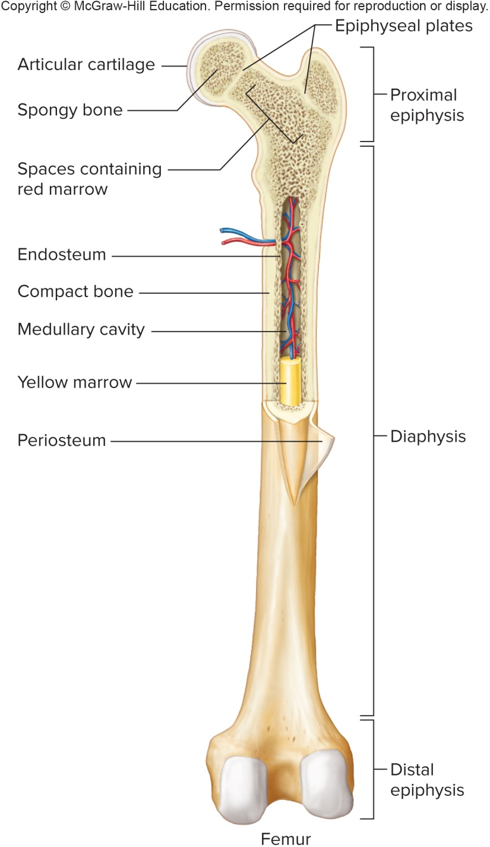
Major Parts of a
Long Bone

Slide 7
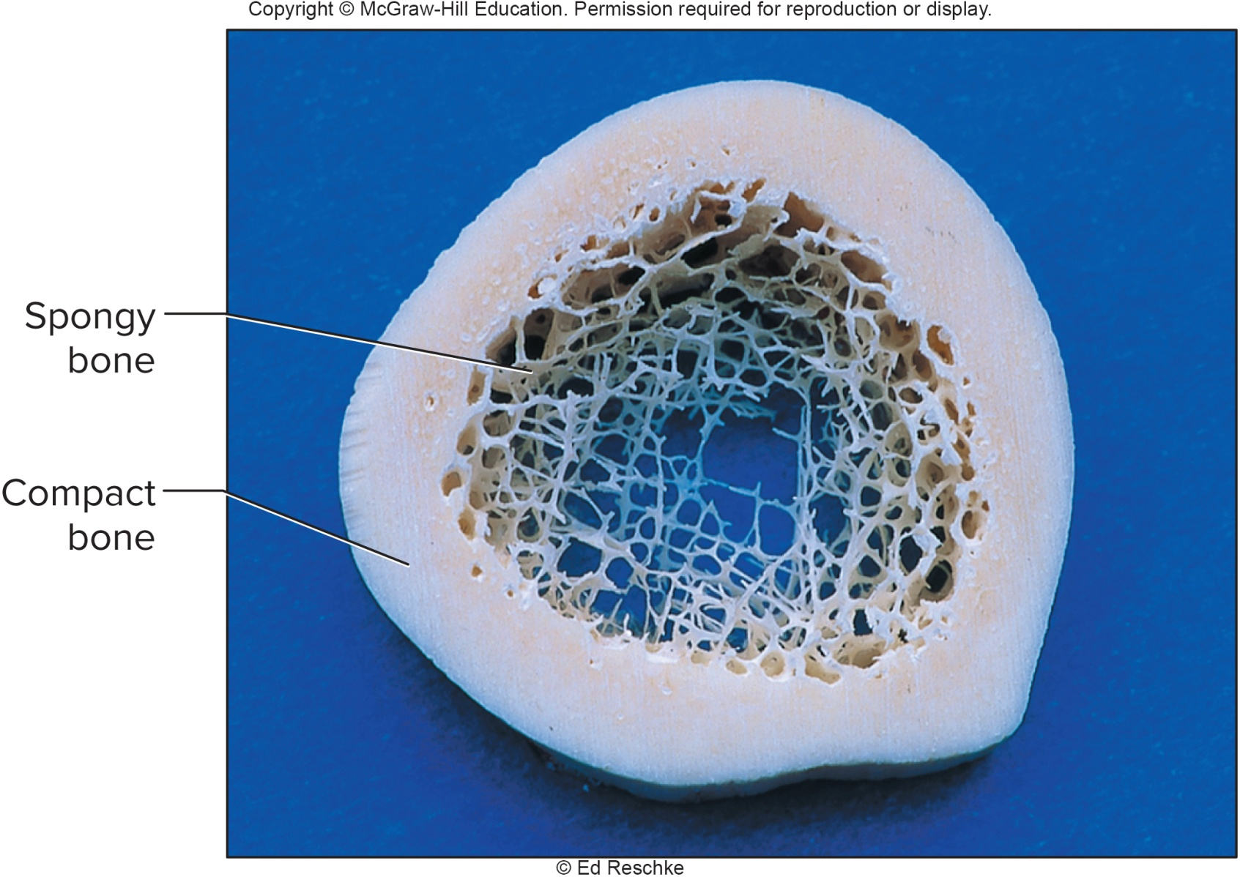
Cross Section of a Long Bone

Slide 8
Microscopic Structure of Bone Tissue
Bone cells, called osteocytes, are located within chambers called lacunae
In compact bone, lacunae lie in concentric circles of matrix called lamellae
Lamellae are deposited around a cylindrical tube called a central (Haversian) canal; central canals contain blood vessels and nerves
Osteocytes pass nutrients and gases through the matrix via tiny canals called canaliculi
Extracellular matrix of bone consists mainly of collagen and inorganic salts:
  Collagen provides strength and resilience
  Inorganic salts (mostly calcium phosphate) provides hardness and resistance to crushing

Slide 9
Microscopic Structure of Bone Tissue (2)
In compact bone, osteocytes and extracellular matrix layers are organized into osteons (Haversian systems) that are cemented together
Central canals contain blood vessels and nerve fibers, and extend longitudinally through the bone tissue
Central canals of adjacent osteons are interconnected by transverse perforating (Volkmann’s) canals; these help osteons share blood supply and nerves
Unlike compact bone, spongy bone is made of osteocytes and extracellular matrix that lie within trabeculae

Slide 10
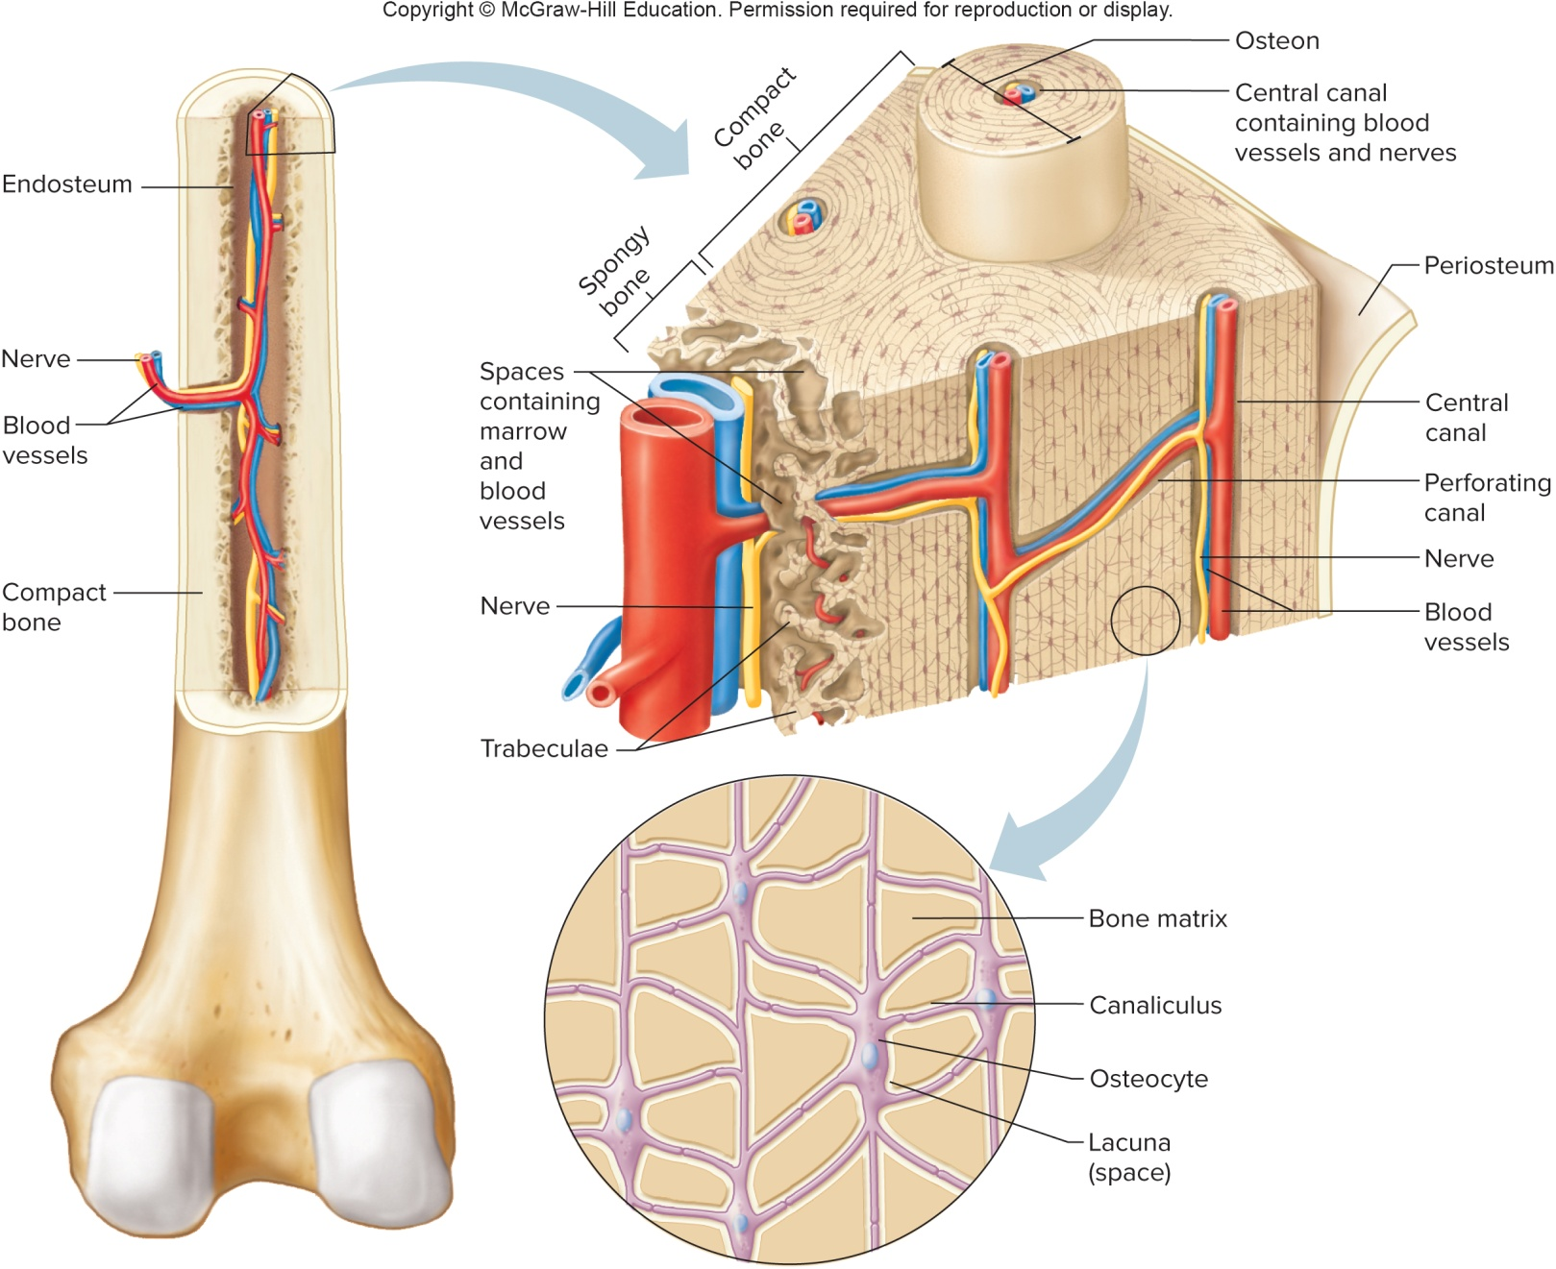
Compact and Spongy Bone

Slide 11
7.3: Bone Development and Growth
Bones form by replacing existing connective tissues in the fetus
There are 2 methods of connective tissue replacement:
  Intramembranous bones originate within sheet-like layers of connective tissue
  Endochondral bones form from a hyaline cartilage model
Formation of bone from connective tissue is called ossification

Slide 12
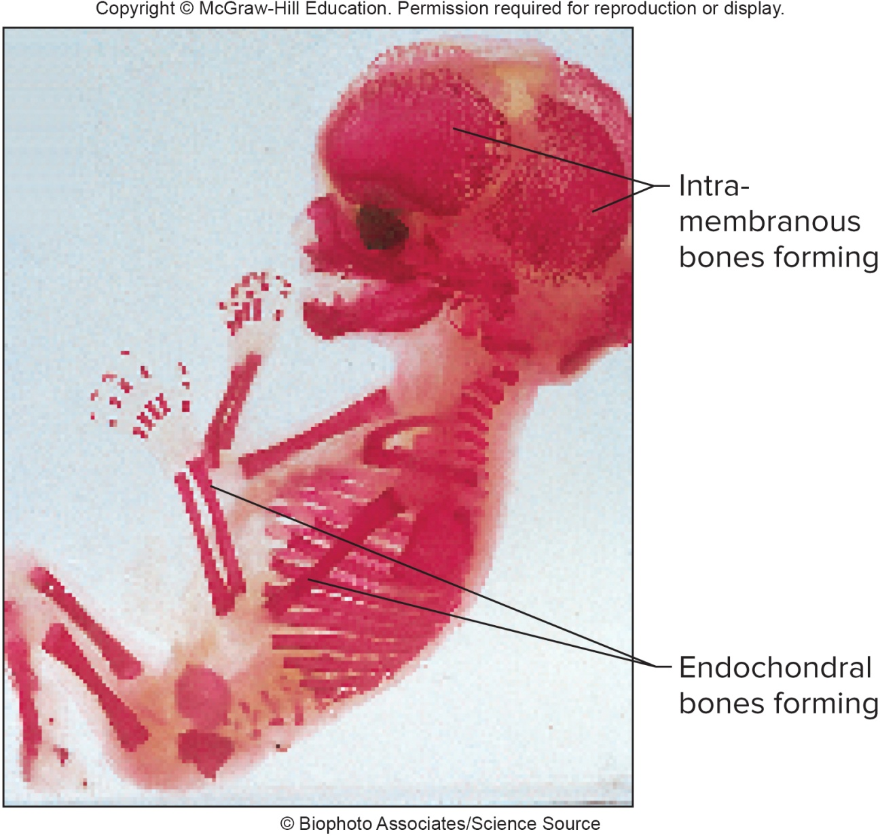
Ossification in a 14-Week Fetus

Slide 13
Intramembranous Bones
Intramembranous bones develop from sheet-like layers of undifferentiated connective tissue
The broad, flat bones of the skull form as intramembranous bones
Some progenitor cells differentiate into osteoblasts, bone-forming cells
Osteoblasts deposit a bony matrix around themselves in all directions, forming spongy bone
Once the osteoblasts have encased themselves with matrix, they are called osteocytes
Cells of the membranous tissue that lie outside the developing bone give rise to the periosteum
Osteoblasts on the inside of the periosteum form a layer of compact bone over the spongy bone

Slide 14
Endochondral Bones
Endochondral bones develop as hyaline cartilage models shaped like the future bones; the cartilage is then replaced with bone tissue
Most of the bones of the skeleton fall into this category
Cartilage is first broken down in the diaphysis, and progressively replaced with bone, while the periosteum develops on the outside
Disintegrating cartilage is invaded by blood vessels and osteoblasts that first form spongy bone at the primary ossification center in the diaphysis
Osteoblasts from the periosteum lay down compact bone around the primary ossification center
Secondary ossification centers appear later in the epiphyses
A band of hyaline cartilage, the epiphyseal plate, remains between the two ossification centers
Layers of cartilage cells undergoing mitosis make up the epiphyseal plate; this will be a growth area for the bone to increase in length

Slide 15
Endochondral Bones (2)
Bone-resorbing cells, called osteoclasts, break down the calcified matrix
Bone-building cells, called osteoblasts, then deposit bone in place of calcified cartilage
A long bone continues to lengthen while the cartilaginous cells of the epiphyseal plate are active; once the plate ossifies, the bone can no longer grow in length
As compact bone is deposited on the outside of the developing bone, the medullary cavity forms in the diaphysis, as osteoclasts erode the bone on the inside
Medullary cavity eventually fills with bone marrow, which produces blood cells

Slide 16
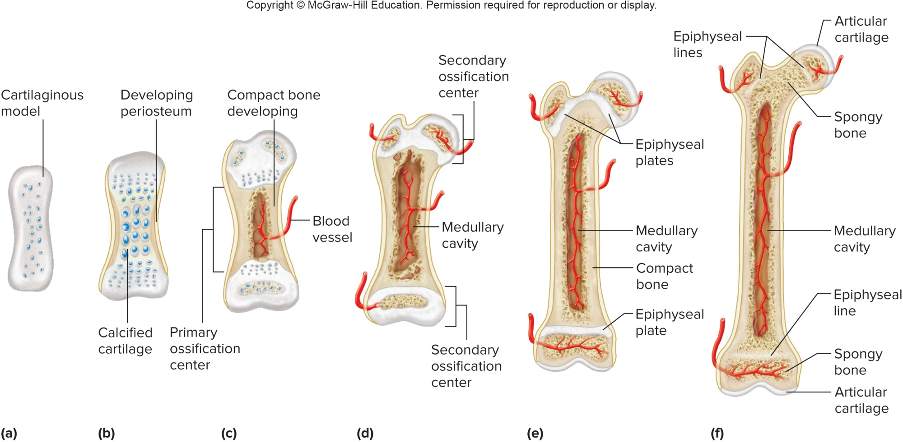
Development of an Endochondral Bone

Slide 17
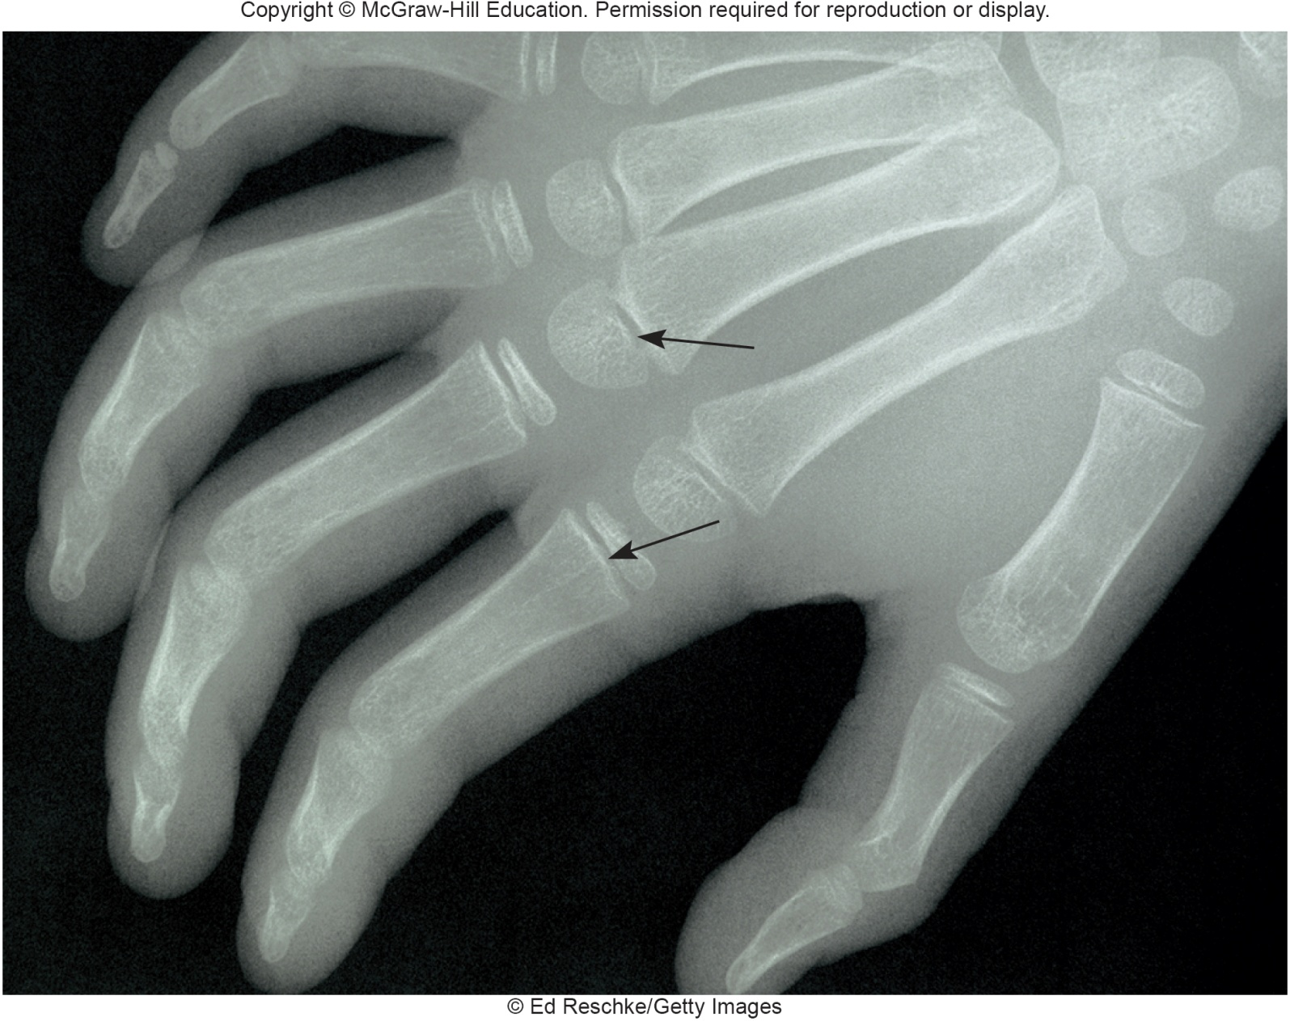
Epiphyseal Plates in a Child’s Hand

Slide 18
Homeostasis of Bone Tissue
Osteoclasts resorb and osteoblasts deposit bone throughout life, in a process called bone remodeling
An average of 3% to 5% of bone calcium is exchanged each year
The remodeling process is controlled by hormones that regulate blood calcium levels

Slide 19
Factors Affecting Bone Development,
Growth, & Repair
Nutrition: vitamin D is needed for calcium absorption
Hormonal secretions:
  Growth hormone: stimulates division of cartilage cells of the epiphyseal plate
  Sex hormones: stimulate ossification of the epiphyseal plates to end growth in height
Physical exercise: when muscles pull on bones at their attachment sites, it stresses the bone, which will cause it to increase in thickness and strength

Slide 20
7.4: Bone Function
Support and protection:
  Bones give shape to the head, face, thorax, and limbs
  Bones such as the pelvis and lower limbs provide support for the body’s weight
  Bones of the skull protect the eyes, ears, and brain
  Bones of the rib cage and shoulder girdle protect the heart and lungs
  Bones of the pelvic girdle protect lower abdominal and reproductive organs
Movement:
Bones act with muscles to cause movement of limbs and other body parts

Slide 21
Bone Function (2)
Blood cell formation (hematopoiesis):
Blood cell formation begins in the yolk sac during embryonic development
They are later manufactured in the liver and spleen, and then finally in the bone marrow
Two kinds of marrow occupy the medullary cavities and the larger central canals of bone:
  Red marrow occupies the spongy bone of the skull, ribs, sternum, clavicles, vertebrae, and pelvis in adults. It functions in the formation of red blood cells, white blood cells, & platelets. Its color comes from the O₂-carrying pigment hemoglobin.
  Yellow marrow stores fat and occupies most cavities of bone in adults

Slide 22
Bone Function (3)
Storage of inorganic salts:
The extracellular matrix of bone is rich in calcium salts, mainly in the form of calcium phosphate
Calcium is important in many metabolic processes, such as muscle contraction, nerve impulse conduction, and blood clotting
Calcium in bone is a reservoir for body calcium
When blood levels of calcium are low, osteoclasts release calcium from bone under the influence of the parathyroid hormone
When blood calcium is too high, osteoclasts are inhibited, and osteoblasts are stimulated to deposit bone matrix by the hormone calcitonin
Bone also stores magnesium, sodium, potassium, & carbonate ions
Bones can also accumulate harmful metallic elements, such as lead, radium, and strontium

Slide 23
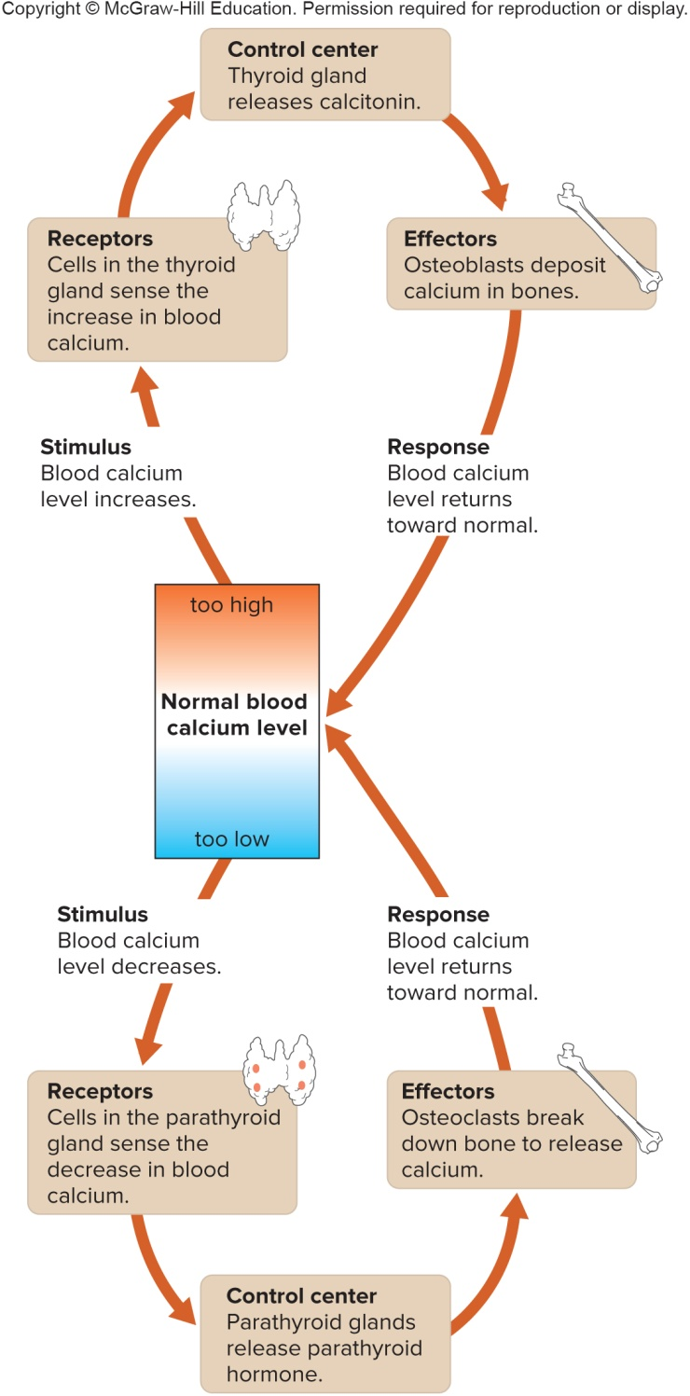
Hormonal Regulation of Bone Calcium

Slide 24
7.5: Skeletal Organization
The skeleton can be organized into 2 major portions: the axial skeleton and the appendicular skeleton
The axial skeleton consists of the bony and cartilaginous parts that support the and protect the head, neck and trunk:
  Skull: cranium and facial bones
  Hyoid bone: supports the tongue and aids in swallowing
  Vertebral column
  Thoracic cage: ribs and sternum

Slide 25
Skeletal Organization (2)
The appendicular skeleton consists of the bones of the upper and lower limbs and the bones that anchor the limbs to the axial skeleton:
  Pectoral girdle: clavicle and scapula
  Upper limbs: humerus, ulna, radius, carpals, metacarpals, and phalanges
  Pelvic girdle: 2 hip bones
  Lower limbs: femur, patella, tibia, fibula, tarsals, metatarsals, and phalanges

Slide 26
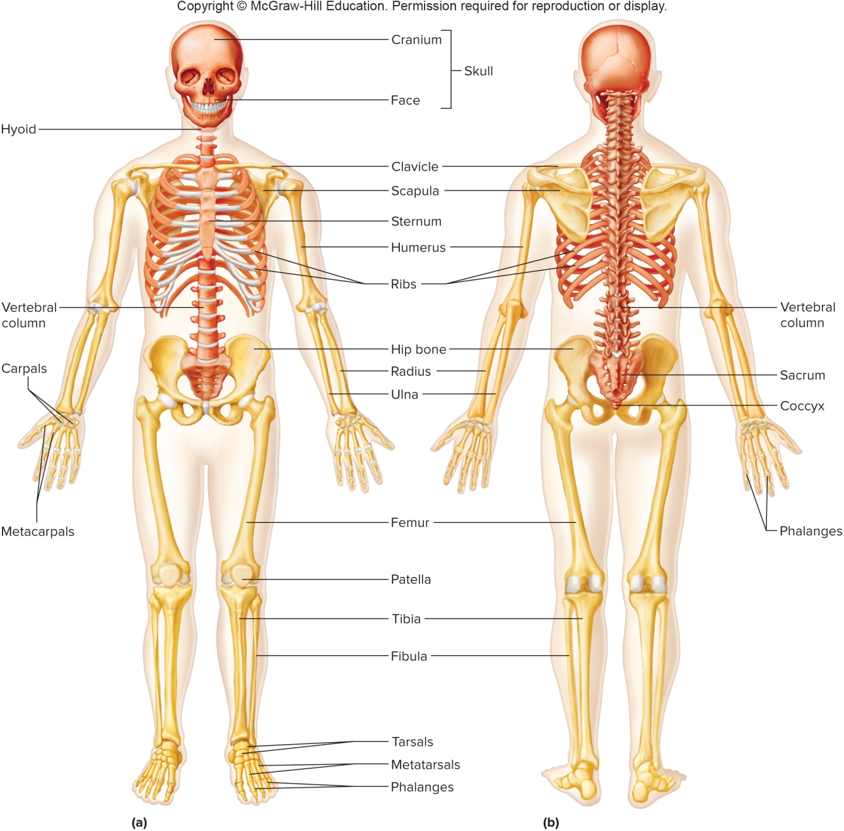
Major Bones of the Skeleton

Slide 27
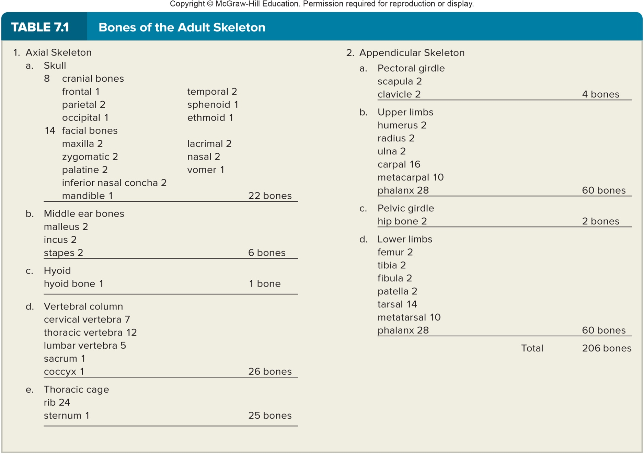
Bones of the Adult Skeleton

Slide 28
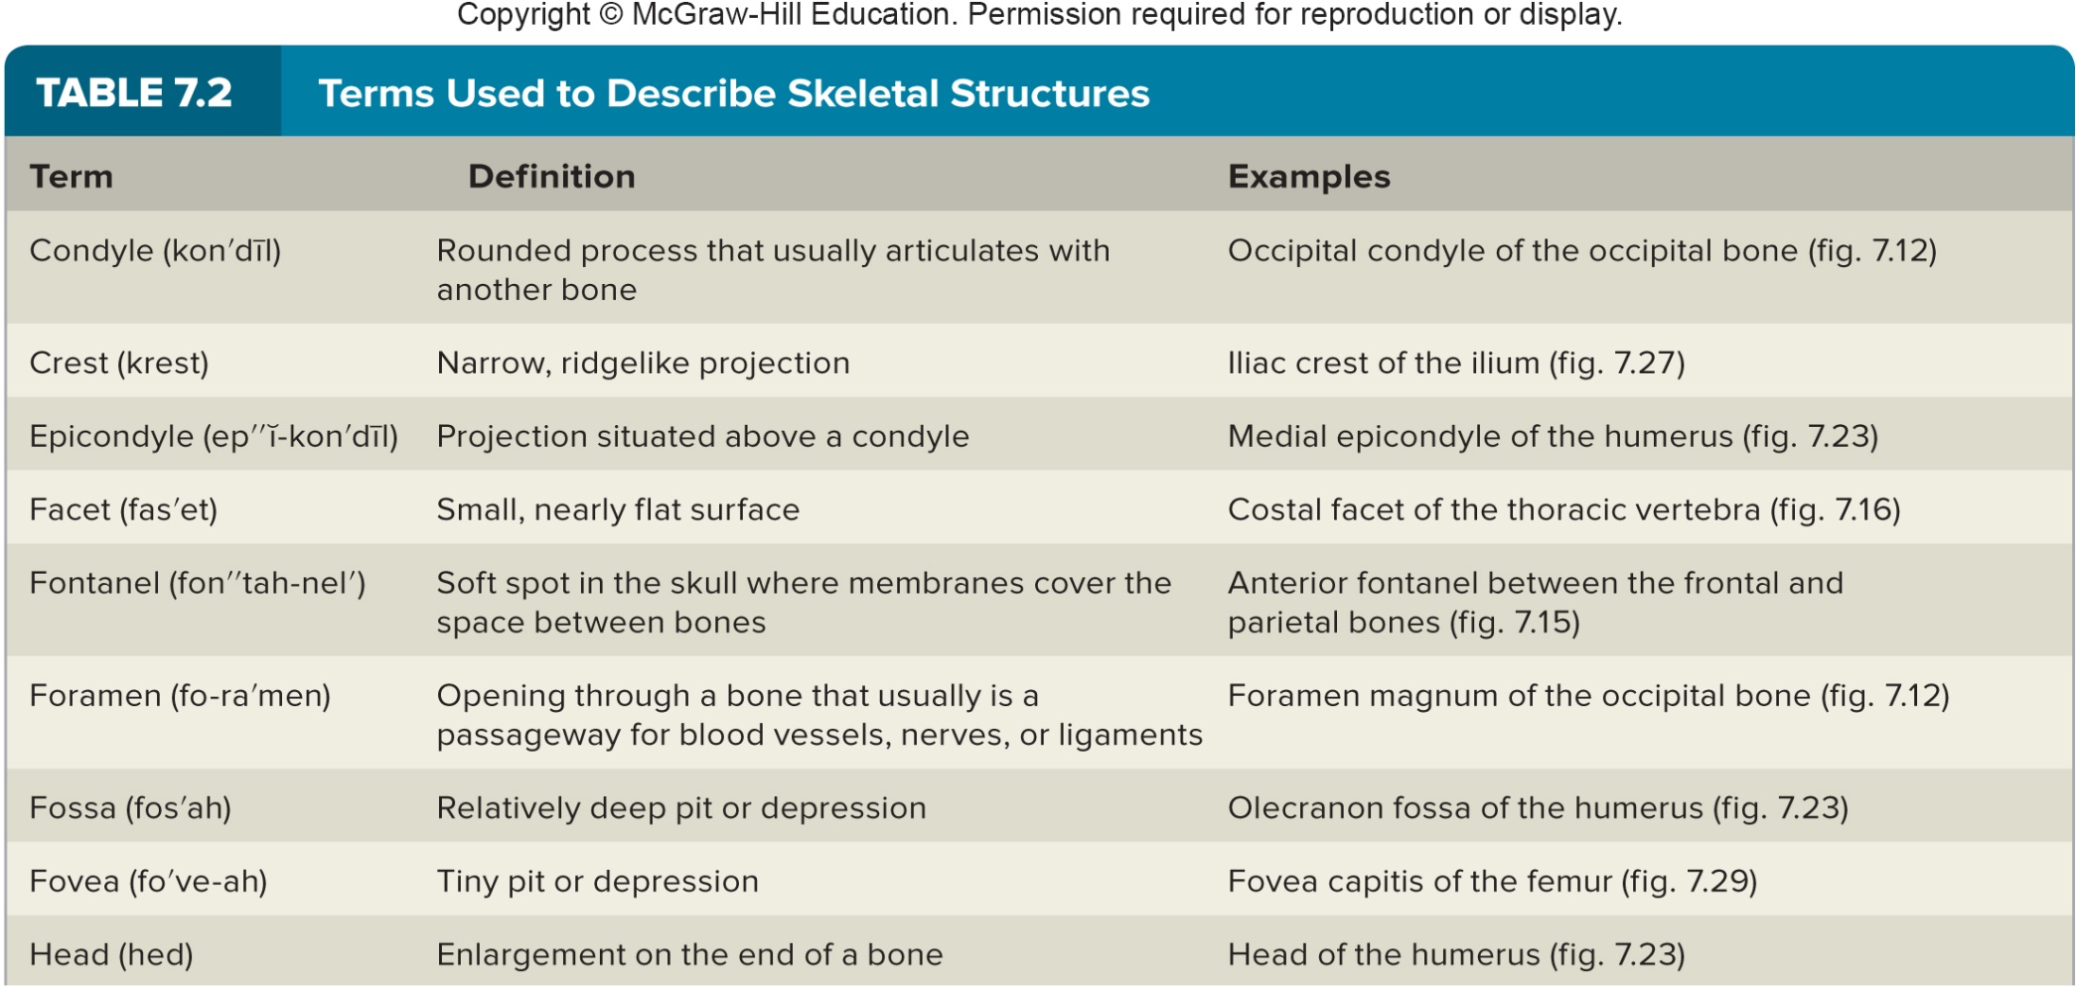
Terms Used to Describe Skeletal Structures

Slide 29
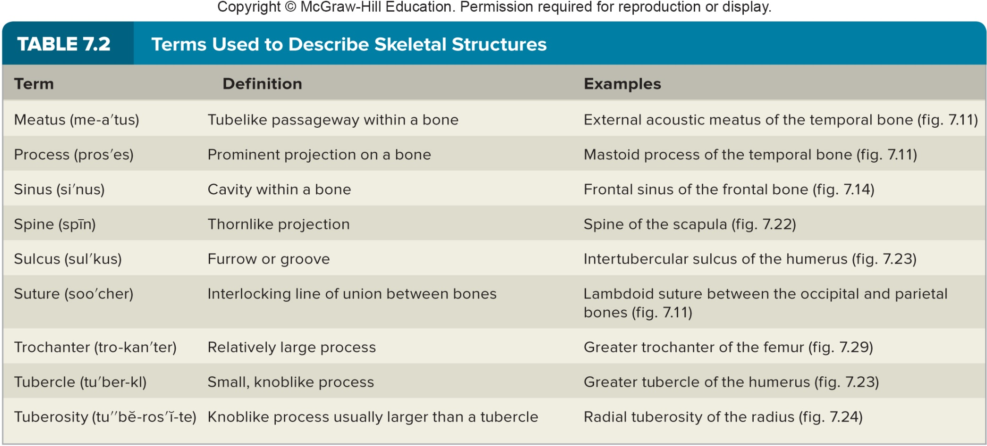
Terms Used to Describe Skeletal Structures(2)

Slide 30
7.6: Skull
The skull:
Made up of 22 bones: 8 cranial bones and 14 facial bones; there are also 3 bones in each middle ear
Except for lower jaw, skull bones are connected by immovable joints called sutures
Bones of the cranium:
Encloses and protects the brain, provides attachments for muscles, and contains air-filled paranasal sinuses that reduce its weight and increase vocal resonance.
Frontal bone forms anterior part of skull, above eyes; features include the supraorbital foramen and the frontal sinuses
Parietal bones form the roof and sides of the skull, just behind the frontal bone; they join along the midline at the sagittal suture, and meet the frontal bone along the coronal suture

Slide 31
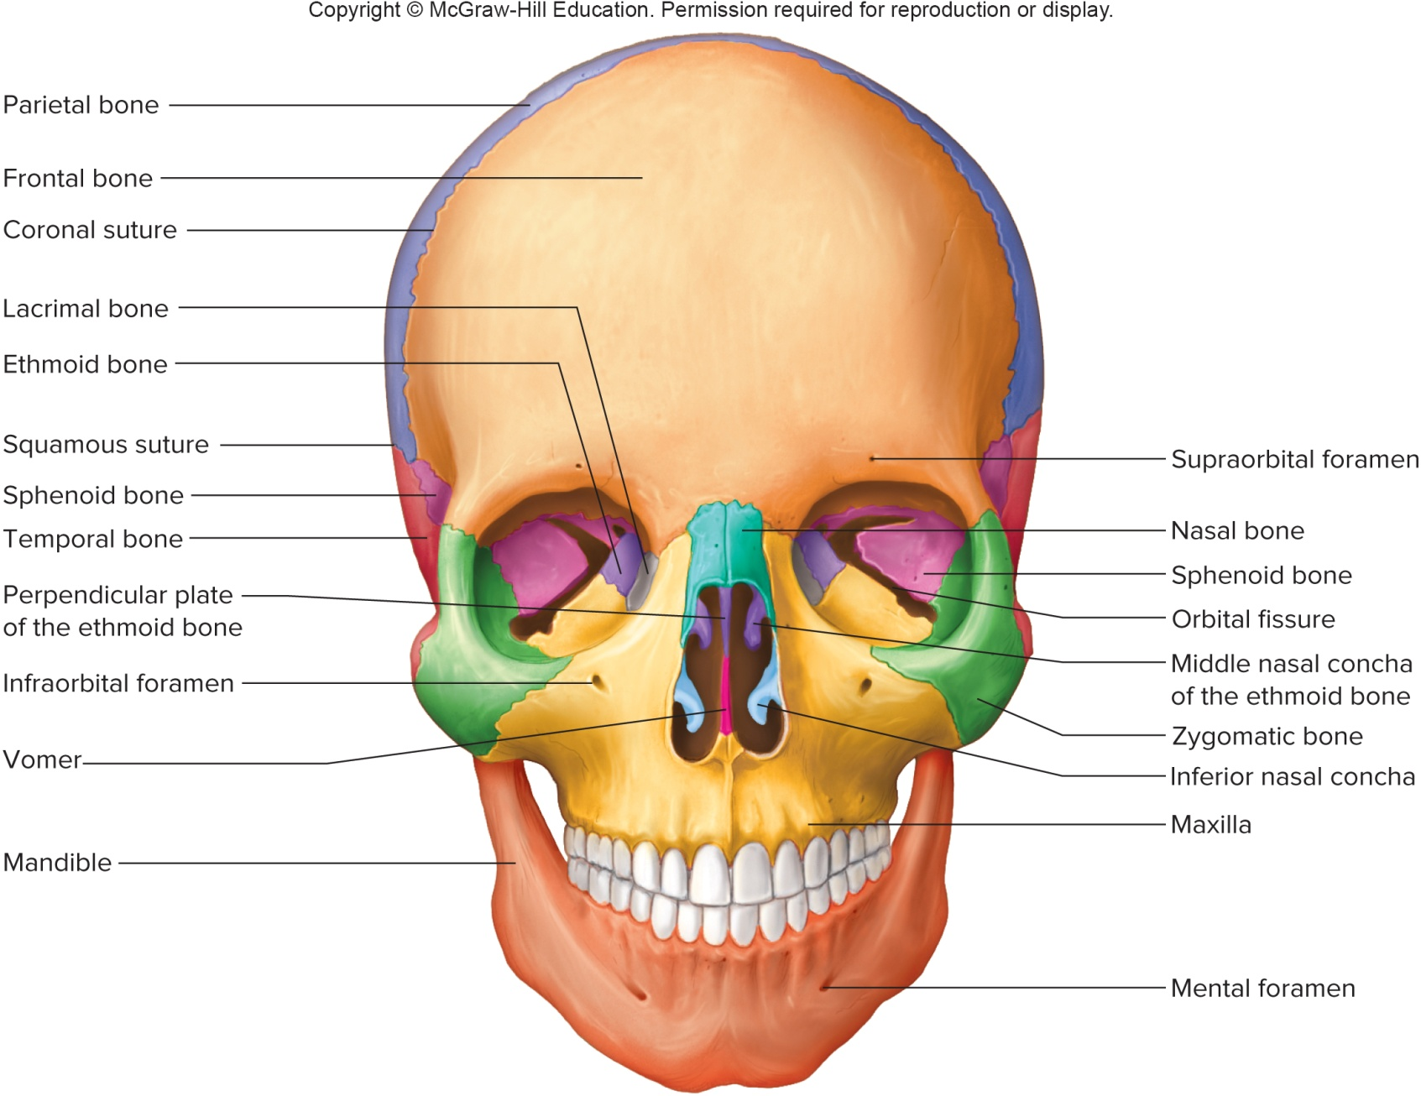
Anterior View of the Skull

Slide 32
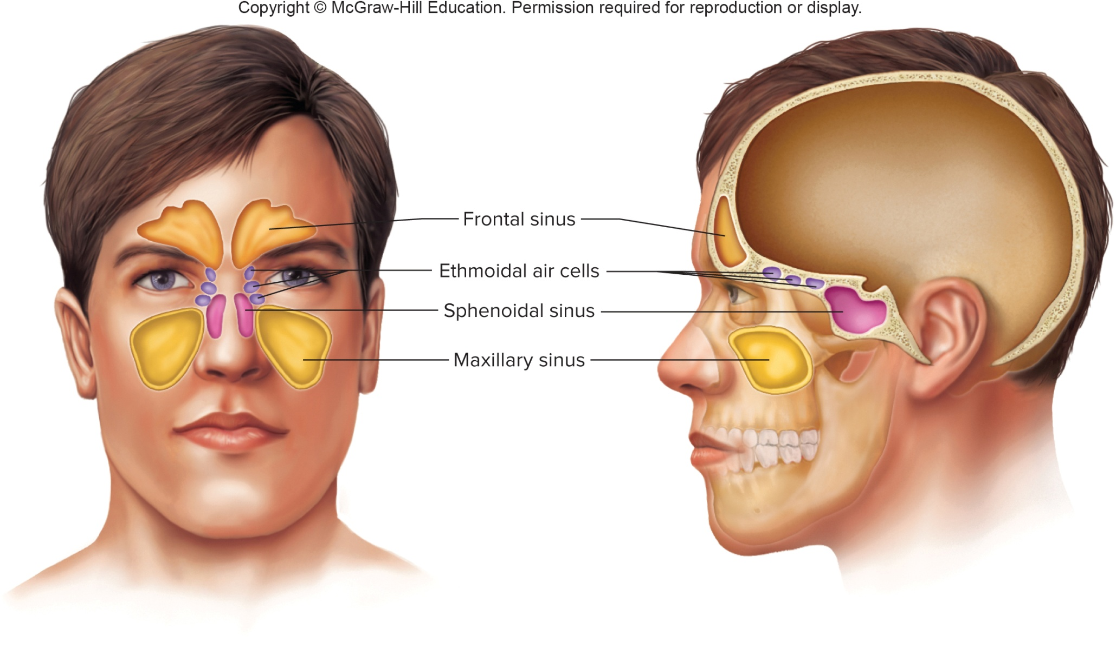
The Paranasal Sinuses

Slide 33
The Cranium
The occipital bone forms the back of the skull and the base of the cranium; features include foramen magnum, and occipital condyles; joins parietal bones at lambdoid suture
The temporal bones form parts of the sides and base of the cranium; features include the external acoustic meatus, mandibular fossae, mastoid process, styloid process, and zygomatic process; connects to parietal bones at squamous suture
The sphenoid bone helps form the base of the cranium, sides of the skull and portions of the orbits; features include the sella turcica and sphenoidal sinuses
The ethmoid bone is located in front of the sphenoid bone; features include the cribriform plates, crista galli, a perpendicular plate, superior and middle nasal conchae, and ethmoidal sinus

Slide 34
Facial Skeleton
Contains 13 immovable bones and a movable lower jawbone
These bones form the basic shape of the face, and provide attachments for muscles that move the jaw and control facial expressions
Bones of the Facial Skeleton:
The maxillae form the upper jaw, hard palate, floor of the eye orbits, sides of the nasal cavity, house the upper teeth, and contain large maxillary sinuses; features include the maxillary sinuses, palatine and alveolar processes, and alveolar arch
  Palatine bones are L-shaped bones located behind the maxillae, that form the floor & lateral walls of the nasal cavity and the posterior portion of the hard palate

Slide 35
Facial Skeleton (2)
Zygomatic bones form the cheekbones and lateral walls of the orbits; features include the temporal process, which joins the zygomatic process to form the zygomatic arch
Lacrimal bones form part of the medial walls of the orbits
Nasal bones form the bridge of the nose
Vomer bone makes up a portion of the nasal septum
Inferior nasal conchae are fragile, scroll-shaped bones that support mucous membranes in the nasal cavity
Mandible, or lower jawbone, supports the lower teeth and includes the body, mandibular condyle, coronoid process, and alveolar arch

Slide 36
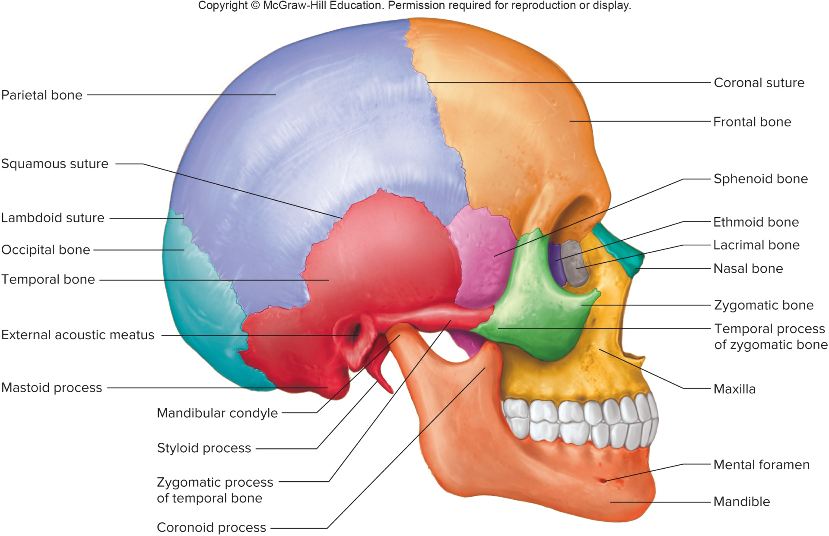
Lateral View of the Skull

Slide 37
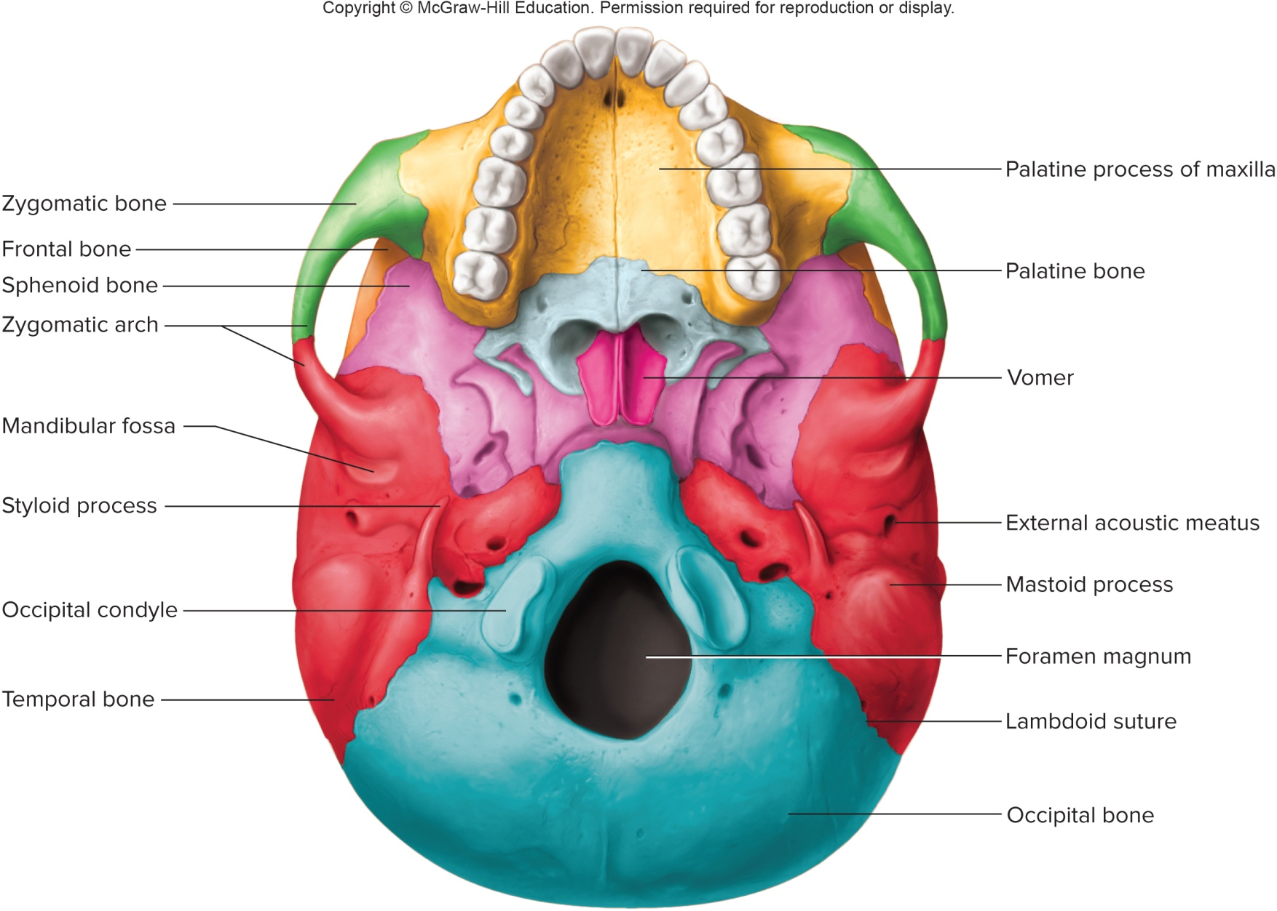
Inferior View of the Skull

Slide 38
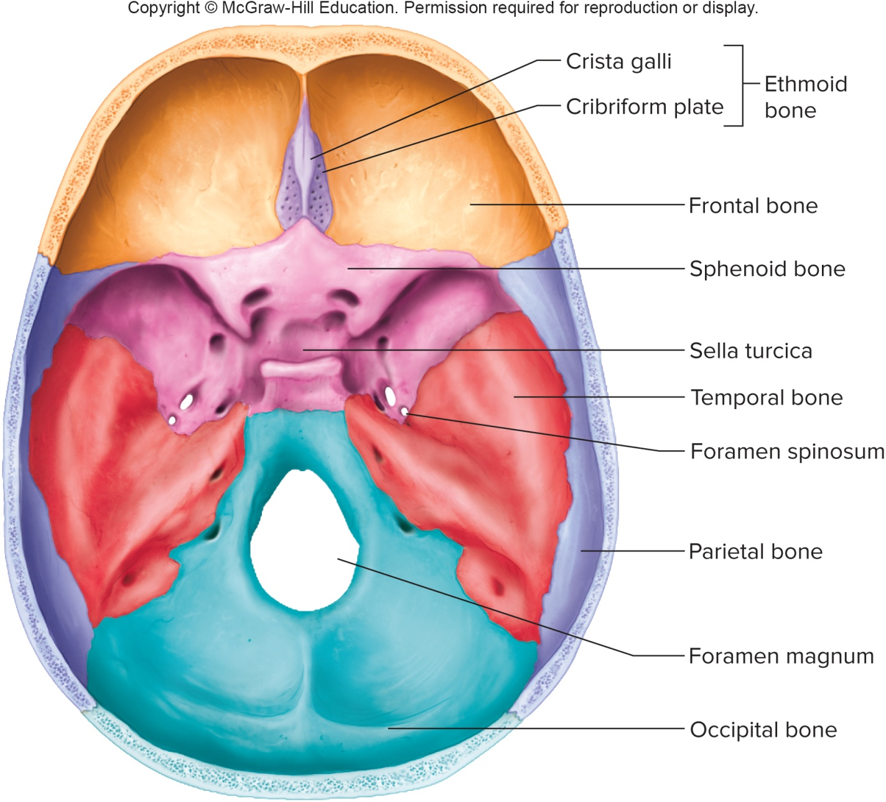
Floor of the Cranial Cavity, Viewed from Above

Slide 39
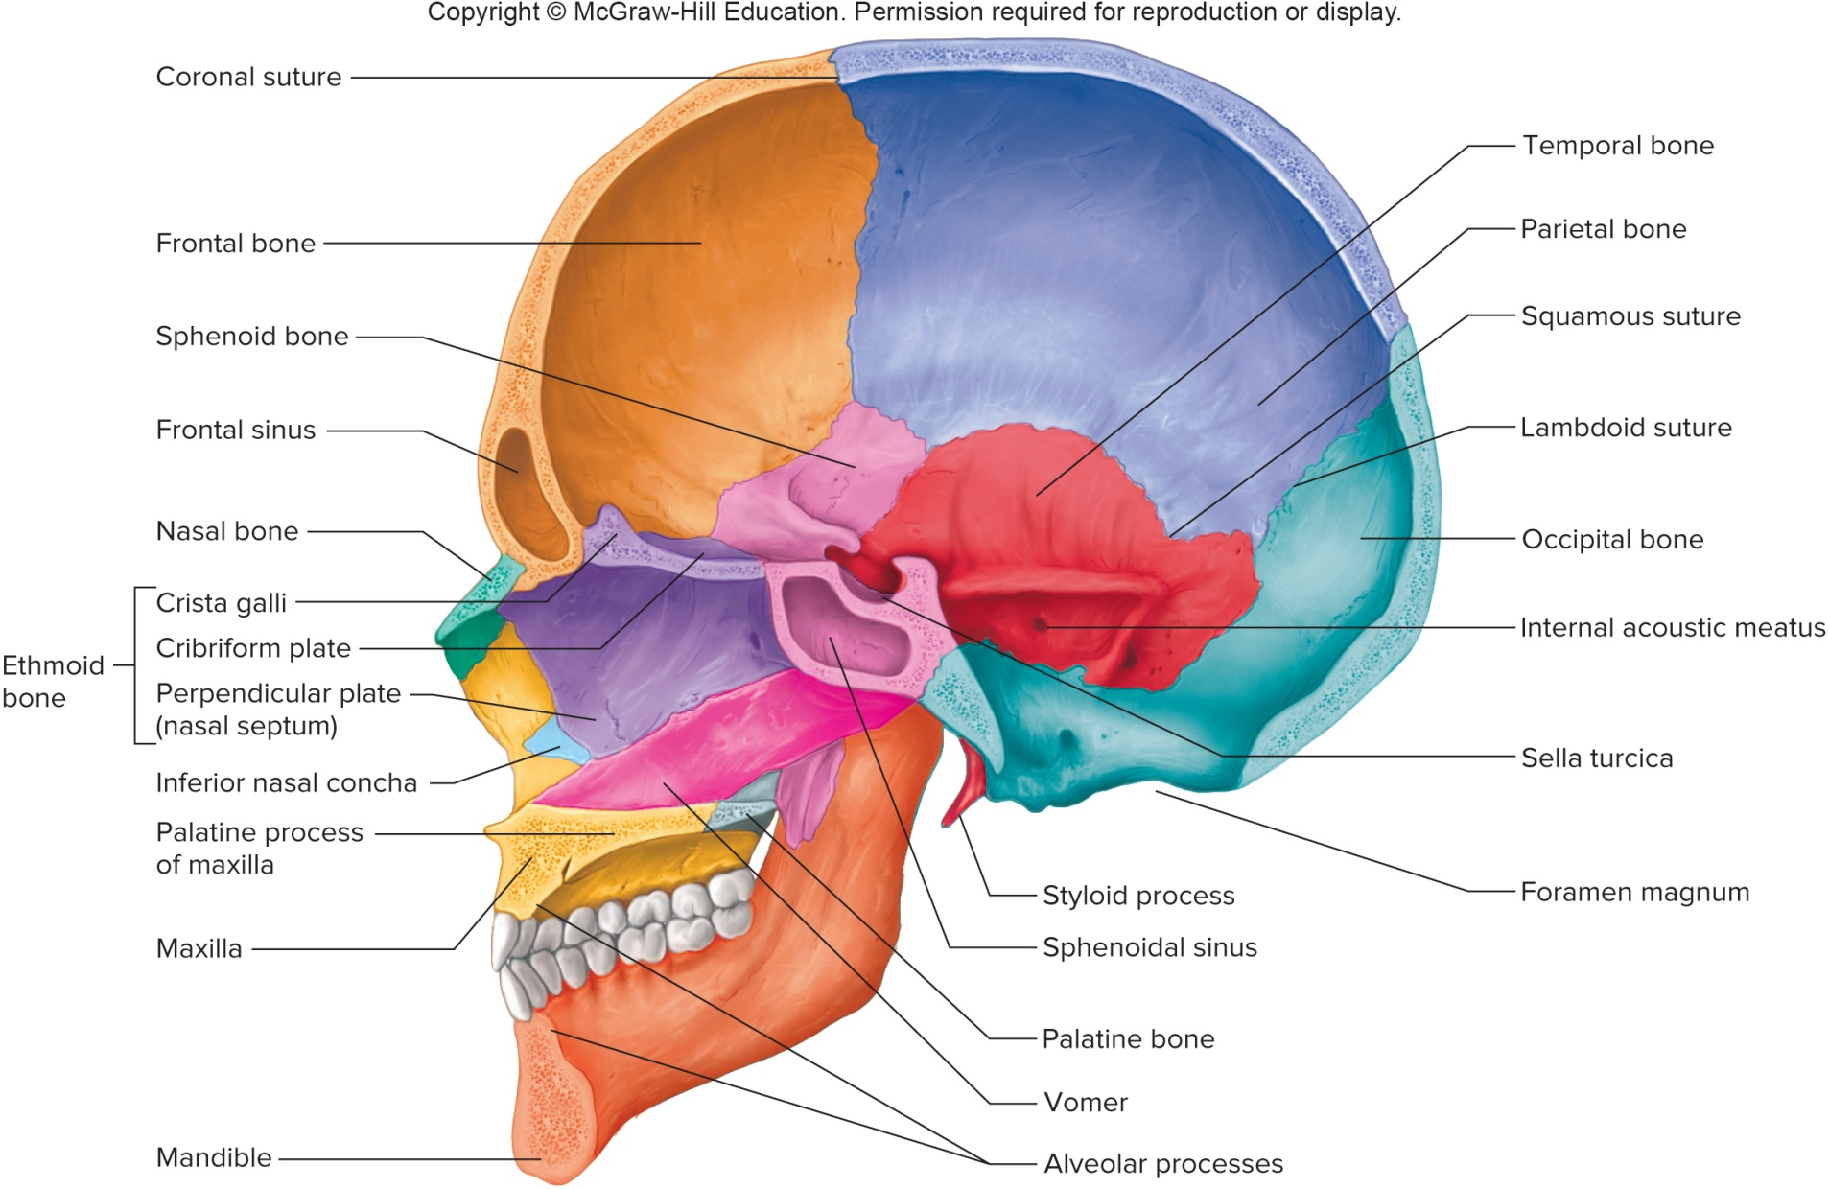
Sagittal Section of the Skull

Slide 40
Infantile Skull
Not completely developed at the time of birth
Fibrous membranes connect cranial bones
Fontanels (soft spots) are membranous areas of incomplete intramembranous ossification; allow bone movement during childbirth and brain growth
As cranial bones grow together, fontanels will eventually close
Infantile skull has small face, prominent forehead, large orbits
Nasal cavity and jaw are small, and sinuses are not completely formed yet

Slide 41
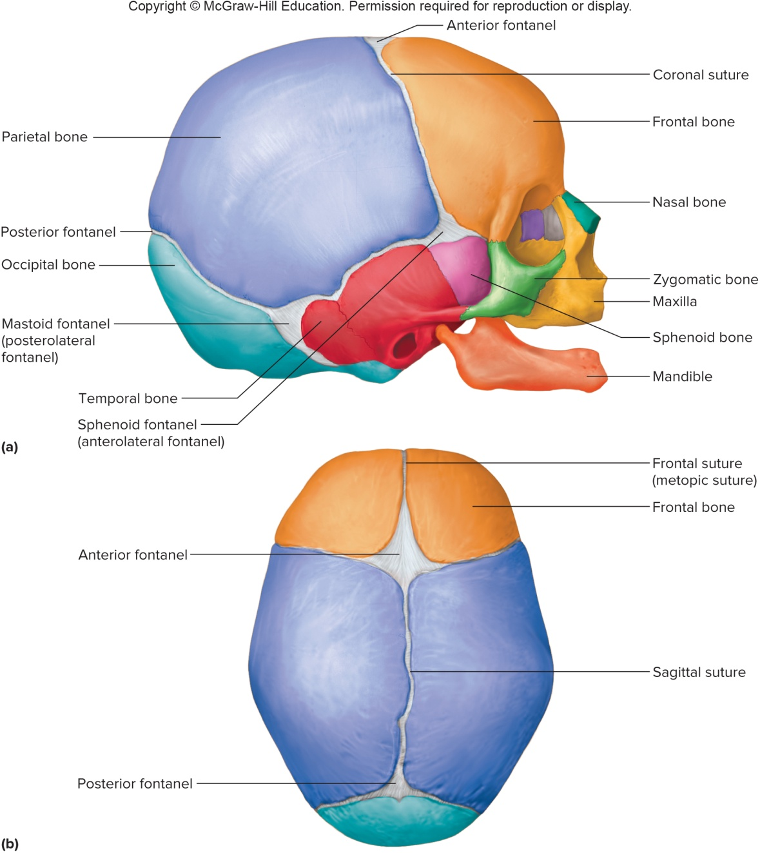
Fontanels of the Infantile Skull

Slide 42
7.7: Vertebral Column
Vertebral Column:
Forms vertical axis of skeleton
Runs from skull to pelvis
It supports the head and trunk and protects the spinal cord
Composed of bony vertebrae, separated by fibrocartilaginous intervertebral discs
Vertebrae are connected by ligaments
Structure of a Typical Vertebra:
A typical vertebrae consists of a body, pedicles, laminae, spinous process, vertebral foramen, transverse processes, superior and inferior articular processes and intervertebral foramina

Slide 43
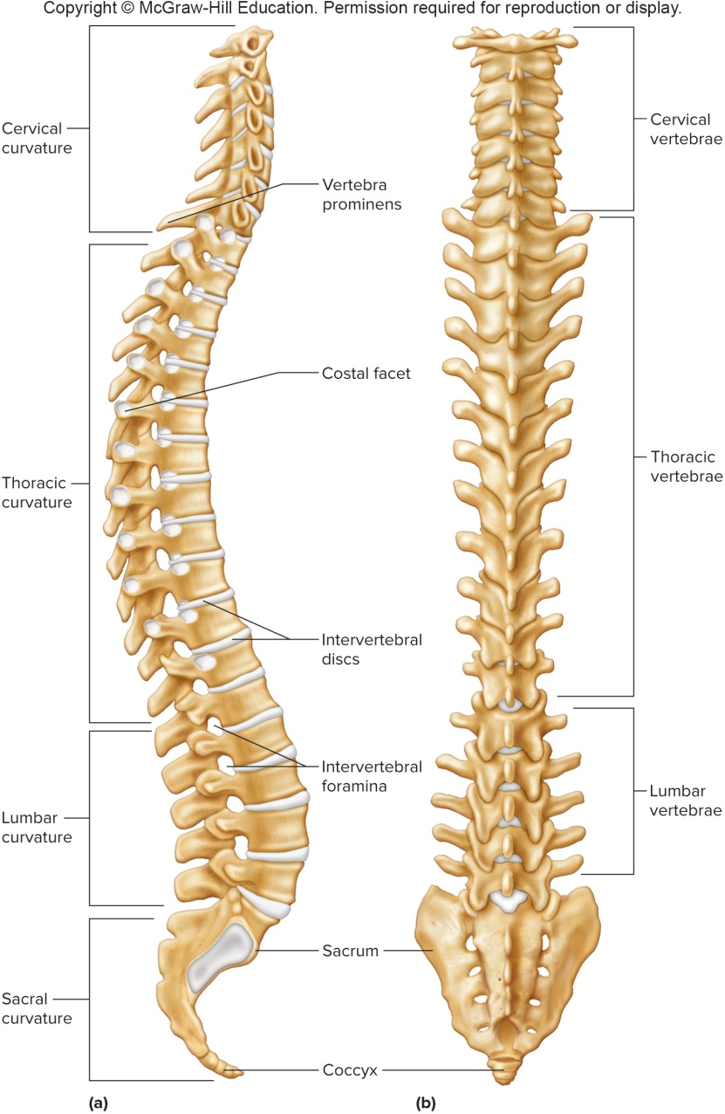
The Vertebral Column: Lateral & Posterior Views

Slide 44
Cervical Vertebrae
There are 7 cervical vertebrae in the neck
These bones support the head
They are unique in that they have distinctive transverse foramina in their transverse processes; they serve as passageways for blood vessels of the brain
Vertebrae 2-6 have bifid spinous processes, which no other vertebrae have
The first vertebra, atlas, supports the head; it has two facets that articulate with the occipital condyles of the skull, and has no body or spinous process
The second vertebra, axis, contains the tooth-like dens that pivots within the atlas

Slide 45
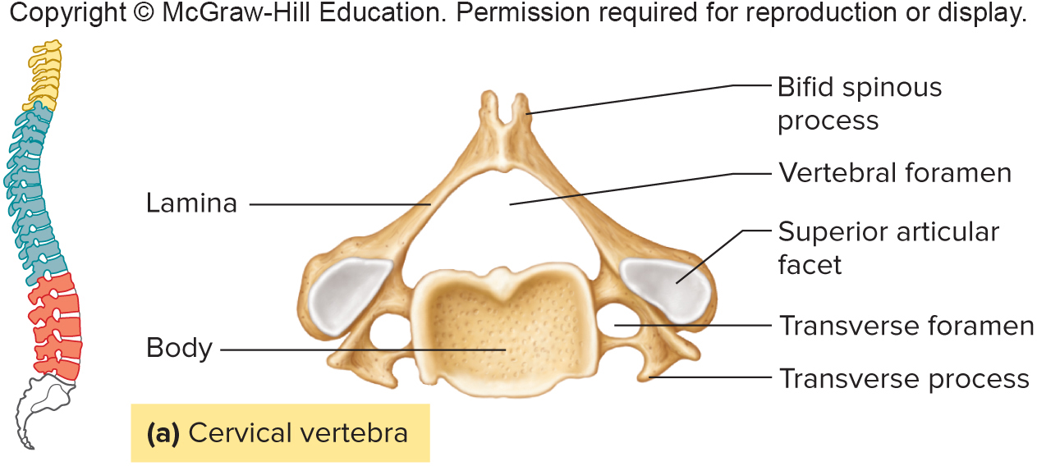
A Cervical Vertebra

Slide 46
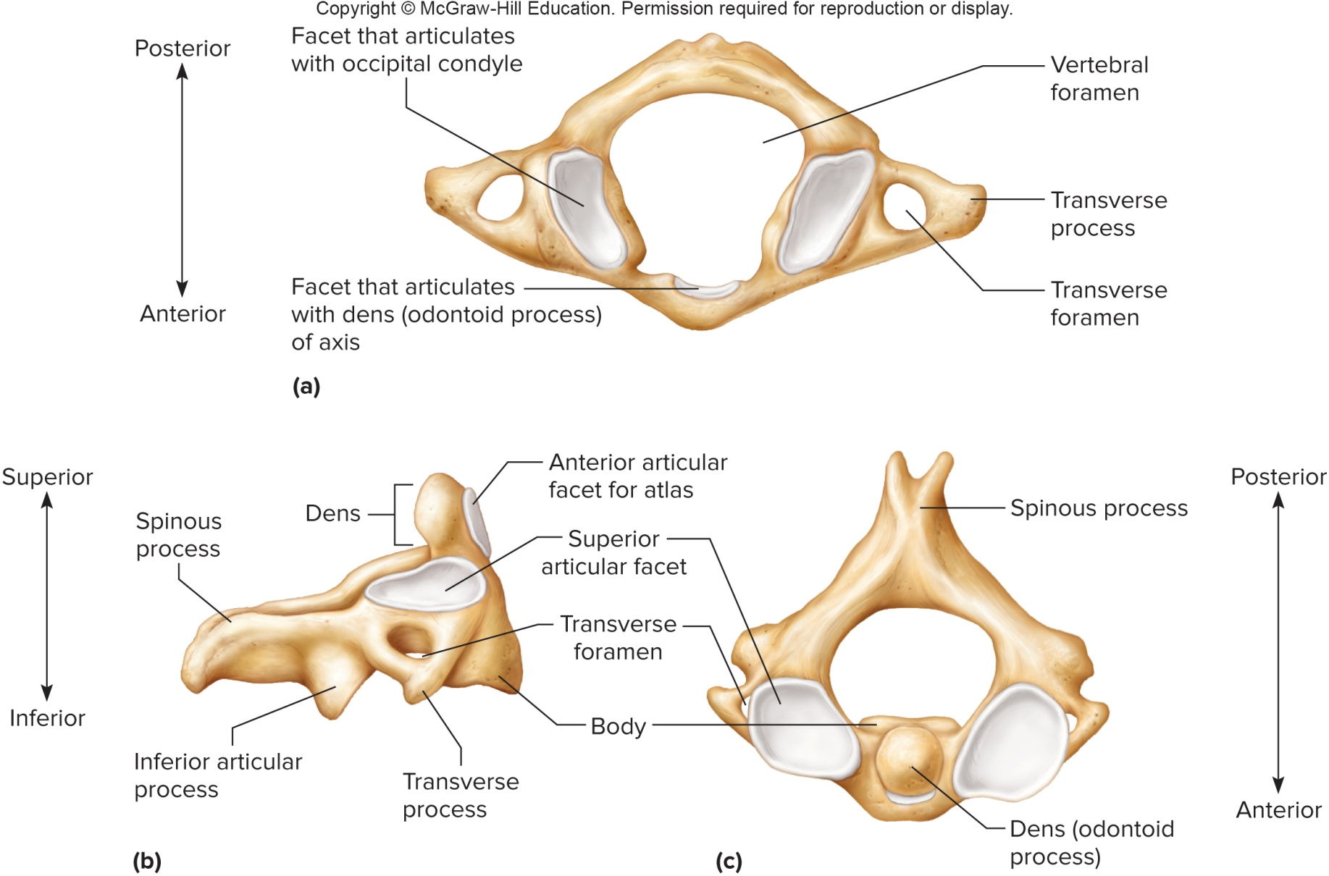
Atlas and Axis

Slide 47
Thoracic Vertebrae
There are 12 thoracic vertebrae in the thoracic region
They articulate with the ribs, and are larger and stronger than the cervical vertebrae
Features include a long, pointed spinous process and facets on the side of the body to articular with the ribs
Proceeding inferiorly, the bodies become larger, and are able to bear more weight

Slide 48
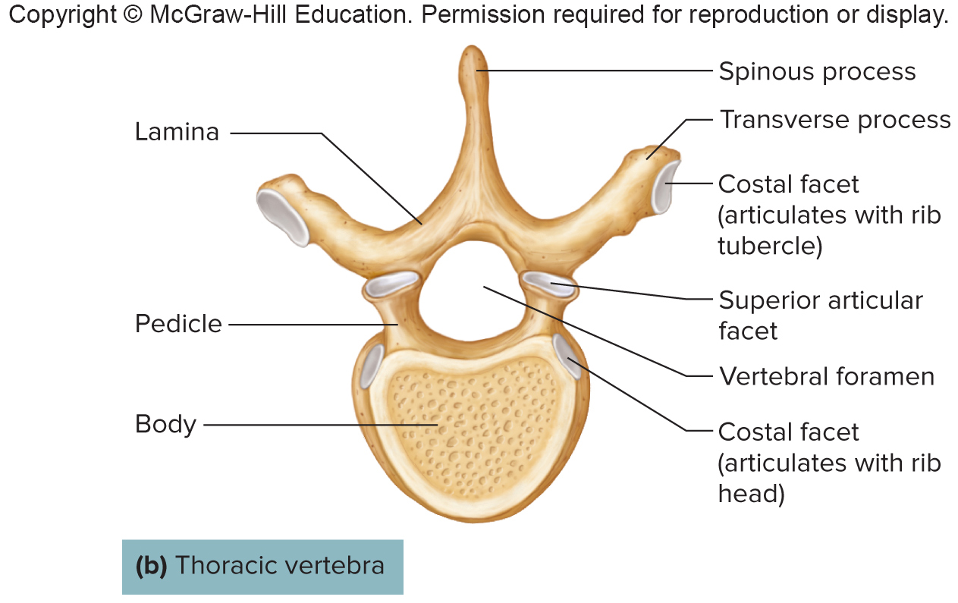
A Thoracic Vertebra

Slide 49
Lumbar Vertebrae
There are 5 lumbar vertebrae in the small of the back (loin)
They support the weight of the body
They are much larger and stronger than the cervical and thoracic vertebrae
They are adapted for weight-bearing

Slide 50
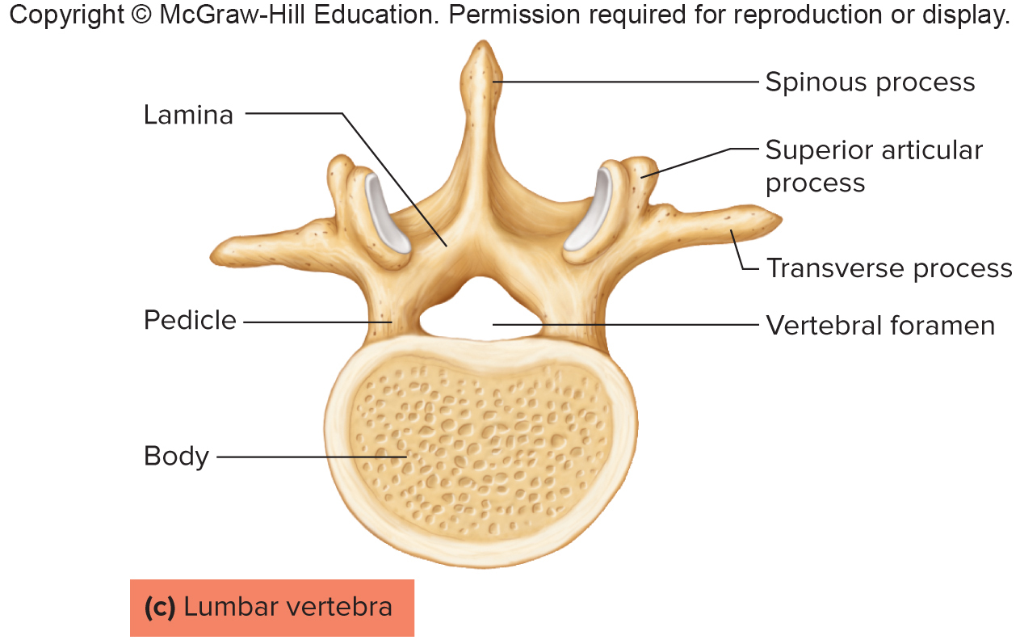
A Lumbar Vertebra

Slide 51
The Sacrum and Coccyx
Sacrum:
The sacrum is a triangular structure at the base of the vertebral column
Consists of 5 fused vertebrae
Features include a ridge of tubercles, posterior sacral foramina, sacral canal, sacral hiatus and 4 pairs of anterior sacral foramina
Coccyx:
The coccyx is also called the tailbone
Forms the lowest part of the vertebral column
Typically composed of 4 fused vertebrae

Slide 52
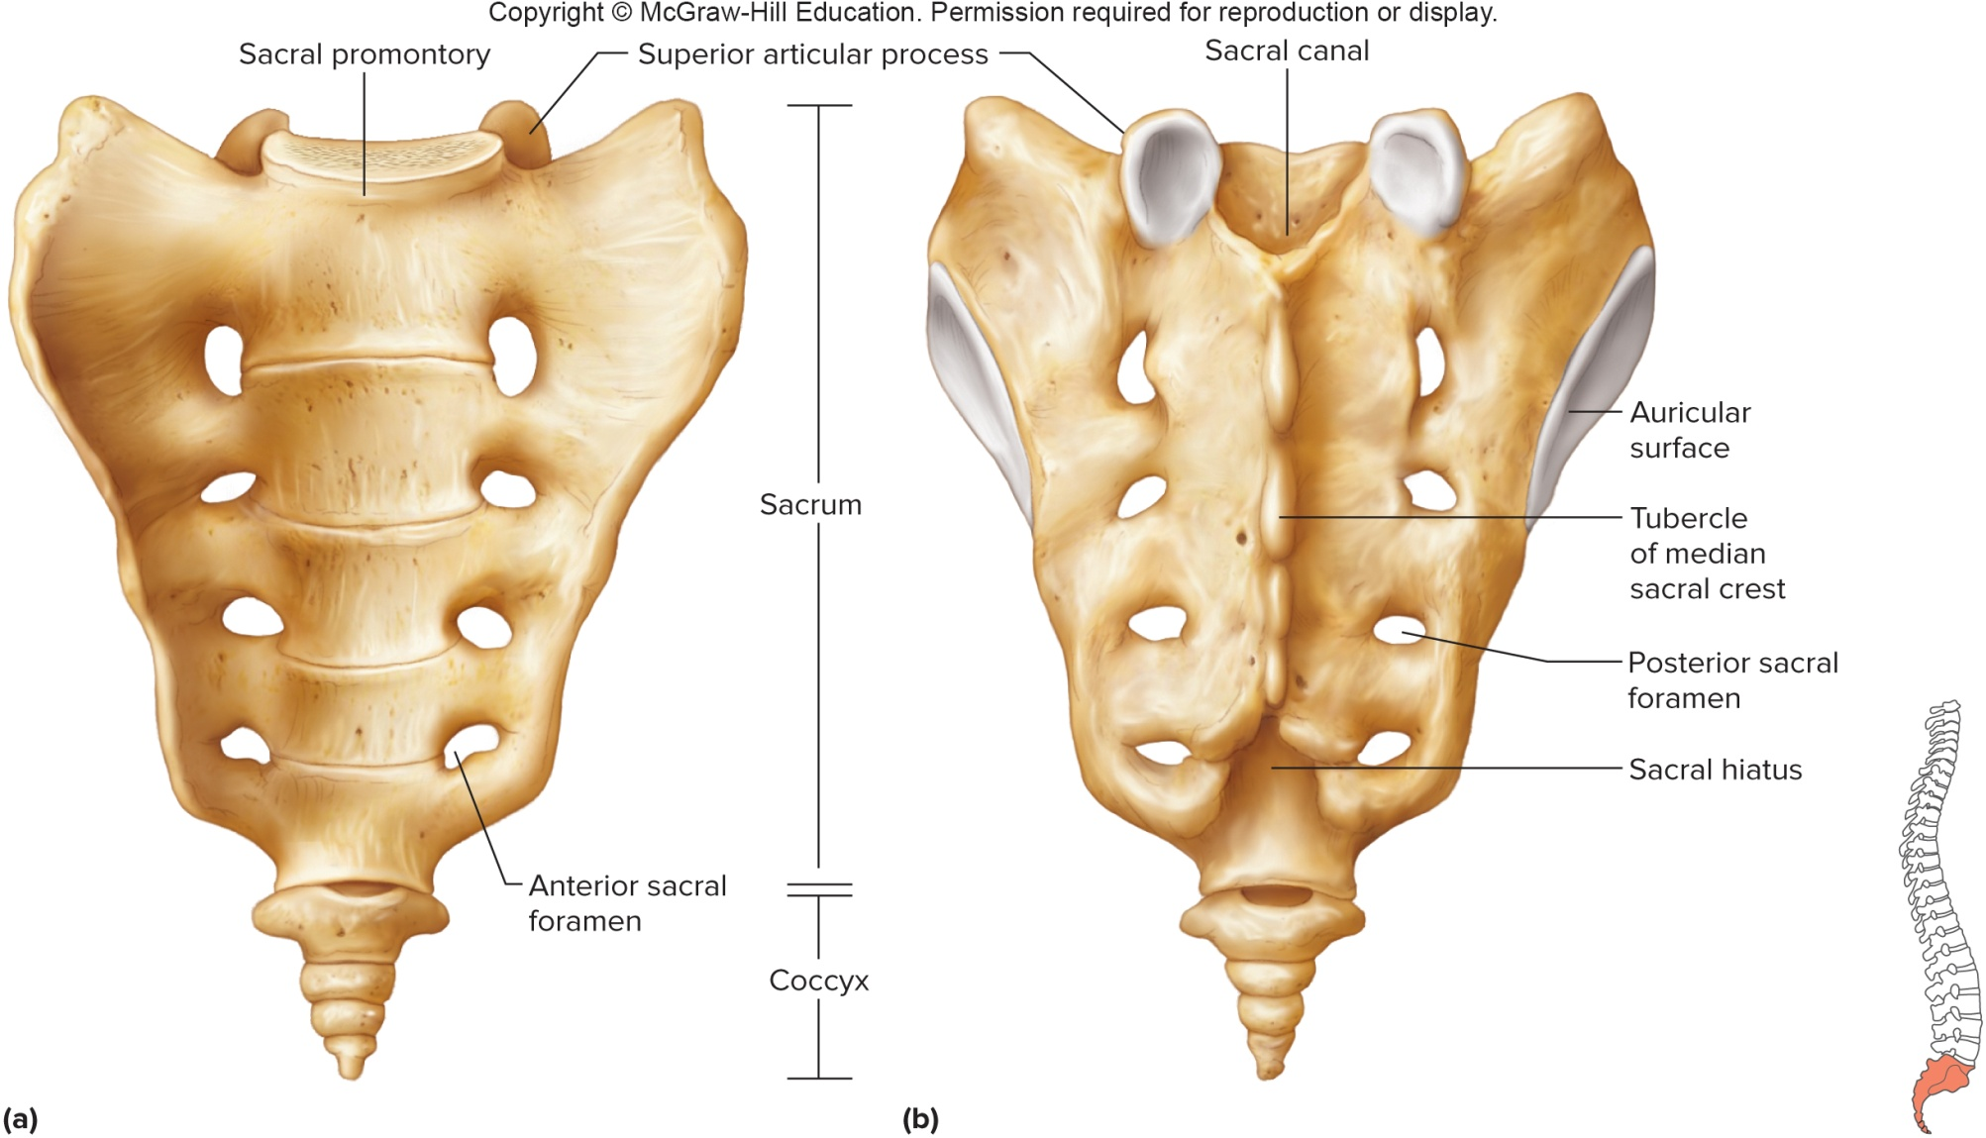
The Sacrum and Coccyx (2)

Slide 53
7.8: Thoracic Cage
The thoracic cage consists of the ribs, thoracic vertebrae, sternum, and costal cartilages
Supports the pectoral girdle and upper limbs
Protects the viscera in the thoracic and upper abdominal cavities
Plays a role in breathing

Slide 54
The Ribs
Normally humans have 12 pairs of ribs
Ribs attach to the thoracic vertebrae
The superior 7 pairs of ribs are true (or vertebrosternal) ribs; these connect to the sternum directly by their costal cartilages
The inferior 5 pairs are false ribs, because they do not reach the sternum directly:
  The upper 3 pairs join the cartilages of the 7th rib
  The lower 2 pairs are floating (vertebral) ribs, because they have no cartilaginous attachments to the sternum
Features of a typical rib include a curved shaft, head, & tubercle
  The head articulates with the facet of the thoracic vertebra
  The tubercle articulates with the transverse process of the vertebra

Slide 55
The Sternum
The sternum is also called the breastbone
Located along the anterior midline of the thoracic cage
Its 3 portions are an upper manubrium, middle body, and lower xiphoid process
Sternum articulates with clavicles

Slide 56
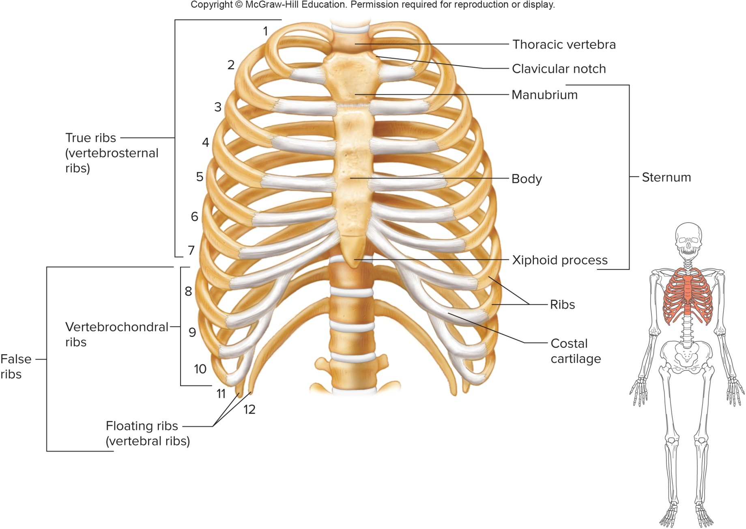
View of the Thoracic Cage

Slide 57
7.9: Pectoral Girdle
Pectoral girdle (shoulder girdle):
Makes an incomplete ring
Supports the upper limbs, and is an attachment site for muscles that move them
Composed of 2 scapulae (shoulder blades) and 2 clavicles (collarbones)
Clavicles (collarbones):
Elongated, S-shaped bones located at the base of the neck, that function to brace the scapulae
Provide attachment sites for muscles that move upper limbs, chest and back

Slide 58
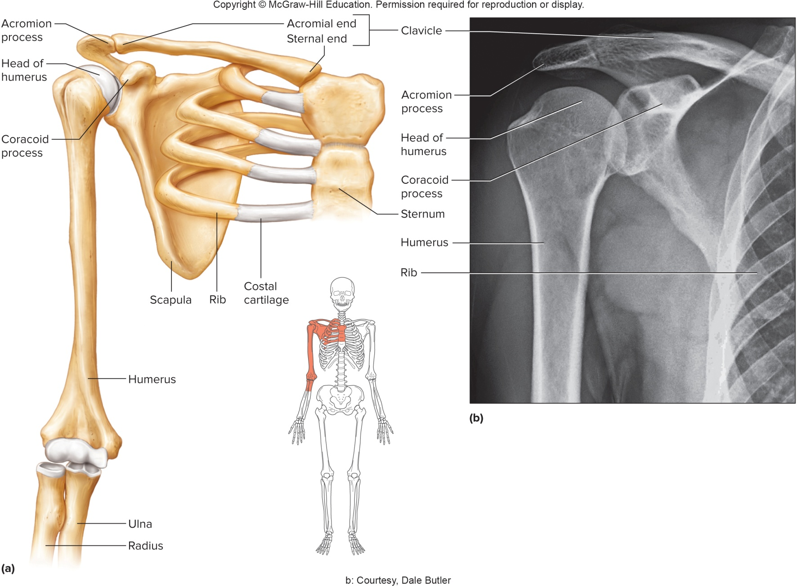
The Pectoral Girdle (2)

Slide 59
Scapulae
Scapulae (shoulder blades):
Broad, triangular bones on either side of the upper back
A spine divides the posterior scapula into unequal portions
The spine ends with the acromion process, which articulates with clavicle; the acromion process forms the tip of the shoulder
The coracoid process provides attachment sites for limb and chest muscles
The glenoid cavity articulates with the head of the humerus

Slide 60
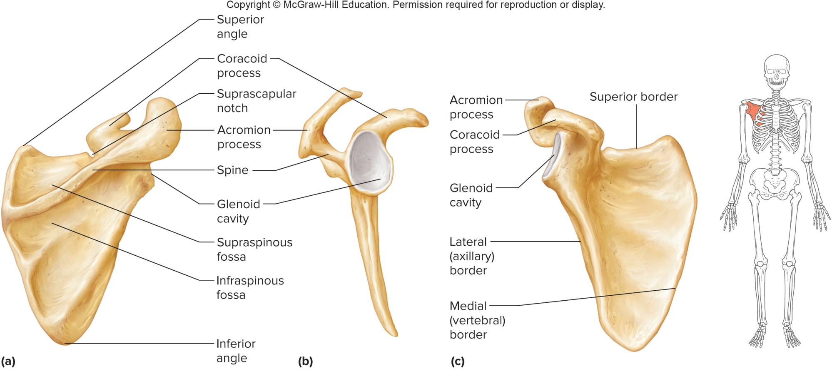
The Scapula

Slide 61
7.10: Upper Limb
Bones of the upper limb form the framework for the arm, forearm, and hand
They also provide for muscle attachments
They function with muscles to move limb parts
Bones of the upper limb:
  Humerus
  Radius
  Ulna
  Carpals
  Metacarpals
  Phalanges

Slide 62
The Humerus
Humerus:
A long bone extending from the scapula to the elbow
Only bone of the upper arm
It articulates with the scapulae at its head, with the radius at the capitulum, and with the ulna at the trochlea
Other features include the greater and lesser tubercles, intertubercular sulcus, anatomical and surgical necks, deltoid tuberosity, 2 condyles (capitulum & trochlea), 2 epicondyles, coronoid fossa, and olecranon fossa

Slide 63
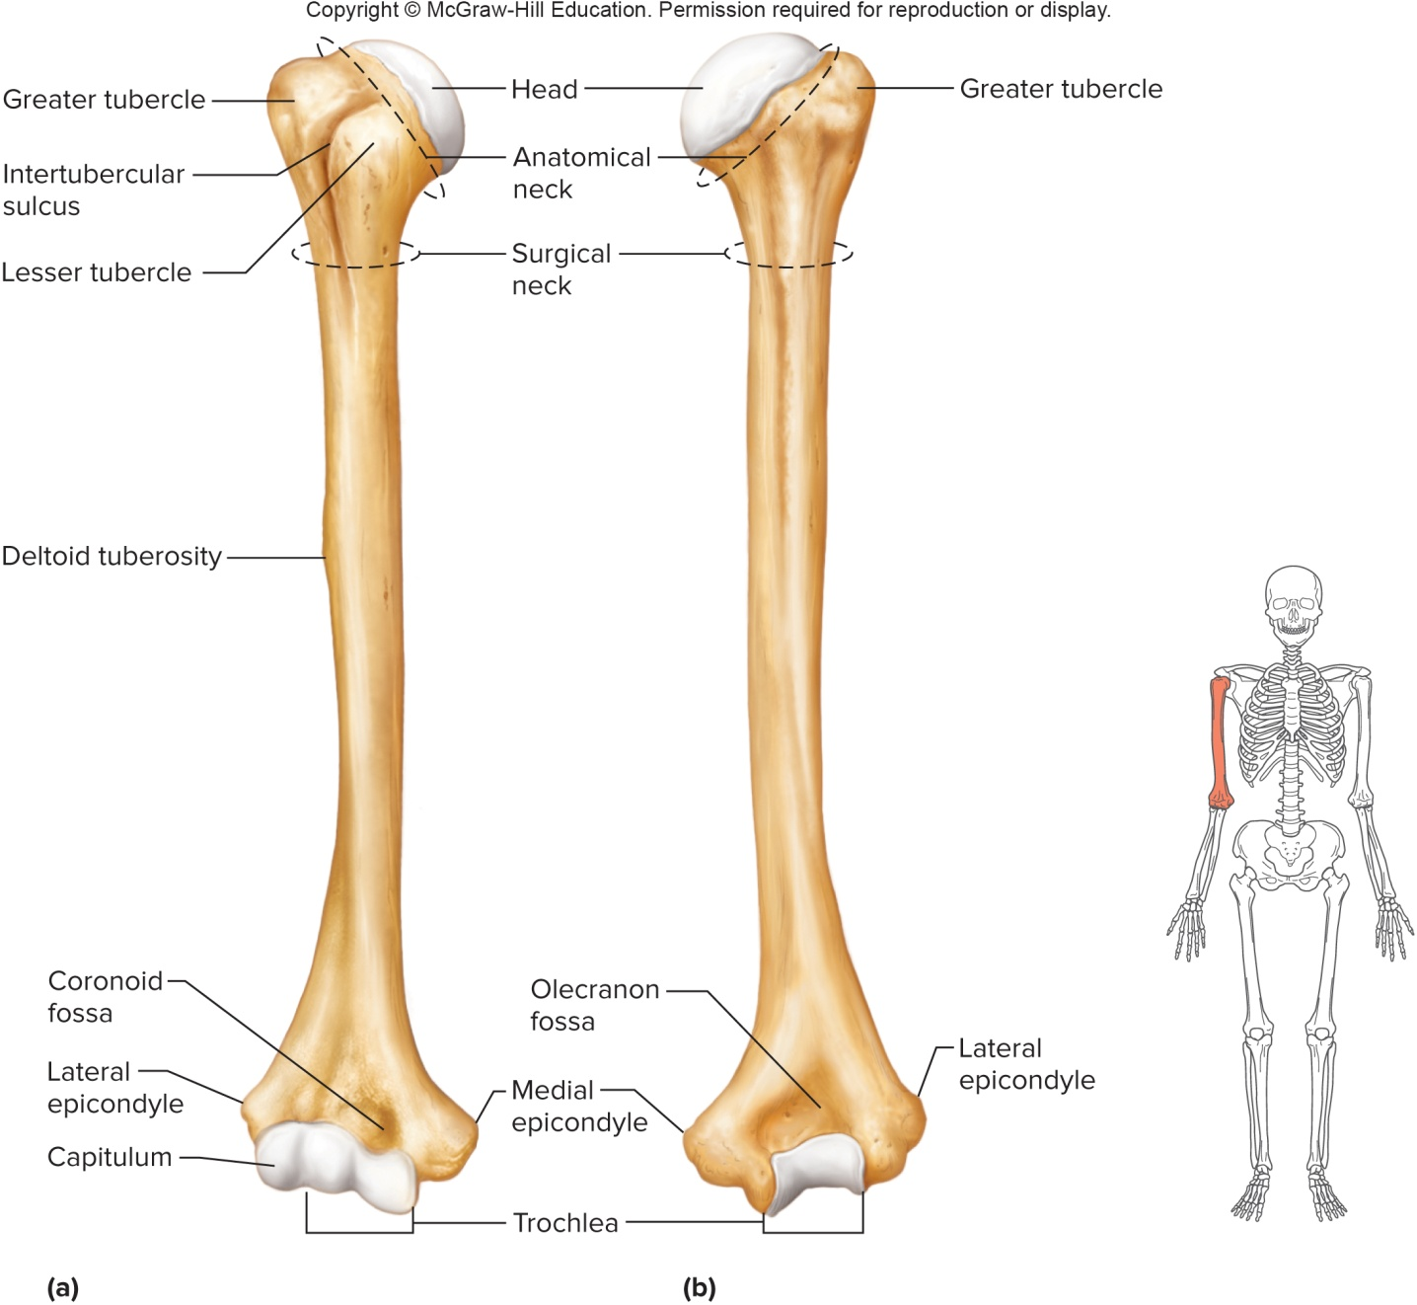
The Humerus: Anterior & Lateral Views

Slide 64
The Radius and Ulna
Radius:
Located on the thumb (lateral) side of the forearm, extending from the elbow to the wrist
The disc-like head of the radius articulates with the capitulum of the humerus and radial notch of ulna; allows rotation of radius
Other features of the radius include the radial tuberosity and styloid process
Ulna:
The longer of the 2 bones of the forearm, lateral to the radius
Trochlear notch that articulates with the trochlea of the humerus
Other features include the olecranon process, coronoid process, head, and styloid process
The distal end (head) articulates with the ulnar notch of radius
The ulna is on the medial side in anatomical position

Slide 65
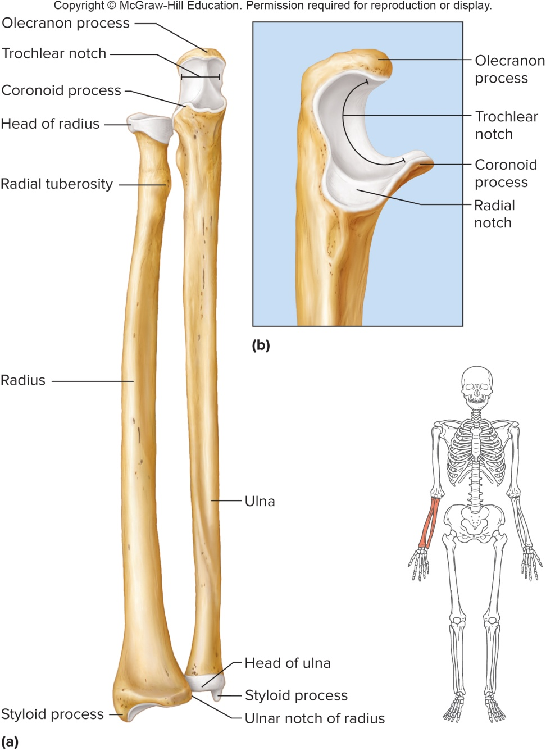
The Radius and Ulna (2)

Slide 66
The Hand
The hand:
Consists of the wrist, palm, and fingers
The wrist is made up of 8 carpal bones, arranged into 2 rows of 4; the entire group is called the carpus
The framework of the hand is made up of 5 metacarpal bones
The fingers are each composed of 3 phalanges, except the thumb, which has only 2

Slide 67
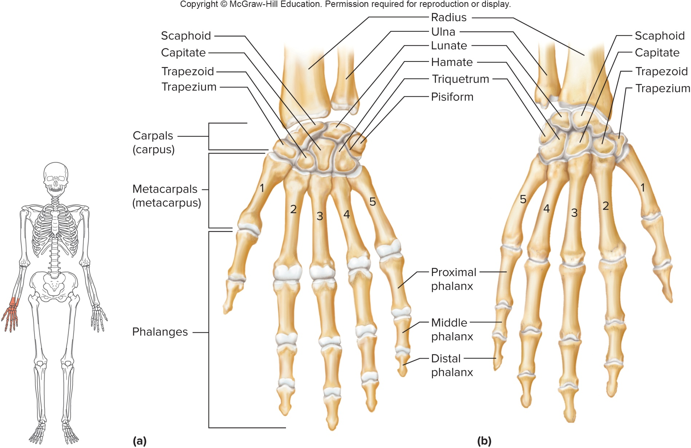
The Hand in Anterior & Posterior View

Slide 68
7.11: Pelvic Girdle
Pelvic Girdle:
Consists of the 2 hip (coxal or innominate) bones
The hip bones articulate with each other anteriorly, and with sacrum posteriorly
The pelvis consists of the sacrum, coccyx and pelvic girdle
It supports the trunk of the body on the lower limbs, provides attachments for the lower limbs and protects the organs within it, such as the urinary bladder, and end of large intestine

Slide 69
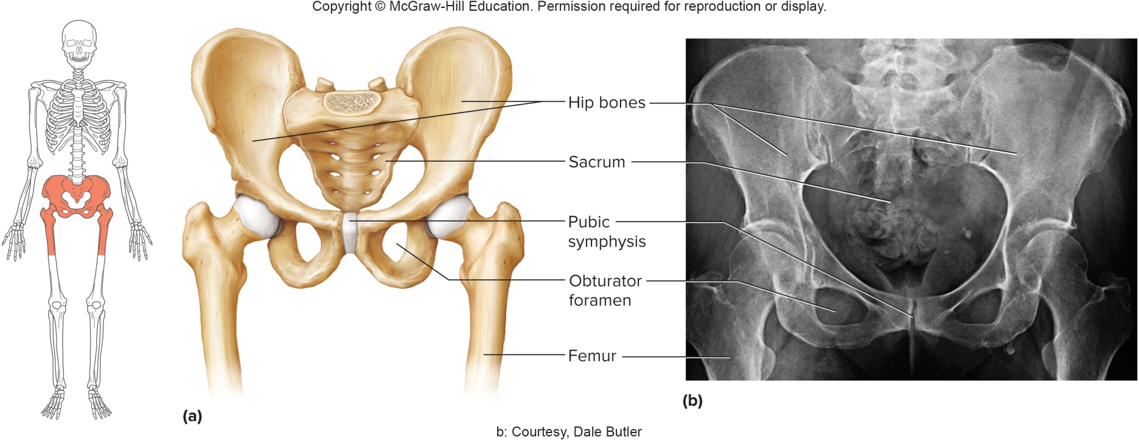
The Pelvic Girdle (2)

Slide 70
The Hip Bone
Each hip bone is made up of 3 bones: ilium, ischium, and pubis
These 3 bones are fused in the region of the acetabulum, the cuplike depression that articulates with the head of the femur
The ilium is the largest and upper-most portion of the hip bone; features include the iliac crest, sacroiliac joint, and the anterior superior iliac spine
The ischium forms the L-shaped, posterior portion, that supports weight during sitting; features include the ischial tuberosity and ischial spine
The pubis constitutes the anterior portion of each hip bone; the 2 pubic bones join at the pubic symphysis; other features include the pubic arch, obturator foramen, and pelvic brim

Slide 71
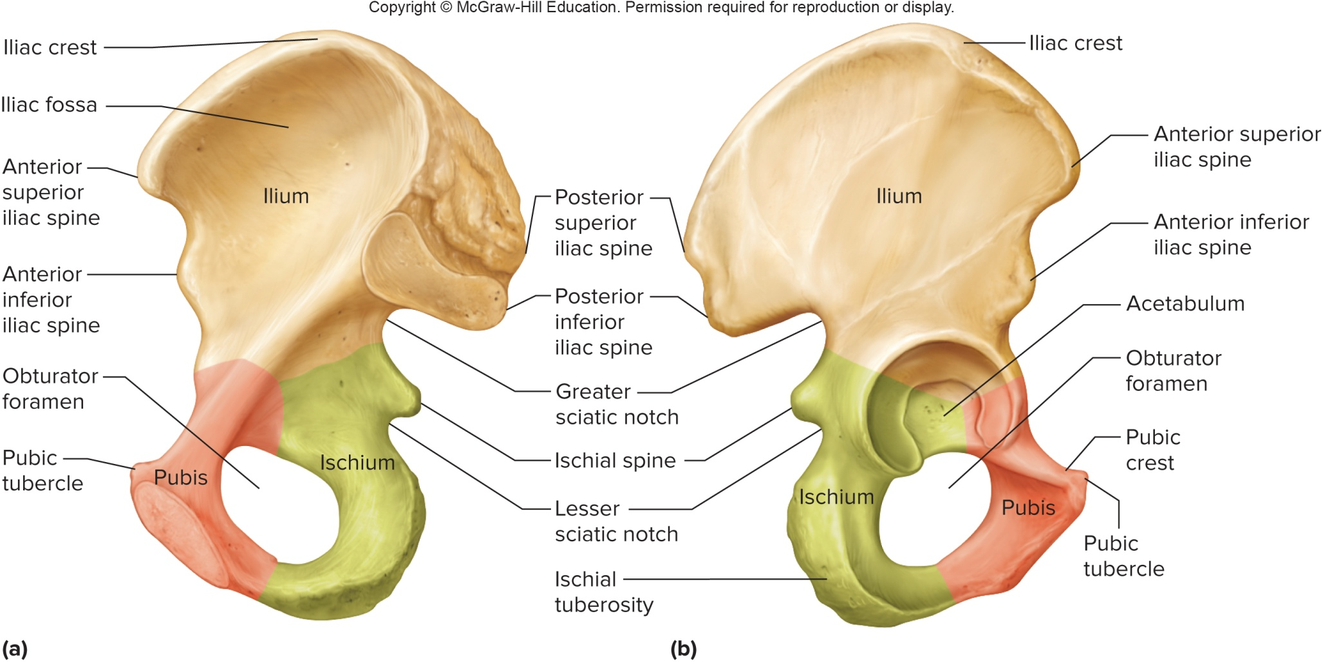
The Hip Bone: Medial & Lateral Views

Slide 72
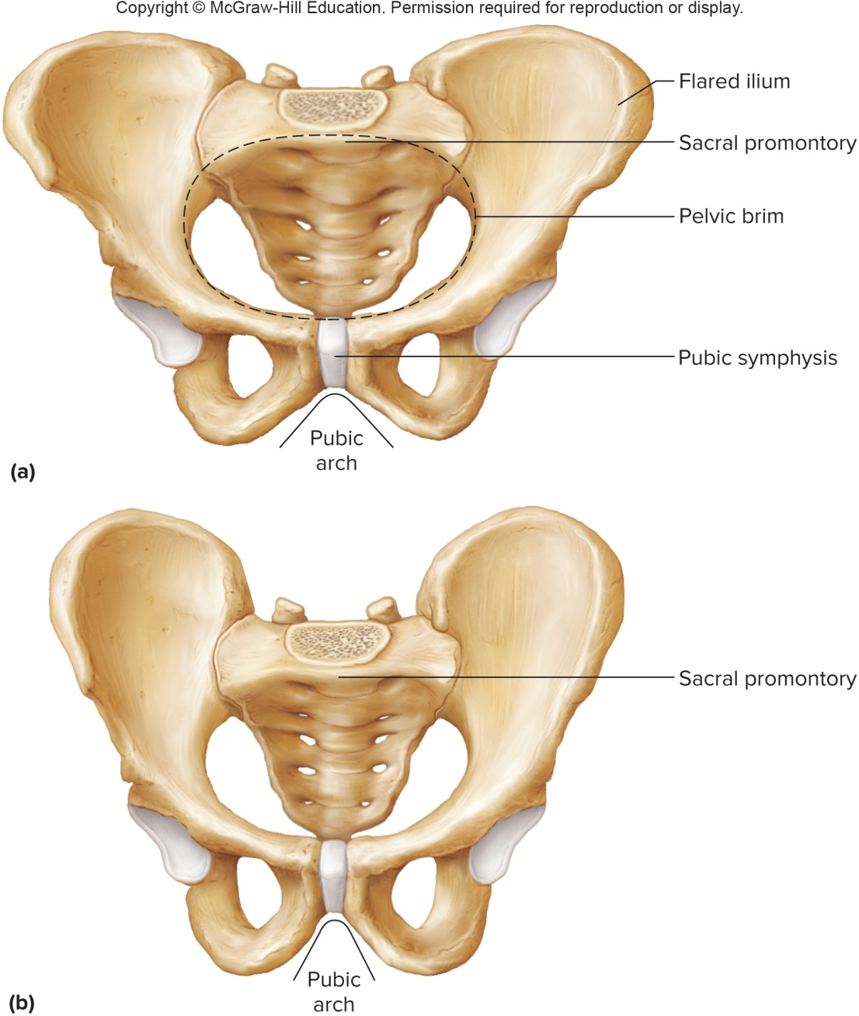
Female and Male Pelves

Slide 73
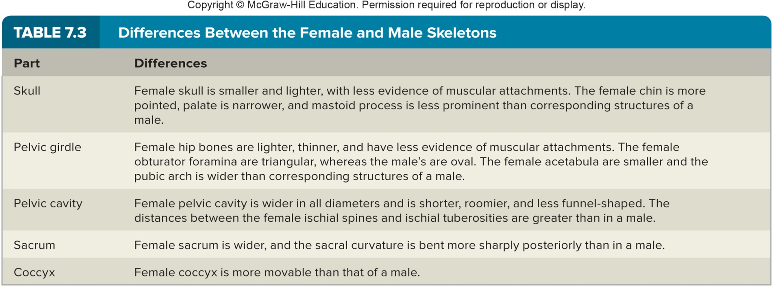
Differences Between Male & Female Skeletons

Slide 74
7.12: Lower Limb
The bones of the lower limb provide the framework for the thigh, lower leg, and foot
Bones of the lower limb:
  Femur
  Tibia
  Fibula
  Patella
  Tarsals
  Metatarsals
  Phalanges

Slide 75
Femur
The femur:
Also called the thighbone
Extends from the hip to the knee
The longest bone in the body
Its head fits into the acetabulum of the hip bone
It also articulates with the tibia at the medial and lateral condyles
Other features of the femur include the fovea capitis, neck, and greater and lesser trochanters
The patella (kneecap) articulates with the femur at distal anterior surface, and is situated in the tendon that passes anteriorly over the knee

Slide 76
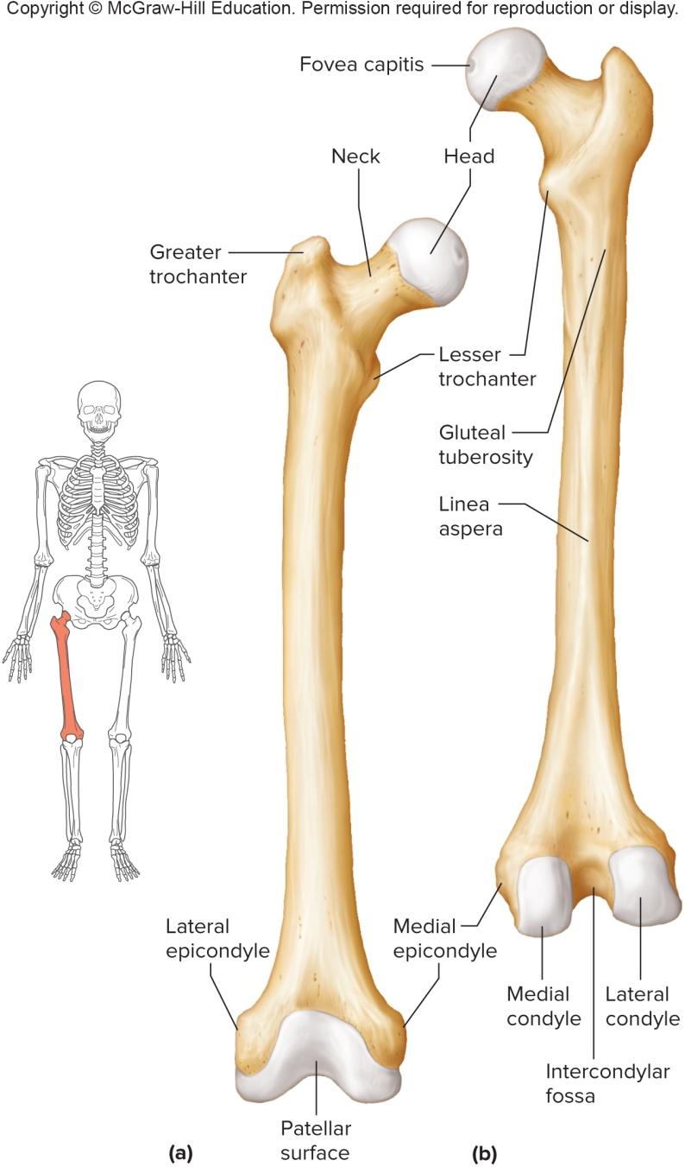
Femur (2)

Slide 77
The Tibia and Fibula
Tibia:
The tibia is also called the shinbone; weight-bearing
Larger of 2 lower leg bones; found on medial side
Articulates with the femur at the medial and lateral condyles, and with the talus of the ankle
Its anterior tibial tuberosity is the point of attachment for the patellar ligament, the continuation of the patellar tendon
Other features include the medial malleolus (inner ankle)
Fibula:
A slender bone lying lateral to the tibia
It does not bear body weight, and is not part of the knee joint
Features include the head and a distal lateral malleolus (outer ankle)

Slide 78
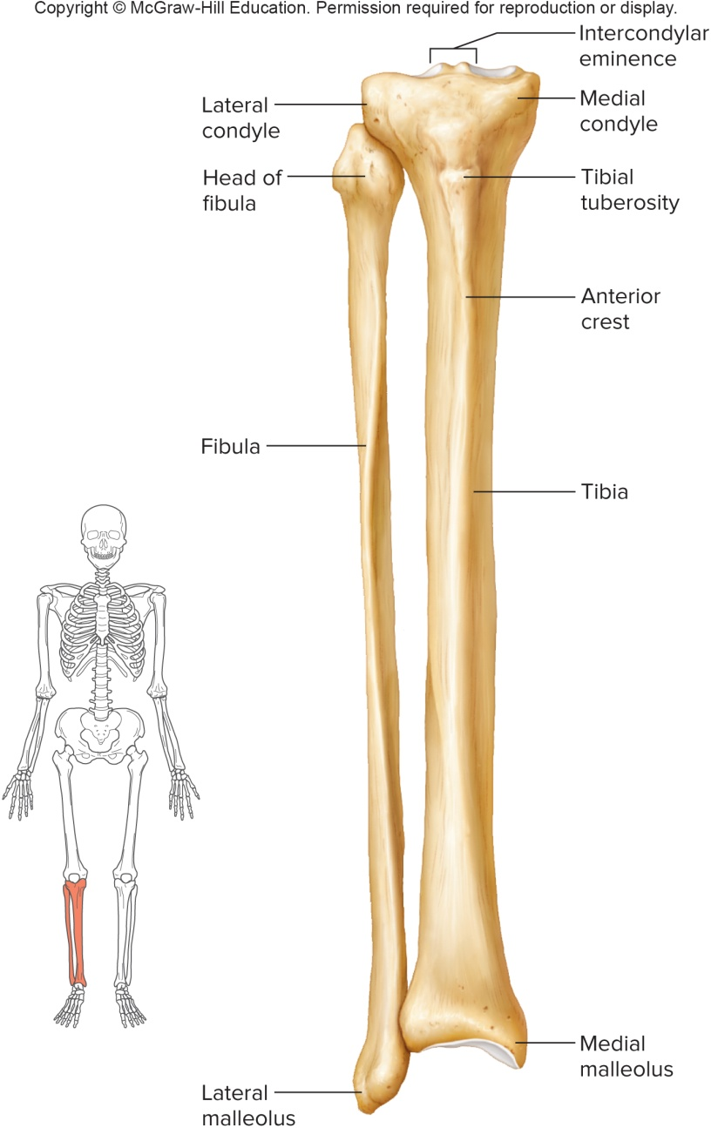
The Tibia and Fibula (2)

Slide 79
The Foot
The foot consists of the ankle, the instep and toes:
Ankle (tarsus):
  Composed of 7 tarsal bones
  The talus articulates with the tibia and fibula
  The calcaneus (heel bone) supports the body weight
Instep (metatarsus):
  Consists of 5 long metatarsal bones
  Distal heads form ball of foot
  Forms arches of foot, along with the tarsals
Toes:
  Each toe consists of 3 phalanges: proximal, middle, distal phalanx
  Exception is great toe, which lacks a middle phalanx

Slide 80
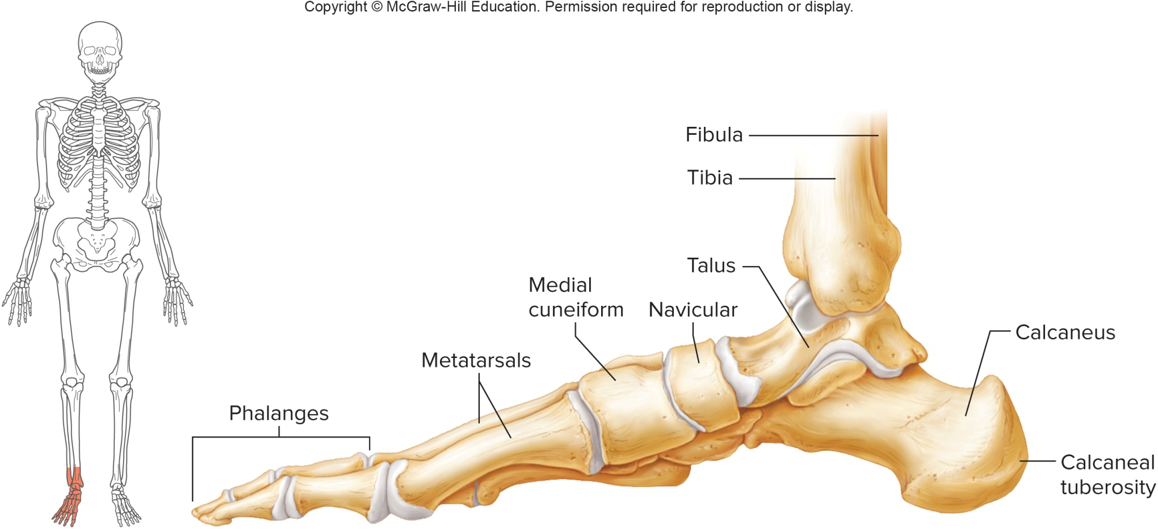
Medial View of the Right Foot

Slide 81
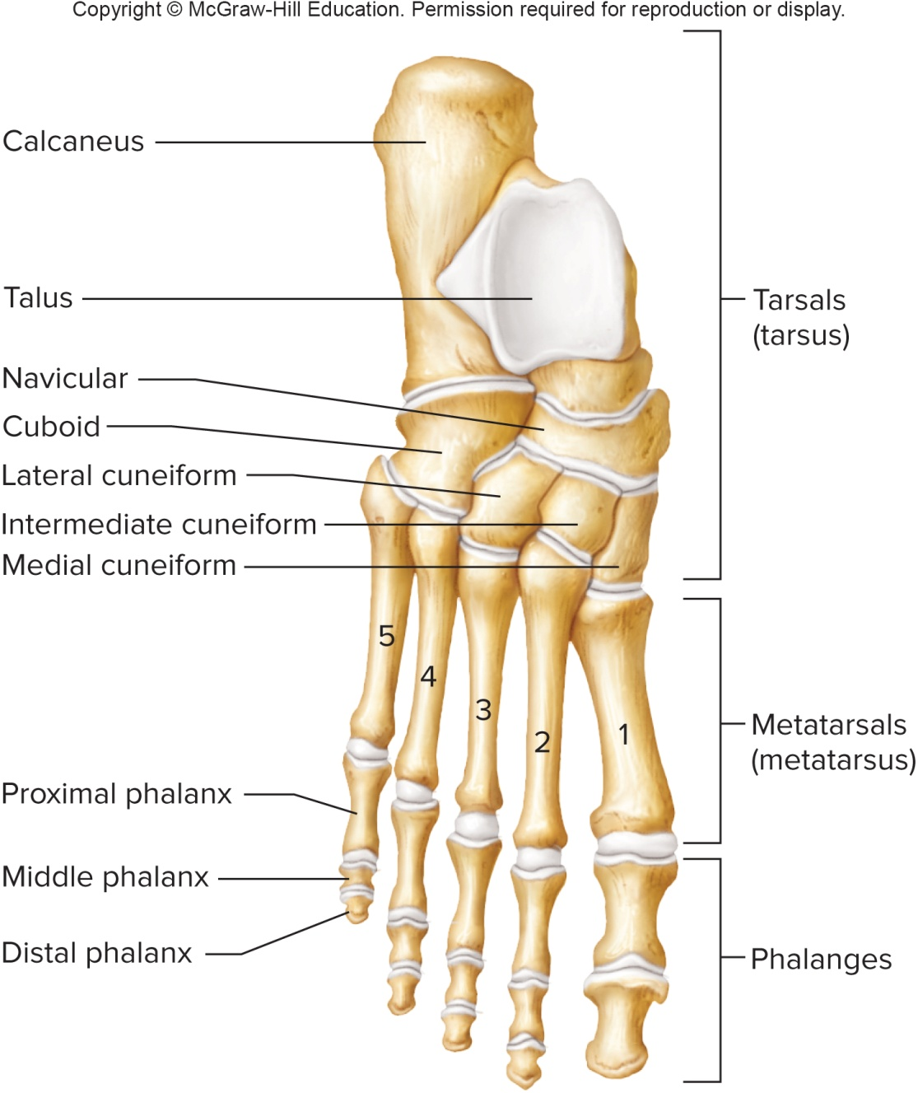
Superior View of the Right Foot

Slide 82
7.13: Joints
Joints (articulations):
Functional junctions between bones
Joints enable a wide variety of body movements, bind parts of the body together, make bone growth possible, and permit shape changes during childbirth
Joints can be classified according to the degree of movement they allow:
  Immovable, or synarthrotic
  Slightly movable, or amphiarthrotic
  Freely movable, or diarthrotic
Joints can also be classified according to the type of tissue that binds them together:
  Fibrous: composed of dense connective tissue
  Cartilaginous: composed of cartilage
  Synovial: having a complex structure

Slide 83
Fibrous Joints
Fibrous joints:
Found between bones that lie in close contact
Held close together by layer of dense connective tissue
Most are immovable, such as the sutures of the skull
A few are slightly movable, such as the joint between the distal tibia and fibula

Slide 84
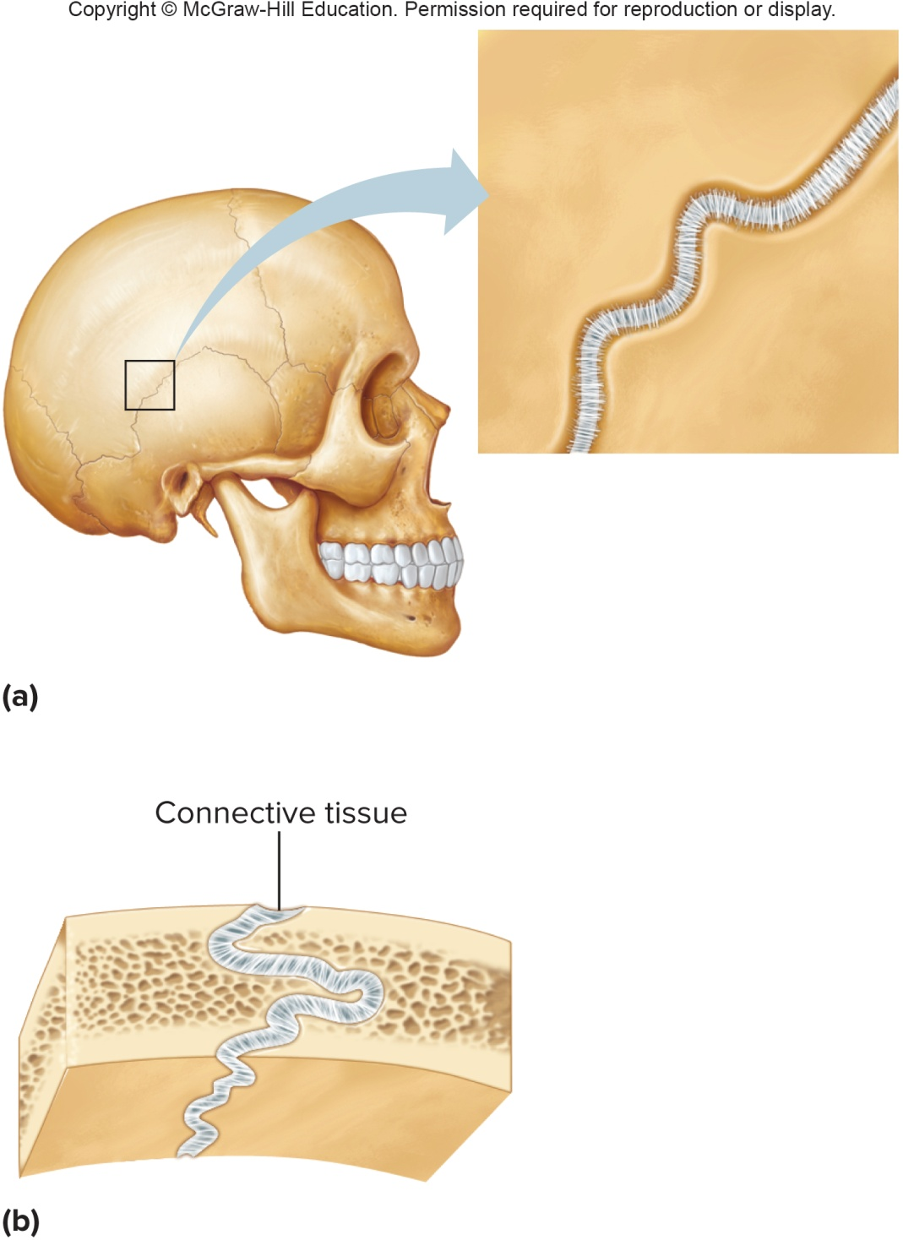
Fibrous Joints (2)

Slide 85
Cartilaginous Joints
Cartilaginous joints:
Connected by either hyaline or fibrocartilage
Intervertebral discs between vertebrae help absorb shock and are slightly movable
Other examples of cartilaginous joints include the pubic symphysis and the first rib with the sternum

Slide 86
Synovial Joints
Synovial joints:
Are diarthrotic (allow free movement)
Have a more complex structure than fibrous or cartilaginous joints
Most joints of the skeleton are synovial joints
The articular ends of bones in a synovial joint are covered with hyaline (articular) cartilage
A joint capsule consists of an outer layer of dense connective tissue, and an inner layer, called the synovial membrane
The synovial membrane secretes synovial fluid, which lubricates the joints

Slide 87
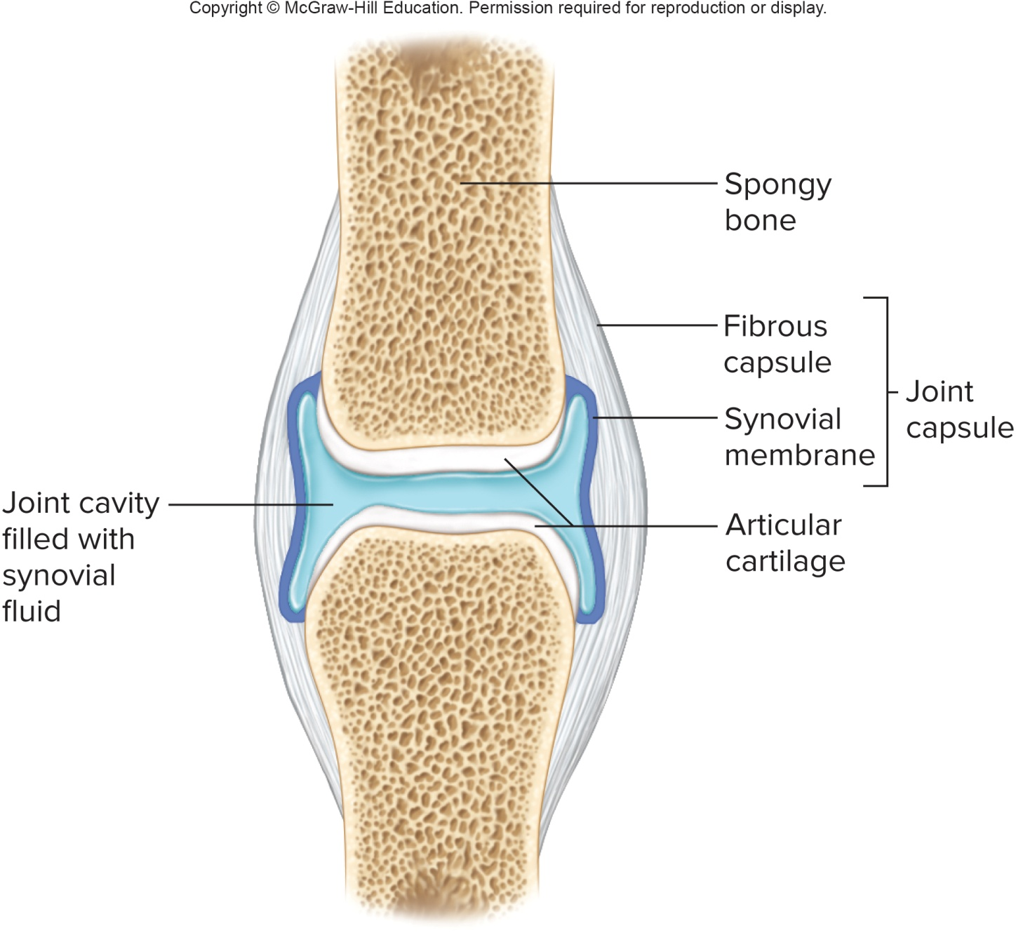
The General Structure of a Synovial Joint

Slide 88
Synovial Joints (2)
Some synovial joints contain shock absorbing pads of fibrocartilage called menisci (singular is meniscus)
Some synovial joints have fluid-filled sacs called bursae that aid in movement of tendons as they slide over bone
Synovial joints are classified by shape of their parts and the movements they allow

Slide 89
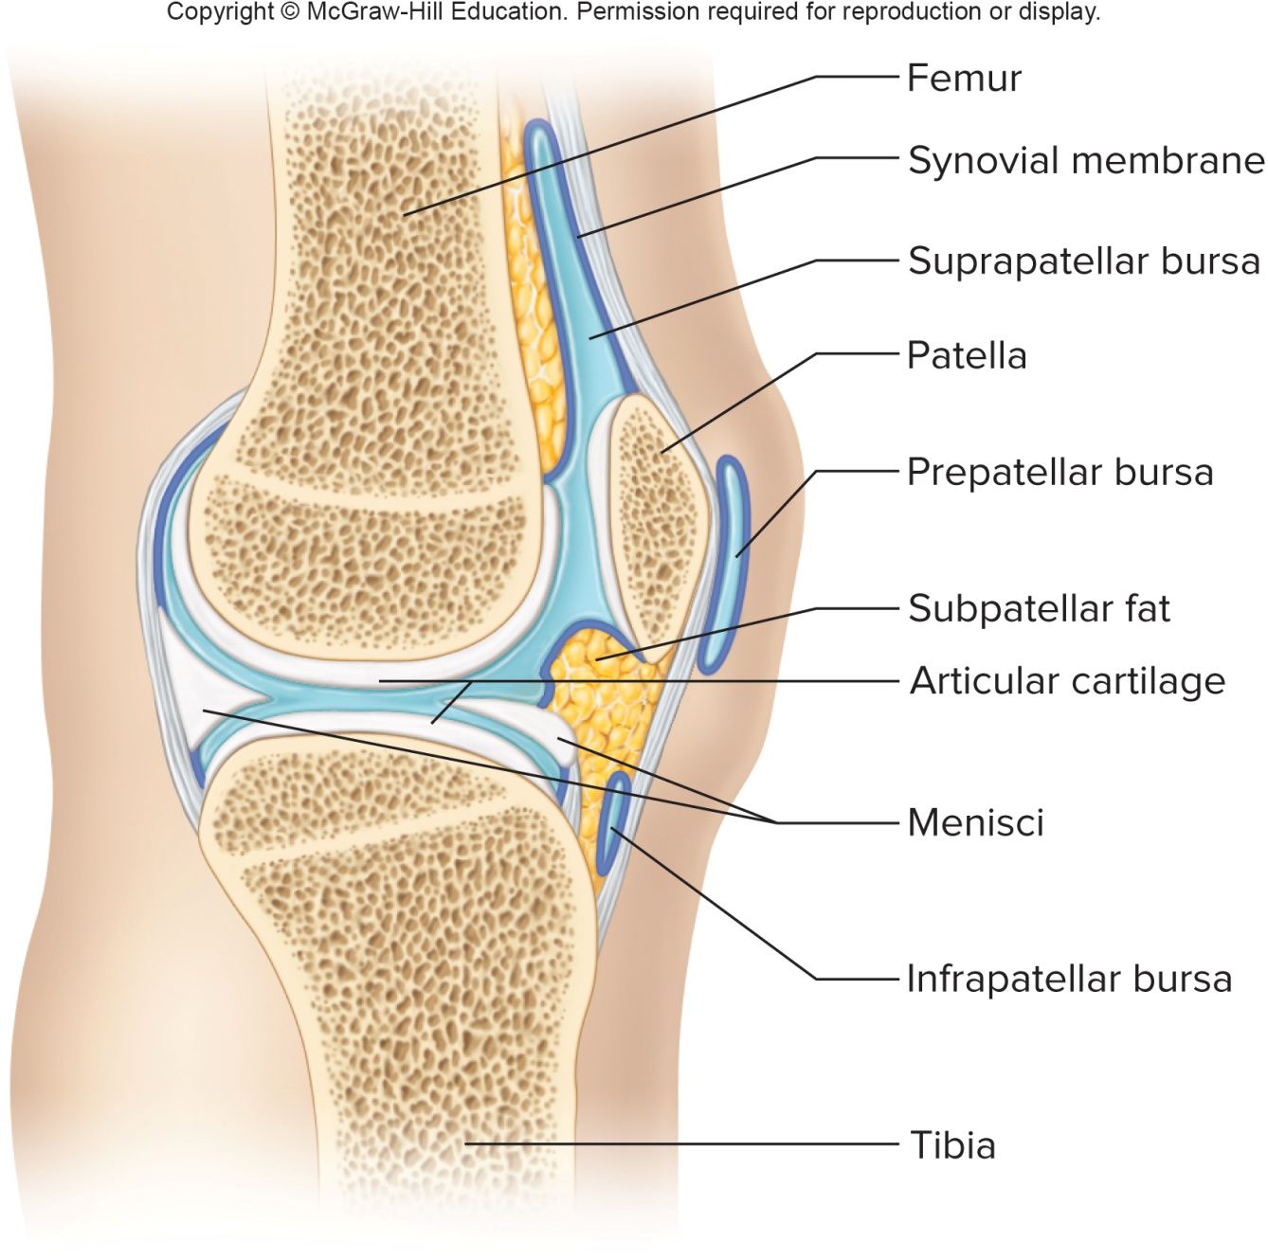
The Menisci and Bursae of the Knee Joint

Slide 90
Classification of Synovial Joints
Ball-and-socket (spheroidal) joint:
Consists of a bone with a globular or egg-shaped head articulating with the cup-shaped cavity of another bone
Allows widest range of motion, including movement in all planes (multiaxial)
Examples: the shoulder and hip joints
    Condylar (ellipsoidal) joint:
    Consists of an ovoid condyle fitting into an elliptical cavity
    Permits back and forth and side to side movements within 2 planes (biaxial), but not rotation
    Examples: joints between metacarpals and phalanges

Slide 91
Classification of Synovial Joints (2)
Plane (gliding) joint:
Articulating surfaces are nearly flat or slightly curved
Allows a sliding or twisting movement (nonaxial)
Examples: joints of the wrist and ankle, as well as those between vertebrae, sacroiliac joints
    Hinge joint:
    A convex surface of a bone fits into a concave surface of another
    Allows movement in 1 plane (uniaxial), like hinge of a door
    Examples: the elbow and joints between phalanges

Slide 92
Classification Synovial Joints (3)
Pivot (trochoid) joint:
A cylindrical surface rotates within a ring of bone and ligament
Allows only rotation around central axis (uniaxial)
Examples: joint between the dens of the axis and the atlas
Saddle (sellar) joint:
Found between bones that have both concave and convex areas in their articulating surfaces; bones have complementary surfaces
Permits a variety of movements, mostly in 2 planes (biaxial)
Example: the joint between the trapezium (carpal) and the metacarpal of the thumb

Slide 93
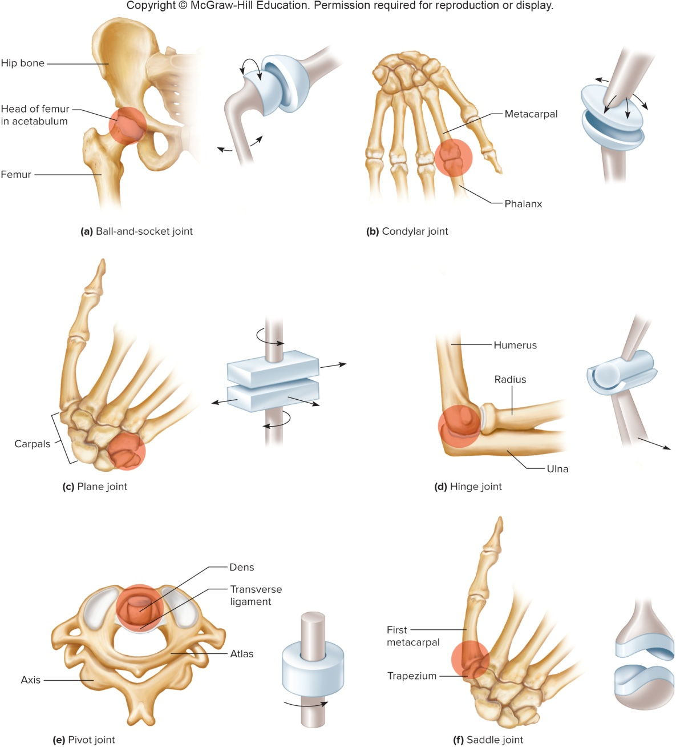
Types & Examples of Synovial Joints

Slide 94
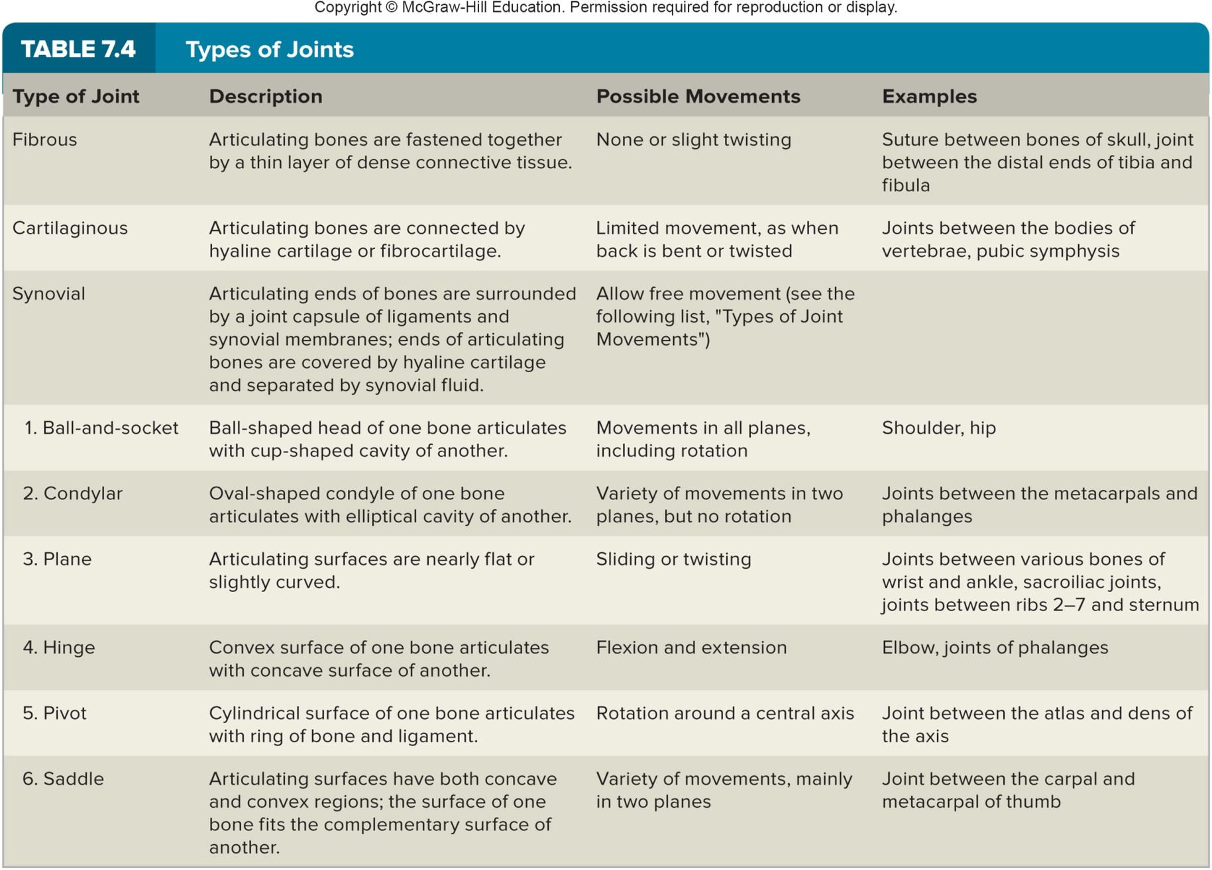
Summary: Types of Joints

Slide 95
Types of Joint Movements
When skeletal muscles move, they produce movement at synovial joints
When a muscle contracts, its fibers pull its more movable end, the insertion, toward its more fixed end, the origin, causing a specific movement at a joint
Terms to describe joint movements:
  Flexion: bending parts at a joint, so that the angle between them decreases
  Extension: straightening parts at a joint, so that the angle between them increases
  Lateral flexion: bending the head, neck, or trunk to the side
  Hyperextension: straightening beyond normal anatomical position
  Abduction: moving a body part away from the midline
  Adduction: moving a body part toward the midline

Slide 96
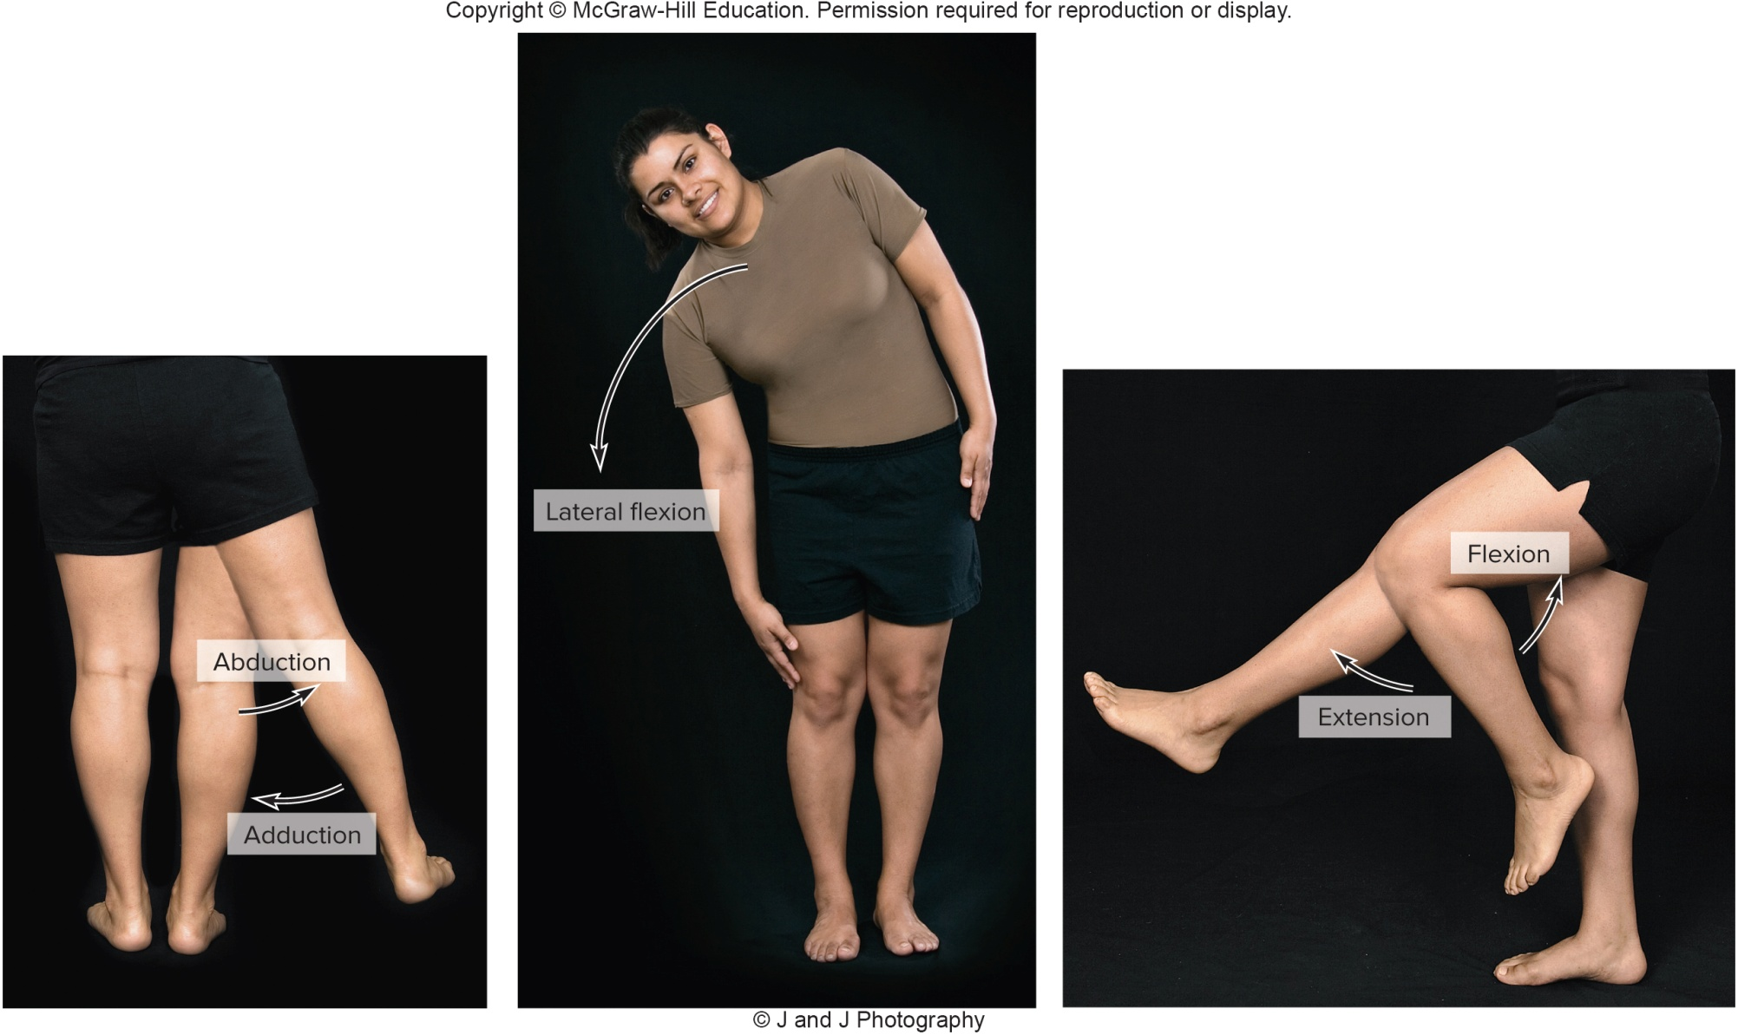
Types of Joint Movements (2)

Slide 97
Types of Joint Movements (3)
Terms to describe joint movements, continued:
Dorsiflexion: ankle movement that brings the foot closer to the shin
Plantar flexion: ankle movement that moves the foot farther from the shin; points the toes
Rotation: movement of a part around an axis
Circumduction: movement of a part so its end follows a circular path
Pronation: rotation of forearm so that the palm is facing downward or posteriorly
Supination: rotation of forearm so that the palm is facing upward or anteriorly

Slide 98
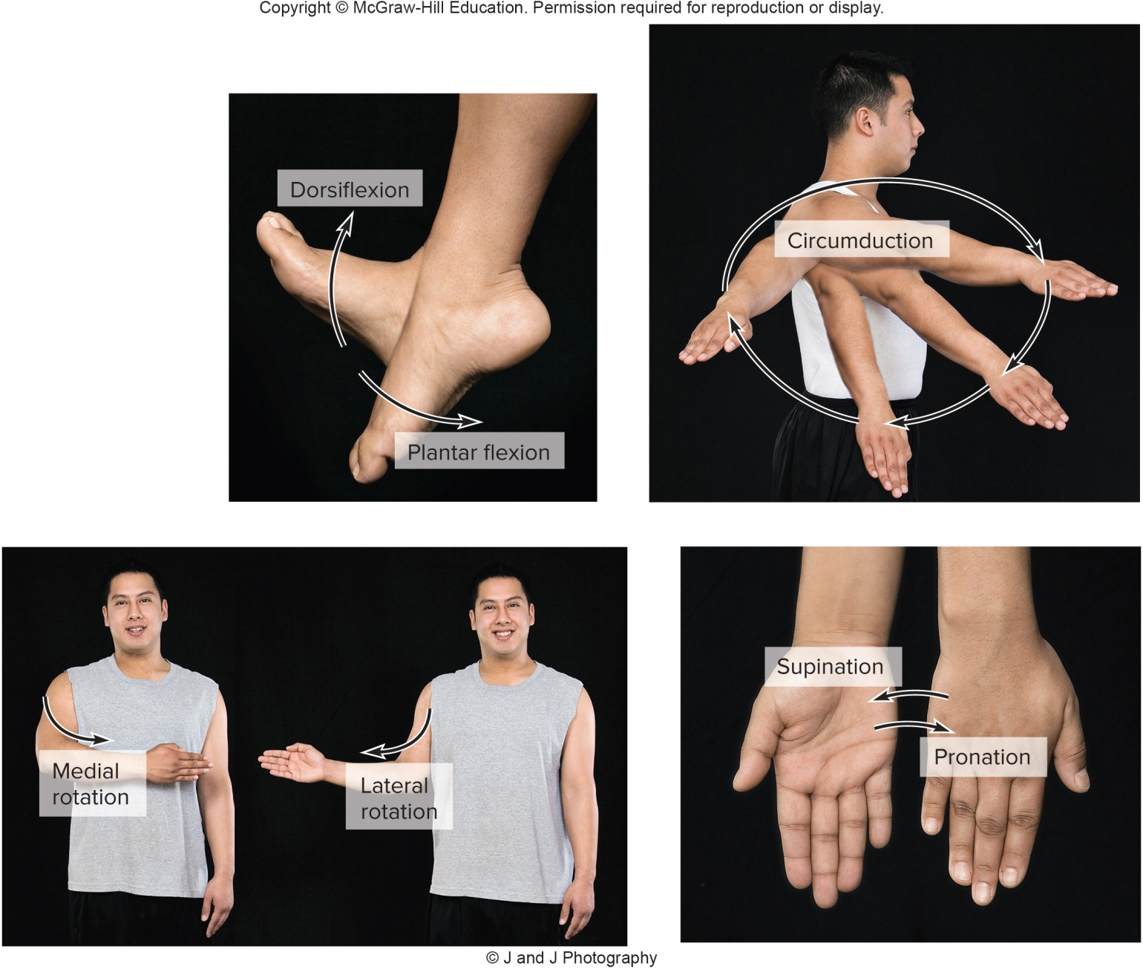
Types of Joint Movements (4)

Slide 99
Types of Joint Movements (5)
Terms to describe joint movements, continued:
    Inversion: turning the sole (plantar surface) of the foot medially
Eversion: turning the sole (plantar surface) of the foot laterally
Protraction: moving a part of the body forward
Retraction: moving a part of the body backward
Elevation: raising a part of the body
Depression: lowering a part of the body

Slide 100
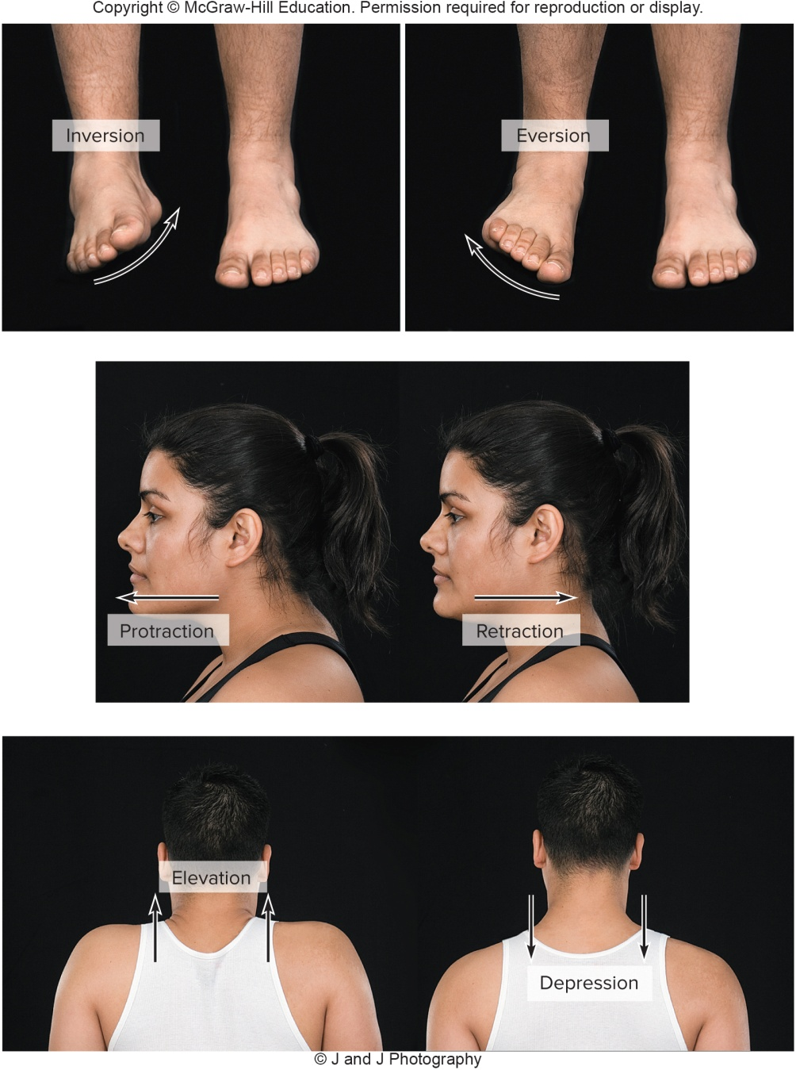
Types of Joint Movements (6)

