Slide 1
Chapter 05
Lecture Outline
See separate PowerPoint slides for all figures and tables pre-inserted into PowerPoint without notes.

Slide 2
5.1: Introduction to the Tissues
Similar cells are arranged in tissues that provide specific functions for the body
Cells of different tissues are structured differently, which leads to their differences in function
The tissues of the human body include 4 major types:
  Epithelial tissues: form protective coverings and function in secretion and absorption
  Connective tissues: support soft parts and bind structures together
  Muscular tissues: produce body movement
  Nervous tissue: conduct impulses to control and coordinate body activities

Slide 3
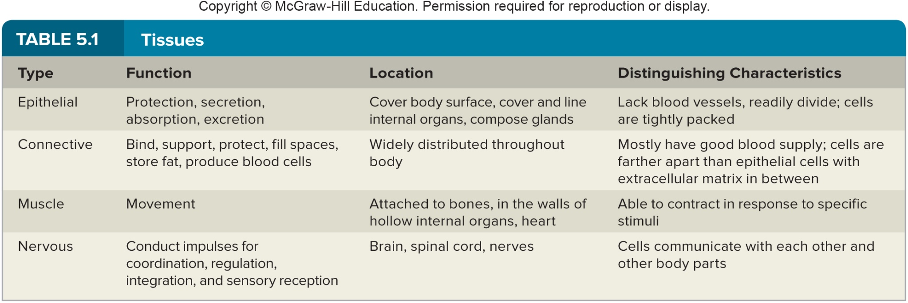
Tissues

Slide 4
Tissues (2)
Tissues are 3-dimensional structures
Micrographs: photos of very thin sections of tissue specimens
By observing micrographs, the microscopic structure of tissues can be studied
Tubular body structures can be observed through micrographs

Slide 5
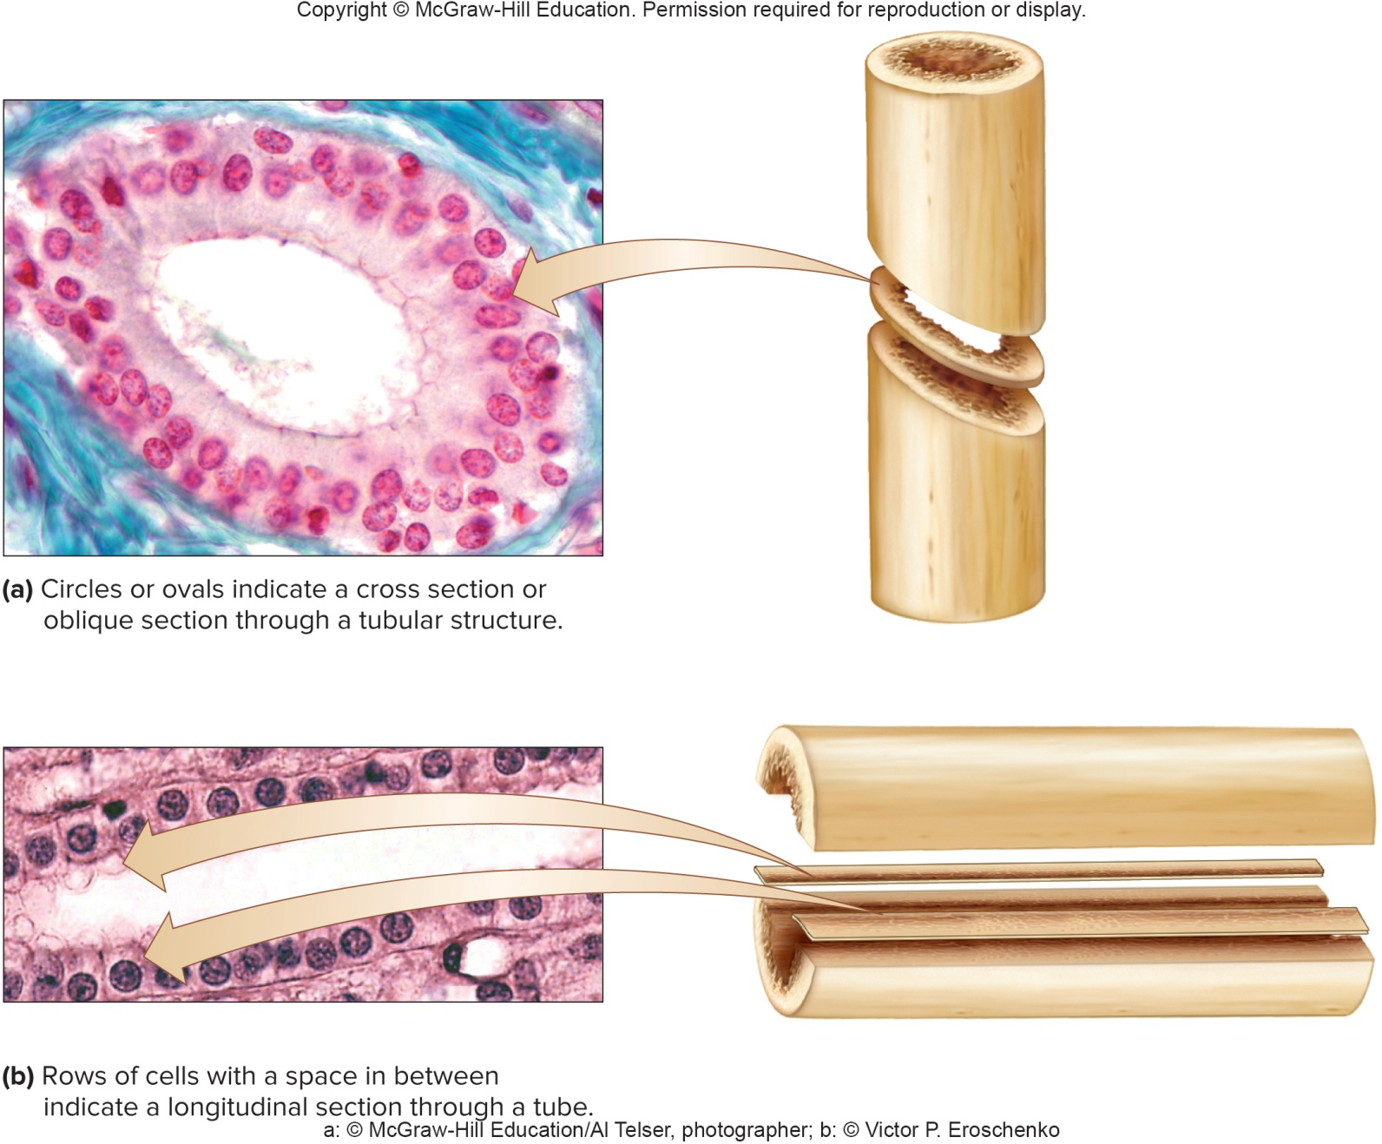
Tissue Sections

Slide 6
5.2: Epithelial Tissues
General Characteristics:
Epithelial tissue is widespread throughout the body
It covers organs, lines body cavities and hollow organs, and makes up glands
Epithelial tissue always has a free (apical) surface exposed to the outside or internally to an open space
Epithelial tissues are anchored to a basement membrane
They are made up of tightly packed cells containing little intercellular material, generally lack blood vessels, and readily divide
Nourished by cells in underlying connective tissues

Slide 7
Epithelial Tissues (2)
Epithelial tissues function in protection, secretion, absorption, and excretion.
Classification is by cell shape and the number of cell layers:
  Shapes: squamous, cuboidal, or columnar
  Number of layers: simple (1 layer) and stratified (2 or more layers)
Free surfaces can be modified to reflect specific functions – cilia, microvilli

Slide 8
Simple Squamous Epithelium
Simple squamous epithelium:
Made up of a single layer of thin, flattened cells
Cells are tightly packed together
Cells have broad, thin nuclei
Due to flattened structure of cells, this type is found in diffusion and filtration sites
Because it is suited for diffusion, it functions in the exchange of gases in the alveoli of the lungs, and lines blood and lymph vessels, as well as body cavities
It is also very delicate, and can be damaged easily

Slide 9
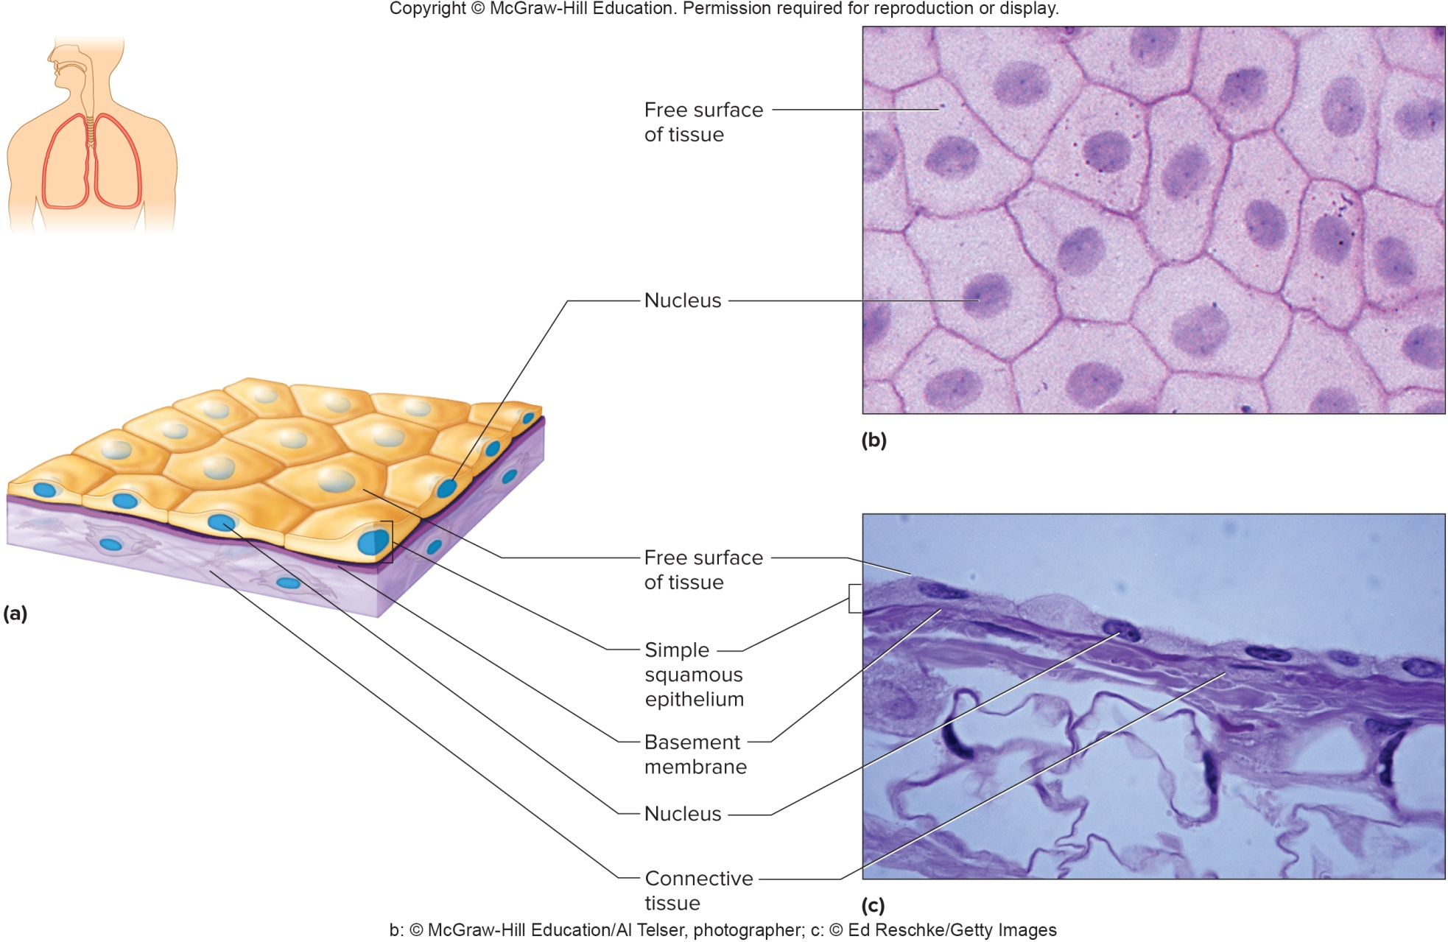
Simple Squamous Epithelium (2)

Slide 10
Simple Cuboidal Epithelium
Simple cuboidal epithelium consists of a single layer of cube-shaped cells with centrally located nuclei
Lines most kidney tubules, covers ovaries, and lines ducts of some glands
It functions urine formation in the kidneys, and glandular secretion
When it lines tubules or ducts, free surface faces lumen, the hollow channel

Slide 11
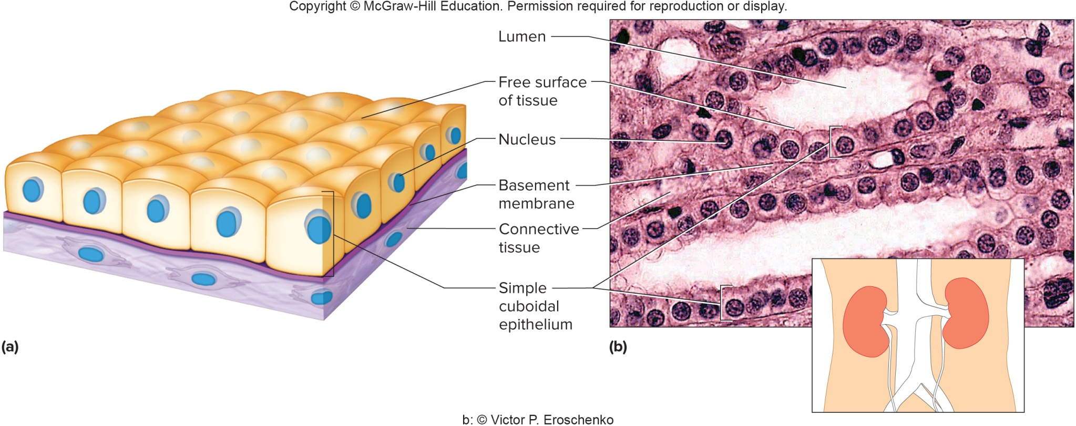
Simple Cuboidal Epithelium (2)

Slide 12
Simple Columnar Epithelium
Simple columnar epithelium:
Made up of one row of tall, elongated cells
Nuclei are located near the basement membrane
Cells may be ciliated or nonciliated
Nonciliated cells line the uterus, stomach, and intestines, where they protect underlying tissues, secrete digestive fluids, and absorb nutrients
Cilia are long extensions from the free surfaces of certain cells; they beat in a certain direction to move cells or mucus
Ciliated cells are found in the uterine tubes, and help move egg cells toward the uterus
Some cells contain tiny microvilli (smaller than cilia) to increase surface area for absorption
Goblet cells are scattered among the cells; secrete mucus onto the free surface of the tissue for lubrication or protection

Slide 13
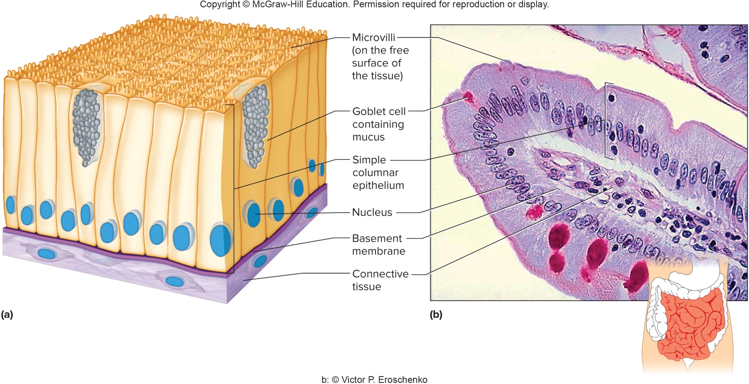
Simple Columnar Epithelium (2)

Slide 14
Pseudostratified Columnar Epithelium
Pseudostratified Columnar Epithelium:
The cells appear layered due to the varying positions of their nuclei within the row of cells, but are not truly layered
Cells vary in shape
All cells reach basement membrane, but not all reach free surface
Most have cilia along their free surface
Goblet cells are scattered among the epithelial cells; secrete mucus
Found in the passageways of the respiratory system
In the respiratory tract, the mucus traps dust and microorganisms, and the cilia sweep them away from the airways

Slide 15
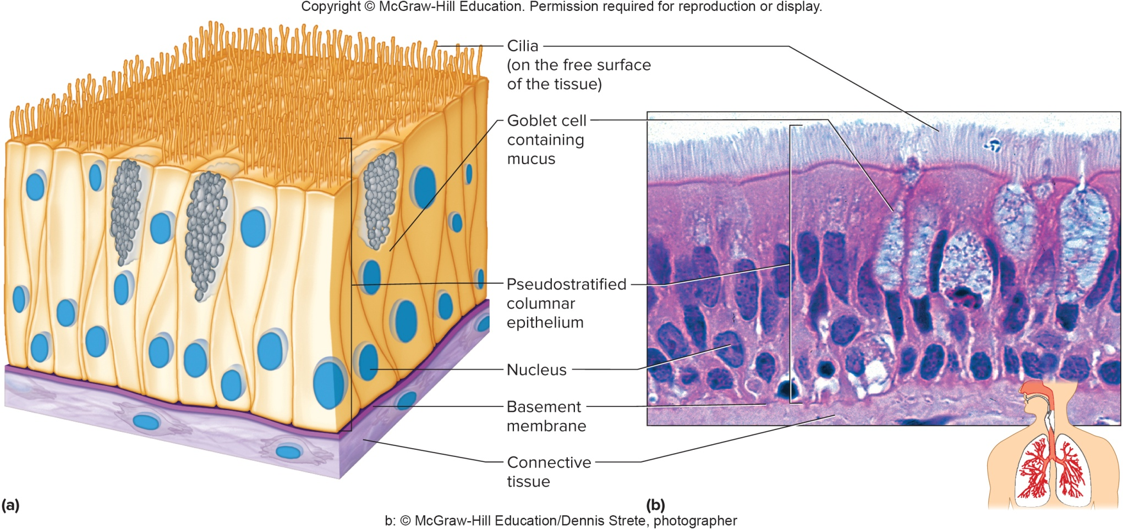
Pseudostratified Columnar Epithelium (2)

Slide 16
Stratified Squamous Epithelium
Stratified squamous epithelium:
Made up of many layers of flattened cells that are designed to protect underlying layers
This type of epithelium is named for the shape of the outermost layers of cells; these layers are composed of squamous cells
Cells divide in the deeper layers, and push the older cells outward, where they begin to flatten
Makes up the outer layer of skin (epidermis), and lines the mouth, esophagus, vagina, and anal canal
In the skin, outer layers of cells undergo keratinization, producing a dry, water-proof, protective layer, in which outer cells are dead
Keratinization does not occur in areas in which tissues remain moist and alive: oral cavity, esophagus, vagina, or anal canal

Slide 17
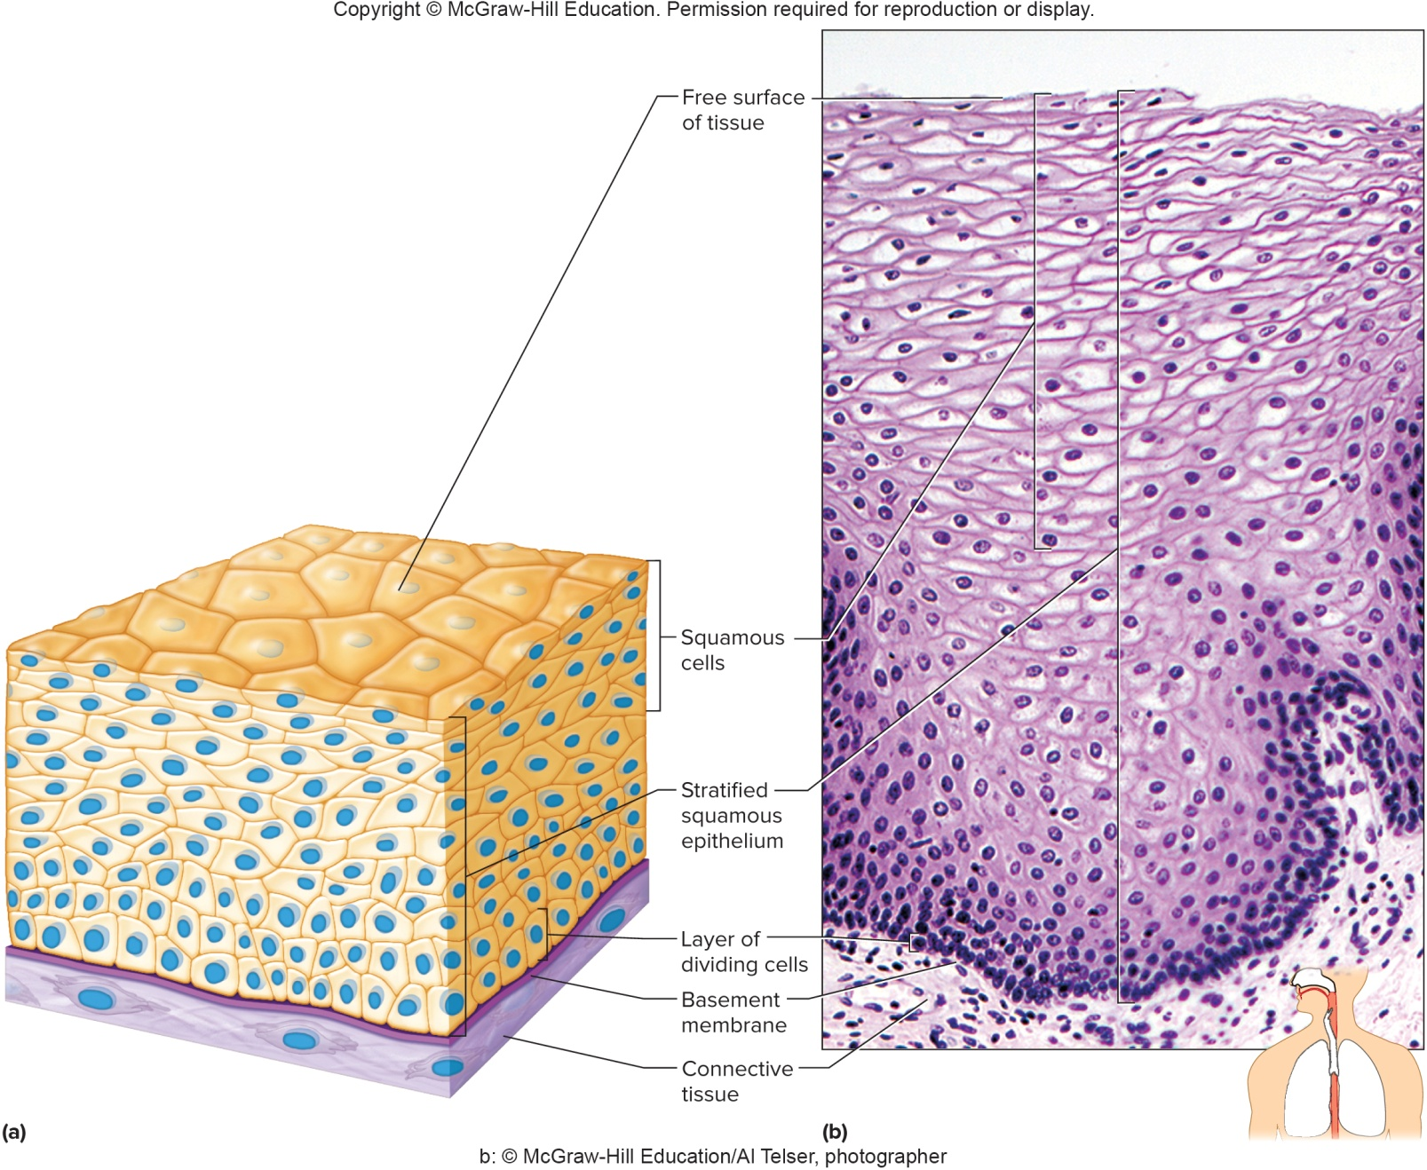
Stratified Squamous Epithelium (2)

Slide 18
Stratified Cuboidal Epithelium
Stratified cuboidal epithelium:
Consists of 2 - 3 layers of cuboidal cells
This tissue is found lining a lumen
Several layers of cells provide greater protection than one single layer
Lines ducts of the mammary glands, sweat glands, salivary glands, pancreas, ovarian follicles, and seminiferous tubules

Slide 19
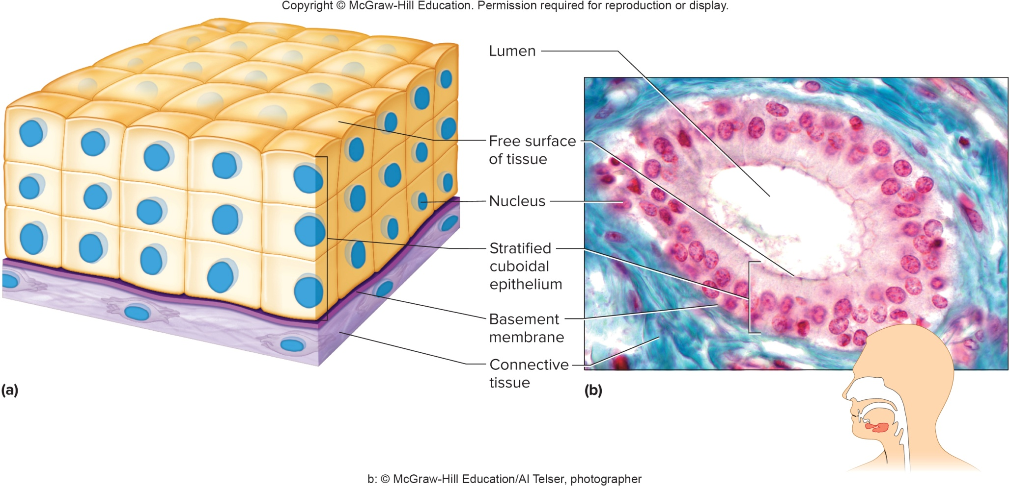
Stratified Cuboidal Epithelium (2)

Slide 20
Stratified Columnar Epithelium
Stratified columnar epithelium:
Consists of several layers of cells
Columnar cells on the surface, and cuboidal cells are found in the basal layers
This type of tissue is rare
Found in the male urethra and linings of large gland ducts

Slide 21
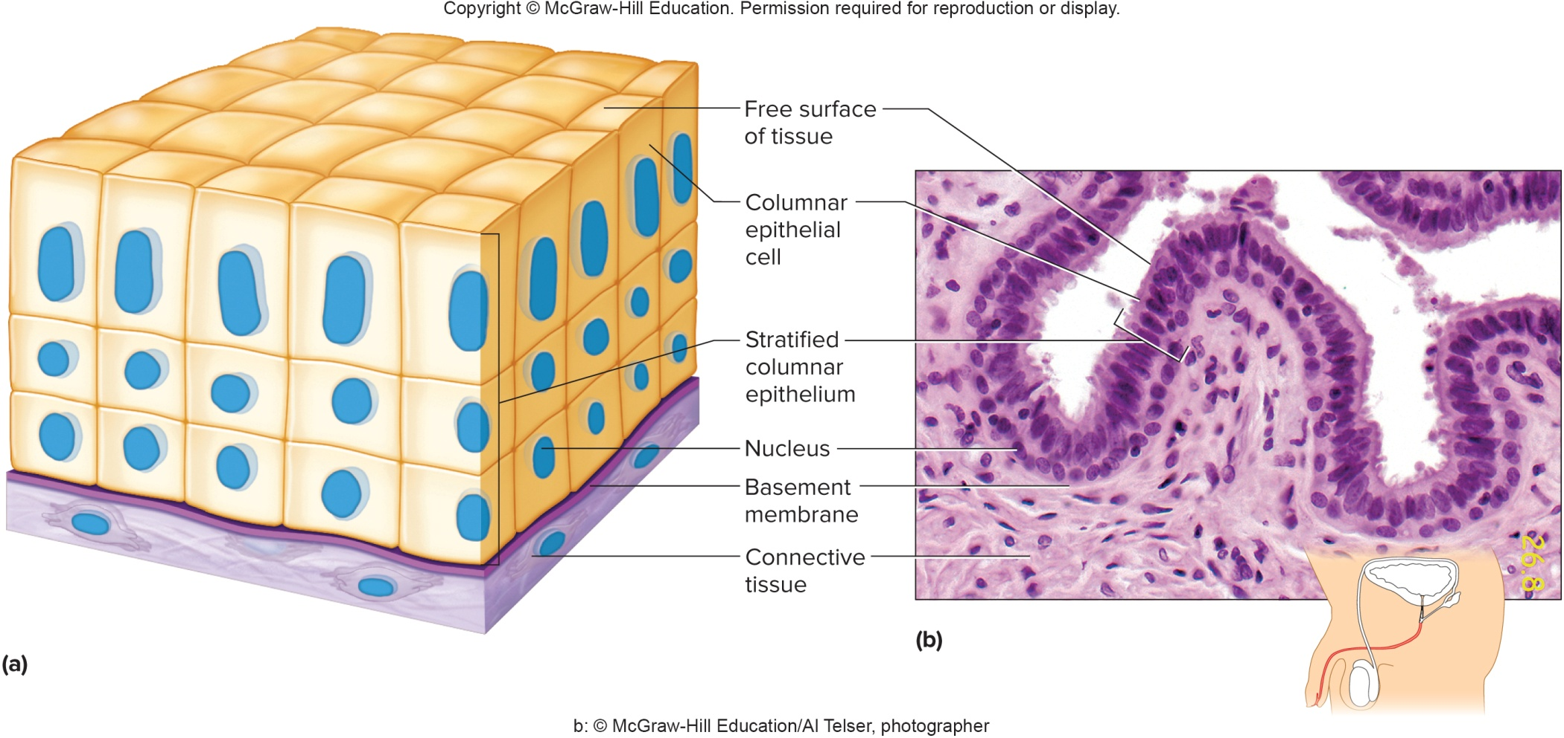
Stratified Columnar Epithelium (2)

Slide 22
Transitional Epithelium
Transitional epithelium:
Designed to distend (stretch) and return to its normal size, in response to changing tension
Found in the lining of the urinary bladder, urethra, and ureters
Upon contraction of a wall of one of these organs, the tissue is composed of several layers of cells of irregular shape
Upon distension, the cells become elongated
Functions as an expandable lining, and prevents urine from diffusing back into the internal environment

Slide 23
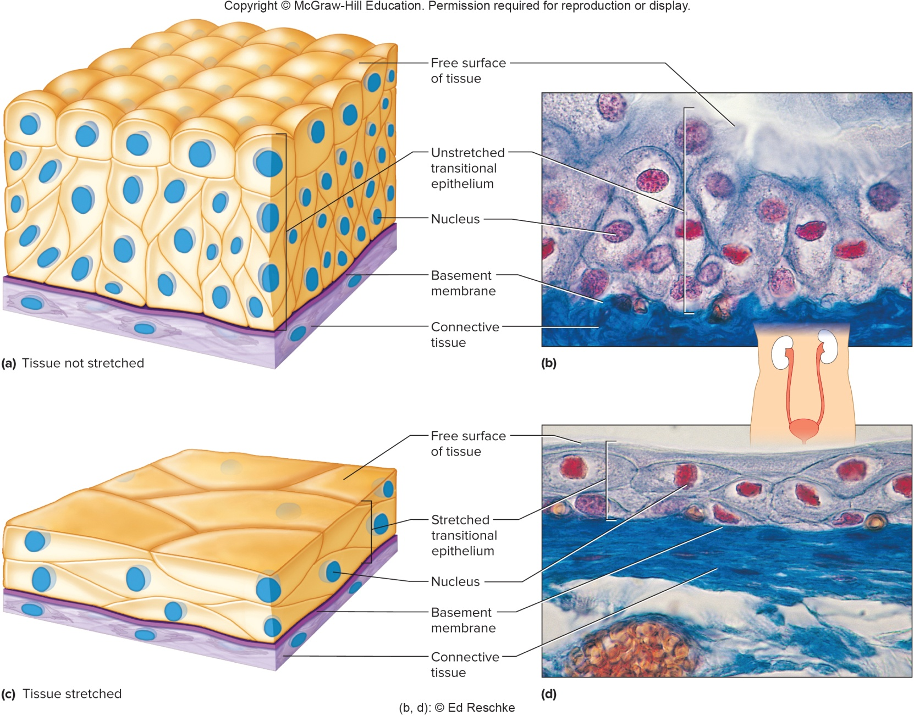
Transitional Epithelium (2)

Slide 24
Glandular Epithelium
Glandular epithelium:
Made up of cuboidal or columnar cells designed to produce and secrete substances into ducts or into body fluids
Glands that secrete products into ducts that open to a body surface are exocrine glands
Glands that secrete into body fluids or blood are endocrine glands

Slide 25
Classification of Exocrine Glands
Exocrine glands are classified by the ways the glands secrete their products:
Merocrine glands are the most common type; they release fluid products by exocytosis:
  Some are serous; they produce a watery fluid, sometimes with high enzyme concentration
  Others are mucous; they produce a thicker, protective substance (mucus)
  Examples are the pancreas, salivary glands, and sweat glands
Apocrine glands pinch off a portion of their cell bodies during secretion; mammary glands
Holocrine glands release entire cells that disintegrate to release their secretions; sebaceous (oil) glands

Slide 26
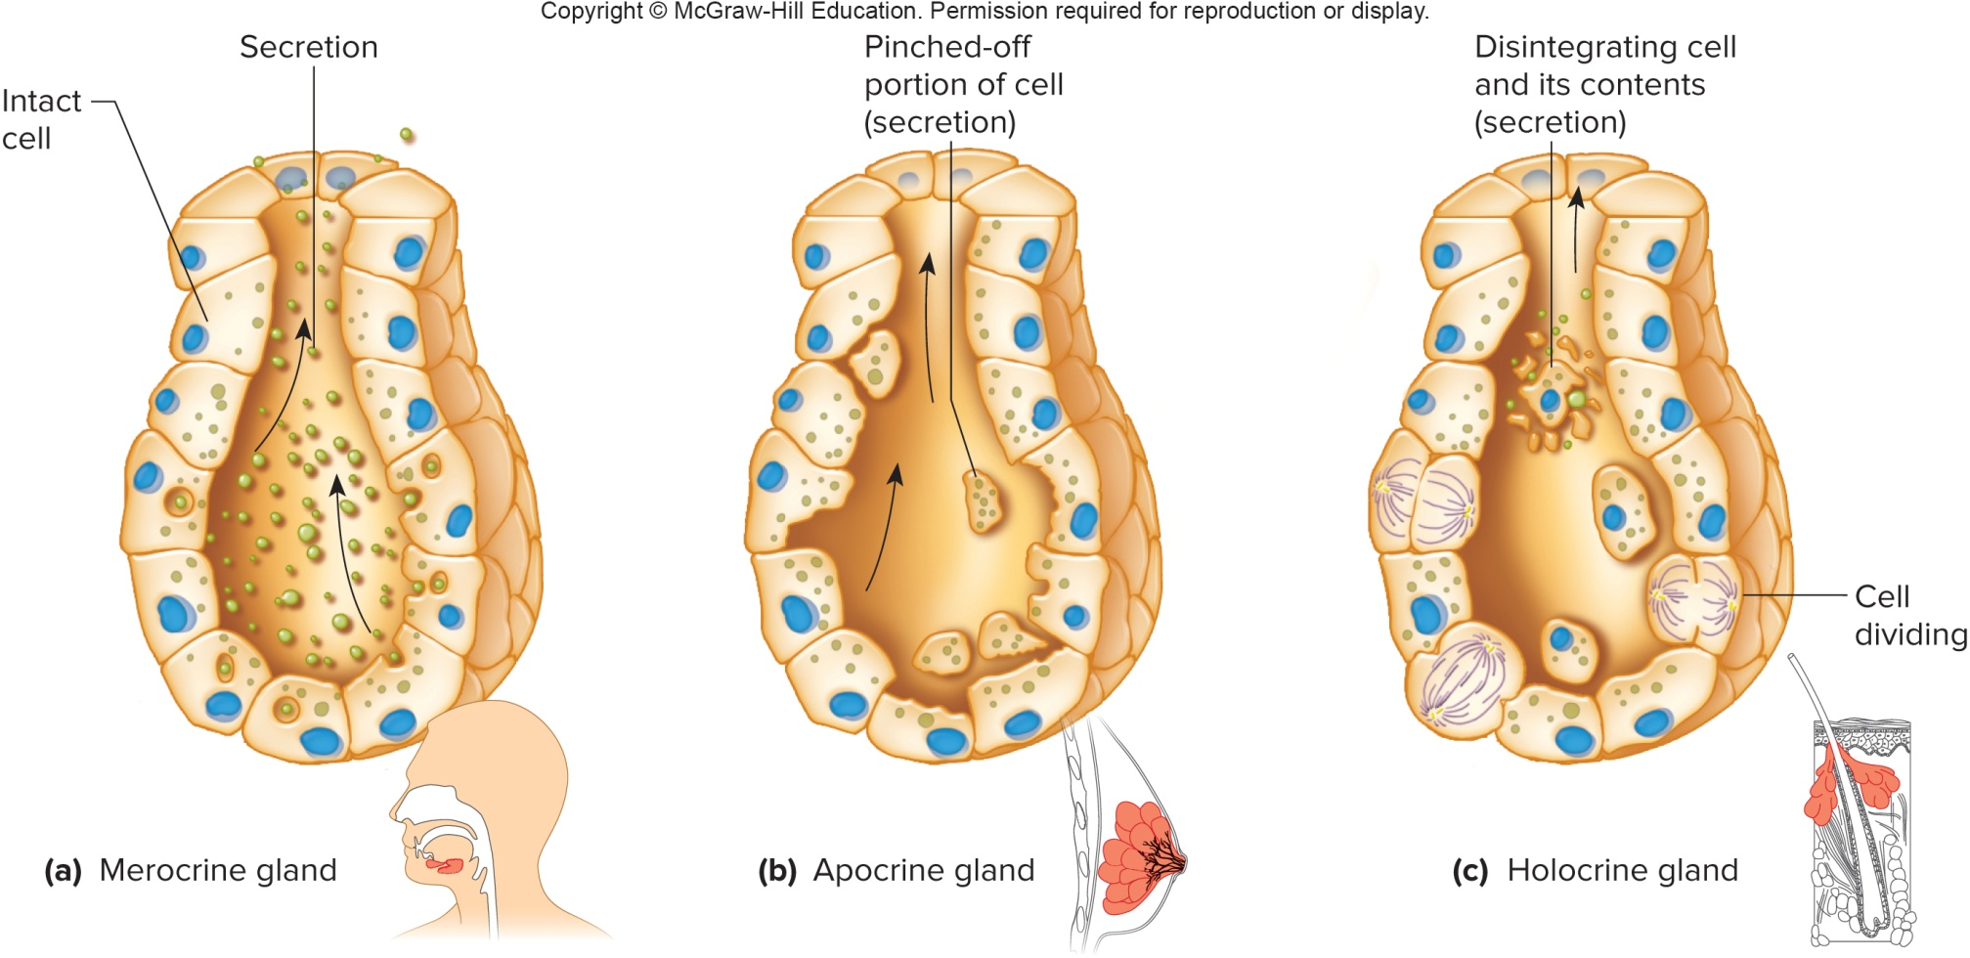
Classification of Exocrine Glands (2)

Slide 27
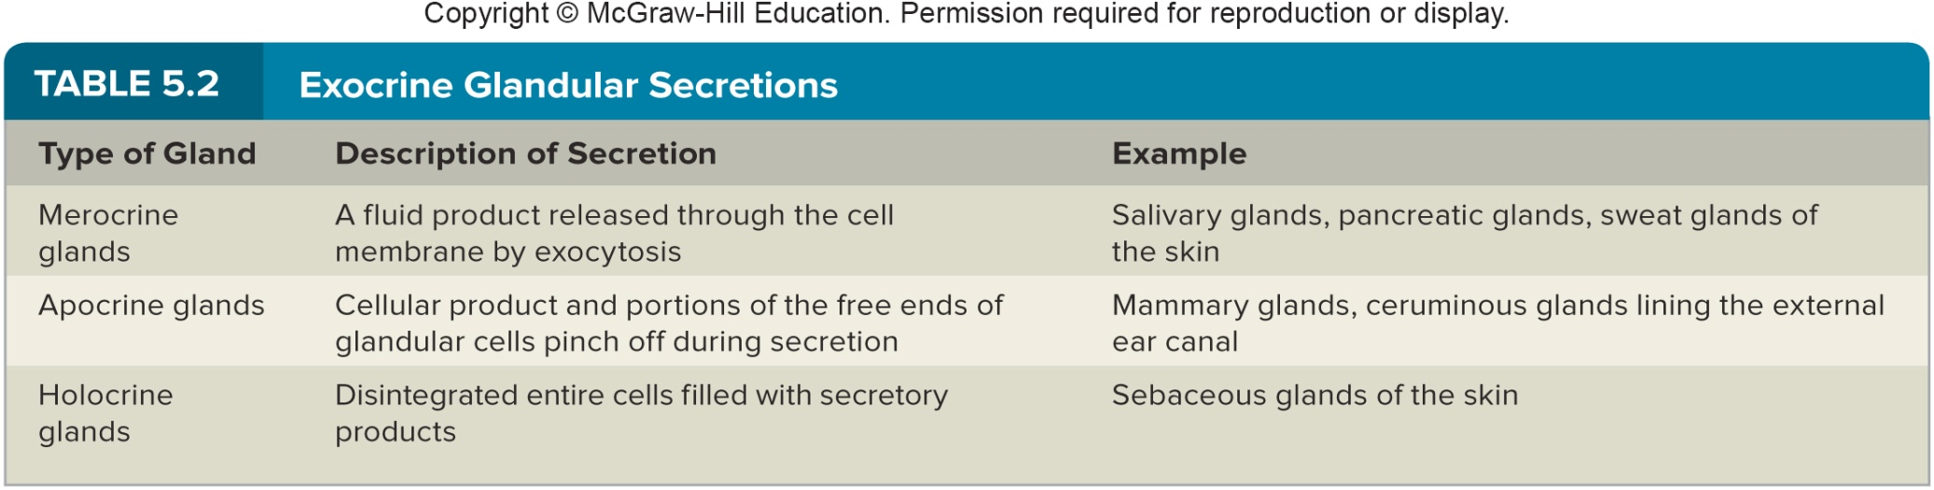
Exocrine Gland Secretions

Slide 28
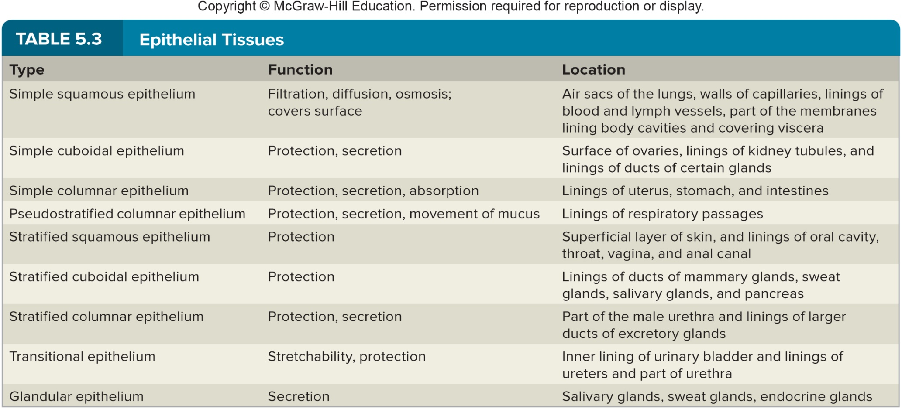
Summary: Epithelial Tissues

Slide 29
5.3: Connective Tissues
General characteristics of connective tissues:
Connective tissues bind, support, protect, serve as frameworks, fill spaces, store fat, produce blood cells, protect against infection, and help repair tissue damage
Unlike epithelial tissues, connective tissue cells are far apart from each other
Connective tissues have an abundance of extracellular matrix, or intercellular material, composed of protein fibers and ground substance
Consistency varies from liquid to rigid, depending on the ground substance
Most connective tissues can divide
Most have a good blood supply (except cartilage)

Slide 30
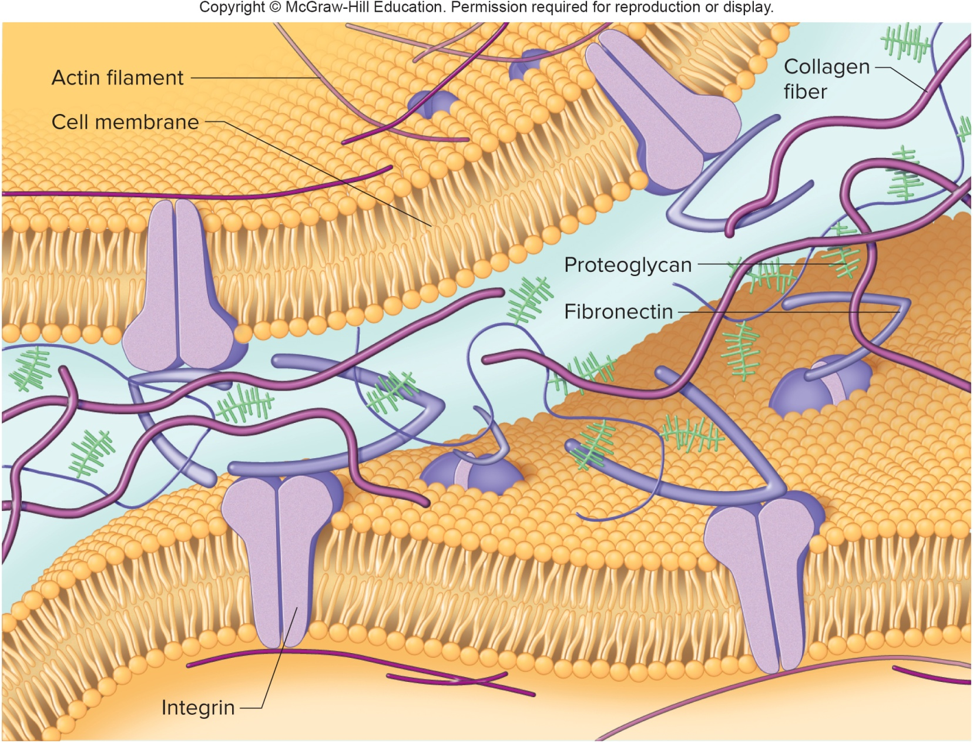
The Extracellular Matrix of Connective Tissue

Slide 31
Major Cell Types of Connective Tissue
Categories of connective tissue cells:
Fixed: stay in a tissue for a long time
Wandering: can move through tissues in response to infection or injury; stay in a tissue temporarily
Fibroblast: most common fixed cell type; a large, star-shaped cell that secretes fibers
Wandering macrophages (histiocytes): function as phagocytes; defend against infection and foreign particles
Mast cells: large, fixed cells, located near blood vessels; release heparin (anticoagulant) and histamine (promotes inflammation)

Slide 32
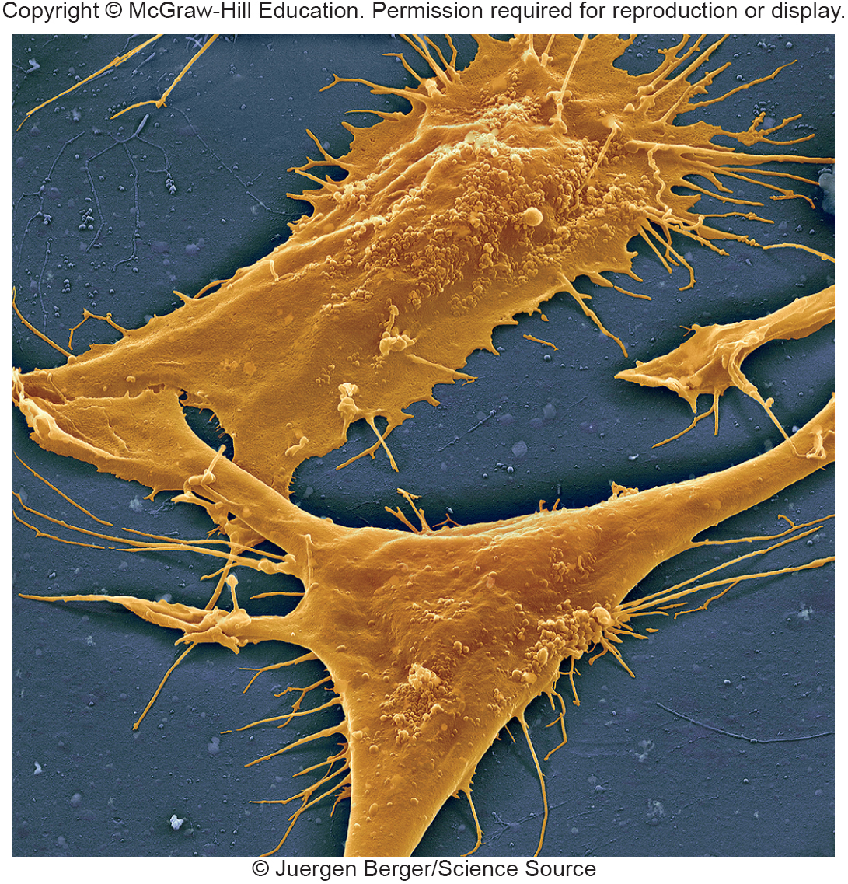
Fibroblasts

Slide 33
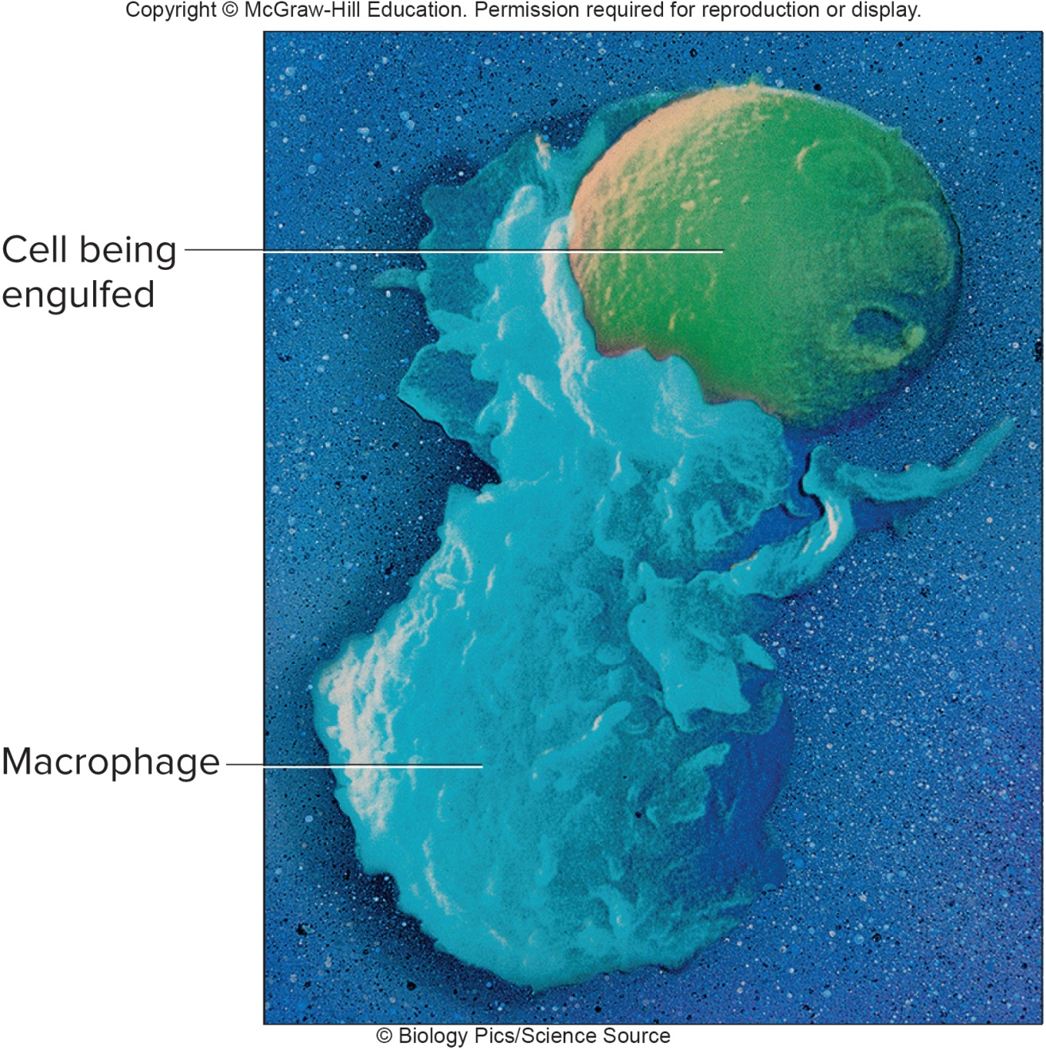
Macrophage Engulfing a Bacterium

Slide 34
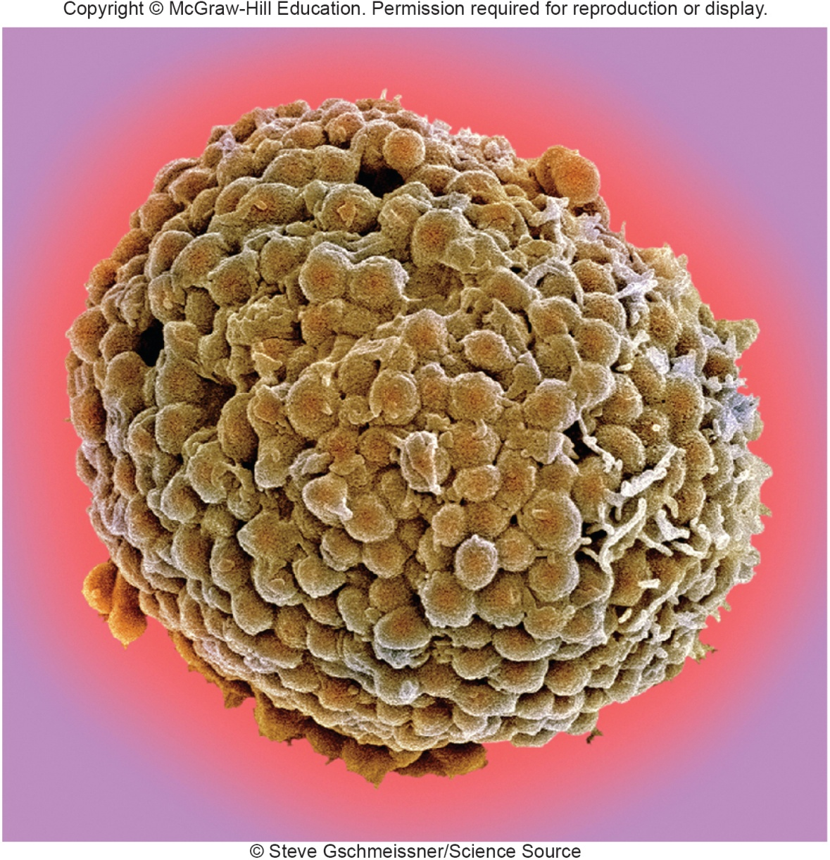
A Mast Cell

Slide 35
Connective Tissue Fibers
Fibroblasts produce the 3 types of fibers found in connective tissues:
Collagen (white) fibers: thick threads of collagen protein; found in long, parallel bundles; high tensile strength to hold structures together, but not very elastic; examples: tendons, ligaments
Elastic (yellow) fibers: made of the protein elastin; occur in thin branching fibers arranged in a network; stretchy and add flexibility to certain types of connective tissues; example: vocal cords
Reticular fibers: thin collagen fibers that form branching, supportive networks in a variety of tissues; example: spleen

Slide 36
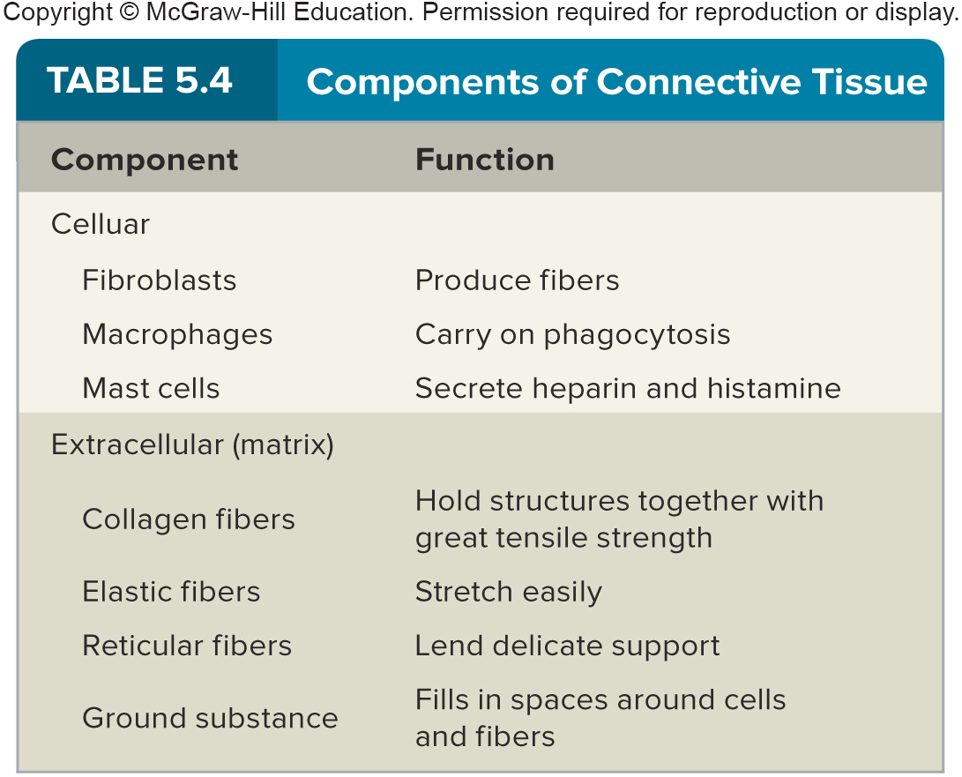
Components of Connective Tissue

Slide 37
Categories of Connective Tissue
Main categories of connective tissue:
Connective tissue proper:
Loose connective tissue
Dense connective tissue
Specialized connective tissue:
Cartilage
Bone
Blood

Slide 38
Loose Connective Tissue
Types of loose connective tissue:
Areolar tissue:
- Forms thin, delicate membranes
- Main cell type is fibroblasts;
- Matrix consists of a gel-like ground substance with collagen and reticular fibers
- Examples: binds skin to underlying tissues, under most epithelial layers, between muscles
Adipose tissue:
- Contains adipocytes, which store fat in cytoplasm
- Found under skin, between muscles, around kidneys, around abdominal membranes, behind eyeballs
- Functions: Cushions joints & organs, stores energy, insulates body

Slide 39
Loose Connective Tissue (2)
Reticular connective tissue:
- Contains thin, reticular fibers
- Fibers form a 3-dimensional network
- Forms a framework for certain internal organs (liver, spleen)

Slide 40
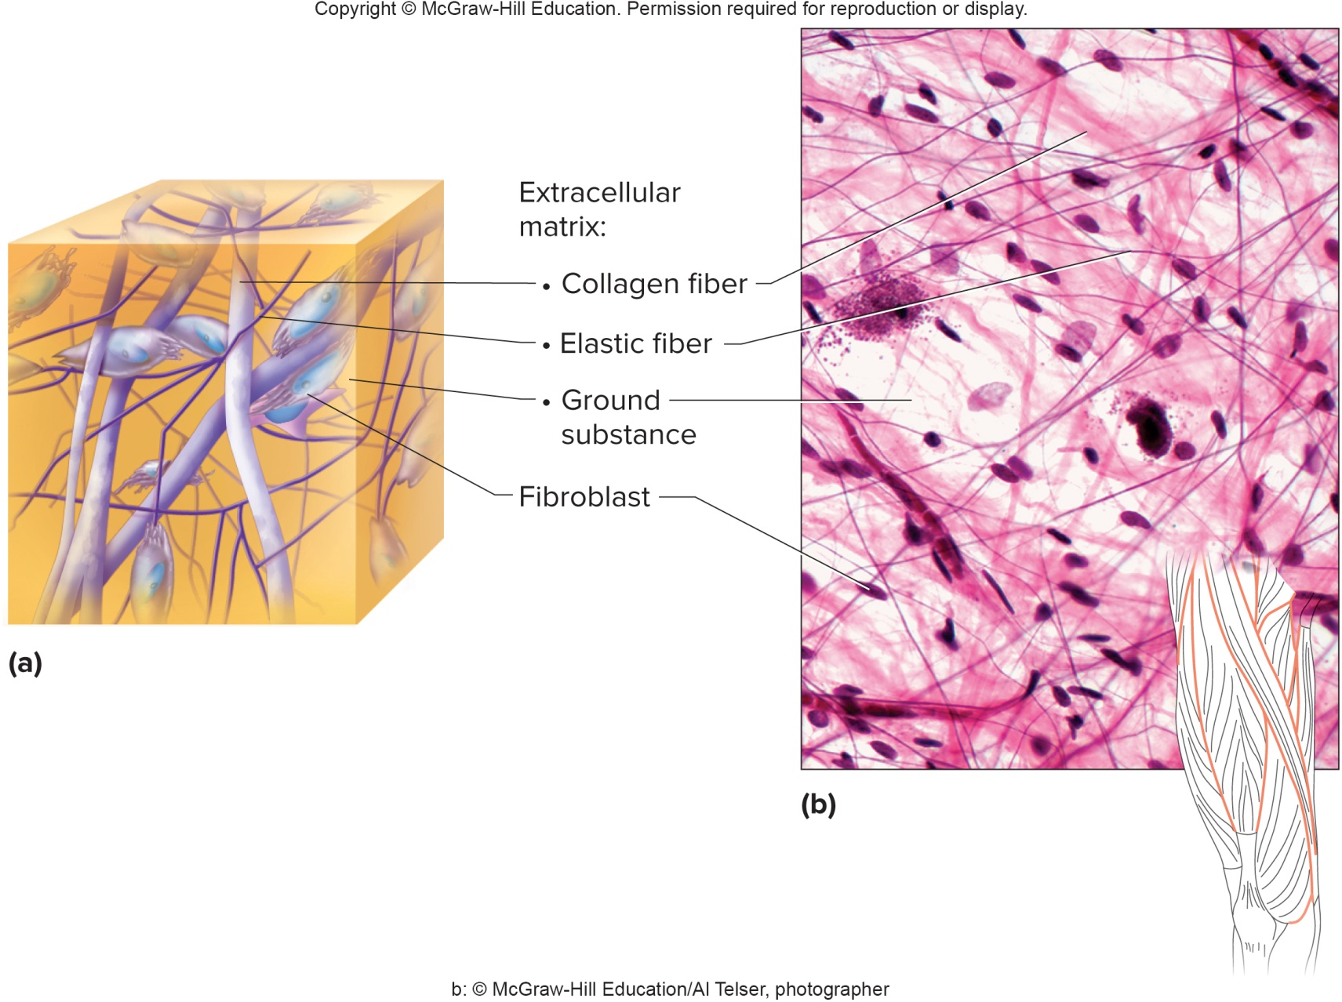
Areolar Tissue

Slide 41
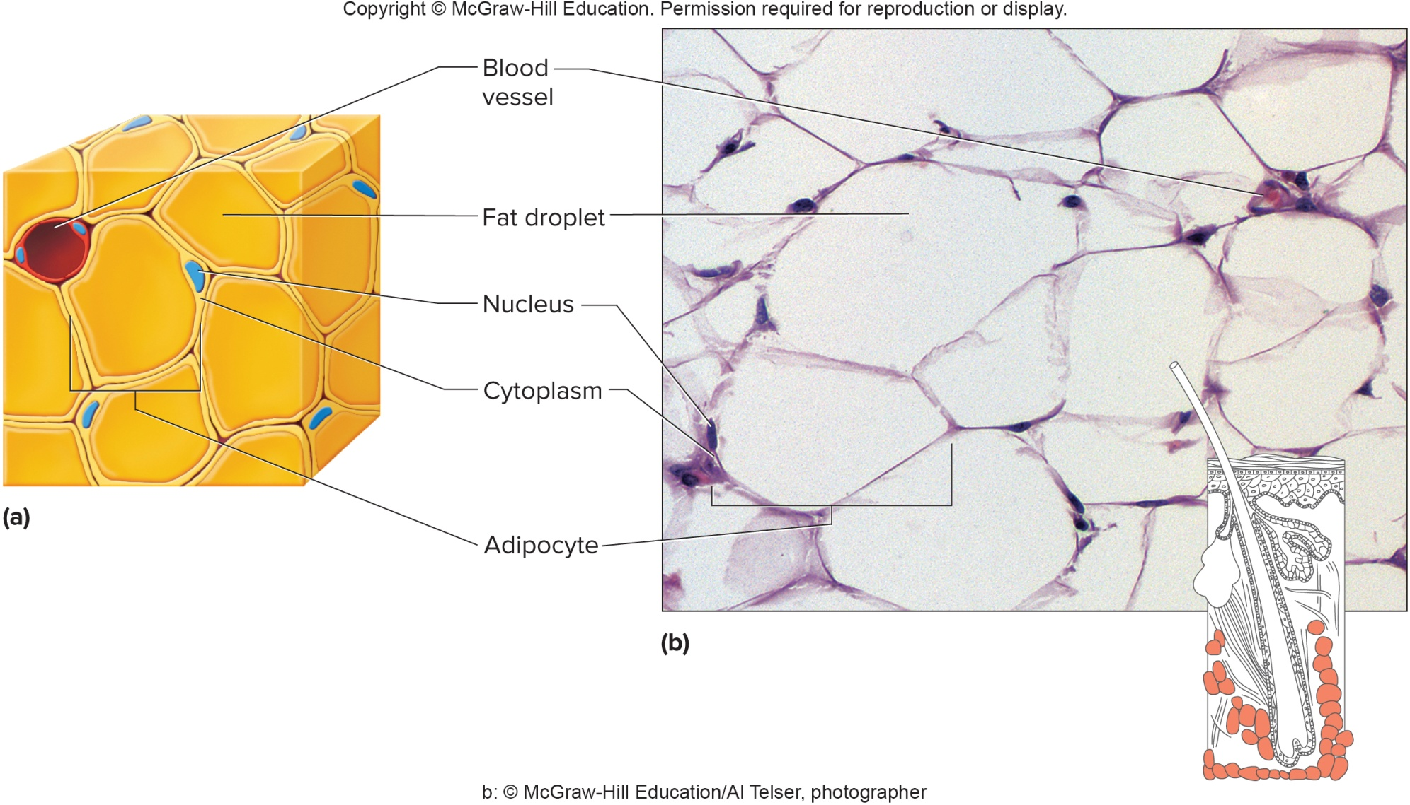
Adipose Tissue

Slide 42
Dense Connective Tissue
Dense connective tissue:
Consists of densely packed collagen fibers and a network of elastic fibers
It does not have many cells, but most are fibroblasts
Fibers are very strong, so the tissue can withstand pulling forces
Has a poor blood supply, so heals slowly
It is found in tendons, ligaments, and the white layer of the eyeball (sclera)

Slide 43
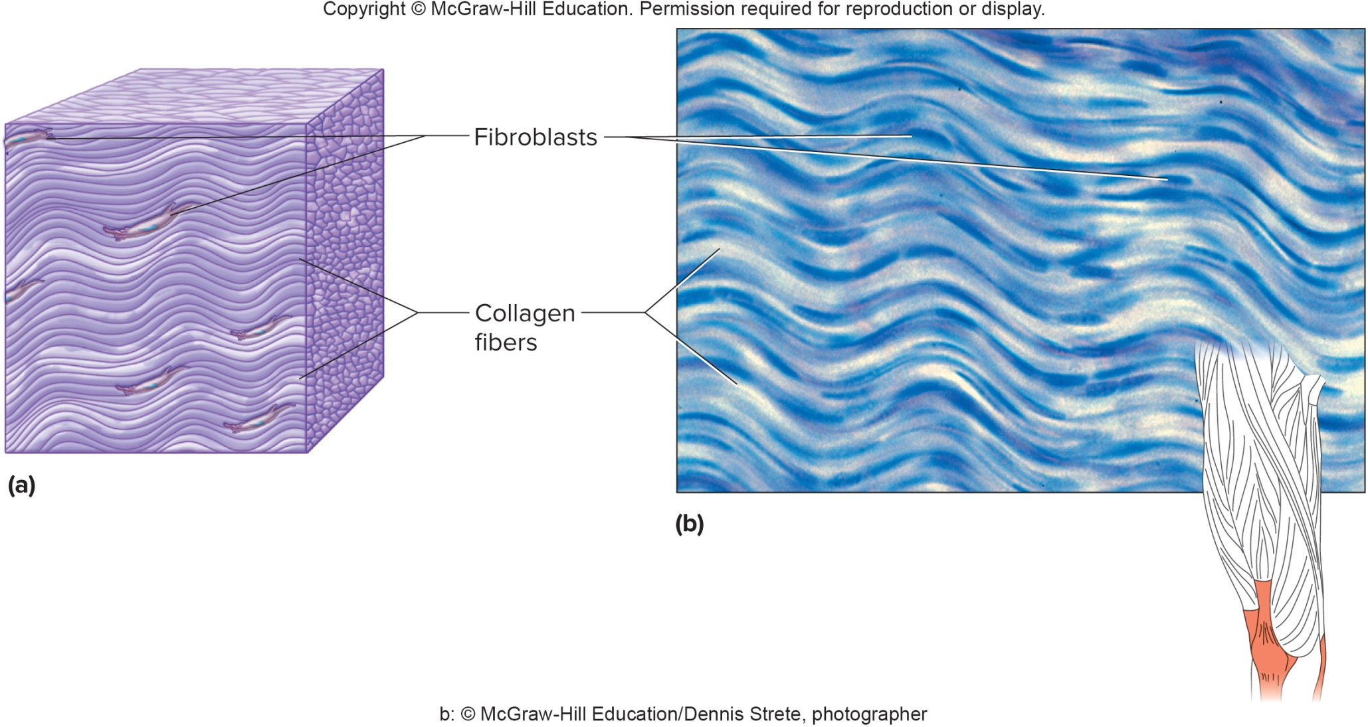
Dense Connective Tissue (2)

Slide 44
Cartilage
Cartilage is a rigid connective tissue
Provides a supportive framework for various structures, protects underlying tissues, makes models for developing bones
It lacks a vascular system and so heals slowly
Abundant matrix, with collagen fibers in a gel-like ground substance
Chondrocytes (cartilage cells) lie within lacunae (chambers) in the matrix
Cartilaginous structures are enclosed within a connective tissue covering called the perichondrium
Neither the cartilage nor the perichondrium have a good blood supply, but the cartilage cells get some nutrients from the perichondrium; however, cartilage is slow to heal
The 3 types of cartilage differ by their matrix

Slide 45
3 Types of Cartilage
  Hyaline cartilage:
  - The most common type of cartilage
  - Contains fine collagen fibers in matrix; appears glassy
  - Found on the ends of bones, supports respiratory structures and passages, also important in embryonic development of many bones and bone growth
  Elastic cartilage:
  - Contains elastic fibers in dense network
  - Provides framework for the external ears and parts of the larynx
  Fibrocartilage:
  - Tough tissue containing many collagenous fibers
  - Good shock absorber
  - Found in intervertebral discs, knees and pelvic girdle

Slide 46
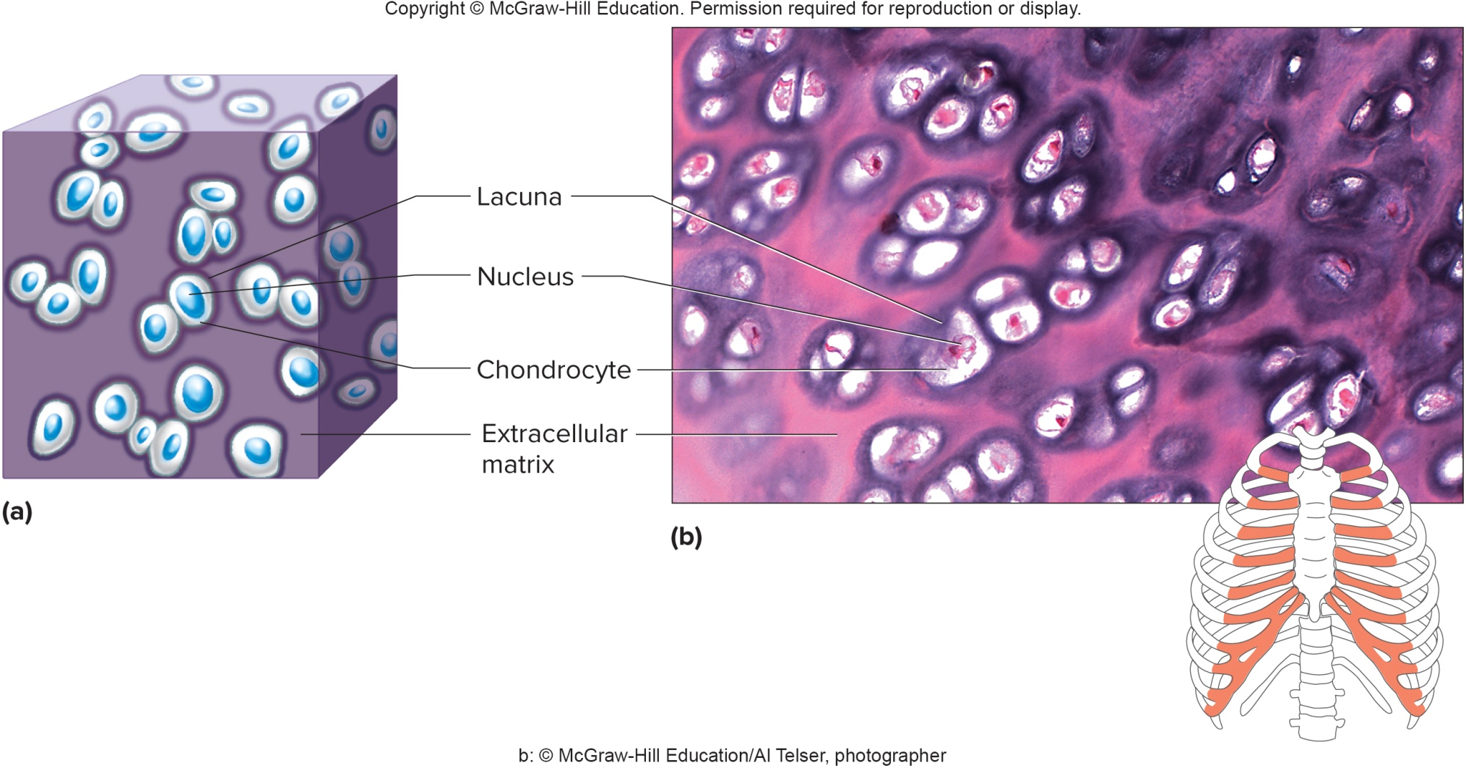
Hyaline Cartilage

Slide 47
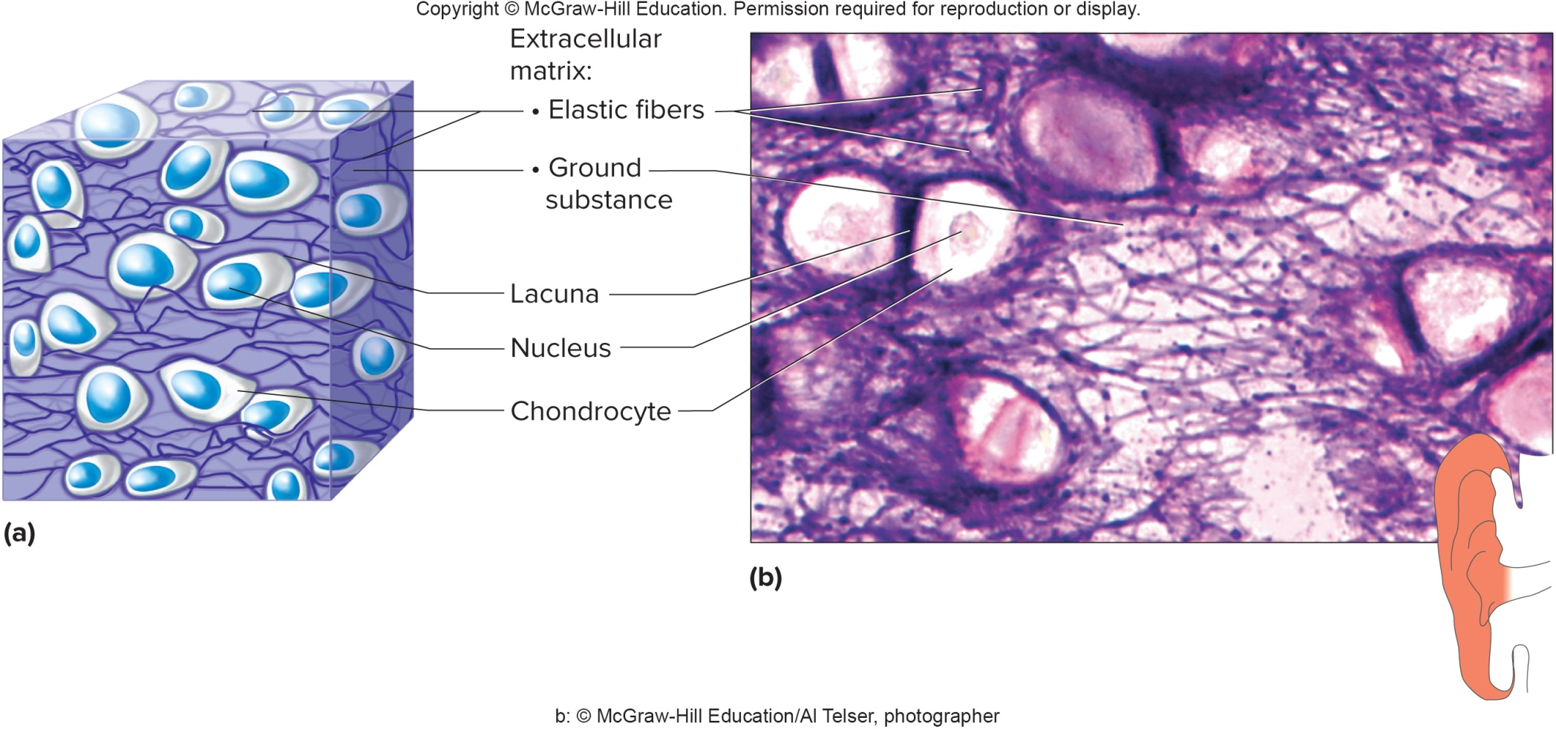
Elastic Cartilage

Slide 48
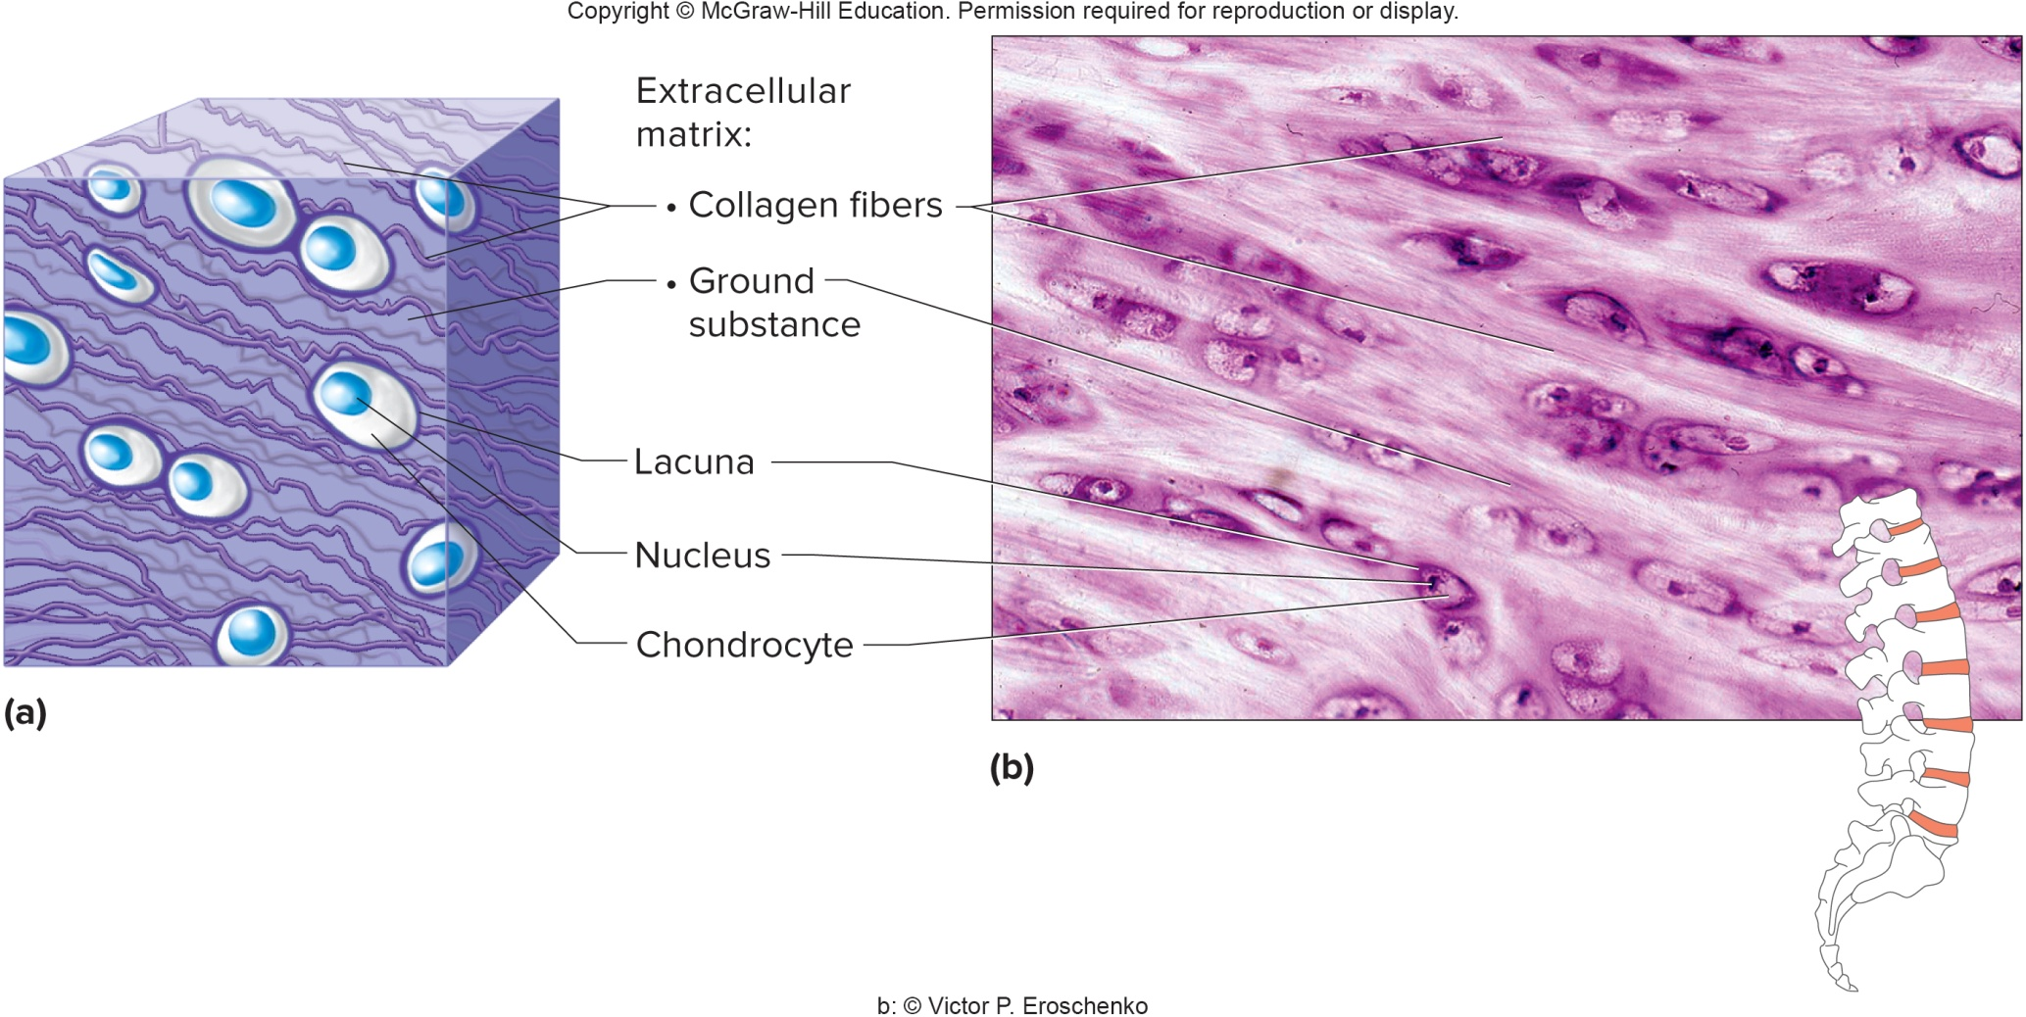
Fibrocartilage

Slide 49
Bone (Osseous Tissue)
Bone:
The most rigid connective tissue, due to presence of mineral salts (calcium salts) and collagen within the matrix
Bone supports and protects many body structures in cranial & thoracic cavities
Forms sites for muscle attachments
Site for blood cell formation (bone marrow)
Stores and releases chemicals, such as calcium and phosphorus
2 types of bone tissue: compact and spongy
In compact bone, bone cells, called osteocytes, lie within lacunae and are arranged in concentric circles (lamellae) around central or Haversian canals; cylindrical subunits are called osteons or Haversian systems
Central canals contain blood vessels, and distribute blood to the cells through tiny tubes called canaliculi
Bone has a good blood supply, enabling rapid recovery after an injury

Slide 50
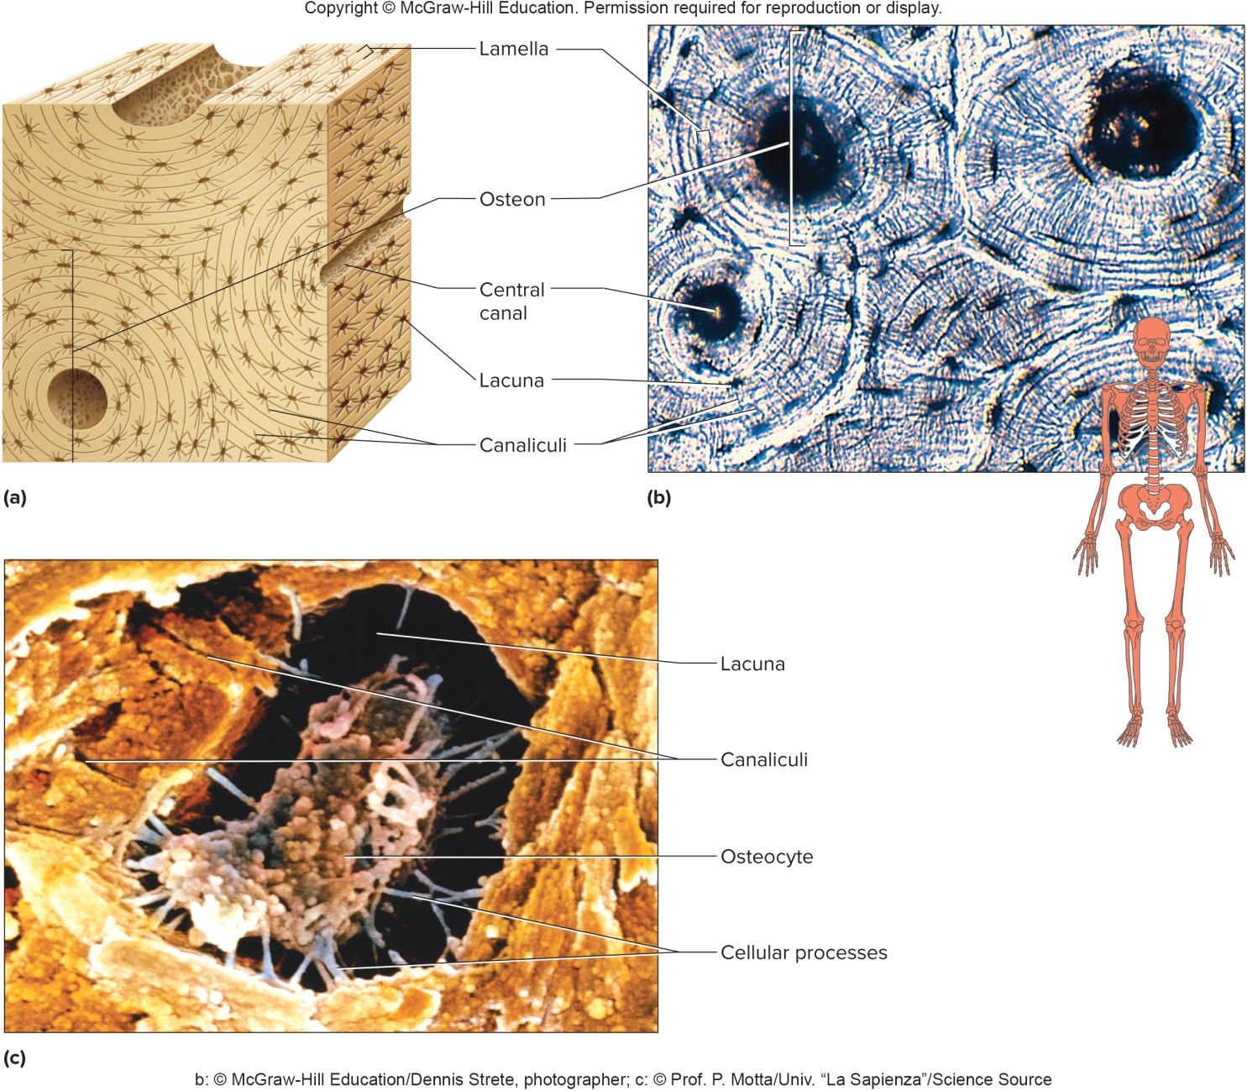
Bone Tissue, Osteons, and Osteocytes

Slide 51
Blood
Blood functions to transport substances throughout the body
Transports substances between interior cells and cells that exchange nutrients, gases, and wastes with the environment
Blood is composed of formed elements suspended in a liquid matrix called plasma.
The formed elements include red blood cells to carry oxygen, white blood cells for protection against infection, and platelets for blood clotting
Most blood cells are produced by the red bone marrow within certain long bones

Slide 52
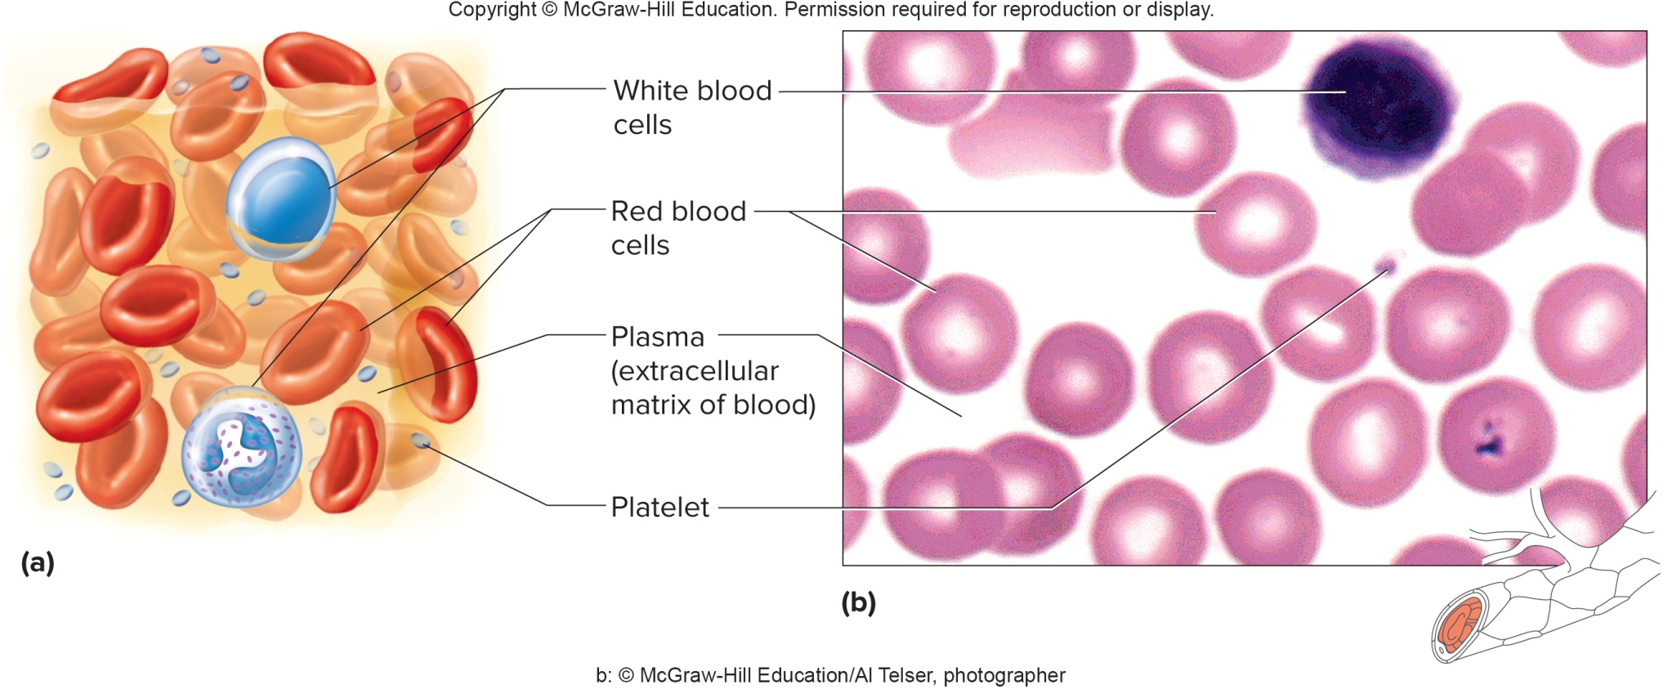
Blood (2)

Slide 53
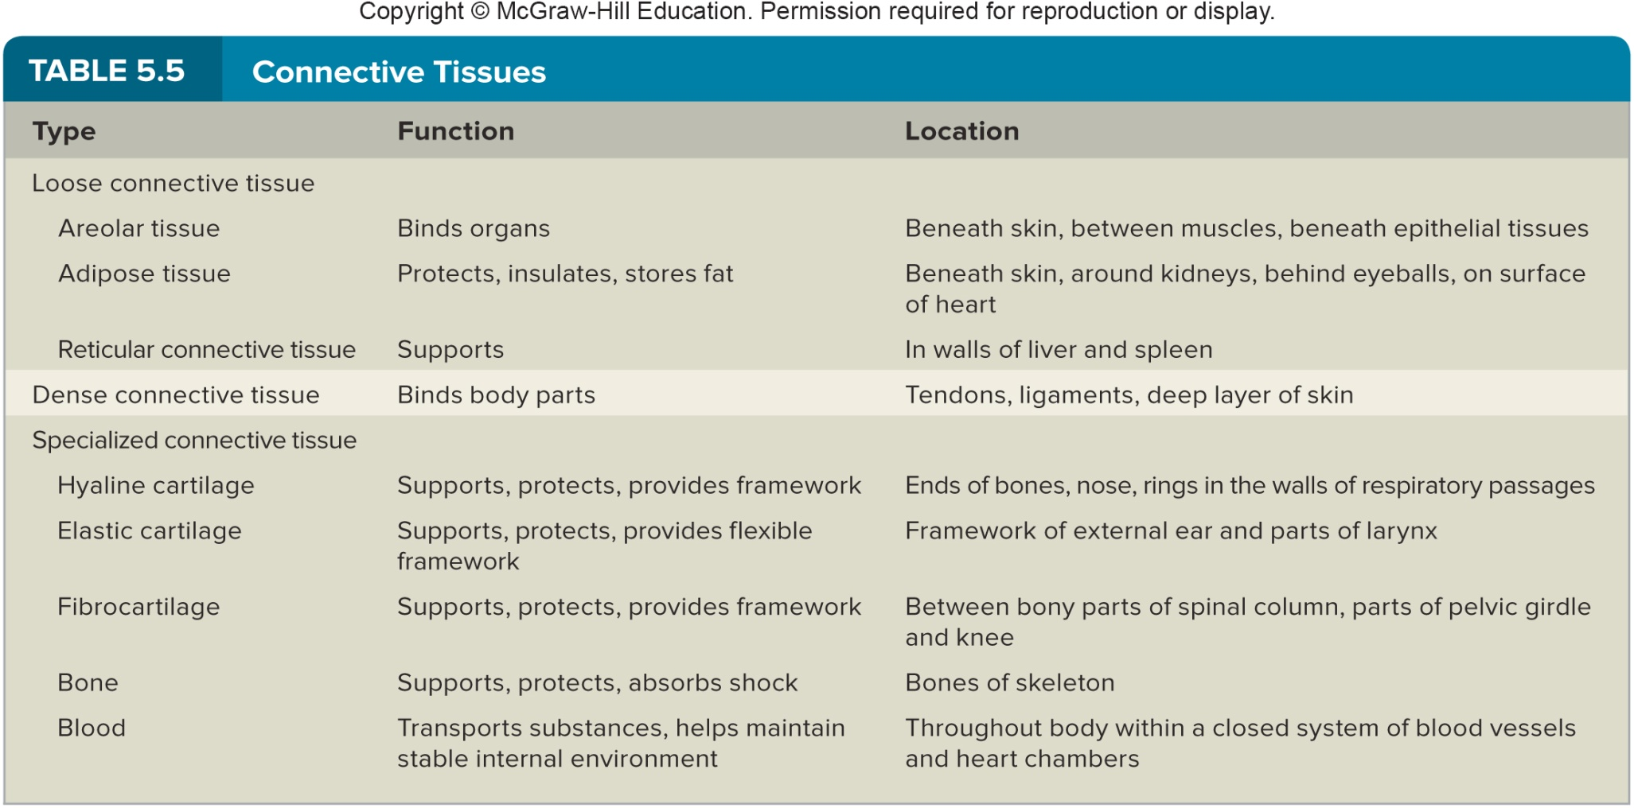
Summary: Connective Tissues

Slide 54
5.4: Types of Membranes
There are 4 types of membranes in the body: 3 types of epithelial membranes and 1 type of connective tissue membrane
Epithelial membranes are thin, sheet-like structures composed of epithelium and connective tissues, covering body surfaces and lining body cavities; there are 3 types:
- Serous membranes
- Mucous membranes
- Cutaneous membrane
Synovial membrane:
- Lines joints and is composed entirely of connective tissue

Slide 55
Types of Epithelial Membranes
Serous membranes:
Line body cavities that do not open to the outside (thoracic and abdominal cavities)
Consist of simple squamous epithelium and a layer of areolar connective tissue
Examples: pleura, pericardium, and peritoneum
Double-layered membranes:
  The parietal portion lines the cavity wall
  The visceral portion covers the organs
  There is a small amount of lubricating serous fluid between the 2 layers

Slide 56
Types of Epithelial Membranes (2)
Mucous membranes:
Line cavities and tubes that open to the outside of body
Include the oral and nasal cavities, and tubular organs of the digestive, respiratory, urinary, and reproductive systems
Consist of some type of epithelium and a layer of areolar connective tissue
Contain goblet cells that produce mucus
Cutaneous membrane:
The skin
A dry membrane that is keratinized for protection and water-proofing

Slide 57
5.5: Muscle Tissues
General characteristics of muscle tissues:
Muscle cells, or fibers, have the ability to contract and shorten to provide movement
3 types of muscle tissue: skeletal, smooth and cardiac
40% of body weight is skeletal muscle, and 10% is smooth and cardiac muscle

Slide 58
Skeletal Muscle Tissue
Skeletal muscle tissue:
Makes up muscles that attach to bones
Voluntary: it can be controlled by conscious effort
The cells (muscle fibers) are long and cylindrical, striated (have a striped appearance), have many nuclei
Skeletal muscle cells contract only when stimulated by nerve cells (neurons)
Skeletal muscle move head, trunk, and limbs

Slide 59
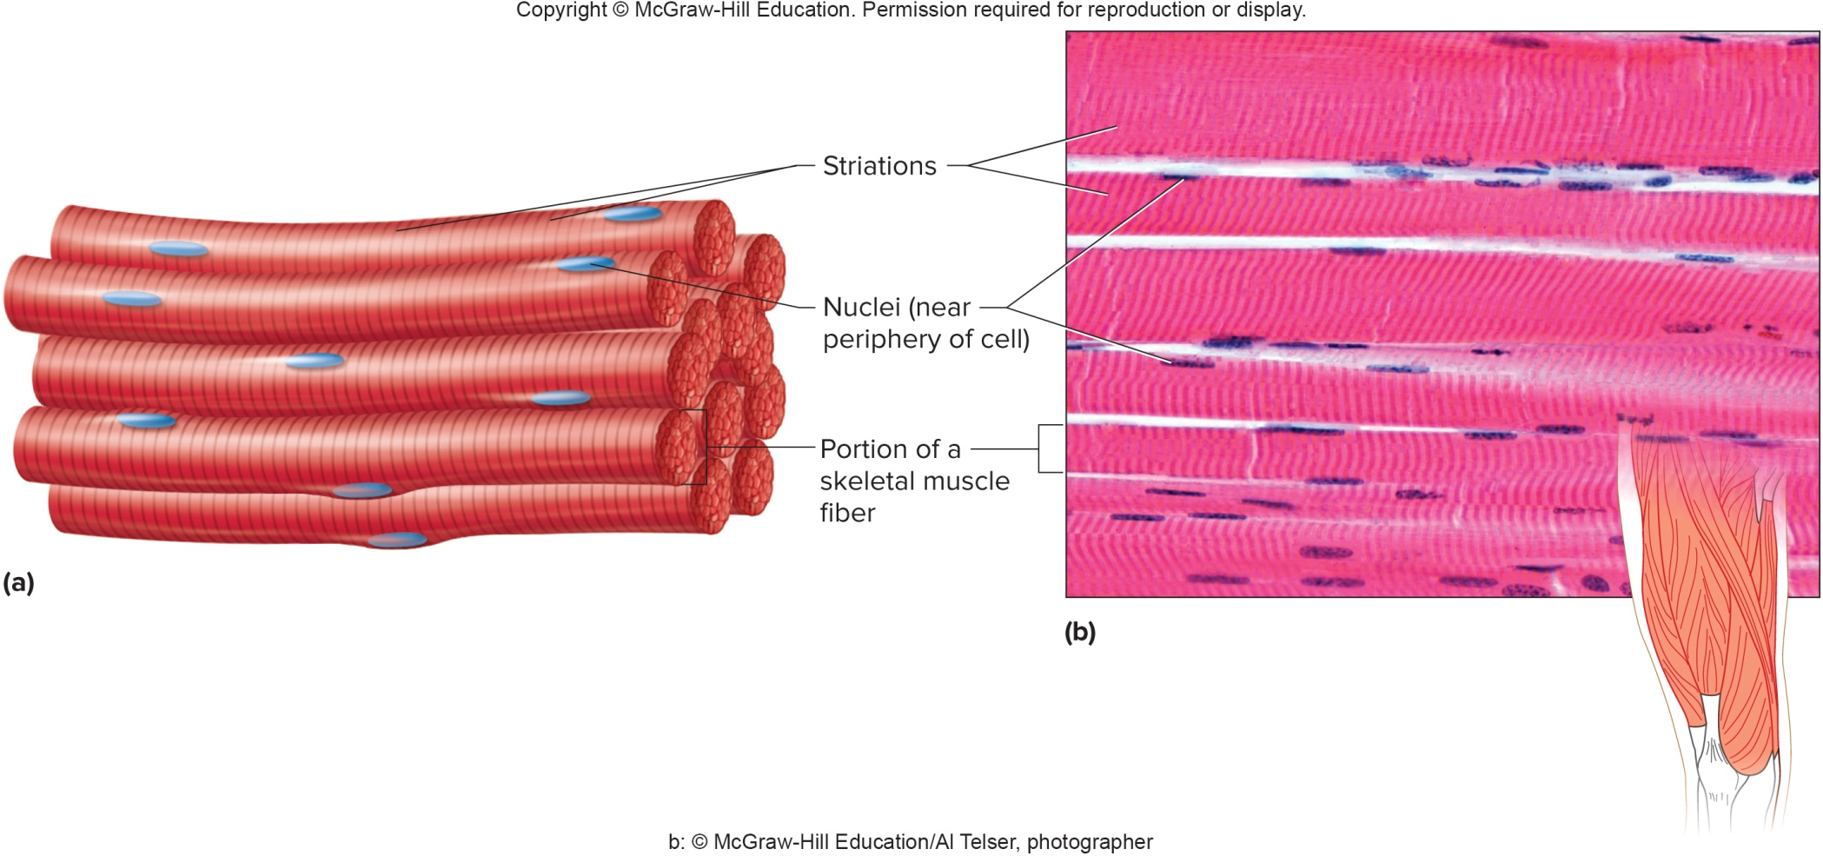
Skeletal Muscle Tissue (2)

Slide 60
Smooth Muscle Tissue
Smooth muscle tissue:
Found in the walls of hollow internal organs, such as in the digestive tract, blood vessels, and urinary bladder
Named because smooth muscle cells lack striations
Cells are spindle-shaped, with 1 central nucleus
Involuntary, since it cannot be stimulated to contract with conscious effort

Slide 61
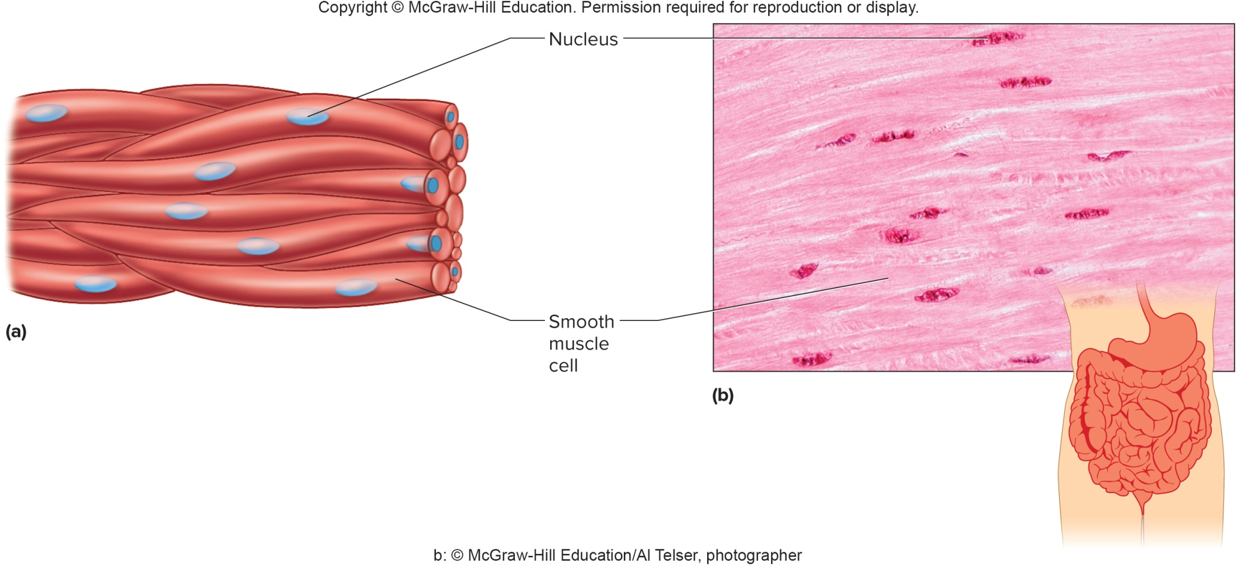
Smooth Muscle Tissue (2)

Slide 62
Cardiac Muscle Tissue
Cardiac muscle tissue:
Found only in the heart
Consists of branching cells (fibers), each with a single nucleus
Branching cells for branching networks
Cells are connected to each other with intercalated discs, special gap junctions that send impulses from cell to cell
Involuntary; cannot be controlled by conscious effort
Striated; has a striped appearance

Slide 63
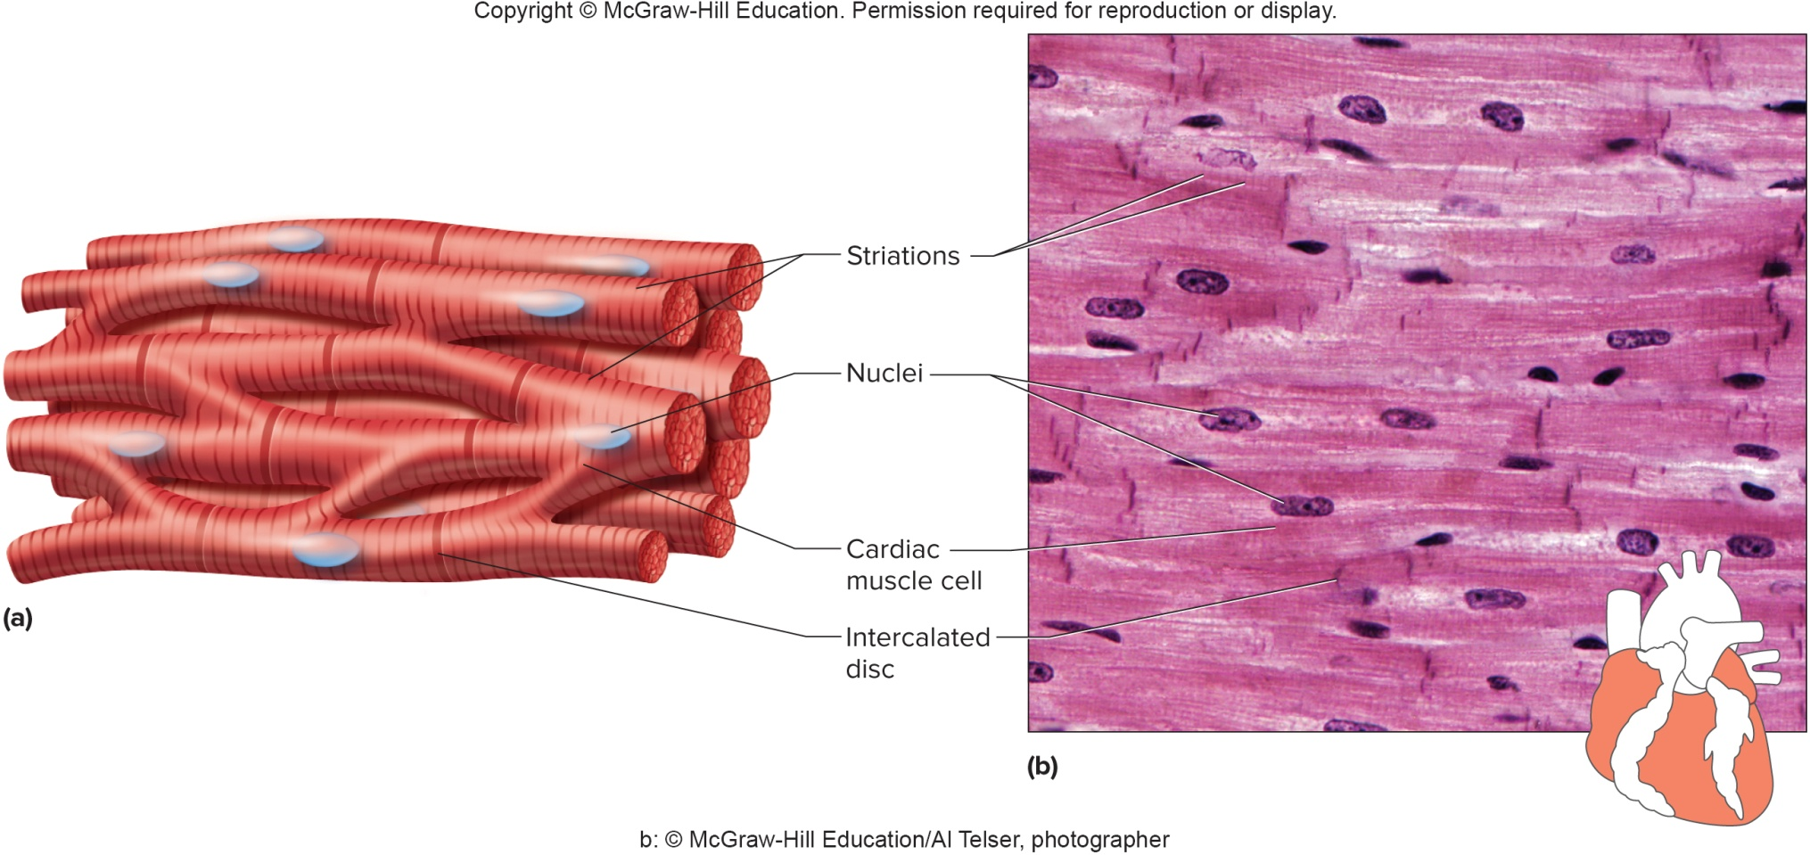
Cardiac Muscle Tissue (2)

Slide 64
5.6: Nervous Tissues
Nervous tissues:
Found in the brain, spinal cord, and peripheral nerves
Neurons, or nerve cells, respond to certain types of environmental stimuli or changes, by conducting electrical impulses to other neurons, muscles, and glands
Neurons have unique cellular processes (extensions), called dendrites and axons
Coordinate and regulate body functions
Neuroglia are cells that support, nourish, and communicate with neurons, but do not conduct impulses

Slide 65
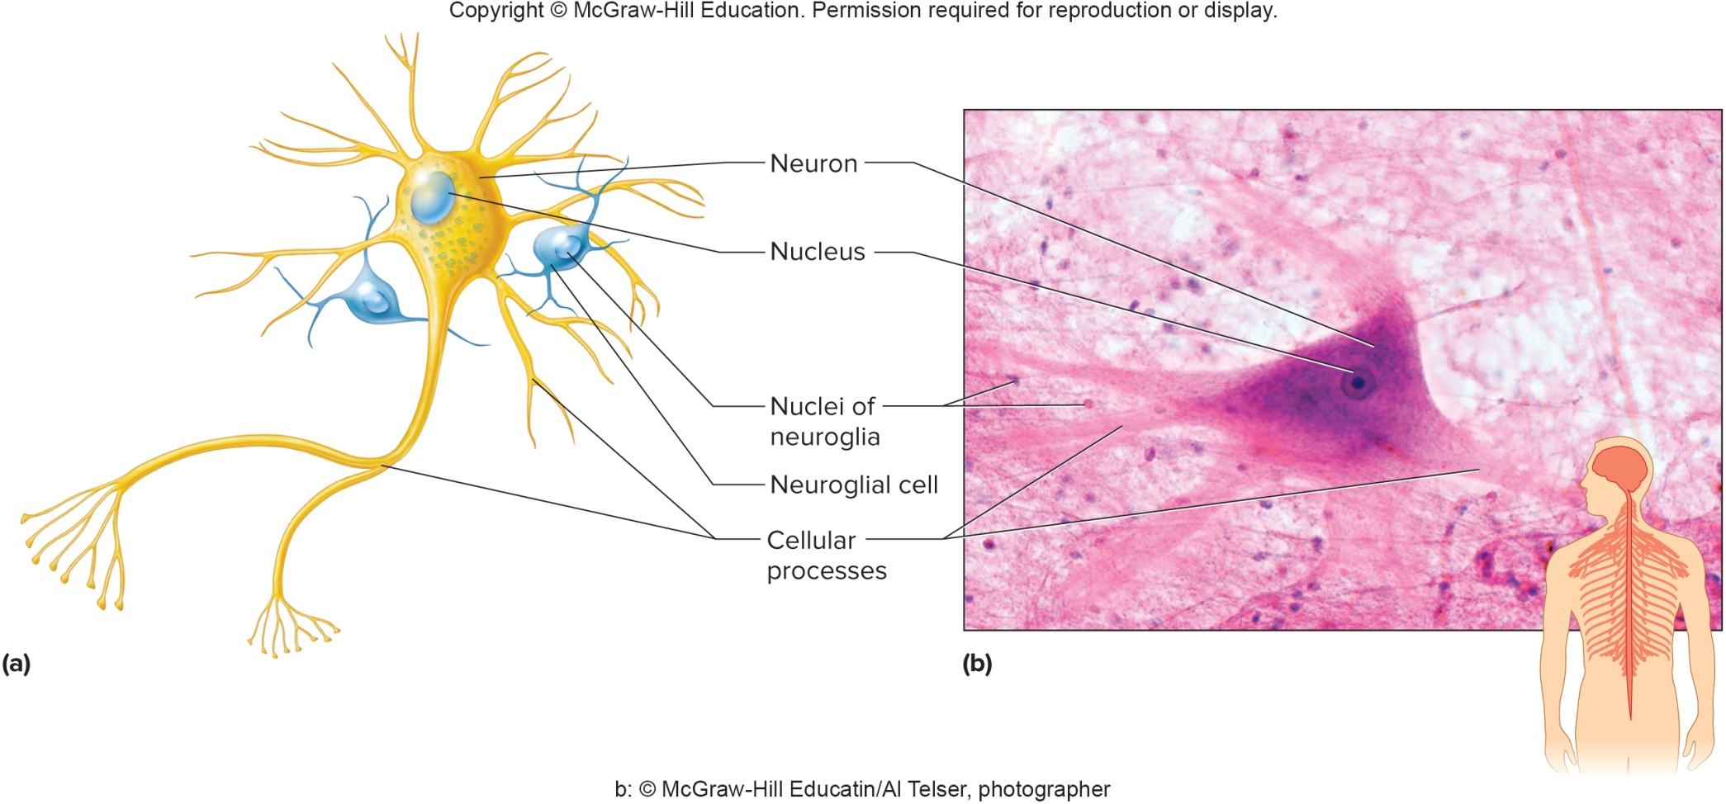
Nervous Tissues (2)

Slide 66
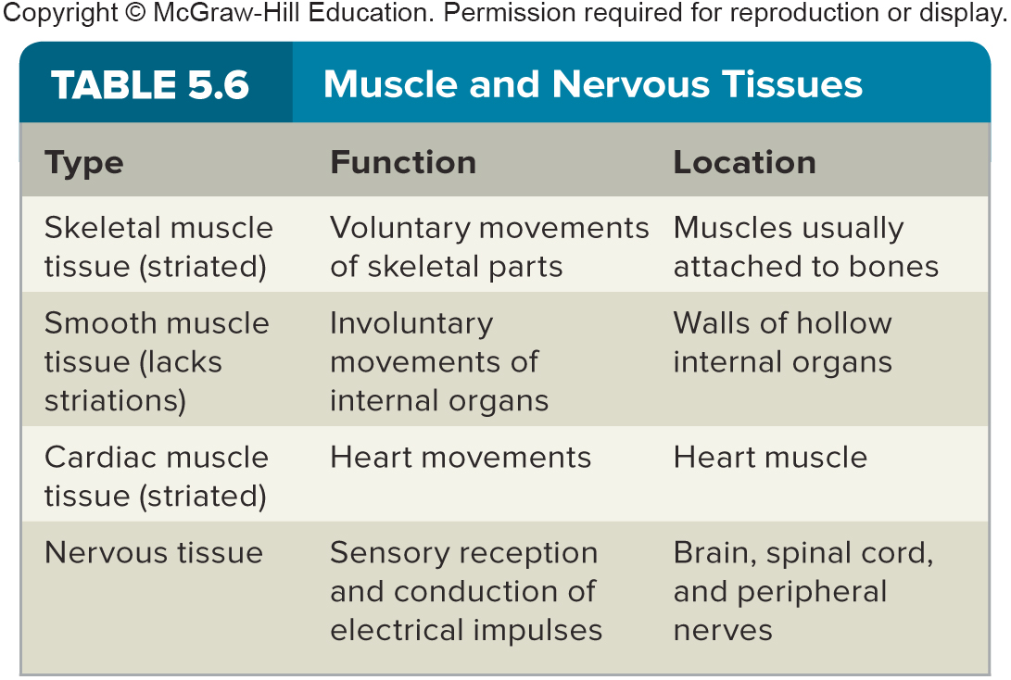
Muscle and Nervous Tissues

