Slide 1
Chapter 03
Lecture Outline
See separate PowerPoint slides for all figures and tables pre-inserted into PowerPoint without notes.

Slide 2
3.1: Introduction
A cell is the unit of life
A cell continually carries out metabolic activities essential for life, as well as specialized functions, and adapts to changing conditions
Cells interact to form tissues, organs, and organ systems
The human body consists of 30 trillion cells that vary considerably in shape and size, yet have much in common
Differences in cell shape make different functions possible
Examples: Nerve cells have long extensions that conduct
electrical impulses, while epithelial cells in the mouth are flat,
thin, and densely packed, to provide a protective barrier
Genes control a cell’s actions and responses

Slide 3
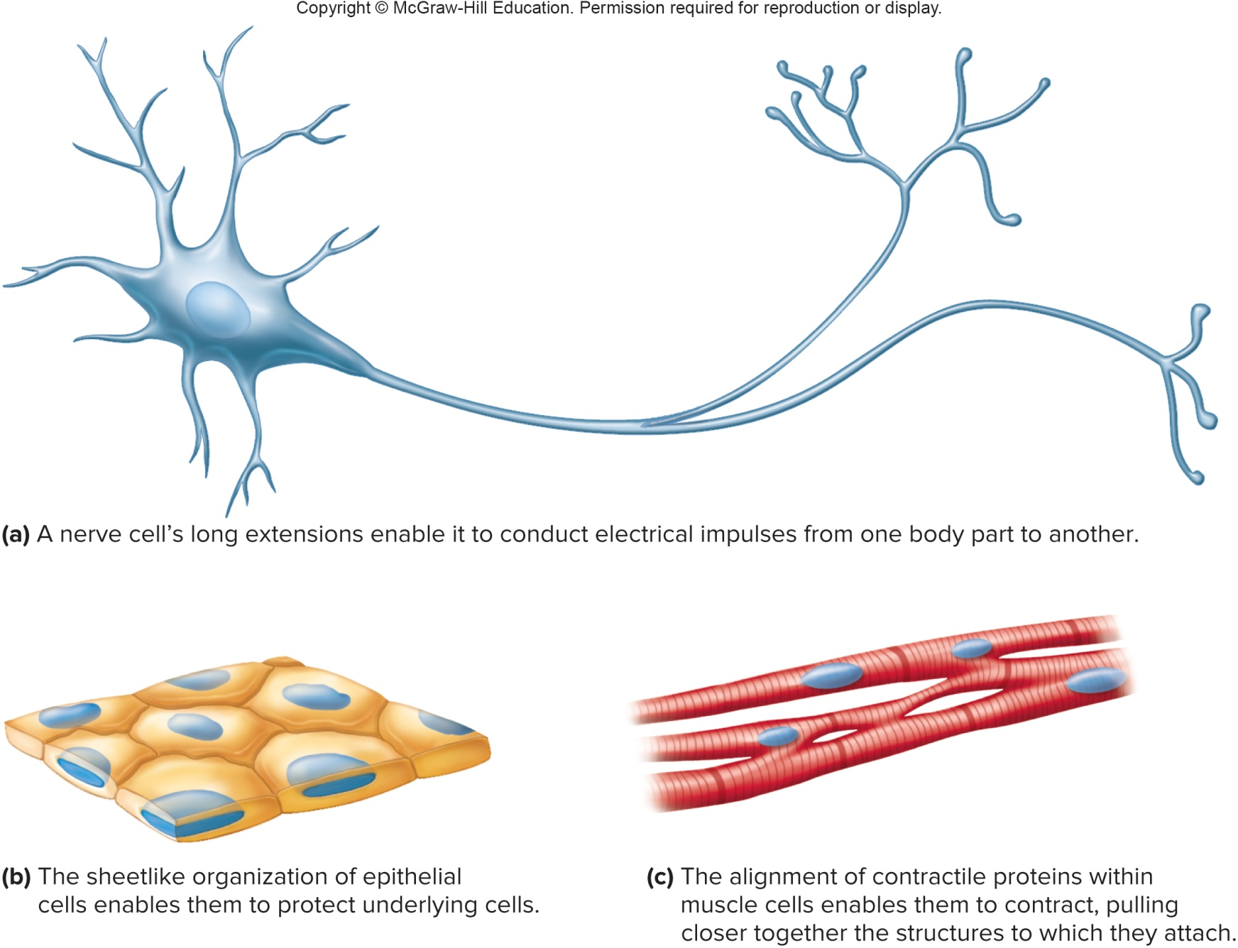
Cells Vary in Shape and Function

Slide 4
3.2: A Composite Cell
A composite cell includes many different cell structures; most cells contain most of these structures, but no cell contains all of them.
A cell consists of three main parts:
- Nucleus: Contains DNA (genetic material) and directs cell’s activities
- Cytoplasm: Organelles and fluids that make up the majority of the cell; between nucleus and cell membrane
- Cell membrane: Boundary that encloses the cell
Within the cytoplasm are specialized organelles (little organs) that perform specific functions for the cell
Organelles are suspended in a fluid called the cytosol

Slide 5
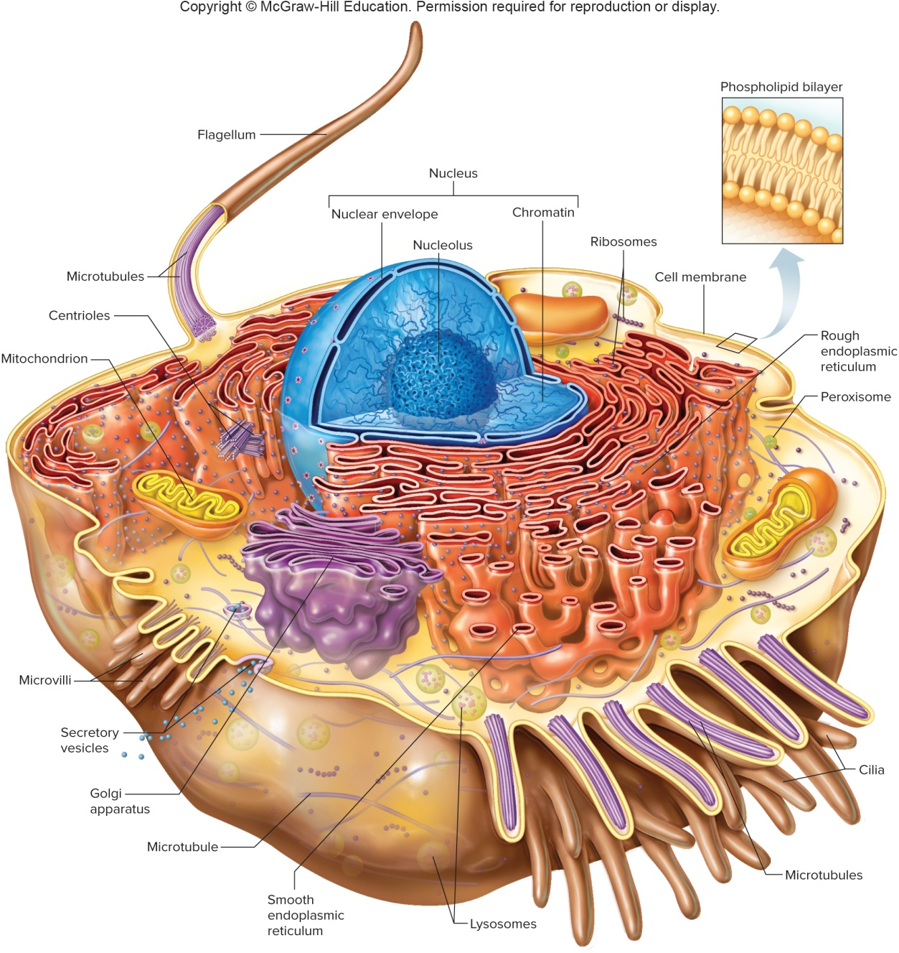
Illustration of a Composite Cell

Slide 6
Cell Membrane
Cell membrane is also called plasma membrane
Boundary that contains the cell contents
Regulates the movement of substances in and out of the cell
Participates in signal transduction, method of communication with other cells
Helps cells adhere to other cells
General Characteristics:
  Extremely thin, flexible, and elastic
  Selectively permeable – regulates entry/exit of substances
  Has complex surface features, with adaptations to increase surface area

Slide 7
Cell Membrane Structure: Lipids
Composed mainly of lipids and proteins, and some carbohydrates
The basic framework of the cell membrane consists of a double layer (bilayer) of phospholipids, with fatty acid tails turned inward and the water-soluble heads facing the surfaces
The phospholipids can move, forming a stable fluid film
Lipid-soluble molecules (respiratory gases, steroid hormones) can pass through the lipid portion of the membrane
Cell membrane is impermeable to water-soluble molecules
  Embedded cholesterol molecules stabilize the membrane, and help make it less permeable to water-soluble substances

Slide 8
Cell Membrane Structure: Proteins
Many types of proteins are found in the cell membrane
Proteins are classified by their relationship to the phospholipid bilayer:
- Integral: span width of bilayer; may protrude on 1 or both sides
- Transmembrane: integral proteins that protrude on both sides
- Peripheral: associate with the outside of one membrane surface
Membrane proteins vary in shape: rodlike, globular, fibrous
Membrane proteins vary in function:
  - Some proteins function as receptors or growth factors on the
  cell surface, starting signal transduction
  - Other proteins transport ions or molecules across cell
  membrane, such as ion channels

Slide 9
Cell Membrane Structure: Proteins (2)
Other proteins have carbohydrates attached (glycoproteins) and are used for cell identification; this helps identify cells as “self,” protecting them from attack by the immune system
Proteins that protrude into the cell will anchor supportive rods and tubules, forming a cytoskeleton
Membrane proteins called cellular adhesion molecules (CAMs) help determine one cell’s interactions with other cells.

Slide 10
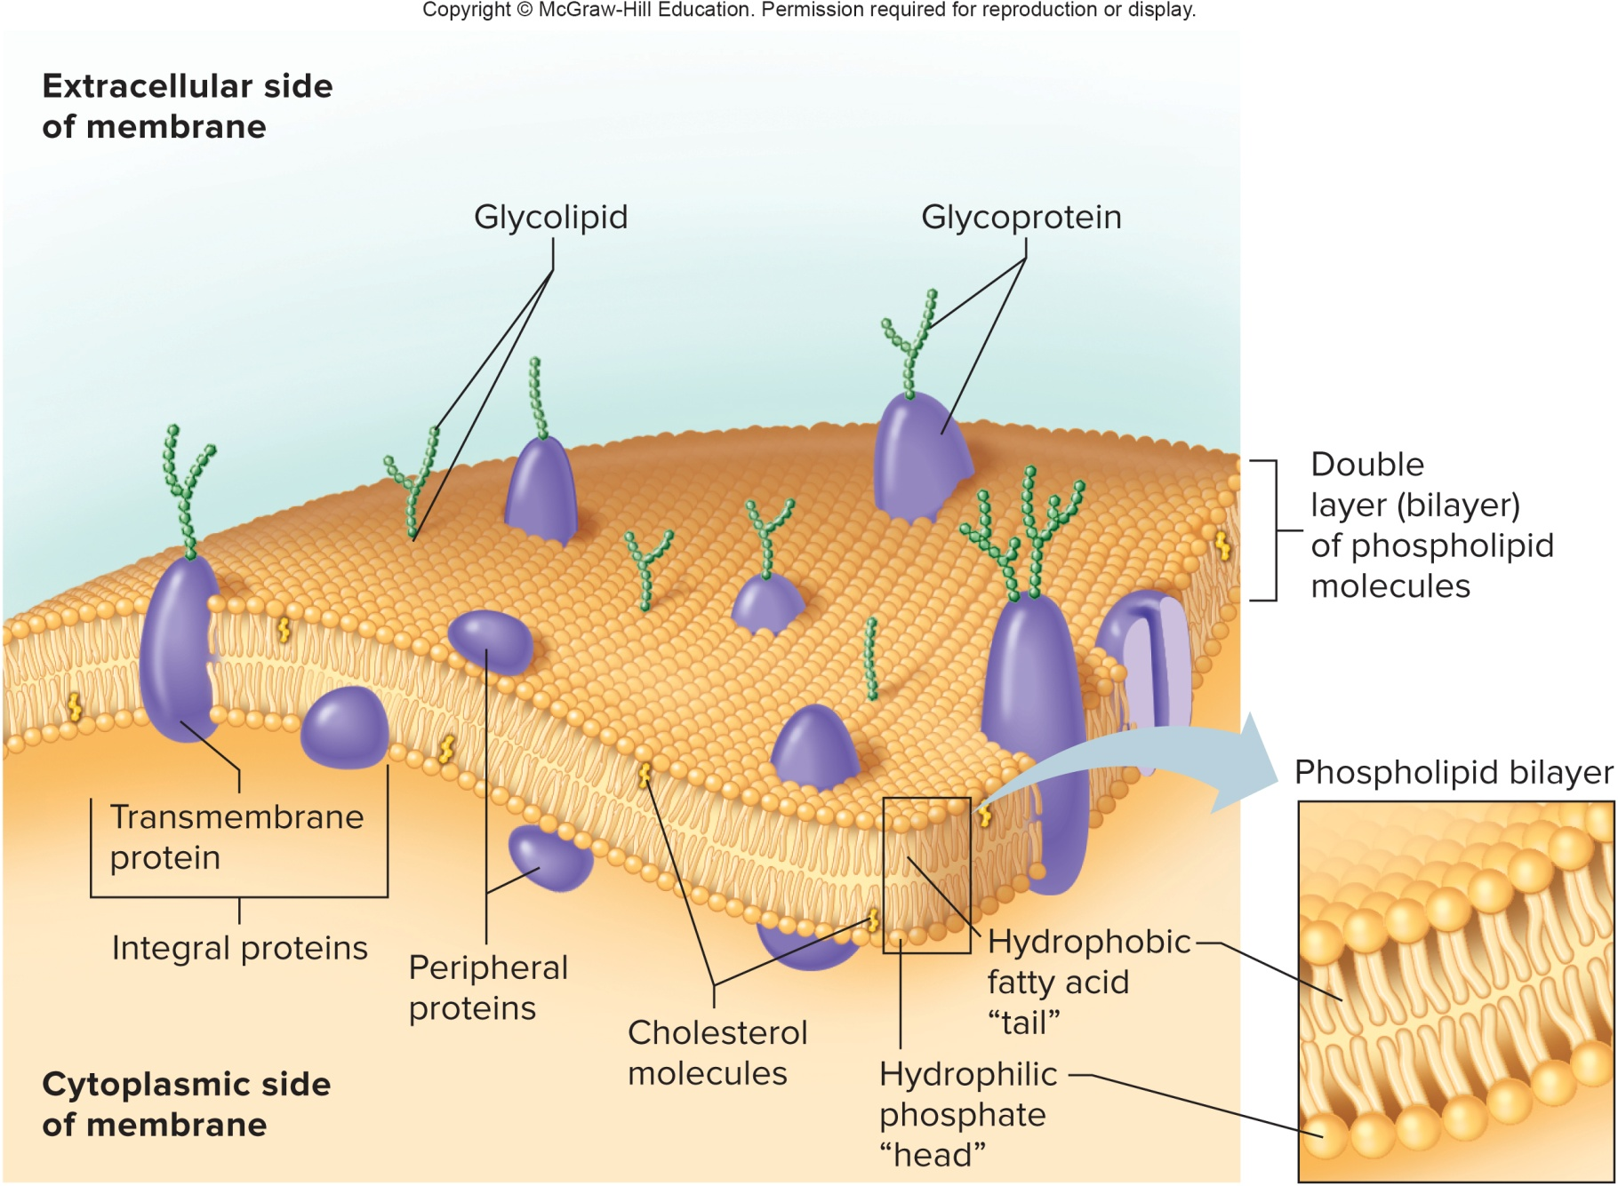
Structure of the Cell Membrane

Slide 11
The Cytoplasm
The cytoplasm makes up most of cell volume, and consists of a clear liquid (cytosol), a supportive cytoskeleton, and networks of membranes and organelles
Organelles
Ribosomes:
Tiny, spherical structures composed of RNA and protein
Provide structural support and enzyme activity for protein synthesis
Not membranous
Found in cytoplasm or bound to rough endoplasmic reticulum

Slide 12
Organelles
Endoplasmic reticulum (ER):
Made up of membranes, flattened sacs, and vesicles
Provides a tubular transport system inside the cell
Functions as a transport network throughout the cell
2 types of ER:
- Rough ER: contains ribosomes, and functions in protein synthesis and processing
  - Smooth ER: does not contain ribosomes, and functions in lipid synthesis, absorption of fats, and metabolism of drugs

Slide 13
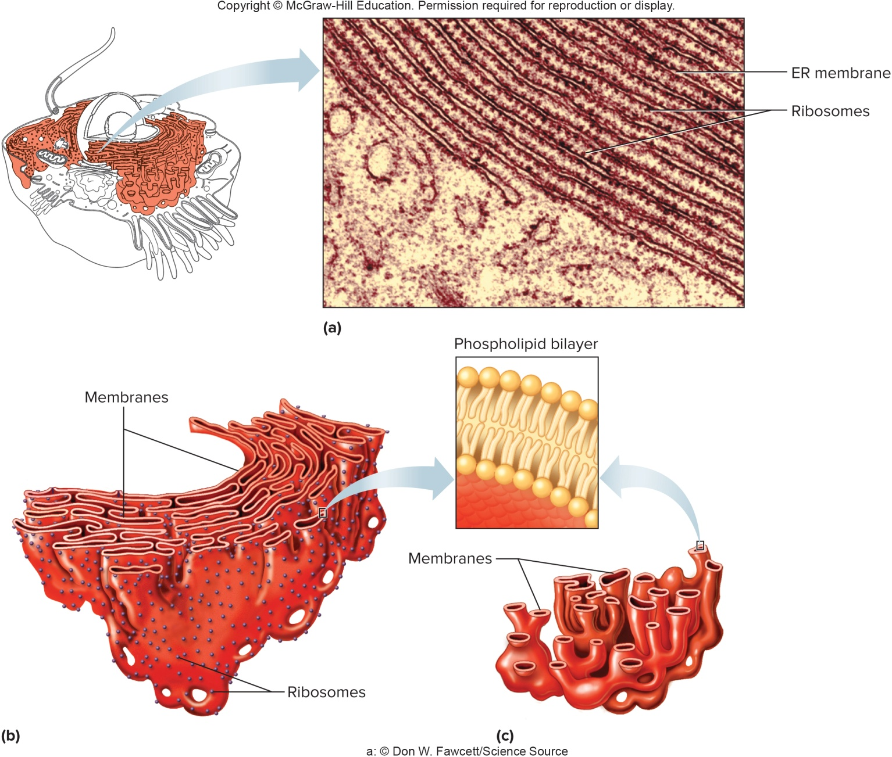
The Endoplasmic Reticulum

Slide 14
Organelles (2)
Vesicles:
Membranous sacs
Store or transport substances within or between cells
Golgi apparatus:
Composed of flattened, membranous sacs
Refines, packages, and transports proteins formed in the rough ER
Vesicles formed in the ER travel to the Golgi apparatus, which may modify their contents by adding sugar molecules to the proteins, to stabilize their structure or to enable folding.
A new vesicle pinches off the Golgi apparatus and may then move to the cell membrane to secrete its contents to the outside (exocytosis)

Slide 15
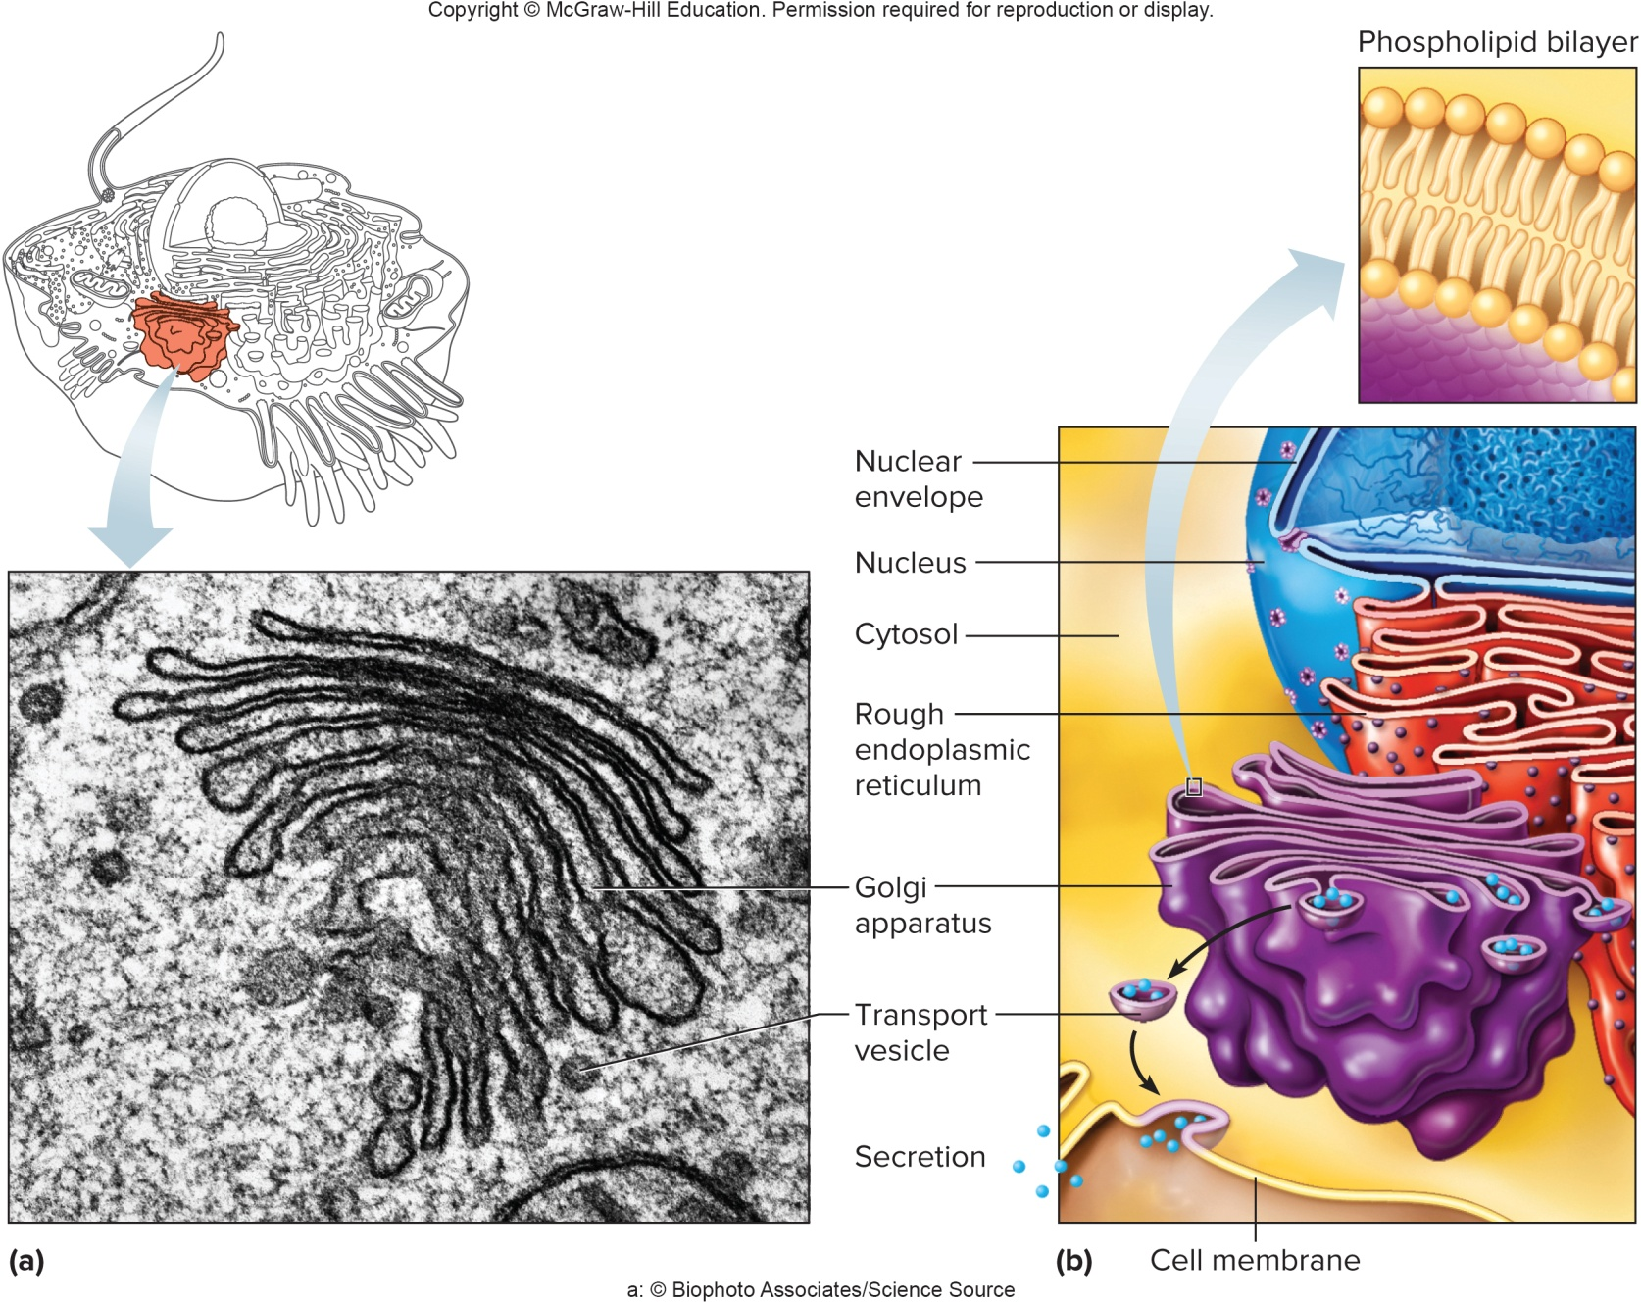
The Golgi Apparatus

Slide 16
Organelles (3)
Mitochondria:
Elongated fluid-filled sacs
House many chemical reactions that extract energy from nutrients
Contain enzymes needed for cellular respiration
The inner membrane of the mitochondrion is folded into cristae, which hold the enzymes needed in energy transformations to make ATP
Store the energy in chemical bonds of ATP
Very active cells contain thousands of mitochondria
Mitochondria have their own DNA and reproduce by dividing

Slide 17
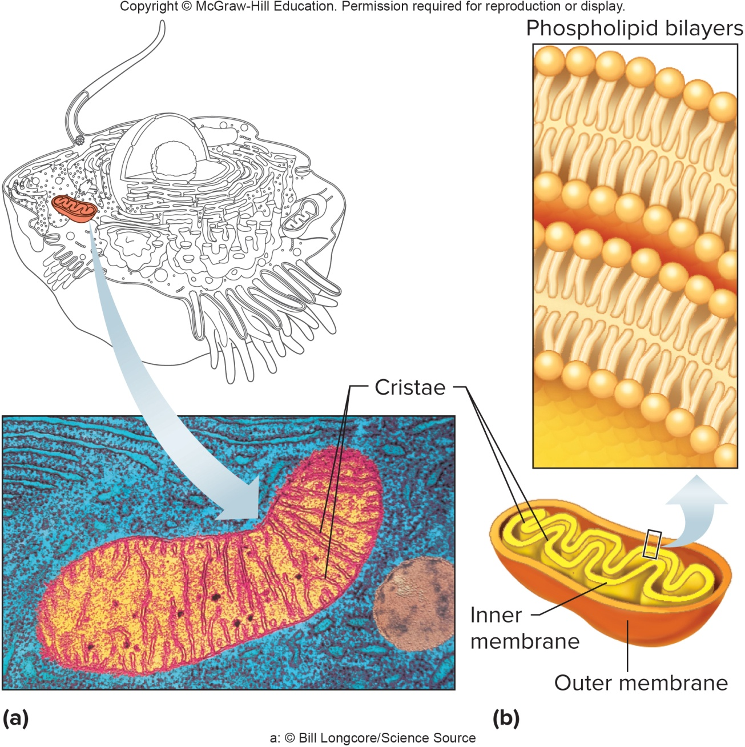
Mitochondria

Slide 18
Organelles (4)
Lysosomes:
Membranous sacs
Contain enzymes that break down nutrients, ingested materials, debris, worn out cell parts, cholesterol (in some cells), toxins, and drugs
Peroxisomes:
Also membranous sacs
Contain a different set of enzymes than lysosomes
Their enzymes function in the breakdown of fatty acids and hydrogen peroxide, and detoxification of alcohol

Slide 19
Other Cellular Structures
In the cytoplasm, there are several structures, which are not organelles, but rather part of the cytoskeleton.
Microfilaments and microtubules are thin, threadlike structures that serve as the cytoskeleton of the cell:
Microfilaments: made of the protein actin; cause various cellular movements; group together to form myofibrils in muscle
Microtubules: made of the globular protein tubulin, are attached in a spiral to form a long tube; important in cell division
Intermediate fibers: made of different proteins in different cells, are abundant in skin cells and neurons

Slide 20
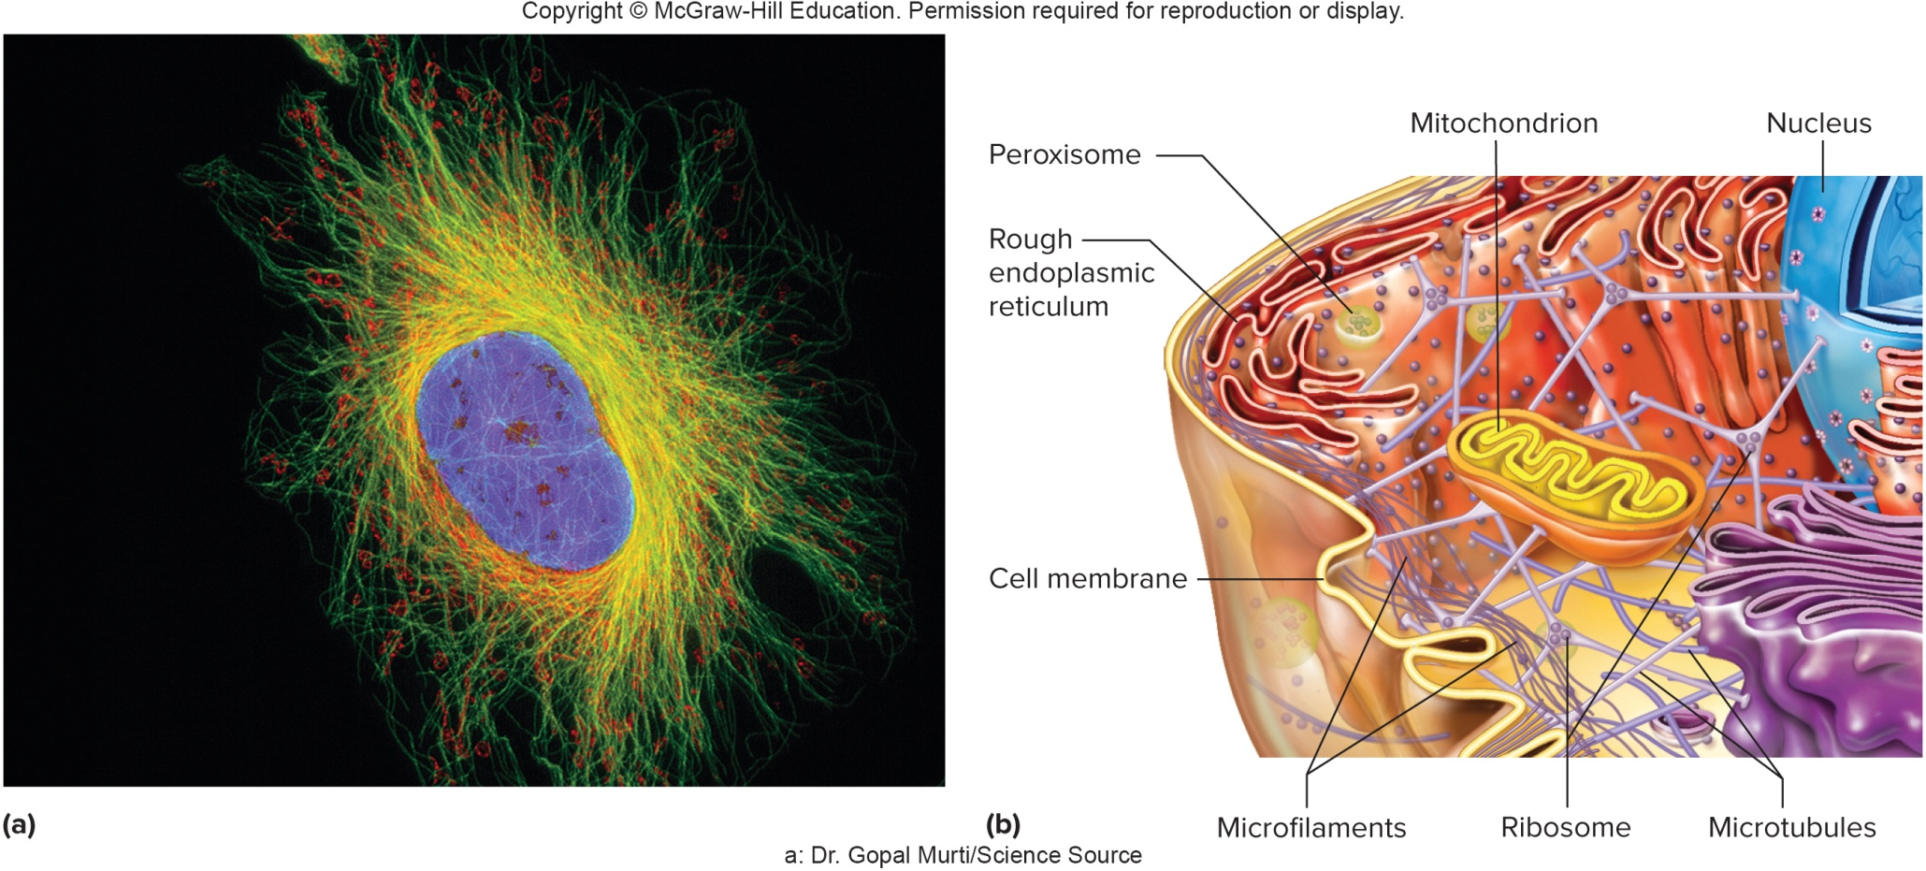
The Cytoskeleton

Slide 21
Other Cellular Structures (2)
Centrosome:
A non-membranous structure, made up of two hollow cylinders called centrioles, that function in the separation of chromosomes during cell division; made of nine groups of three microtubules
Cilia:
Motile extensions from the cell; short cilia are abundant on the free surfaces of certain epithelial cells and move in a wave (respiratory linings, for example) to move fluids or whole cells
Flagella:
Another type of motile extension from cell; usually a cell only has 1 flagellum; the only human cell with a flagellum is a sperm cell; the flagellum allow the sperm to swim toward the egg cell

Slide 22
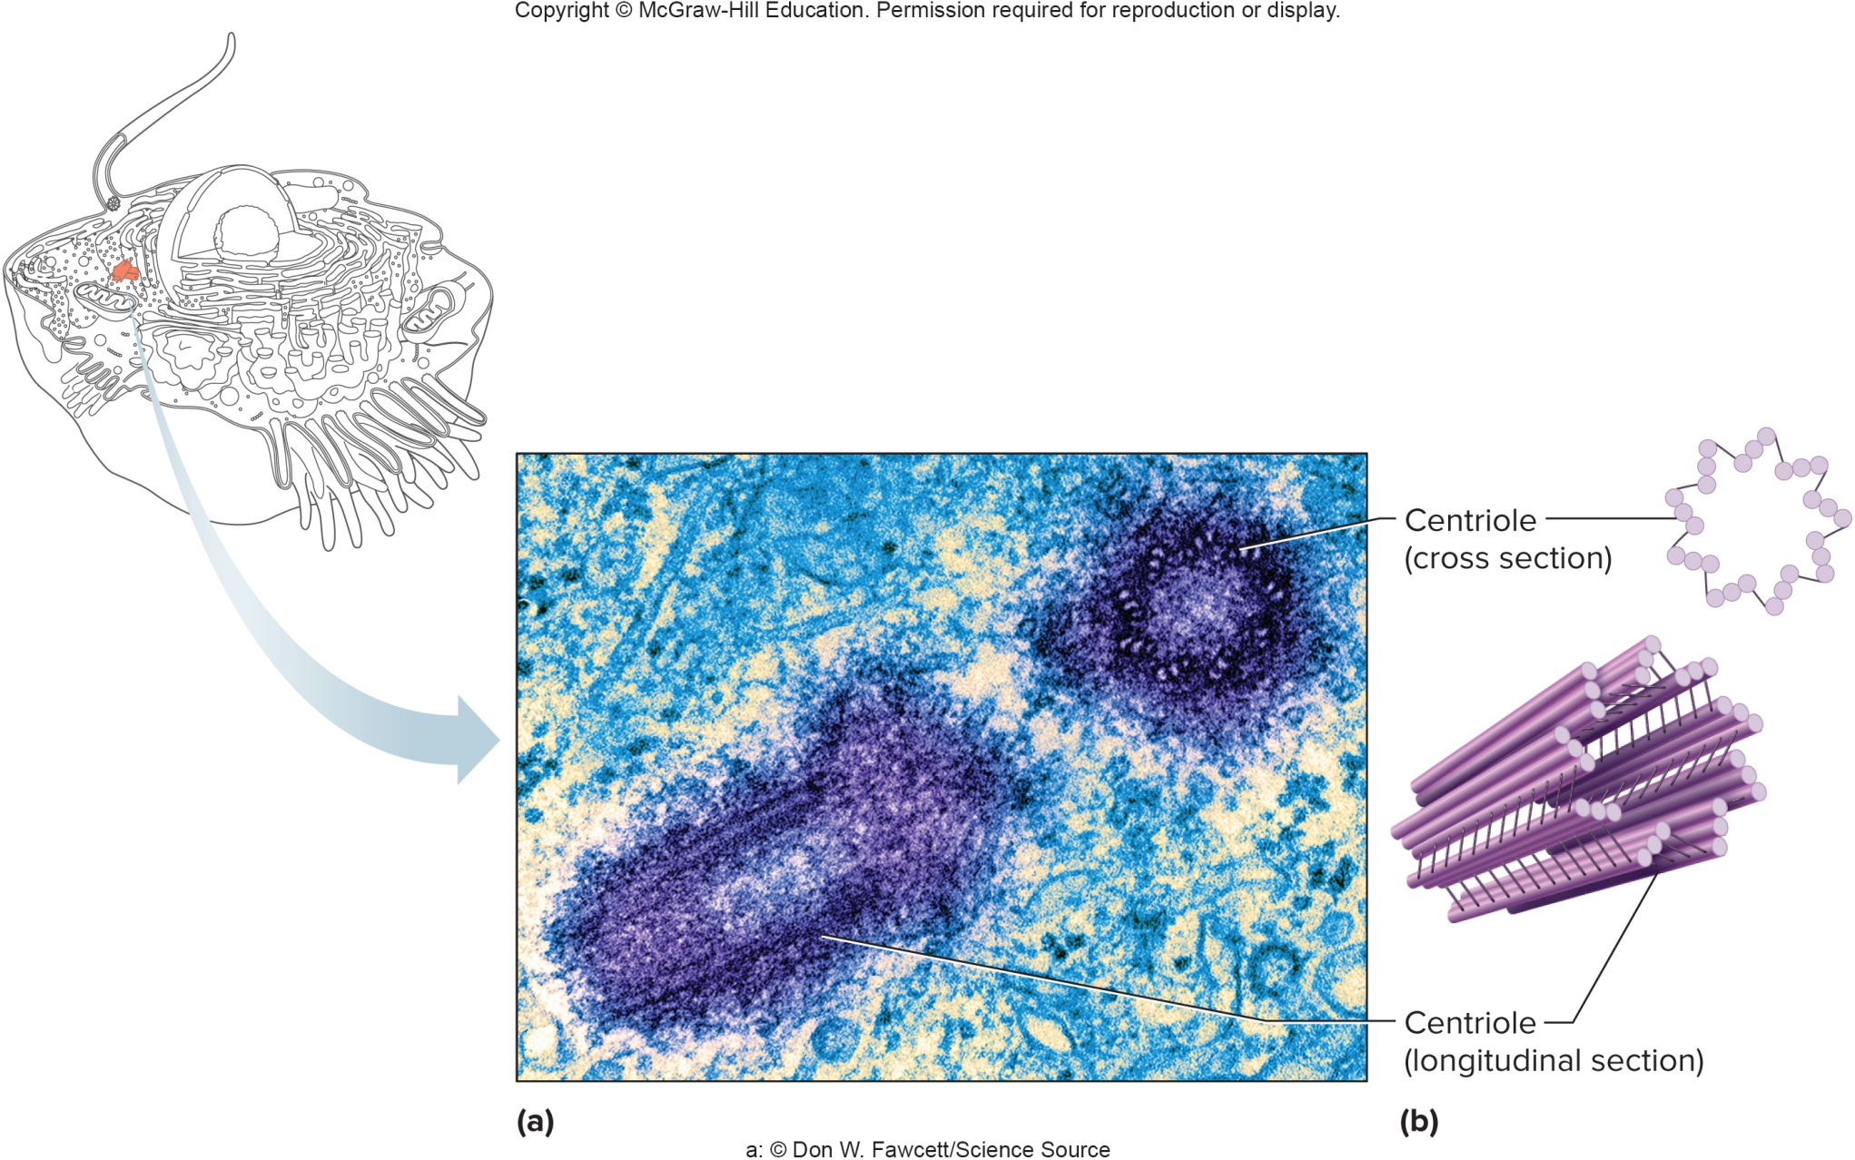
The Centrosome (Centrioles)

Slide 23
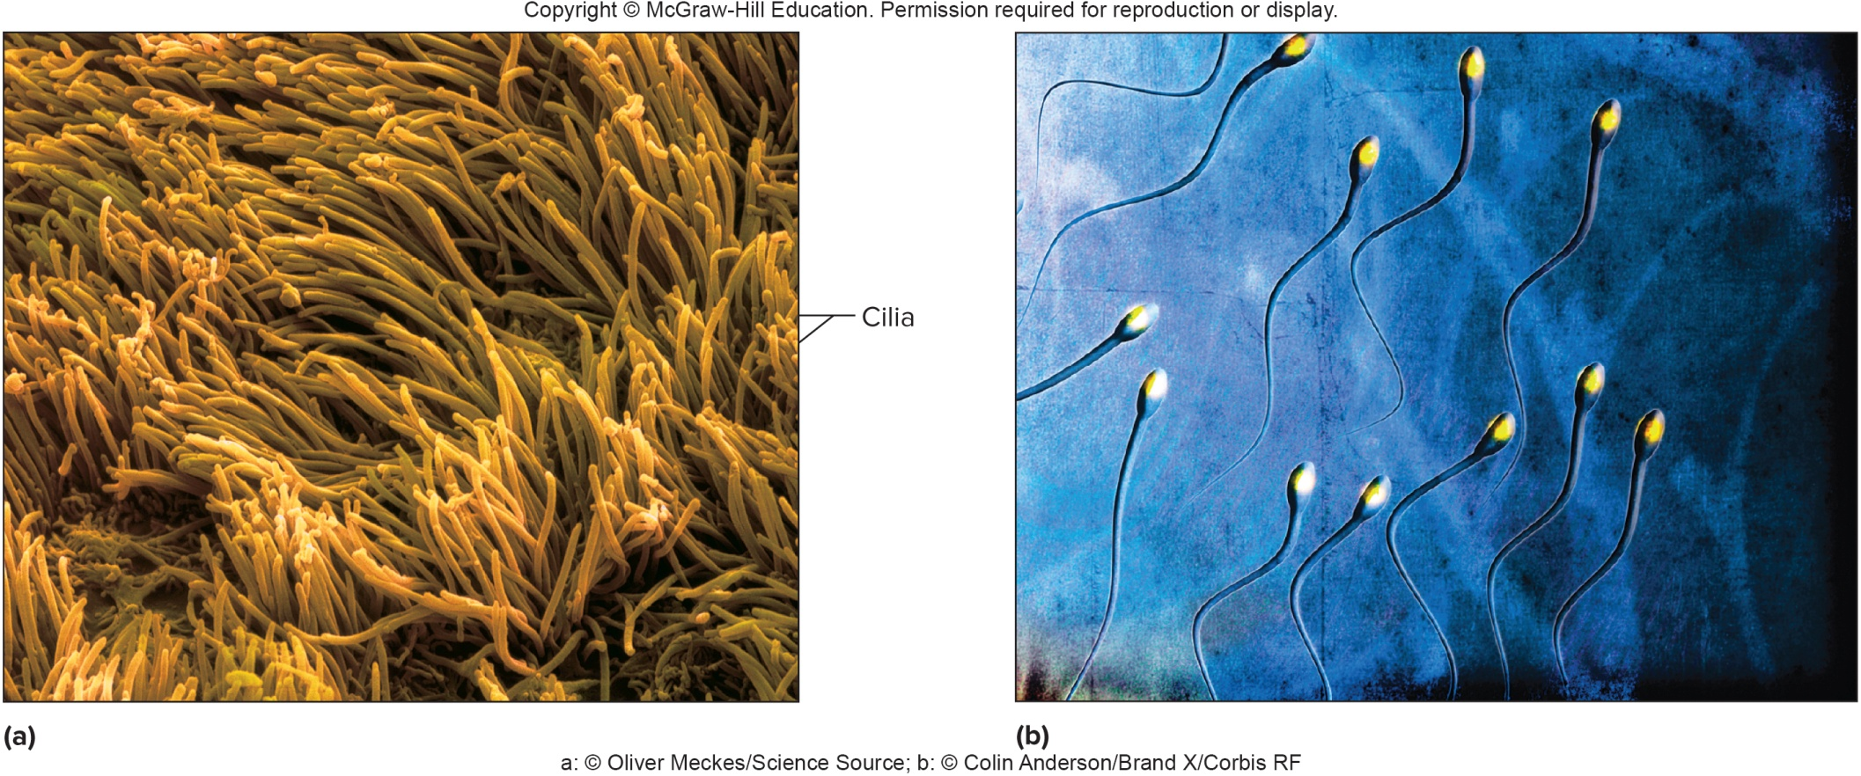
Cilia and Flagella

Slide 24
The Cell Nucleus
The nucleus contains genetic material, DNA, which controls cell activities
The fairly large nucleus is surrounded by a double-layered nuclear envelope, containing relatively large nuclear pores that allow the passage of certain substances
Contains a fluid called nucleoplasm
The nucleolus is a small, dense body in the nucleus, composed of RNA and protein; it is the site of ribosome production
Chromatin consists of loosely coiled fibers of protein and DNA found in the nucleus
Condensed DNA is referred to as chromosomes; this form of DNA occurs during cell division

Slide 25
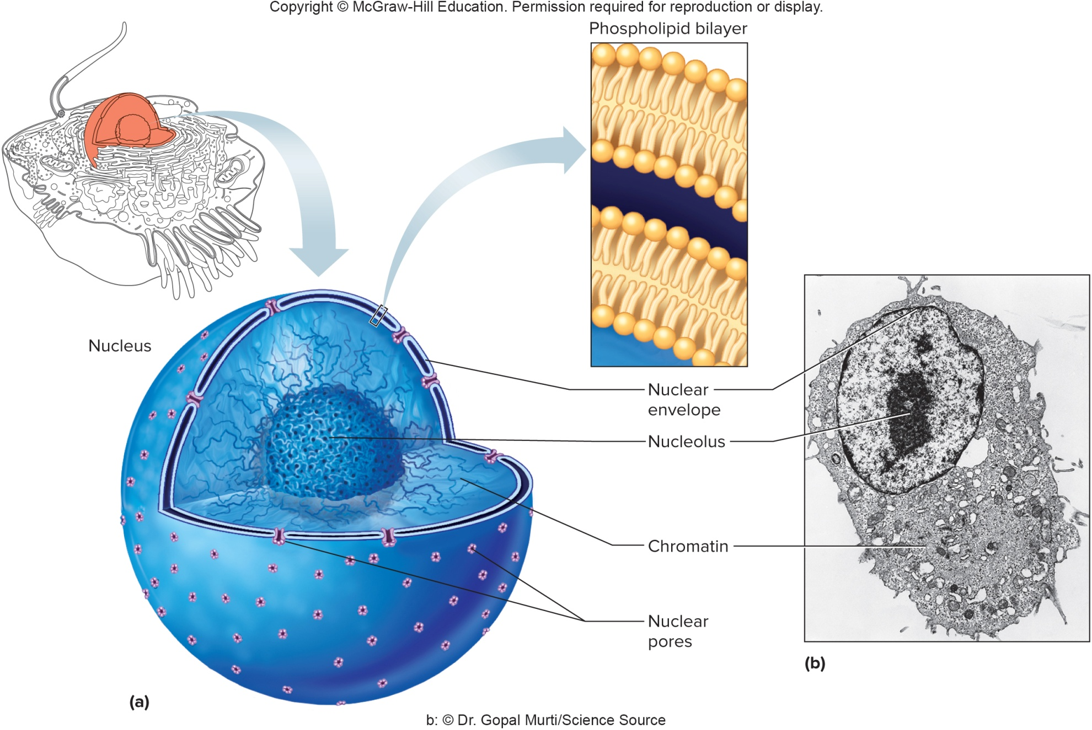
The Cell Nucleus (2)

Slide 26
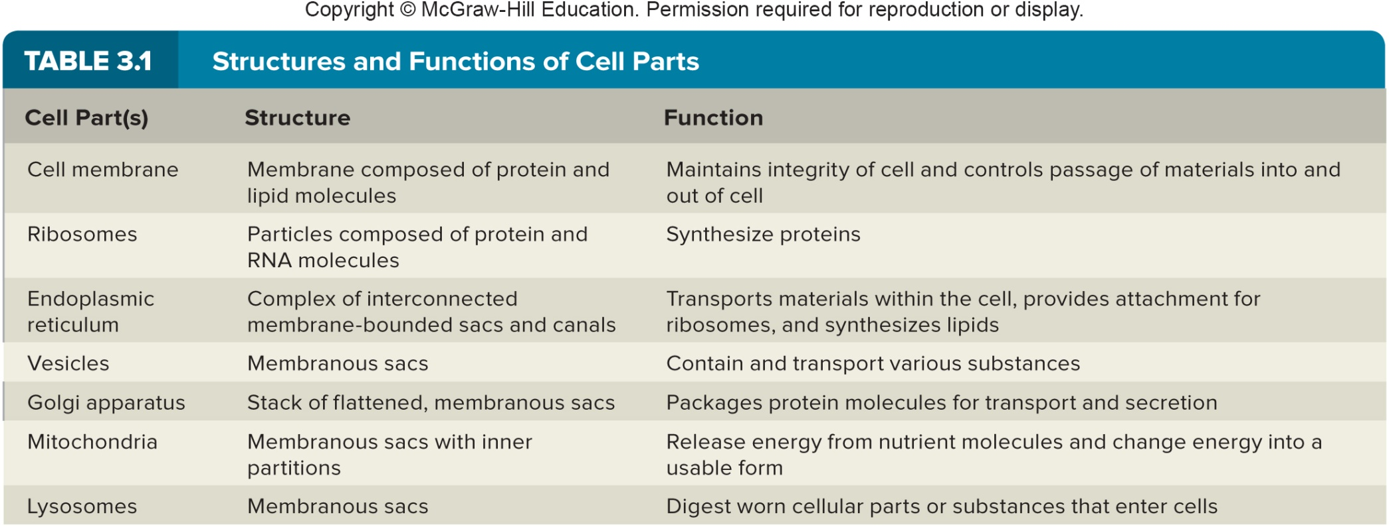
Structures and Functions of Cell Parts

Slide 27
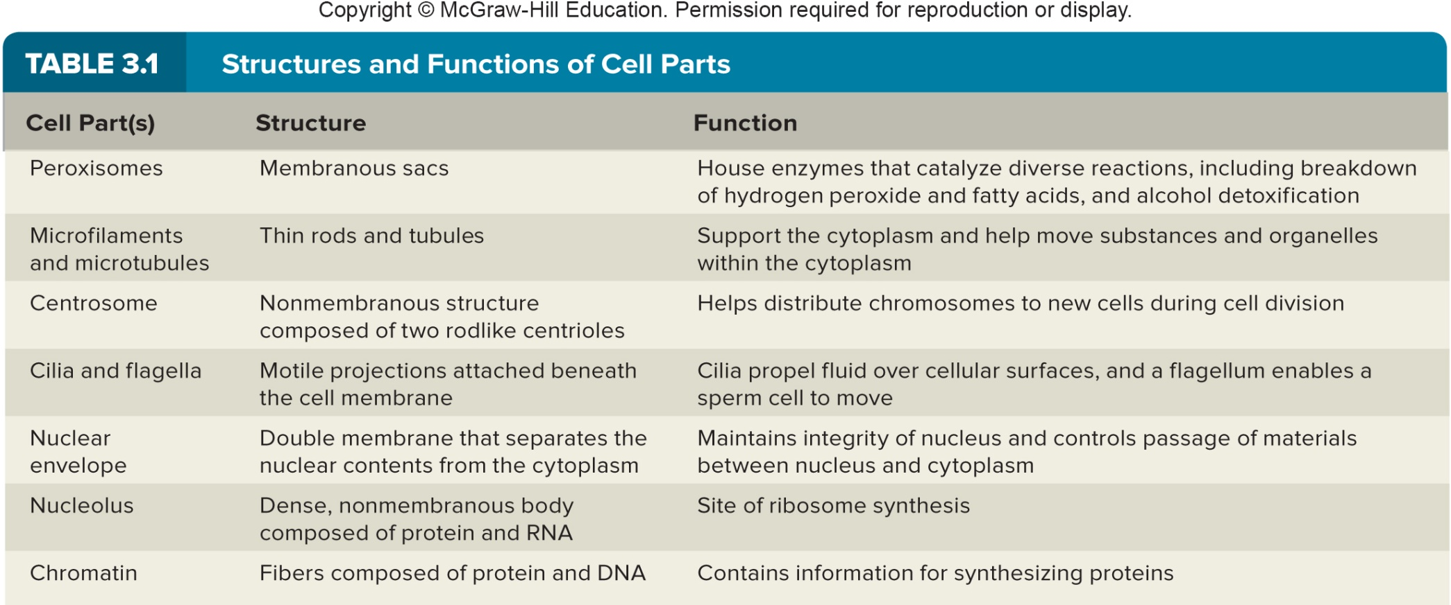
Structures and Functions of Cell Parts(2)

Slide 28
3.3: Movements Into and Out of the Cell
The cell membrane is a selective barrier, which controls which substances pass through it
Mechanisms of movement across the membrane may be passive, requiring no energy from the cell, or active, requiring cellular energy
Examples of passive transport mechanisms: diffusion, facilitated diffusion, osmosis, and filtration
Examples of active transport mechanisms: active transport, endocytosis, and exocytosis

Slide 29
Passive Mechanisms: Diffusion
Diffusion:
Movement of molecules or ions in a liquid or gas from a region of higher concentration to one of lower concentration
This is referred to as moving down the concentration gradient
Caused by the random motion and collisions of particles
At diffusional equilibrium, particles have become uniformly distributed; they continue to move, but there is no net change in concentration
Diffusion enables oxygen and carbon dioxide molecules to be exchanged between the air and the blood in the lungs, and between blood and tissue cells
Diffusion across cell membranes occurs only if cell membrane is permeable to the substance, and there is a concentration gradient
A sugar cube placed into a glass of water will disperse over time, by the process of diffusion

Slide 30
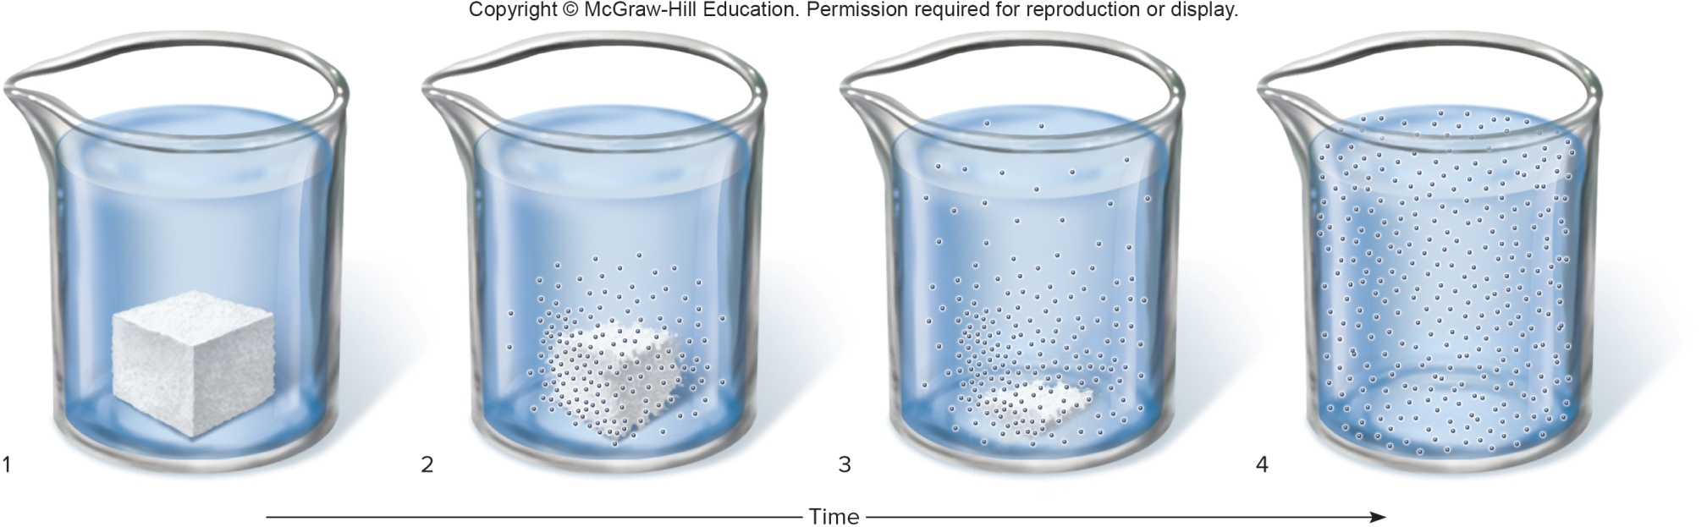
Example of Diffusion:
Dissolving a Sugar Cube in a Glass of Water

Slide 31
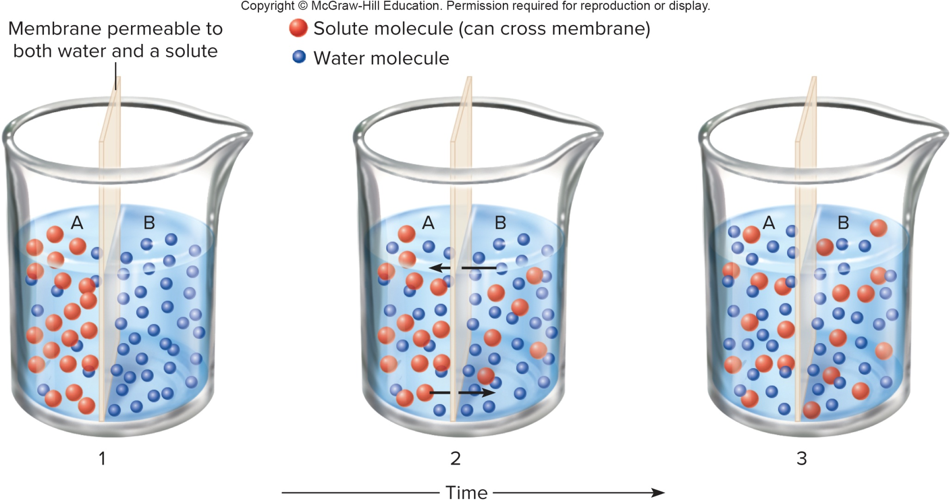
Example of Diffusion Across a
Permeable Membrane

Slide 32
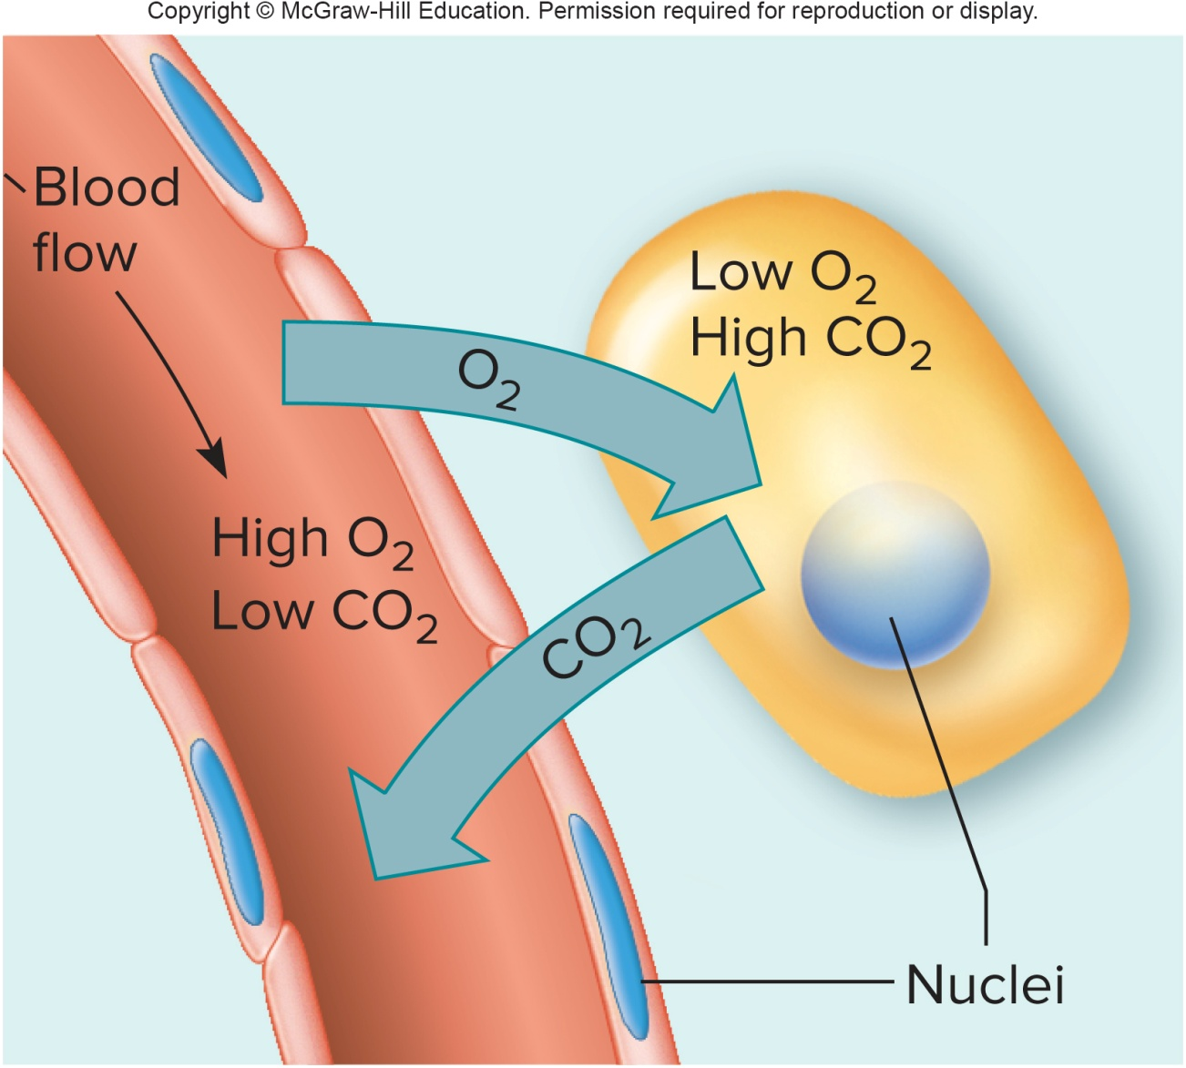
Example of Diffusion: Exchange of O₂ and CO₂
Between the Capillaries & Body Cells

Slide 33
Passive Mechanisms: Facilitated Diffusion
Facilitated diffusion is a method of transport of substances across the cell membrane, using membrane proteins to carry the substances across the phospholipid bilayer
Substances transported by facilitated diffusion, such as glucose and amino acids, cannot pass through the phospholipid bilayer, since they are water-soluble or too large; they require the help of a carrier molecule
One type of facilitated diffusion involves the use of ion channels to transport ions across the cell membrane
The number of carrier molecules in the cell membrane limits the rate of this process

Slide 34
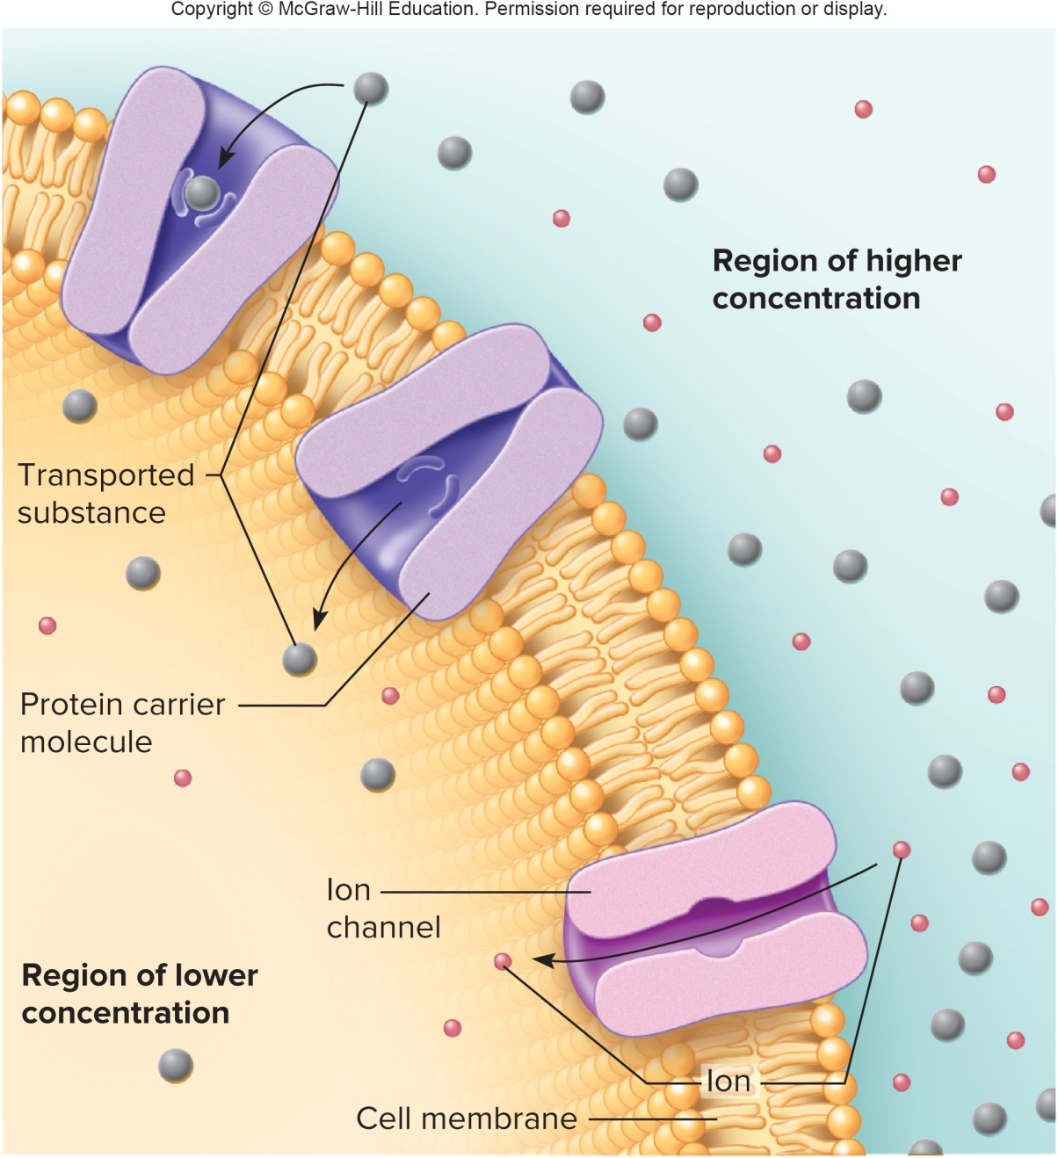
Facilitated Diffusion

Slide 35
Passive Mechanisms: Osmosis
Osmosis:
Movement of water across a selectively permeable membrane, into an area that contains an impermeant solute
Osmosis is a special case of diffusion, in which water moves across a selectively permeable membrane, from an area of greater water concentration (where there is less osmotic pressure and fewer solutes) to an area of lower water concentration (where there is greater osmotic pressure and more solutes)
During osmosis, water moves from a region of lower solute concentration to a region of higher solute concentration
The membrane is permeable to water but impermeable to the solutes
Osmotic pressure is the pressure needed to lift a volume of water; more impermeable solutes creates more pressure

Slide 36
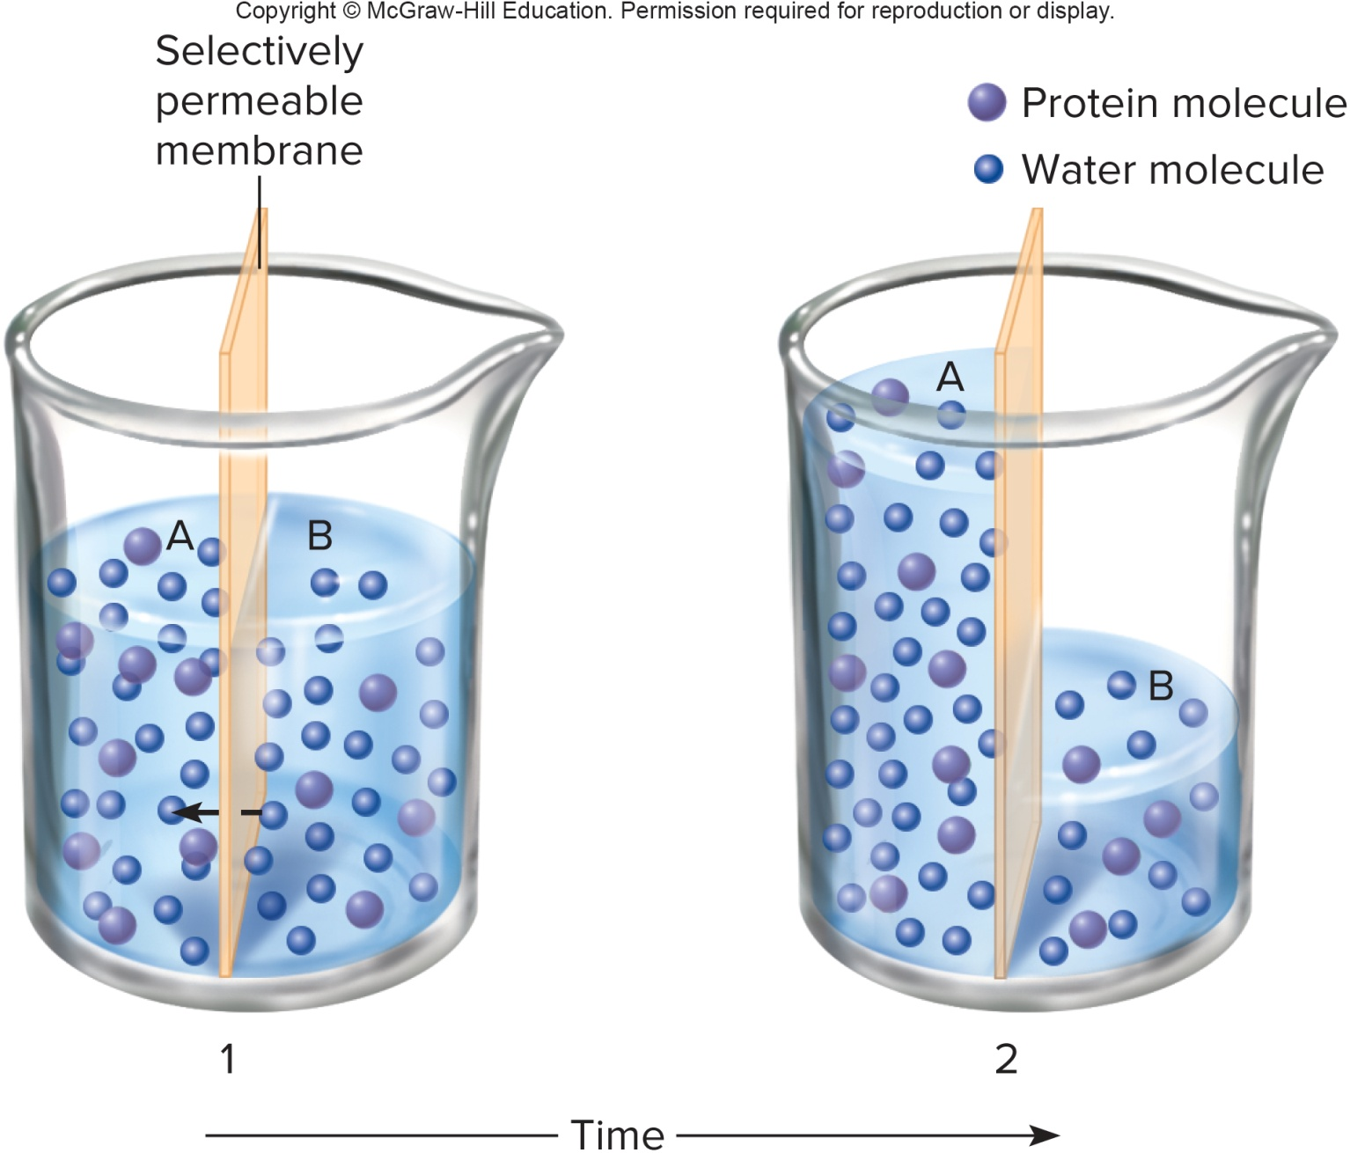
Osmosis

Slide 37
Types of Osmotic Solutions
The greater the impermeant solute concentration in a solution, the greater its osmotic pressure
Water moves toward solutions with greater osmotic pressure
Cell membranes are usually permeable to water, so water equilibrates by osmosis, and makes osmotic pressure equal in the intracellular and extracellular fluids
A solution with the same osmotic pressure as body fluids is called isotonic; 0.9% NaCl solution is isotonic to human cells
A solution with higher osmotic pressure than body fluids is hypertonic; cells placed in a hypertonic solution with lose water and shrink
A solution with lower osmotic pressure than body fluids is hypotonic; cells placed in a hypotonic solution will gain water and swell

Slide 38
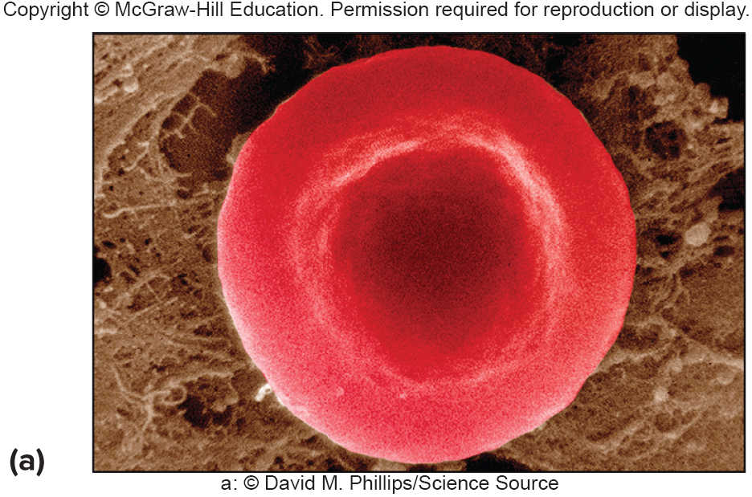
A Red Blood Cell in an Isotonic Solution:
No Change in Cell Volume

Slide 39
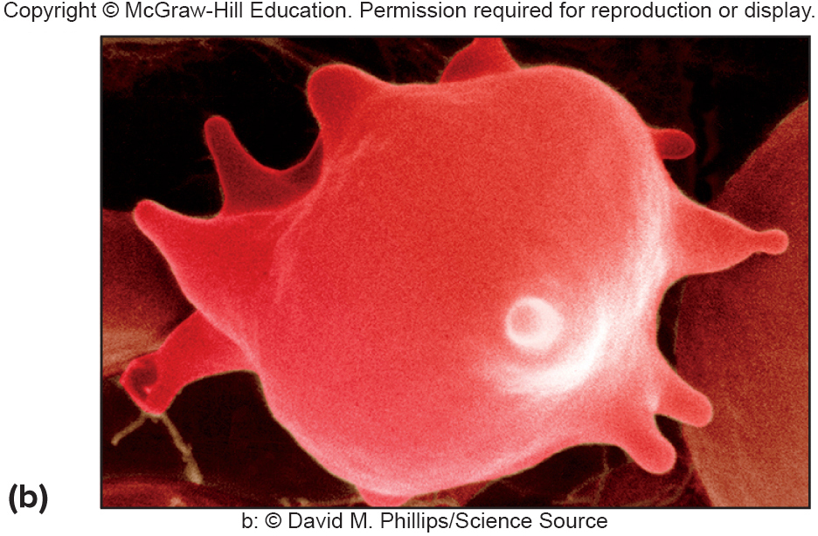
A Red Blood Cell in a Hypertonic Solution:
Cell Shrinks

Slide 40
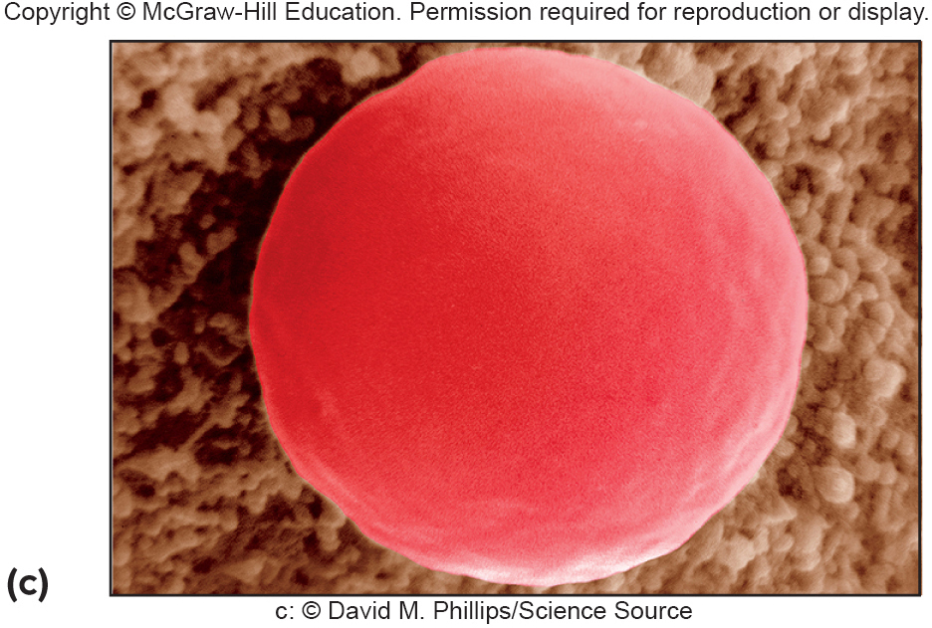
A Red Blood Cell in a Hypotonic Solution:
Cell Swells

Slide 41
Passive Mechanisms: Filtration
Filtration:
The process of forcing molecules through membranes due to pressure
Blood pressure, due to the action of the heart, is a type of hydrostatic pressure, which is used as the force for filtration
Filtration is used by the body to produce tissue fluid from blood plasma; water and small solutes are sent through the walls of capillaries, to deliver O₂ and nutrients to the cells, while large particles, like plasma proteins, remain in the capillaries
Particles are generally limited in movement by their size in the filtration process

Slide 42
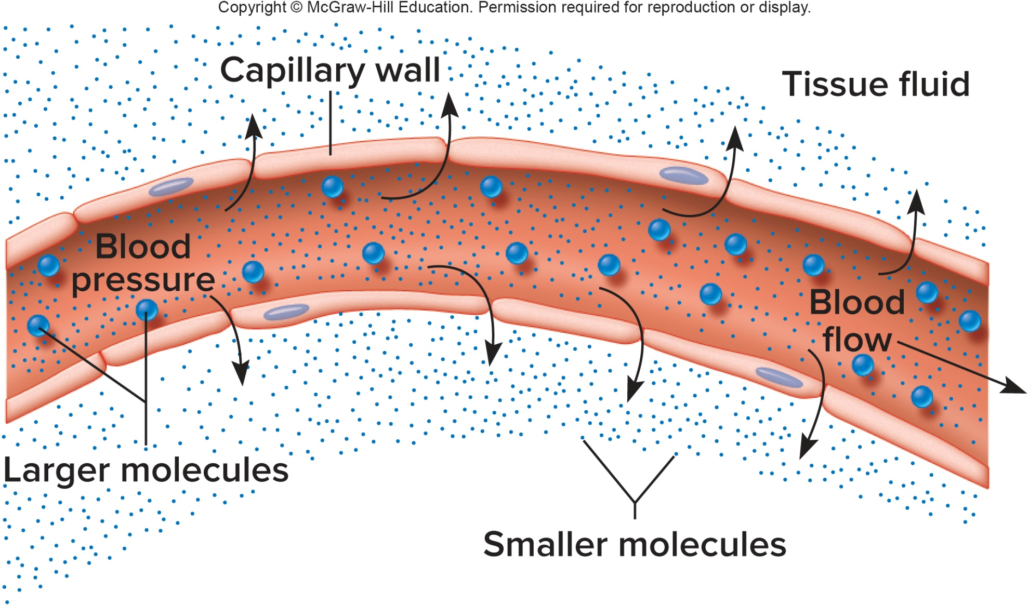
Filtration of Small Molecules
Through Capillary Walls

Slide 43
Active Mechanisms: Active Transport
Active mechanisms move substances from a region of lower concentration to a region of higher concentration, and need ATP (adenosine triphosphate) as an energy source
Active Transport:
Process of moving substances from an area of low concentration to an area of high concentration, through carrier molecules in cell membranes, using ATP energy
The carrier proteins may also be called pumps, since they move substances against the concentration gradient
As much as 40% of a cell's energy may be used to fuel this process
Substances moved by active transport: Na⁺, K⁺, Ca⁺², H⁺, some sugars, and some amino acids

Slide 44
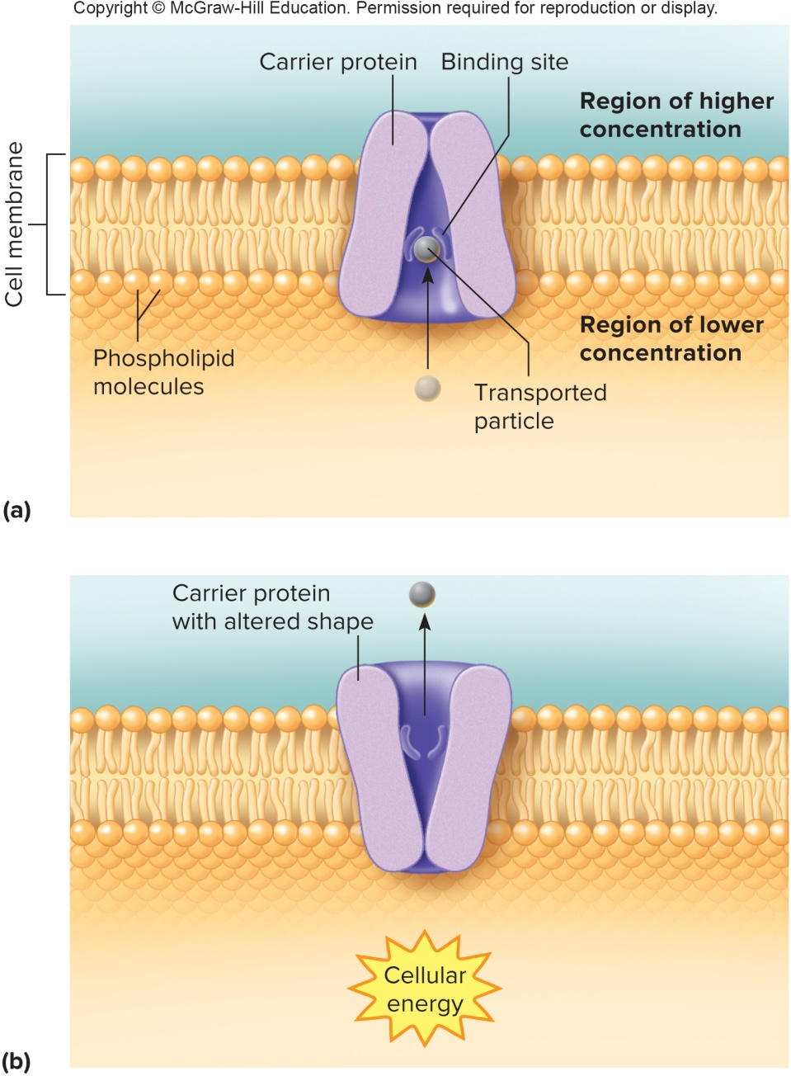
Active Transport

Slide 45
Active Mechanisms: Endocytosis & Exocytosis
In endocytosis and exocytosis, large substances are moved into or out of a cell without crossing the cell membrane
In endocytosis, molecules that are too large to be transported by other means are conveyed inside a vesicle that forms from a section of the cell membrane
Exocytosis is the movement of materials out of the cell in a vesicle that fuses with the cell membrane and opens up to the outside to secrete the material

Slide 46
Three Types of Endocytosis
Pinocytosis:
Process by which cells engulf liquids
“Cell drinking”
Small indentation in cell membrane surrounds fluid, creating a vesicle
Phagocytosis:
Process by which the cell takes in solid particles, such as when a white blood cell engulfs a bacterium
“Cell eating”
Once the vesicle enters the cell, it will combine with a lysosome and the contents will be digested by lysosomal enzymes
Receptor-mediated endocytosis:
Process by which the cell takes in very specific molecules (ligands), that bind to specific receptors on the cell membrane

Slide 47
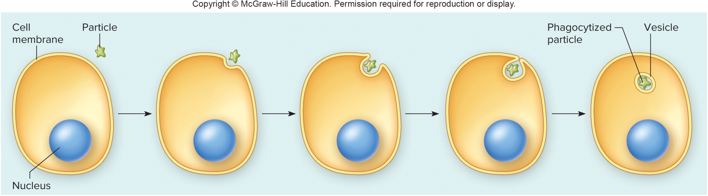
Phagocytosis

Slide 48
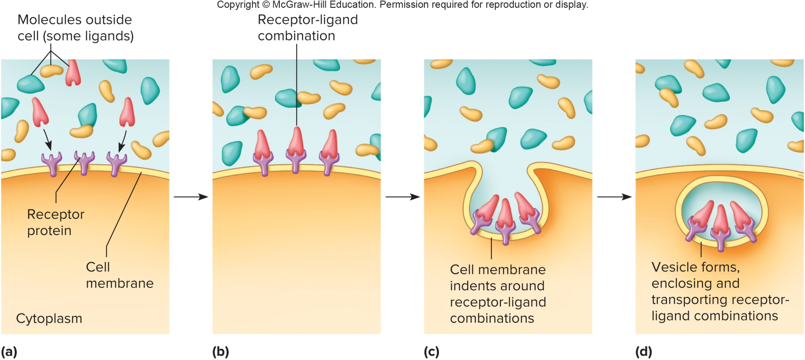
Receptor-Mediated Endocytosis

Slide 49
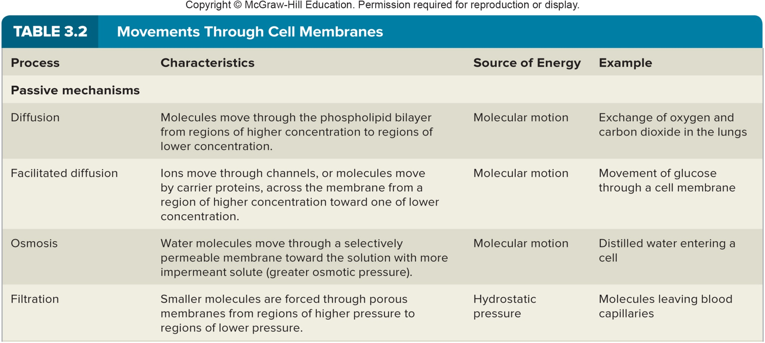
Movements Through Cell Membranes: Passive Mechanisms

Slide 50
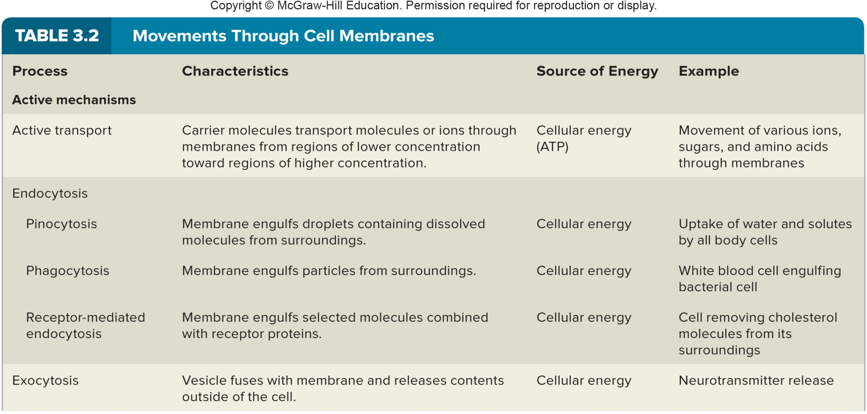
Movements Through Cell Membranes: Active Mechanisms

Slide 51
3.4: The Cell Cycle
Cell Cycle:
The series of changes a cell undergoes from the time it is formed until it divides
Main phases are interphase, mitosis, and cytokinesis (division of the cytoplasm)
Daughter cells will then undergo changes to become specialized
Whether the cell cycle progresses at a certain time is controlled by special protein checkpoints
Restriction checkpoints determines fate of cell: to continue cell cycle and divide, to enter a non-dividing stage as a specialized cell, or to die
Most cells do not divide continually. Cells have a maximum number of times they can divide, because of built-in “clocks” (telomeres) on the tips of chromosomes, which shorten with each cell division

Slide 52
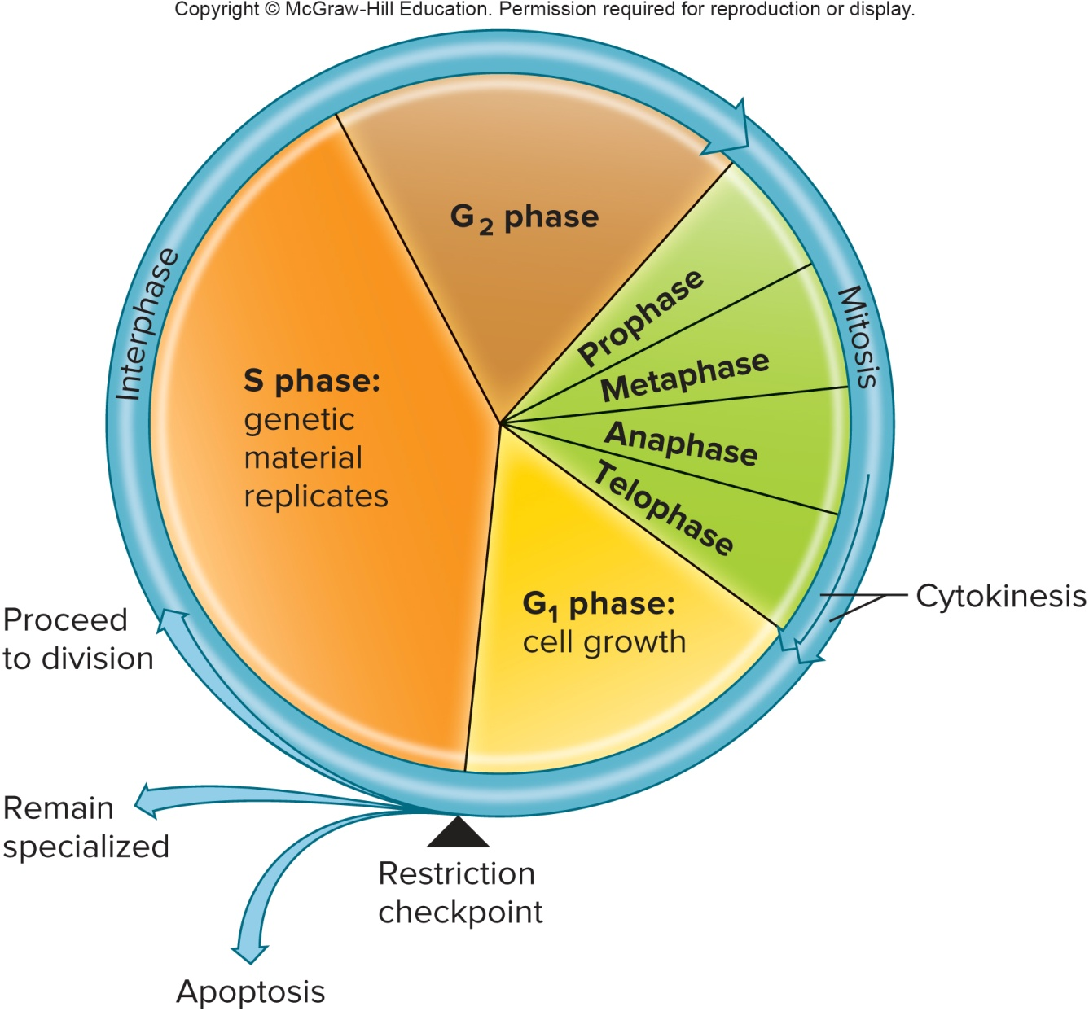
The Cell Cycle (2)

Slide 53
Interphase
Interphase:
Phase of the cell cycle, before cell division begins, in which the cell grows and synthesizes new molecules, membranes, DNA, and organelles
This is a time of great synthetic activity, rather than a time of rest
During the G₁ and G₂ (“gap” or “growth”) phases of interphase, the cell grows and structures other than DNA are duplicated
During the S (“synthesis”) phase of interphase, the DNA of the cell is replicated in preparation for cell division

Slide 54
Cell Division
2 types of cell division:
Meiosis:
Rare type, used for gametogenesis, sperm & egg production
Ensures that mature gametes have ½ the normal number of chromosomes as normal body cells
Cell Division (Mitosis + Cytokinesis):
More common type of cell division, used to increase number of cells
Mitosis is division of the nucleus
Cytokinesis is the division of the cytoplasm
Regulated carefully, so that each of two daughter cells receives an
exact copy of the mother cell's genetic material (DNA)

Slide 55
Stages of Mitosis
Mitosis is described as a series of four stages, but the process is
actually continuous:
1. Prophase:
The first stage of mitosis
DNA condenses visible chromosomes (made of two chromatids connected with a centromere)
Centrioles migrate to the poles
Microtubules of the cytoskeleton organize into spindle fibers
The nuclear membrane and nucleolus disassemble

Slide 56
Stages of Mitosis (2)
Metaphase:
Spindle fibers attach to centromeres on the chromosomes
Chromosomes randomly align midway between centrioles
3. Anaphase:
Sister chromatids are pulled apart
Chromatids are now considered individual chromosomes
Chromatids are pulled along the shortening spindle fibers toward opposite centrioles
4. Telophase:
The final stage of mitosis
Begins when the chromosomes have completed their migrations to opposite sides
A nuclear envelope and nucleolus assemble for each forming cell
The spindle fibers disassemble
The chromosomes unwind, and take back their chromatin form

Slide 57
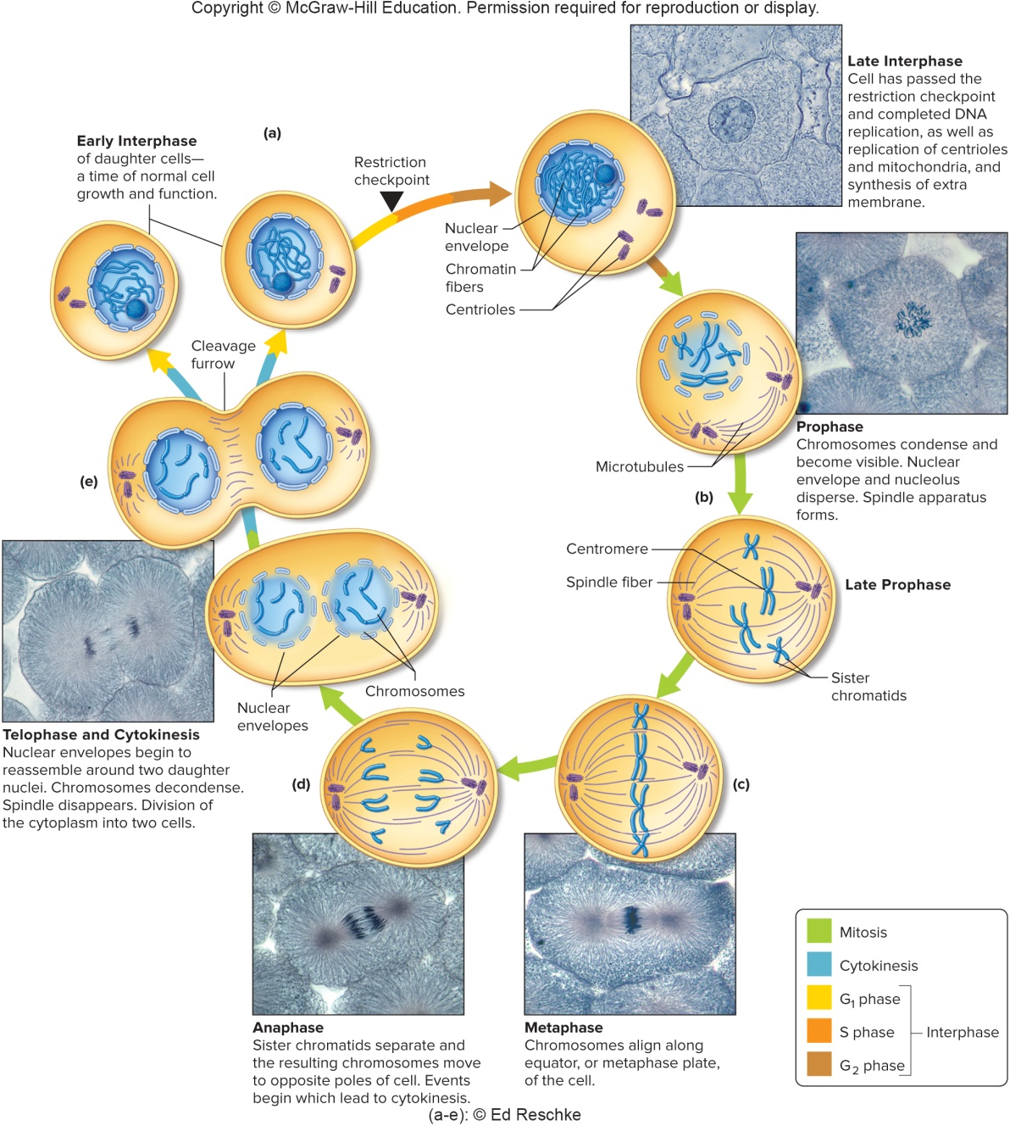
Stages of Mitosis (3)

Slide 58
Cytokinesis (Cytoplasmic Division)
Cytokinesis:
Cytoplasmic division
Begins during anaphase of mitosis, when cell membrane constricts
around middle of cell
Constriction, called the cleavage furrow, continues throughout
telophase; it eventually pinches the daughter cells apart
Contractile ring of microfilaments attaches to inside of cell membrane; it divides the cytoplasm
The two daughter cells may have varying amounts of cytoplasm and organelles, but they share identical genetic information

Slide 59
Cell Differentiation
Differentiation:
The process by which cells develop/specialize into different types of cells with specialized functions
Humans have >290 types of differentiated cells
Cell differentiation allows cells to specialize by using different parts
of the complete genome that is present in each cell; in various
types of cells, some genes are “turned on” while others are
“turned off”
Stem cells retain the ability to divide without specialization; their
presence in the cell allows for continuous growth and renewal
Progenitor cells are daughters of stem cells that are partially
specialized
Stem and progenitor cells allow cells to retain the ability to produce cells that will become the differentiated cells in each area of the body

Slide 60
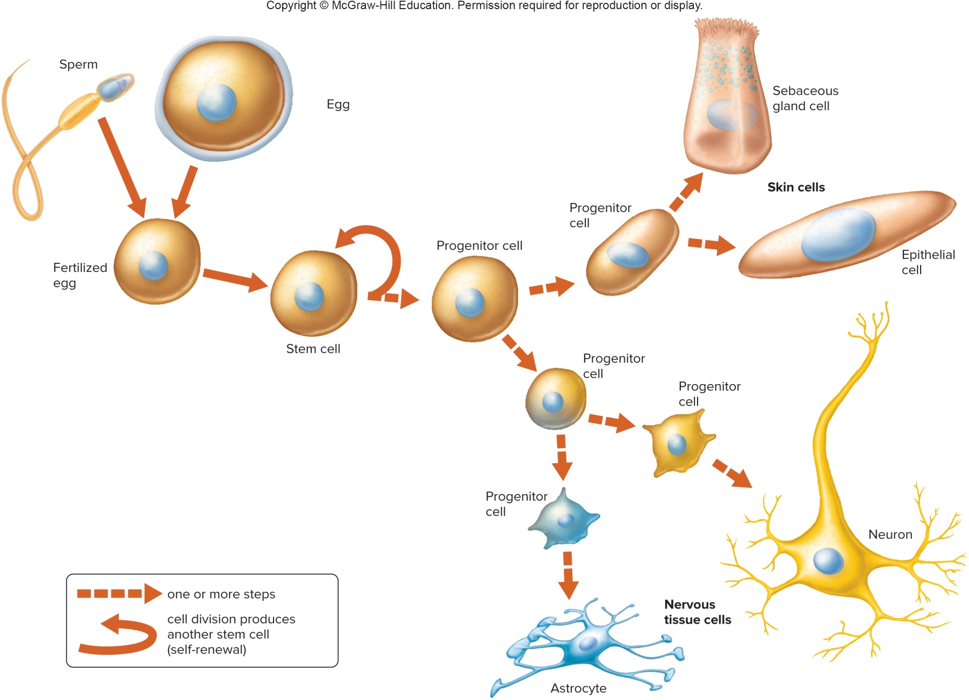
Stem and Progenitor Cells

Slide 61
Cell Death
Not all cells divide or differentiate; some die
Apoptosis is a form of cell death that is a normal part of
development, rather than from injury or disease
Removes overgrown tissues and damaged cells
Steps of apoptosis:
  - Cell rounds up and bulges
  - Nuclear membrane breaks down
  - Chromatin condenses and enzymes cut up the chromosomes
  - Cell shatters into many membrane-bound pieces
  - Scavenger cells engulf and destroy the fragments

