Slide 1
Chapter 01
Lecture Outline
See separate PowerPoint slides for all figures and tables pre-inserted into PowerPoint without notes.

Slide 2
1.1: Introduction:
History of the Study of the Human Body
The early students of anatomy and physiology were most likely concerned with treating illnesses and injuries.
Early healers relied on superstitions and magic. Later, herbs and potions were used to treat certain ailments.
Techniques for accurate observations and performing experiments were developed.
Greek and Latin words are still the basis of the language for anatomy and physiology.
Scientific method has been used to gather information about the natural world, including the workings of the body

Slide 3
1.2: Anatomy and Physiology
Anatomy deals with the structure (morphology) of the body and its parts (form and organization)
Physiology studies the functions of these parts and how they work
The two disciplines are closely interrelated because the functional role of a part depends on how it is constructed.
Anatomists rely on observation and dissection, while physiologists employ experimentation.
It is more common to discover new information about physiology but anatomical discoveries are being made as well.

Slide 4
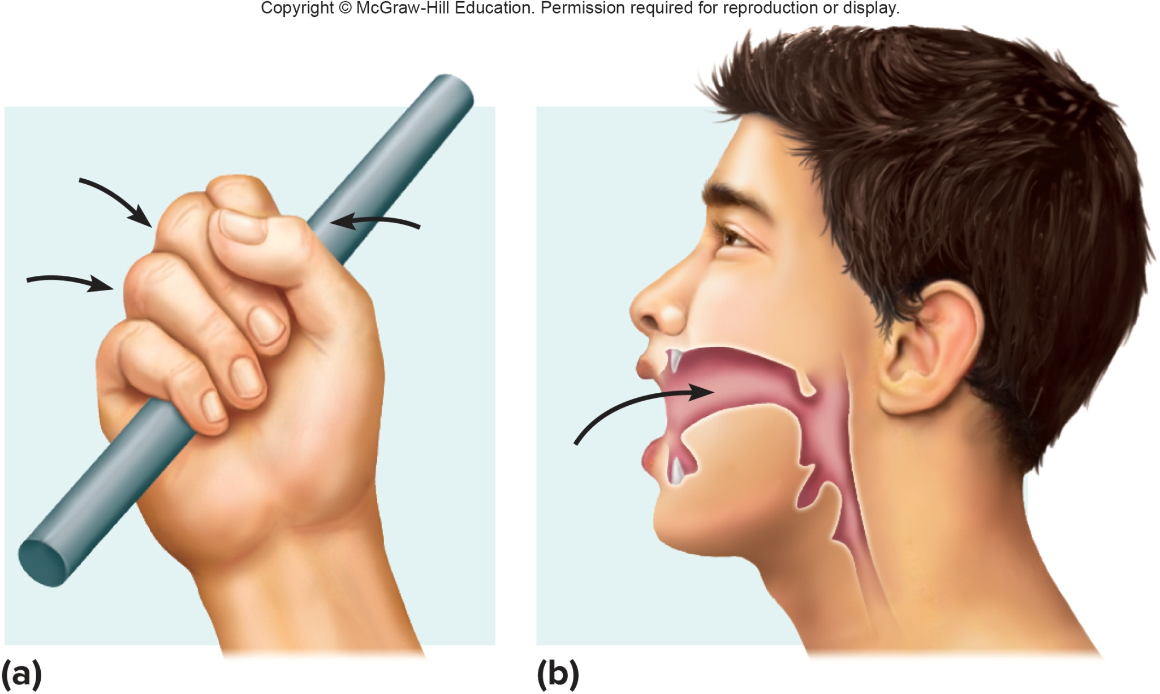
Function is Determined by Structure

Slide 5
1.3: Levels of Organization
All materials, non-living and living, are composed of chemicals.
The human body is the sum of its parts, and these parts can be studied at a variety of levels of organization.
  Chemicals:
    Atoms are the smallest unit of a chemical
    Molecules consist of two or more atoms
    Macromolecules are large, biologically important molecules inside cells.
  Organelles are aggregates of macromolecules used to carry out a specific function in the cell; these are the first level of organization found only in living organisms.

Slide 6
Levels of Organization (2)
  Cells are the basic units of structure and function for living things.
  Tissues are groups of cells functioning together.
  Organs are groups of tissues with specialized functions.
  Groups of organs function together as organ systems.
  Organ systems functioning together make up an organism.

Slide 7
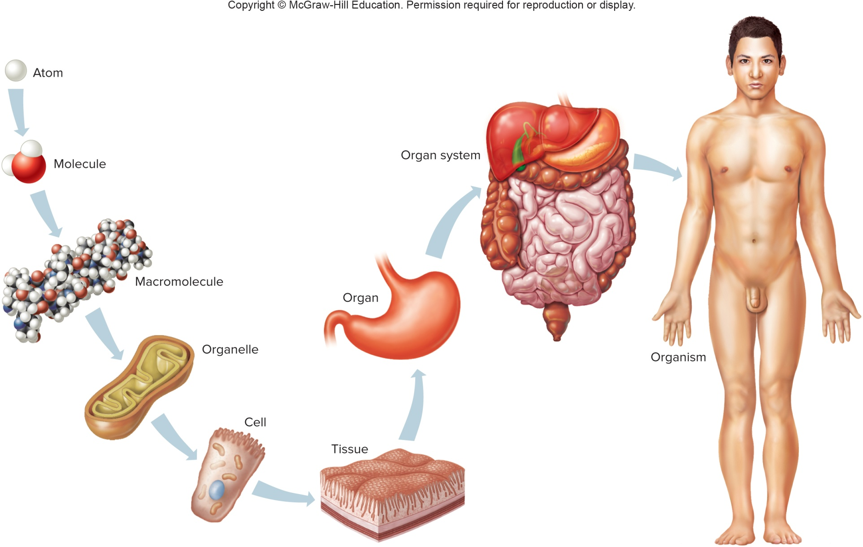
Levels of Organization (3)

Slide 8
1.4: Characteristics of Life
Fundamental characteristics of life are traits shared by all organisms:
Movement – change in position of the body or a body part; motion of an internal organ
Responsiveness – reaction to internal or external change
Growth – increase in size without change in shape
Reproduction – new organisms or new cells
Respiration – use of oxygen and removal of CO₂, to release energy from food
Digestion – breakdown of food into simpler forms

Slide 9
  Characteristics of Life (2)
Absorption – movement of substances through membranes and into fluids
Circulation – movement within body fluids
Assimilation – changing nutrients into chemically different forms
Excretion – removal of metabolic wastes
Taken together, the physical and chemical events that obtain, release, and use energy are a large part of metabolism: the sum of all chemical reactions going on in cells.

Slide 10
1.5: Maintenance of Life
In order to maintain life, all living organisms require certain environmental factors. Requirements of Organisms for Life:
Water:
  - Most abundant chemical in the body
  - Required for many metabolic processes
  - Provides the environment for metabolic processes
  - Transportation medium
  - Regulated body temperature
  - Makes up intracellular and extracellular fluid compartments
Food:
  - Provides the body with needed nutrients
  - Used for energy, raw building materials for growth and repair,
  and to regulate chemical reactions

Slide 11
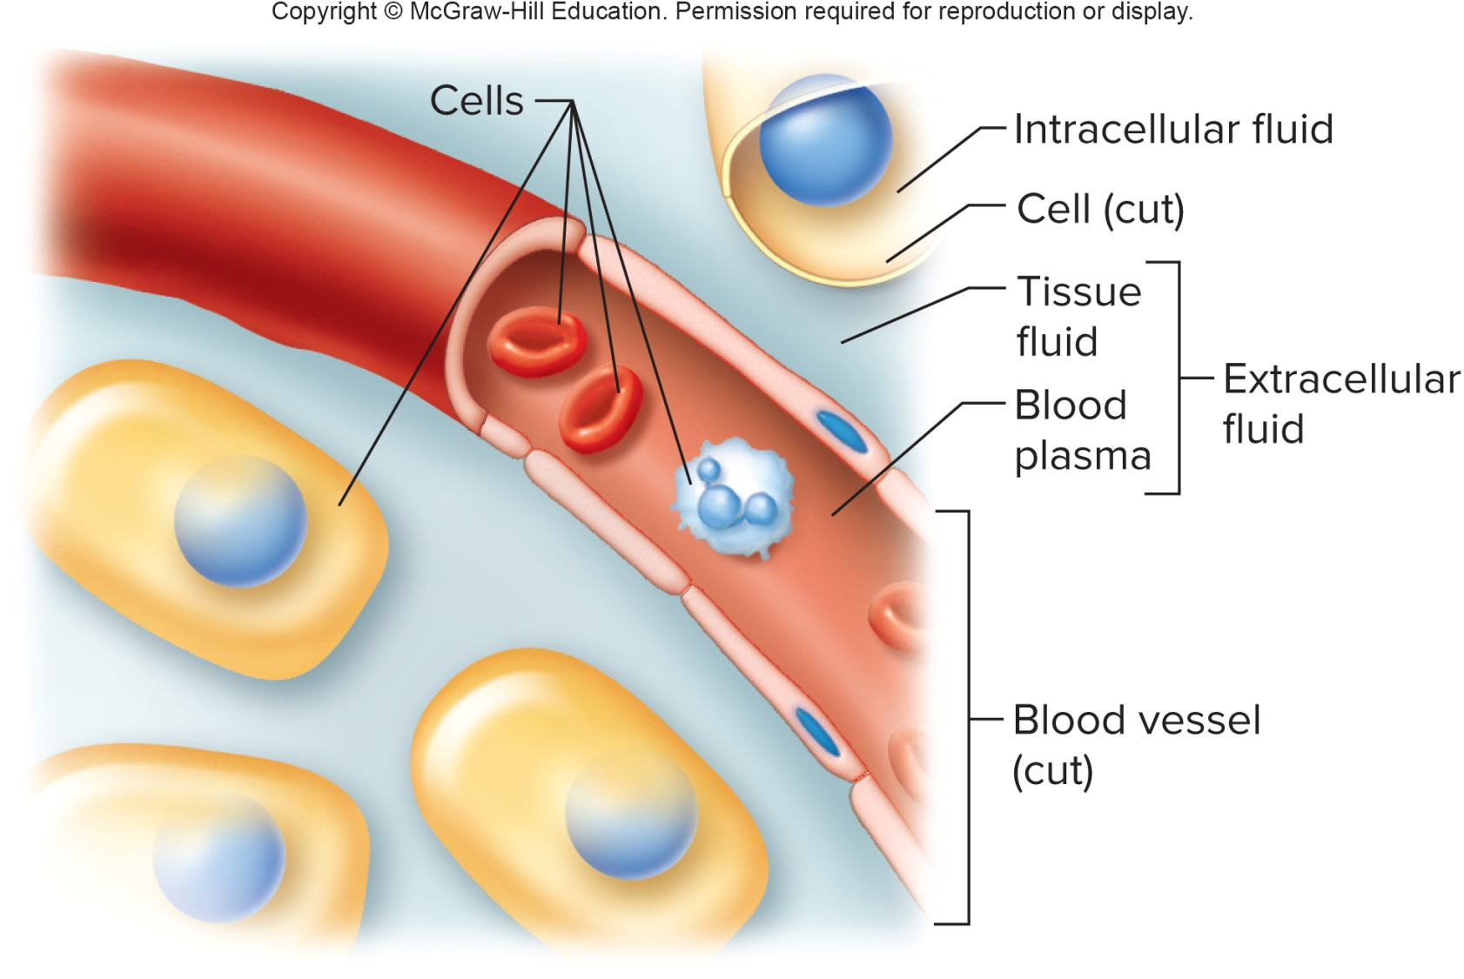
Intracellular and Extracellular Fluids

Slide 12
Requirements of Organisms for Life
Oxygen:
Releases energy from food
Heat:
Form of energy produced in metabolic reactions; temperature
controls reaction rates in the body
Pressure:
- Force applied to something
- Atmospheric pressure is needed for breathing
- Hydrostatic (water) pressure is needed to move blood through
blood vessels
Both the quality and quantity of these factors are important.

Slide 13
Homeostasis
When factors in the external environment (the outside world) change, conditions in the internal environment (the fluid around the body cells) must remain stable.
Maintenance of a stable internal environment is called homeostasis.
Homeostasis is regulated through control systems which have receptors, a set point, and effectors in common.
  Receptors are of many types whose job is to monitor for changes
  The set point is the normal value or range of values
  Effectors are muscles or glands that respond to the changes to return to stability

Slide 14
  Homeostasis (2)
Homeostatic mechanisms:
Self-regulating control systems that the body uses to maintain homeostasis
The body functions properly only when heat, pressure, and the concentrations of water, nutrients, oxygen, etc., remain within narrow specific ranges
Each individual uses homeostatic mechanisms to keep body levels within a normal range; normal ranges can vary from one individual to the next.
Example: Regulation of body temperature in a manner similar to the functioning of a home heating/cooling thermostat
Example: Regulation of blood pressure by pressure-sensitive receptors and muscle cells in the blood vessels

Slide 15
Components of Homeostatic Mechanisms
Homeostatic Mechanisms have 3 components:
Receptors:
Structures that monitor deviations from a set point, and provide information about changes in specific conditions (stimuli) in the internal environment
Set Point:
The normal, homeostatic value for a particular variable, which the body tries to maintain (for example, the set point for body temperature is 98.6ºF or 37ºC)
Effectors:
Muscle cells or glands that bring about the changes necessary to bring a variable back to its set point or normal range

Slide 16
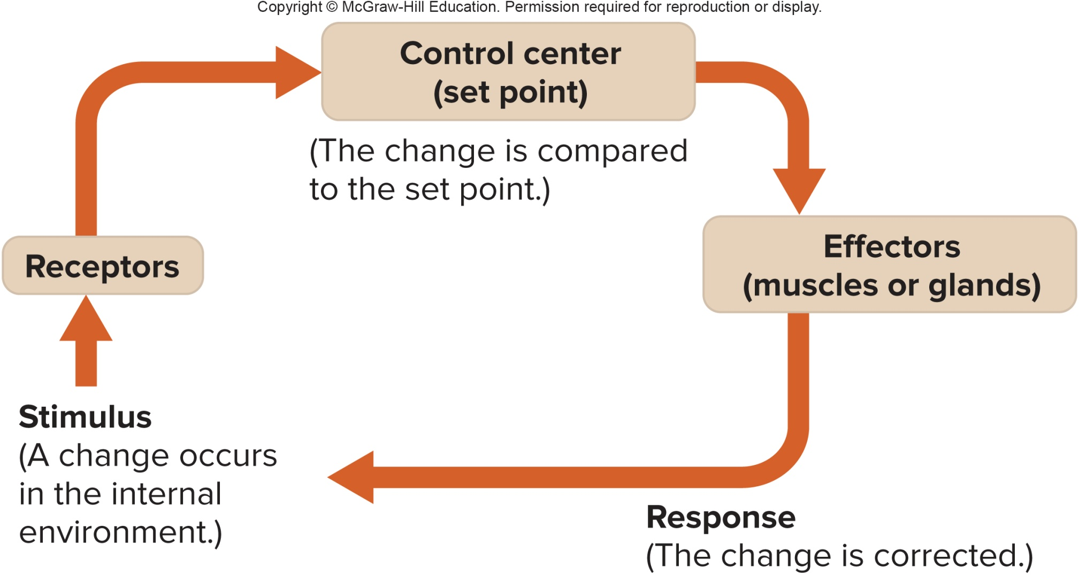
Components of Homeostatic Mechanisms (2)

Slide 17
Negative Feedback
Negative Feedback:
A mechanism by which a deviation in a variable from its set point is corrected
Used in many homeostatic mechanisms
When receptors detect that a variable has deviated from its set point, effectors return conditions toward normal
As the variable returns toward its set point, the effectors gradually shut down; this prevents the correction from progressing too far
Example: A thermostat is similar to a homeostatic control mechanism in the body; it contains receptors, a set point, and effectors, and it maintains normal room temperature

Slide 18
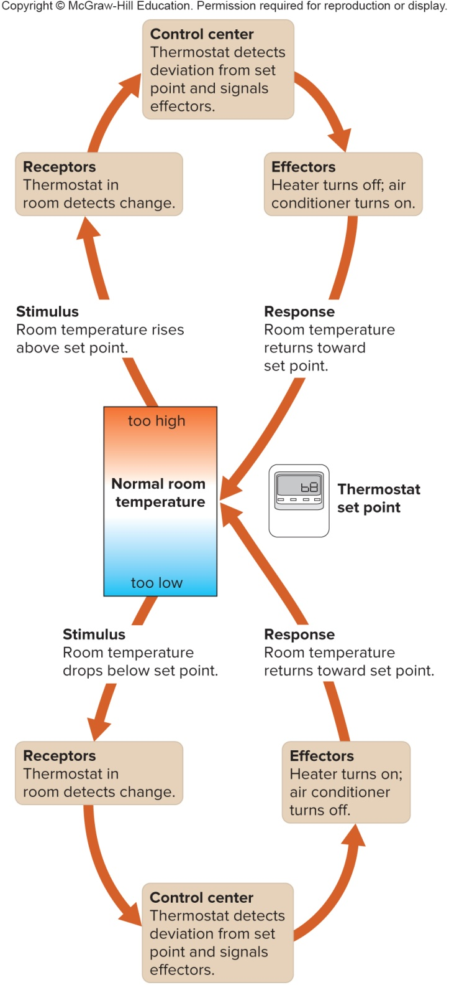
A Thermostat as an
Example of
Negative Feedback

Slide 19
Temperature Regulation in the Body
Responses to Cold Environmental Temperature:
Thermoreceptors detect drop in body temperature
Send nerve signals to control center in brain
Blood vessels in skin constrict, to prevent heat loss through the skin, and conserve heat
Certain muscles are caused to contract involuntarily (shivering) to produce body heat
Sweat glands are inactive
Body is warmed, and body temperature returns toward normal
Responses to Warm Environmental Temperature:
Thermoreceptors detect rise in body temperature
Send nerve signals to control center in brain
Sweat glands are activated to secrete sweat, which cools the skin
Blood vessels in skin dilate to lose heat to the outside

Slide 20
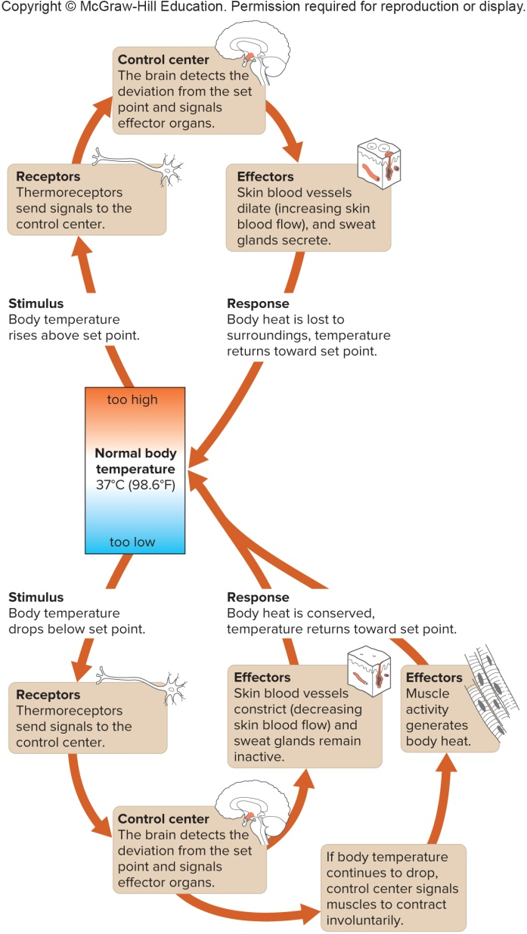
Homeostatic Regulation of Body Temperature

Slide 21
Contributions by Organ Systems to Homeostasis
Organ systems contribute to homeostasis in various ways
Digestive system brings nutrients into the body
Respiratory system brings in oxygen and gets rid of carbon dioxide
Cardiovascular system distributes oxygen and nutrients to the body cells, and transports wastes away from them
Urinary and respiratory systems remove the wastes from the body

Slide 22
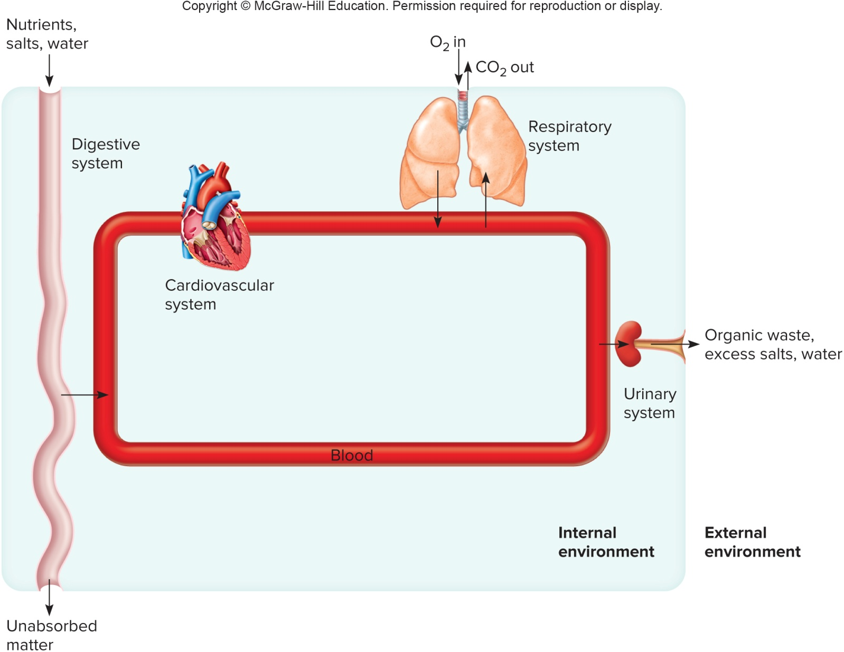
Contributions by Organ Systems to Homeostasis (2)

Slide 23
Positive Feedback Mechanisms
Positive Feedback Mechanism:
A mechanism by which a deviation in a variable from its set point moves conditions away from the normal state
Change from set point gets larger
Many positive feedback mechanisms produce unstable conditions in the body, but they are short-lived, and do bring about homeostasis
Examples associated with normal health:
  Blood clotting leads to more blood clotting, which stops bleeding
  During childbirth, uterine contractions stimulate more uterine contractions, which lead to birth of baby

Slide 24
1.6: Organization of the Human Body
Body Cavities:
The body can be divided into an axial portion (head, neck, and trunk) and an appendicular portion (upper and lower limbs)
The axial portion contains several cavities that house body organs:
  - Cranial cavity – brain
  - Vertebral canal – spinal cord
  Thoracic cavity – heart, lungs, mediastinum
  Abdominopelvic cavity:
  1. Abdominal cavity – viscera of digestion and the spleen
  2. Pelvic cavity – end of large intestine, urinary bladder,
  and internal reproductive organs
  A broad, thin muscle called the diaphragm separates the thoracic and abdominopelvic cavities

Slide 25
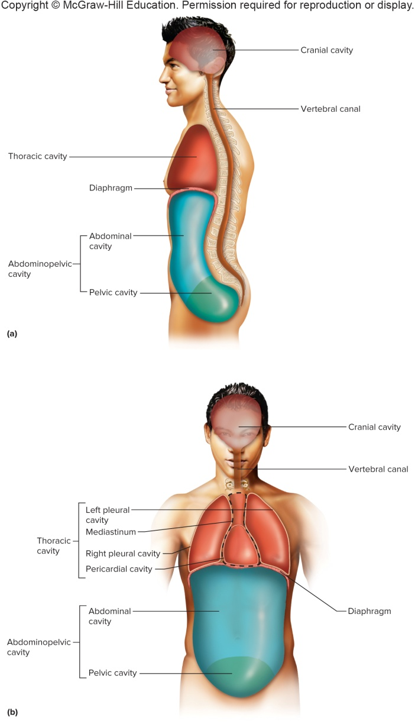
Major Body Cavities:
Lateral and Anterior Views

Slide 26
Small Cavities in the Head
Smaller cavities within the head include:
Oral cavity:
Mouth area; contains tongue and teeth
Nasal cavity:
Inside nose; divided into left and right portions by nasal septum, and contains sinuses
Orbital cavities:
Contain eyes along with their nerves and skeletal muscles
Middle ear cavities:
Contain middle ear bones

Slide 27
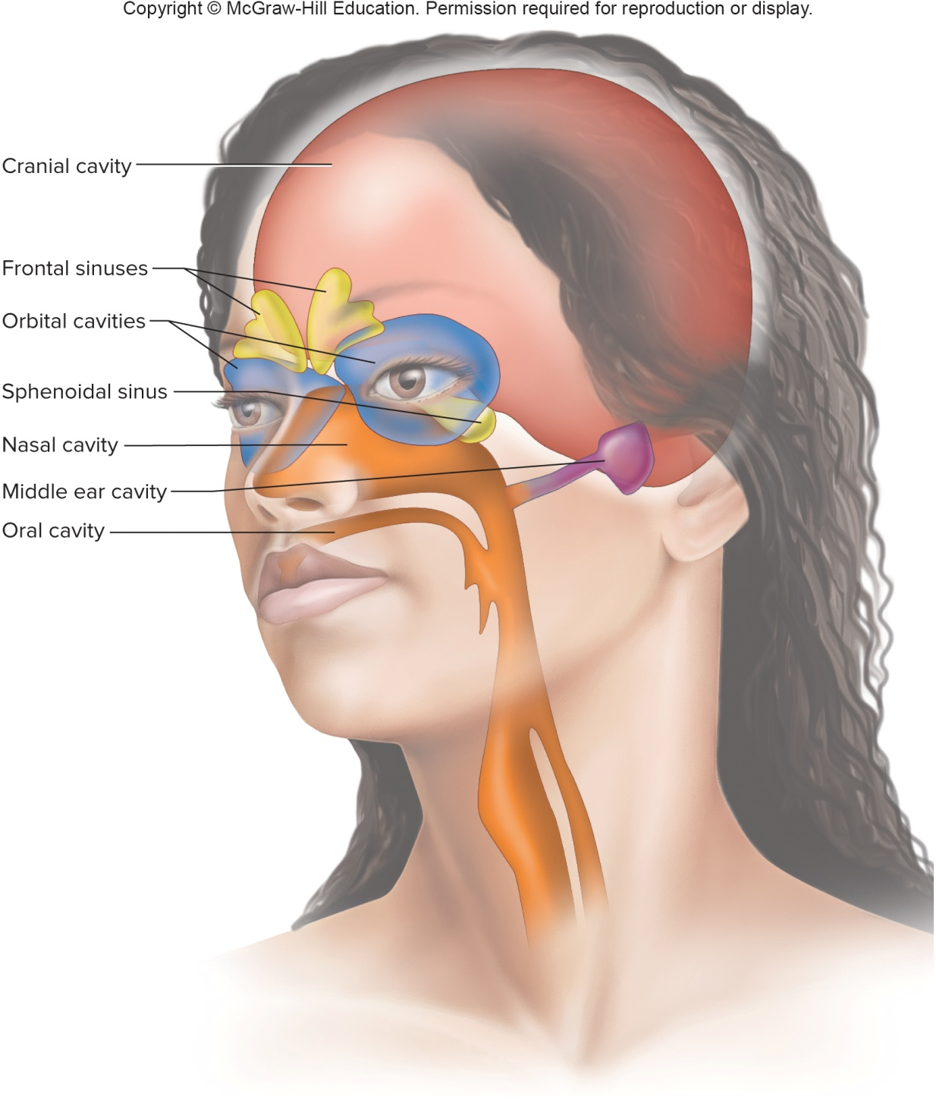
Small Cavities in the Head (2)

Slide 28
Thoracic and Abdominopelvic Membranes
Double-layered membranes
The parietal portion attaches to wall cavity and the visceral portion covers the internal organ
  Pleural Membranes: Line the thoracic cavity; the parietal pleura lines the inner wall of thoracic cavity, while the visceral pleura covers the lungs; a thin layer of serous fluid separates the two layers; potential space between layers is pleural cavity
  Pericardial membranes: Surrounds heart; the parietal pericardium makes up outer layer, and the visceral pericardium covers the heart; serous fluid separates the two layers; potential space between layers is pericardial cavity
  Peritoneal membranes: Line the abdominopelvic cavity; a parietal peritoneum lines the wall, while the visceral peritoneum covers the organs; potential space between layers is the peritoneal cavity

Slide 29
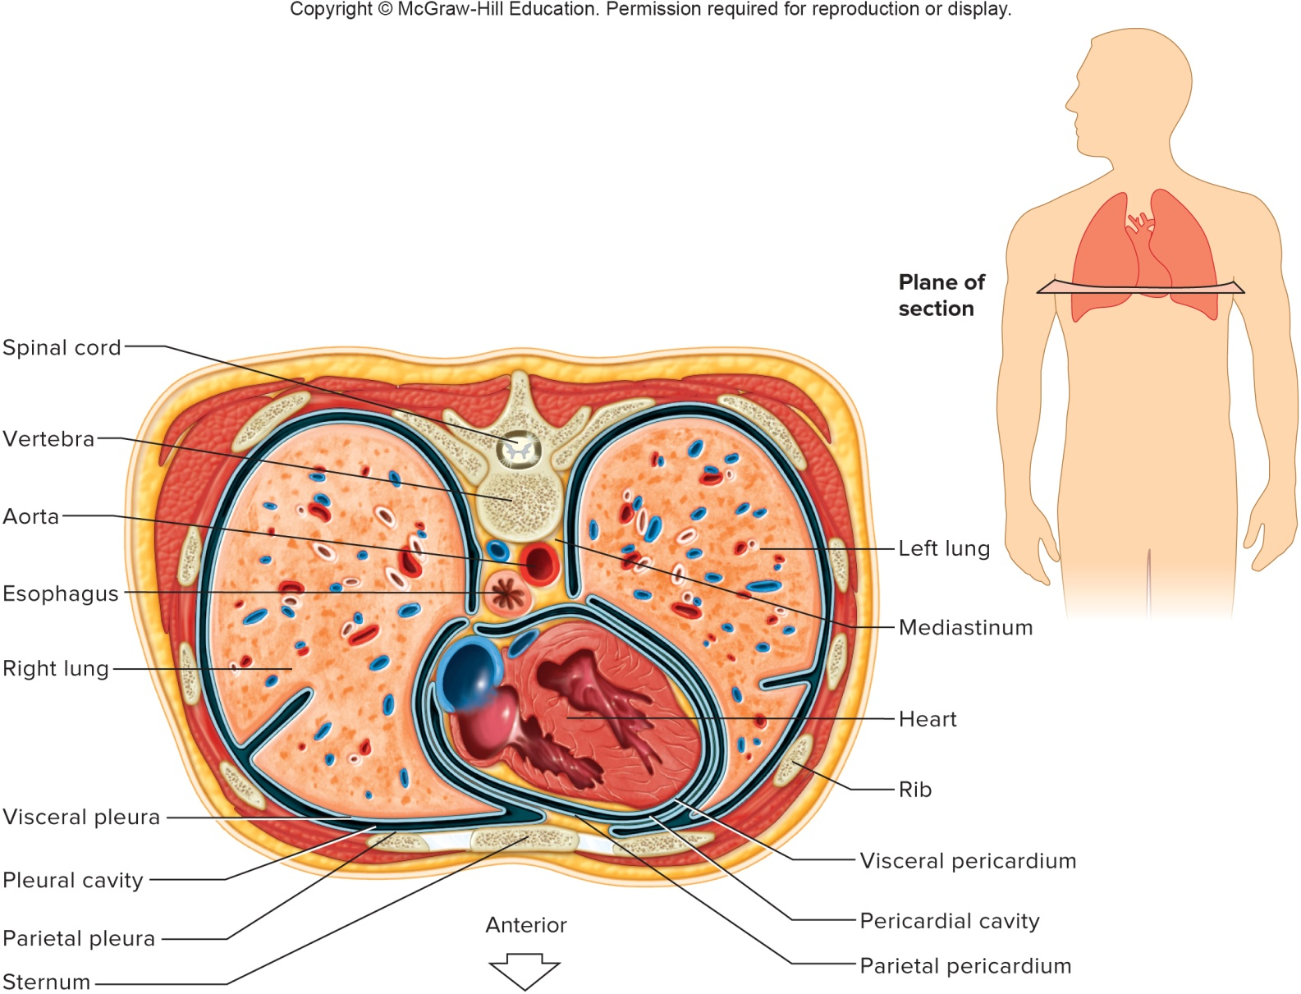
Transverse Section
Through the Thorax

Slide 30
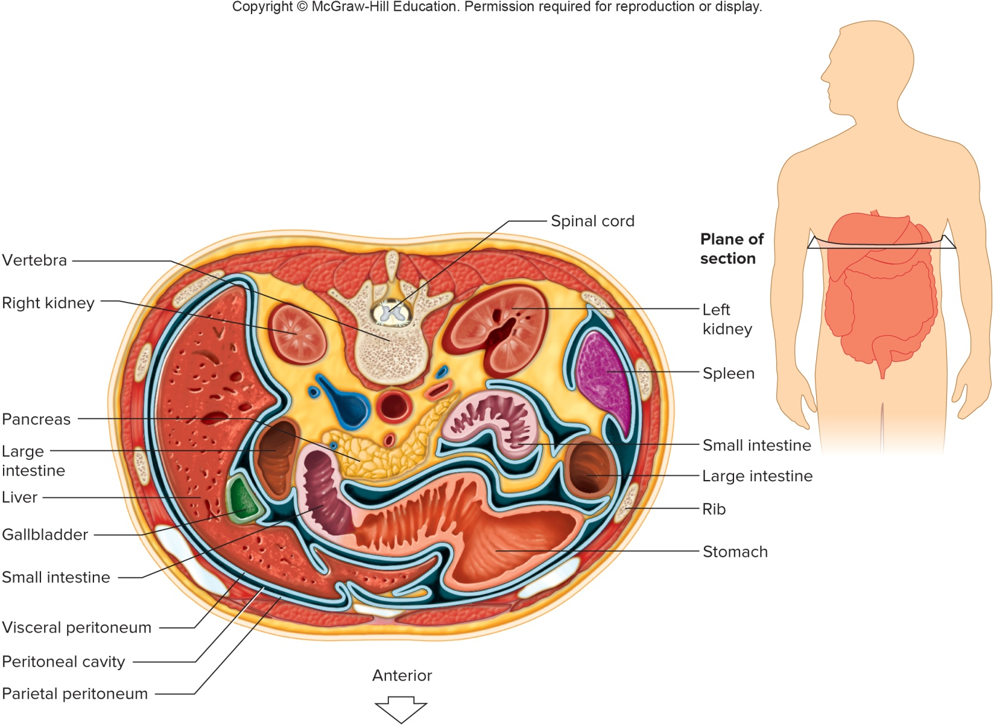
Transverse Section
Through the Abdomen

Slide 31
Organ Systems
Body consists of several organ systems
Each system contains a group of organs that work together to accomplish a specific function
Each system contributes to homeostasis

Slide 32
Organ Systems: Body Covering
Body System that Provides the Body Covering:
The integumentary system provides the body covering
This system includes skin, hair, nails, and various glands
It protects underlying tissues, helps regulate body temperature, senses changes via a variety of sensory receptors, and synthesizes certain products

Slide 33
  Organ Systems: Support and Movement
Body Systems that Provide Support and Movement:
Skeletal system:
Consists of bones, ligaments and cartilages
Supports, protects, provides frameworks, stores inorganic salts, and houses tissues that produce blood cells
Muscular system:
Consists of the muscles
Provides body movement and posture, and is major source of body heat

Slide 34
  Organ Systems: Integration & Coordination
Body Systems that Provide Integration & Coordination:
Nervous system:
Consists of the brain, spinal cord, nerves, and sense organs
Cells communicate with each other and with muscles and glands via neurotransmitters
Cells function in either sensory reception, integration of incoming information, or stimulation of muscles and glands
Endocrine system:
Consists of all glands that secrete chemical messengers called hormones
Includes the hypothalamus, pituitary, thyroid, parathyroid, pineal, and thymus glands, pancreas, ovaries, and testes, along with other organs that secrete hormones
Hormones alter metabolism of specific target cells
Hormones are slower to respond than neurotransmitters, but effects last longer

Slide 35
  Organ Systems: Transport
Body Systems that Provide Transport of Substances through the Body:
Cardiovascular system:
Consists of the heart, blood vessels, and the blood
It distributes oxygen, nutrients, and hormones throughout the body, while removing wastes from the cells
Lymphatic system:
Consists of lymphatic vessels, lymph nodes, thymus, spleen, and lymph (fluid)
Drains excess tissue fluid and returns it to the blood
Lymphocytes are cells of immunity; defend body against infection

Slide 36
  Organ Systems: Absorption and Excretion
Body Systems that Provide Absorption and Excretion:
Digestive system:
Consists of the mouth, esophagus, stomach, intestines, and accessory organs
Receives, breaks down, and absorbs nutrients
Respiratory system:
Exchanges O₂ and CO₂ between the blood and air
Consists of the lungs and air passageways (nasal cavity, pharynx, larynx, trachea, bronchi)
Urinary system:
Consists of the kidneys, ureters, bladder, and urethra
Removes wastes from the blood and helps to maintain water and electrolyte balance

Slide 37
  Organ Systems: Reproduction
Body Systems that Provide Reproduction:
The reproductive systems of the male and female produces new organisms together
Male reproductive system:
- Consists of the testes, scrotum, epididymides, ductus deferentia,
seminal vesicles, prostate gland, bulbourethral glands, penis, and
urethra
- Produce and maintain sperm, and conduct them to the female
reproductive tract
Female reproductive system:
- Consists of ovaries, uterine tubes, uterus, vagina, clitoris, vulva
- Produces female sex cells (egg cells or oocytes)
- Houses the developing offspring and functions in birth

Slide 38
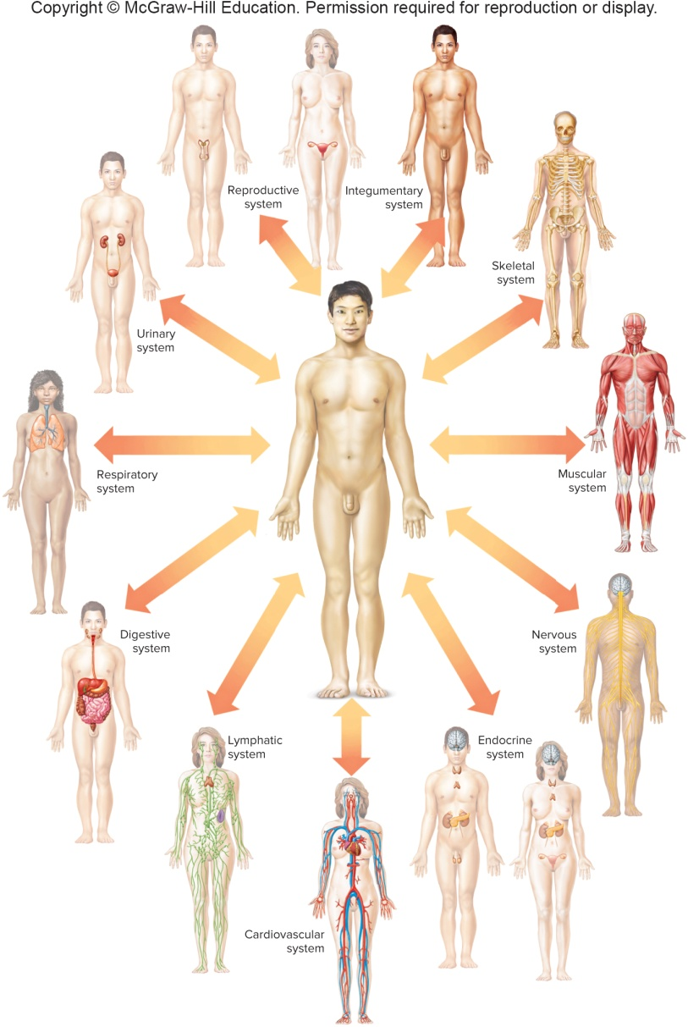
Organ Systems Interact for Homeostasis

Slide 39
1.7: Anatomical Terminology
Anatomical position:
Body erect, face forward, upper limbs at sides with palms forward
Terminology assumes that body is in anatomical position
Terms of relative position:
Terms that describe location of one body part with respect to another
Superior – above another part
Inferior – below another part
Anterior (ventral) – toward the front
Posterior (dorsal) – toward the back
Median – closer to the midline (when body is divided into left and right halves)
Lateral – toward the side, away from midline
Bilateral – paired structures with one on each side

Slide 40
Terms of Relative Position
Ipsilateral – structures on the same side of body
Contralateral – structures on the opposite sides of body
Proximal – closer to point of attachment to trunk or another referenced body part
Distal – further from the point of attachment to trunk or another referenced body part
Superficial or peripheral – near the surface or outward
Deep – more internal

Slide 41
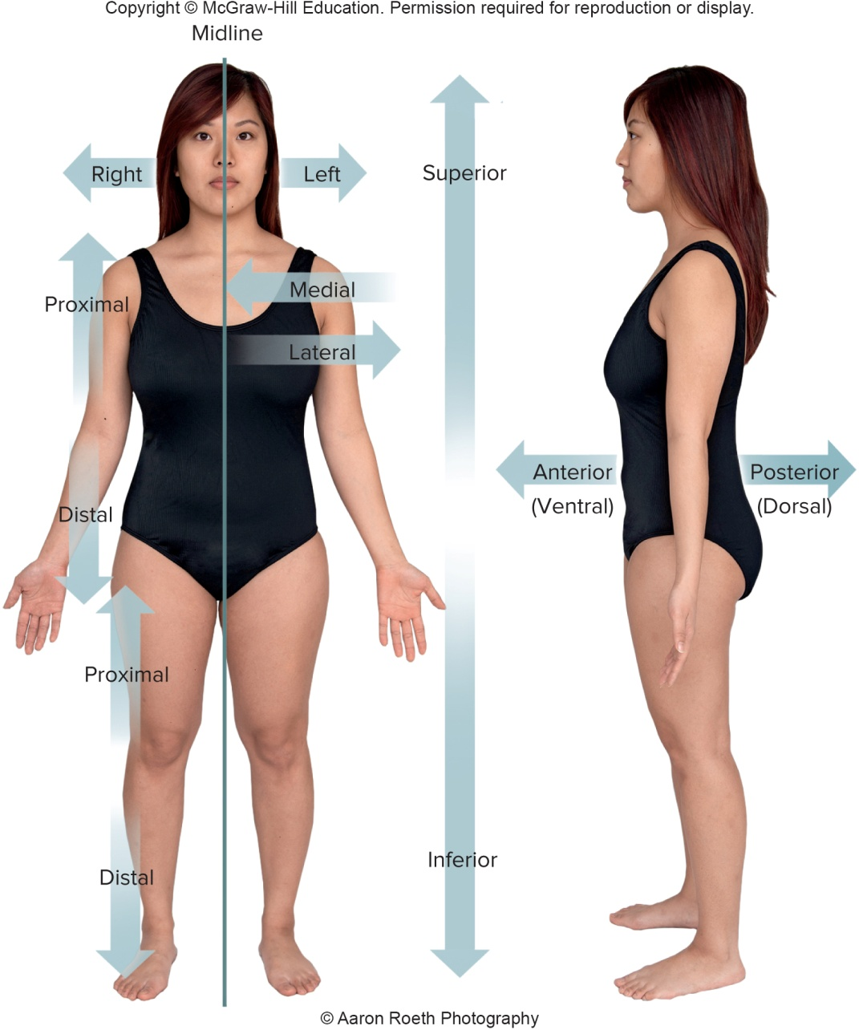
Terms of Relative Position (2)

Slide 42
Terminology of Body Sections
Sagittal section:
Divides the body into right and left portions
If it passes along the midline and divides the body into equal parts it is a median or midsagittal section
A section lateral to the midline is parasagittal
Transverse (horizontal) section:
Divides the body into superior and inferior portions
Frontal (coronal) section:
Divides the body into anterior and posterior sections

Slide 43
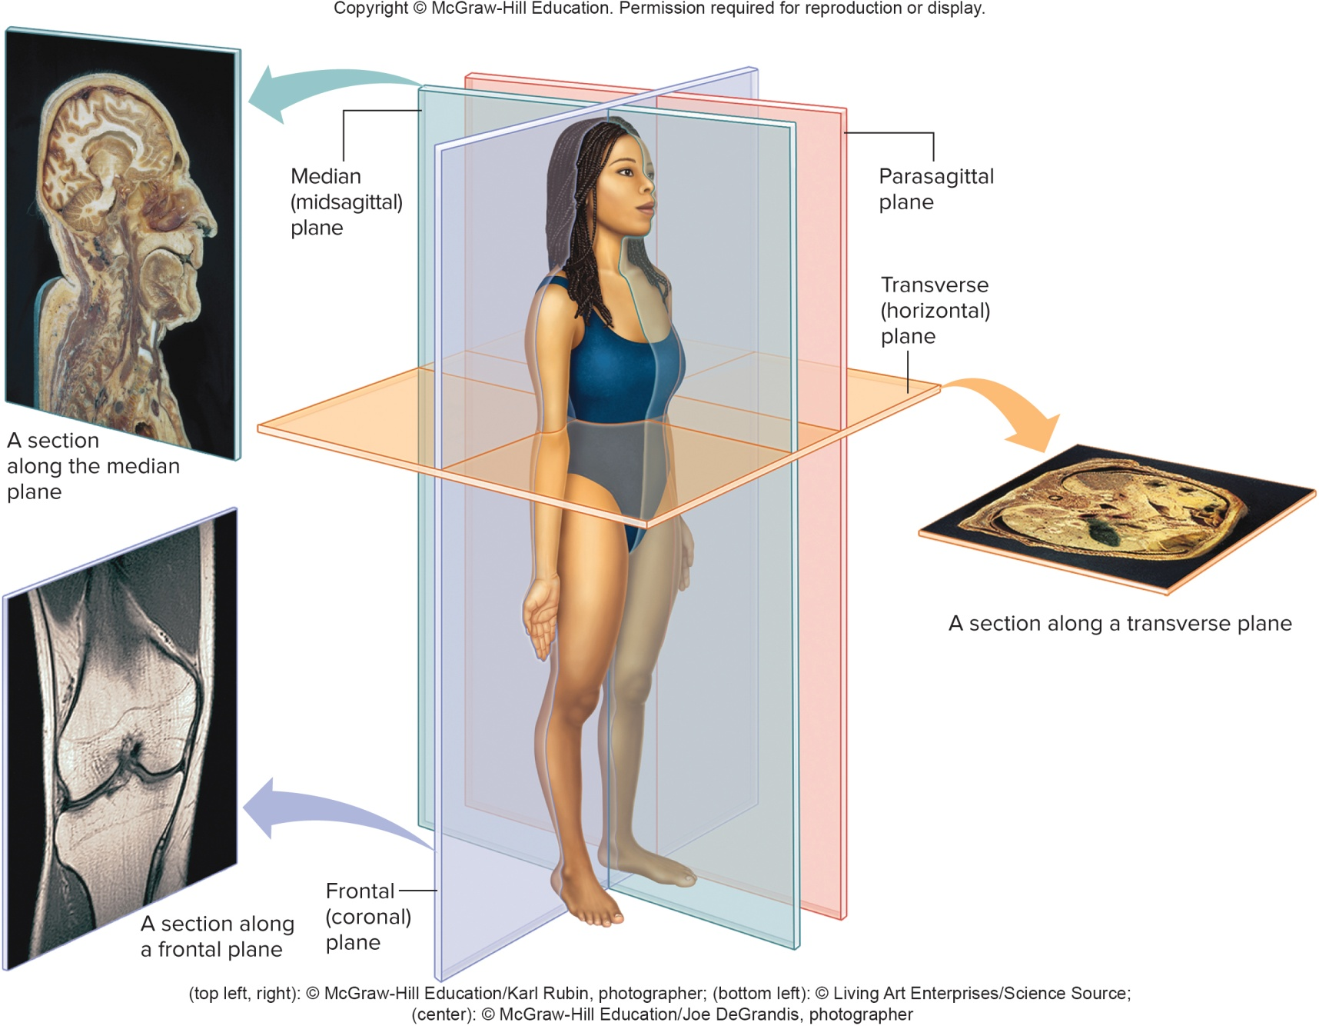
Body Sections

Slide 44
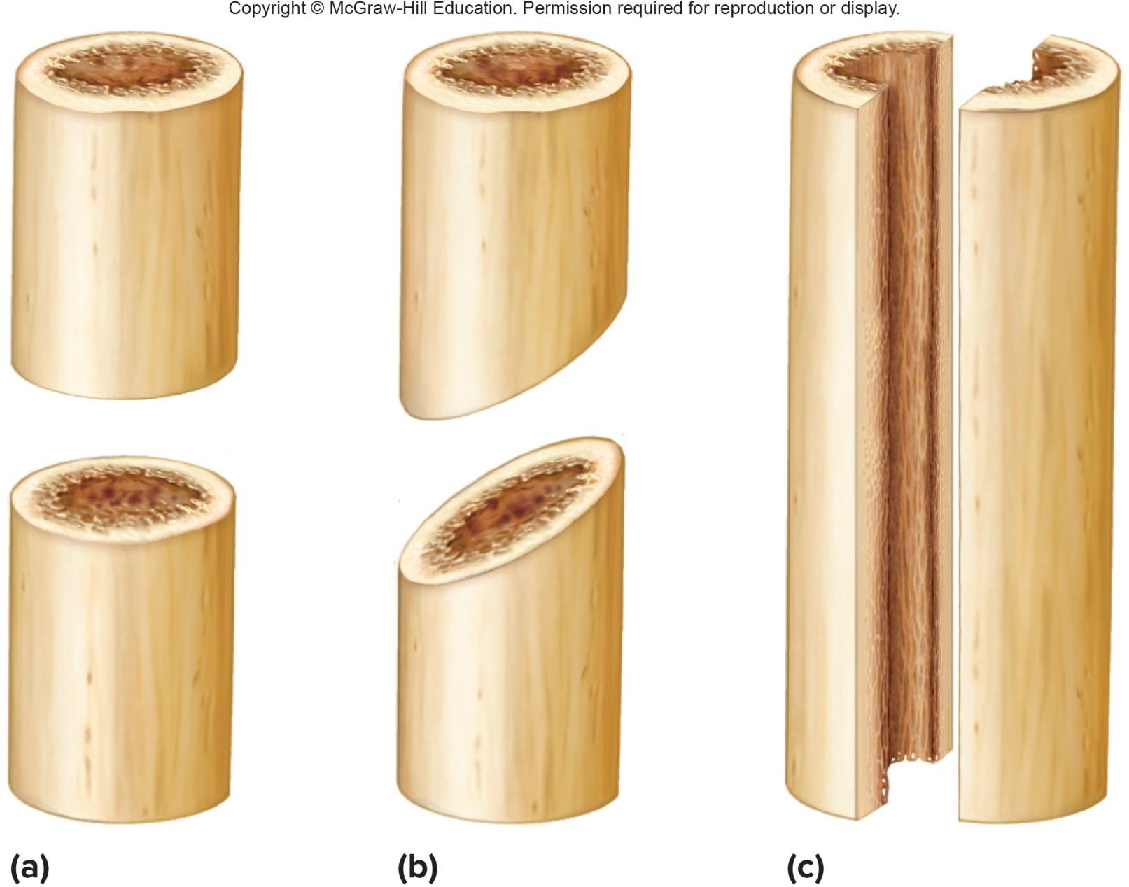
Body Sections in Cylindrical Organs

Slide 45
Body Regions of the Abdominal Area
The abdominal area can be subdivided into nine regions:
Epigastric – Upper middle part
Right and left hypochondriac – To the sides of epigastric region
Umbilical – Middle part
Right and left Lateral (lumbar) – To the sides of umbilical region
Pubic (Hypogastric) – lower middle part
Right and left inguinal (iliac) – To the sides of hypogastric region
The abdominal area can also be subdivided into 4 quadrants:
Right upper quadrant
Right lower quadrant
Left upper quadrant
Left lower quadrant

Slide 46
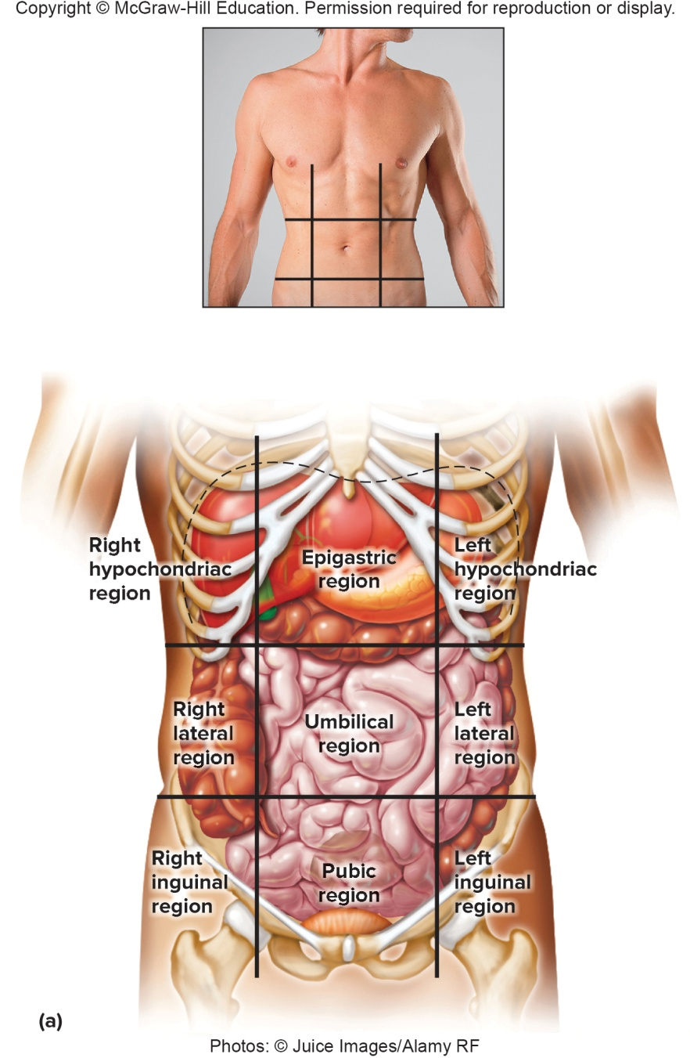
Body Regions of the Abdominal Area (2)

Slide 47
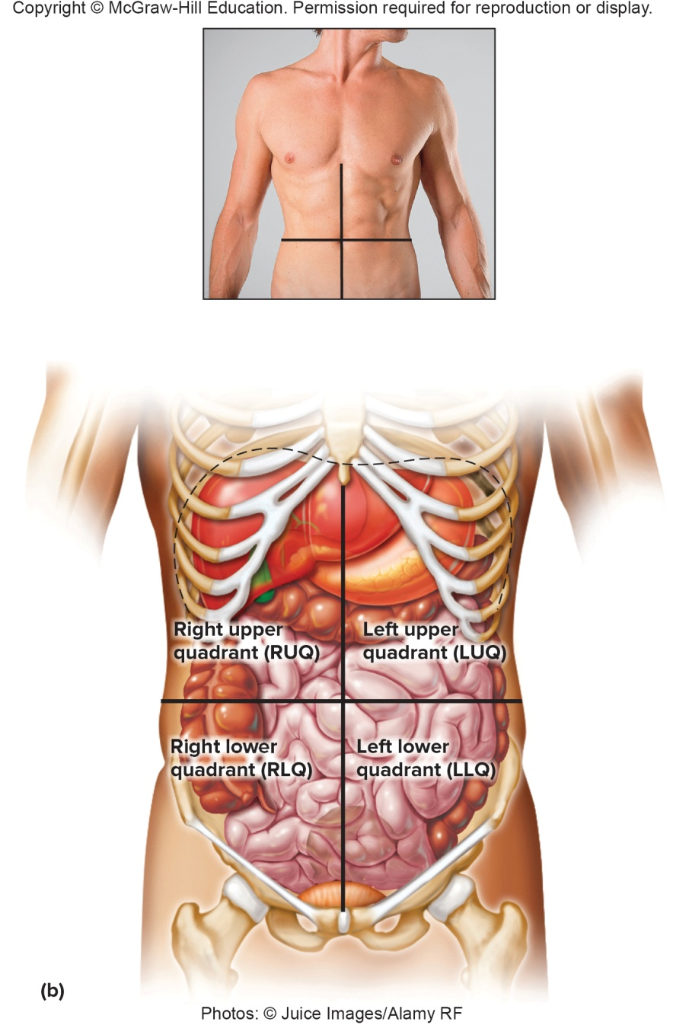
Quadrants of the Abdominal Area

Slide 48
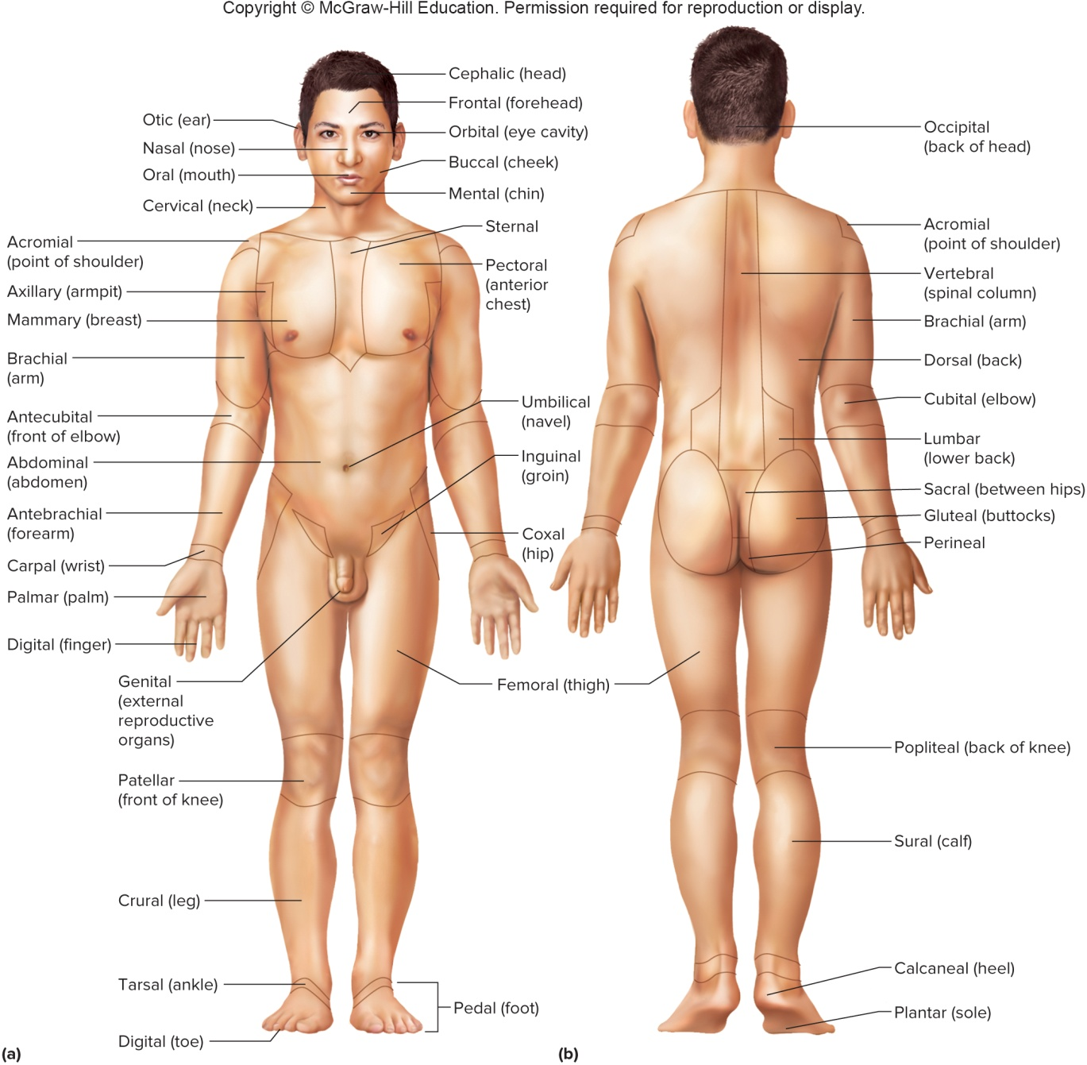
Terms for Various Body Regions

