Slide 1
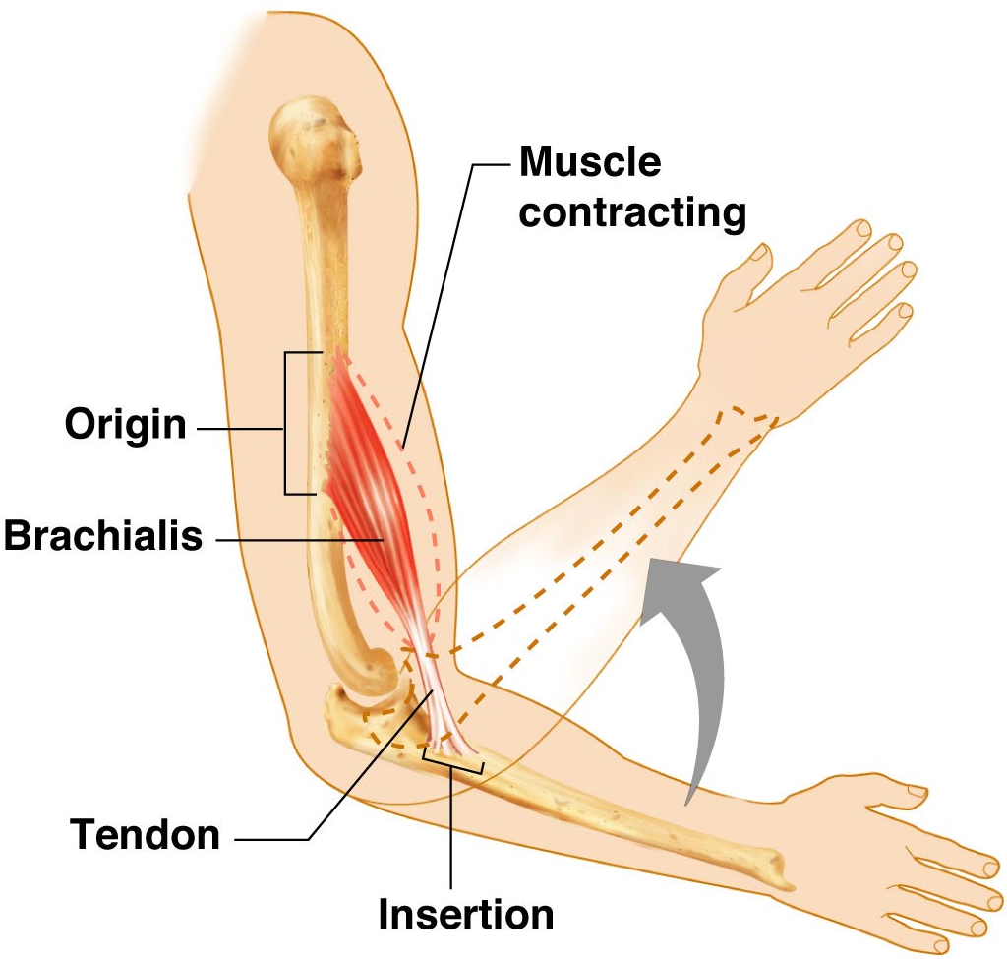
Figure 6.12

Slide 2
Types of Ordinary Body Movements
Flexion
  Decreases the angle of the joint
  Brings two bones closer together
  Typical of hinge joints like knee and elbow
Extension
  Opposite of flexion
  Increases angle between two bones

Slide 3
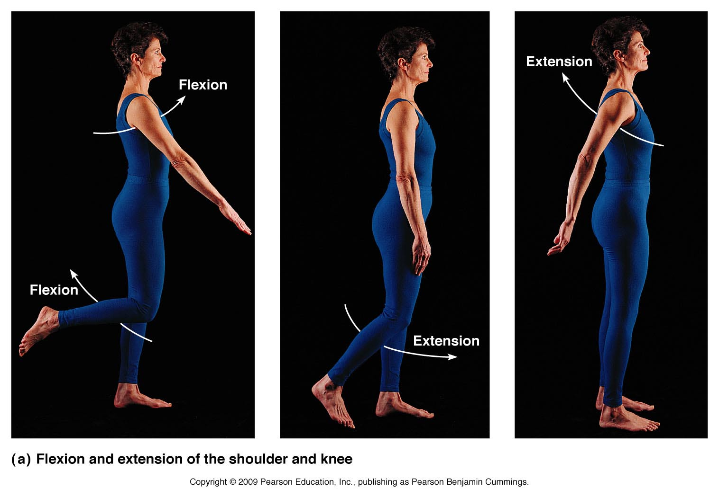
Figure 6.13a

Slide 4
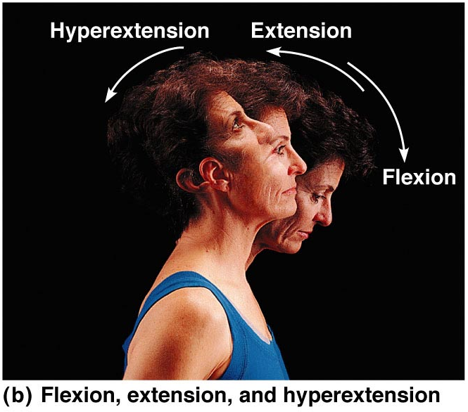
Figure 6.13b

Slide 5
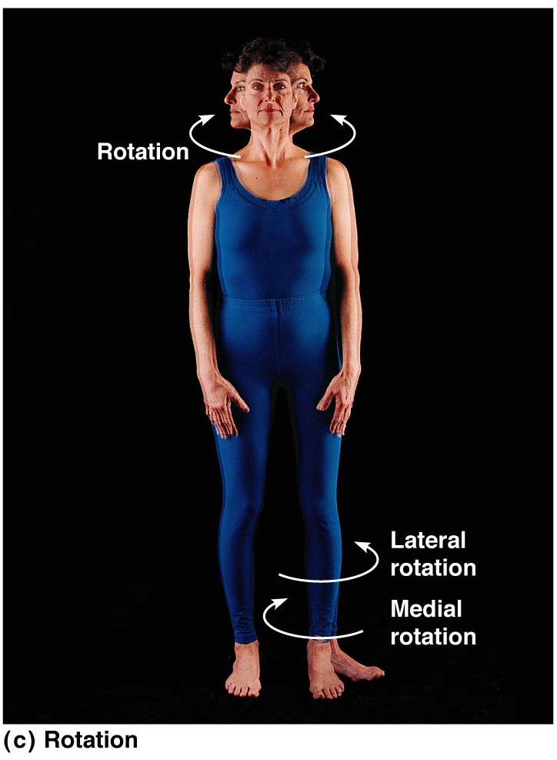
Figure 6.13c

Slide 6
Types of Ordinary Body Movements
Abduction
  Movement of a limb away from the midline
Adduction
  Opposite of abduction
  Movement of a limb toward the midline

Slide 7
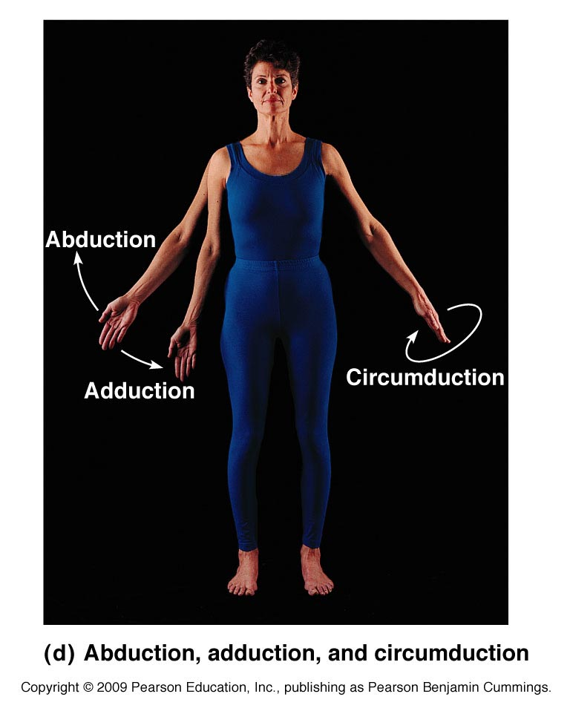
Types of Ordinary Body Movements
Figure 6.13d

Slide 8
Types of Ordinary Body Movements
Circumduction
  Combination of flexion, extension, abduction, and adduction
  Common in ball-and-socket joints

Slide 9
Types of Ordinary Body Movements
Figure 6.13d

Slide 10
Special Movements
Dorsiflexion
  Lifting the foot so that the superior surface approaches the shin
Plantar flexion
  Depressing the foot (pointing the toes)

Slide 11
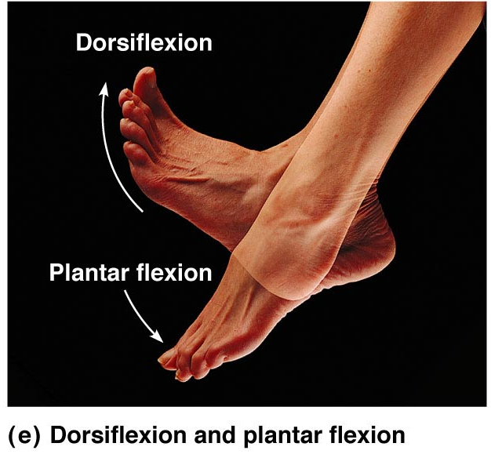
Special Movements
Figure 6.13e

Slide 12
Special Movements
Inversion
  Turn sole of foot medially
Eversion
  Turn sole of foot laterally

Slide 13
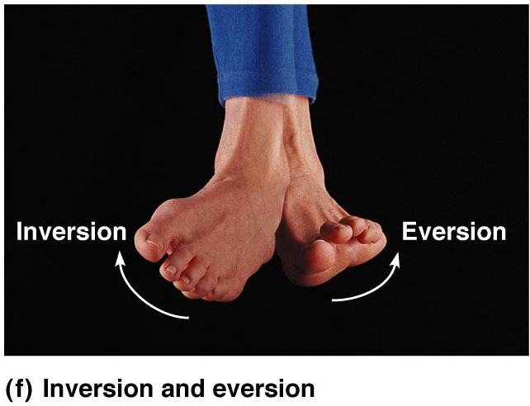
Special Movements
Figure 6.13f

Slide 14
Special Movements
Supination
  Forearm rotates laterally so palm faces anteriorly
Pronation
  Forearm rotates medially so palm faces posteriorly

Slide 15
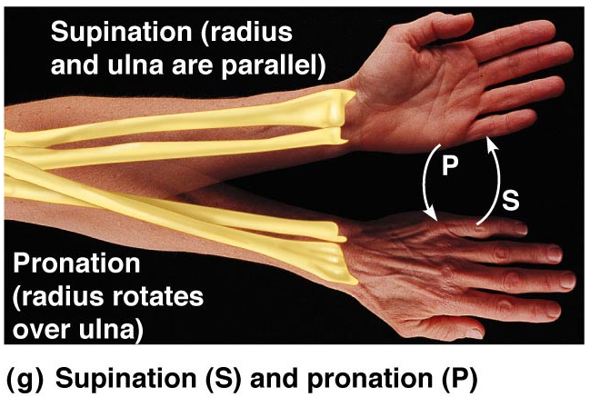
Special Movements
Figure 6.13g

