Slide 1

Finance Training
Training For School Secretaries and Bookkeepers
Updated 10/26/2022

Slide 2
Agenda
Account Structure
P-Cards
Travel
SmartFind Express
Updated 10/26/2022

Slide 3
Account Structure
Organization Key and Function/Object
Click here to
return to agenda

Slide 4
The Organization Key
10 251 152 00
Fund Loc Project Subj
  The org key consists of 10 digits
    Fund -2 digits
    Location – 3 digits
    Project -3 digits
    Subject – 2 digits
Click here to
return to agenda

Slide 5
Fund – 2 digits in the Org Key
10 251 152 00
Fund Loc Project Subj
Fund
  The first 2 digits refer to the fund
  Different funds have different documentation requirements
Funds used at Schools and Departments are:
  Fund 100 (10) is the General Fund – This is District Funds
  Funds starting with 4* are Federal Funds (ex: 42 & 46)
    Food Service is fund 410 (41)
    Fund 42* will remain, fund 43* is closed
    Fund 46*, ESSER III, closes 9/30/2024 but may close earlier, budgets are set
  Capital Projects Fund 370 (37)
    Can only have function 7400 and an object starting with a 6**
Click here to
return to agenda

Slide 6
Location – 3 digits in the key
12 345 678 90
Fund Loc Project Subj
Location
  The next 3 digits in the Org Key
  It is the last 3 digits of the four digit school or location number
  It represents your school or department
  Examples:
      Location 0021 is Sallie Jones Elementary
        Use 021 for the Location in the Org Key
      Departments with zero after the “9”, drop the “0”
        9033 is ESE’s Department number;
        Use 933 for the Location in the Org Key
Click here to
return to agenda

Slide 7
Projects - 3 Digits in the Key
10 251 152 00
Fund Loc Project Subj
Projects
  The next 3 digits in the Org Key
  Refers to funds set aside for a specific purpose
  Examples:
    000 Account: Basic operating budget for each school or department
    011 to 299: General Fund projects (Ex: 152-School Improvement)
    300 to 399: Capital Fund projects (Ex: 371, 372, 375-Instructional Equipment) Only func 7400/Obj 6*
    400 to 499: Federal Fund projects
      Exceptions: A few others do not have 400 project numbers.
      ESSER III projects are 005 and 004
      The exceptions typically have an identifying subject (the last two digits of the org key).
      For example, 005LL, 005SP etc. Each of these represent a separate grant.
Click here to
return to agenda

Slide 8

Subject – 2 Digits in the Key
10 251 152 00
Fund Loc Project Subj
Subject
  Used primarily to break down projects that may have to be separated for reporting or easier budgeting, further specifies monies inside a project.
  Most commonly used with Grants and can include letters
    Example: 10191178G5
    Project 178 is CLEF grants, the G5 specifies the Disaster Funding Grant
Click here to
return to agenda

Slide 9
Function & Object
The Function and Object consists of 7 digits
They are defined by Florida Department of Education in the
Financial and Program Cost Accounting and
Reporting for Florida Schools (Red Book)
      Function - 4 digits
      Object – 3 digits
Function Object
642
Click here to
return to agenda

Slide 10
Functions – 4 digits
7400 642
Function Object
Functions
  4 digit code
  Describes the objective or purpose of an item being purchased
  Example:
  5xxx: Instruction – dealing directly with teaching of students
  6xxx: Student and Instructional Support
  7xxx: General Support Services
  8xxx: General Support Services
  9100: Community Services such as before and
  after-school care
Click here to
return to agenda

Slide 11
Function con’t
7400 642
Function Object
Extra Info
  Function 6400 – Instructional Staff Training
    Is for Instructional Staff, Para’s are function 7700
    Subs to cover teachers on leave for training should be coded to 6400
  Function 7300 – School Administration
    Supplies for the office (do not use 5100 for office supplies)
  Function 7400 – Facilities Acquisition and Construction
    Must be used in Capital Funds – with 6** objects, no supplies
    Normally will not be used by schools in other funds
  Function 7600 – Food Service
    Normally, only used by Food Service Department
    Cannot be used in the General Fund
    Normally, will not be used by schools
Click here to
return to agenda

Slide 12
Object Codes – 3 digits
7400 642
Function Object
Object
  Defines the item being purchased. It indicates the types of goods and services obtained as a result of a specific expenditure.
  Examples:
    100: Salaries (Only use for creating PAF)
    200: Benefits (Only used by Payroll)
    300: Purchased Services
    400: Energy (Not used at the school level)
    500: Material and Supplies
    600: Capital Outlay
    700: Other (Mostly for substitutes – 753 & 754)
Click here to
return to agenda
Notes:
We’ll review Salaries and Benefits in more detail .

Slide 13
Object Codes – 3 digits
Salaries
5100 100
Function Object
Salary object codes are 100 numbers
    1x1 (ending in a “1”) are primary paylines
      Examples: 121 are teachers
      151 are para’s
    1x2 (ending in a “2”) are overtime payroll
      Example: 162 is Custodial overtime
    1x9 (ending in a 9) are other pay
Click here to
return to agenda

Slide 14
Object Codes – 3 digits
Benefits
5100 210
Function Object
Benefits object codes are 200 numbers
    They include:
      Retirement
      Employer portion of social security and Medicare
      Worker’s compensation
      Health insurance
      Life and long-term disability
Click here to
return to agenda

Slide 15
Object Codes – 3 digits
Purchased Services
5100 300
Function Object
Purchased services object codes are 300 numbers
  331: In-County travel
  332: Out-of-County travel – This includes all conference fees, registration, travel, hotel, and parking
  333: Taxable meals
    When travel does not require an over night stay, the meals are taxable and are added to your payroll check.
  369: Technology Web (Software) related Rentals (Subscriptions)
  MUST be on a PO and approved by the Superintendent of IT
  373: Postage
  395: In-house professional development (speakers that come to CCPS)
Click here to
return to agenda

Slide 16
Object Codes – 3 digits
Energy
7900 430
Function Object
Energy object codes are 400 numbers
  They include:
      Electricity
      Water
      Gas
  They are generally coded to your location with project number 000, subject 01 as they are not in your operating budget.
  These object codes are not used by schools. If gas is purchased it should be coded to travel.
Click here to
return to agenda

Slide 17
Object Codes – 3 digits
Materials and Supplies
5100 510
Function Object
Materials and Supplies object codes are 500 numbers
  510 is the object code for Consumable (supplies that are intended to be used quickly, paper) and we include low value supplies (stapler).
  Be sure to use the correct function. 5*** is for classroom supplies, 7300 is for front office supplies.
Click here to
return to agenda

Slide 18
Object Codes – 3 digits
Capital Outlay
7400 642
Function Object
Capital Outlay object codes are 600 numbers
  Assets that last longer than a year.
  CCPS capitalization threshold is $5,000, schools do not typically purchase capitalized assets. These are purchased through Procurement or Construction departments
  If the cost is below $5,000 the asset is not capitalized.
    610 – Books-includes any book for student in-school use.
    642 - Non-capitalized furniture, fixtures, or equipment.
    644 – Non-capitalized computer hardware-Must be purchased through the IT department.
  If the cost is $5,000 or more the asset is capitalized.
    641 – Capitalized furniture, fixtures, or equipment.
    643 – Capitalized computer hardware-Must be purchased through IT
    Normally in fund 370, must be function 7400
Click here to
return to agenda

Slide 19
Object Codes – 3 digits
Other
5200 730
Function Object
Other expenditures object codes are 700 numbers
  They include:
    730: Dues, professional memberships, webinars
    753: Substitute for teacher
    754: Substitute for para
Click here to
return to agenda

Slide 20
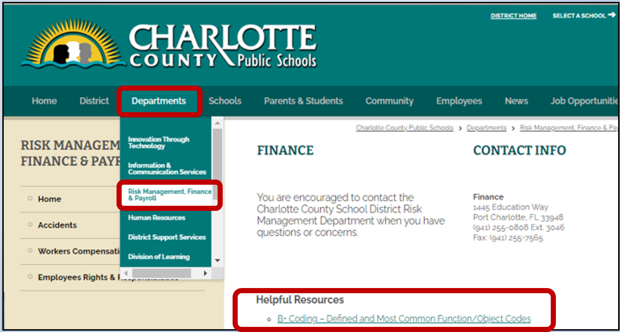

Account Structure –
Organization Key and Function/Object
Helpful Resources
Visit www.yourcharlotteschools.net
Select Departments > Risk Management, Finance & Payroll
To view more detail and
A list of most common Function/Object codes
Please refer to the Red Book- Florida Dept of Education Financial and Program Cost Accounting and Reporting for Florida Schools for detailed required coding.
Click here to
return to agenda

Slide 21
P-CARDs
Click here to
return to agenda

Slide 22
Purchasing Card
P-Cards
  Open Transaction Log (Excel file) that Lori sends monthly
    Log each month’s purchases (Please do not print and hand write the log.)
    Email, within 7 days, the completed Transaction Log in Excel to Linda Porter and Lori Jones.
  Send the completed Monthly Transaction Log with backup receipts and other required documentation within 7 days of receiving your statement via Pony Mail to Linda Porter
    IMPORTANT: Include
      A printed copy of the Transaction Log with authorized signatures
      A copy of the P-card statement with authorized signatures
      Any back-up documentation
Click here to
return to agenda

Slide 23
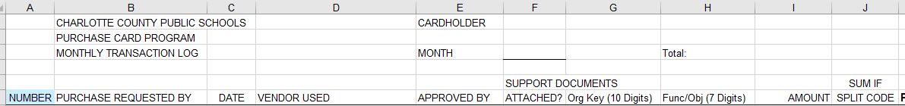
Purchasing Card
P-Cards
  Transaction Log Number the Log and Receipt - Make sure to number each transaction on the log and enter the corresponding number on each receipt and/or documentation.
  Book purchases must have prior approval. Submit signed approval for with log.
  Federal purchases (org code starting with a 4*) MUST have an approved Federal Authorization Form. Prior approval from the Grant Administrator is required.
  Industry Certification (project 184) expenditures should be for the program that generated the funding and should be for the benefit of the students and the program.
  Purchases over $2,500 must be on a PO (except for travel).
Click here to
return to agenda

Slide 24
P-Cards (Continued)
  Web-based subscriptions (object 369) may NOT be purchased with a P-card. A PO with IT approval is required.
  Inventoried Items that need to be tracked should NOT be purchased with a P-card, such as laptops, Chromebooks, cameras, tech equipment, capitalized equipment.
  Gift Cards - Gift cards should not be purchased.
  Food, Candy, Toys, Gifts may NOT be purchased.
  Taxes – No taxes my be charged.
Click here to
return to agenda

Slide 25
Travel
  Conferences – Before making reservations document:
    Who is going
    Name and Purpose of the conference
    Get an Agenda
    Date and Location of conference
    Funding Source (proper approvals)
    You should have all this information before the P-card charges are made.
  Remind travelers - a hotel receipt must be submitted (even for prepaid rooms) along with the conference agenda, check receipt for taxes.
  Travel Out-of-State – Must have Board approval in advance. Board Memo must be attached to the travel reimbursement request and P-card statement.
  In-County Travel – Use the mileage chart provided in the reimbursement form.
Click here to
return to agenda

Slide 26
SMARTFIND EXPRESS
Click here to
return to agenda

Slide 27
SmartFind Express
  Substitutes – All substitutes should be entered in SmartFind Express.
  Payroll- Will pay substitutes according to what has been approved in SmartFind Express. Make sure you have verified all subs hours before submitting the payroll report. If a job is not verified the sub will not get paid.
  Duty Leave – You must have a valid GL code to request a sub. The GL code should come from the person sending you on the duty leave. Do not use a previous code unless you verify it is still correct. Grants close and the code you used previously may not still be correct.
Click here to
return to agenda

Slide 28
Finance Training
Thank You for All You Do

