Slide 1
7th Grade Expectations
What teachers expect from students and parents and what students and parents can expect from teachers.

Slide 2
About our teachers:
-Highly qualified to teach specific subject areas
-Will contact home when concerned about failing grades
-Will also share positive behaviors and achievements
-All teachers see roughly 150 students each day
-Each teacher has their individual style, however, all align to school expectations

Slide 3

Subjects Taught
Every student attends: If your child is NOT in band/chorus your child attends*:
-PE -Health for 1 semester
-Math - Keyboarding for 1 semester
-Science *Your child can be placed in RtI if recommended by the Data/RtI Support Team
-English
-Social Studies

Slide 4
Google Classroom: For Students
Teachers will post assignments, notes, and announcements to students on google classroom
If a teacher posts anything in any manner it will send kids an email
Parents can be invited to join also as a guardian (not the same access)

Slide 5
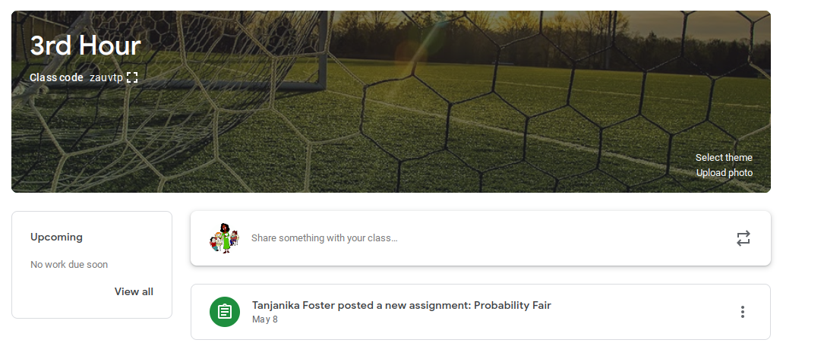
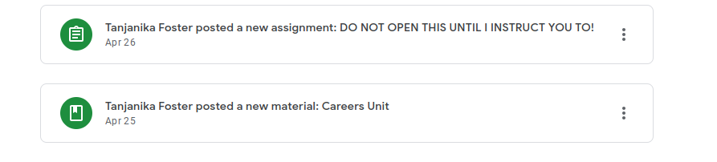

Slide 6
Checking Grades via Skyward
Can your child access their grades? Can you access his/her grades?
Here are some key points about Skyward and how the teachers use it here at CMS.
No computer? Download the Skyward app on your smartphone. (Available for Apple and Android)

Slide 7
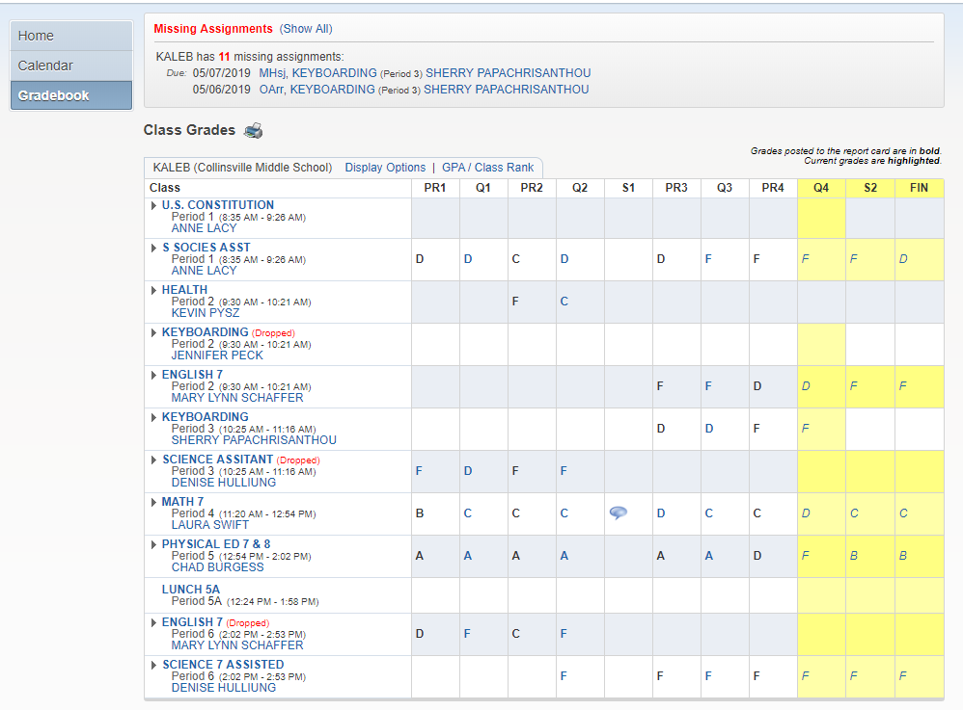
Number of missing assignments
Click teacher’s name to message via Skyward

Slide 8
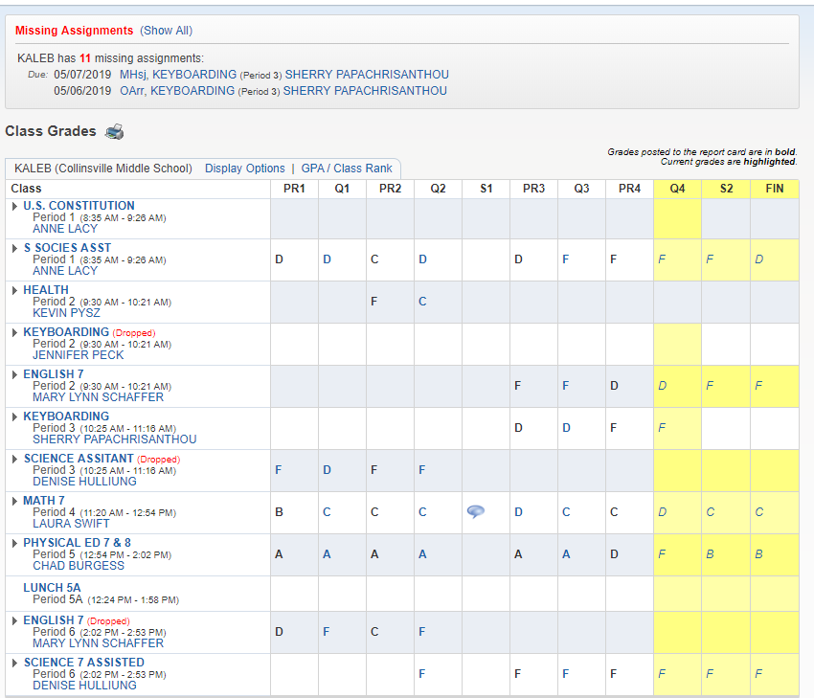
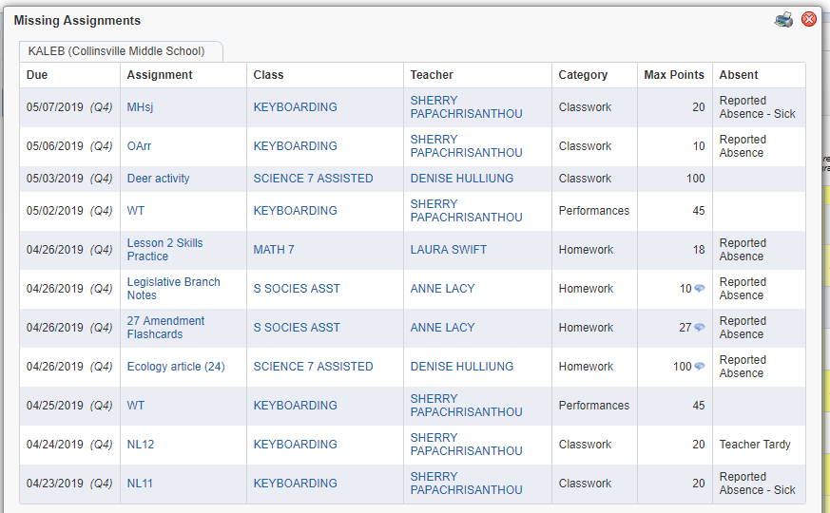
Click on “show all” next to “missing assignments” to see the list of what is missing

Slide 9
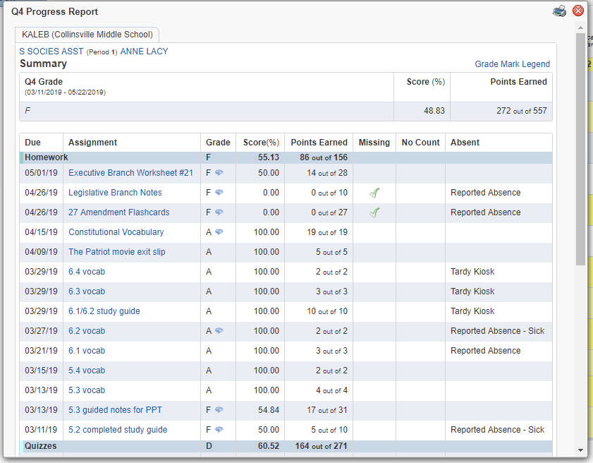
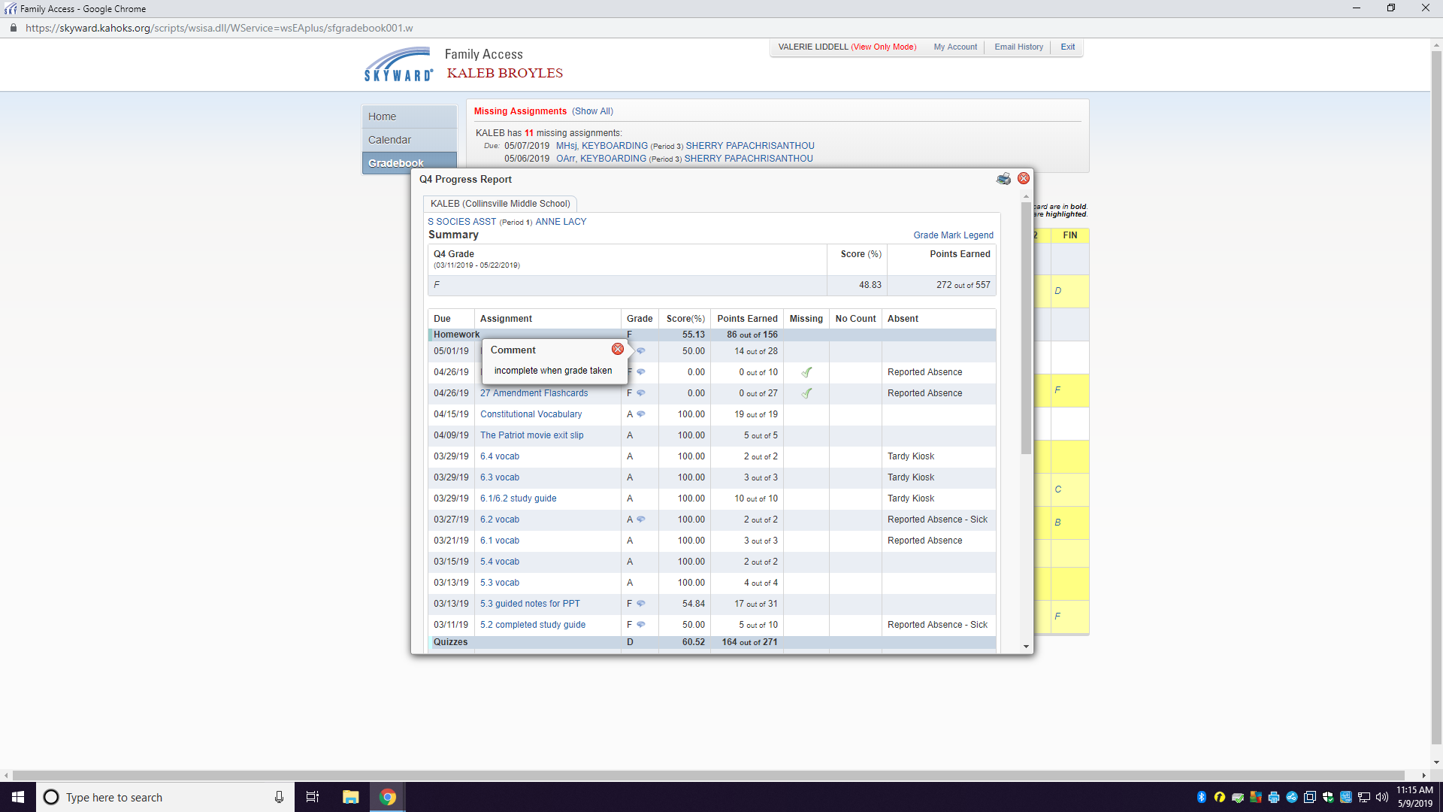
Click on the blue letter to bring up all the assignments for that grade.
Blue speech bubble is a comment posted by the the teacher. Click on it to see what the comment is.

Slide 10
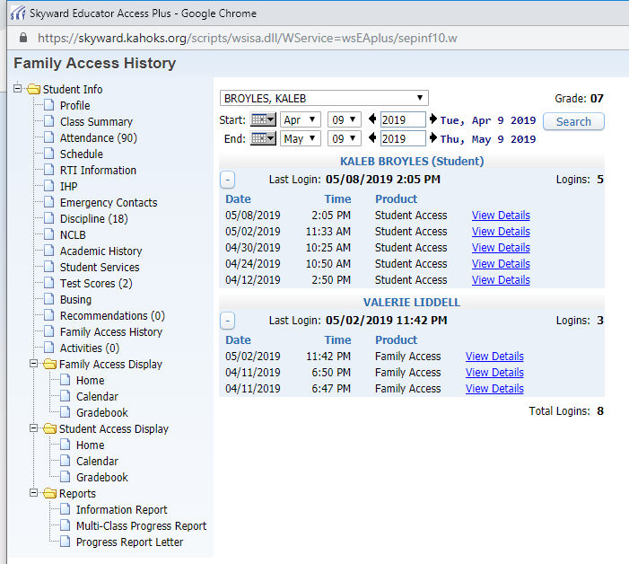
Concerned about discipline or attendance?
This student has been absent 90 days this year and has 18 discipline referrals.
Keep in mind, we can see how often and when grades have been checked by both the student and parent.

Slide 11
Parents
Teachers
Students
Remember to pass in middle school and avoid summer school, you must pass your 4 core subjects- English, Math, Science and Social Studies. If your child fails just one, he/she will have to attend summer school.

Slide 12
If you or your child has a question about a grade, please make sure your child knows the proper steps to find the answer-
Check your Skyward if you still have a question…
Have student ask the teacher politely in person or by email if you still have a question...
Talk to your parents and have your parents email or call the teacher if you still have a question…
Call the office to make an appointment with the teacher

Slide 13
Khan Academy
ProdigyMath
IXL
BrainPop
Article of the Week
NewsELA
Reading Counts!
These are various websites that teachers use to enrich and reinforce concepts in the classroom.

Slide 14
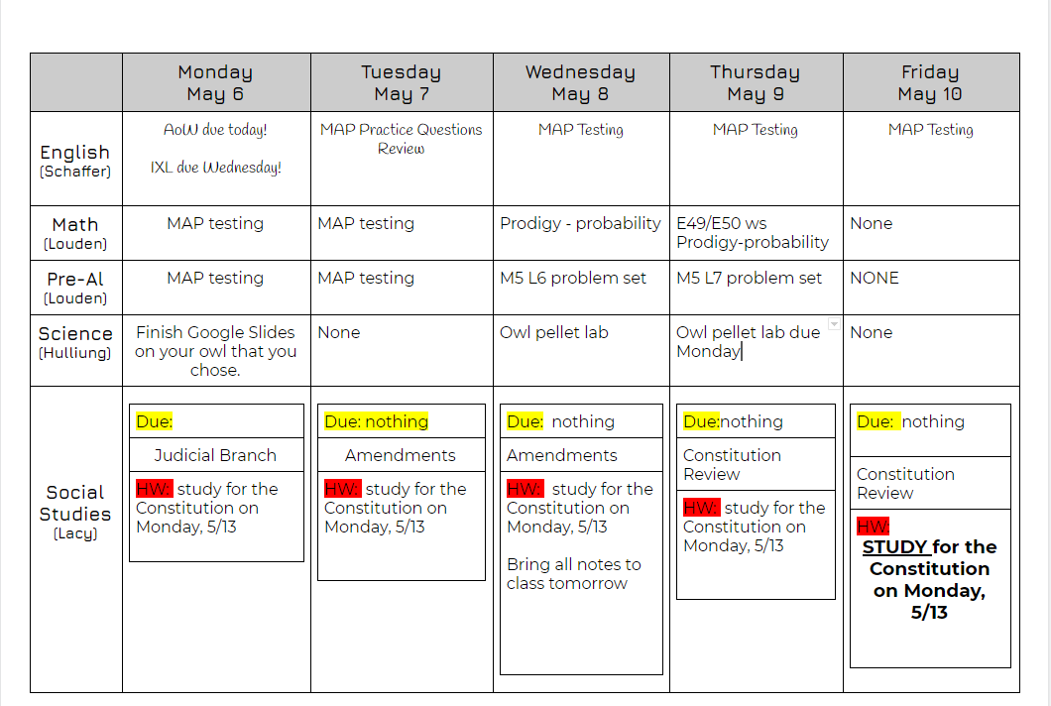
Live Google Document with assignments… what does “live” mean?

Slide 15

