Slide 1
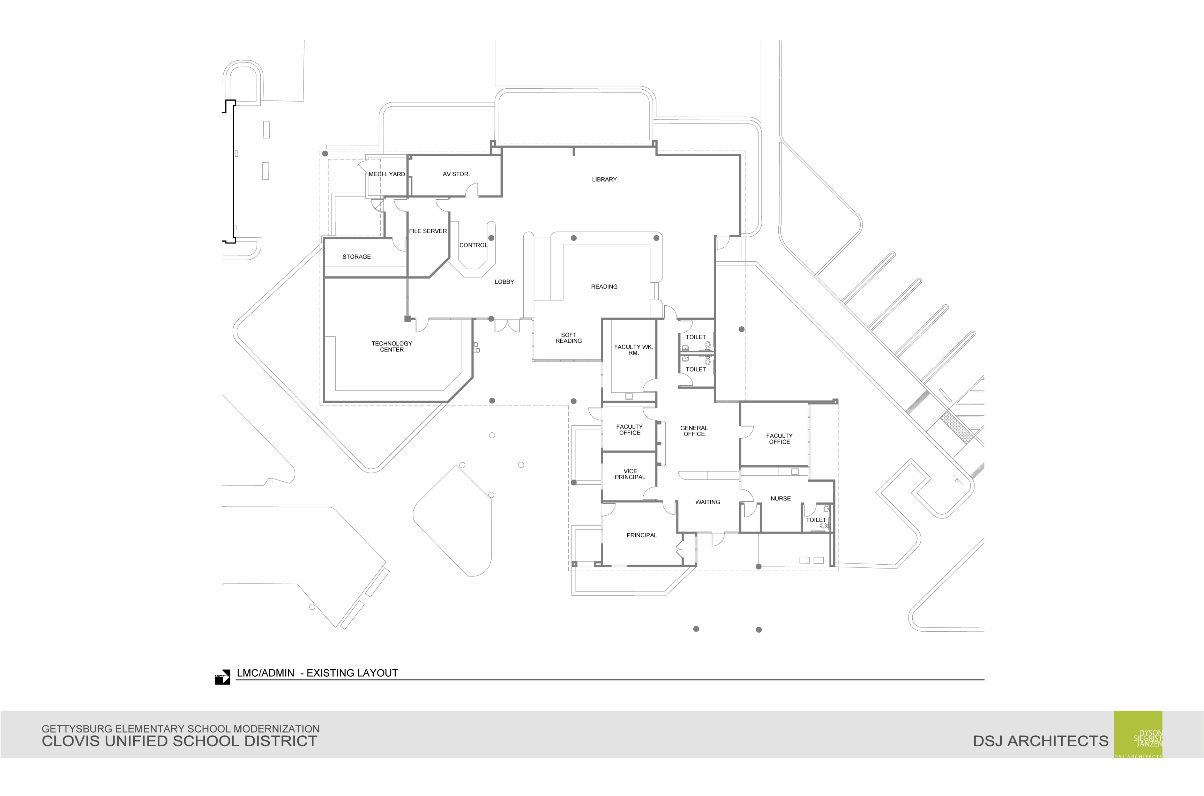






Clovis East Area SART Committee
ES 35 – Fowler/McKinley New School Preparations
October 4, 2022
ES 35

Slide 2
Overview of Tasks
Facets of Opening a New School
Define the Problem/Purpose
Rationale for Boundary Adjustment
Develop Boundary Change Criteria
Review the Process
Timeline
Next Steps

Slide 3
Defining the Problem / Purpose
Continued development in the Loma Vista and Southeast Fresno development areas
Overcrowding and projected student enrollment growth in the Clovis East area

Slide 4
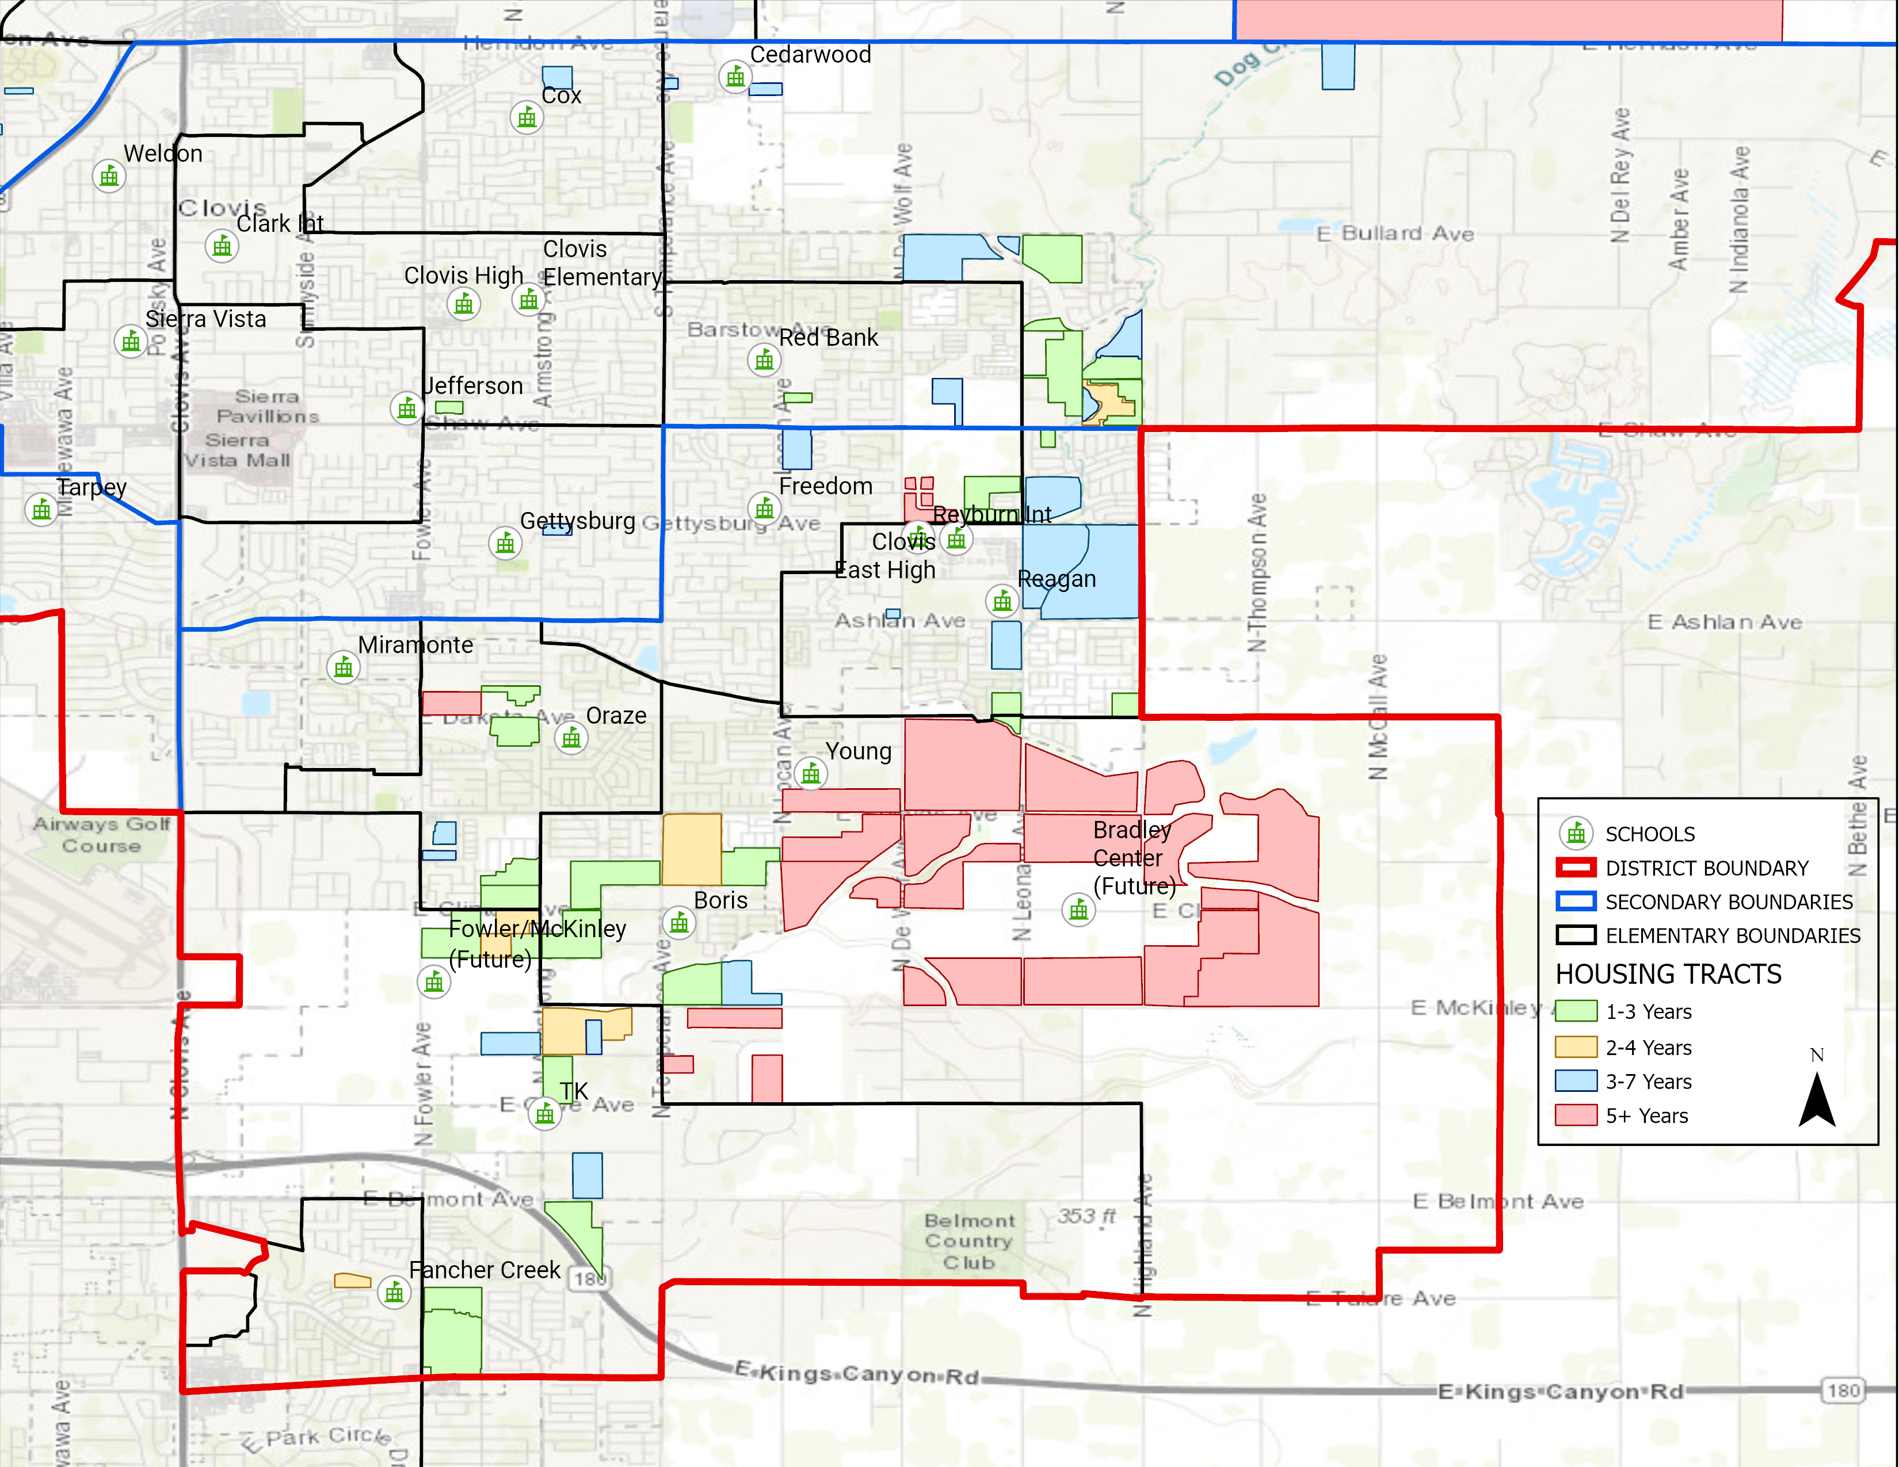
Development Area

Slide 5
Rationale for Boundary Adjustment
Boris, Oraze, Reagan and T-K elementary schools have substantial growth projected from new development within the next 3 years
Growth is projected to continue throughout the area for the 10-year projection period
Existing school sites will exceed their enrollment capacities in the immediate future

Slide 6
Clovis East Area Projected Enrollment
Elementary School | Target Capacity | 2022-23 | 2023-24 | 2024-25 | 2025-26 | 2026-27 | 2027-28 | 2028-29 | 2029-30 | 2030-31 | 2031-32 | 2032-33
Boris | 800 | 746 | 822 | 859 | 917 | 942 | 1020 | 1076 | 1146 | 1306 | 1479 | 1658
Fancher Creek | 750 | 682 | 691 | 705 | 725 | 734 | 747 | 768 | 773 | 777 | 779 | 783
Freedom | 800 | 697 | 691 | 704 | 720 | 746 | 778 | 818 | 839 | 859 | 868 | 875
Miramonte | 750 | 568 | 592 | 594 | 604 | 616 | 614 | 601 | 605 | 608 | 610 | 613
Oraze | 800 | 831 | 872 | 875 | 890 | 899 | 913 | 920 | 932 | 939 | 945 | 952
Reagan | 800 | 749 | 774 | 777 | 818 | 862 | 929 | 990 | 1024 | 1035 | 1042 | 1049
Temperance Kutner | 750 | 635 | 712 | 774 | 871 | 943 | 950 | 967 | 989 | 1006 | 1017 | 1026
Young | 708 | 650 | 643 | 659 | 671 | 680 | 699 | 778 | 843 | 911 | 979 | 1053
Notes:
*review target capacity
Sourced: https://mycusd-my.sharepoint.com/:x:/g/personal/michaelward_clovisusd_k12_ca_us/ET3FE4tibelLt8nvlRSXGkwBlwqVo23S0OVsCy1kWmHEMQ?e=s9xeAb

Slide 7
Develop Boundary Criteria
Utilize existing school design capacity whenever possible
Keep neighborhoods together
Create long lasting boundaries
Contiguous boundaries that minimize gerrymandering
Reduce operational costs (busing)
Forward planning as we will be planning the creation of new area boundary (steering committee starts January 2023)
Avoid multiple moves for students through these processes

Slide 8
Process
October – February 2023 – Executive Committee for Boundary Adjustment will draft scenarios and review feedback from Steering Committee and Community Forum and make final recommendations to the Clovis USD Governing Board
October – November – District Steering Committee for Boundary Adjustment will provide input on scenarios from various departments (Transportation, SpEd, Principals, etc.)
November 7 – Evening Parent Meeting at Clovis East High School to share information
December 6 – Community Forum held to gather input on the boundary adjustment at Clovis East MPR
February 1 – Final recommendations go to the Governing Board for information
February 15 – Governing Board takes action on the boundary adjustment

Slide 9
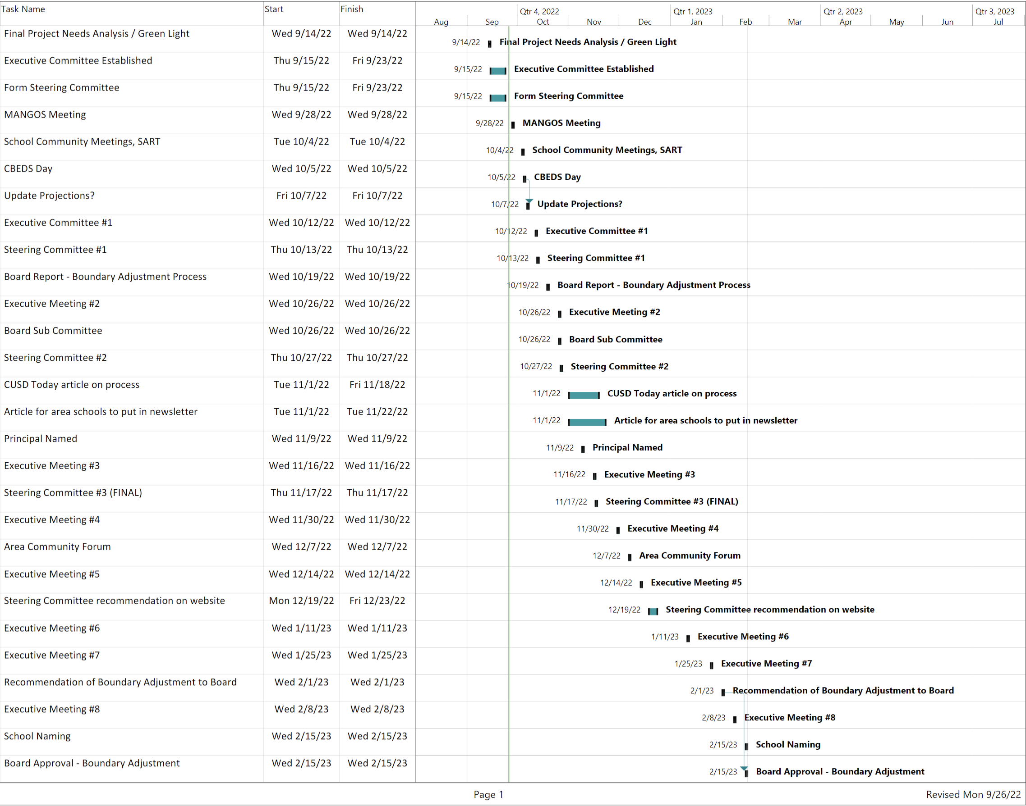

Slide 10
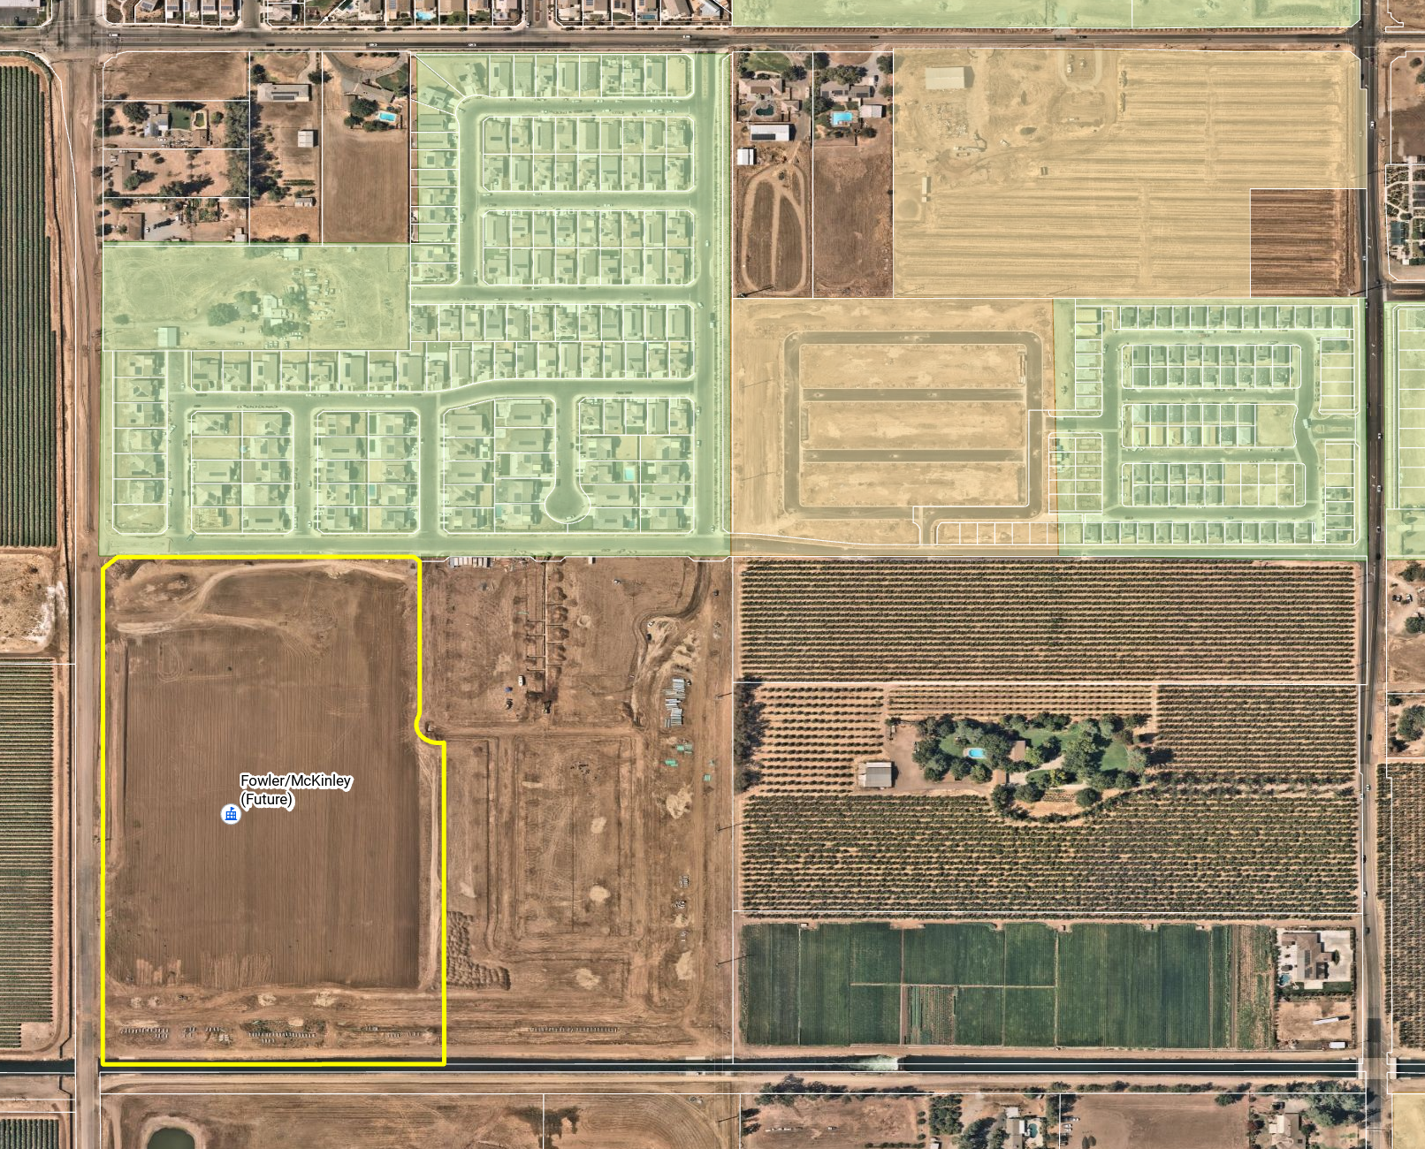
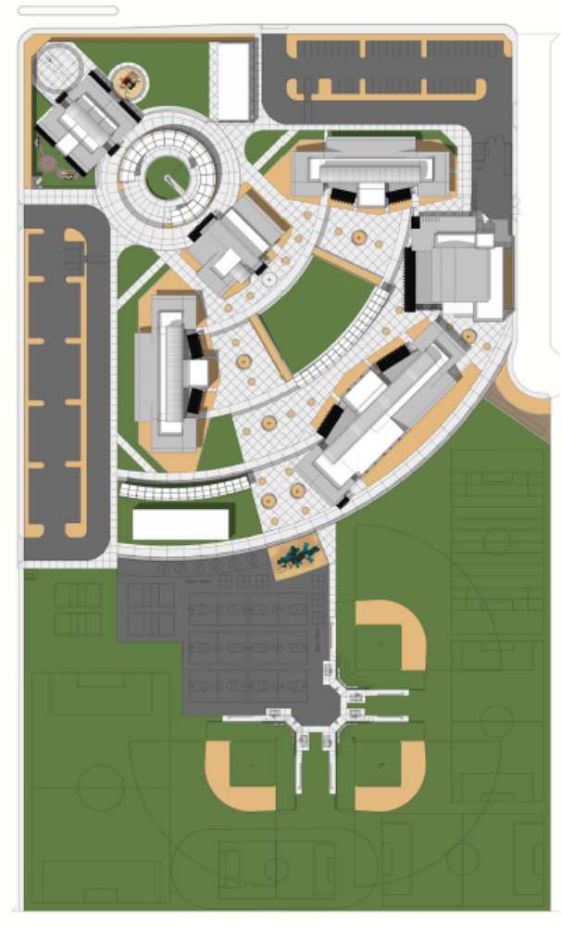
Fowler/McKinley School Site
CLINTON AVE
ARMSTRONG AVE
FOWLER AVE
MCKINLEY AVE

Slide 11

Thank You
Questions?

Slide 12
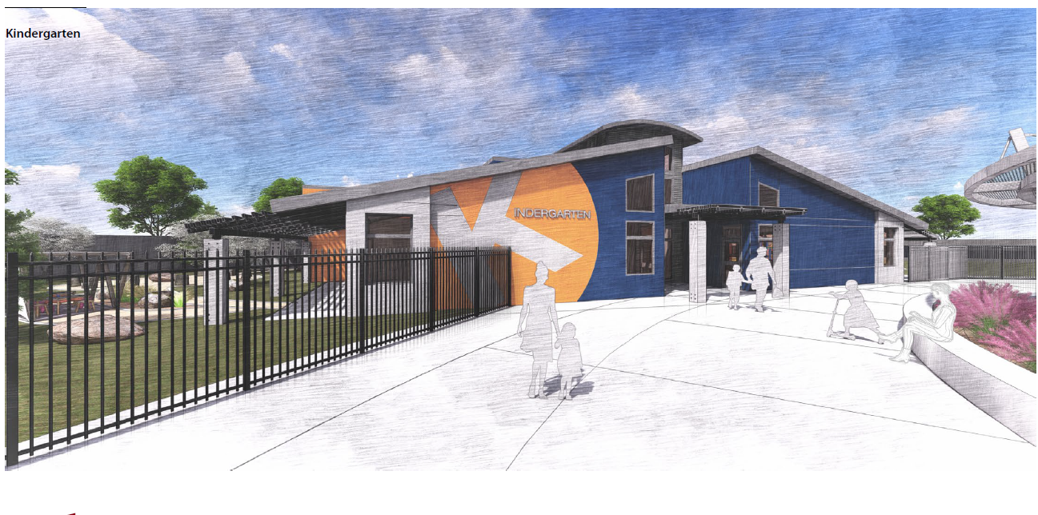

Slide 13
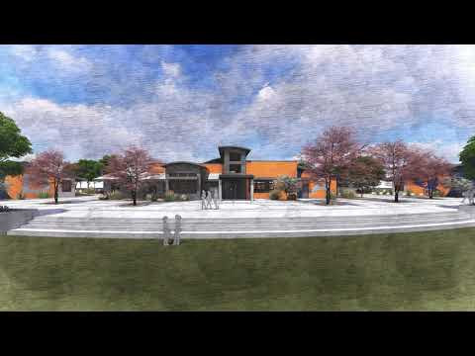

Slide 14
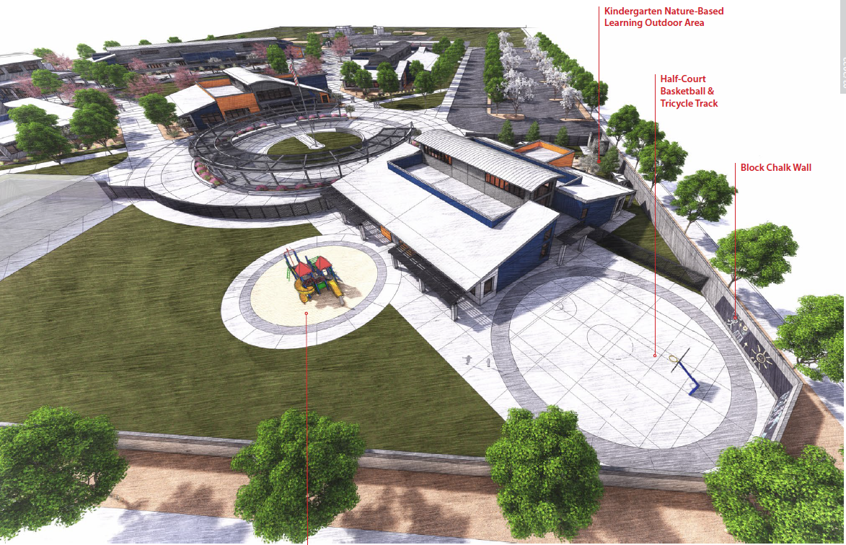

Slide 15
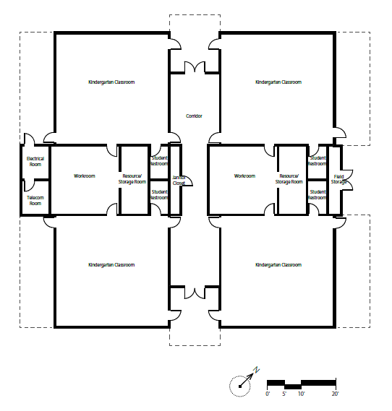

Slide 16
