Slide 1

ROAR to Success
Digital Citizenship

Slide 2

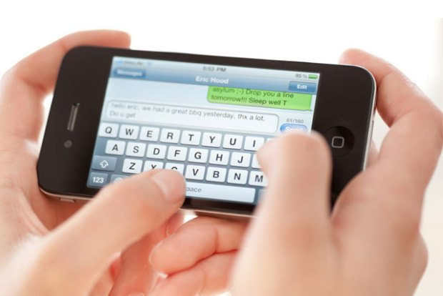




What is a Digital Citizen?
A member of a worldwide community linked by the internet

Slide 3

How Should Cubs roar as digital citizens?
Remember Safety First
Outstanding Character
Act Responsibly
Respect for All

Slide 4

Digital Citizens
Communicate responsibly and kindly with one another
Protect their own and each other’s private information online
Stand up to cyberbullying
Respect each other’s ideas and opinions
Give proper credit when they use other’s work

Slide 5
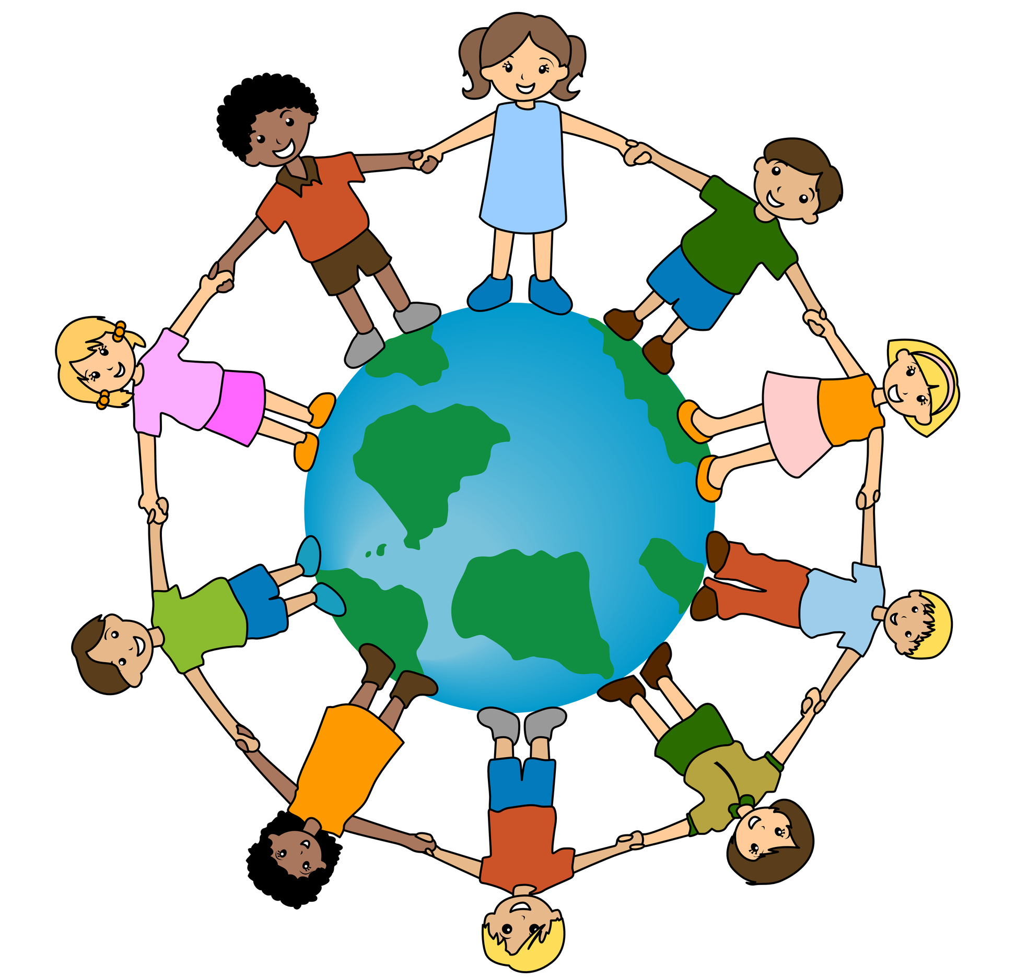
Digital citizens
Think with their heads
Feel with their hearts
Listen to their guts
Stand up for what is right
…When they use the internet!

Slide 6

Garfield Cub 16-17 trends
2% Facebook
14% Email
21% Instagram
23% Snapchat
68% Text messaging

Slide 7
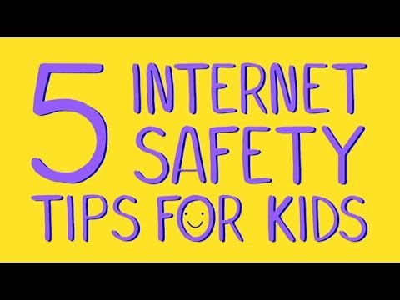
Remember safety first

Slide 8

Remember safety first
Each time you share information about yourself online, stop and think: “Am I giving out information that I should keep private?”
Personal information is often safe to share. But you should never share private information without the permission of a parent, guardian or teacher.
Think before you share:
your last name the name of your school
your age your address
your birthdate

Slide 9
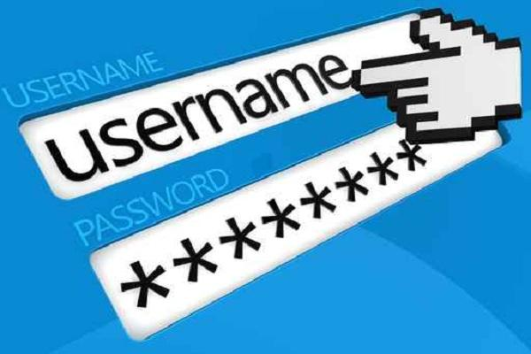
sTrong Passwords
Passwords should not have private information in them such as:
  Your name
  Your birth date
  Your address
You should share passwords with your parents.
You should not share passwords with your friends.
You should not use passwords that are easy to guess such as pet’s name or your nickname.

Slide 10

Internet friends vs in-person friends?
If things get creepy or uncomfortable when you’re chatting online, take action.
    Log out of the website or messaging service
    Tell a parent or trusted adult
    Ignore the person, or block that person from chatting with you

Slide 11
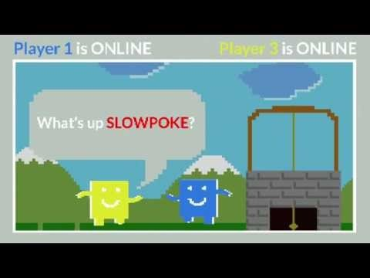
Outstanding character
What should you do when someone uses mean or scary language on the internet?

Slide 12

Cyberbullying
Cyberbullying is using the internet or cell phones to upset someone else on purpose, often over and over again.

Slide 13
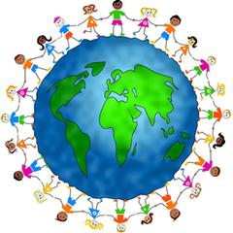
Act responsibly
Our rings of responsibility:
To ourselves
To our friends and family
To our community

Slide 14

Rings of responsibility
I get permission to post photos of others.
I stand up to cyberbullying.
I give credit for information I find online.
I protect my passwords.
I keep my private information private.
I post my opinions respectfully.

Slide 15

Respect for all
Whose is it, anyway?
How can you show respect for people’s work?
Be sure that you use citations to
give people credit for their work.

Slide 16
Okay or no way?
1. David had basketball practice and didn’t have time to do his homework. Justin offers to let him copy his, and sends it to David in an email.
2. Maria has to write a paragraph about water resources for science. She finds a paragraph on a website that is just right. She copies it in her own handwriting.
3. Omar copies a webpage into his book report and adds his own first sentence.
4. Lisa spends a lot of time researching the web. She finds a great drawing on a site. She prints it for the cover of her social studies report and gives credit to the illustrator in her report.

Slide 17
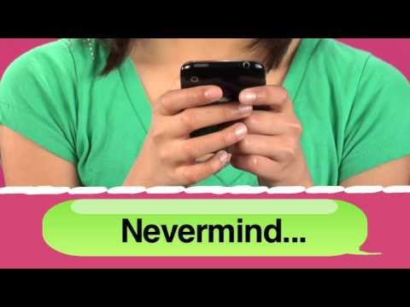
Mindful messaging
Without facial expression or voice inflection, digital messages can be misconstrued.

Slide 18
Credits
Digital Citizenship by Common Sense Education, Inc. 2016

