Slide 1
Garfield Elementary School
Hear me ROAR!

Slide 2

ROAR!
Remember safety first
Outstanding Character
Act Responsibly
Respect for all

Slide 3
You can be a
ROARin’ Cub…
In the Cub Cafe
In the Hallway
On the Playground
In the Bathroom
In the Library/ Computer Lab
Before and After school
In the Classroom

Slide 4
Important Voice Levels to remember
Level 0 – No talking
Level 1 – Whisper, only my partner can hear
Level 2 – Normal, only people near me can hear
Level 3 – Loud voice, my whole class can hear
Level 4 – Really loud, emergency or outside

Slide 5
ROARin’ Cub
Cafeteria Behavior
Remember Safety First
  Walk to and from Café
  Stay in your seat until dismissed
  Eat your own food
  Keep hands and feet to yourself self
Outstanding Character
  Use good manners
  Keep Cub Café clean
  Be polite to lunch staff
Act Responsibly
  Stay in your place in line
  Keep feet under the table
Respect for All
  Voice level 2
  Use kind words

Slide 6
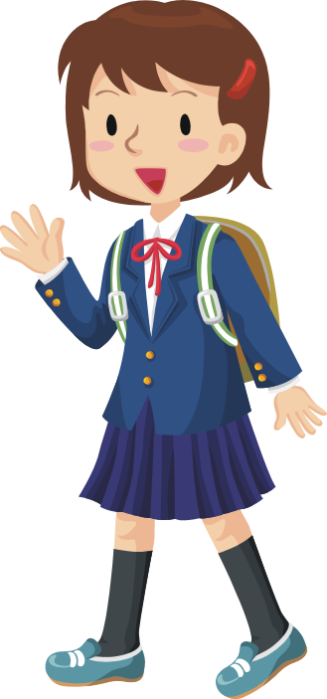
ROARin’ Cub
Playground Behavior
Remember Safety First
  Play in approved areas
  Use equipment properly
Outstanding Character
  Keep the playground clean
  Invite others to play
  Walk away from trouble
Act Responsibly
  Freeze when the bell rings
  Walk to and from recess quickly
Respect for All
  Hands and feet to self
  Solve conflict peacefully
  Use kind words

Slide 7
ROARin’ Cub
Hallway Behavior
Remember Safety First
  Walk on the sidewalk
  Keep hands and feet to yourself
Outstanding Character
  Hold the door open for others
  Silent greetings
Act Responsibly
  Go directly to your destination
  Hold onto your materials
Respect for All
  Voice level 1

Slide 8

ROARin’ Cubs
Bathroom Behavior
Remember Safety First
  Use the bathroom for intended purposes
  Use soap and water for washing hands
  Keep water in the sink
Outstanding Character
  Keep the bathroom clean
  Notify adults of problems
Act Responsibly
  Wait patiently for your turn
  Conserve water and materials
  Use restroom at appropriate times
Respect for All
  Voice level 2
  Respect others’ privacy

Slide 9

ROARin’ Cub
Library Behavior
Remember Safety First
  Walk at all times
  Keep hands and feet to yourself
  Use shelf markers for intended purposes only
Outstanding Character
  Keep the library clean
  Use good manners
Act Responsibly
  Return chairs and materials to their spot
  Return books on time and in the same condition they were checked out
Respect for All
  Voice level 1
  Handle and use materials with care

Slide 10
ROARin’ Cubs
Computer Lab Behavior
Remember Safety First
  Walk at all times
  Keep hands and feet to yourself
Outstanding Character
  Keep the computer lab clean
  Use only approved internet sites
  Use good manners
Act Responsibly
  Return chairs and materials to their spot
  Follow computer/iPad rules
Respect for All
  Voice level 2
  Handle and use computers with care

Slide 11
When I make good choices...
I feel good about myself
I am a better friend
I am a better student
My teachers will tell me what a good job
I am doing

