Slide 1


SART Meeting
Garfield Elementary School

Slide 2

School Assessment Review Team (SART)
Parent Representatives
District SART
Richard Bragg
Area SART Richard Bragg
Intercultural Diversity Advisory Council
Kevin Kozuki
Clean Campus
Aron Swearengen
SART Survey Coordinator
Chandel Perkins

Slide 3



Today’s Agenda
Introductions
Bell Schedule
Dress Code Reviews

Slide 4

Why a
Bell Schedule
Change?
BELL SCHEDLE
A new law that requires California’s intermediate and high schools to revise start times by the start of the 2022-23 school year.
SB328
In Effect
2022-23
Intermediate Schools no earlier than 8:00 a.m.,
High Schools no earlier than 8:30 a.m.
Shared Operations (transportation, food service, etc.) Require Changes
at Most, if not all, sites
Will impact elementary school bell schedule due to bus transportation
and food service
Notes:
Let’s start with a little background about why we are talking about changing our bell schedules.
California has a new law (SB328) requiring secondary schools to move their start times later in the morning. Intermediate schools must start no earlier than 8:00 a.m. and high schools must start first period no earlier than 8:30 a.m.
Most, if not all, of our Clovis Unified schools K-12 will have to modify bell schedules because we all rely on our existing transportation fleet, food service staff and other infrastructure that is impacted by changes to our grades 7-12 schedules.
Elaborate on your current schedule and some of the changes that will be required by shifting either earlier or later

Slide 5

Bell Schedule Timeline
SEPTEMBER -
NOVEMBER
JANUARY 12
Process Feedback with Steering Committee & Shared with Leadership
Board Meeting – Action Taken on Study Recommendations
1
2
3
4
5
AUGUST -
SEPTEMBER
OCTOBER -
DECEMBER
Start of New School Year
Site Meetings to Review
and Gather Feedback
Release of Draft Schedules Process Responses with Community
Process with Governing Board as Information Item on Dec. 10
New Schedules Take Effect at All Schools
Notes:
The timeline for changes to our bell schedules is shown here. We started in August with discussions and meetings across all of our school sites. Over the course of August and September we’ll use all of our access points for students, staff and parents to engage in conversations about the need to modify bell schedules and things that we need to factor into these decisions.
Feedback from these meetings will then be processed by our leadership team over the fall. Then, in October/November initial recommendations will be shared back to our community to give you a chance to respond with any additional feedback before a recommendation is finalized and shared with the Governing Board for discussion at their December meeting and then action at their meeting in January. The new bell schedules will then become effective for the 2021-22 school year.
We want to create a timeline for this, as well as our dress code, conversation that gives us time to involve our community in identifying challenges and potential solutions that best meet the needs of our students.

Slide 6
Our Goals
BELL SCHEDLE
Comply with SB328
Minimize Disruption to Existing Schedules Where Possible
Make Operational Adjustments to Support Changes
Notes:
As we hold this discussion, we need to keep in mind these goals that guide our decision-making about what bell schedules will… and won’t work.
We must first and foremost comply with this new law, but we want to also make sure that we minimize disruptions to families as much as possible and continue to provide the academic and co-curricular offerings that benefit our kids.
And, throughout this process we have to make sure that we are able to support our schools operationally – with the custodial, transportation, food service and other operational resources for them to operate successfully.

Slide 7
Things to Think About:
Bell Schedules
BELL SCHEDLE
When do Co-Curricular Events and Sports happen?
Impact on Game Days & Shared Referees
Options for Campus Club
Programs for Students with Special Needs
Bedtime and Wake Up Time
Some Considerations for Our Schools
Notes:
Customize this slide for your school and the elements of your school schedule that will be most pertinent to your community.
Secondary schools will need to discuss zero period and other components of your co-curricular and academic scheduling
Elementary schools will likely need to discuss childcare availability through campus club

Slide 8
Parameters for
Bell Schedule
Discussions
BELL SCHEDLE
Maximize Academic Options
Provide Co-Curricular Schedules Accessible to All Students
Work Within Existing Infrastructure of Transportation, Food Service, Custodial and Other Operational Capacities, As Possible
Meet Instructional Minutes Requirements
Evaluate Options to Achieve
Our Goal
Notes:
As we hold our conversation today and collect feedback, I also wanted to share the parameters that have been developed.
I’m sure that as we go, there will be a lot of great thinking of options and possibilities that could be considered, and as we talk through your feed back we’ll measure it against these bigger parameters that any bell schedules ultimately approved must consider.

Slide 9
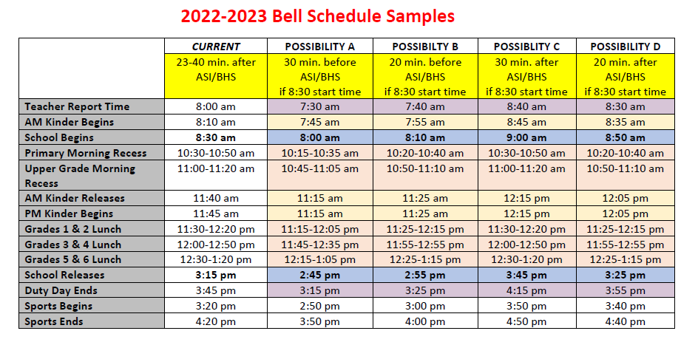
Possible Start/End Times for Our School
Notes:
Sample schedules will be provided for you to include here as the starting point for discussion

Slide 10
Dress Code Review Timeline
JANUARY 12
SEPTEMBER -
NOVEMBER
Board Meeting – Action Taken on Student Dress Code &
Any Changes Become Effective for Second Semester
Process Feedback with Steering Committee &
Discussion with Leadership
1
2
3
4
AUGUST -
SEPTEMBER
OCTOBER -
DECEMBER
Site Meetings to Review &
Gather Feedback
Release of Draft Findings Process Responses with Community
Process with Governing Board as Information Item on Dec. 10
Notes:
We’re following a similar timeline for our dress code review, with the Governing Board expected to take action on any findings from this study at their meeting in January, which coincides with the beginning of the second semester. We anticipate that any changes would also take effect right after they are acted on by the Governing Board.

Slide 11

Why a
Dress Code
Review?
DressCode
Inter School Council Annual Report to Board: Review of Dress Code on Leggings & to Review Enforcement
Perceptions & Facts Related to Consistency and Enforcement
Does the Dress Code Currently Fulfill its Purpose & Parameters?
Resulting from Our Annual Review
Notes:
Each year ISC reviews Parent SART Data and feedback from students, along with school administration feedback to complete a report that is then provided to the Governing Board and Administration.
That’s because we recognize that our dress code needs to be a living document in order that it continues to fulfill its purpose and effectiveness.
At their meeting in May, the students of ISC asked that we review leggings to see if the current policy continues to meet its purpose, and to look at the consistency and processes of enforcement across the district.
We’ve also heard from some in the community that they have concerns over enforcement and the perception of students about our dress code.
We recognize that our students and very importantly their parents have a voice (just like they do annually through our SART and student surveys and regular conversations and dialogue with our school teams) in this process. So do our teachers and staff who benefit from the educational environment created in part by our dress code, and as it falls to them to enforce the policy on our campuses.
Specifically, we are reviewing:
Perceptions and facts related to consistency of enforcement and
Does the dress code, in its current form, fulfill its purpose and parameters (above)
Are there areas that warrant revision because of conflicts with its purpose and parameters?
specifically, student members of the ISC have asked that the dress code related to wearing leggings be revisited
consider public allegations of inconsistency of enforcement and concerns over the processes to evaluate whether a student is in violation of the dress code

Slide 12
Purpose of a
Dress Code
in Clovis Unified
DressCode
Support Student Safety
Promote Health & Hygiene
Prepare Students for Their Future
Establish a Learning Environment Focused on Education
Notes:
As I shared a few minutes ago, our dress code exists for some very specific purposes.
The dress code itself is gender neutral and non-discriminatory.
Safety is the key component and purpose for our dress code, as it both creates standards of dress and grooming that promote physical safety (our shoe guidelines), as well as to promote a mutually respectful and safe environment on campus (excluding gang related, profane or hate-motivated attire or slogans, etc.).
Hygiene is another important component of our dress code as we strive to keep the hundreds/thousands of students on our campuses healthy as they use the same chairs/desks/facilities.
The dress code also exists to prepare our students for their futures, where they will often encounter times when understanding how dress and grooming interact with their roles in life. It also establishes education as our students’ “job” while they are in school. Just like the bulk of America’s employers (80% of whom require some form of a dress code), we want our students to treat their “job” seriously. When they are coming to school the dress code helps them put “their head in the game” so to speak.
The dress code’s valuable role in education is most effective when carried out with consistency and fairness.

Slide 13
Parameters for
Dress Code Review
DressCode
Gender Neutral
Legally Compliant
Accessible to All Families
Consistently Enforced
Addresses Potential Safety Threats to Students
These parameters are in place to ensure Clovis Unified’s Dress and Grooming policy meets its purpose and intent.
Notes:
We know that all of you here, just like the 62% of our parents who most recently indicated they were in support of the dress code as is or even more strict, you have some opinion about the dress code. I’m sure that as we go, there will be a lot of things to think about and discuss, and as we talk through your feedback, we’ll measure it against these bigger parameters to make sure that we are considering solutions/suggestions that will continue to maintain the purpose of having a dress code for our schools.

Slide 14
Community feedback
Before you leave, please fill out dress code suggestion form and bell schedule form
Online Feedback
https://www.cusd.com/BellScheduleDressCodeReview.aspx

