Slide 1

Citizens Committee to Study Capital Facility Needs

Slide 2
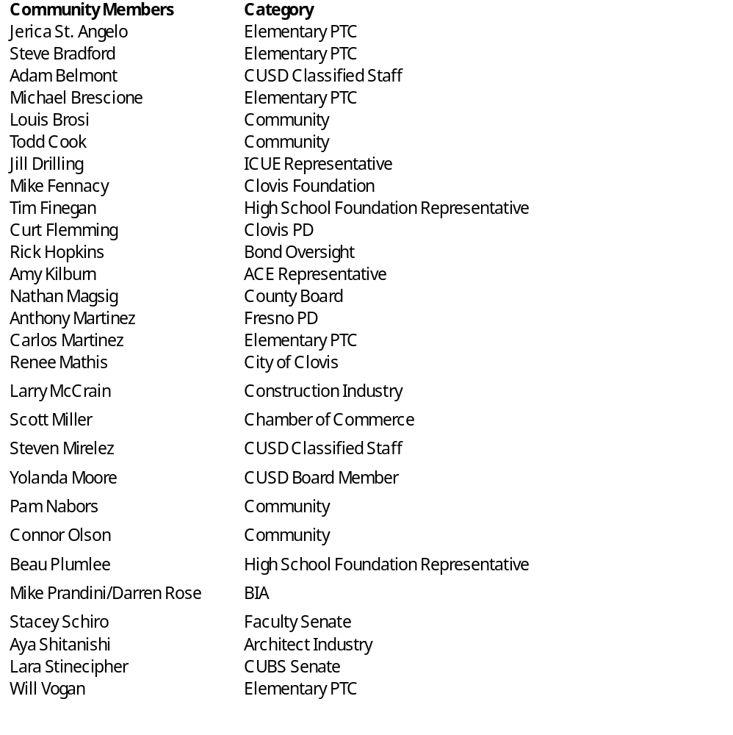
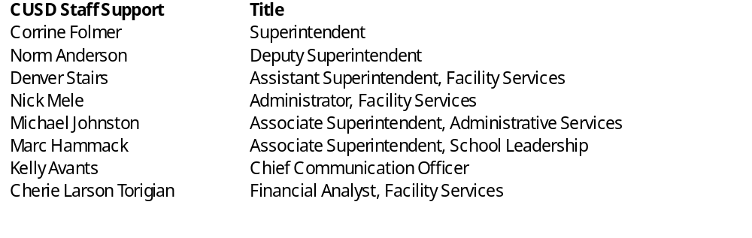
Committee Members

Slide 3
Tasks of Committee
Determine facility needs and prioritize those needs
Study city and county development plans in the area
Study tax rates and implications on the current tax rate to meet facility needs
Study results of voter opinion survey
Determine if Bond Measure is needed
If needed, determine Bond Measure amount the community can support
Recommend final Bond Measure amount and project priorities to CUSD Administration
Notes:
Passed legislation that authorized match funds for new construction and modernization.
1 D included the Career Technical Education funds.
Prop 51 - $7B for K-12 ( $3B new construction, $3B Modernization, $500M Charter, $500M CTE)

Slide 4
Review of Committee process
  Comprised of 29 community members appointed by Superintendent representing all groups in our community.
  Six meetings from January 2024 – May 2024.
  Topics Included
    Committee orientation
    Financial Reports
    Enrollment Projections and New School needs as well as needs at existing sites
    Land Use Decisions Affecting CUSD
    Community Survey Results, Project Priority Development
    Project List
    Recommendations
Notes:
Passed legislation that authorized match funds for new construction and modernization.
1 D included the Career Technical Education funds.
Prop 51 - $7B for K-12 ( $3B new construction, $3B Modernization, $500M Charter, $500M CTE)

Slide 5
Process
Committee is led by a citizen selected by committee members that chairs and facilitates the process
CUSD staff provided background data and information for discussion
Consensus model is used for direction and recommendation to CUSD Governing Board
Notes:
Passed legislation that authorized match funds for new construction and modernization.
1 D included the Career Technical Education funds.
Prop 51 - $7B for K-12 ( $3B new construction, $3B Modernization, $500M Charter, $500M CTE)

Slide 6
Bond Measure History in CUSD
Nov. 1986
$59 Million
Passed – 71.6% Voter Approval
Nov. 1991
$95 Million
Failed – 58.3% Voter Approval
June 1992
$79 Million
Failed – 63.5% Voter Approval
Mar. 1993
$49.2 Million
Passed – 66.7% Voter Approval
Mar. 1996
$98 Million
Passed – 66.9% Voter approval
Mar. 2001
$79 Million
Passed 64.4% Voter Approval: Passed Using 55% Threshold under Prop 39
Mar. 2004
$169 Million
Passed 63.5% Voter Approval: Passed Using 55% Threshold under Prop 39
June 2012
$298 Million
Passed 65.2% Voter Approval: Passed Using 55% Threshold under Prop 39
Mar. 2020
Nov. 2020
$408 Million
  Failed – 49.6% Voter Approval
$335 Million
  Passed 60.3% Voter Approval: Passed Using 55% Threshold under Prop 39
Notes:
Passed legislation that authorized match funds for new construction and modernization.
1 D included the Career Technical Education funds.
Prop 51 - $7B for K-12 ( $3B new construction, $3B Modernization, $500M Charter, $500M CTE)

Slide 7
Historical Annual Tax Rates per $100,000 of Assessed Home Value
$224 1986-1993 7 years
$197 1994-2010 16 years
$186 2011-2012 1 year
$155 2012 – present 12 years

Slide 8
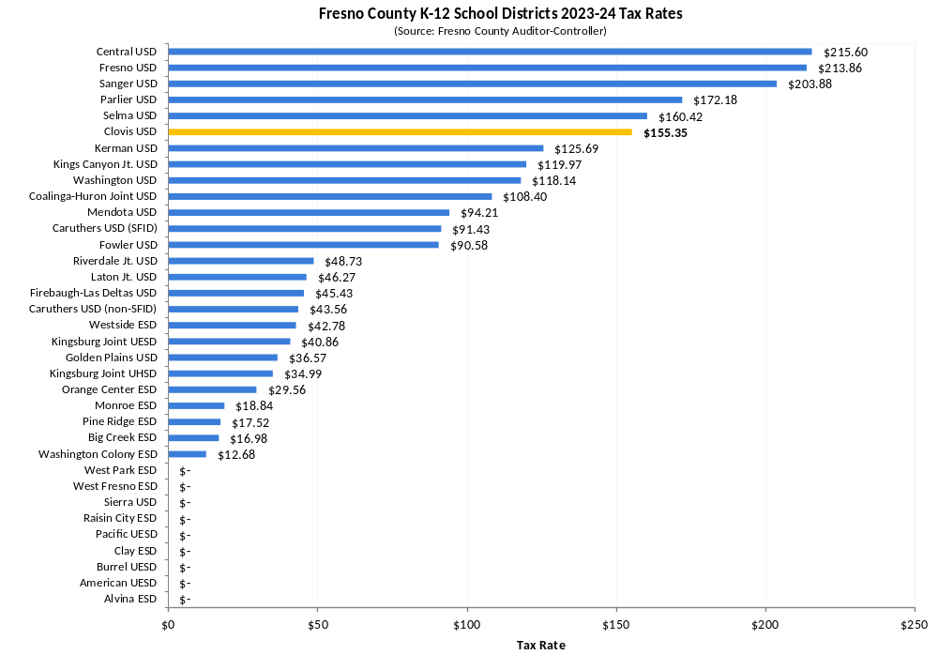
Fresno County K-12 Tax Rates
Note: Fowler USD approved a new bond in March 2024 with a $50 tax rate, which will likely be levied starting in 2024-25.

Slide 9
 |  |  | Total Project Cost | W/Escalation
New Schools/Facilities
New Elementary Design |  |  | $6,000,000.00 | $6,000,000.00
Complete TBEC |  |  | $180,000,000.00 | $180,000,000.00
Miscellaneous new construction |  |  | $27,300,000.00 | $30,030,000.00
Total |  |  | $213,300,000.00 | $216,030,000.00
Improve/Repair/Safety
Modernization |  |  | $129,731,685.20 | $142,704,853.72
Building Infrastructure |  |  | $69,824,690.00 | $76,807,159.00
Energy Upgrades |  |  | $45,600,000.00 | $47,160,000.00
Safety Upgrades |  |  | $32,500,000.00 | $35,700,000.00
Athletic Upgrades |  |  | $20,150,000.00 | $22,166,500.00
Technology |  |  | $6,500,000.00 | $7,150,000.00
Total |  |  | $304,306,375.20 | $331,688,512.72
Total Facility Needs |  |  | $517,606,375.20 | $547,718,512.72
Total Project Needs

Slide 10
 | Total W/Escalation
New Schools/Facilities
New Elementary Design | $6,000,000.00
Complete TBEC | $180,000,000.00
Miscellaneous new construction | $30,030,000.00 | 100% funded
Total | $216,030,000.00
Improve/Repair/Safety
Modernization | $71,352,426.86 | 50% reduction
Building Infrastructure | $46,084,295.40 | 40% reduction
Energy Upgrades | $23,580,000.00 | 50% reduction
Safety Upgrades | $35,700,000.00
Athletic Upgrades |  | remove
Technology | $7,150,000.00
Total | $183,866,722.26
Total | $399,896,722.26
Committee (prioritized) Recommendation
$400M
Maintains
$155 rate

Slide 11
Recommendations from the Citizens Committee to Study Capital Facility Needs
Submit a $400 Million bond measure to the voters to meet the capital facility needs of the District for the period of 2025 - 2028.
Direct district staff to work with bond council and underwriters to prepare a bond measure resolution for consideration of the Governing Board in the month of July 2024.
Submit the bond to the voters in November 2024.

Slide 12
Facility needs timeline
January
2024
February
2024
March
2024
April
2024
May
2024
June
2024
July
2024
August
2024
September
2024
October
2024
November
2024
Citizens Committee to Study Capital Facility Needs
Administration info sharing and gathering
Board Consideration of Placing Bond Measure
Bond Election
Notes:
KEVIN
2019-20 - Monitor Growth / Water sustainability / Economy, Housing Development, City of Fresno Impact Fee Study
Would require us starting an RFP for Educational Specifications 7-12 and start design work immediately following
No development north of McKinley – consider boundary change

Slide 13
Purpose of Committee
Develop and prioritize capital facility needs to advise the District Administration/CUSD Governing Board on a bond measure amount the community will support to complete the needed projects in CUSD
Take a transparent look at all aspects of our facility needs - gathering input from all perspectives in our community
Notes:
Passed legislation that authorized match funds for new construction and modernization.
1 D included the Career Technical Education funds.
Prop 51 - $7B for K-12 ( $3B new construction, $3B Modernization, $500M Charter, $500M CTE)

