Slide 1



Distrito Escolar Unificado del Valle de Chino
PLAN DE CONTROL LOCAL Y RENDICIÓN DE CUENTAS
2024-2025
Centro escolar: Reunión de participación de Padres / Comunidad
Notes:
Welcome attendees.

Slide 2

NORMAS y CORTESÍAS PARA LAS REUNIONES
•Mantener el aprendizaje de los alumnos como centro de atención
•Asumir las mejores intenciones en los demás
•Participar con respeto
•Comenzar y terminar a tiempo
•Silenciar los celulares

Slide 3

NUESTROS OBJETIVOS PARA HOY
Entender cómo funciona la Fórmula de Financiación del Control Local (LCFF) y cómo apoya las metas del Plan de Responsabilidad del Control Local (LCAP) del Distrito.
Revisar las cuatro metas del LCAP del Distrito Escolar Unificado del Valle de Chino y las medidas y servicios relacionados.
Proporcionar información sobre las metas y medidas del LCAP/SPSA
Notes:
The objective of today's meeting, is as follows: (state the 3 objectives).
Feel free to use the Collaboration Strategies for Students by modeling a “no opt out environment” to illicit parent participation while reviewing today’s objectives and throughout the presentation when applicable.

Slide 4



¿Qué es la Fórmula de Financiación del Control Local (LCFF)?
Cada estudiante genera una beca básica que financia los gastos educativos básicos, tales como: salarios de los empleados, gastos de construcción y material educativo.
Bajos ingresos, aprendices de inglés y jóvenes de crianza temporal/sin hogar, generan financiación adicional, por encima de la beca básica (20%) para aumentar y mejorar los servicios y los logros de estos grupos específicos.
Los distritos con más de un 55% de bajos ingresos, aprendices de inglés o jóvenes de crianza o sin hogar reciben un 50% adicional de la beca básica.
CVUSD no reúne los requisitos para recibir ayudas a la concentración.
BECAS BÁSICAS
BECAS SUPLEMENTARIAS
BECAS DE CONCENTRACIÓN
Notes:
The funding formula for Districts changed in 2013-2014 when LCFF was enacted.
LCFF funds include a base level of funding for all Local Education Agencies (LEAs) and extra funding - called "supplemental and concentration" grants - to LEAs based on the enrollment of high needs students (foster youth, English learners, and low-income students). CVUSD receives base grants and supplemental grants.
The LCFF gives school districts more flexibility in deciding how to use state funds. In exchange and as part of the legislation, school districts must work with parents, educators, students, and the community to develop a Local Control and Accountability Plan (LCAP) that shows how they will use these funds to serve students.
With a diversity of student needs, resources in the plan are allocated to support the achievement of all students with additional actions and services provided to English learner (EL), low income (LI), and foster youth (FY) students.

Slide 5




METAS LCAP DEL DISTRITO
Meta 1 Condiciones del aprendizaje | Meta 2 Participación | Meta 3 Resultados de los alumnos | Meta 4 Asistencia específica
Prioridades Estatales 1, 2, 7, & 8 | Prioridades Estatales 3, 5, & 6 | Prioridades Estatales 4, 7, & 8 | Prioridades Estatales 4, 5, & 6
Todos los alumnos reciben un entorno de enseñanza y aprendizaje de alta calidad. | Los alumnos, los padres, las familias y el personal están conectados y comprometidos con su escuela para garantizar el éxito de los alumnos. | Todos los alumnos están preparados para la universidad y la carrera profesional después de la graduación. | El Distrito Escolar de Chino Valley está comprometido a aumentar la preparación universitaria y profesional de los estudiantes en Buena Vista (BV), Chino Valley Learning Academy (CVLA), y Boys Republic High School (BR): énfasis específico en la mejora de las tasas de graduación, el dominio de las matemáticas, la conectividad escolar, y el rendimiento en el Indicador Universitario y Profesional.
Notes:
We have 4 LCAP goals for this year.
Goal 1: All students are provided a high-quality teaching and learning environment.
There continues to be room for improvement regarding quality of instruction as well as the learning environment. It became evident that a safe and high-quality learning environment continues to be essential for student success. High quality universal technology along with instructional technology is essential to support the instructional program and close the achievement gap. By providing teachers instructional tools, staff can elevate/boost student engagement and success. Through strategic and targeted support, the achievement gap in ELA and Math for unduplicated students is narrowed. This includes fully credentialed teachers, Induction support for new teachers, professional development, ICs, and Common Core materials focusing on essential standards. Additionally, providing supplemental programs, such as music, can provide interdisciplinary learning and enrichment opportunities, and assist in the development of a well-rounded education for unduplicated students. Along with these items, well-maintained facilities promote a safe and healthy environment which can influence students to perform academically at the highest levels
Goal 2: Students, parents, families, and staff are connected and engaged to their school to ensure student success.
Student and family engagement was an important component in learning. Research shows engaged students are more likely to achieve academically and attend class regularly. Staff, students, and the community participated in the District’s Annual Survey to report satisfaction levels regarding academic support, student support, school leadership, family involvement, communication, safety and behavior, and remote learning. The data available informs the LCAP. Unduplicated student groups have been impacted as they experienced unique barriers. For this group of students, it is recommended that the District continues to coordinate services through Student Support Services (SSS), maintain Foster Youth (FY) counselor, keep the Chino Valley Learning Academy (CVLA); support the Family Engagement Center and the HOPE Center; provide the mental health services and programs; offer bilingual translation services; hold community forums and maintain Multi- Tiered System of Support-Behavior.
Goal 3: Students are prepared for college and career beyond graduation.
Students need to be prepared for their future. Administration of the Essential Standards Assessment indicate a performance gap on grade level standards for unduplicated student groups, and the district will continue to provide intervention support, tutoring services for foster youth and homeless populations. The California College Guidance Initiative (CCGI) will continue to inform students and parents A-G information for post-secondary education. Other programs such as college nights, Advanced Via Individual Determination (AVID) for first-generation college students, career centers, dual enrollment, subsidized Advanced Placement (AP) fees, professional development and support for English learner students will continue.
Goal 4: Chino Valley School District is committed to increasing the college and career readiness of students at Buena Vista (BV), Chino Valley Learning Academy (CVLA), and Boys Republic High School (BR): targeted emphasis on improving Graduation Rates, Mathematics proficiency, school connectedness, and performance on the College and Career Indicator.

Slide 6
¿Cómo se ajustan las cuatro metas del LCAP del Distrito a las ocho prioridades del Estado de California?
Meta 1: Condiciones del aprendizaje
Servicios Básicos((Prioridad 1)
Implementación de los Estándares Estatales (Prioridad 2)
Acceso al curso (Prioridad 7)
Otros Resultados de los alumnos (Prioridad 8)
Meta 2:
Participación
Participación de los Padres (Prioridad 3)
Participación de los alumnos(Prioridad 5)
Ambiente Escolar (Prioridad 6)
Meta 3:
Resultados de los alumnos
Rendimiento de los alumnos (Prioridad 4)
Acceso al curso (Prioridad 7)
Otros resultados de los alumnos (Prioridad 8)
Meta 4:
Asistencia Específica
Rendimiento de los alumnos (Prioridad 4)
Participación de los alumnos(Prioridad 5)
Ambiente Escolar (Prioridad 6)
Notes:
The state priorities are categorized into three areas:
Conditions of Learning (basic services, implementation of state standards, course access)
Credentialed teacher, common core instructional materials, facilities are in good repair, and students have access to courses that lead to college and career.
Student Outcomes (student achievement and other student outcomes)
Programs and services are in place to promote student learning.
Engagement (parental involvement, student engagement and school climate)
Promote parent engagement and participation in student’s education process.
Students have good attendance and are engaged in their education.
Students are provided a safe learning environment.
Targeted Assistance (student achievement and other student outcomes at specific schools that meet low-performing schools
criteria in EC Section 52064(e)(6))
Additional targeted supports are in place to promote student learning at Buena Vista HS and Boys Republic

Slide 7
¿Cómo se mide el éxito escolar a nivel local?
Servicios Básicos (Prioridad Estatal 1) ✓Maestros acreditados ✓Materiales para la enseñanza ✓Instalaciones en buen estado | Implementación de los Estándares Aprobados por el Consejo Estatal (Prioridad Estatal 2) ELA, Matemáticas, ELD, CTE, Salud, Ciencias Sociales, Educación Física, NGSS,VAPA, Lengua mundial | Acceso a un Programa de Estudios Generales (Prioridad Estatal 7) Grados 1-6 ELA, Matemáticas, Ciencias Sociales, Ciencia, VAPA, Salud y Educación Física Grados 7-12 ELA, Matemáticas, Ciencias Sociales, Ciencia, VAPA, Salud, Educación Física, Lengua mundial y CTE
Participación de los Padres (Prioridad Estatal 3) | Ambiente Escolar (Prioridad Estatal 6) | Otros indicadores seleccionados localmente para apoyar las 8 Prioridades Estatales
Notes:
Local measures/indicators are used to help determine success. Those measures include basic services, implementation of state standards, access to a broad course of study, parent engagement, school climate, and other selected indicators that support the State's Eight Priorities.

Slide 8
INDICADORES LOCALES
Rendimiento determinado por el distrito,
basado en las herramientas de autorreflexión adoptadas por el Estado.
no se ha cumplido durante 2 o más años
cumplido
No cumplido
Notes:
Read slide. CVUSD has met all local indicators.

Slide 9
¿Cómo se mide el éxito escolar con los Indicadores Estatales de California?
Indicador académico (Prioridad Estatal 4) Grados 3-8, y 11 CAASPP in ELA y Matemáticas | Indicador de progreso de los aprendices de inglés (Prioridad Estatal 4) | Índices de Suspensión y Expulsión (Prioridad Estatal 6)
Indicador de estudios universitarios y profesionales (Prioridad Estatal 4, 7, & 8) ✓11º grado CAASPP en ELA y Matemáticas ✓Finalización de A-G ✓Finalización del itinerario CTE ✓Puntuación AP 3+ ✓Matrícula doble ✓JROTC ✓Sello estatal de alfabetización bilingüe | Índice de graduación de la preparatoria (Prioridad Estatal 5) | Faltas crónicas (Prioridad Estatal 5)
Notes:
California has established State measures/indicators to determine school success. The measures/indicators include the academic indicator, English Learner Progress indicator, suspension & expulsion rates, college and career indicator, high school graduation rate, and chronic absenteeism.

Slide 10
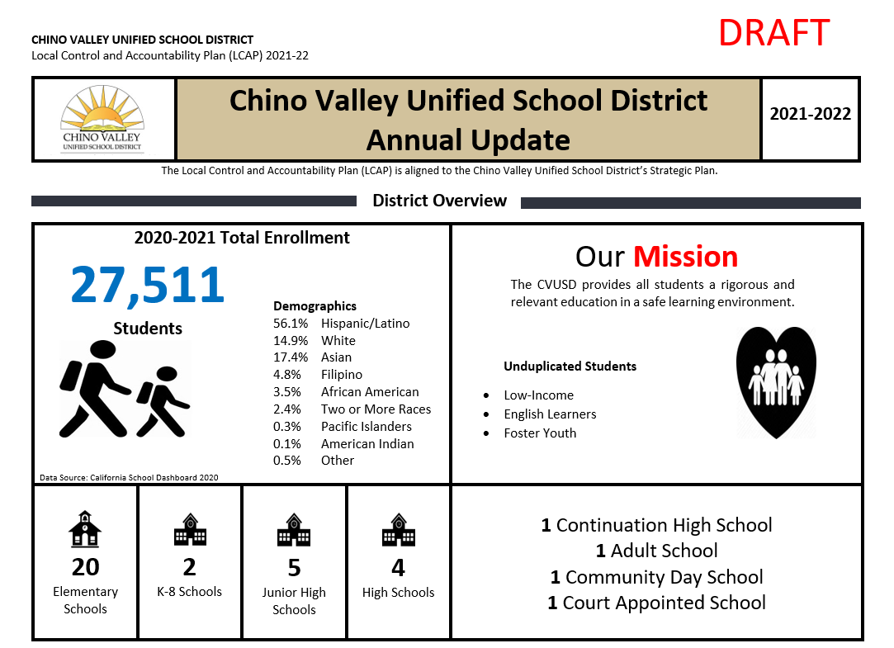
Supervisión del progreso de SPSA
Notes:
Add specific SCHOOL SITE SPSA progress monitoring data to share with your community.

Slide 11
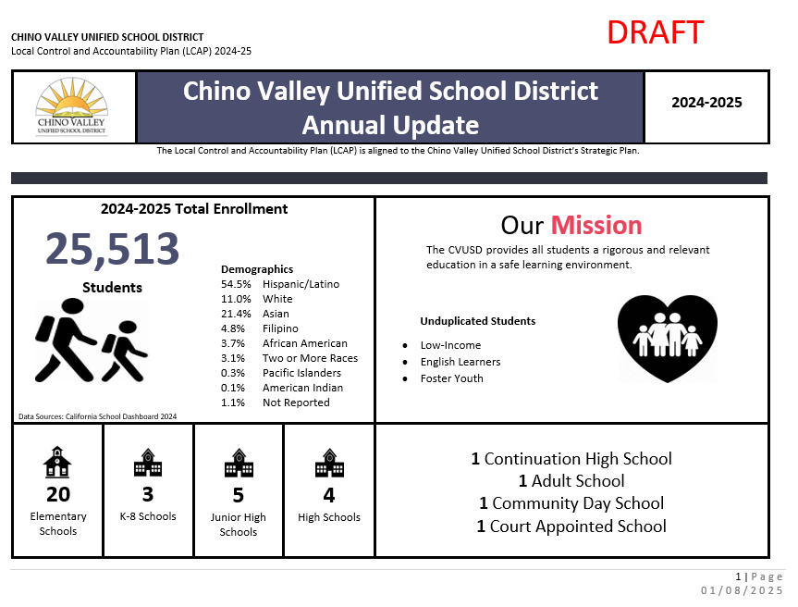

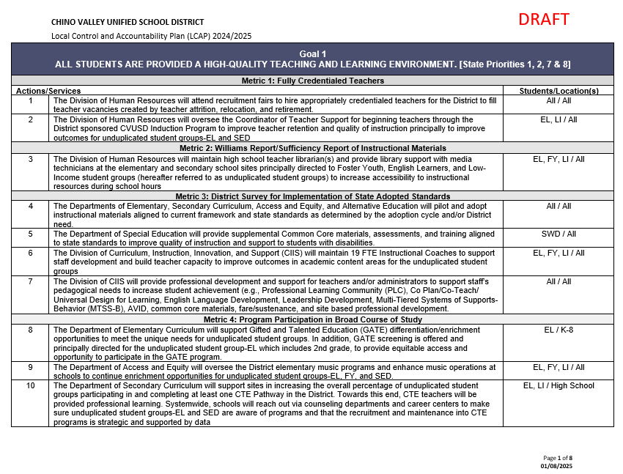
Documentos para la reunión de participación
1
3
2
Notes:
The annual update, which is always in Draft form because we are still waiting for data from CDE – In the slide deck
The goals, actions and services document
The LCAP parent engagement input sheet

Slide 12
Actualización anual - Página 1
Notes:
Facilitation Directions:
Review the Annual Update packet
Chino Valley Unified School District (CVUSD) offers premier educational opportunities for approximately 25,513 students, from Transitional Kindergarten through 12th grade.
There are 20 elementary schools, three (3) K-8 schools, five (5) junior high schools, four (4) comprehensive high schools, one (1) continuation high school, one (1) adult school, one (1) community day school, and one (1) court appointed school.
The District has an LCFF unduplicated count comprised of 10.3% English Learners, 0.5% Foster Youth, and 51.9% who are classified as low income.
The racial/ethnic diversity of the school community reflect the following: African American 3.8%, American Indian 0.1%, Asian 20.2%, Filipino 5.0%, Hispanic of Latino 55.1%, Two or More Races 2.9%, Pacific Islander 0.2%, White 11.7%, Not Reported 1.0%.
CVUSD is home to 21 California Distinguished Schools, some that have been designated Distinguished multiple times. It is also home to a California Gold Ribbon School, National Blue Ribbon School, Title I Academic Achieving Schools, California Honor Roll Schools, California Positive Behavioral Interventions and Supports (PBIS) Coalition Medal Award Winning Schools, and a California Department of Education Service Learning Leaders School. The Golden Bell Award for outstanding programs has been awarded to a District school and career academy. The District was also awarded a Seal of Biliteracy by the State in recognition of students who have studied and attained proficiency in two or more languages.
As one of 547 school districts in the U.S. and Canada, CVUSD has been honored by the College Board with placement on the 5th Annual Advanced Placement (AP) District Honor Roll for increasing access to AP course work while simultaneously maintaining or increasing the percentage of students earning scores of 3 or higher on the AP exams.
Our student test scores traditionally remain at the top of schools throughout the County of San Bernardino and the state. In addition to its stellar academic programs, CVUSD is set apart by its thriving performing arts and athletic programs as well as state and nationally recognized marching bands, color guards, robotics, and Odyssey of the Mind creative challenge teams.
CVUSD has been designated as a Model School Attendance Review Board (SARB) District four times by the State Superintendent of Public Instruction for its attendance improvement and decreasing dropout rates. The SARB process is available for students who are experiencing issues beyond the norm and provides resources for families to overcome barriers that may be contributing to students’ truancy.
The District is responsive to the needs of our students and families through a wide variety of programs. Before and after school care is available for students at several school sites. HOPE Family Resource Centers assist students and their families with food and clothing, counseling, housing information, tutoring referrals and more. In addition, a Health Clinic and its satellite center offer physical exams, illness care, assistance with Medi-Cal approval, and immunizations, including the flu shot. Furthermore,
Parenting forums provided by the District and law enforcement partners inform parents about school trends and how to keep their children safe. With a diversity of student needs, resources in the plan are allocated to support the achievement of all students with additional actions and services provided to English learner (EL), low income (LI), and foster youth (FY) students.

Slide 13




CONTRIBUCIONES DE LOS SOCIOS EDUCATIVOS 2023-24
21,271 COMENTARIOS
2 ENCUESTAS
18,086
SOCIOS EDUCATIVOS COMPROMETIDOS
59 REUNIONES
Notes:
Our Educational Partner input data is an important part of the LCAP. There was a significant amount of educational partner engagement that led to the contribution of this year’s plan.
Reflective of our educational partner feedback,
For Goal 1, educational partner input has suggested an emphasis on a Music, technology, professional development, and upgraded facilities. There is a need to continue to support new teachers through the CVUSD induction program and to continue to offer professional development for all teachers and administrators to support high quality instruction. Educational partners also expressed the need to expand the District’s infrastructure along with updated technology tools and emphasized the need to continue to maintain and upgrade facilities.
For Goal 2, educational partner input has suggested maintaining K-12 intervention counselors and school nurses, offering a safe and welcoming environment, and improving chronic absenteeism. Furthermore, educational partners have emphasized the necessity to provide supplemental education to help students stay connected to school and improve academic outcomes.
For Goal 3, educational partner input suggests continued growth of college and career awareness programs across all schools, including AP Courses and Career Centers. To assist students in achieving success, educational partners recommended that the District look to grow intervention programs and offer more tutoring.

Slide 14
Metas, Medidas y Servicios
Notes:
Facilitation Directions
Read Goal
For each metric, review the status and the related actions and services
Clarify any questions about the outcomes, actions, and services
Principals: In your presentations to the community, you should highlight achievements at your school related to the specific actions and services and what is occurring at your respective feeder group school schools (For example, if you are the elementary, you could talk about the junior high and the high school; if you are the junior high school, you would talk about the high school
After the review of each goal, you should STOP and let parents/community members comment on the input sheet: comment on the progress, actions/services they feel are important in attaining the goal, and/or other suggestions for the goal

Slide 15
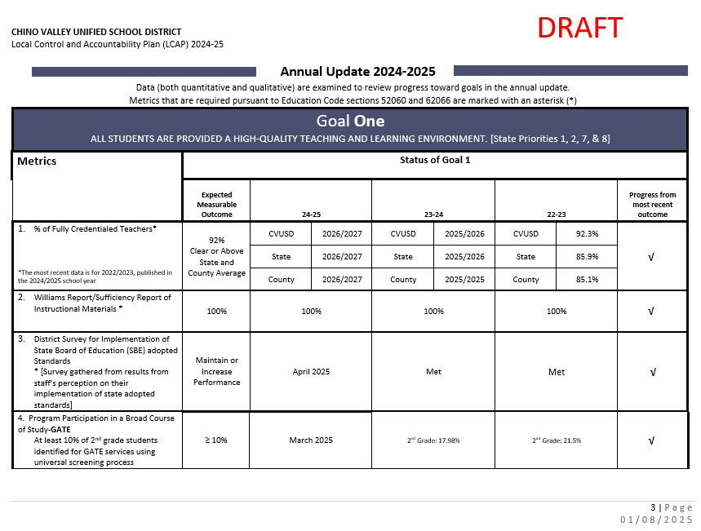
Comparación lado a lado
Notes:
Next you will do a side-by-side comparison of the annual update AND the Goals, Actions, and Services packet. This is pages 3-12 of the annual update packet. The annual update pages have been added to the presentation so that you can project the slides and have the parents flip through the goals, actions, and services packet. The facilitation guide provides you with more details on how to share each goal, metric, and actions.
Read Goal and share with parents that each goal has metrics
Within each metric, there is an expected measurable outcome (target goal); status columns represent data collected each year; progress from most recent outcome column represents our last data reference with one of the symbols below which will show our progress to our “expected measurable outcome”• Review the metrics for each goal • Within each goal, there are supporting actions and services. For each metric, review the related actions and services on the “Goals, Actions, and Services” document
Clarify any questions about the outcomes, actions, and services •
Principals: In your presentations to the community, you should highlight achievements at your school related to the specific actions and services and what is occurring at your respective feeder group school schools (For example, if you are the elementary, you could talk about the junior high and the high school; if you are the junior high school, you would talk about the high school
After the review of each goal, you should STOP and let parents/community members comment on the input sheet: comment on the progress, actions/services they feel are important in attaining the goal, and/or other suggestions for the goal

Slide 16
Actualización Anual - Meta 1
Notes:
Side-by-side review with the Goals, Actions, and Services packet.

Slide 17
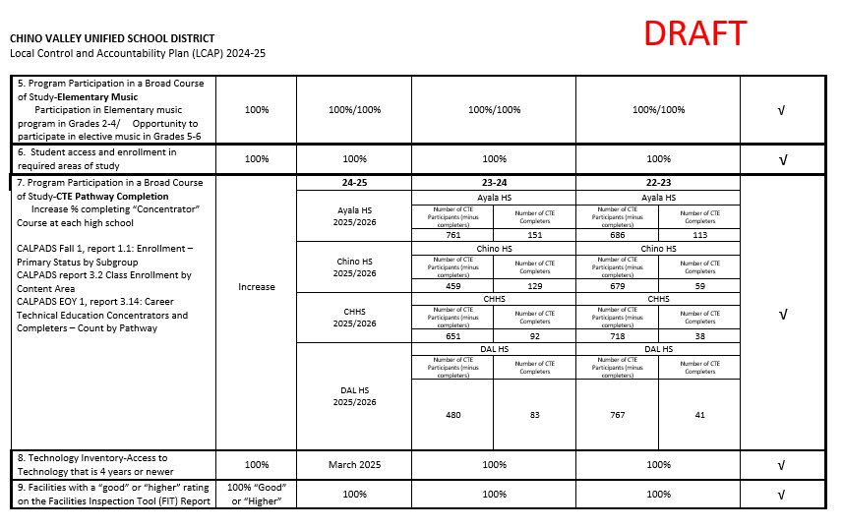
Actualización Anual - Meta 1 Continúa
Notes:
Side-by-side review with the Goals, Actions, and Services packet.

Slide 18
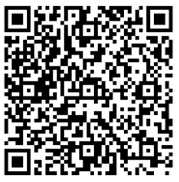



Meta 1 Condiciones de Aprendizaje
Prioridades Estatales 1, 2, 7, & 8
Todos los alumnos disfrutan de un entorno de enseñanza y aprendizaje de alta calidad.
Revisar el progreso de la Meta 1 del LCAP y las medidas y servicios relacionados.
Obtener comentarios sobre la Meta 1 del LCAP y las medidas y servicios relacionados.
Notes:
Review LCAP Goal 1 from Annual Update packet and the Goals, Actions, and Services Packet together to obtain feedback on form
QR CODE to 4 square document
Explain how the School Site LCAP Parent Engagement Meeting Input Form will be filled out during the presentation

Slide 19
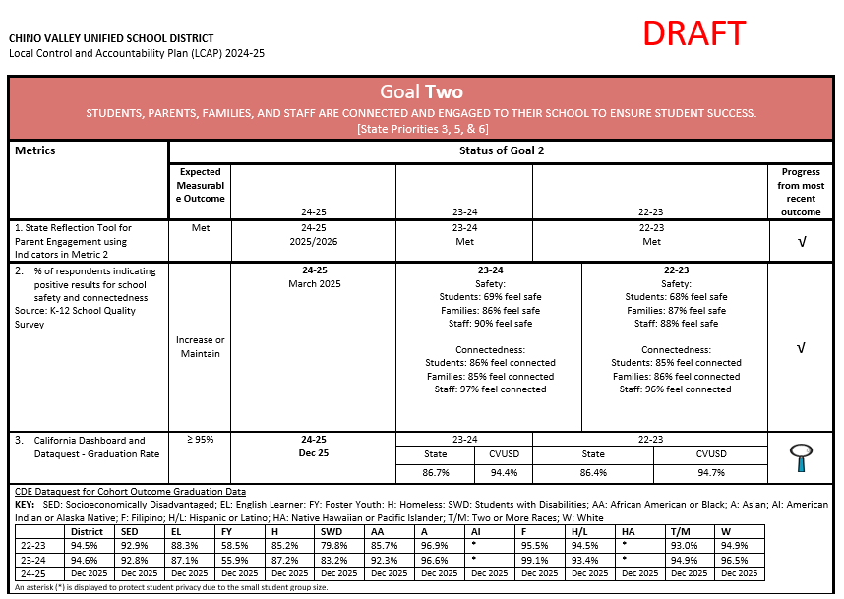
Actualización Anual - Meta 2
Notes:
Side-by-side review with the Goals, Actions, and Services packet.

Slide 20
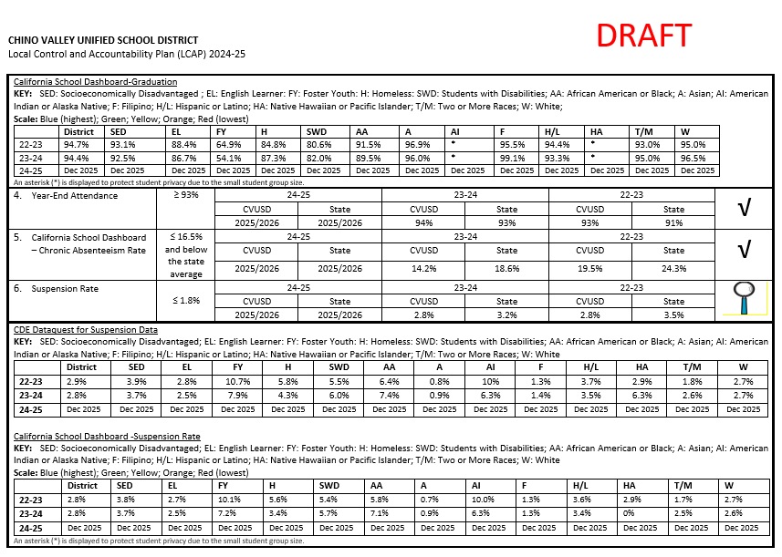
Actualización Anual - Meta 2 Continúa
Notes:
Side-by-side review with the Goals, Actions, and Services packet.

Slide 21
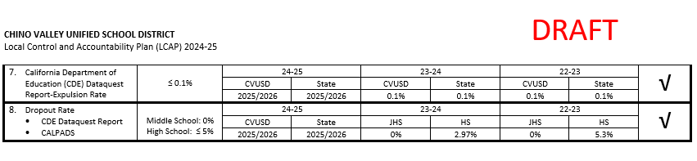
Actualización Anual - Meta 2 Continúa
Notes:
Side-by-side review with the Goals, Actions, and Services packet.

Slide 22

Meta 2 Participación
Prioridades Estatales 3, 5, & 6
Los alumnos, los padres, las familias y el personal están conectados y comprometidos con su escuela para garantizar el éxito de los alumnos.
Revisar el progreso de la Meta 2 del LCAP y las medidas y servicios relacionados.
Obtener opiniones sobre la Meta 2 del LCAP y las medidas y servicios relacionados.
Notes:
Review LCAP Goal 2 from Annual Update packet and the Goals, Actions, and Services Packet together to obtain feedback on form

Slide 23
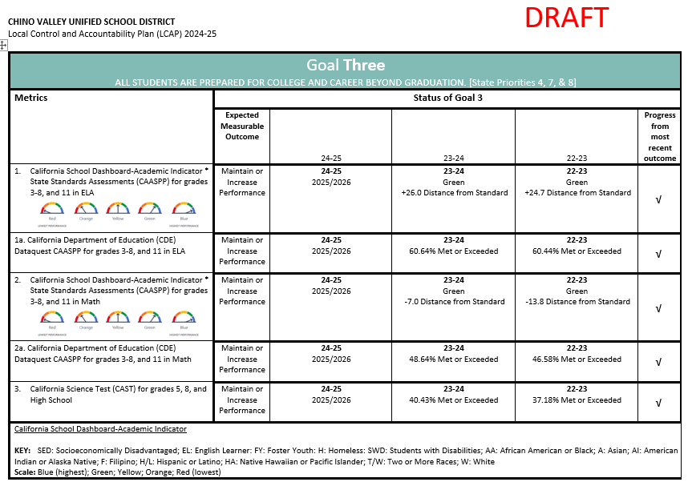
Actualización Anual - Meta 3
Notes:
Side-by-side review with the Goals, Actions, and Services packet.

Slide 24
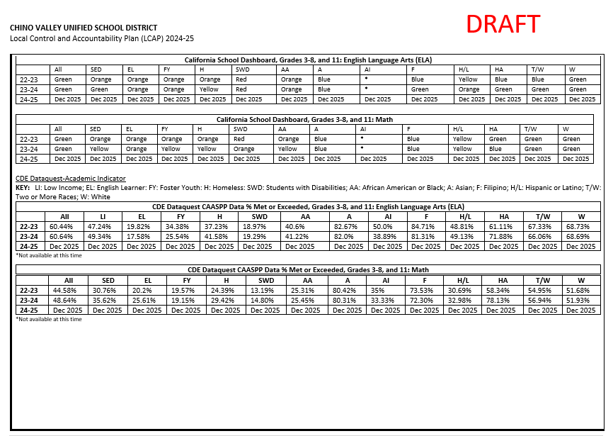
Actualización Anual - Meta 3 Continúa
Notes:
Side-by-side review with the Goals, Actions, and Services packet.

Slide 25
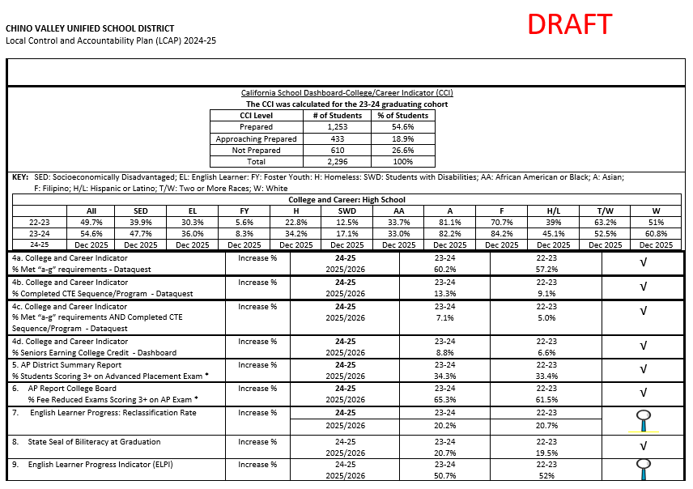
Actualización Anual - Meta 3 Continúa
Notes:
Side-by-side review with the Goals, Actions, and Services packet.

Slide 26
Meta 3 Resultados de los alumnos
Prioridades Estatales 4, 7, & 8
Todos los alumnos están preparados para la universidad y la carrera profesional después de la graduación.
Revisar el progreso de la Meta 3 del LCAP y las medidas y servicios relacionados.
Obtener opiniones sobre la Meta 3 del LCAP y las medidas y servicios relacionados.
Notes:
Review LCAP Goal 3 from Annual Update packet and the Goals, Actions, and Services Packet together to obtain feedback on form

Slide 27
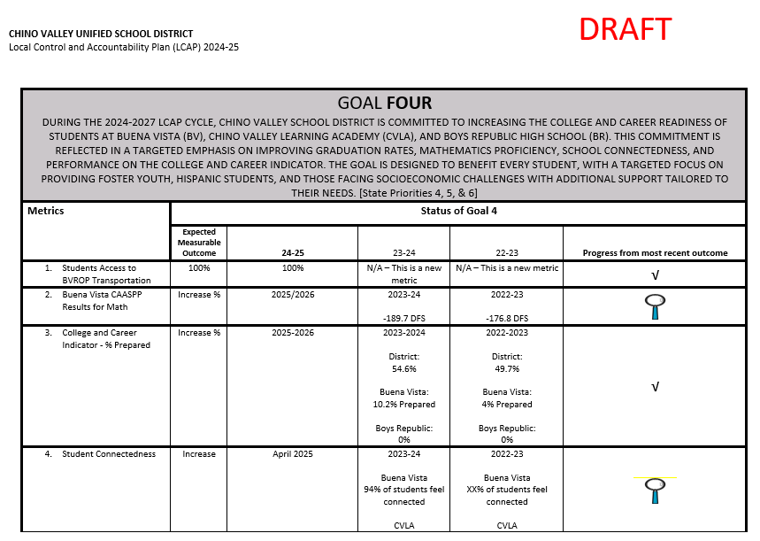
Actualización Anual - Meta 4
Notes:
Side-by-side review with the Goals, Actions, and Services packet.

Slide 28
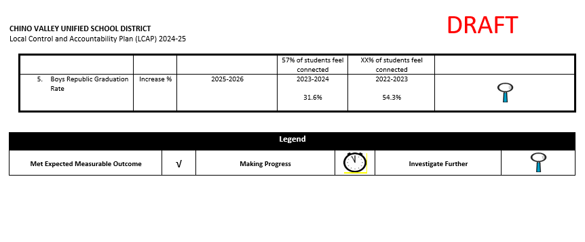
Actualización Anual - Meta 4 Continúa
Notes:
Side-by-side review with the Goals, Actions, and Services packet.

Slide 29

Meta 4 Asistencia específica
Prioridades Estatales 4, 5, & 6
El Distrito Escolar de Chino Valley está comprometido a aumentar la preparación universitaria y profesional de los estudiantes en Buena Vista (BV), Chino Valley Learning Academy (CVLA), y Boys Republic High School (BR): énfasis específico en la mejora de las tasas de graduación, el dominio de las matemáticas, la conectividad escolar, y el rendimiento en el Indicador Universitario y Profesional
Revisar el progreso de la Meta 4 del LCAP y las medidas y servicios relacionados.
Obtener opiniones sobre la Meta 4 del LCAP y las medidas y servicios relacionados.
Notes:
Review LCAP Goal 3 from Annual Update packet and the Goals, Actions, and Services Packet together to obtain feedback on form

Slide 30
Gracias por su valiosa contribución.
Por favor, recuerde dejar su hoja de aportaciones LCAP con nosotros.
Notes:
Don’t forget to collect School Site LCAP Parent Engagement Meeting Input Form as parents exit

