Slide 1



Chino Valley Unified School District
LOCAL CONTROL AND ACCOUNTABILITY PLAN
2024-2025
School Site: Parent/Community Engagement Meeting
Notes:
Welcome attendees.

Slide 2

MEETING NORMS AND COURTESIES
•Keep student learning as a focus
•Assume best intentions in others
•Participate with respect
•Start and end on time
•Silence cell phones

Slide 3

OUR OBJECTIVES FOR TODAY
Understand how the Local Control Funding Formula (LCFF) works and supports the District's Local Control Accountability Plan (LCAP) goals
Review Chino Valley Unified School District’s four LCAP goals and related actions and services
Provide input on the LCAP/SPSA goals and actions
Notes:
The objective of today's meeting, is as follows: (state the 3 objectives).
Feel free to use the Collaboration Strategies for Students by modeling a “no opt out environment” to illicit parent participation while reviewing today’s objectives and throughout the presentation when applicable.

Slide 4



What is the
Local Control Funding Formula (LCFF)?
Every student generates a base grant which funds basic educational costs, such as: employee salaries, building costs, and instructional materials.
Low income, English learners, and foster youth/homeless, generate additional funding, above the base grant (20%) to increase and improve services and achievement for these specific groups.
Districts with more than 55% low income, English learners, or foster youth/homeless receive an additional 50% of the base grant.
CVUSD does not qualify for concentration grants.
BASE GRANTS
SUPPLEMENTAL GRANTS
CONCENTRATION GRANTS
Notes:
The funding formula for Districts changed in 2013-2014 when LCFF was enacted.
LCFF funds include a base level of funding for all Local Education Agencies (LEAs) and extra funding - called "supplemental and concentration" grants - to LEAs based on the enrollment of high needs students (foster youth, English learners, and low-income students). CVUSD receives base grants and supplemental grants.
The LCFF gives school districts more flexibility in deciding how to use state funds. In exchange and as part of the legislation, school districts must work with parents, educators, students, and the community to develop a Local Control and Accountability Plan (LCAP) that shows how they will use these funds to serve students.
With a diversity of student needs, resources in the plan are allocated to support the achievement of all students with additional actions and services provided to English learner (EL), low income (LI), and foster youth (FY) students.

Slide 5




DISTRICT LCAP GOALS
Goal 1 Conditions of Learning | Goal 2 Engagement | Goal 3 Student Outcomes | Goal 4 Targeted Assistance
State Priorities 1, 2, 7, & 8 | State Priorities 3, 5, & 6 | State Priorities 4, 7, & 8 | State Priorities 4, 5, & 6
All students are provided a high-quality teaching and learning environment. | Students, parents, families, and staff are connected and engaged to their school to ensure student success. | All students are prepared for college and career beyond graduation. | Chino Valley School District is committed to increasing the college and career readiness of students at Buena Vista (BV), Chino Valley Learning Academy (CVLA), and Boys Republic High School (BR): targeted emphasis on improving Graduation Rates, Mathematics proficiency, school connectedness, and performance on the College and Career Indicator.
Notes:
We have 4 LCAP goals for this year.
Goal 1: All students are provided a high-quality teaching and learning environment.
There continues to be room for improvement regarding quality of instruction as well as the learning environment. It became evident that a safe and high-quality learning environment continues to be essential for student success. High quality universal technology along with instructional technology is essential to support the instructional program and close the achievement gap. By providing teachers instructional tools, staff can elevate/boost student engagement and success. Through strategic and targeted support, the achievement gap in ELA and Math for unduplicated students is narrowed. This includes fully credentialed teachers, Induction support for new teachers, professional development, ICs, and Common Core materials focusing on essential standards. Additionally, providing supplemental programs, such as music, can provide interdisciplinary learning and enrichment opportunities, and assist in the development of a well-rounded education for unduplicated students. Along with these items, well-maintained facilities promote a safe and healthy environment which can influence students to perform academically at the highest levels
Goal 2: Students, parents, families, and staff are connected and engaged to their school to ensure student success.
Student and family engagement was an important component in learning. Research shows engaged students are more likely to achieve academically and attend class regularly. Staff, students, and the community participated in the District’s Annual Survey to report satisfaction levels regarding academic support, student support, school leadership, family involvement, communication, safety and behavior, and remote learning. The data available informs the LCAP. Unduplicated student groups have been impacted as they experienced unique barriers. For this group of students, it is recommended that the District continues to coordinate services through Student Support Services (SSS), maintain Foster Youth (FY) counselor, keep the Chino Valley Learning Academy (CVLA); support the Family Engagement Center and the HOPE Center; provide the mental health services and programs; offer bilingual translation services; hold community forums and maintain Multi- Tiered System of Support-Behavior.
Goal 3: Students are prepared for college and career beyond graduation.
Students need to be prepared for their future. Administration of the Essential Standards Assessment indicate a performance gap on grade level standards for unduplicated student groups, and the district will continue to provide intervention support, tutoring services for foster youth and homeless populations. The California College Guidance Initiative (CCGI) will continue to inform students and parents A-G information for post-secondary education. Other programs such as college nights, Advanced Via Individual Determination (AVID) for first-generation college students, career centers, dual enrollment, subsidized Advanced Placement (AP) fees, professional development and support for English learner students will continue.
Goal 4: Chino Valley School District is committed to increasing the college and career readiness of students at Buena Vista (BV), Chino Valley Learning Academy (CVLA), and Boys Republic High School (BR): targeted emphasis on improving Graduation Rates, Mathematics proficiency, school connectedness, and performance on the College and Career Indicator.

Slide 6
How do the District’s four LCAP goals align with the eight CA State priorities?
Goal 1: Conditions of Learning
Basic Services (Priority 1)
Implementation of State Standards (Priority 2)
Course Access (Priority 7)
Other Student Outcomes (Priority 8)
Goal 2:
Engagement
Parent Involvement (Priority 3)
Student Engagement (Priority 5)
School Climate (Priority 6)
Goal 3:
Student Outcomes
Student Achievement (Priority 4)
Course Access (Priority 7)
Other Student Outcomes (Priority 8)
Goal 4:
Targeted Assistance
Student Achievement (Priority 4)
Student Engagement (Priority 5)
School Climate (Priority 6)
Notes:
The state priorities are categorized into three areas:
Conditions of Learning (basic services, implementation of state standards, course access)
Credentialed teacher, common core instructional materials, facilities are in good repair, and students have access to courses that lead to college and career.
Student Outcomes (student achievement and other student outcomes)
Programs and services are in place to promote student learning.
Engagement (parental involvement, student engagement and school climate)
Promote parent engagement and participation in student’s education process.
Students have good attendance and are engaged in their education.
Students are provided a safe learning environment.
Targeted Assistance (student achievement and other student outcomes at specific schools that meet low-performing schools
criteria in EC Section 52064(e)(6))
Additional targeted supports are in place to promote student learning at Buena Vista HS and Boys Republic and CVLA

Slide 7
How is school success measured locally?
Basic Services (State Priority 1) ✓Credentialed Teachers ✓Instructional Materials ✓Facilities in Good Repair | Implementation of State Board Approved Standards (State Priority 2) ELA, Math, ELD, CTE, Health, Social Science, PE, NGSS,VAPA, World Language | Access to a Broad Course of Study (State Priority 7) Grades 1-6 ELA, Math, Social Science, Science, VAPA, Health, and PE Grades 7-12 ELA, Math, Social Science, Science, VAPA, Health, PE, World Language, and CTE
Parent Engagement (State Priority 3) | School Climate (State Priority 6) | Other Locally Selected Indicators to Support the 8 State Priorities
Notes:
Local measures/indicators are used to help determine success. Those measures include basic services, implementation of state standards, access to a broad course of study, parent engagement, school climate, and other selected indicators that support the State's Eight Priorities.

Slide 8
LOCAL INDICATORS
Performance determined by the district,
based on the state adopted self-reflection tools.
not met for 2 or more years
met
not met
Notes:
Read slide. CVUSD has met all local indicators.

Slide 9
How is school success measured by the CA State Indicators?
Academic Indicator (State Priority 4) Grades 3-8, and 11 CAASPP in ELA and Math | English Learner Progress Indicator (State Priority 4) | Suspension and Expulsion Rates (State Priority 6)
College and Career Indicator (State Priorities 4, 7, & 8) ✓11th grade CAASPP in ELA and Math ✓A-G Completion ✓CTE pathway completion ✓AP Score 3+ ✓Dual Enrollment ✓JROTC ✓State Seal of Biliteracy | High School Graduation Rate (State Priority 5) | Chronic Absenteeism (State Priority 5)
Notes:
California has established State measures/indicators to determine school success. The measures/indicators include the academic indicator, English Learner Progress indicator, suspension & expulsion rates, college and career indicator, high school graduation rate, and chronic absenteeism.

Slide 10
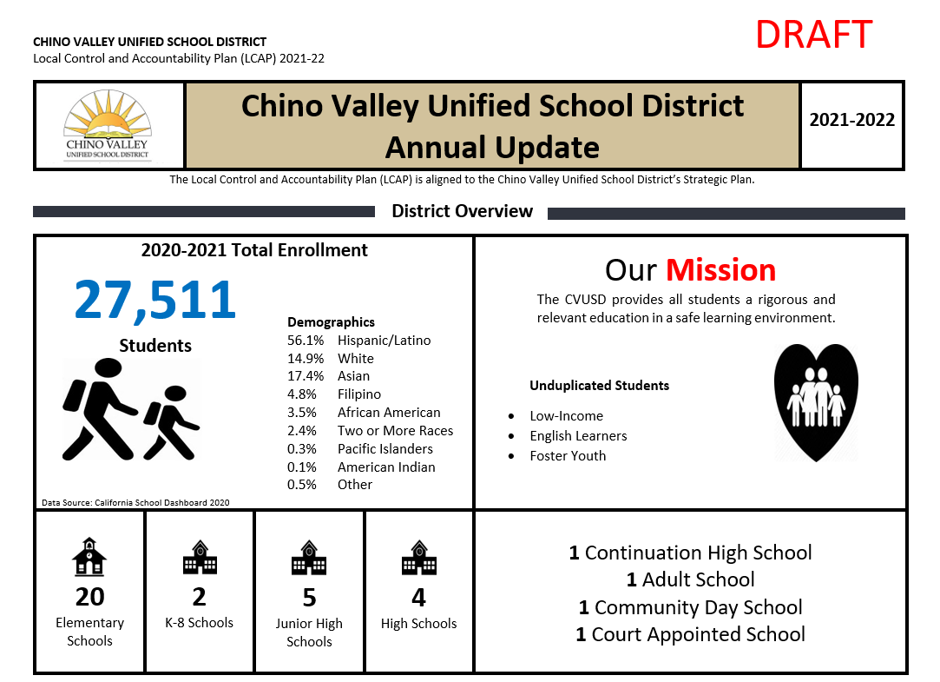
SPSA Progress Monitoring
Notes:
Add specific SCHOOL SITE SPSA progress monitoring data to share with your community.

Slide 11
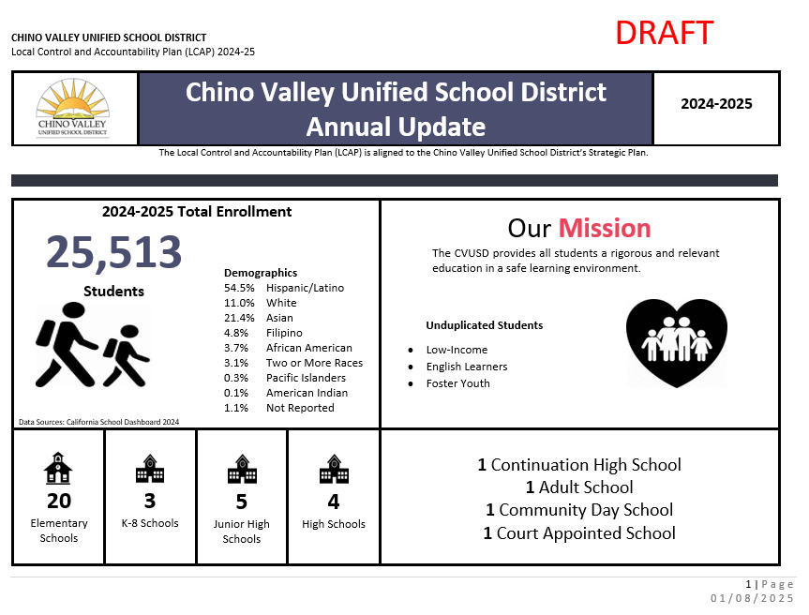
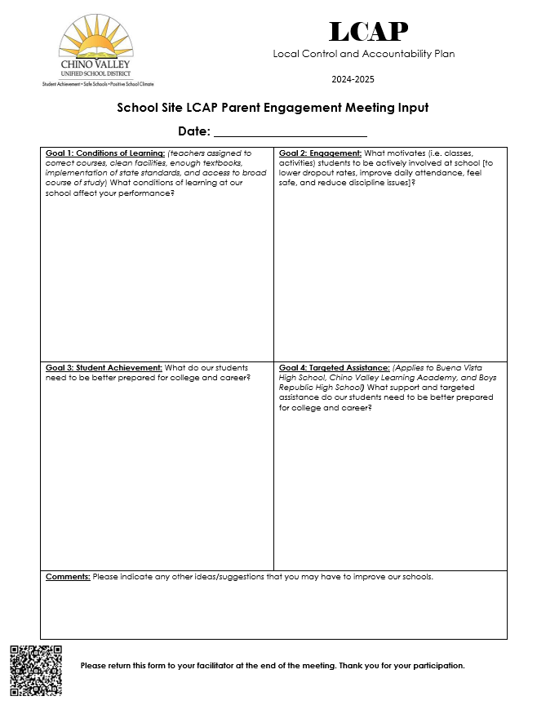
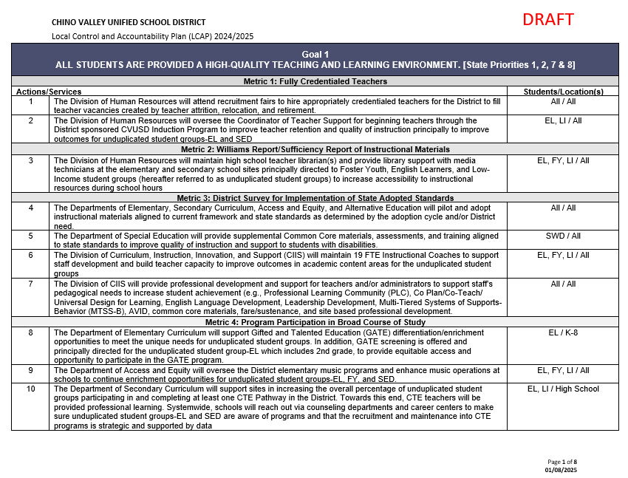
Documents for the Engagement Meeting
1
3
2
Notes:
The annual update, which is always in Draft form because we are still waiting for data from CDE – In the slide deck
The goals, actions and services document
The LCAP parent engagement input sheet

Slide 12
Annual Update – Page 1
Notes:
Facilitation Directions:
Review the Annual Update packet
Chino Valley Unified School District (CVUSD) offers premier educational opportunities for approximately 25,513 students, from Transitional Kindergarten through 12th grade.
There are 20 elementary schools, three (3) K-8 schools, five (5) junior high schools, four (4) comprehensive high schools, one (1) continuation high school, one (1) adult school, one (1) community day school, and one (1) court appointed school.
The District has an LCFF unduplicated count comprised of 10.3% English Learners, 0.5% Foster Youth, and 51.9% who are classified as low income.
The racial/ethnic diversity of the school community reflect the following: African American 3.8%, American Indian 0.1%, Asian 20.2%, Filipino 5.0%, Hispanic of Latino 55.1%, Two or More Races 2.9%, Pacific Islander 0.2%, White 11.7%, Not Reported 1.0%.
CVUSD is home to 21 California Distinguished Schools, some that have been designated Distinguished multiple times. It is also home to a California Gold Ribbon School, National Blue Ribbon School, Title I Academic Achieving Schools, California Honor Roll Schools, California Positive Behavioral Interventions and Supports (PBIS) Coalition Medal Award Winning Schools, and a California Department of Education Service Learning Leaders School. The Golden Bell Award for outstanding programs has been awarded to a District school and career academy. The District was also awarded a Seal of Biliteracy by the State in recognition of students who have studied and attained proficiency in two or more languages.
As one of 547 school districts in the U.S. and Canada, CVUSD has been honored by the College Board with placement on the 5th Annual Advanced Placement (AP) District Honor Roll for increasing access to AP course work while simultaneously maintaining or increasing the percentage of students earning scores of 3 or higher on the AP exams.
Our student test scores traditionally remain at the top of schools throughout the County of San Bernardino and the state. In addition to its stellar academic programs, CVUSD is set apart by its thriving performing arts and athletic programs as well as state and nationally recognized marching bands, color guards, robotics, and Odyssey of the Mind creative challenge teams.
CVUSD has been designated as a Model School Attendance Review Board (SARB) District four times by the State Superintendent of Public Instruction for its attendance improvement and decreasing dropout rates. The SARB process is available for students who are experiencing issues beyond the norm and provides resources for families to overcome barriers that may be contributing to students’ truancy.
The District is responsive to the needs of our students and families through a wide variety of programs. Before and after school care is available for students at several school sites. HOPE Family Resource Centers assist students and their families with food and clothing, counseling, housing information, tutoring referrals and more. In addition, a Health Clinic and its satellite center offer physical exams, illness care, assistance with Medi-Cal approval, and immunizations, including the flu shot. Furthermore,
Parenting forums provided by the District and law enforcement partners inform parents about school trends and how to keep their children safe. With a diversity of student needs, resources in the plan are allocated to support the achievement of all students with additional actions and services provided to English learner (EL), low income (LI), and foster youth (FY) students.

Slide 13




EDUCATIONAL PARTNER INPUT 2023-24
21,271 COMMENTS
2 SURVEYS
18,086 EDUCATIONAL
PARTNERS ENGAGED
59 MEETINGS
Notes:
Our Educational Partner input data is an important part of the LCAP. There was a significant amount of educational partner engagement that led to the contribution of this year’s plan.
Reflective of our educational partner feedback,
For Goal 1, educational partner input has suggested an emphasis on a Music, technology, professional development, and upgraded facilities. There is a need to continue to support new teachers through the CVUSD induction program and to continue to offer professional development for all teachers and administrators to support high quality instruction. Educational partners also expressed the need to expand the District’s infrastructure along with updated technology tools and emphasized the need to continue to maintain and upgrade facilities.
For Goal 2, educational partner input has suggested maintaining K-12 intervention counselors and school nurses, offering a safe and welcoming environment, and improving chronic absenteeism. Furthermore, educational partners have emphasized the necessity to provide supplemental education to help students stay connected to school and improve academic outcomes.
For Goal 3, educational partner input suggests continued growth of college and career awareness programs across all schools, including AP Courses and Career Centers. To assist students in achieving success, educational partners recommended that the District look to grow intervention programs and offer more tutoring.

Slide 14
Goals, Actions, and Services
Notes:
Facilitation Directions
Read Goal
For each metric, review the status and the related actions and services
Clarify any questions about the outcomes, actions, and services
Principals: In your presentations to the community, you should highlight achievements at your school related to the specific actions and services and what is occurring at your respective feeder group school schools (For example, if you are the elementary, you could talk about the junior high and the high school; if you are the junior high school, you would talk about the high school
After the review of each goal, you should STOP and let parents/community members comment on the input sheet: comment on the progress, actions/services they feel are important in attaining the goal, and/or other suggestions for the goal

Slide 15
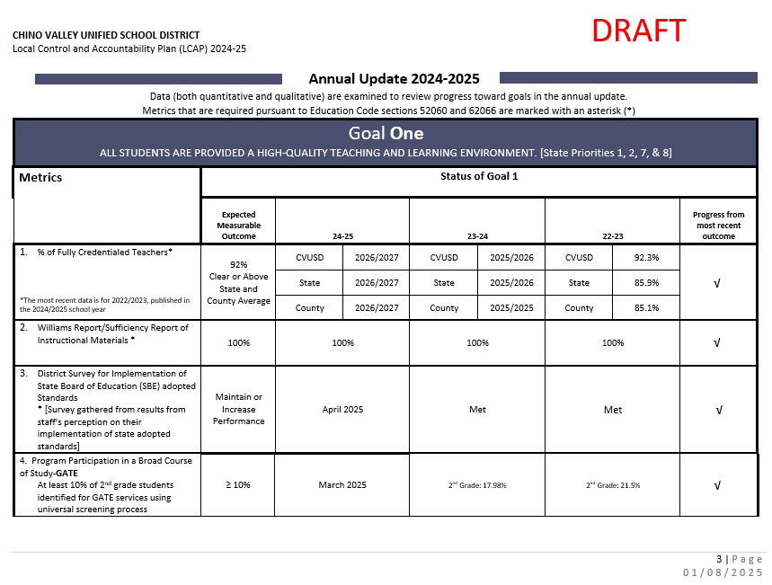
Side-by-side Comparison
Notes:
Next you will do a side-by-side comparison of the annual update AND the Goals, Actions, and Services packet. This is pages 3-12 of the annual update packet. The annual update pages have been added to the presentation so that you can project the slides and have the parents flip through the goals, actions, and services packet. The facilitation guide provides you with more details on how to share each goal, metric, and actions.
Read Goal and share with parents that each goal has metrics
Within each metric, there is an expected measurable outcome (target goal); status columns represent data collected each year; progress from most recent outcome column represents our last data reference with one of the symbols below which will show our progress to our “expected measurable outcome”• Review the metrics for each goal • Within each goal, there are supporting actions and services. For each metric, review the related actions and services on the “Goals, Actions, and Services” document
Clarify any questions about the outcomes, actions, and services •
Principals: In your presentations to the community, you should highlight achievements at your school related to the specific actions and services and what is occurring at your respective feeder group school schools (For example, if you are the elementary, you could talk about the junior high and the high school; if you are the junior high school, you would talk about the high school
After the review of each goal, you should STOP and let parents/community members comment on the input sheet: comment on the progress, actions/services they feel are important in attaining the goal, and/or other suggestions for the goal

Slide 16
Annual Update – Goal 1
Notes:
Side-by-side review with the Goals, Actions, and Services packet.

Slide 17
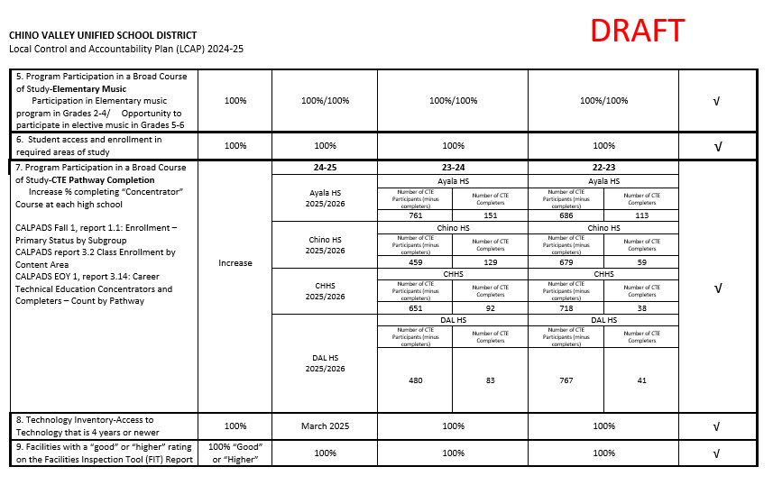
Annual Update – Goal 1 Continued
Notes:
Side-by-side review with the Goals, Actions, and Services packet.

Slide 18
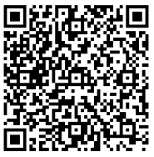



Goal 1 Conditions of Learning
State Priorities 1, 2, 7, & 8
All students are provided a high- quality teaching and learning environment.
Review progress of LCAP Goal 1 and related actions and services
Get feedback on LCAP Goal 1 and related actions and services
Notes:
Review LCAP Goal 1 from Annual Update packet and the Goals, Actions, and Services Packet together to obtain feedback on form
QR CODE to 4 square document
Explain how the School Site LCAP Parent Engagement Meeting Input Form will be filled out during the presentation

Slide 19
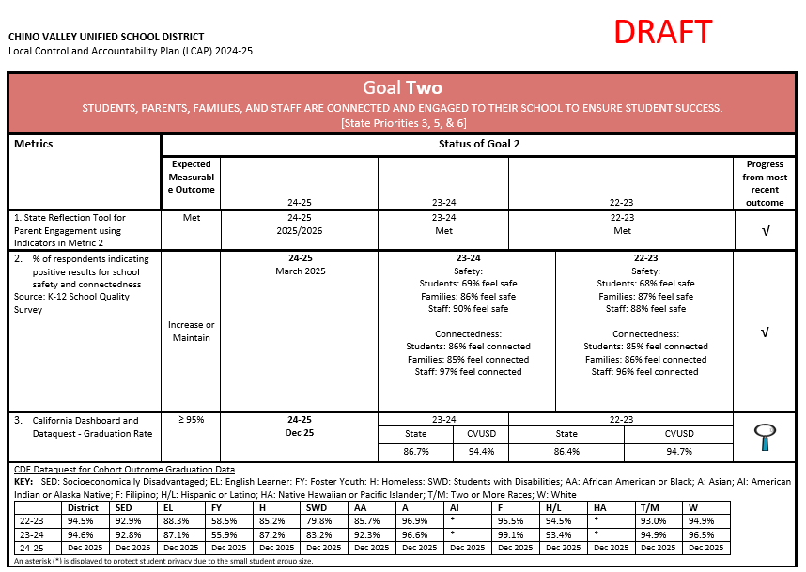
Annual Update – Goal 2
Notes:
Side-by-side review with the Goals, Actions, and Services packet.

Slide 20
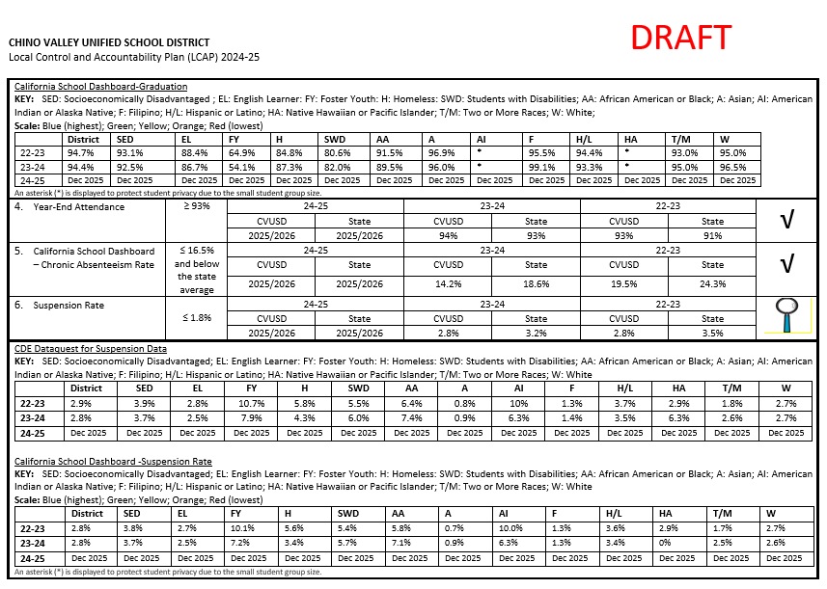
Annual Update – Goal 2 Continued
Notes:
Side-by-side review with the Goals, Actions, and Services packet.

Slide 21
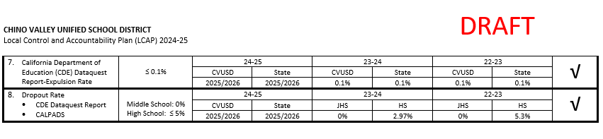
Annual Update – Goal 2 Continued
Notes:
Side-by-side review with the Goals, Actions, and Services packet.

Slide 22

Goal 2 Engagement
State Priorities 3, 5, & 6
Students, parents, families, and staff are connected and engaged to their school to ensure student success.
Review progress of LCAP Goal 2 and related actions and services
Get feedback on LCAP Goal 2 and related actions and services
Notes:
Review LCAP Goal 2 from Annual Update packet and the Goals, Actions, and Services Packet together to obtain feedback on form

Slide 23
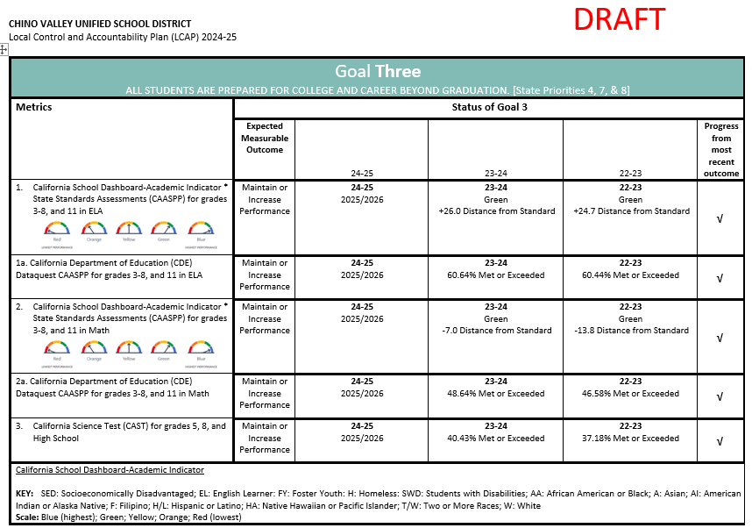
Annual Update – Goal 3
Notes:
Side-by-side review with the Goals, Actions, and Services packet.

Slide 24
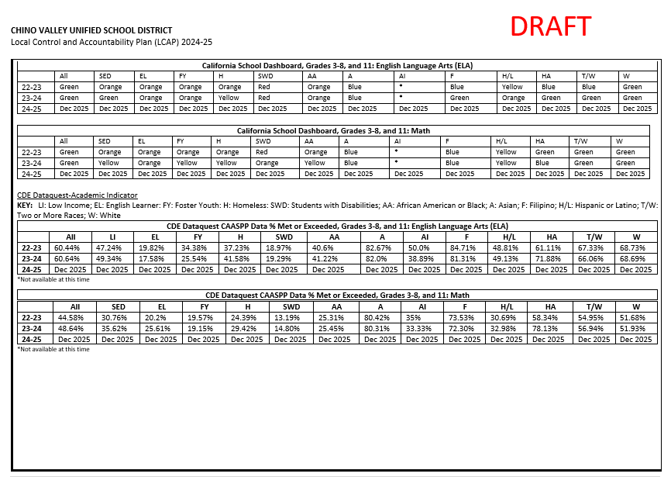
Annual Update – Goal 3 Continued
Notes:
Side-by-side review with the Goals, Actions, and Services packet.

Slide 25
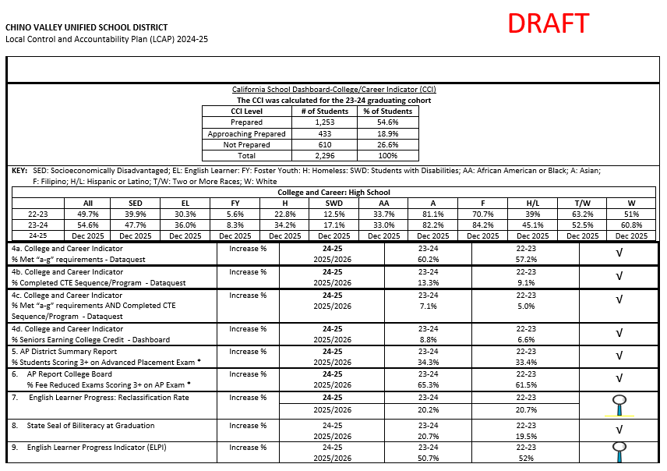
Annual Update – Goal 3 Continued
Notes:
Side-by-side review with the Goals, Actions, and Services packet.

Slide 26
Goal 3 Student Outcomes
State Priorities 4, 7, & 8
All students are prepared for college and career beyond graduation.
Review progress of LCAP Goal 3 and related actions and services
Get feedback on LCAP Goal 3 and related actions and services
Notes:
Review LCAP Goal 3 from Annual Update packet and the Goals, Actions, and Services Packet together to obtain feedback on form

Slide 27
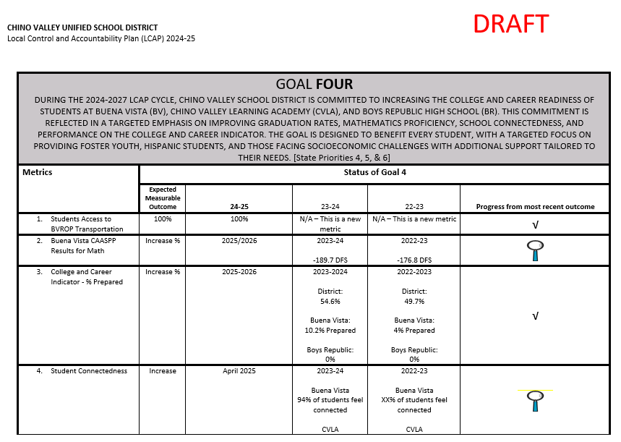
Annual Update – Goal 4
Notes:
Side-by-side review with the Goals, Actions, and Services packet.

Slide 28
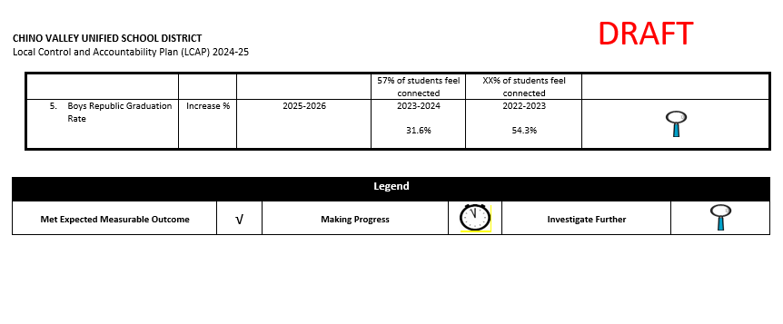
Annual Update – Goal 4 Continued
Notes:
Side-by-side review with the Goals, Actions, and Services packet.

Slide 29

Goal 4 Targeted Assistance
State Priorities 4, 5, & 6
Chino Valley School District is committed to increasing the college and career readiness of students at Buena Vista (BV), Chino Valley Learning Academy (CVLA), and Boys Republic High School (BR): targeted emphasis on improving Graduation Rates, Mathematics proficiency, school connectedness, and performance on the College and Career Indicator.
Review progress of LCAP Goal 4 and related actions and services
Get feedback on LCAP Goal 4 and related actions and services
Notes:
Review LCAP Goal 3 from Annual Update packet and the Goals, Actions, and Services Packet together to obtain feedback on form

Slide 30
Thank you for your valuable input!
Please remember to leave your LCAP input sheet with us.
Notes:
Don’t forget to collect School Site LCAP Parent Engagement Meeting Input Form as parents exit

