Slide 1



奇诺谷联合学区
地方控制和问责计划
2024-2025
学校： 家长／社区参与会议
Notes:
Welcome attendees.

Slide 2

会议礼仪
以学生的学习为中心
假定他人是出于好意
以尊重的态度参与
准时开始和结束
手机静音

Slide 3

我们今天的目标
了解 "地方控制资金公式"（LCFF）如何运作并支持学区的 "地方控制问责计划"（LCAP）目标
审查奇诺谷联合学区的四个 LCAP 目标及相关行动和服务
就 LCAP/SPSA 目标和行动提供建议
Notes:
The objective of today's meeting, is as follows: (state the 3 objectives).
Feel free to use the Collaboration Strategies for Students by modeling a “no opt out environment” to illicit parent participation while reviewing today’s objectives and throughout the presentation when applicable.

Slide 4



什么是地方控制资金公式(LCFF)?
每个学生都可获得基本补助金，用于支付基本教育费用，如员工工资、校舍费用和教材费。
低收入者、英语学习者和寄养青年/无家可归者将获得高于基本补助金（20%）的额外资金，以增加和改善针对这些特定群体的服务和成绩。
低收入、英语学习者或寄养青年/无家可归者超过 55% 的学区可获得额外 50%的基本补助金。CVUSD 没有资格获得集中补助金。
基本拨款
补充拨款
集中拨款
Notes:
The funding formula for Districts changed in 2013-2014 when LCFF was enacted.
LCFF funds include a base level of funding for all Local Education Agencies (LEAs) and extra funding - called "supplemental and concentration" grants - to LEAs based on the enrollment of high needs students (foster youth, English learners, and low-income students). CVUSD receives base grants and supplemental grants.
The LCFF gives school districts more flexibility in deciding how to use state funds. In exchange and as part of the legislation, school districts must work with parents, educators, students, and the community to develop a Local Control and Accountability Plan (LCAP) that shows how they will use these funds to serve students.
With a diversity of student needs, resources in the plan are allocated to support the achievement of all students with additional actions and services provided to English learner (EL), low income (LI), and foster youth (FY) students.

Slide 5




学区 LCAP 目标
目标 1 学习条件 | 目标 2 参与 | 目标 3 学生成果 | 目标 4 有针对性的援助
州优先事项 1, 2, 7, & 8 | 州优先事项 3, 5, & 6 | 州优先事项 4, 7, & 8 | 州优先事项 4, 5, & 6
为所有学生提供高质量的教学环境。 | 学生、家长、家庭和教职员工与学校紧密联系，共同参与，确保学生取得成功。 | 所有学生都为毕业后进入大学和就业做好准备。 | 奇诺谷Buena Vista高中（BV）、Chino Valley Learning Academy（CVLA）和Boys Republic高中（BR）学生的大学和职业准备程度：重点提高毕业率、数学能力、与学校的连结以及大学 和职业指标的成绩。
Notes:
We have 4 LCAP goals for this year.
Goal 1: All students are provided a high-quality teaching and learning environment.
There continues to be room for improvement regarding quality of instruction as well as the learning environment. It became evident that a safe and high-quality learning environment continues to be essential for student success. High quality universal technology along with instructional technology is essential to support the instructional program and close the achievement gap. By providing teachers instructional tools, staff can elevate/boost student engagement and success. Through strategic and targeted support, the achievement gap in ELA and Math for unduplicated students is narrowed. This includes fully credentialed teachers, Induction support for new teachers, professional development, ICs, and Common Core materials focusing on essential standards. Additionally, providing supplemental programs, such as music, can provide interdisciplinary learning and enrichment opportunities, and assist in the development of a well-rounded education for unduplicated students. Along with these items, well-maintained facilities promote a safe and healthy environment which can influence students to perform academically at the highest levels
Goal 2: Students, parents, families, and staff are connected and engaged to their school to ensure student success.
Student and family engagement was an important component in learning. Research shows engaged students are more likely to achieve academically and attend class regularly. Staff, students, and the community participated in the District’s Annual Survey to report satisfaction levels regarding academic support, student support, school leadership, family involvement, communication, safety and behavior, and remote learning. The data available informs the LCAP. Unduplicated student groups have been impacted as they experienced unique barriers. For this group of students, it is recommended that the District continues to coordinate services through Student Support Services (SSS), maintain Foster Youth (FY) counselor, keep the Chino Valley Learning Academy (CVLA); support the Family Engagement Center and the HOPE Center; provide the mental health services and programs; offer bilingual translation services; hold community forums and maintain Multi- Tiered System of Support-Behavior.
Goal 3: Students are prepared for college and career beyond graduation.
Students need to be prepared for their future. Administration of the Essential Standards Assessment indicate a performance gap on grade level standards for unduplicated student groups, and the district will continue to provide intervention support, tutoring services for foster youth and homeless populations. The California College Guidance Initiative (CCGI) will continue to inform students and parents A-G information for post-secondary education. Other programs such as college nights, Advanced Via Individual Determination (AVID) for first-generation college students, career centers, dual enrollment, subsidized Advanced Placement (AP) fees, professional development and support for English learner students will continue.
Goal 4: Chino Valley School District is committed to increasing the college and career readiness of students at Buena Vista (BV), Chino Valley Learning Academy (CVLA), and Boys Republic High School (BR): targeted emphasis on improving Graduation Rates, Mathematics proficiency, school connectedness, and performance on the College and Career Indicator.

Slide 6
学区的四个 LCAP 目标如何与加州的八个优先事项保持一致？
目标 1：
学习条件
基本服务（优先事项 1）
实施州立标准（优先事项 2）
课程机会（优先事项 7）
其他学生成果（优先事项 8）
目标 2：
参与
家长参与（优先事项 3）
学生参与（优先事项 5）
学校氛围（优先事项 6）
目标 3：
学生成果
学生成绩（优先事项 4）
课程机会（优先事项 7）
其他学生成果（优先事项 8）
目标 4：
有针对性的援助
学生成绩（优先事项 4）
学生参与（优先事项 5）
学校氛围（优先事项 6）
Notes:
The state priorities are categorized into three areas:
Conditions of Learning (basic services, implementation of state standards, course access)
Credentialed teacher, common core instructional materials, facilities are in good repair, and students have access to courses that lead to college and career.
Student Outcomes (student achievement and other student outcomes)
Programs and services are in place to promote student learning.
Engagement (parental involvement, student engagement and school climate)
Promote parent engagement and participation in student’s education process.
Students have good attendance and are engaged in their education.
Students are provided a safe learning environment.
Targeted Assistance (student achievement and other student outcomes at specific schools that meet low-performing schools
criteria in EC Section 52064(e)(6))
Additional targeted supports are in place to promote student learning at Buena Vista HS and Boys Republic and CVLA

Slide 7
如何衡量当地学校的成功？
基本服务 （州立优先事项 1） 经认证的教师 教学材料 设施完好无损 | 实施州委员会批准的标准 （州优先事项 2） 英语学习、数学、英语语言发展、职业技术教育、健康、社会科学、体育、NGSS、VAPA、世界语 | 学习广泛的课程​ （州立优先事项 7）​ ​ 一至六年级​ ​英语学习、数学、社会科学、科学、VAPA、健康和体育​ ​ 七至十二年级​ 英语学习、数学、社会科学、科学、VAPA、健康、体育、世界语言和职业技术教育​
家长参与​ （州立优先事项 3）​ | 学校氛围​ （州立优先事项 6）​ | 当地选定的支持八个州立优先事项的其他指标​
Notes:
Local measures/indicators are used to help determine success. Those measures include basic services, implementation of state standards, access to a broad course of study, parent engagement, school climate, and other selected indicators that support the State's Eight Priorities.

Slide 8
学区指标
由学区确定的成绩
基于州采用的自我反思工具
2 年或 2 年以上未达成
达成
未达成

Slide 9
加州指标如何衡量学校的成功？
学业指标 (州立优先事项 4） 3-8 年级和 11 年级 CAASPP 中的 英语和数学 | 英语学习者进步指标 (州立优先事项 4） | 停学率和开除率 (州立优先事项 6）
大学与就业指标 (州立优先事项 4、7 和 8） ✓11 年级 CAASPP 的英语语言学习和数学成绩 ✓完成 A-G 课程 ✓CTE 途径完成情况 ✓AP 分数 3+ ✓双录取 ✓JROTC ✓州双语证书 | 高中毕业率 (州立优先事项 5） | 长期旷课 (州立优先事项 5）

Slide 10
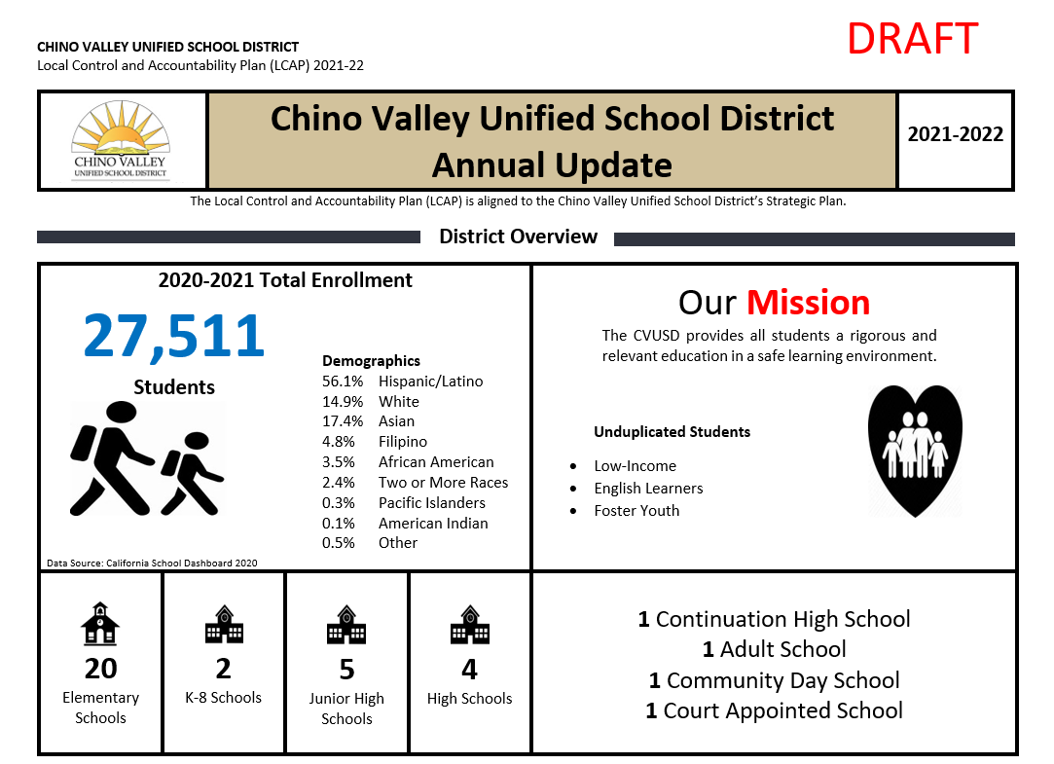
SPSA
进度
监控
Notes:
Add specific SCHOOL SITE SPSA progress monitoring data to share with your community.

Slide 11
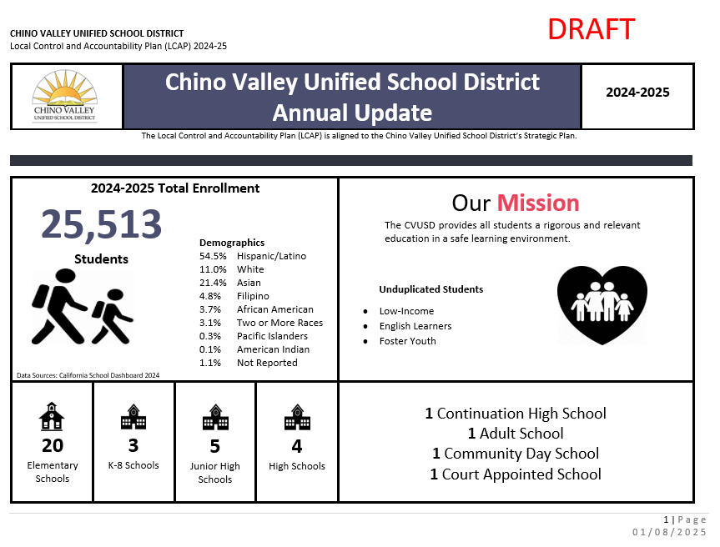
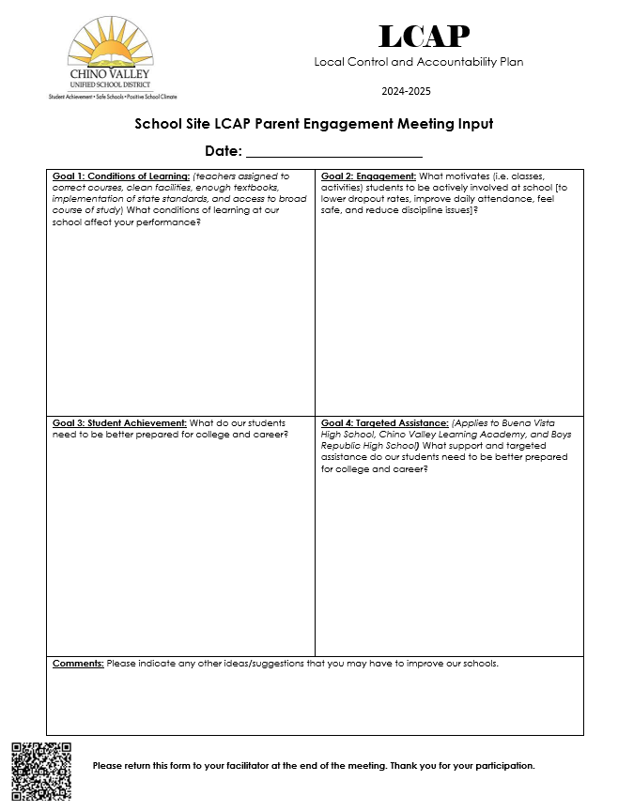
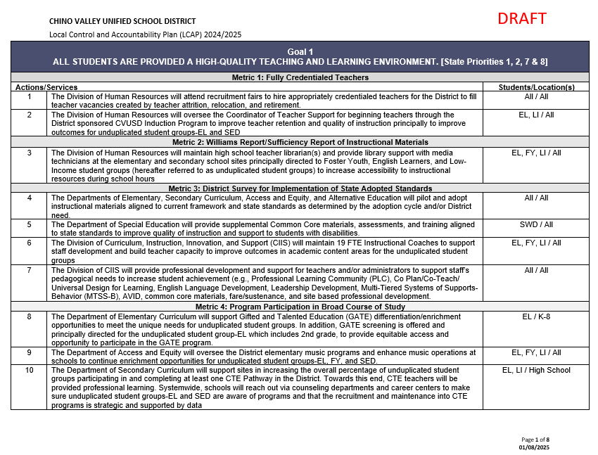
参与会议 的文件
1
3
2
Notes:
The annual update, which is always in Draft form because we are still waiting for data from CDE – In the slide deck
The goals, actions and services document
The LCAP parent engagement input sheet

Slide 12
年度
更新
第一頁
Notes:
Facilitation Directions:
Review the Annual Update packet
Chino Valley Unified School District (CVUSD) offers premier educational opportunities for approximately 25,513 students, from Transitional Kindergarten through 12th grade.
There are 20 elementary schools, three (3) K-8 schools, five (5) junior high schools, four (4) comprehensive high schools, one (1) continuation high school, one (1) adult school, one (1) community day school, and one (1) court appointed school.
The District has an LCFF unduplicated count comprised of 10.3% English Learners, 0.5% Foster Youth, and 51.9% who are classified as low income.
The racial/ethnic diversity of the school community reflect the following: African American 3.8%, American Indian 0.1%, Asian 20.2%, Filipino 5.0%, Hispanic of Latino 55.1%, Two or More Races 2.9%, Pacific Islander 0.2%, White 11.7%, Not Reported 1.0%.
CVUSD is home to 21 California Distinguished Schools, some that have been designated Distinguished multiple times. It is also home to a California Gold Ribbon School, National Blue Ribbon School, Title I Academic Achieving Schools, California Honor Roll Schools, California Positive Behavioral Interventions and Supports (PBIS) Coalition Medal Award Winning Schools, and a California Department of Education Service Learning Leaders School. The Golden Bell Award for outstanding programs has been awarded to a District school and career academy. The District was also awarded a Seal of Biliteracy by the State in recognition of students who have studied and attained proficiency in two or more languages.
As one of 547 school districts in the U.S. and Canada, CVUSD has been honored by the College Board with placement on the 5th Annual Advanced Placement (AP) District Honor Roll for increasing access to AP course work while simultaneously maintaining or increasing the percentage of students earning scores of 3 or higher on the AP exams.
Our student test scores traditionally remain at the top of schools throughout the County of San Bernardino and the state. In addition to its stellar academic programs, CVUSD is set apart by its thriving performing arts and athletic programs as well as state and nationally recognized marching bands, color guards, robotics, and Odyssey of the Mind creative challenge teams.
CVUSD has been designated as a Model School Attendance Review Board (SARB) District four times by the State Superintendent of Public Instruction for its attendance improvement and decreasing dropout rates. The SARB process is available for students who are experiencing issues beyond the norm and provides resources for families to overcome barriers that may be contributing to students’ truancy.
The District is responsive to the needs of our students and families through a wide variety of programs. Before and after school care is available for students at several school sites. HOPE Family Resource Centers assist students and their families with food and clothing, counseling, housing information, tutoring referrals and more. In addition, a Health Clinic and its satellite center offer physical exams, illness care, assistance with Medi-Cal approval, and immunizations, including the flu shot. Furthermore,
Parenting forums provided by the District and law enforcement partners inform parents about school trends and how to keep their children safe. With a diversity of student needs, resources in the plan are allocated to support the achievement of all students with additional actions and services provided to English learner (EL), low income (LI), and foster youth (FY) students.

Slide 13




教育合作伙伴的意见 2023-24
21,271
评论
2 调查问卷
18,086
参与的教育
合作伙伴
59会议
Notes:
Our Educational Partner input data is an important part of the LCAP. There was a significant amount of educational partner engagement that led to the contribution of this year’s plan.
Reflective of our educational partner feedback,
For Goal 1, educational partner input has suggested an emphasis on a Music, technology, professional development, and upgraded facilities. There is a need to continue to support new teachers through the CVUSD induction program and to continue to offer professional development for all teachers and administrators to support high quality instruction. Educational partners also expressed the need to expand the District’s infrastructure along with updated technology tools and emphasized the need to continue to maintain and upgrade facilities.
For Goal 2, educational partner input has suggested maintaining K-12 intervention counselors and school nurses, offering a safe and welcoming environment, and improving chronic absenteeism. Furthermore, educational partners have emphasized the necessity to provide supplemental education to help students stay connected to school and improve academic outcomes.
For Goal 3, educational partner input suggests continued growth of college and career awareness programs across all schools, including AP Courses and Career Centers. To assist students in achieving success, educational partners recommended that the District look to grow intervention programs and offer more tutoring.

Slide 14
目标
行动
和服务
Notes:
Facilitation Directions
Read Goal
For each metric, review the status and the related actions and services
Clarify any questions about the outcomes, actions, and services
Principals: In your presentations to the community, you should highlight achievements at your school related to the specific actions and services and what is occurring at your respective feeder group school schools (For example, if you are the elementary, you could talk about the junior high and the high school; if you are the junior high school, you would talk about the high school
After the review of each goal, you should STOP and let parents/community members comment on the input sheet: comment on the progress, actions/services they feel are important in attaining the goal, and/or other suggestions for the goal

Slide 15
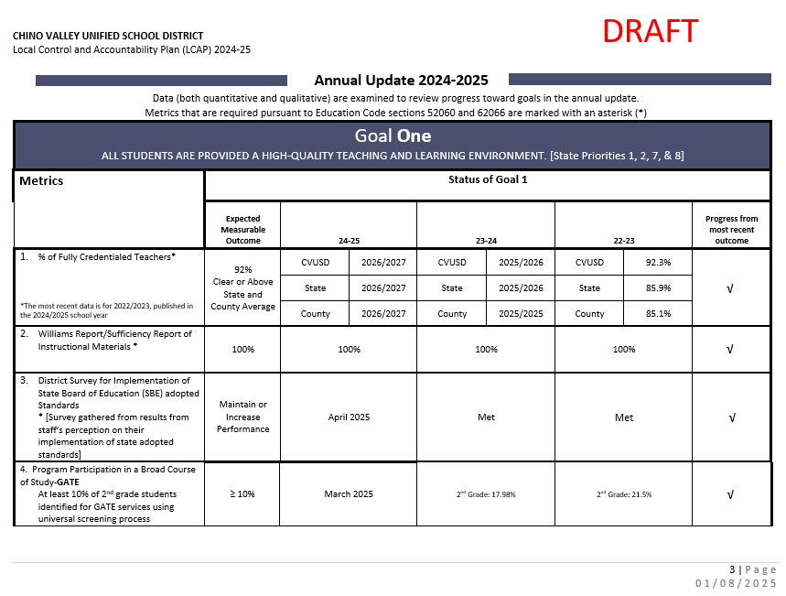
并排比较
Notes:
Next you will do a side-by-side comparison of the annual update AND the Goals, Actions, and Services packet. This is pages 3-12 of the annual update packet. The annual update pages have been added to the presentation so that you can project the slides and have the parents flip through the goals, actions, and services packet. The facilitation guide provides you with more details on how to share each goal, metric, and actions.
Read Goal and share with parents that each goal has metrics
Within each metric, there is an expected measurable outcome (target goal); status columns represent data collected each year; progress from most recent outcome column represents our last data reference with one of the symbols below which will show our progress to our “expected measurable outcome”• Review the metrics for each goal • Within each goal, there are supporting actions and services. For each metric, review the related actions and services on the “Goals, Actions, and Services” document
Clarify any questions about the outcomes, actions, and services •
Principals: In your presentations to the community, you should highlight achievements at your school related to the specific actions and services and what is occurring at your respective feeder group school schools (For example, if you are the elementary, you could talk about the junior high and the high school; if you are the junior high school, you would talk about the high school
After the review of each goal, you should STOP and let parents/community members comment on the input sheet: comment on the progress, actions/services they feel are important in attaining the goal, and/or other suggestions for the goal

Slide 16
年度更新 – 目标 1
Notes:
Side-by-side review with the Goals, Actions, and Services packet.

Slide 17
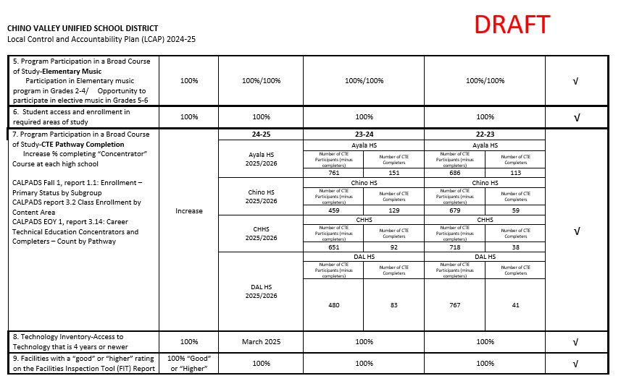
年度更新 – 目标 1 续
Notes:
Side-by-side review with the Goals, Actions, and Services packet.

Slide 18
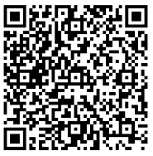



目标1 学习条件
州立优先事项1, 2, 7, & 8
为所有学生提供高质量的 教学环境。
审查 LCAP 目标 1 及相关行动和服务的进展情况
获取有关 LCAP 目标 1 及相关行动和服务的反馈意见
Notes:
Review LCAP Goal 1 from Annual Update packet and the Goals, Actions, and Services Packet together to obtain feedback on form
QR CODE to 4 square document
Explain how the School Site LCAP Parent Engagement Meeting Input Form will be filled out during the presentation

Slide 19
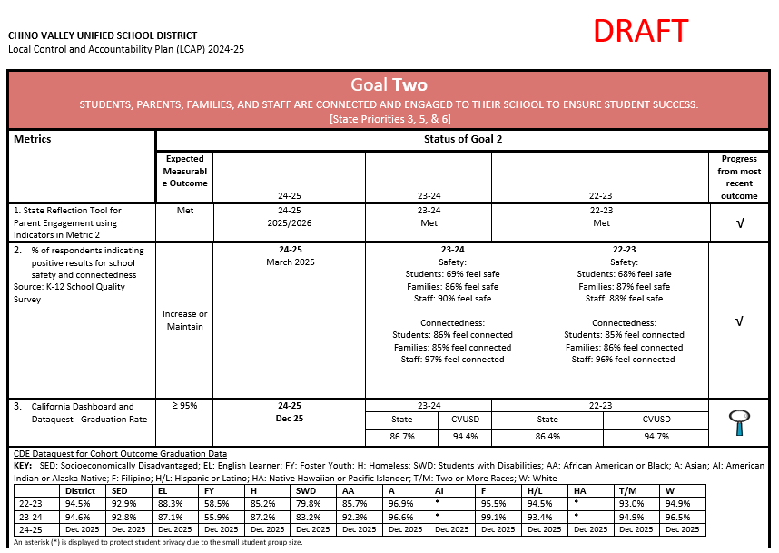
年度更新 – 目标 2
Notes:
Side-by-side review with the Goals, Actions, and Services packet.

Slide 20
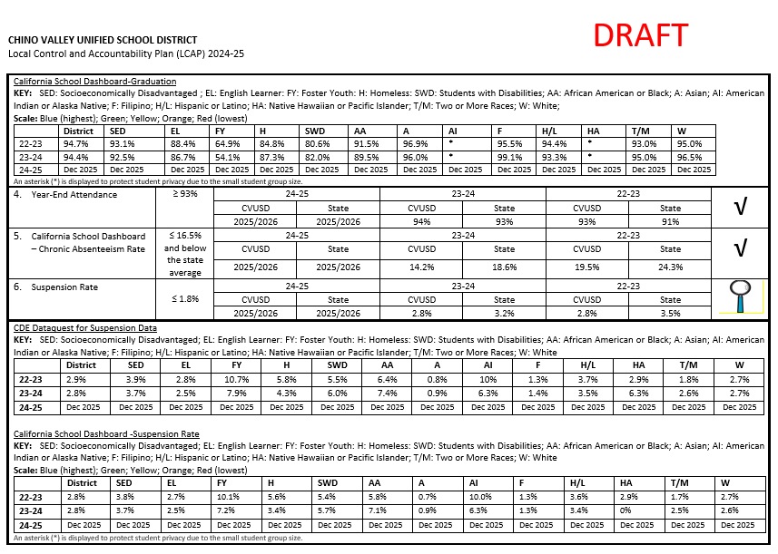
年度更新 – 目标 2 续
Notes:
Side-by-side review with the Goals, Actions, and Services packet.

Slide 21
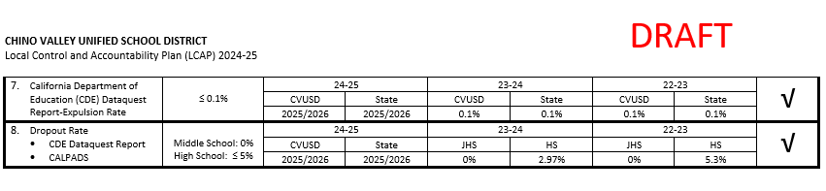
年度更新 – 目标 2 续
Notes:
Side-by-side review with the Goals, Actions, and Services packet.

Slide 22

目标 2 参与
州优先事项 3, 5, & 6
学生、家长、家庭和教职员工与学校紧密联系，共同参与，确保学生取得成功
审查 LCAP 目标 2 及相关行动和服务的进展情况
获取有关 LCAP 目标 2 及相关行动和服务的反馈意见
Notes:
Review LCAP Goal 2 from Annual Update packet and the Goals, Actions, and Services Packet together to obtain feedback on form

Slide 23
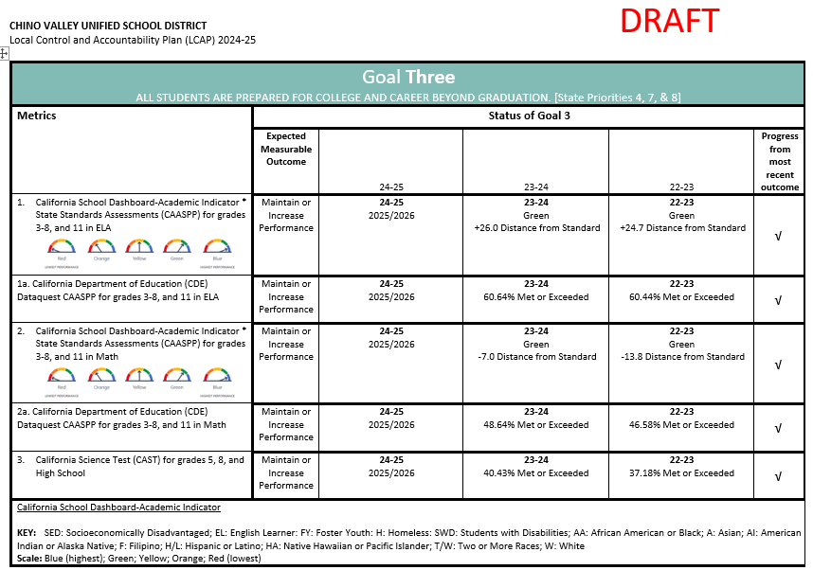
年度更新 – 目标 3
Notes:
Side-by-side review with the Goals, Actions, and Services packet.

Slide 24
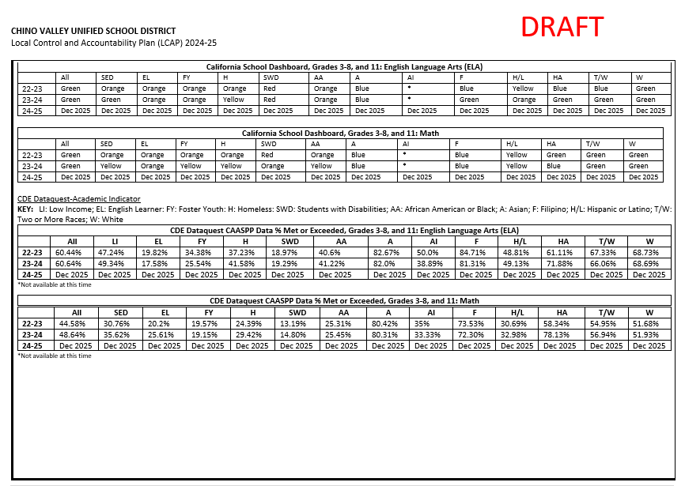
年度更新 – 目标 3 续
Notes:
Side-by-side review with the Goals, Actions, and Services packet.

Slide 25
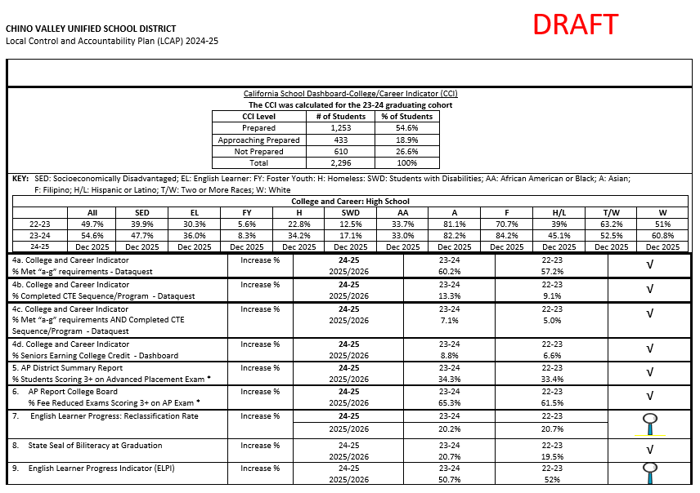
年度更新 – 目标 3 续
Notes:
Side-by-side review with the Goals, Actions, and Services packet.

Slide 26
目标 3 学生成果
州立优先事项 4, 7, & 8
所有学生都为毕业后进入大学和就业做好准备。
审查 LCAP 目标 3 及相关行动和服务的进展情况
获取有关 LCAP 目标 3 及相关行动和服务的反馈意见
Notes:
Review LCAP Goal 3 from Annual Update packet and the Goals, Actions, and Services Packet together to obtain feedback on form

Slide 27
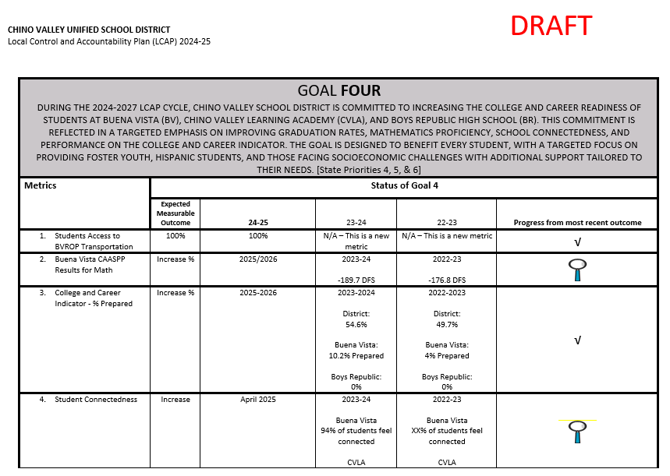
年度更新– 目标 4
Notes:
Side-by-side review with the Goals, Actions, and Services packet.

Slide 28
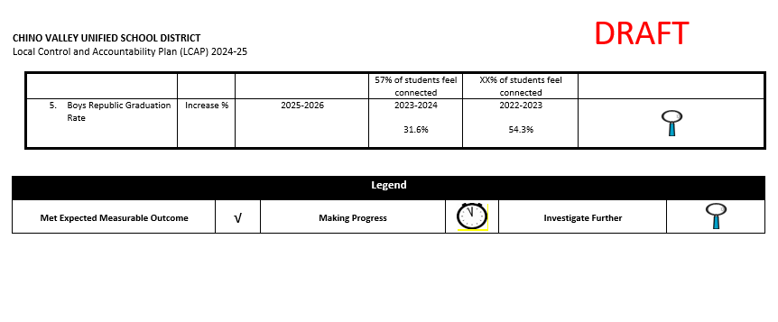
年度更新– 目标 4 续
Notes:
Side-by-side review with the Goals, Actions, and Services packet.

Slide 29

目标 4 有针对性的援助
州立优先事项 4, 5, & 6
奇诺谷Buena Vista高中（BV）、Chino Valley Learning Academy（CVLA）和Boys Republic高中（BR）学生的大学和职业准备程度：重点提高毕业率、数学能力、与学校的连结以及大学 和职业指标的成绩。
审查 LCAP 目标 4 及相关行动和服务的进展情况
审查 LCAP 目标 4 及相关行动和服务的进展情况
Notes:
Review LCAP Goal 3 from Annual Update packet and the Goals, Actions, and Services Packet together to obtain feedback on form

Slide 30
感谢您的宝贵意见！
请记得将您的 LCAP 建议表留给我们。
Notes:
Don’t forget to collect School Site LCAP Parent Engagement Meeting Input Form as parents exit

