Slide 1








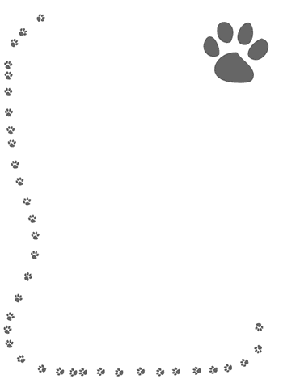

Supply List
Extra Help
Port Charlotte Middle
Home of the Terriers!
School Binder (provided)
Chromebook (provided)
Pencils
Black and/or blue pens
Yellow highlighters
Colored pencils
Lined paper
Hand-held pencil sharpener
1-3 oz hand sanitizer for student use and kept in backpack
*1 box of Kleenex
Extra help is always available upon student request.
Grading Policy
Students will be graded using a total points system. Under this system, all assignments will be given a predetermined point total which will count towards the overall quarter grade.
8th Grade English, Language Arts
Absences
If a student is absent, it is the responsibility of the student to make up the material missed. Each student has two days per day missed to complete a missed assignment. There is a board in the back of the room that has copies of assignments and other missed work. Daily plans/assignments will also be posted on Google Classroom and my teacher website. It is the responsibility of the student to check that board and Google Classroom and turn in said assignments by the due date.
Ms. Lindsay Carriera
941-255-7460 ext. 236
Lindsay.carriera@yourcharlotteschools.net
Monitoring your child’s academic progress in class will help keep him or her on track. Parents/guardians can log in to FOCUS to see grades, attendance, and schedules. Please check FOCUS 1-2 times a week
My Teacher Webpage
COURSE DESCRIPTION
http://yourcharlotteschools.net/pcm
Use the school website to access teacher web pages. My webpage has a detailed description of daily objectives, classwork and homework assignments.
The purpose of this course is to provide grade 8 students, using texts of high complexity, integrated language arts study in reading, writing, speaking, listening, and language for college and career preparation and readiness.
* Course description taken from cPalms
~ Homework assignments are mostly items that were not completed in class.
~ Homework assignments will be posted on Google Classroom.

