Slide 1
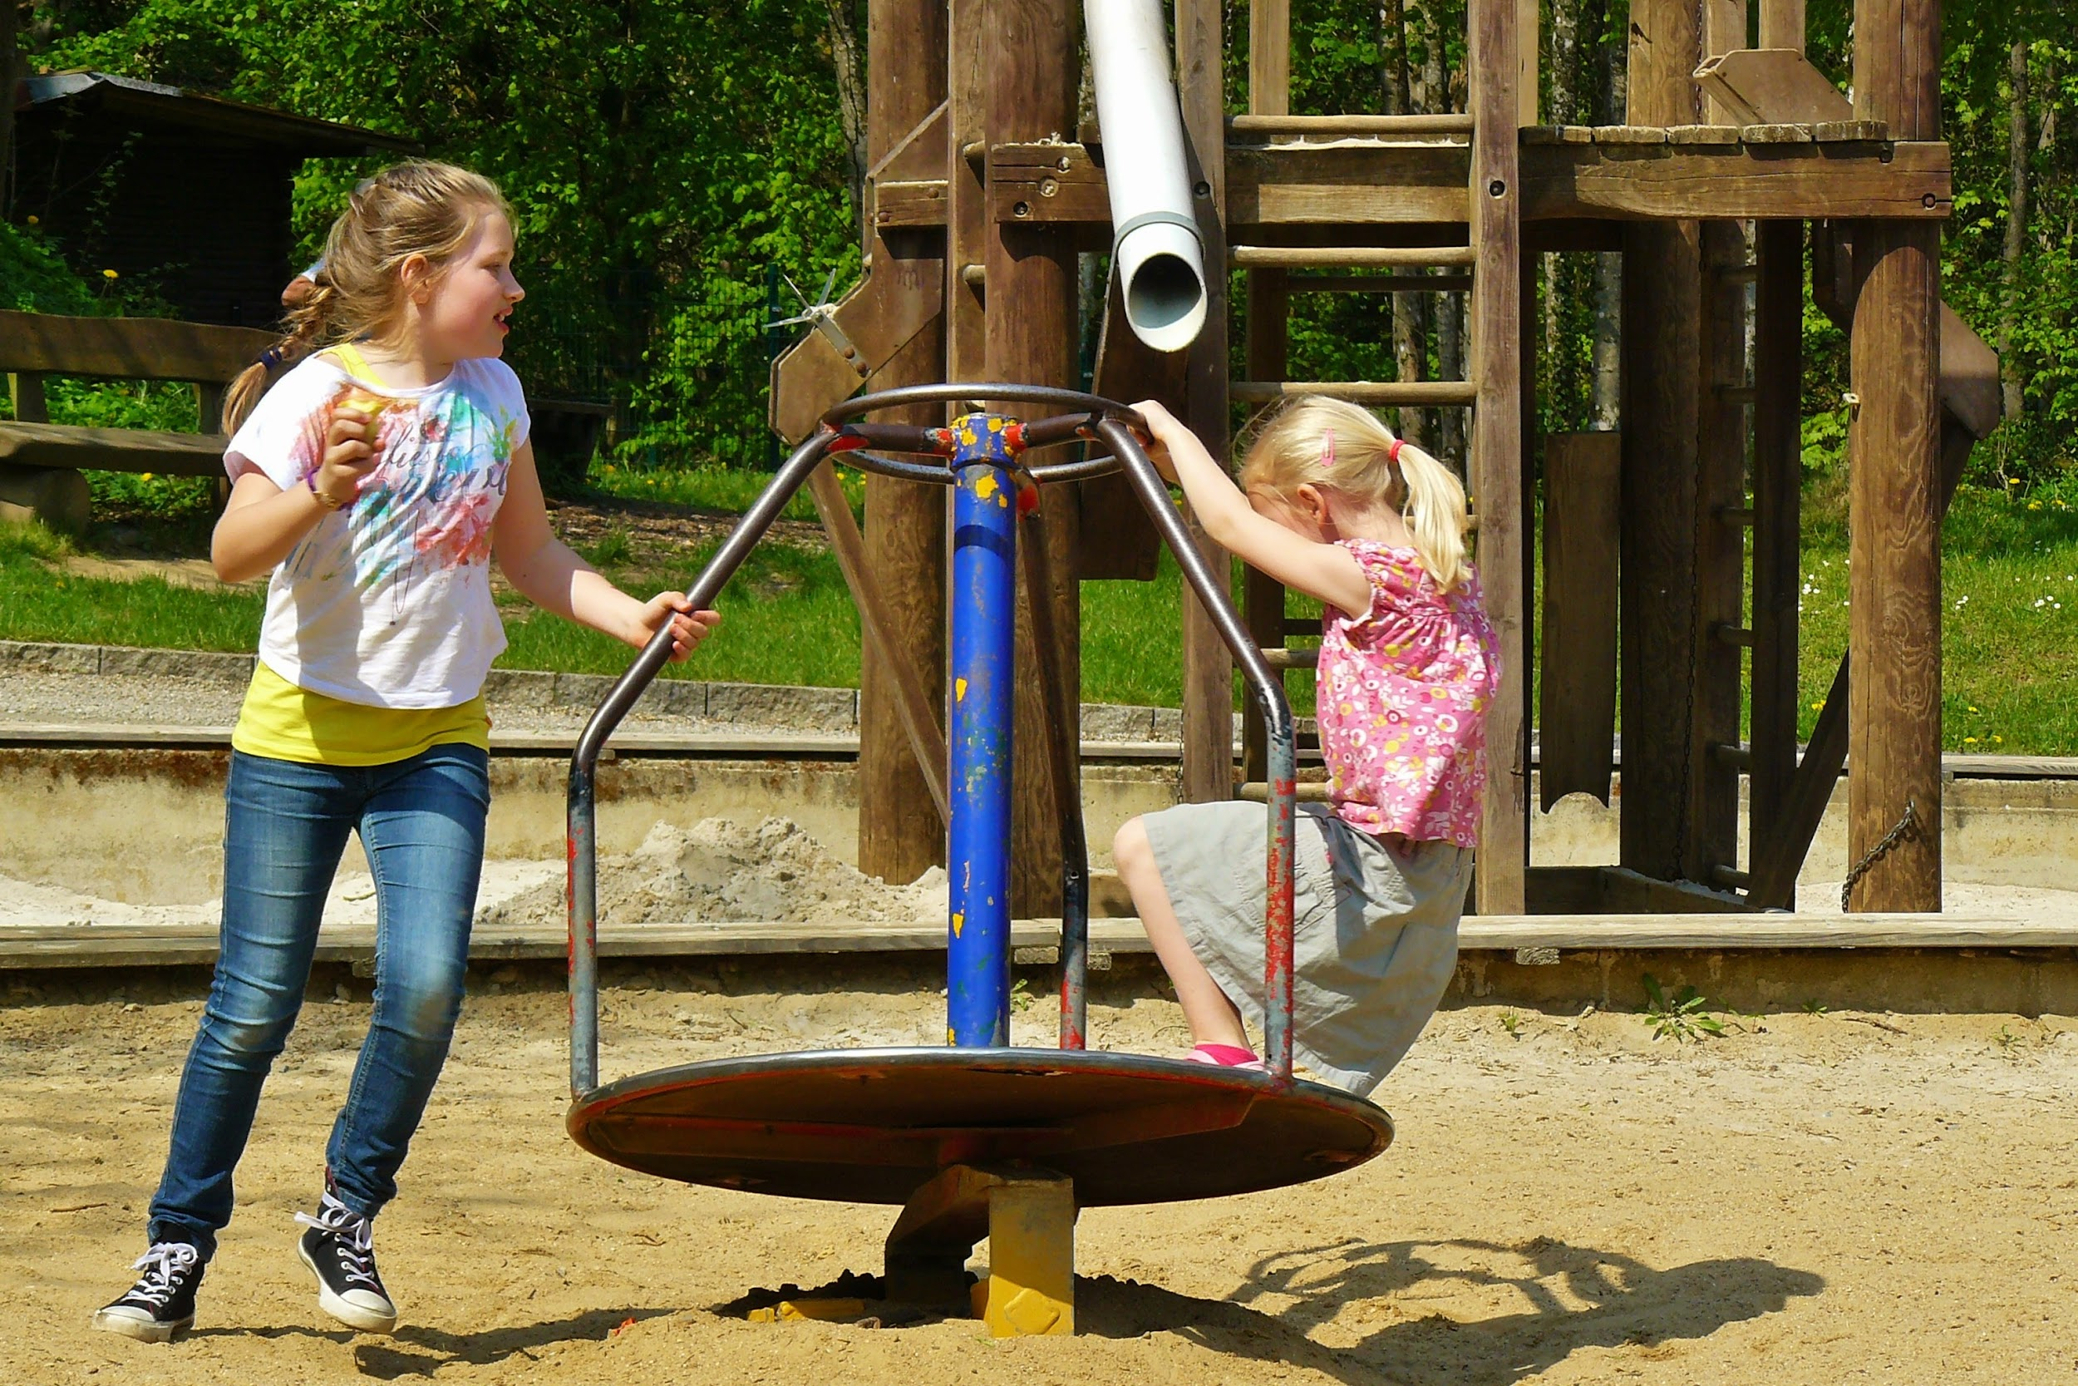
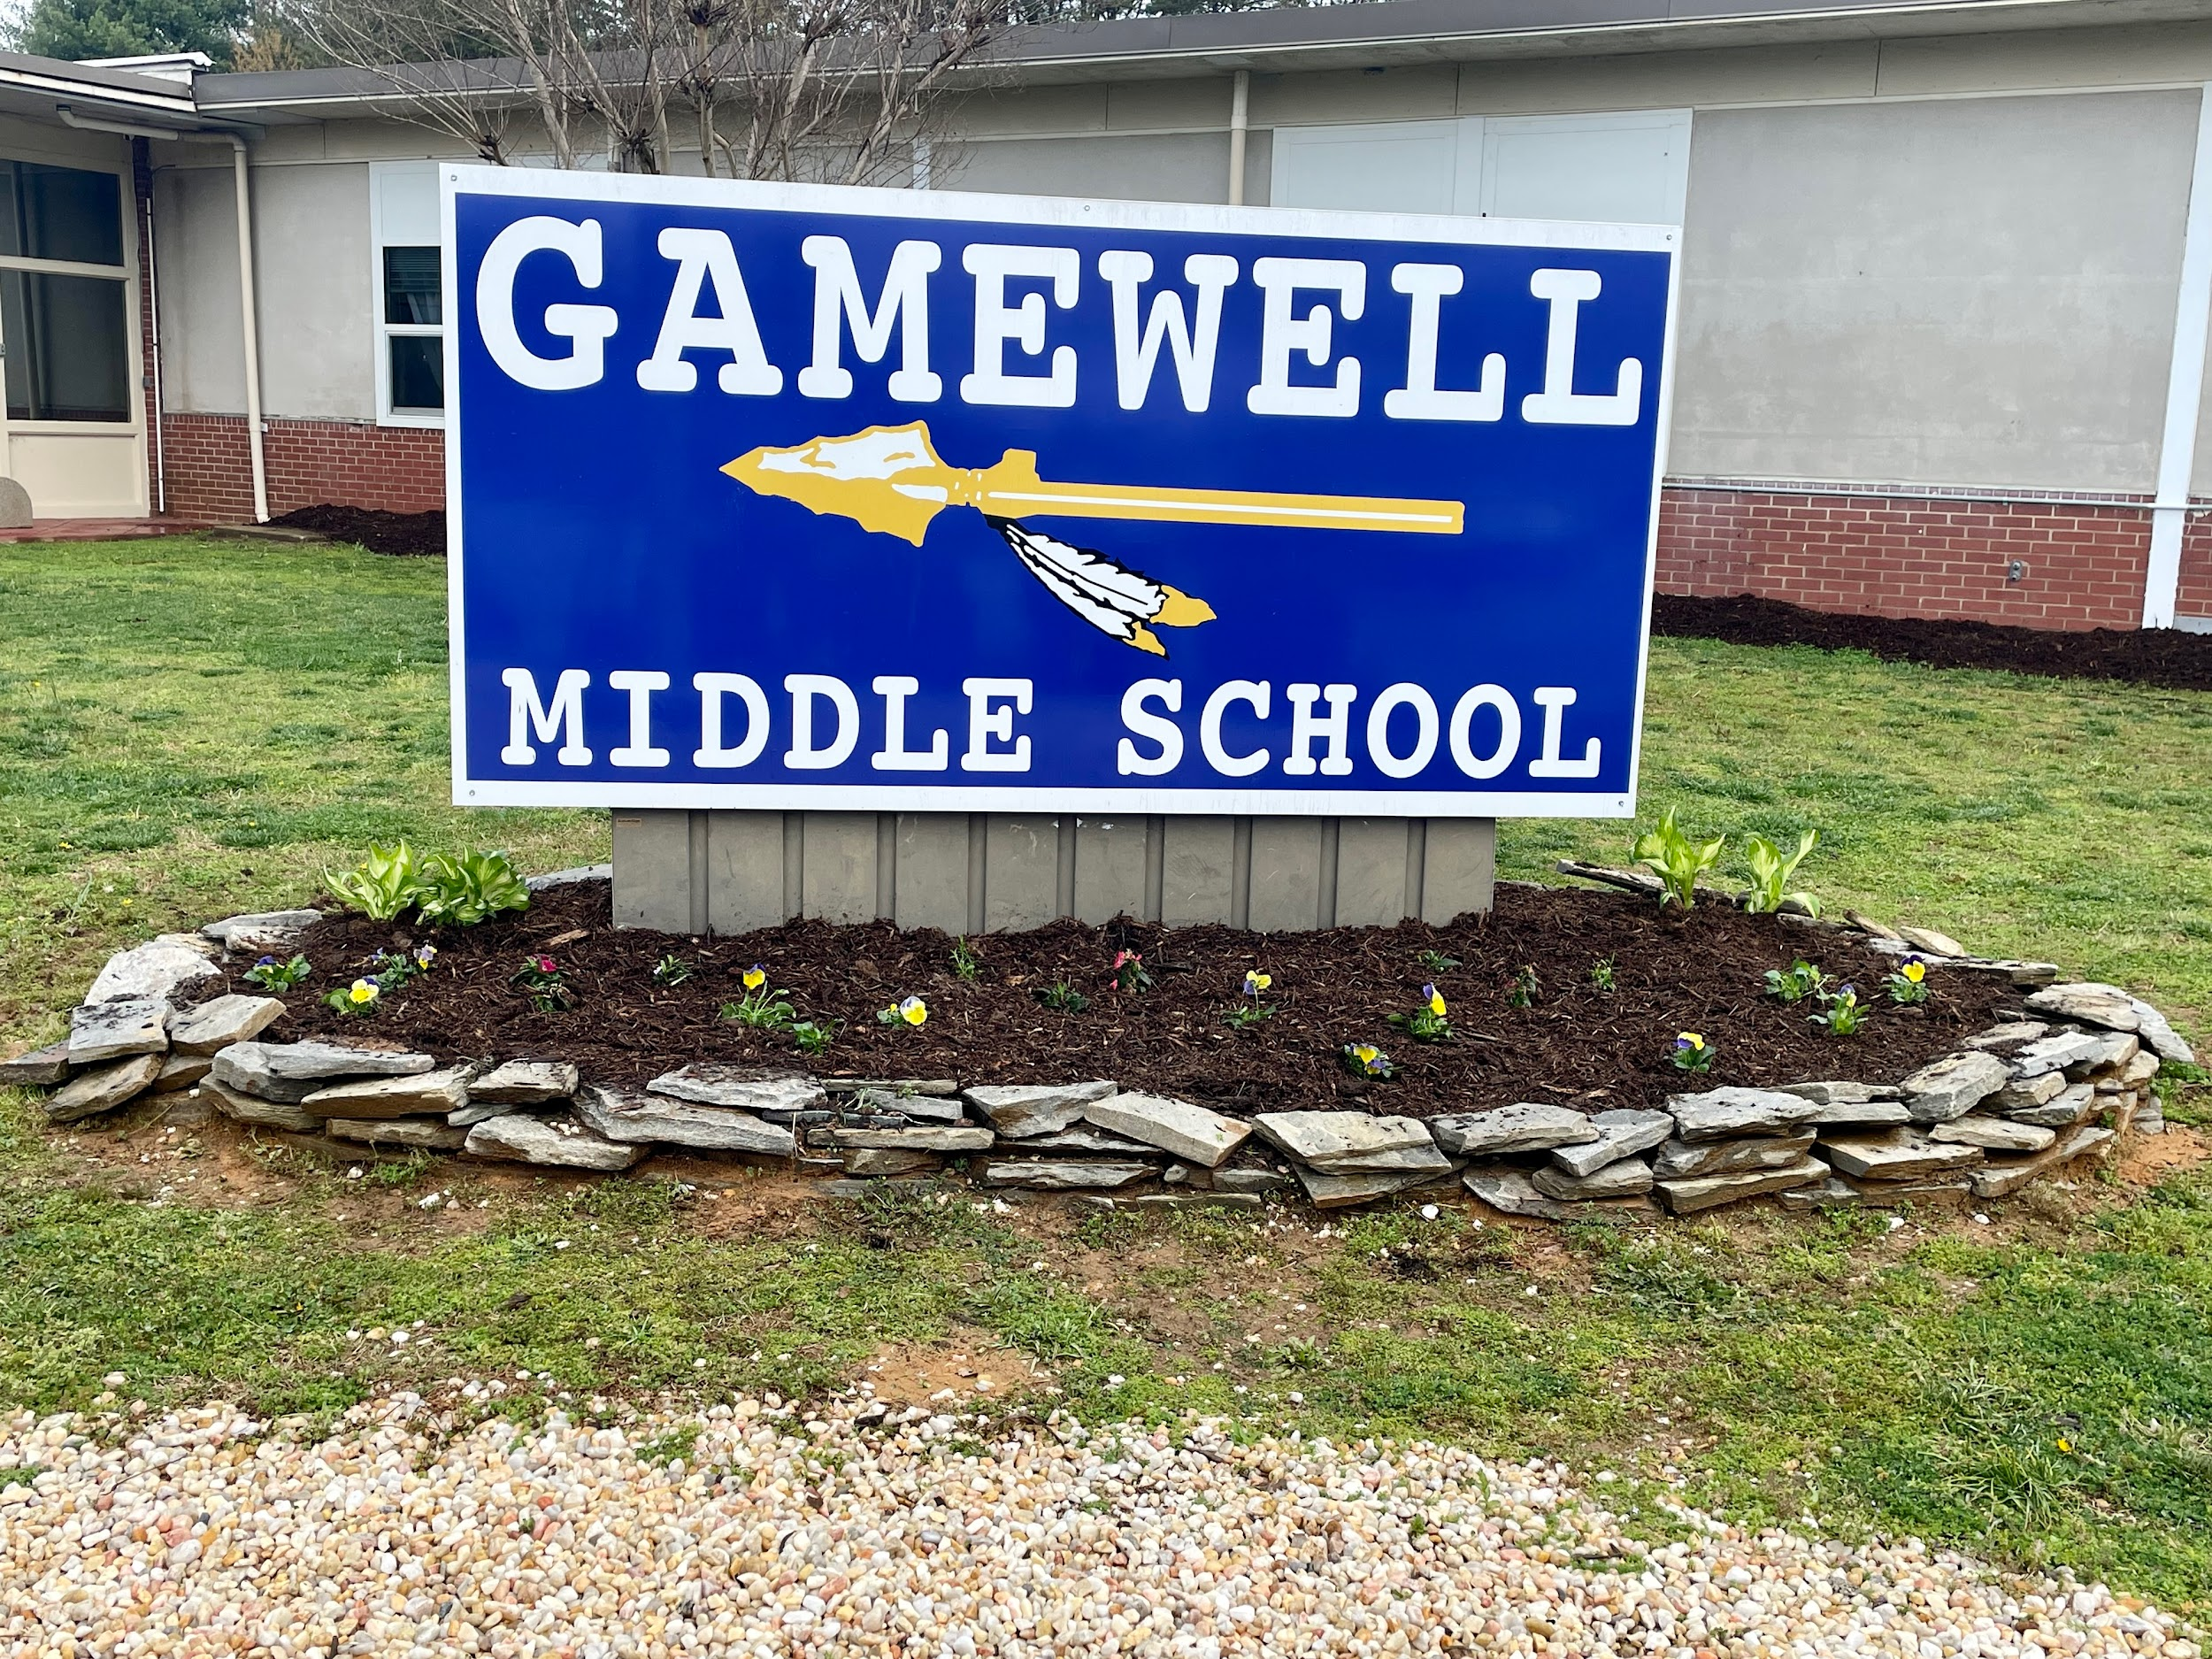
Gamewell Middle School
TITLE I
PARENT INFORMATION
2023 - 2024

Slide 2

WHAT IS TITLE I?
TITLE I IS A FEDERAL PROGRAM THAT PROVIDES ADDITIONAL SERVICES TO DISADVANTAGED STUDENTS.
SCHOOLS WITH STUDENTS AT 35% OR HIGHER LOW INCOME QUALIFY FOR FUNDING.

Slide 3

PARENT INVOLVEMENT
1% OF TITLE I MONEY GIVEN TO OUR SCHOOL MUST BE SPENT ON PARENT INVOLVEMENT.
READING AND MATH NIGHTS ARE FUNDED BY THIS 1% OF OUR PARENT INVOLVEMENT BUDGET. *BUDGETS HAVE NOT BEEN GIVEN TO SCHOOLS YET.
PARENTS HAVE A RIGHT TO BE INVOLVED IN THEIR CHILD’S EDUCATION.
On the following slides is our:
  Is our UPDATED Parent and Family Engagement Policy and Student-Parent School Compact.

Slide 4

2023-2024
Gamewell Middle School
Parent and Family Engagement Policy
At Gamewell Middle School, we believe it is essential for the school, parents, and the community to work together to provide the best educational experiences possible for each student. Parents are always welcome at Gamewell Middle, and every effort will be made by the school staff to communicate and work closely with parents as we endeavor to build a strong and effective partnership.
In order to develop and build this partnership between parents, the community, and the school, we will provide:
Monthly parent-cfst-administration morning meetings to discuss various topics.
Monthly celebrations for character education
Utilization of a bi-lingual liaison will be available to help parents during certain times of the week.
An annual meeting will be held where parents will meet the teachers and staff and will learn about the Title I program. This will be during our Open House right before school starts
Meetings will be held at different times during the day to better accommodate parents’ schedules
A Title I student-Parent-School Compact will detail how parents, school staff, and students will share responsibility for successful learning
Student Led parent conferences once per semester to give students the opportunity to explain to their parents what they are learning and about grade level expectations, academic assessments, curriculum requirements, state educational standards, and other issues related to the success of students
Notification via talking points for progress report and report card availability via powerschool
  Follow Up with Google Form to parents to ensure reports were viewed
A survey of parents will be distributed to provide a forum for parents to express their opinions about the current Title I program, as well as to share ideas for school improvement, program improvement and topics for training
Information will be disseminated through newsletters, the school website, teacher communication (emails, Talking Points, Blackboard Connect, social media, and phone calls)
Materials and training will be provided to help parents work with their children to improve achievement; staff training will be provided to help the staff learn best practices for teaching reading and math
Opportunities will be provided for parents to be involved in the planning and review of the school improvement plans as well as participation in the School Improvement Team to strengthen parental involvement within the school

Slide 5
Student-Parent Compact
The Caldwell County Board of Education has adopted Shared Accountability Standards (Policy 7532) that establish promotion requirements for students. The Board of Education strongly believes that learning takes place when there is shared effort, interest, and motivation by students, parents, and staff. Parents play a vital role in their children’s success at school, and it is critical that parents work with teachers to ensure that their children meet higher academic standards.
Gamewell Middle School establishes promotion requirements for students. Gamewell Middle School strongly believes that learning takes place when there is shared effort, interest, and motivation by students, parents, and staff. Parents play a vital role in their children’s success at school, and it is critical that parents work with teachers to ensure that their children meet higher academic standards.
As a student at Gamewell Middle School I pledge to Be Responsible, Respect, Achieve, Value, Excel and Safe
Respecting myself and the property and rights of others
Attending school regularly and arriving on time
Following the school rules
Coming to school dressed appropriately, with necessary materials, and prepared to work
Asking my teacher questions when I don’t understand
Completing and returning my assignments on time
Monitoring my grades using Powerschool
Maintaining safety will moving through the building
Student Signature___________________________________________ Date_____________
As the parent/guardian of _________________________, I pledge to…
Provide ample, quiet study time at home and encourage good study habits
Make sure my son/daughter is well-rested and at school on time
Support the school staff in their efforts to promote appropriate behavior
Reinforce the school rules
Encourage my son/daughter to read/do homework prescribed by his/her teacher(s)
Talk regularly with son/daughter’s teacher(s)
Attend parent/teacher conferences as requested
Monitor my child’s grades using Powershool and communication with teacher
Parent Signature___________________________________________ Date_____________
As a classroom teacher at Gamewell Middle School, I believe every child can learn and I pledge to …
Explain my expectations, instructional goals, and grading system to the student and parent
Enter at least 1 grade per week & consistently monitor student progress
Teach the North Carolina Standard Course of Study
Provide a classroom climate that is positive and conducive to learning
Communicate with parents through talking points, phone calls, conferences, & progress reports.
Employ a variety of teaching methods which work best for students
Respect the cultural differences of my students
Explain, promote, and enforce school/classroom rules
Teacher Signature__________________________________________ Date_____________

Slide 6

WHAT DO WE USE OUR FUNDING FOR EACH YEAR?
OUR GMS TITLE I BUDGET SPENDING HAS STAYED CONSISTENT OVER THE YEARS WITH VERY LITTLE CHANGE. HOWEVER, FUNDING CHANGES EACH YEAR FOR EACH SCHOOL.
INCLUDED IN THE SPENDING OF OUR TITLE I FUNDS (SUBJECT TO CHANGE):
2 TEACHER POSITION
1 Instructional Assistant
1 Part-Time Tutor
EDUCATIONAL PROGRAMS
READING/MATH/STEAM NIGHT ACTIVITIES FOR OUR STUDENTS AND PARENTS
STAFF DEVELOPMENT WORKSHOPS

Slide 7
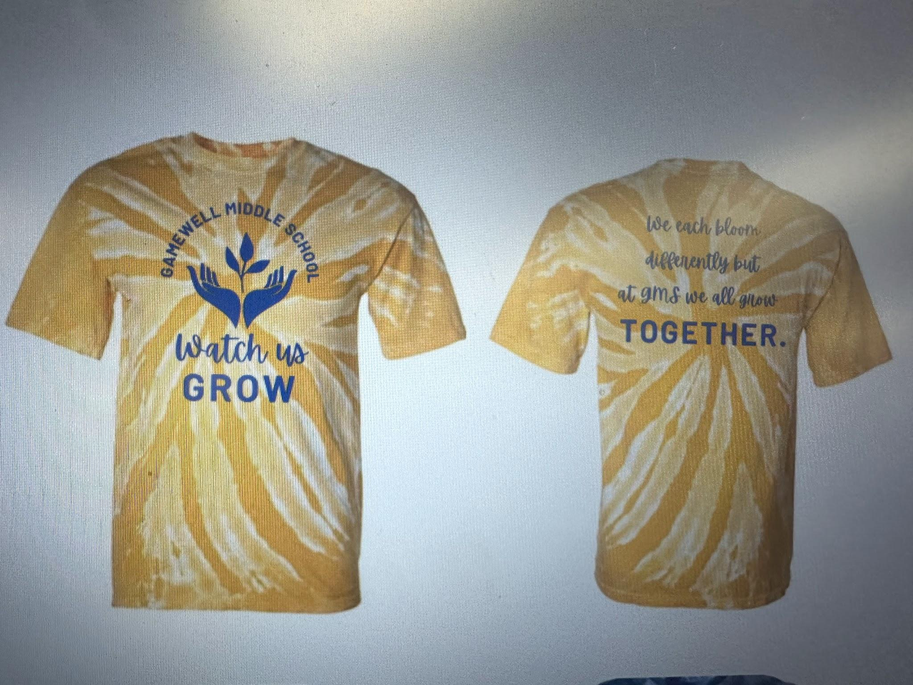
2023-2024 School Improvement Goals
GMS students will increase performance in all tested subjects (Math, ELA, Science) by the end of the 2023-2024 school year.
GMS students will Improve academic performance on EOGs of our TSI-SWD subgroup by the conclusion of the 2023-2024 school year.
GMS will increase School, Family, and Community Engagement.
GMS will identify the individual instructional and behavioral needs of each child through implementation of multi-tiered system of support and PBIS

Slide 8

Sign In and Sign Up
Make sure to sign in that you attended open house
Please check any of the items that you would like to be contacted for to help Gamewell Middle School

Slide 9

THANK YOU FOR COMING!
WE LOOK FORWARD TO A GREAT 2023-2024 SCHOOL YEAR!

