Slide 1
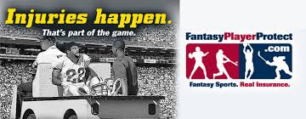
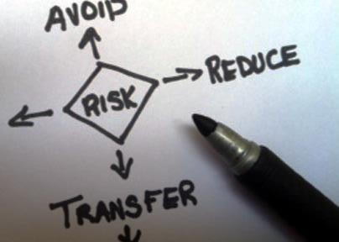
SEM2 3.08
Explain the need for sport/event insurance.
Conduct a risk assessment of an event.

Slide 2
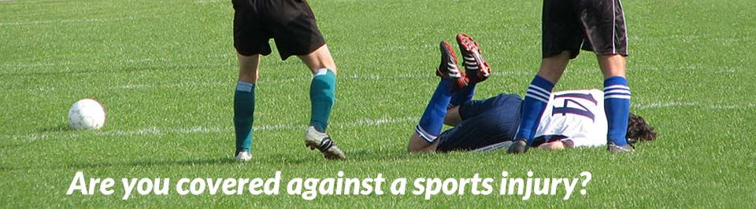
Comprehensive General Liability Coverage
One of the most widely used types of insurance. This type of insurance covers basic liabilities to other parties for bodily injury or property damage caused by the insured.

Slide 3

Cross-Liability
Coverage
Cross liability insurance happens when someone who is insured files a claim against another insured person who has the same policy. This plan covers the insured who has been hit with the claim in the same way as if they had belonged to separate policies. Even so, cross liability insurance does not increase the insurance company’s limit of liability.
Source: http://www.theinsurancepedia.com/2011/04/what-is-cross-liability-insurance/

Slide 4

Rider
A provision of an insurance policy that is purchased separately from the basic policy and that provides additional benefits at additional cost. Standard policies usually leave little room for modification or customization, beyond choosing deductibles and coverage amounts. Riders help policyholders create insurance products that meet their specific needs.
Source: investopedia.com

Slide 5
Rider example
For example, an accelerated death benefit rider on a life insurance policy would provide the insured with a payout while he or she was still alive, in the event of a terminal illness. The insured could use these funds to pay for medical expenses and to increase the quality of their remaining life. When the insured passes away, their beneficiaries will receive a reduced life insurance benefit, since the rider allowed a portion of the policy to be used early.
Source: www.investopedia.com

Slide 6
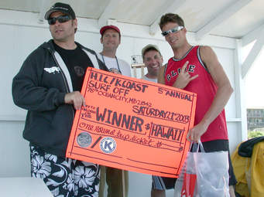
Prize Indemnity
“This type of coverage allows you to promote your business, sporting event or charity by offering a sporting event contest such as a hole in one, putting contest, golf shootout, football toss, football field goal contest, hockey red line shot, hockey blue line shot, basketball half court shot, basketball 3/4 court shot, or basketball parlay. You setup the event, purchase prize indemnity insurance and offer a huge payout to the participants and Direct Event Insurance takes on the risk.”
http://directeventinsurance.com/s/frequently-asked-questions/

Slide 7

Umbrella Policy
This type of liability insurance provides coverage over a single underlying policy, or several different underlying policies. The limits provided by this policy will not respond to the loss until after some specified underlying policies limits are spent, exhausted, or otherwise not available. If underlying limits are not available, and the coverage is not excluded from the Excess/Umbrella coverage, this policy will respond as primary.
http://www.sportsinsurance.com/glossary/?culture=en-us#glossary_s

Slide 8
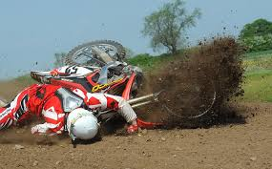
Sport-Accident
Insurance
Liability insurance covers losses resulting from accidents and personal injuries.
Basic liability insurance protects the sport/event organization against financial losses and lawsuits that result from injuries to spectators, volunteers, and employees during the sport/event. This type of insurance typically covers a fan who is hit by a baseball during a game, or a volunteer who is hurt on site during a concert.

Slide 9

Event Insurance
There are numerous types of events you may want to consider insuring. If you are planning a single-occurrence event of a short duration (e.g. a wedding, family/class/alumni reunions, bar/bat mitzvahs, non-commercial sporting events, neighborhood/homeowner association block parties, fundraisers, fairs, etc.), you will need to consider the types of liability to which you may be exposed. Event insurance typically provides coverage for event cancellation, liability, personal injury, property damage, etc.
Event insurance video

Slide 10
Explain reasons for obtaining sport/event insurance.
Insurance is a contractual agreement in which one company (insurer) will pay for specified losses incurred by the other company (sport/event organization or facility) in return for payment (premiums).
Sport/Event organizations reduce their risk of financial losses by purchasing various forms of insurance.

Slide 11
Describe the use of cancellation insurance.
Event organizers purchase cancellation insurance to cover losses resulting from possible catastrophic conditions. For example, if a large event is canceled due to acts of terrorism and is not rescheduled, the insurance often covers spectator ticket refunds and vendor payments (e.g., concessions, food) that the event organizers owe.
Various forms of cancellation insurance cover financial losses due to weather (e.g., tornadoes) and threats of terrorism.
Cancellation insurance often includes options that cover the costs associated with refunding money to ticket purchasers, which affects event sales.

Slide 12

Risk Assessment.
Risk is the possibility of financial gain or loss or personal injury.
Click here for an article about the five steps of risk assessment.

Slide 13
Demonstrate procedures for conducting an event’s risk assessment.
Ticket takers, security guards, guest relations representatives, and merchandise sales personnel are examples of employees who might provide insight when conducting risk assessment. For example, sales personnel can provide information regarding shoplifting and its risks.
By gathering as much information as possible from staff members, sport/event organizations can conduct comprehensive risk assessments in many areas and develop appropriate procedures to handle each situation or issue.

