Slide 1
SEM2 3.01
Explain ticketing and seating arrangements

Slide 2
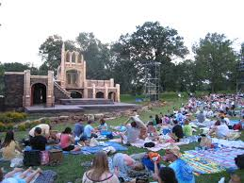
Festival / Lawn Seating
Festival or lawn seating is an open seating arrangement in which spectators can sit anywhere they desire.
Some concert venues have this type of seating arrangement.
The spectator generally pays less for the ticket and is not close to the stage or event.

Slide 3
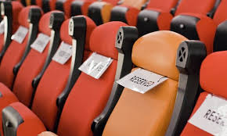
Reserved Seating
Reserved seating is often located within close range of the event and seats are assigned or numbered.
When spectators purchase reserved-seat tickets, the facility holds specific seats for the spectators in certain sections of the facility.

Slide 4
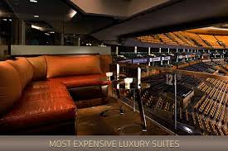
Luxury Boxes/ Suite Seats
Luxury boxes are generally purchased by businesses and have more amenities than other seating arrangements.
Tickets for box or suite seats are the most expensive, have the best view, and are often purchased by businesses for entertaining clients.

Slide 5

General Admission Seats
General admission allows spectators to sit anywhere in a very specific area. General admission seats are usually closer to the stage or event than festival seats, but farther away than reserved seats.
General admission seats are usually the least expensive, and offer seats on a first-come, first-serve basis, in limited sections of the arena or stadium.
These seats are usually located in areas of the facility that do not provide the best view of the sport event.
These seats tend to attract value-oriented spectators.

Slide 6
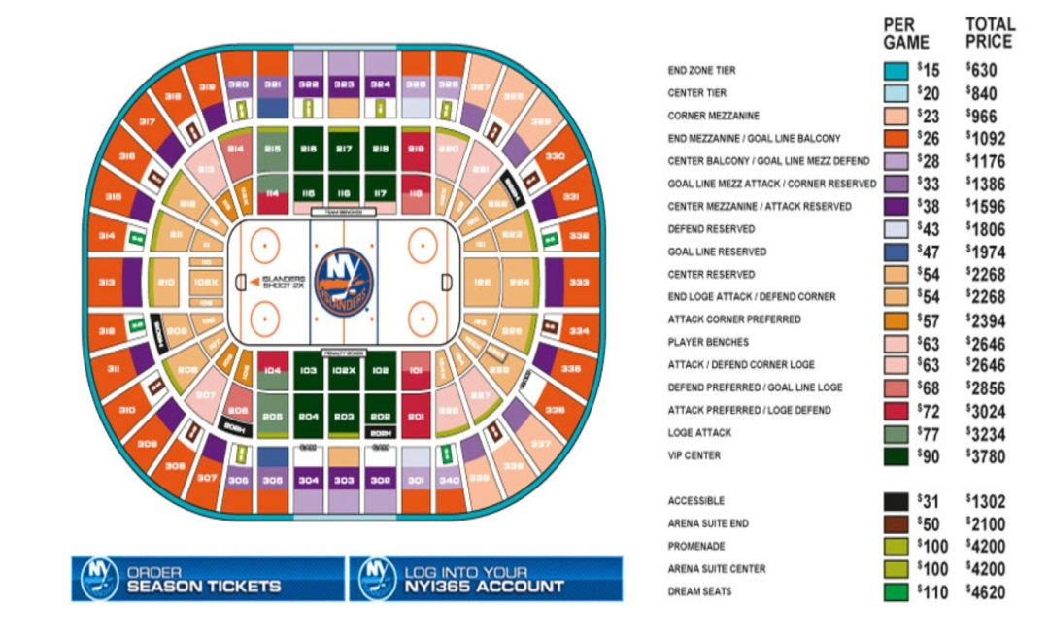
Knowing Prices of Seat Types is Important
Sport/event marketers should be familiar with the seating arrangements in the facility where the sport or event will be held.
They should also know the prices for each type of seat such as box seat, balcony seat, end-zone seat, etc.

Slide 7
Knowing Prices of Seat Types is Important
Marketers need this information to be able to help customers obtain the type of seats they want at the price they want to pay.
For example, some customers may be willing to pay a higher price for seats in a preferred section because they want to have an unobstructed view.
Others may be more interested in saving money and are not concerned with location.

