Slide 1
SEM II 2.08 Explain the use of advertising agencies.
Understands the concepts and strategies needed to communicate information about products, services, images, and/or ideas to achieve a desired outcome

Slide 2
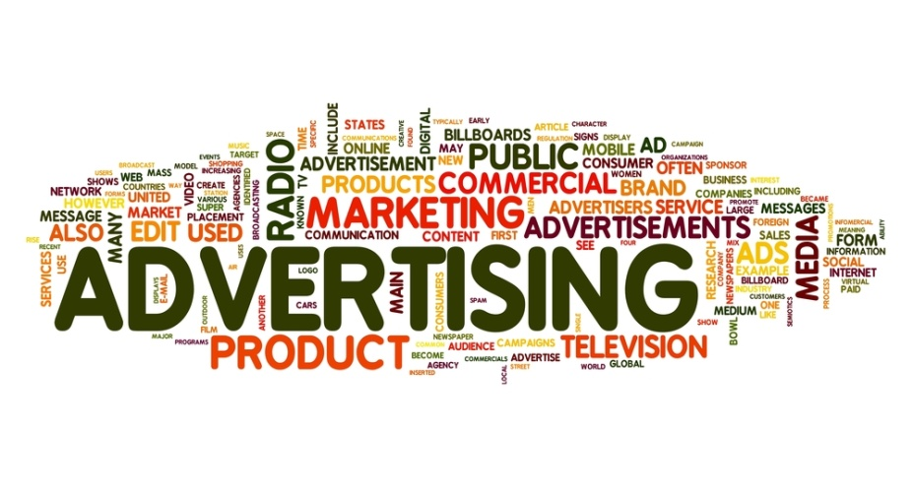
What is An Advertising Agency?
A business that develops and implements promotional plans for clients.
Also sometimes referred to as public relations or promotional communications agencies.

Slide 3

Why use an advertising agency?
They view the market place from an unbiased perspective.
They can provide methods to track you results
They are generally up to date with the latest hype! Including social media, email and all technological advances.
They can get you deals and save you more money than if you made all the contacts on your own.
Overall, they improve the efficiency and effectiveness of your marketing!

Slide 4
Why use an ad agency CONT’d
It is key to check out the advertising agency’s track record before selecting them to be responsible for your business’ promotional efforts.
They often have expert talent in the various areas of advertising.
Advertising agencies employ specialists who are able to provide businesses with many services, such as creative writing. Businesses often do not have employees on staff who have the training or talent to write effective copy for promotional or marketing materials. By hiring advertising agencies, businesses are able to obtain the copywriting services they need.

Slide 5
Their Structure
Advertising agencies are generally broken down into several departments, including:
  Account Services
  Account Planning
  Finance and Accounts
  Media Buying
  Production
These departments are present in larger agencies or full service ones because media buying and boutique agencies likely won’t have the need for all of these parts

Slide 6
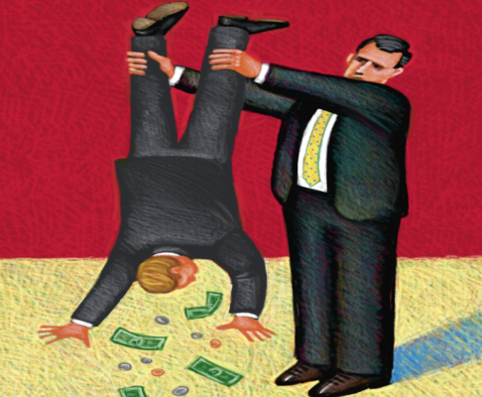
How are the compensated?
Agencies fee structures are designed to be beneficial to their clients, in that they want to provide them with a good return on their investment. Bearing that in mind, advertising agency fee structures are also designed to create a profit for the agency itself.
Fee structures are either:
  Commission based
    This is tied to the success of the advertisements.
  Service based
    This is based upon the services they provide.
  Project Based
    Similar to service based but based pricing based on particular projects.
  Combined
    Combines the elements of the other fee structures. Agency might charge an upfront fee then additionally require service or commission charges.

Slide 7
Full-service Agencies
Offers complete line of services that are not limited to promotion but include other kinds of services.
Offer a complete range of creative and media services and work across the full range of advertising media, including press, radio, television, outdoor and digital media.
Involved in planning, creating, producing advertisements, performing research and selecting media.
  Some provide non-advertising related services depending upon the needs of the specific client.
Often times these agencies do their own market research instead of enlisting outside help.
Often have a “creative department”.
  Clients often select specific agencies because of their creative abilities. The creative department develops ideas, writes copy, handles the graphics, etc. These activities often are the basis of the agency

Slide 8

Boutique Agencies
Specialize in providing creative services.
Main job is the creation of the advertisement or branding.
Businesses who employ these agencies must assume some of the other responsibilities on their own because they do not handle them.

Slide 9

Media Buying Agencies
While some agencies (full service agencies) provide all types of services, some agencies just provide media buying services.
Specialize in buying media time and space.

